Slide 1
Amazon sales Data

Slide 2
Introduction
Annual net sales of Amazon 2004-2023In the last reported year, the multinational e-commerce company's net revenue was almost 576 billion U.S. dollars, up from 514 billion U.S. dollars in 2022.
Sales management has gained importance to meet increasing competition and the need for improved methods of distribution to reduce cost and to increase profits. Sales management today is the most important function in a commercial and business enterprise

Slide 3
Details of Data
To analyze the sales trend month-wise, year-wise, and yearly_month-wise, following steps have to be perform:
Parse the 'Order Date' column to extract month and year.
Aggregate sales data by month, year, and yearly_month.
Plot the trends.

Slide 4
Main KPIs
Month-wise
Year-wise
Yearly month-wise

Slide 5
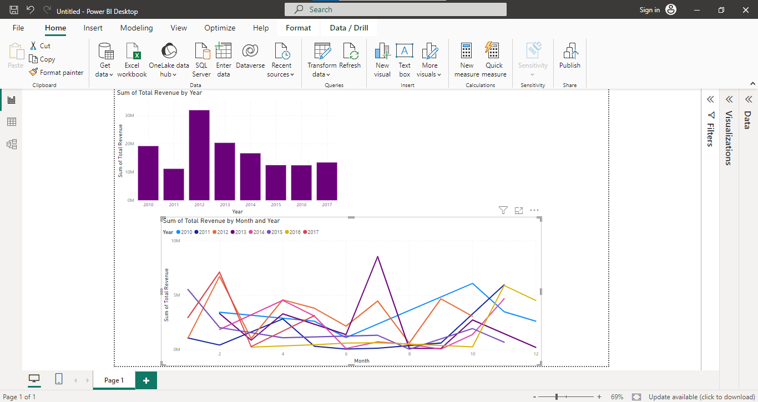
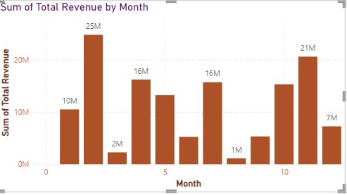
Dashboard

Slide 6
Thank you

