Slide 2
Contents
1.Introduction
2.Web Client-Server Communication and Architecture
3.The websocket protocol as transport for The SIP.
4.Applications of Websocket protocol
5.Simulation

Slide 3

What are Web Sockets?
Bidirectional, Full duplex client/server communication

Slide 4
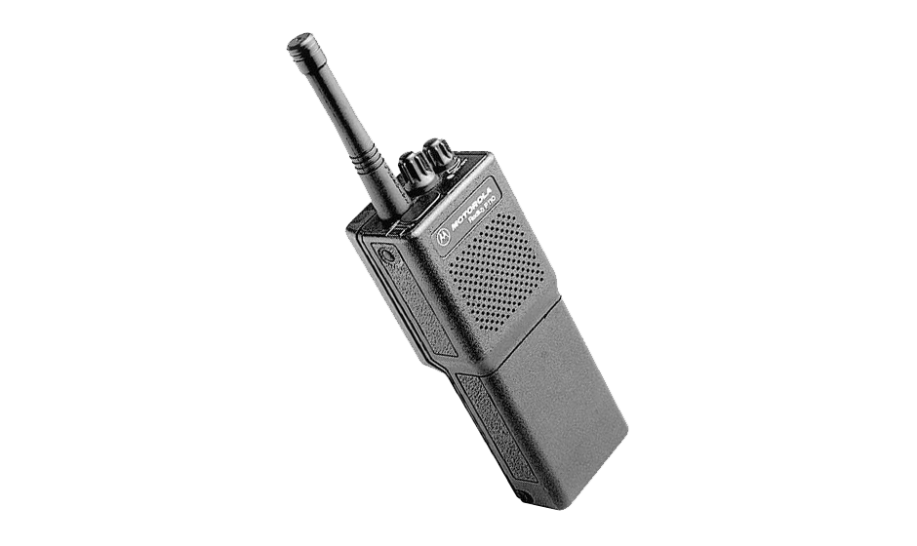
Communication : 1.Half Duplex
2.Full Duplex
Half Duplex:

Slide 5

Full duplex communications:

Slide 6
The Websocket Protocol
The WebSocket Protocol enables two-way communication between a client running untrusted code in a controlled environment to a remote host that has opted-in to communications from that code. The protocol consists of an opening handshake followed by basic message framing, layered over TCP.
The Goal

Slide 7
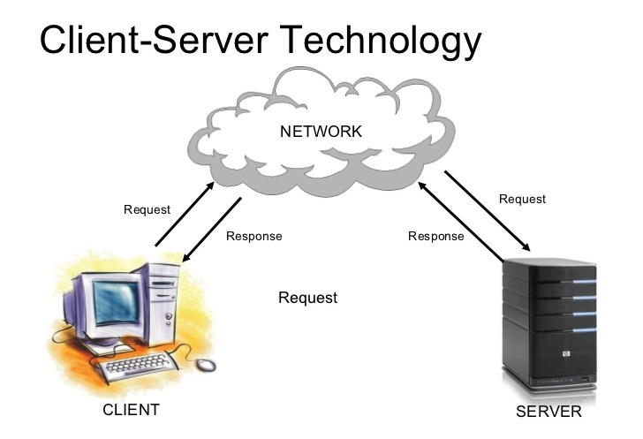
Web Client-Server Communication

Slide 8
Websocket is designed to be implemented in web browsers and web servers, but it can be used by any client or server application
In instant messaging
Online multiplayer games
Instant Email notifications
Desktop notifications
Real time data monitoring systems

Slide 9
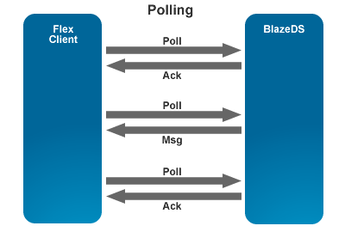
Http Polling, Long Polling and WebSockets
Http Polling:
Polling is "nearly real-time“
Client sends HTTP requests at regular intervals and immediately receives a response

Slide 10
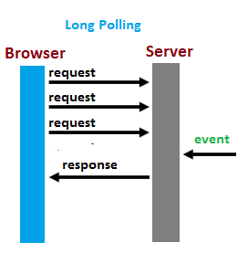
Http Long Polling :
Browser sends a request to the server, server keeps the request open for a set period
Limited speed
Request/response headers add overhead on the wire

Slide 11
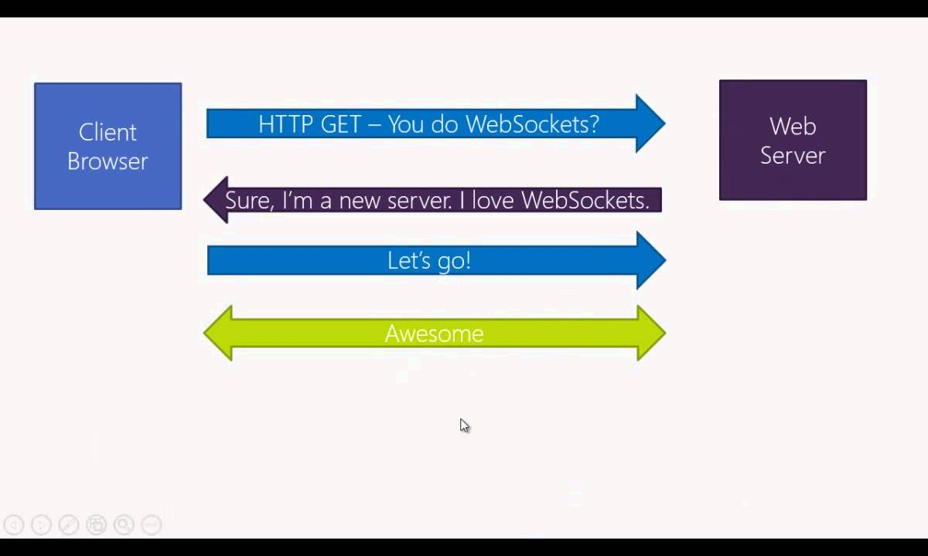
WebSockets:

Slide 12
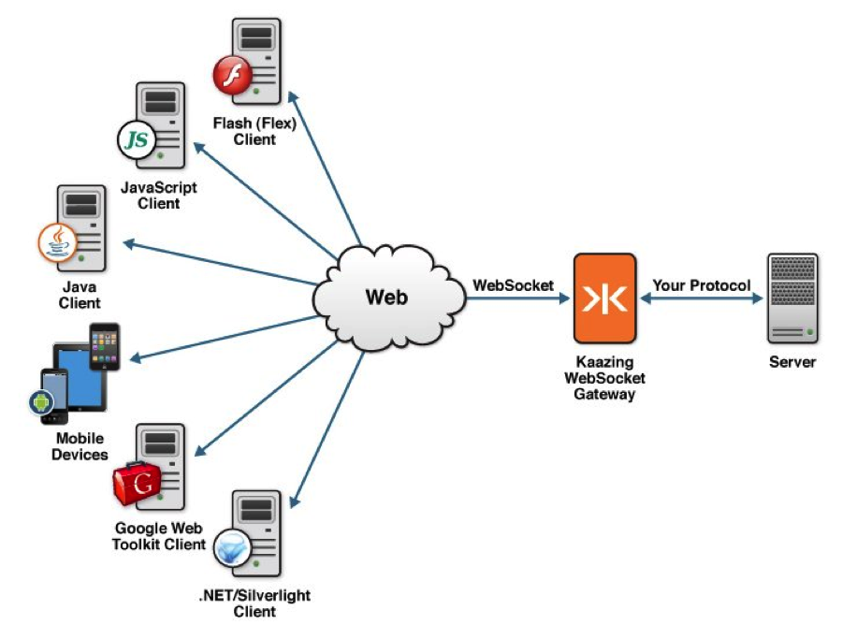
Architecture of WebSockets

Slide 13
Experimental Design
Traditional HTTP Request :
Use case A:
1,000 clients polling every second: Network throughput is (871 x 1,000) = 871,000 bytes = 6,968,000 bits per second (6.6 Mbps)
Use case B:
10,000 clients polling every second: Network throughput is (871 x 10,000) = 8,710,000 bytes = 69,680,000 bits per second (66 Mbps)
Use case C:
100,000 clients polling every 1 second: Network throughput is (871 x 100,000) = 87,100,000 bytes = 696,800,000 bits per second (665 Mbps)

Slide 14
HTML5 Websocket :
Use case A:
1,000 clients receive 1 message per second: Network throughput is (2 x 1,000) = 2,000 bytes = 16,000 bits per second (0.015 Mbps)
Use case B:
10,000 clients receive 1 message per second: Network throughput is (2 x 10,000) = 20,000 bytes = 160,000 bits per second (0.153 Kbps)
Use case C:
100,000 clients receive 1 message per second: Network throughput is (2 x 100,000) = 200,000 bytes = 1,600,000 bits per second (1.526 Kbps)

Slide 15
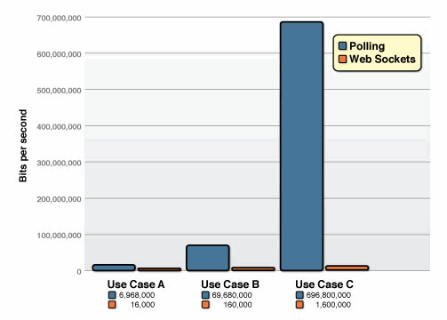

Slide 16
Compression Algorithms :
Huffman algorithm :
changes lengths of bits to represent characters depending on the frequency of data. Characters in a data file are converted to a binary code. The most frequently used character has the shortest length of bits and vice versa.
LZ77 algorithm:
that replaces repeated occurrences of words with pointers to the word which is found previously.

Slide 17
LZW algorithm :
It looks for duplicate data and replaces repeating data with symbols or codes. Duplicate data is defined in a dynamic index dictionary table.
Deflate algorithm :
combination of LZ77 and Huffman algorithms. The Deflate algorithm gives flexible ways to compress data.

Slide 18
LZW algorithm : TXT,BMP
Huffman algorithm : PNG,JPG,GIF
Deflate algorithm: very flexible as it’s combination of LZ77 and huffman encoding algorithm.

Slide 19
The WebSocket Protocol as a Transport for the Session Initiation Protocol (SIP)

Slide 20
The Websocket Protocol:
The WebSocket SIP Subprotocol

Slide 21
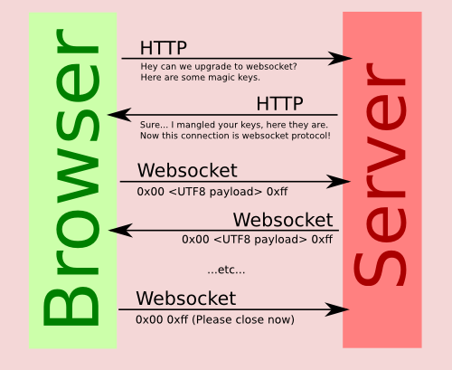
1.Hand-shaking

Slide 22
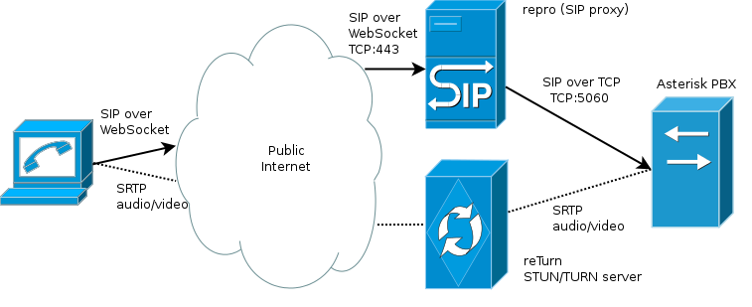
SIP WebSocket Transport

Slide 23
Locating a SIP Server

Slide 24
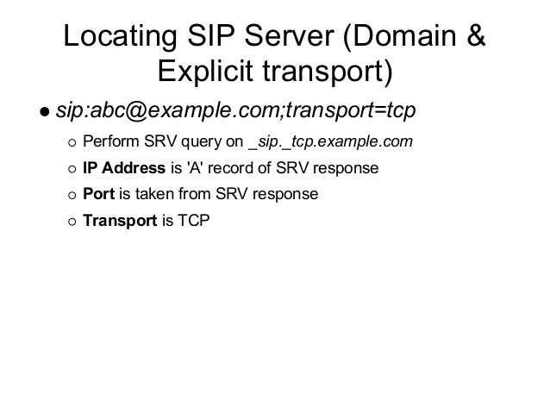

Slide 25
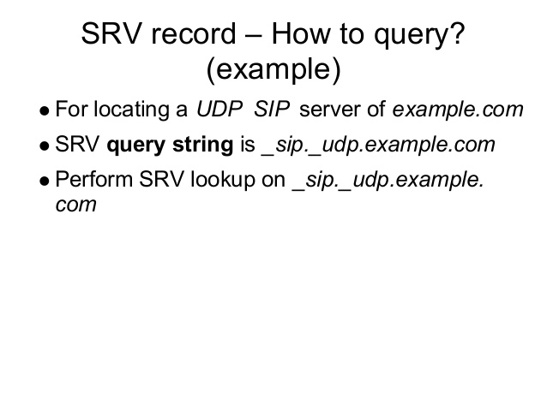

Slide 26
Connection and Registration

Slide 27
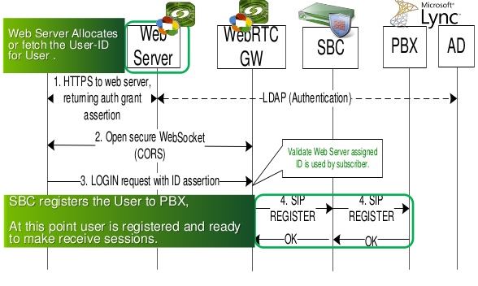

Slide 28
Security Considerations
A RAW TCP/UDP API FOR JAVASCRIPT WOULD BE DANGEROUS
THE WEBSOCKETS PROTOCOL IS ASYNCHRONOUS(CLIENT SIDE)
DATA FROM CLIENT TO SERVER IS MASKED(PREVENT IN-LINE PROXY)
CAN BE SECURED USING TLS

Slide 29
SIGNALING OVER TLS
TLS PROVIDES : 1.PRIVACY , 2.INTEGRITY 3.AUTHENTICATION
SERVER AUTHENTICATON AND CLIENT AUTHENTICATION IF CERTIFICATE IS PROVIDED.
LEGAL VALUE
HTTPS AND WSS NECESSARY FOR WebRTC

Slide 30
HTML5 Websocket and it’s applications

Slide 31
Websocket Protocol handshake
Request from client
GET ws://websocket.example.com/ HTTP/1.1
Origin: http://example.com
Connection: Upgrade
Host: websocket.example.com
Upgrade: websocket
Server will upgrade protocol from HTTP to WEBSOCKET and will send response back
Response from server
HTTP/1.1 101 WebSocket Protocol Handshake
Date: Wed, 5 May 2014 04:04:22 GMT
Connection: Upgrade
Upgrade: WebSocket

Slide 32
Transport layer Protocols
Common protocols used for communication
TCP
-Reliable
-Stream oriented
UDP
-Unreliable
-Message oriented protocol
Websocket uses TCP because of its reliability
e.g. Browser enabled games

Slide 33
Tunneling through Proxies
USE :
Private network and the internet
Caching , security and content filtering
Working with websockets :
HTTP CONNECT request to proxy server .
It will open connection to specific host and port

Slide 34
Types of websocket servers
Cloud based websocket services
-Charge based on no. of connections , bandwidth and messages
-Easy for implementation
-Doesn’t provide lower level implementation
Websocket server softwares
-Need to configure whole server
-Takes time for initial setup
-Need dedicated resources to run on hardware
-Lower level implementation is possible

Slide 35
Websocket server Implementation
Language selection
-Compatible for any language
-Node.js : best choice
Websocket server selection
-socket.io
-Socketcluster

Slide 36
Socket.io server
Advantages by socket.io :
Open source websocket framework
Real time analytics
Instant messaging and chat
Binary streaming
Document collaboration
Disadvantages by socket.io :
Difficult to scale

Slide 37
Socketcluster server
How does it is better than other servers :
Complete configurable and extendable real time framework
Attachment to local node.js HTTP server is easy .
Supports pub sub channels
Management and coordination of realtime stack
Fully functional and scalable system out of the box
Less possibility of failures

Slide 38
Scaling
Two types of scaling
Vertical scaling
-Increasing capacity of existing hardware or software by adding resources
-Resizing server with no change in server code
Horizontal scaling
-Connecting various hardware and software entities to work as a single logical unit .
-Unlimited performance increase and at lower cost

Slide 39
Problem with current node.js architecture
Difficult to implement multicore architecture for server
Single threaded architecture
Clustering websocket servers is difficult
Solution is socketcluster library
Fascilitates creation of multi-process real time application

Slide 40
Challeges encountered using socketcluster
U-limit
-Default limit for sending max files over tcp is 1024
Solution
-Editing file named limits.conf to increase the no of connections
C 10 K problem
-The maximum connections that server can reach is 10000
Solution
-Fixing operating system kernel
-Using single threaded architecture like node.js

Slide 41
Experiment for horizontal scalability
Instance type | Amazon s3 m3 xlarge
Experiment time | 60s
No of new communication created at each sec | 20
Client creation period | 1 s
Type of ping | Random number
Ping period | 2.5 sec
Number of clients | 2

Slide 42
Test is run on a server using one store , one load balancer and one worker .

Slide 43
Experimental Summary
Number of communications scale linearly when adding more no. of cores .
In a pure concurrent experiment , socketcluster can handle 25k connections on a single server .
To run socketcluster perfectly it will require highly parallel environment , in low parallel environment it will require load balancers .

