Slide 1
WELCOME TO TWITTER
TEAM-MATES
1)2369_AMRUTA KOTGIRE
2)2370_KETKI KOTHALE
3)2372_SEJAL KSHIRSAGAR
4)2373_AKANKSHA KULKARNI
GitHub link : https://github.com/sejalsksagar/DSA2-Miniproject

Slide 2
AVL tree is created on the basis of username.
It’s node contains reference to the User’s Account object.

Slide 3
ketaki01
AVL TREE
(BALANCED)
amruta03
sejal00
akanksha02
apoorva04
nikita06
shreya05
saniya07

Slide 4
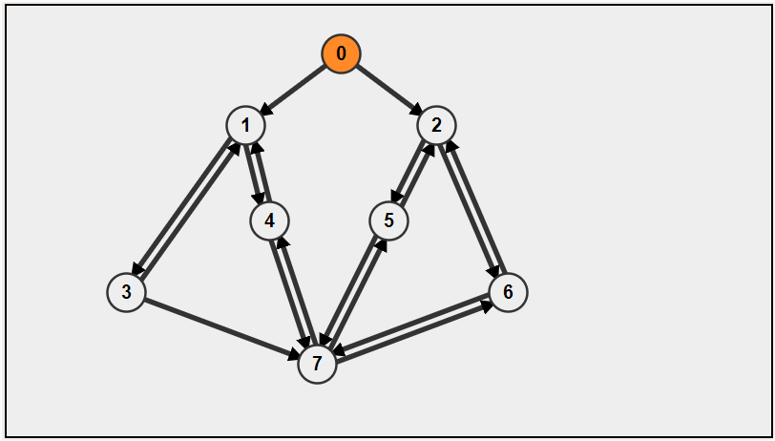
GRAPH
0 → sejal00
1 → ketaki01
2 → akanksha02
3 →amruta03
4 →apoorva04
5 →shreya05
6 →nikita06
7 →saniya07

Slide 5
Graph is used to track of followers and followings of a user.

Slide 6
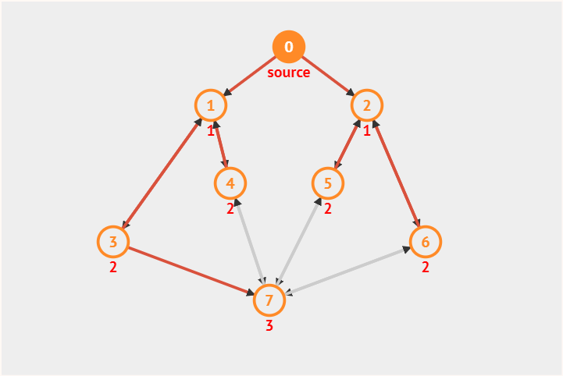
BFS (followings at k-levels)

Slide 7
0
MIN HEAP
3
5
Username Followers
0 → sejal00 0
1 → ketaki01 3
2 → akanksha02 3
3 →amruta03 1
4 →apoorva04 2
5 →shreya05 2
6 →nikita06 2
7 →saniya07 4
1
4
2
6
7

Slide 8
The min heap is created using followers count of all the users
After Heap Sort →
_________________________________________
Username Number of Followers
saniya07 4
akanksha02 3
ketaki01 3
shreya05 2
apoorva04 2
nikita06 2
amruta03 1
sejal00 0
_________________________________________

Slide 9
TIME COMPLEXITY
createAccount() → O(logn) //create account of user (AVL tree)
insert() → O(logn) //insert user information
RR() , LL() , RL() ,LR() → O(1) //AVL Tree Rotations
balanceFactor() → O(1) //find balance factor
height() → O(logn) //find height of AVL tree
searchUsername() → O(logn) //Search username in AVL Tree
inorder() → O(n) // display all users using inorder traversal
display() →O(V+E) //display followers linking using adjacency list
login() → O(logn) //login into the user’s account
bfs() → O(V+E) //display users in different levels based on their followers
followAccount() , unfollowAccount() → O(nlogn) //to follow or unfollow account of other users
printTweet() → O(n) //print all tweets of a user
heapify() → O(logn) //build min heap
heapSort() → O(nlogn) //sorting users in descending order according to their followers

Slide 10
THANK YOU…

