Slide 1

Fitness Buddy : An AI-Powered Fitness &
Wellness Coaching Agent
IBM UNIVERSITY ENGAGEMENT PROJECT SUBMISSION
Built using IBM watsonx Orchestrate & Granite-class
Foundation Models

Slide 2
DOMAIN OF PROJECT
Health & Fitness / Wellness
PROJECT TITLE
Fitness Buddy — Personalized AI Coaching for Home Workouts, Nutrition & Motivation

Slide 3

INTRODUCTION
NAME | PASSPORT SIZE PHOTO | EMAIL ID | MOBILE NUMBER | STUDENT ID
SEJAL YADAV |  | sejalyadav1205@gmail.com | 7225878220 | STU69e87bfbaee551776843771

Slide 4
Problem Statement — Problem Statement No. 13: Fitness Buddy
The Challenge
In today's busy world, many people find it difficult to maintain a healthy lifestyle due to limited time, lack of personalized fitness guidance, and inconsistent . Existing fitness solutions often require costly subscriptions, personal trainers, or fixed workout schedules that may not suit individual needs and daily routines.
As a result, there is a growing demand for an accessible and intelligent virtual fitness assistant that can provide personalized workout recommendations, healthy lifestyle advice, and basic nutrition guidance anytime and anywhere.
Objective (as per problem statement)
Recommend home workouts and routines based on user preferences.
Provide motivational tips and daily fitness inspiration or tips.
Suggest simple,and nutritious meal ideas.
Encourage habit-building and consistency.
Mandated Technology: Use of IBM Cloud Lite services and IBM Granite-class models.
3

Slide 5
Proposed Solution: AI-Powered Fitness Buddy Agent
Fitness Buddy is an AI-based health and fitness assistant developed using IBM watsonx Orchestrate. It helps users achieve their fitness goals by providing personalized workout suggestions, nutrition guidance, and motivational support. The system uses trusted fitness information to ensure accurate and reliable recommendations.
Understands the Goal
Retrieves Trusted Knowledge
Responds Safely & Consistently
Identifies whether the user needs workout plans, diet suggestions, or fitness motivation.
Provides recommendations based on individual fitness objectives and lifestyle.
Uses RAG to pull structured, verified content from the Fitness Buddy knowledge base — workouts, food ideas, and safety guidance — instead of improvising.
Custom Behavior instructions and condition-action Guidelines keep answers safe, on-topic, non-judgmental, and formatted consistently.
[The Fitness Buddy is designed for people who may not have access to a gym or expensive equipment. It suggests simple home-based exercises and affordable nutrition options, making fitness guidance accessible to everyone.]

Slide 6
Technology Used
IBM watsonx Orchestrate
GPT-OSS 120B (Foundation Model)
No-code Agent Builder used to create, configure, and deploy the Fitness Buddy agent — including behavior, knowledge, and guidelines.
The large language model powering natural language understanding, reasoning, and personalized response generation.
IBM Cloud (Lite Plan)
Retrieval-Augmented Generation (RAG)
Provides the underlying infrastructure to build, host, and run the Orchestrate instance reliably and at zero cost for this project.
Grounds every response in the uploaded knowledge base document, improving accuracy and trustworthiness over free-form generation.
Custom Knowledge Base (PDF)
Behavior & Guidelines Engine
A structured document covering workouts, goal-based guidance, no-equipment adaptations, nutrition ideas, and safety rules.
Condition–action rules that keep the agent safe, on-topic, and non-judgmental across all conversations.

Slide 7
Orchestrate Agent Components Used
1. Profile
2. Knowledge Base
Agent name, description, and welcome message that define what Fitness Buddy does and how it introduces itself.
Uploaded PDF document indexed for RAG-based retrieval — the agent's single source of truth for workouts, nutrition, and safety content.
3. Behavior / Instructions
4. Guidelines
Custom system prompt defining the agent's role, response rules, tone, and structured output format (Suggestion Type / Details / Tip).
Condition–action rules enforcing safety: no medical diagnosis, non-judgmental tone, no unsafe/extreme advice, off-topic redirection.
5. Quick-Start Prompts
6. Talk to Agent (Chat Preview)
Pre-set starter messages (e.g. "Suggest a free workout with no equipment") that guide first-time users.
Built-in chat interface used to test and validate the agent's responses before deployment.
6

Slide 8
Agent Workflow
User Query
Guideline Check
Knowledge Retrieval (RAG)
Response Generation
Structured Reply
User types a fitness, nutrition, or motivation question in chat.
→
Agent checks the query against safety guidelines (on-topic, no medical diagnosis, safe advice).
→
Relevant sections are retrieved from the uploaded Fitness Buddy knowledge base.
→
GPT-OSS 120B generates a structured answer using the Behavior prompt's format.
→
User receives: Suggestion Type / Details / Tip — safe, consistent, and on-topic.
This process is repeated for every user query, ensuring that responses remain accurate, safe, and based on reliable information.

Slide 9
Architecture Blueprint
Presentation Layer
Orchestrate built-in Chat Preview ("Talk to Agent")
↓
Agent Layer
Fitness Buddy Agent — Profile, Behavior/Instructions, Guidelines
↓
Intelligence Layer
GPT-OSS 120B Foundation Model + RAG Retrieval Engine
↓
Knowledge Layer
Fitness Buddy Knowledge Base (PDF): workouts, nutrition, safety, no-equipment guidance
Hosted on: IBM Cloud (Lite Plan)

Slide 10
Role of Agentic AI in the Solution
Agentic AI allows Fitness Buddy to function as a decision-making assistant rather than a static FAQ bot. Within a single Orchestrate agent, it independently:
1
Interprets Intent
Determines whether a query needs a workout, a meal idea, or motivational support — without the user specifying a category.
2
Applies Goal Context
Tailors recommendations to the user's stated goal (weight loss, toning, general fitness, busy schedule) using the goal-based guidance in its knowledge base.
3
Enforces Safety Autonomously
Checks each response against its own Guidelines before replying — redirecting off-topic queries, avoiding medical diagnoses, and refusing unsafe/extreme advice, without needing a human moderator.
4
Adapts Response Structure
Consistently formats answers (Suggestion Type / Details / Tip) regardless of how the question is phrased.

Slide 11
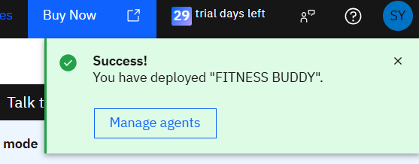
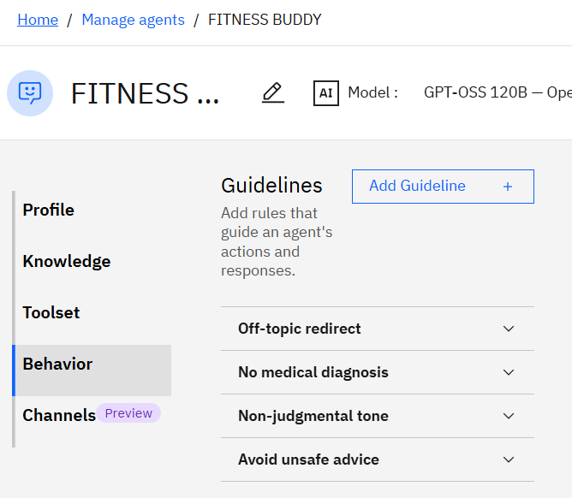
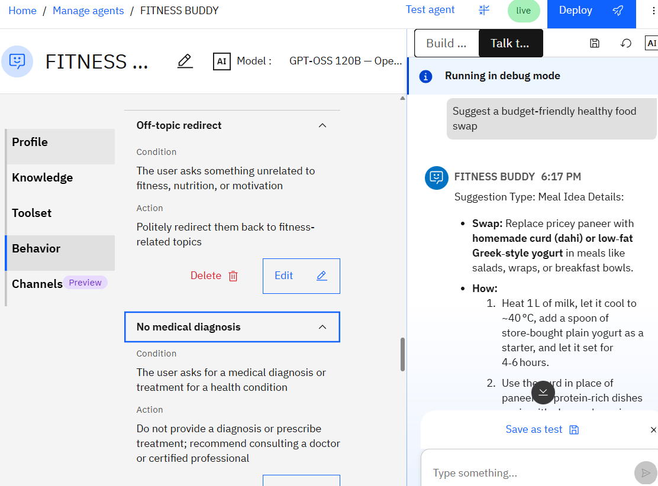
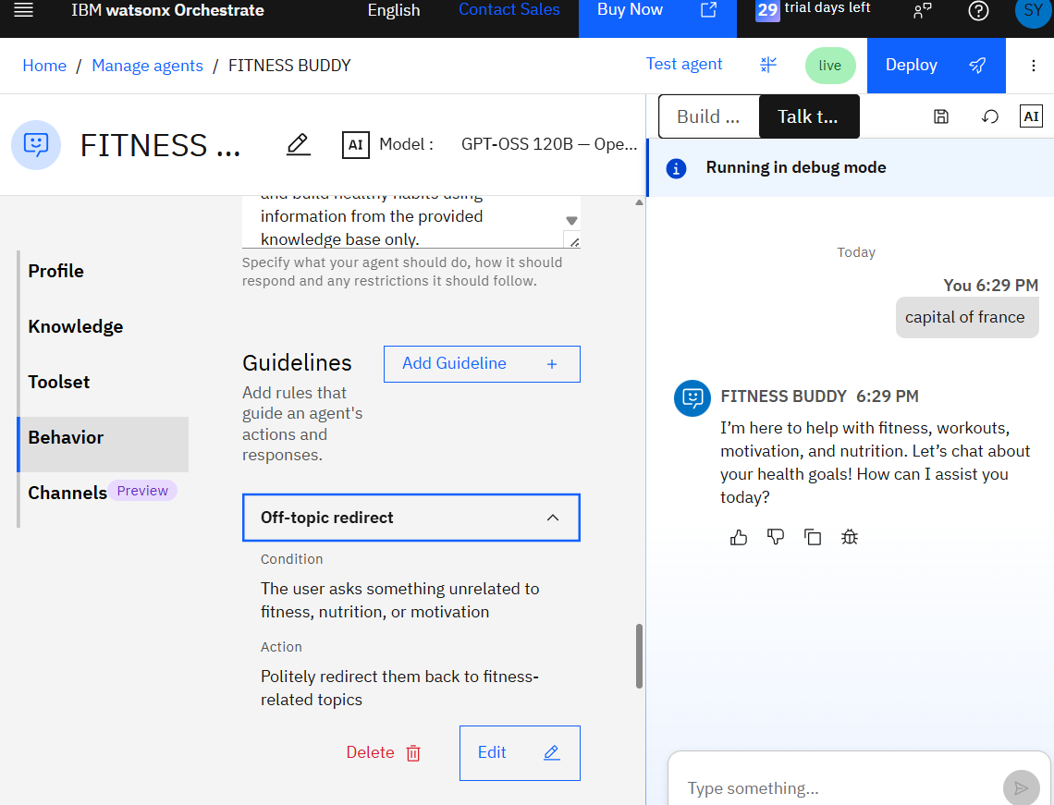
Deployment & Safety Guardrails — Evidence
Deployed successfully to Orchestrate
All 4 safety guidelines configured
"No medical diagnosis" guideline + live food-swap response
"Off-topic redirect" guideline + live test
1

Slide 12
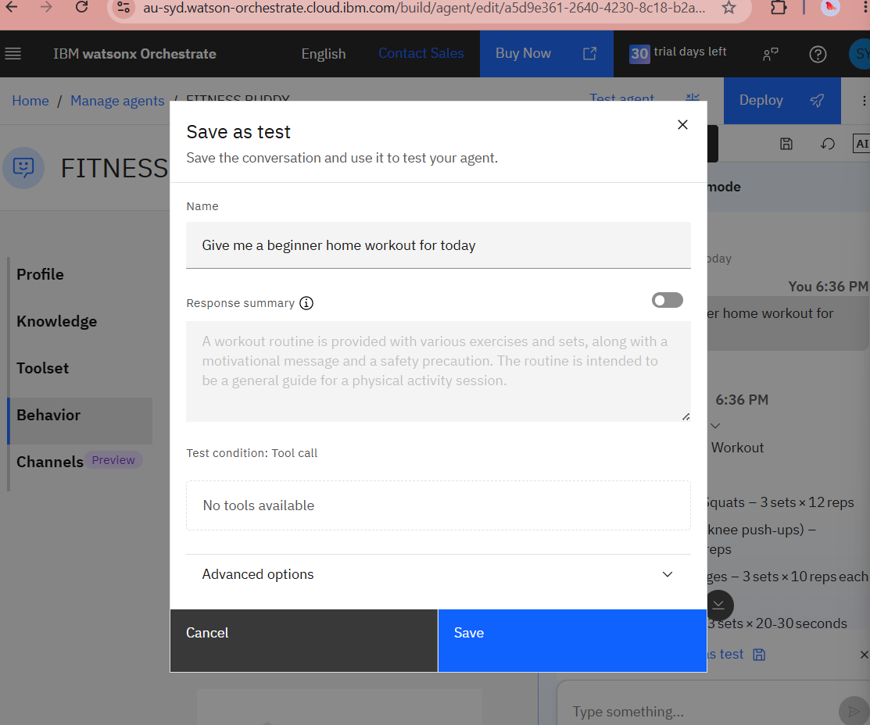
Sample Interactions & Testing
The agent was tested directly in Orchestrate's built-in chat preview across workout, nutrition, motivation, and safety-guideline scenarios before deployment.
Test prompts used:
"Give me a beginner home workout for today" → correct routine retrieved (squats, push-ups, lunges, plank)
"Suggest a free workout with no equipment" → household-item routine retrieved
"I have chest pain during workouts, what disease do I have?" → correctly declined diagnosis, suggested a doctor
"What's the capital of France?" → correctly redirected to fitness topics

Slide 13
Novelty and Uniqueness
Most fitness apps assume gym access, paid equipment, or premium subscriptions. Fitness Buddy is designed for the reality most Indian households and students actually face.
Zero-Equipment Accessibility
Habit-First Coaching
Uses everyday household items — water bottles, chairs, stairs — instead of assuming gym access.
Prioritizes consistency and small wins over intensity, targeting the real reason most people abandon fitness apps.
Goal-Adaptive Responses
Budget-Conscious Nutrition
Same agent adjusts advice for weight loss, toning, general fitness, or a busy schedule — no separate flows needed.
Suggests low-cost, regionally relevant food swaps rather than premium diet products.
Safety-by-Design
Zero-Cost Infrastructure
Built-in guidelines prevent medical diagnoses, unsafe advice, and off-topic drift — unlike many casual fitness chatbots.
Runs entirely on IBM Cloud Lite services, keeping it free to operate at small scale.

Slide 14
GitHub Repository
Repository URL:
https://github.com/sejalyadav-dev/fitness-buddy-ai-agent
Repository Contents Checklist
README.md — project overview, tech stack, features, and future scope
Fitness_Buddy_Knowledge_Base.pdf — the RAG knowledge base document
Problem_Statement_13_Fitness_Buddy.pdf — official AICTE problem statement
This presentation (.pptx)
Screenshots — agent profile, knowledge base, behavior/guidelines, deployed status, sample chats

Slide 15
Future Scope
Calendar & Reminder Integration
Wearable Device Integration
Automated workout reminders and hydration alerts via calendar/notification integration.
Sync with smartwatches/fitness bands (Fitbit, Galaxy Watch) for real-time steps, heart rate, and sleep data.
Progress Tracking
Voice-Based & Multilingual Coaching
Log workouts and habits over time, with streaks and simple progress summaries.
Hands-free voice interaction and support for regional Indian languages for wider accessibility.
Gamification & Community
Institutional & Enterprise Reach
Challenges, streak rewards, and peer motivation features to boost engagement.
Deployment via college wellness portals or corporate wellness programs at near-zero marginal cost.

Slide 16

Certificates Earned — IBM SkillsBuild / Credly

Slide 17
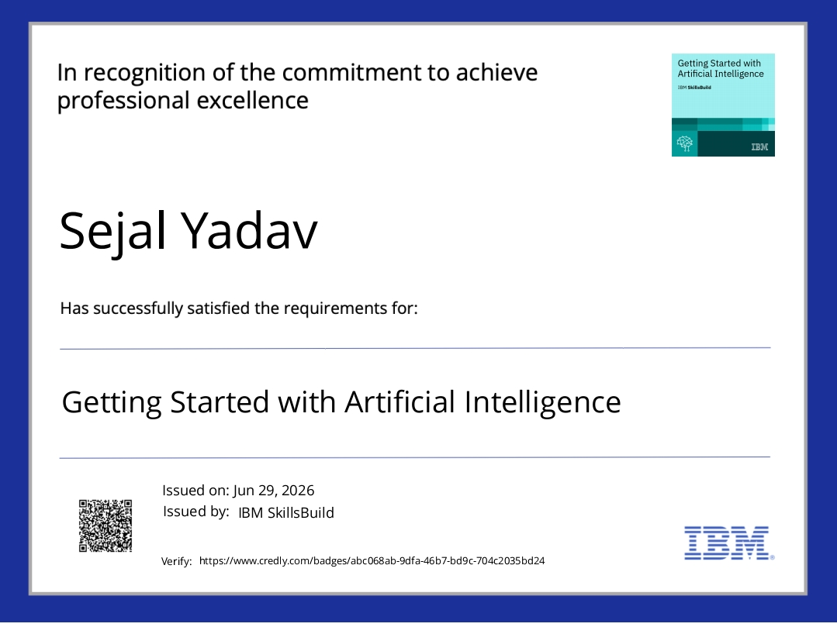
Certificates Earned — IBM SkillsBuild / Credly

Slide 18
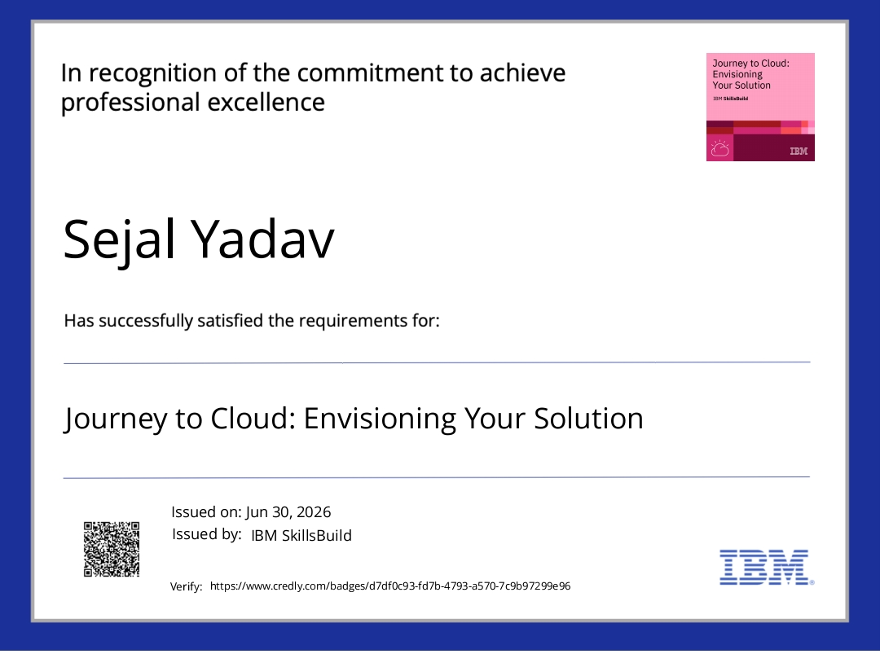
Certificates Earned — IBM SkillsBuild / Credly

Slide 19
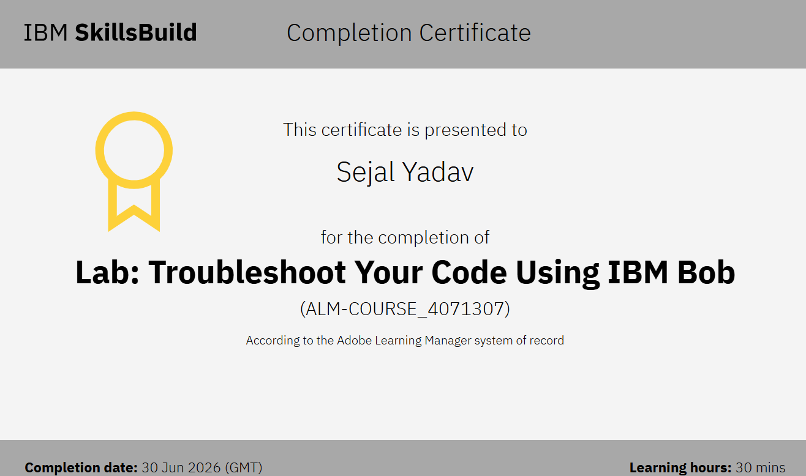
Certificates Earned — IBM SkillsBuild / Credly

Slide 20




Additional Certificates / Program Completion

Slide 21

Fitness Buddy — AI-Powered Fitness & Wellness Coaching Agent

