Slide 1
Course: Data Mining
Project Task
Enes Sejfovski, 211258

Slide 2

Topic
Web application for advertising sales of new and used vehicles in Europe.

Slide 3
Getting the data
Basic data scraping methods used.
About 7000 records with just 3,5-4% duplicates.

Slide 4
Preprocessing and cleaning the data
Used Missingno library for detecting missing values.
Type casting of many of the columns.
Brand and Model columns encoded using OneHotEncoder.

Slide 5
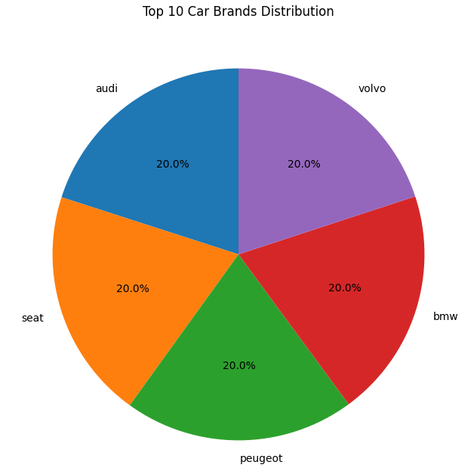
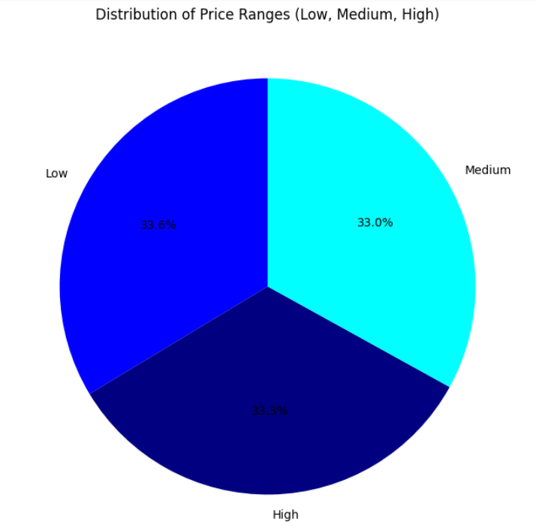
Visualizations

Slide 6
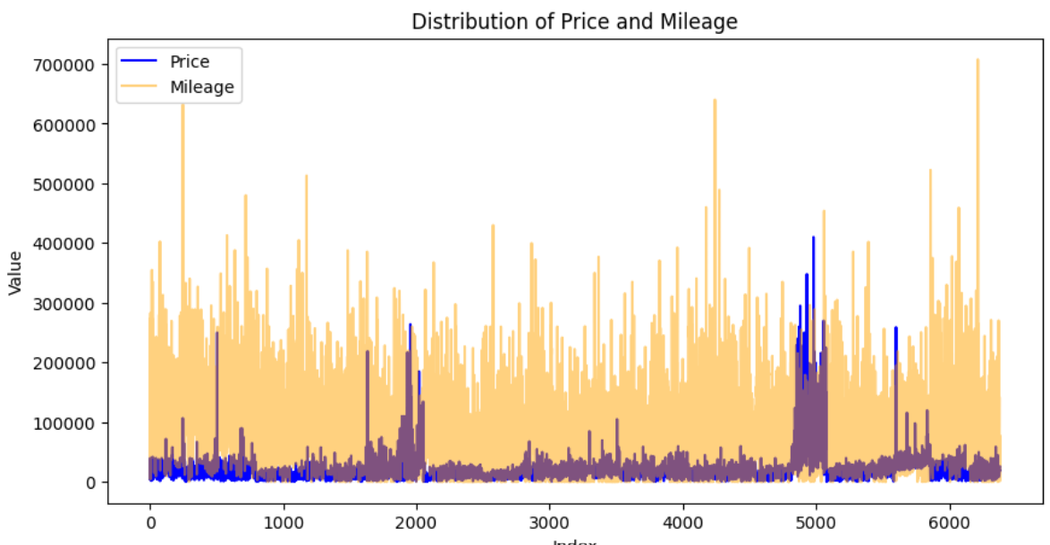
Scaling the data is a must.

Slide 7
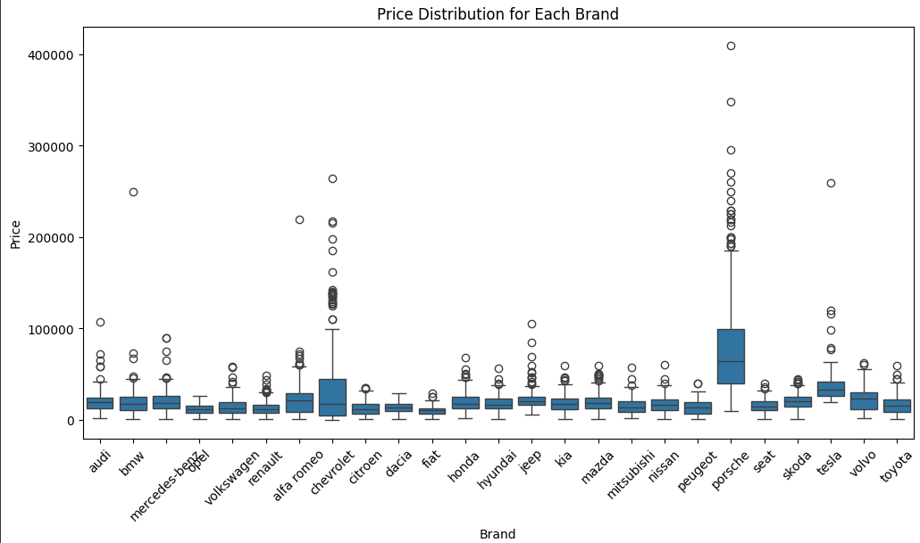
Some brands cost more.

Slide 8
Linear Models
Model | MSE | MAE | R2
Linear Regression | 1.0626156454430e+34 | 1.469843026434e+16 | -8.63354775331171e-05
Lasso Regression | 1.062615645443e+34 | 1.4698430264408e+16 | -1.8765130503251015e-05
Ridge Regression | 0.0004984033404032 | 0.01152295350368598 | 0.8237087995157614
Ridge Model from Grid Search | 0.0004895119753777013 | 0.011431383152769295 | 0.8268537812749552
XGBoost | 0.0012628995118341 | 0.021082000796275473 | 0.5532973939297927

Slide 9
Classification Models
Model | Avg(Precision) | Avg(Recall) | Avg(F1 Score)
Decision Trees | 0.76 | 0.76 | 0.763
Gaussian Nive Bayes | 0.693 | 0.54 | 0.513
KNN Classifier | 0.513 | 0.503 | 0.773
Random Forest Classifier | 0.773 | 0.763 | 0.766

Slide 10
Clustering
Dataset reduced.
Both experiments showing that the ideal number of clusters is 8.

Slide 11
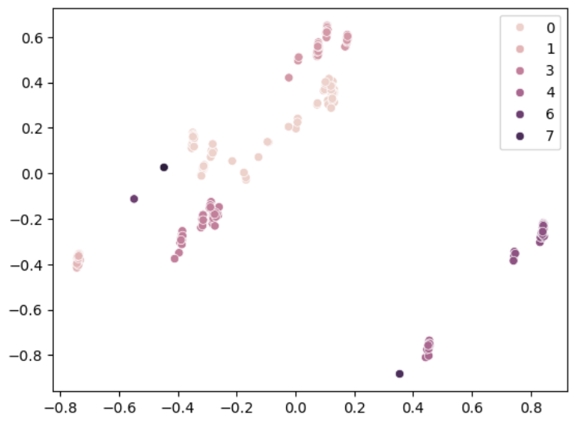
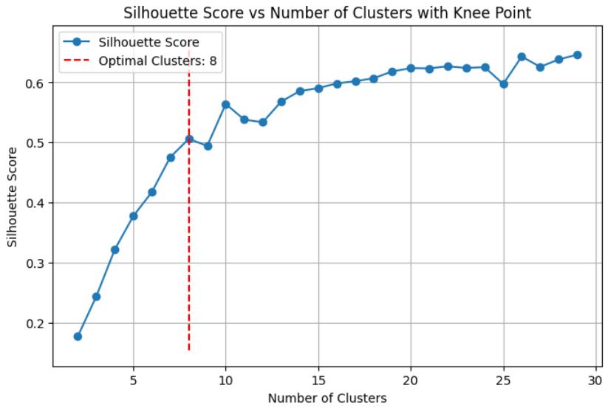
Knee locator in order to find optimal number of clusters
Clustered dataset using DBSCAN model

