Slide 1
Order
Date
Product Cost
Shipping Cost
Confirmation
Number
Total
Cost
Place an order
M
Order
Customer
ID
1
N
Name
Customer
M
Referral
included
Quantity
Review
Number
1
Date of Birth
M
Referring
CustomerID
Referred
CustomerID
Product
Review
1
received
M
Review Text
Address
Product ID
Inventory
Rating
(1 to 5)
Name
Price
Notes:
Task1. ShippingAddress is a multi-valued attribute. ProductCost is derived. Inventory is derived. Quantity is an attribute on includes. (23/25)"

Slide 2
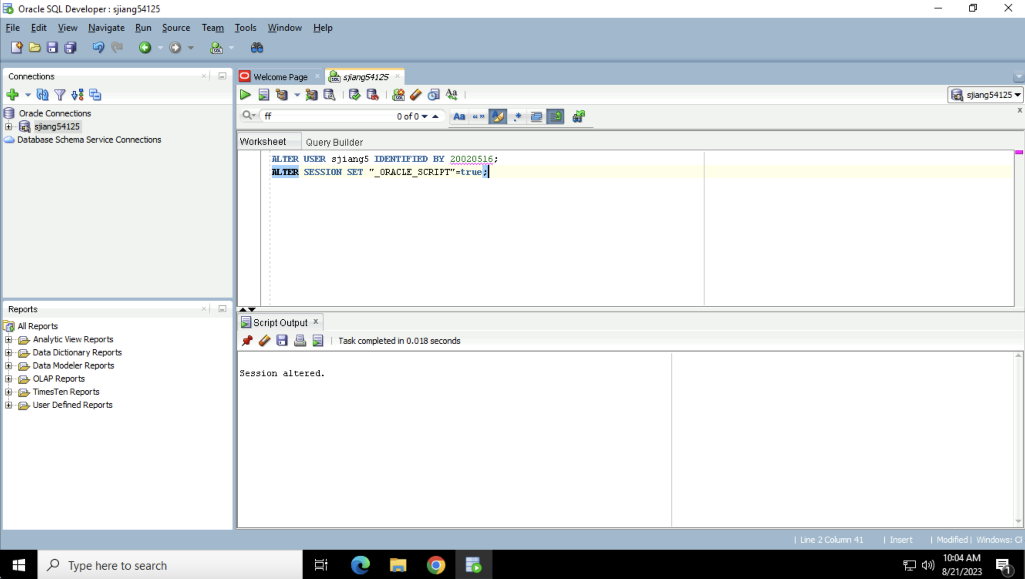

Slide 3
Task1. Missing a relation for the multivalued attribute Address. -4 Don't include the derived attributes. -1
REVIEW (Number, Product ID, Rating, Text)
PRODUCT (ID, Price, Name, Inventory)
Order_Include(Confirmation#, Product ID, Quantity)
ORDER (Confirmation#, Customer ID, Date, ProductCost, ShippingCost, TotalCost)
CUSTOMER (ID, Name, DOB, Address, Refer ID)
ADDRESS (Customer ID, Address)

