Slide 1
Forecasting U.S. Rental Affordability
Time-Series Analysis of Top 20 High-Rent Markets
Data Science Bootcamp Final Project | Sejona Sujit Das

Slide 2
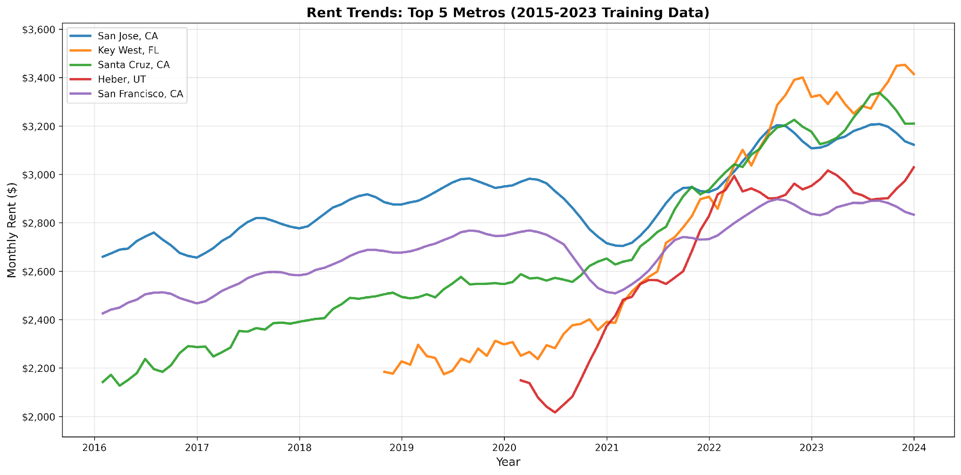
Project Overview & Dataset
RESEARCH QUESTION
Can we build accurate forecasting models that substantially outperform naive baseline predictions?
• 7 models evaluated
• Proper temporal splits (train/val/test)
DATASET
• 2,451 observations (2015-2025)
• Top 20 highest-rent metros
• Zillow ZORI + FRED data
• 11 engineered features

Slide 3
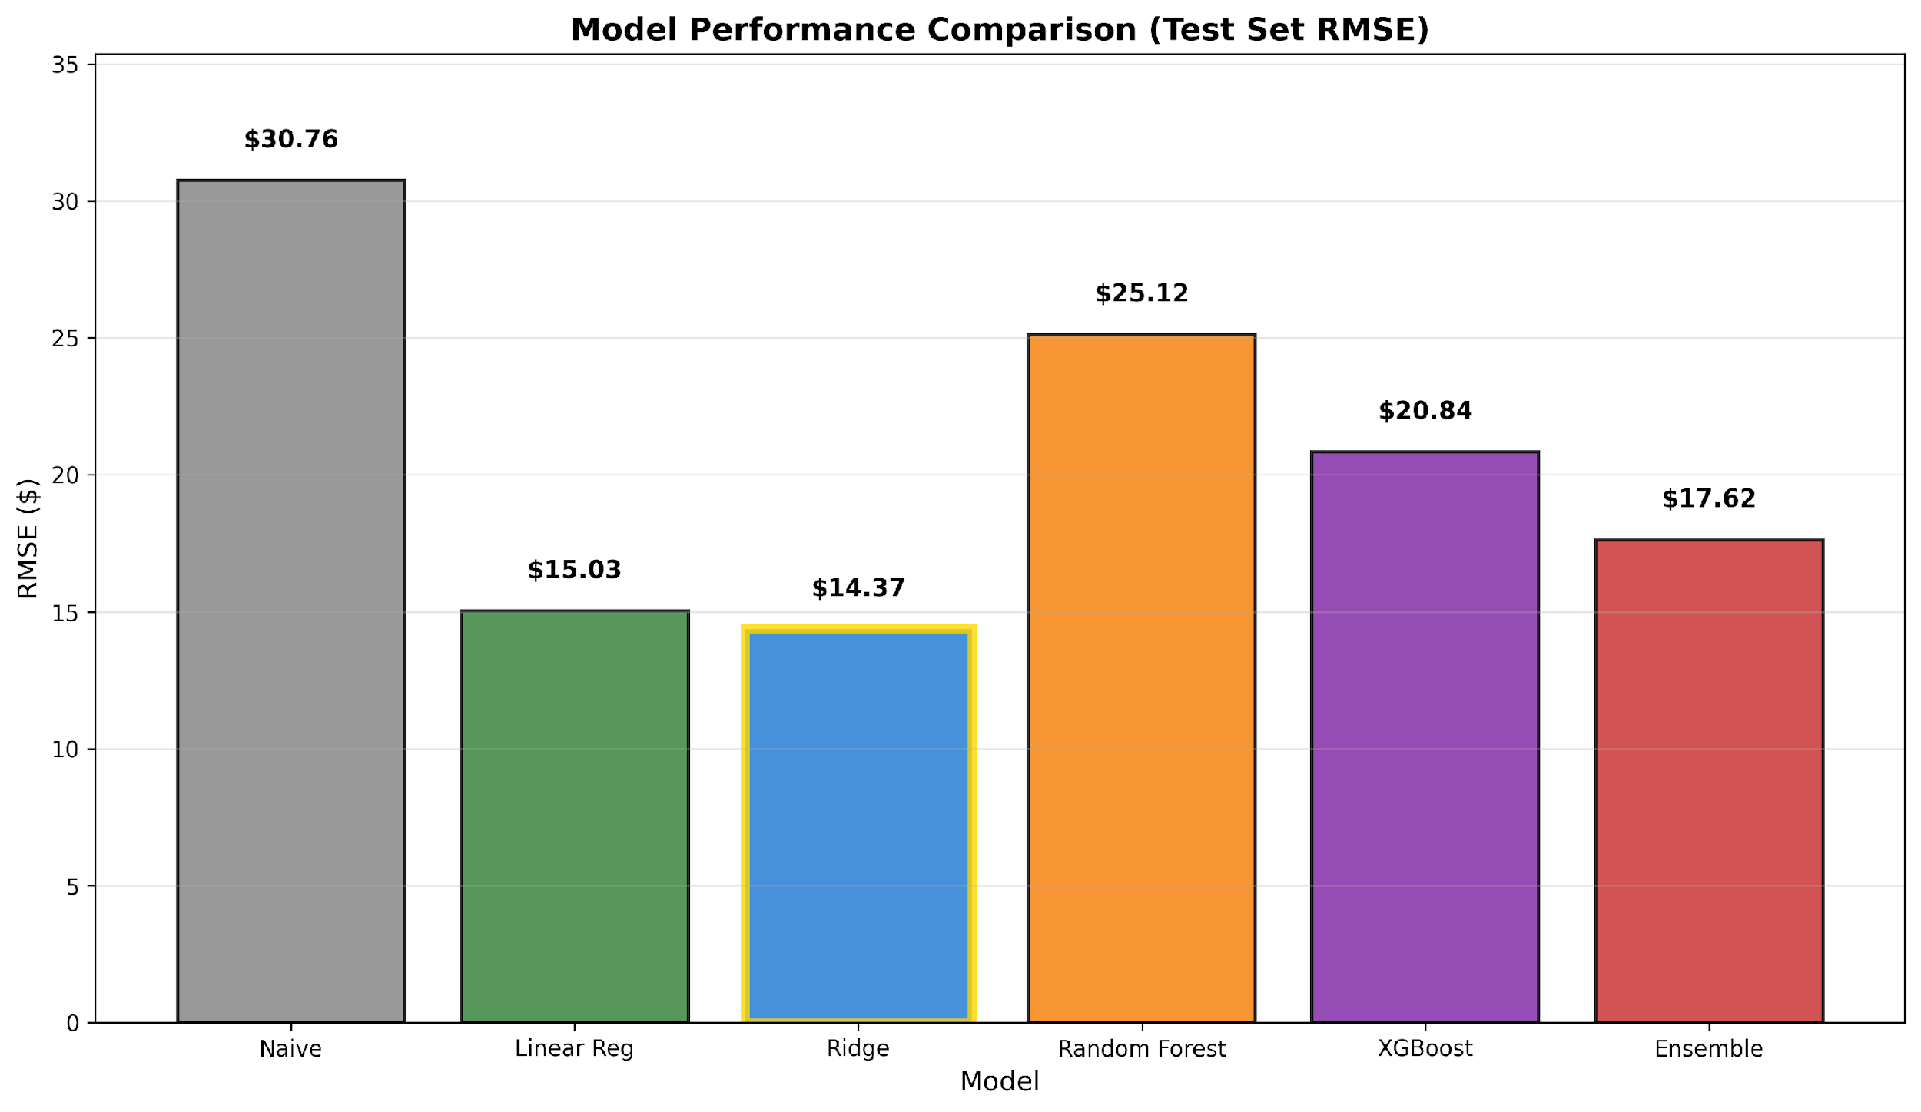
Model Performance
Best Model: Ridge Regression | Test RMSE: $14.37 |
53.3% improvement over baseline

Slide 4
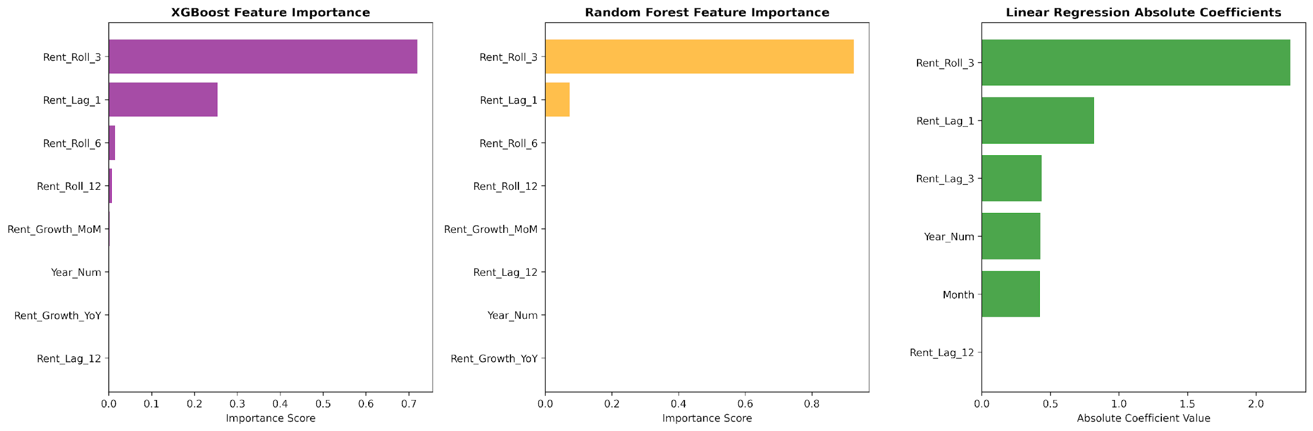
Key Findings: Feature Importance & Geographic Variation
Just 2 features explain 97% of predictions: 3-month rolling average (72%) + previous month rent (25%)

Slide 5
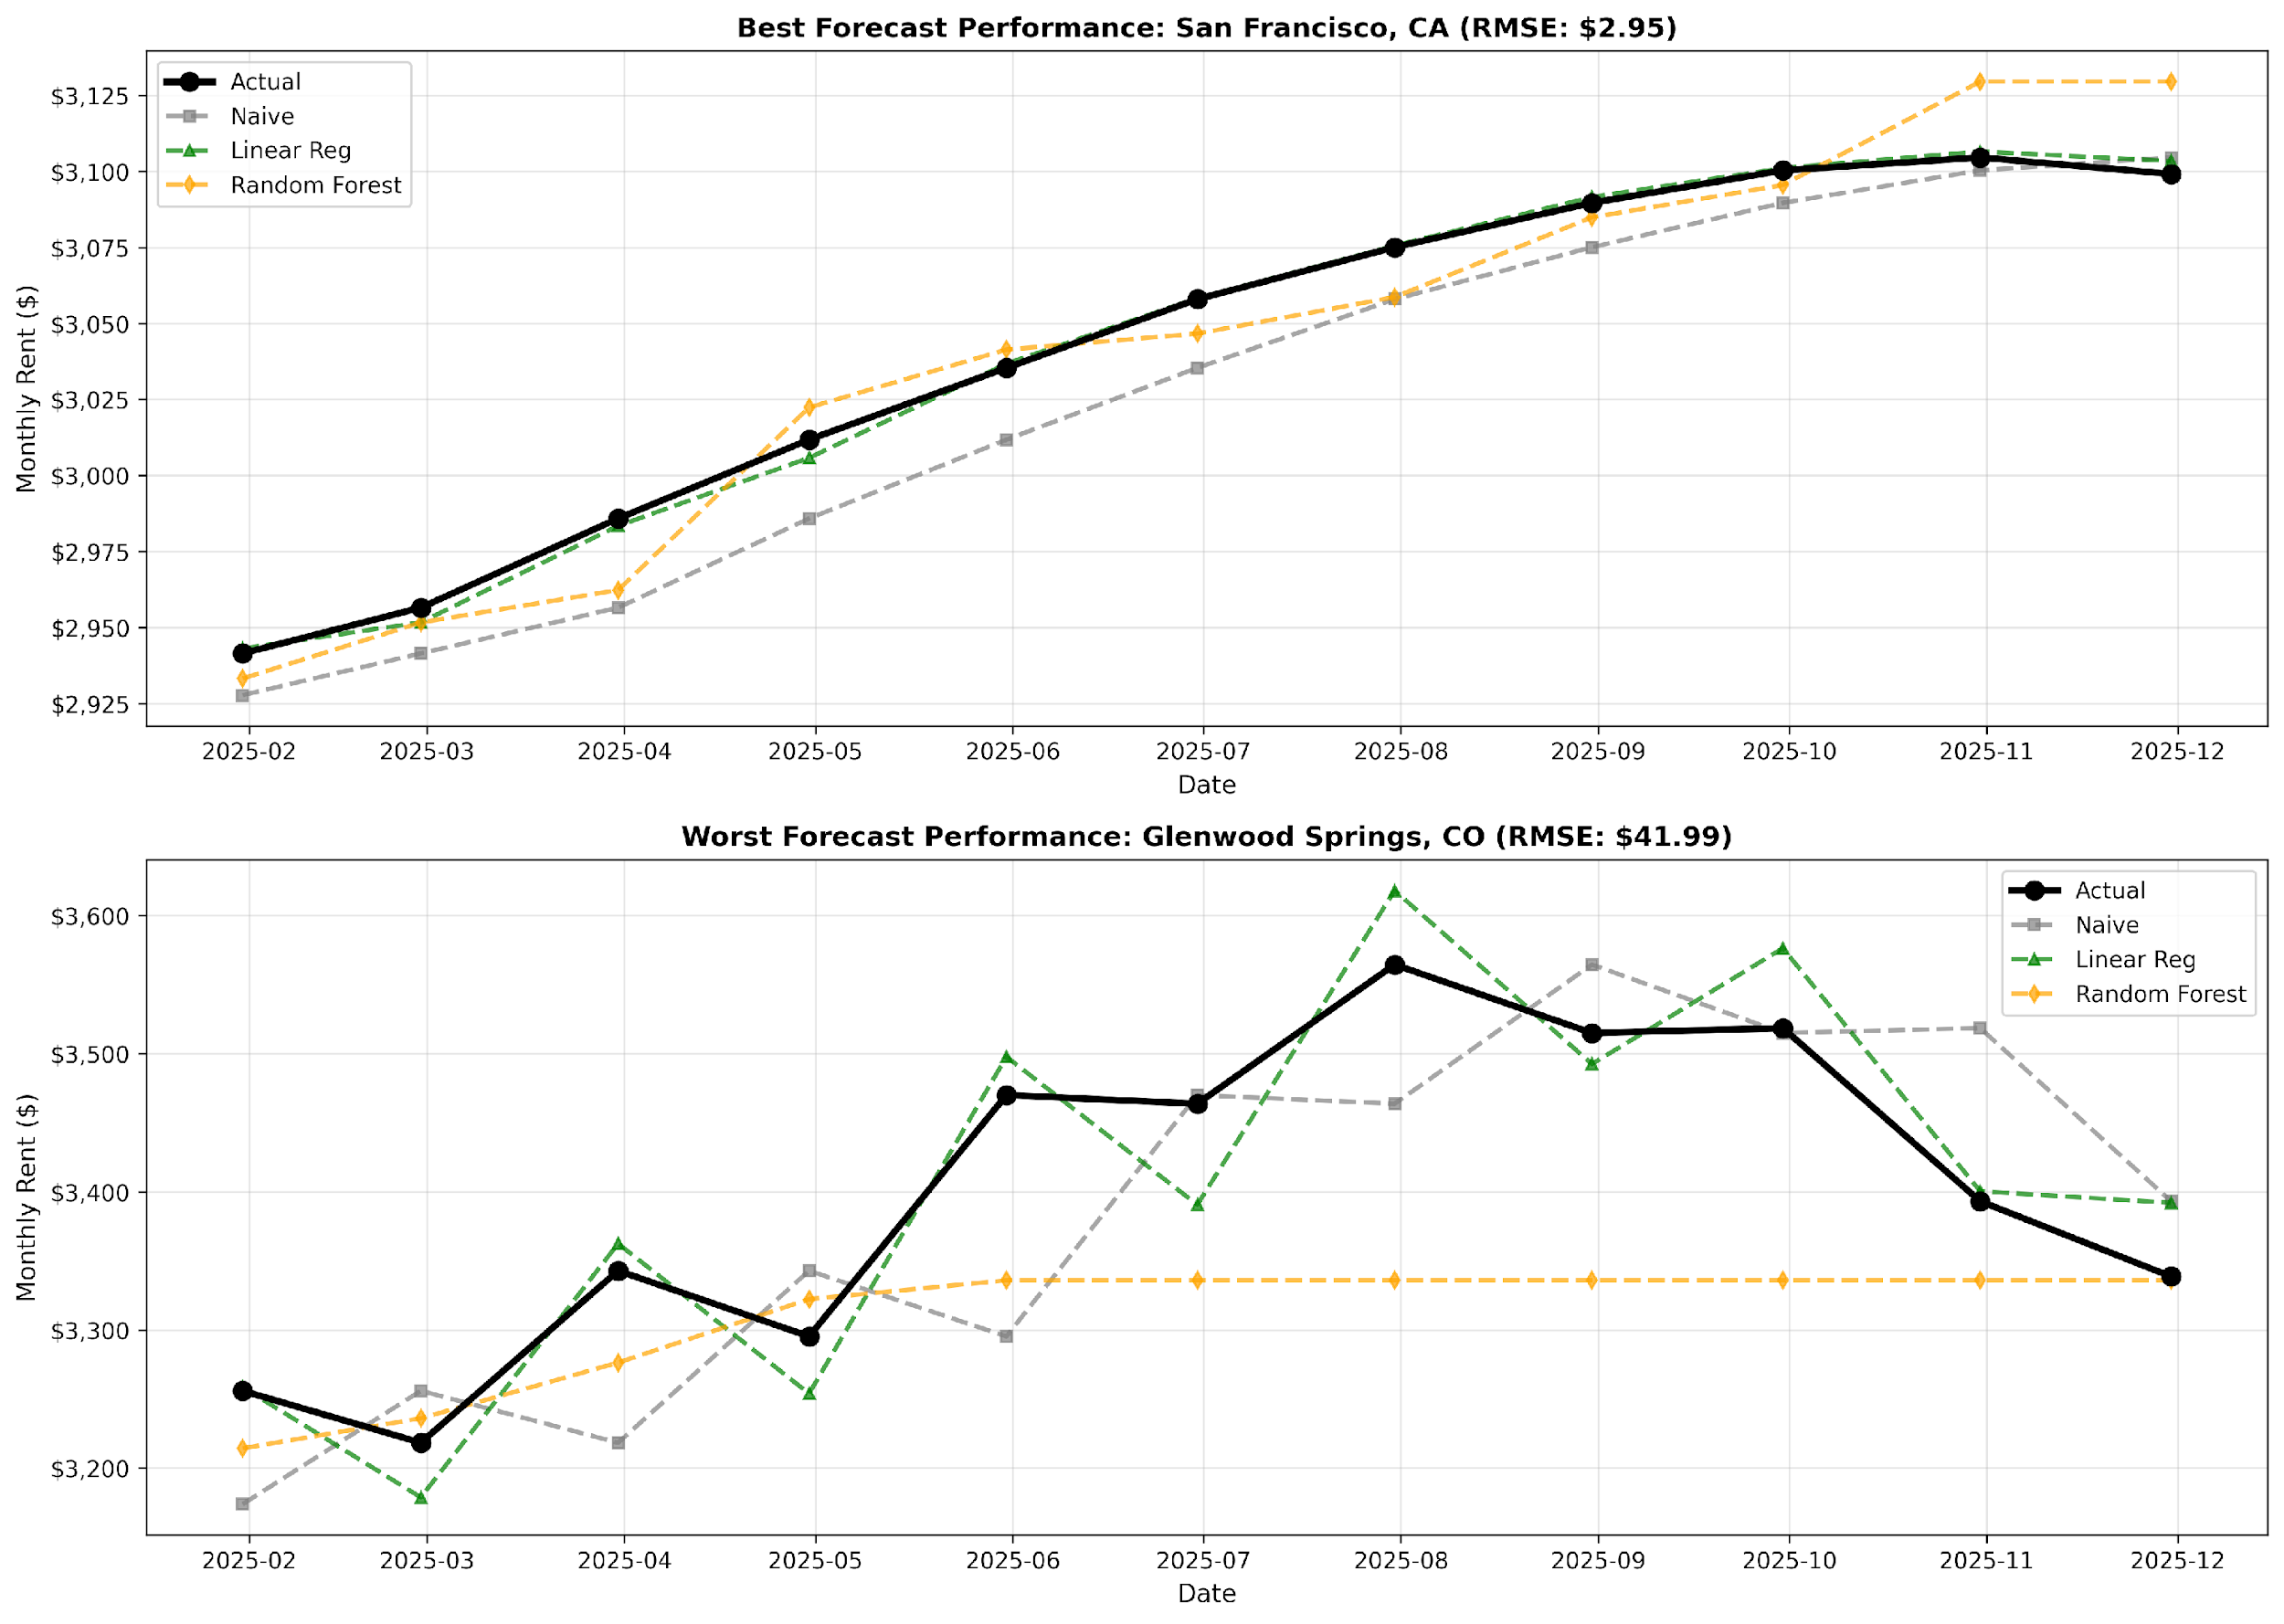
Key Findings: Feature Importance & Geographic Variation
Geographic Variation: San Francisco ($2.95 RMSE) vs Glenwood Springs ($41.99 RMSE)
Large, mature markets with diverse economies are highly predictable. Small resort markets with tourism dependence and seasonal volatility remain challenging.

Slide 6
Conclusions & Real-World Impact
KEY TAKEAWAYS
Ridge/Linear beat Random Forest, etc.
  Rental price dynamics are predominantly linear.
Recent history dominates
  3-month avg + lag explain 97% of variance
High practical accuracy
  ±$28 prediction intervals (95% CI)
REAL-WORLD IMPACT
Property Managers
  Optimize pricing & revenue forecasts
Investors
  Improve acquisition valuations
Policymakers
  Project affordability challenges

Slide 7
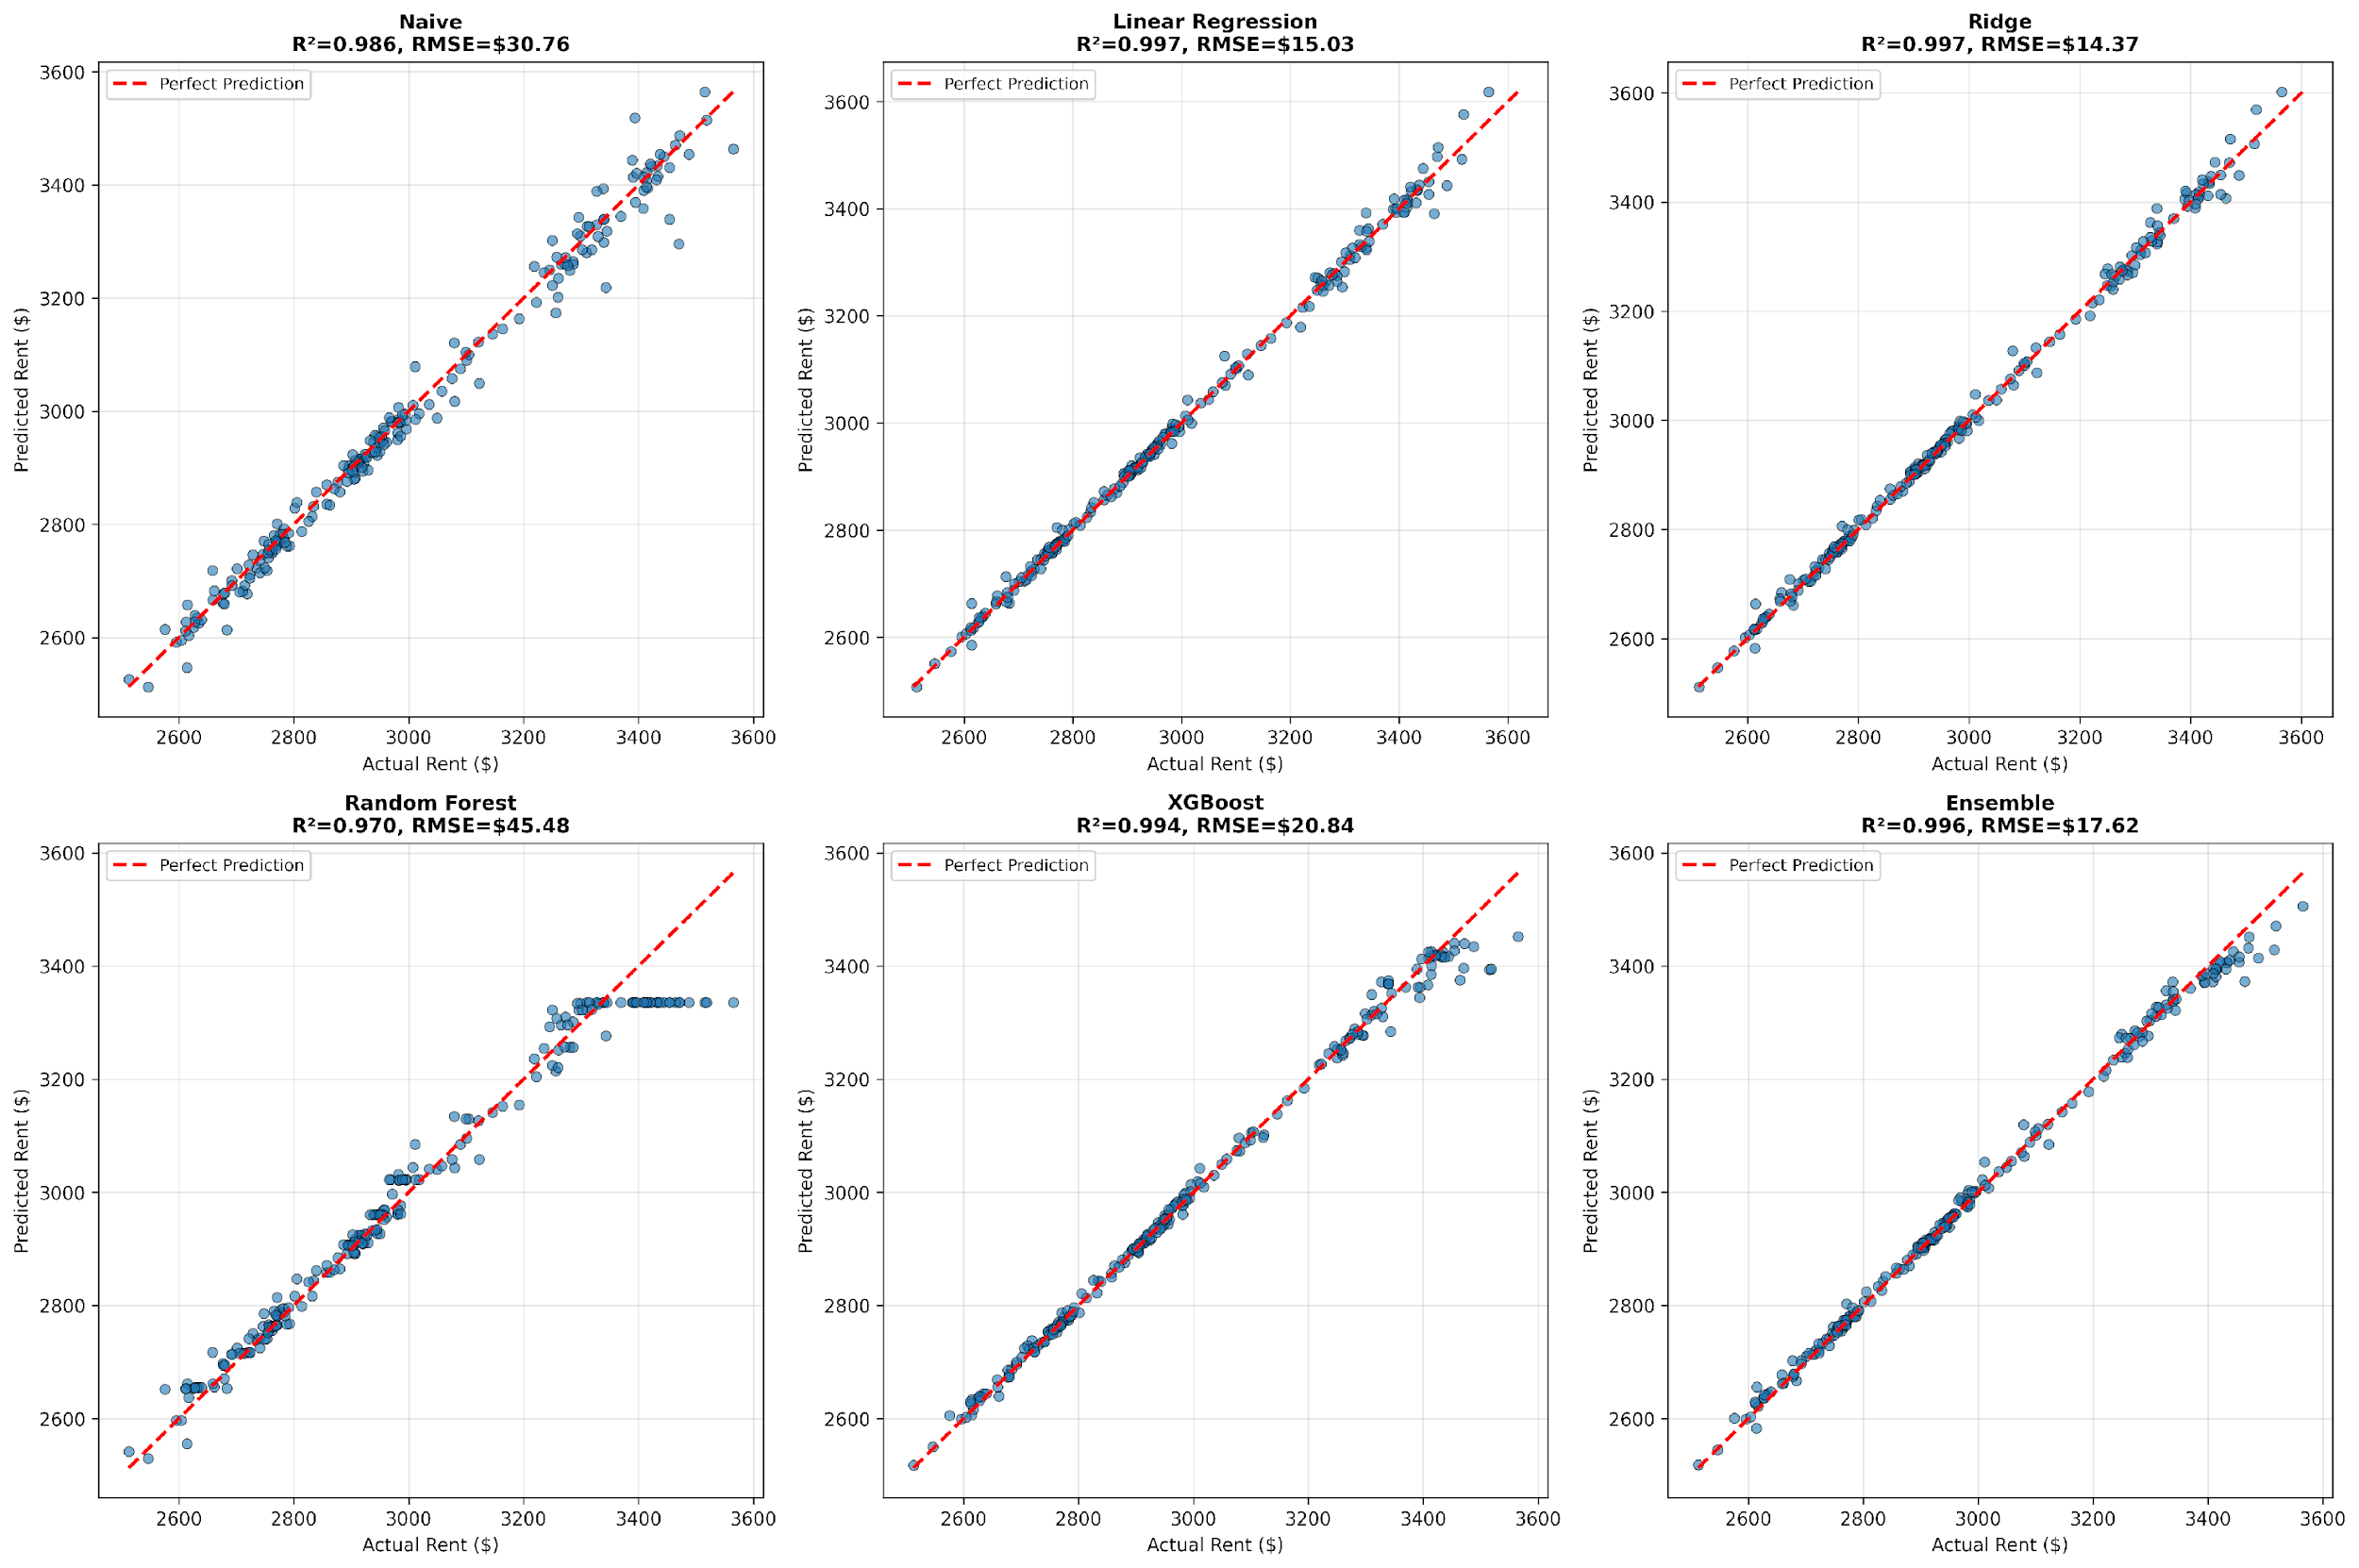
Conclusions & Real-World Impact
RECOMMENDATION
Deploy Ridge Regression (α=0.1) as production forecasting model for high-rent markets. Monitor residuals monthly for regime change detection. This simple, interpretable model provides optimal accuracy while remaining easy to maintain and explain to stakeholders.

