Slide 1
Underwater Optical Wireless Communication
HEMANI KAUSHAL, GEORGES KADDOUM
2021.07.15
세종대학교 스마트기기전공
오승현

Slide 2
ANNOUNCEMENT
Military
tactical surveillance
Reason
Why we have to research about underwater communication?
Industry
Scientific
pollution monitoring,
oil control and maintenance,
offshore explorations
climate change monitoring
oceanography research

Slide 3
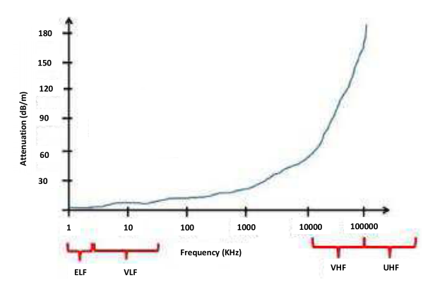
PHYSICAL ASPECTS OF UNDERWATER WIRELESS COMMUNICATION
Acoustic Wave
RF Wave
Optical Wave

Slide 4
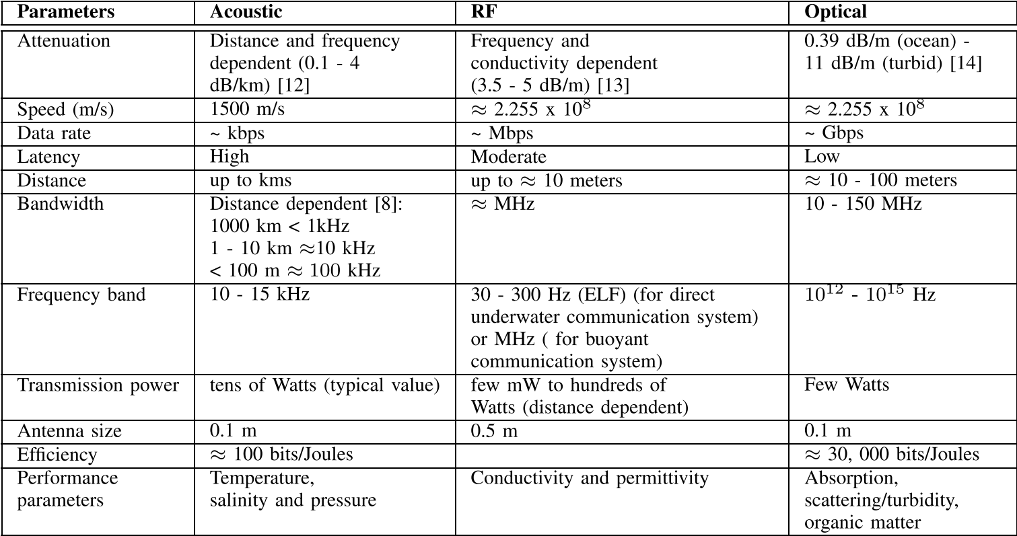
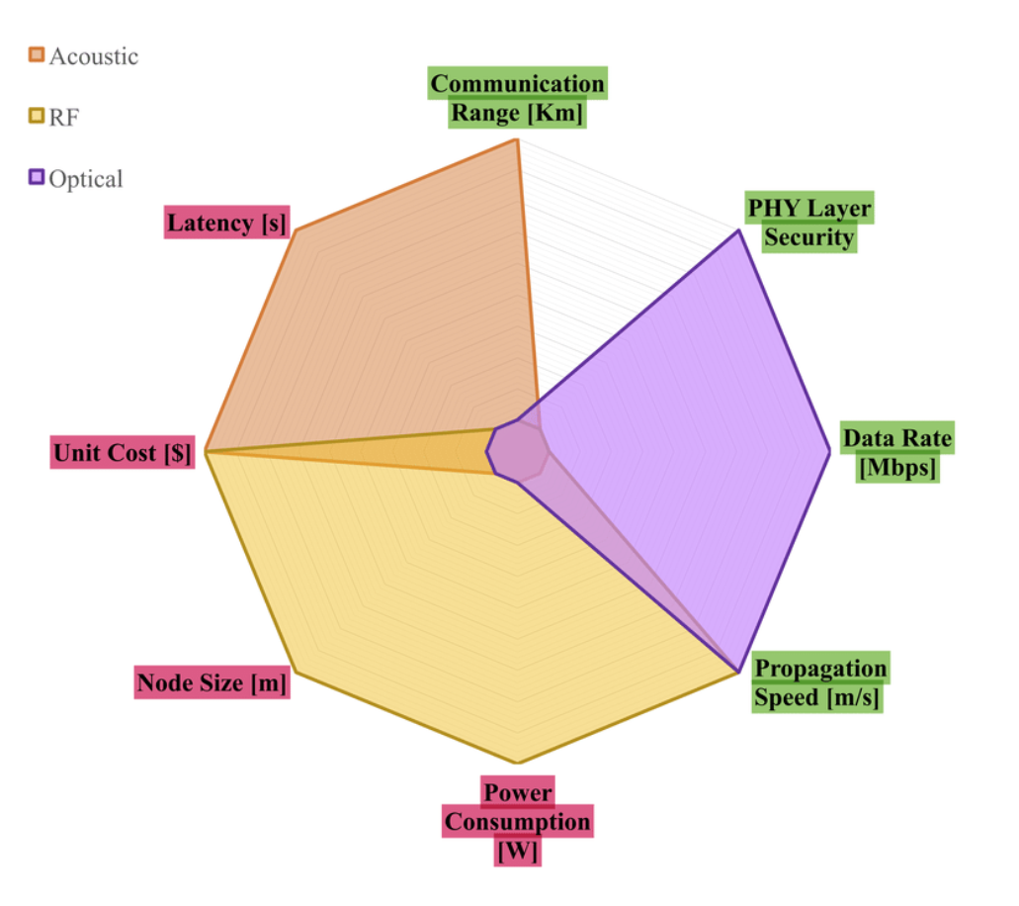
PHYSICAL ASPECTS OF UNDERWATER WIRELESS COMMUNICATION
<Paper : Underwater Optical Wireless Communication - Table 2>
<Paper : Underwater Optical Wireless Communications
Networking, and localization: a survey >

Slide 5

Optical Beam Propagation Underwater
Pure Sea Water
Clear Ocean Water
Coastal Ocean Water
Turbid Harbor

Slide 6
Factors that affect UWOC
1
Absorption and scattering
2
Beam Spreading
3
Turbulence
4
Alignment
5
Multipath interference
6
Physical obstruction
7
Background noise

Slide 7
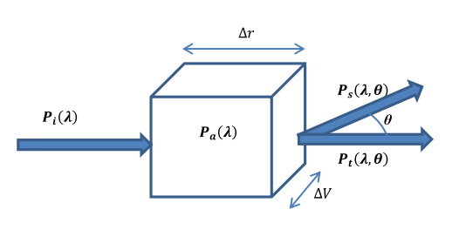

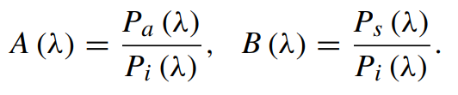
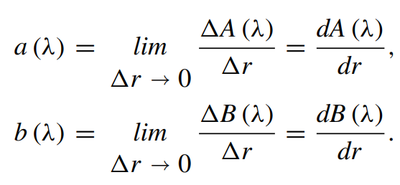


Absorption & scattering and Beam spreading

Slide 8
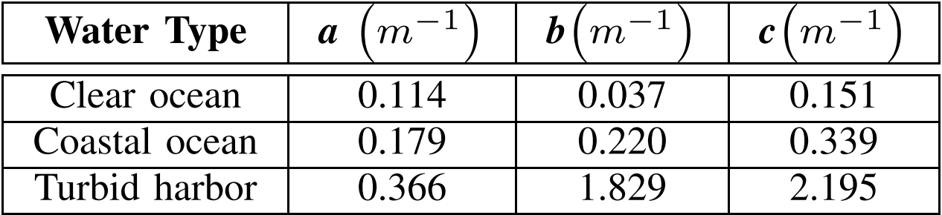
Absorption & scattering and Beam spreading

Slide 9
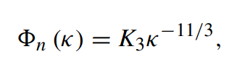

Turbulence
<안드레이 콜모고로프 난류 모델>

Slide 10
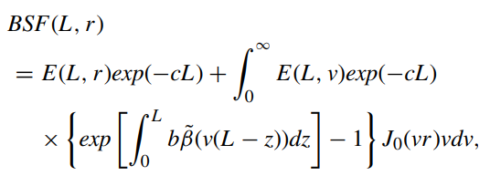
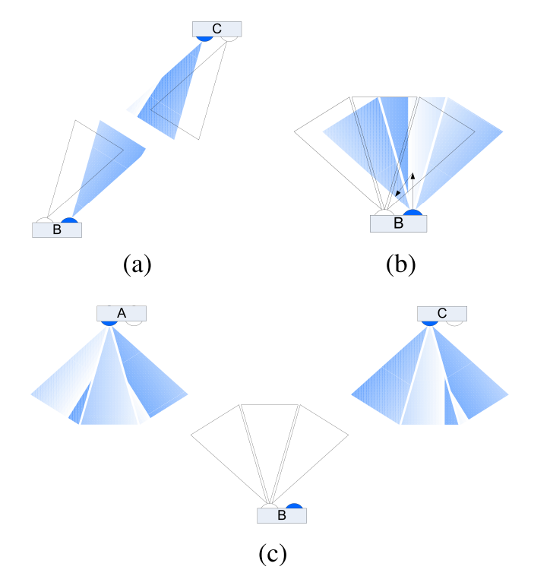
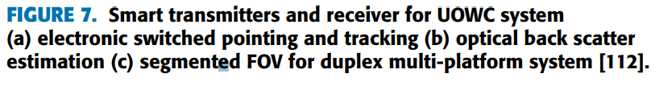
POINTING AND ALIGNMEN

Slide 11
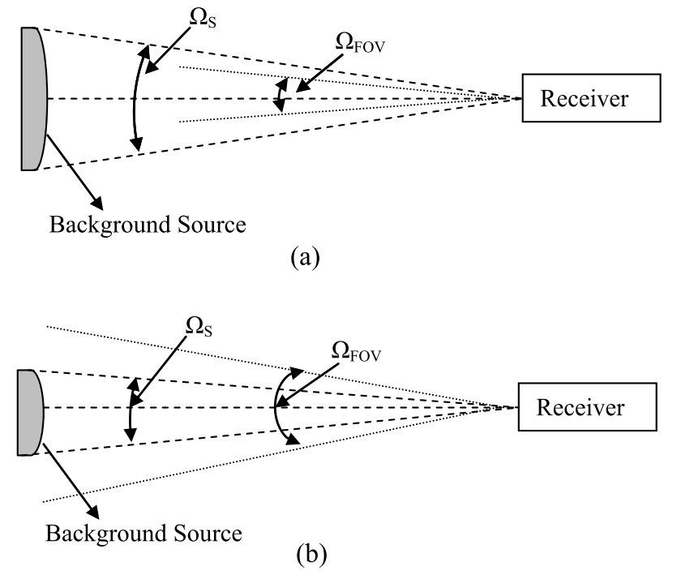
BackGround Noise
diffused extended background noise
background noise from the Sun or other stellar (point) objects
scattered light collected by the receiver.

Slide 12

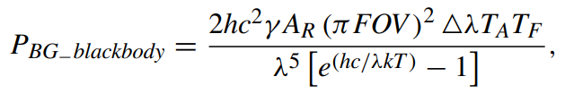

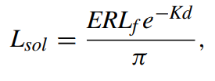
BackGround Noise

Slide 13
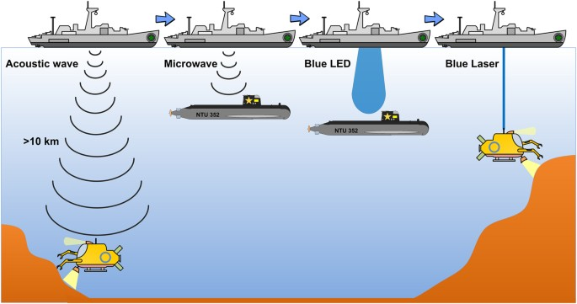
Left Aspect
MULTIPATH INTERFERENCE AND DISPERSION
PHYSICAL OBSTRUCTIONS
ARQ(Automatic Repeat Request)
Hybrid
ARQ
FEC(Forward Error Correction)

Slide 14
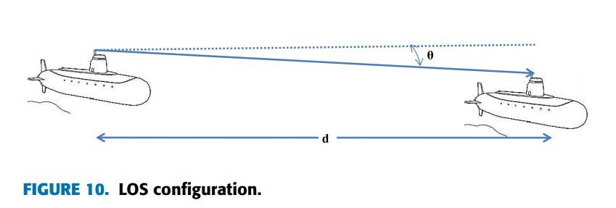
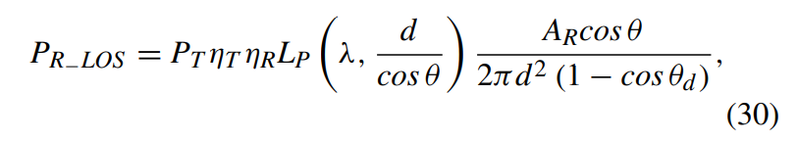
Direct LOS links

Slide 15
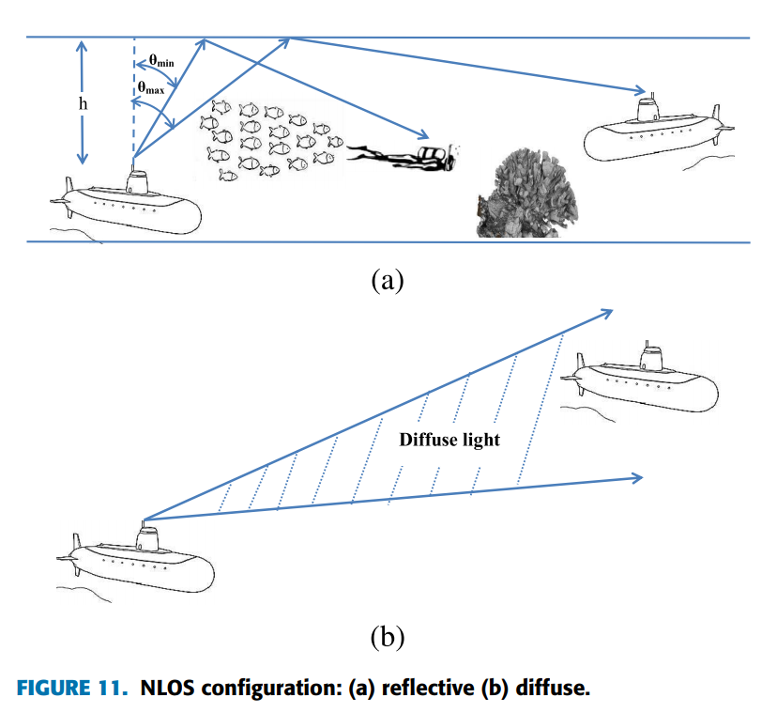
NLOS LINKS

Slide 16
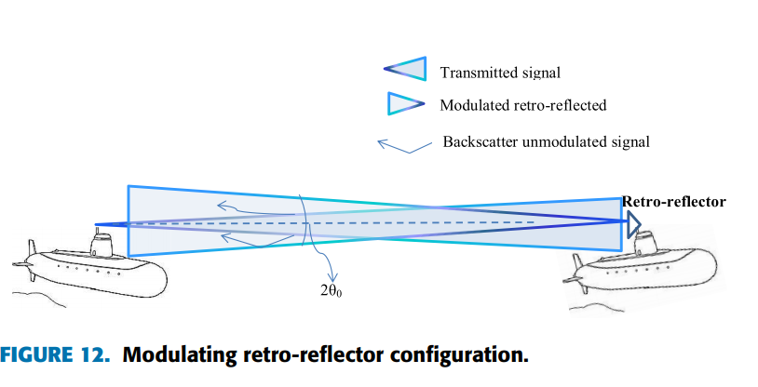
RETRO-REFLECTOR LINKS
i) Photon Limited
Scenario
ii) Contrast Limited

Slide 17
Conclusion
Historical approach
Kind of Aspect
Kind of Links

Slide 18
THANKS

