Slide 1










AWS Cloud
Availability Zone - A
Availability Zone - C
VPC
Internet gateway
Public subnet
Public subnet
AWS CloudFormation
NAT Gateway
NAT Gateway
Private subnet
Private subnet
Amazon CloudWatch
Amazon S3
HANA Master Instance
HANA Standby Instance

Slide 2

AWS Cloud
SAP HANA VPC
10.0.0.0/16
Availability Zone 1
Availability Zone 2
AWS CloudFormation
Private subnet
Private subnet
192.168.1.99
Primary
SAP HANA
SUSE
HA Cluster
Secondary
SAP HANA
Amazon CloudWatch
Amazon S3

Slide 3
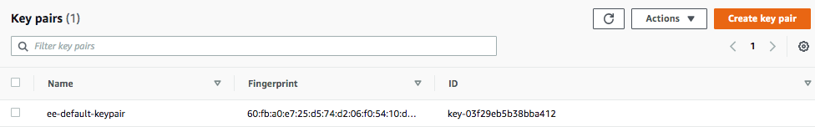

Slide 4
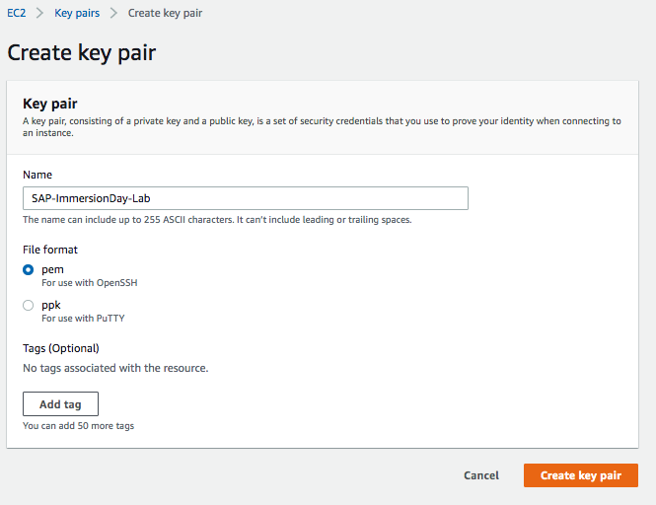

Slide 5
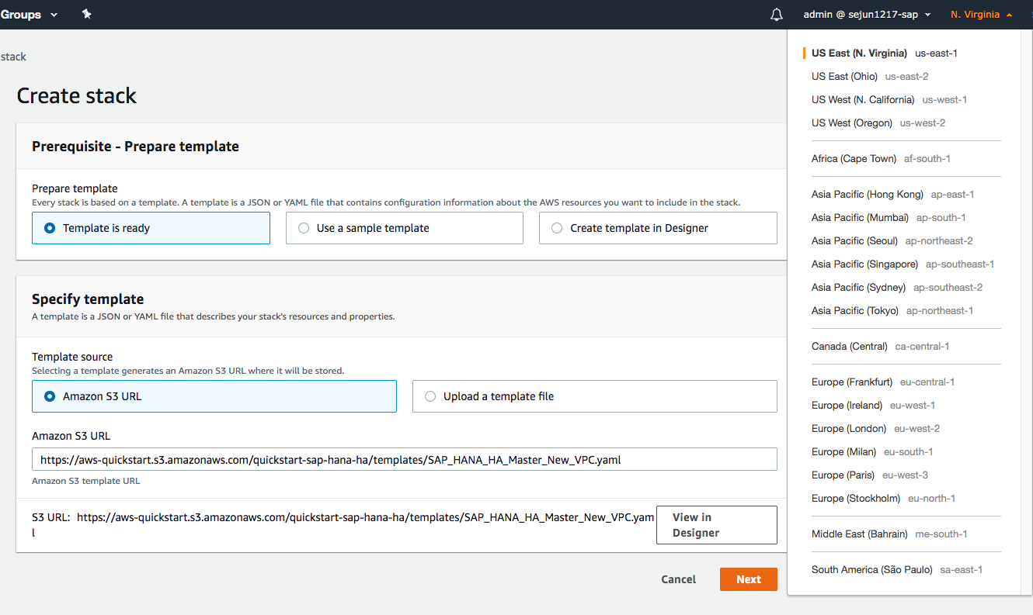

Slide 6
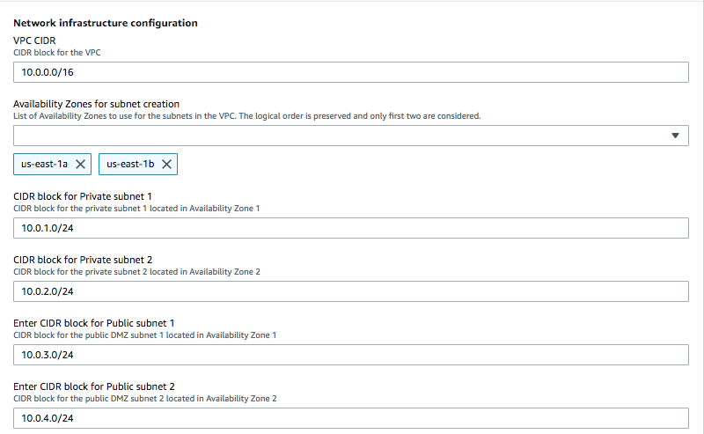

Slide 7
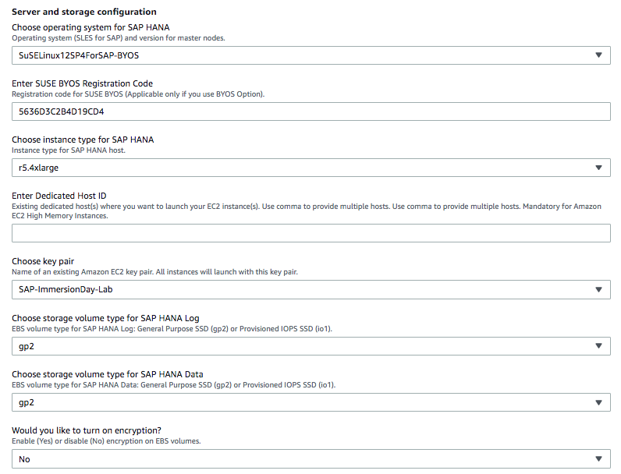
xxxxxxxxxxxxxx

Slide 8
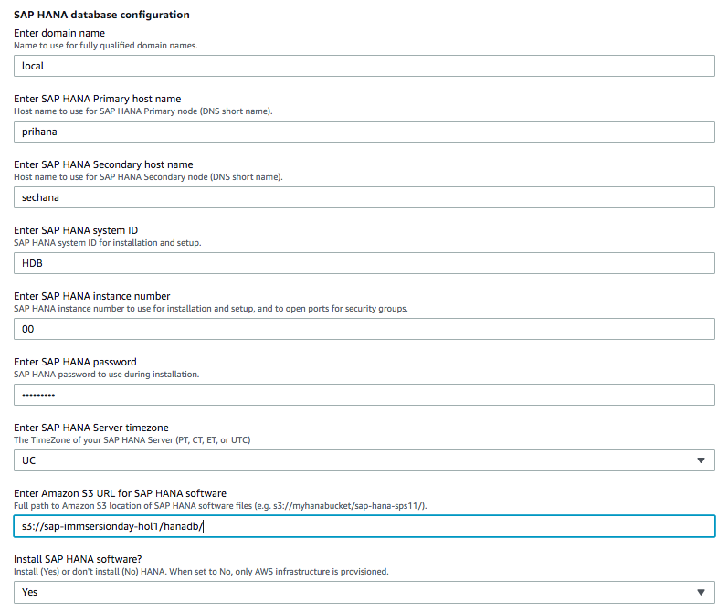
≈
≈

Slide 9
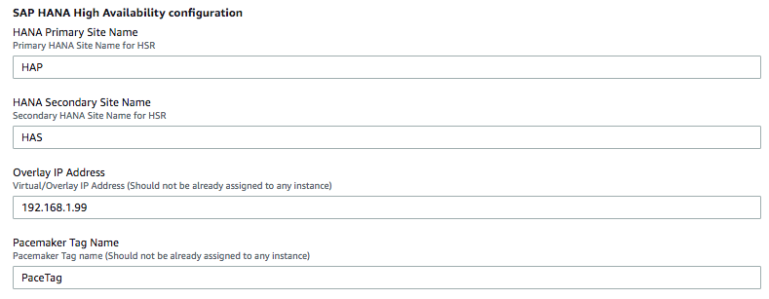

Slide 10
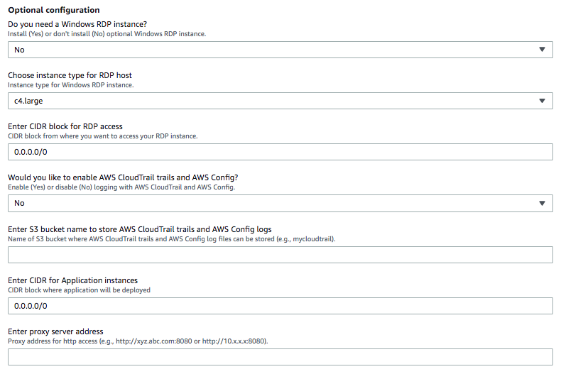

Slide 11
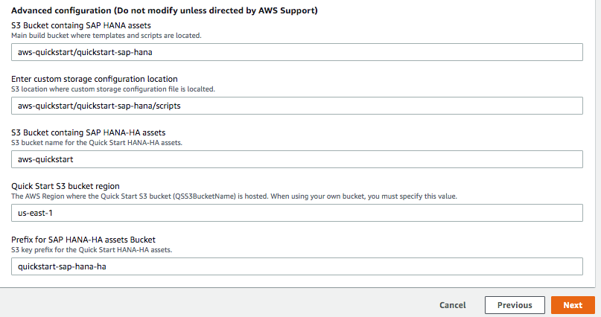

Slide 12
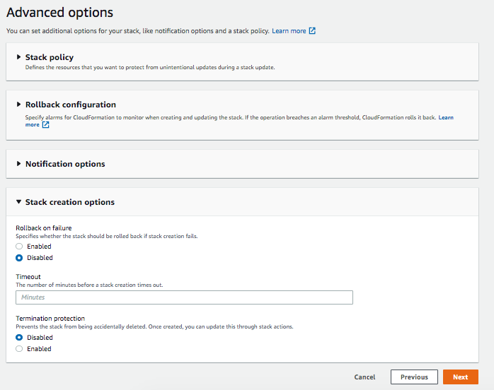

Slide 13
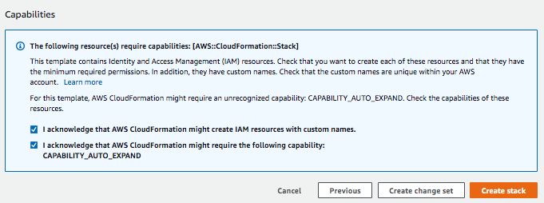

Slide 14
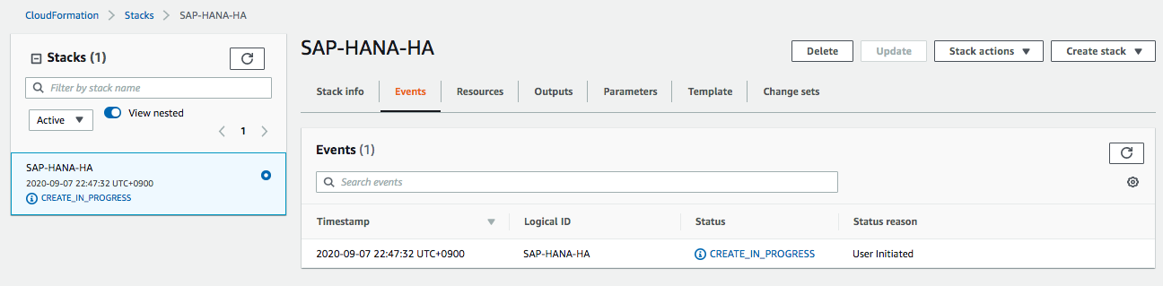

Slide 15
