Slide 1
Software Project Lab -1
Name: Sejuti Sharmin Siddiqui
BSSE Roll: 1420

Slide 2
Project Title- DataSift
Supervised by,
Dr. Sumon Ahmed
Associate Professor
IIT, University of Dhaka

Slide 3
Project Overview
The program analyzes a dataset based on the operation the user wishes to perform.
Input - Dataset and test values given by the user
Output- Analysis and Predictions

Slide 4
Types of Analysis
Project Overview
Regression
Classification
Unsupervised Data Analysis

Slide 5
Motivation
Understanding dependency and co-relation in the data fields
Developing a generalized model that fits
the data
Extracting predictive insights

Slide 6
Regression
Tasks Implemented So Far
What is Regression?
> A statistical model that explains the changes in a dependent variable in terms of one or more independent variables
Simple Linear
Multiple Linear
Simple Polynomial

Slide 7
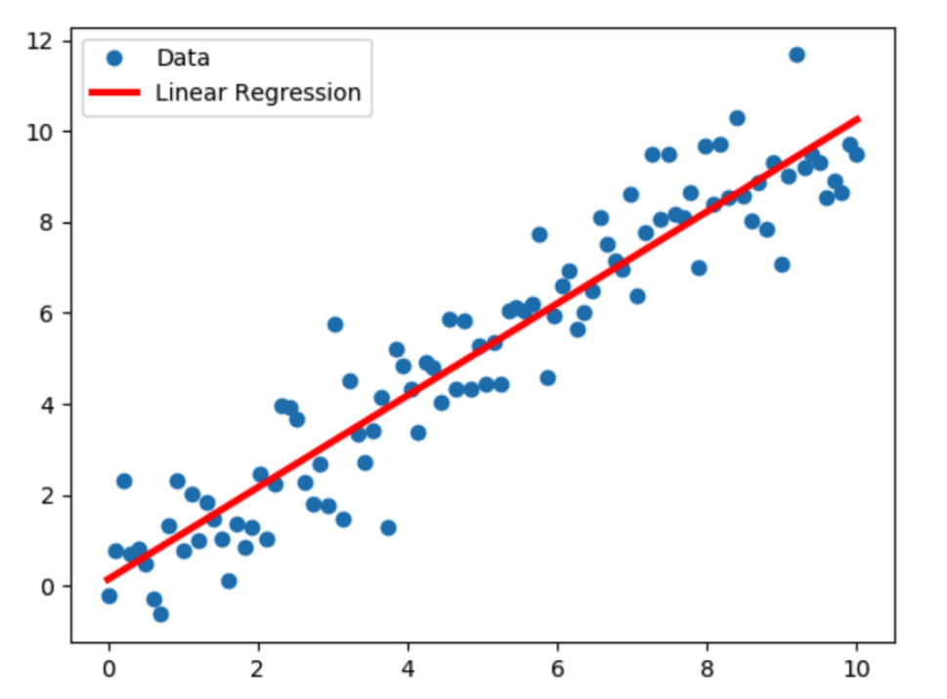
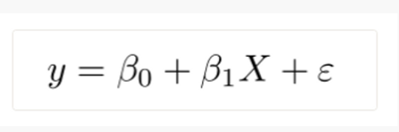
Simple Linear Regression
> The program calculates the slope and intercept in a way that minimizes the Error Sum Square (ESS).

Slide 8
But in reality, the relationship between the independent and the dependent variable might not be so perfectly linear.

Slide 9
We perform-
Where Simple Linear Regression Fails
Polynomial Regression
If the scatter plot of the data shows a
non- linear nature.
Multiple Linear Regression
If there are multiple independent variables influencing the dependent variable.

Slide 10
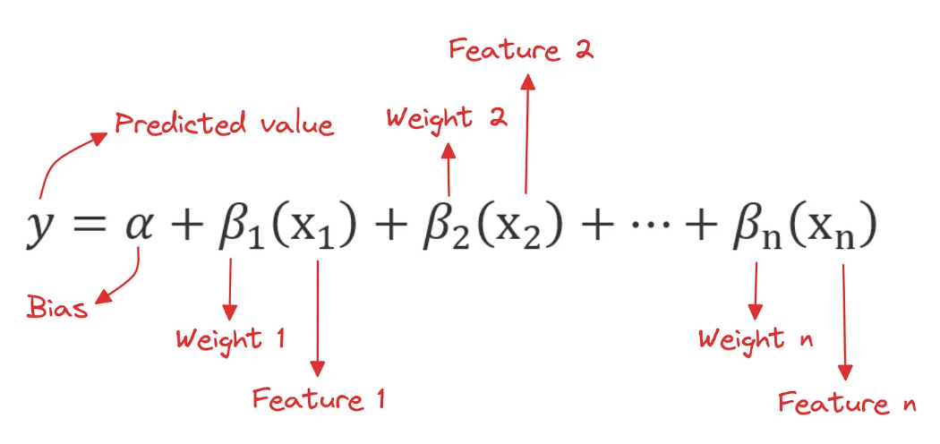
Multiple Linear Regression

Slide 11
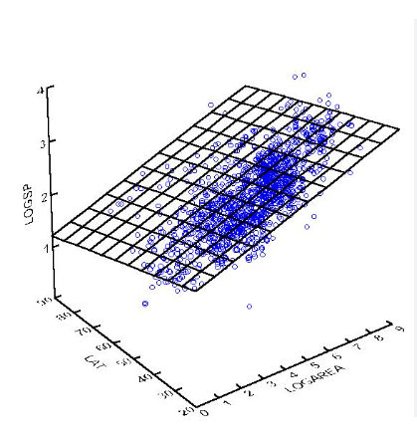
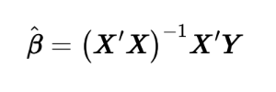
Multiple Linear Regression
Estimation of Regression Parameters
> The Program uses OLS (Ordinary Least Square) method to calculate the parameter matrix.

Slide 12
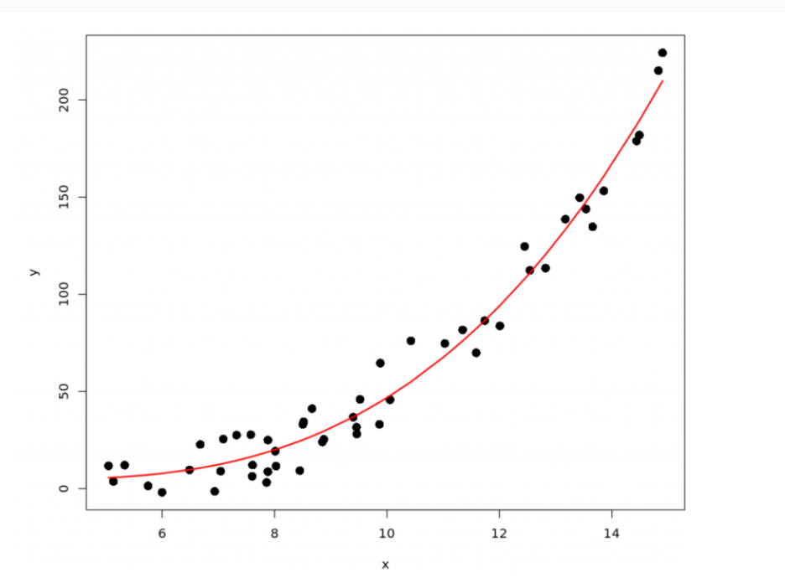

Simple Polynomial Regression
For nth degree polynomial-
> The degree of the polynomial is taken as an input from the user. The program gives a warning message when there is a high chance of overfitting.

Slide 13
Features Implemented
Easy to Interact User Interface
Basic Matrix Toolkit for OLS
Matrix Inversion by Gauss-Jordan Elimination
OLS Method for Parameter Estimation
Coefficient of Determination Calculation for Interpreting the Model

Slide 14
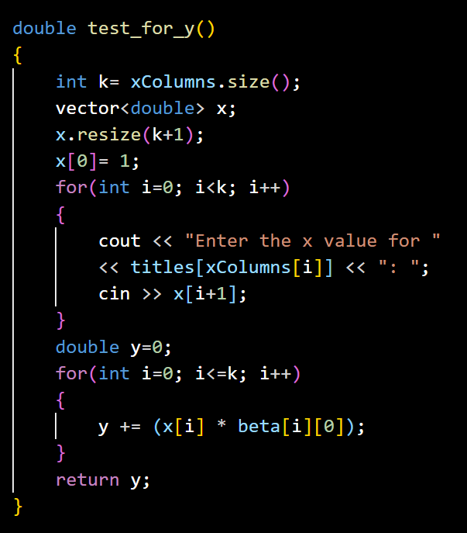
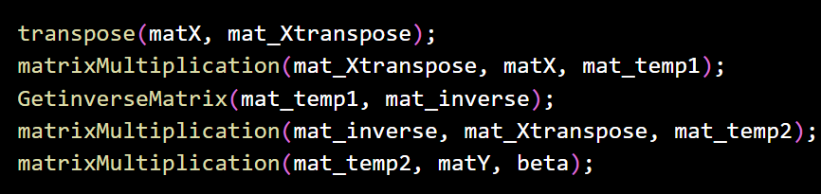
Code Snippets
OLS Calculation-

Slide 15

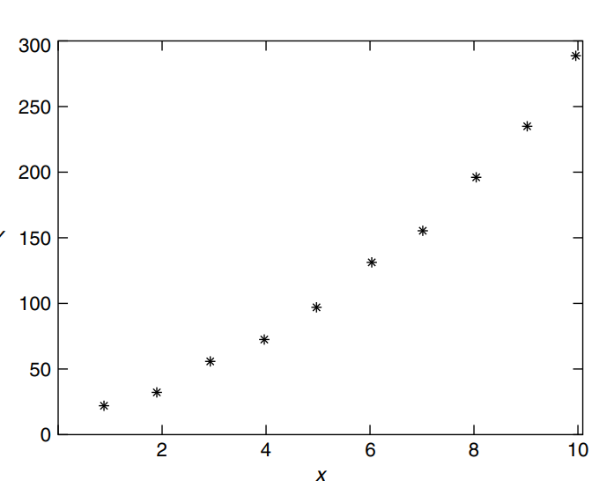
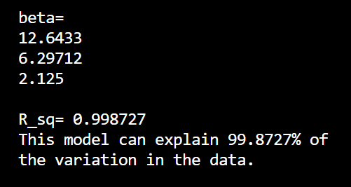
Output Accuracy Test
Input Sample Scatter Plot

Slide 16
Future Feature Plans
Classification
Logistic Regression
Naive Bayes Classification
KNN Classification
Unsupervised Data Analysis
K-means clustering

Slide 17
GitHub Link
URL- https://github.com/sejutiii/SPL-1

Slide 18
THANK YOU!

