Slide 1

Name Entity Recognition

Slide 2

Outline
NLP Introduction
NER Introduction
NER Method Introduction
Implementation
Conclusion

Slide 3
NLP Introduction
Speech Recognition
Natural Language Generation
Name Entity Recognition

Slide 4
What is NER?
我在成大醫院看病的時候，李醫師跟我說腎臟有問題
我跟我爸爸三月十五日的時候都要回診
這樣是四千七百元，記得下禮拜要來看報告喔

Slide 5
Named Entity Recognition
Name Entity
A real-world object, such as persons, locations, organizations, products, etc., that can be denoted with a proper name.
NER Task
Detect the name entities from an unstructured text
這樣是四千七百元，記得下禮拜要來看報告喔
Money - entity
Time - entity

Slide 6
NER Time Line
Traditional Method:
Rule-based
Deep Learning:
CNN-CRF, RNN-CRF,BILSTM-CRF……
Machine Learning:
HMM, CRF……
Recent Method:
Attention-based, Transfer Learning, Semi-supervised,….

Slide 7
Machine Learning common method
HMM (Hidden Markov Model)
A statistical Markov model in which the system being modeled is assumed to be a Markov process
CRF (Conditional Random Fields)
A class of statistical modeling method often applied in pattern recognition

Slide 8
Data in Machine Learning Model
Observation
我
上
星
期
天
在
成
大
醫
院
看
病
的
時
候
text
label
O
B
I
I
I
O
B
I
I
I
O
O
O
O
O
Hidden State
I - Time
I - Time
B - Time
I - Time
I - Location
I - Location
I - Location
B - Location
上星期天
Time
成大醫院
Location
Name Entity

Slide 9
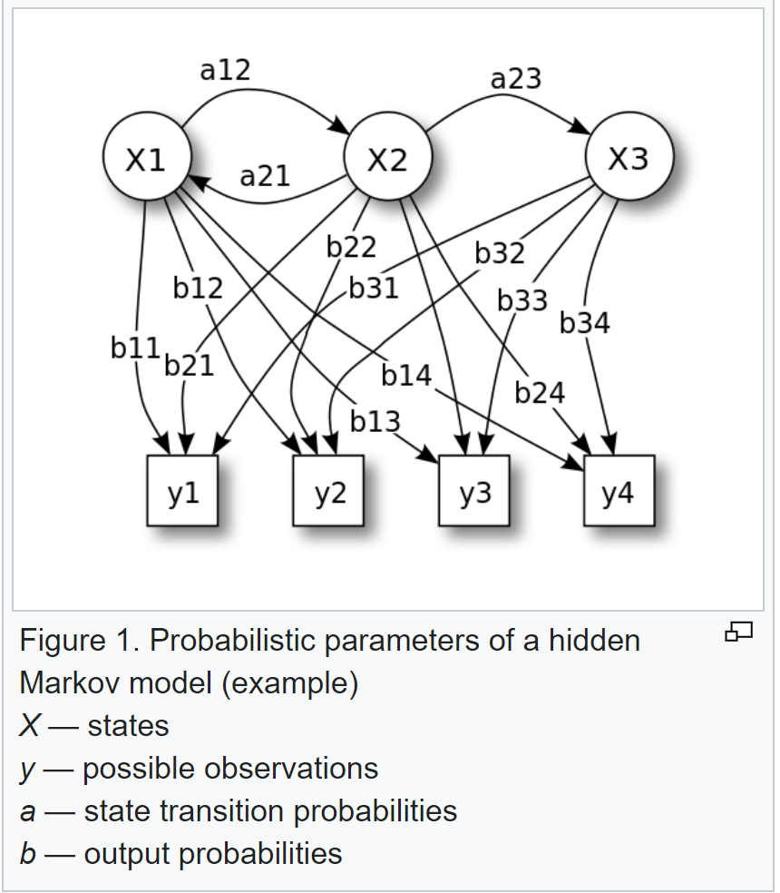
HMM (Hidden Markov Model)

Slide 10
CRF (Conditional Random Fields)
P (x,y) ∝ exp( ω * Φ (x,y) )
The probability of text x in state y
Weight * Feature Vector

Slide 11

CRF Loss Function

Slide 12
HMM v.s. CRF
HMM
P(x,y) = P(y₁ | start) * ΠP(y_{l+1} | y_{l}) * P(end | y_{L}) * ΠP(x_{i} | y_{i})
Transfer probability between states
Observation Probability
CRF
P(x,y) = P(y₁ | start) * ΠP(y_{l+1} | y_{l}) * P(end | y_{L}) * ΠP(t | s)*N_{s,t}(x , y)
Transfer probability between states
Combination Times

Slide 13
Deep Learning common method
BILSTM-CRF

Slide 14
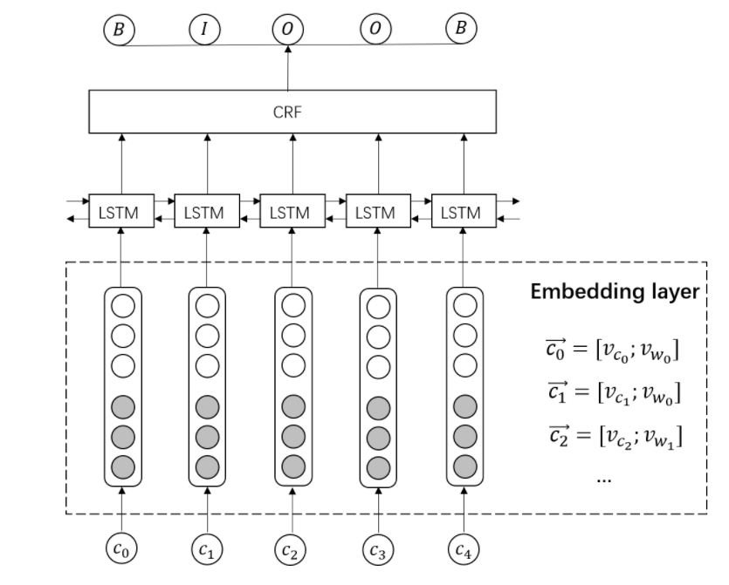
BILSTM-CRF

Slide 15
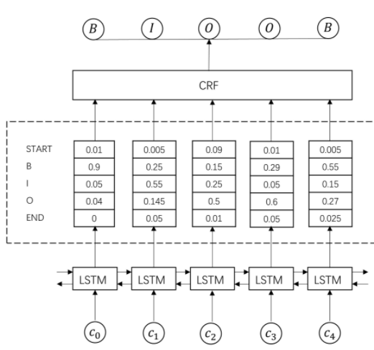
BILSTM-CRF
Emission Score: probability of every label

Slide 16
Recent common method
BERT + BILSTM-CRF

Slide 17
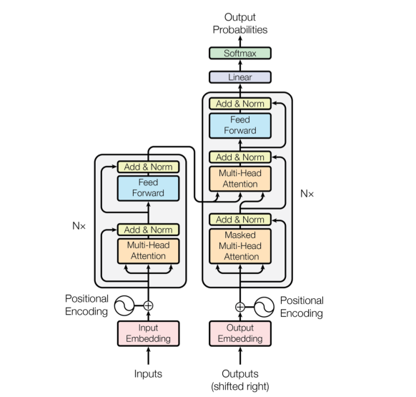
Transformer

Slide 18
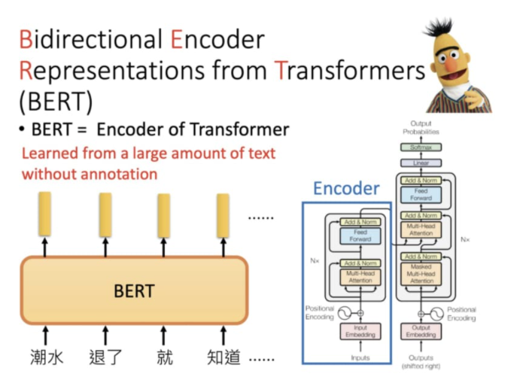
BERT

Slide 19
Implementation
CRF
BERT + BILSTM-CRF

Slide 20
Flow Chart
01. Data
Preprocessing
02. Building
NER Model
03. Features
Extraction
04. Training
05. Changing
Output Format

Slide 21
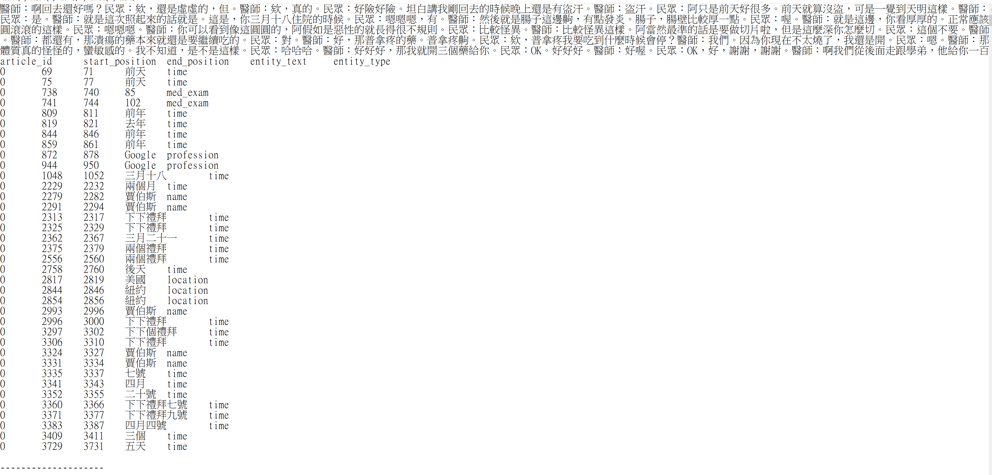
Training Data

Slide 22
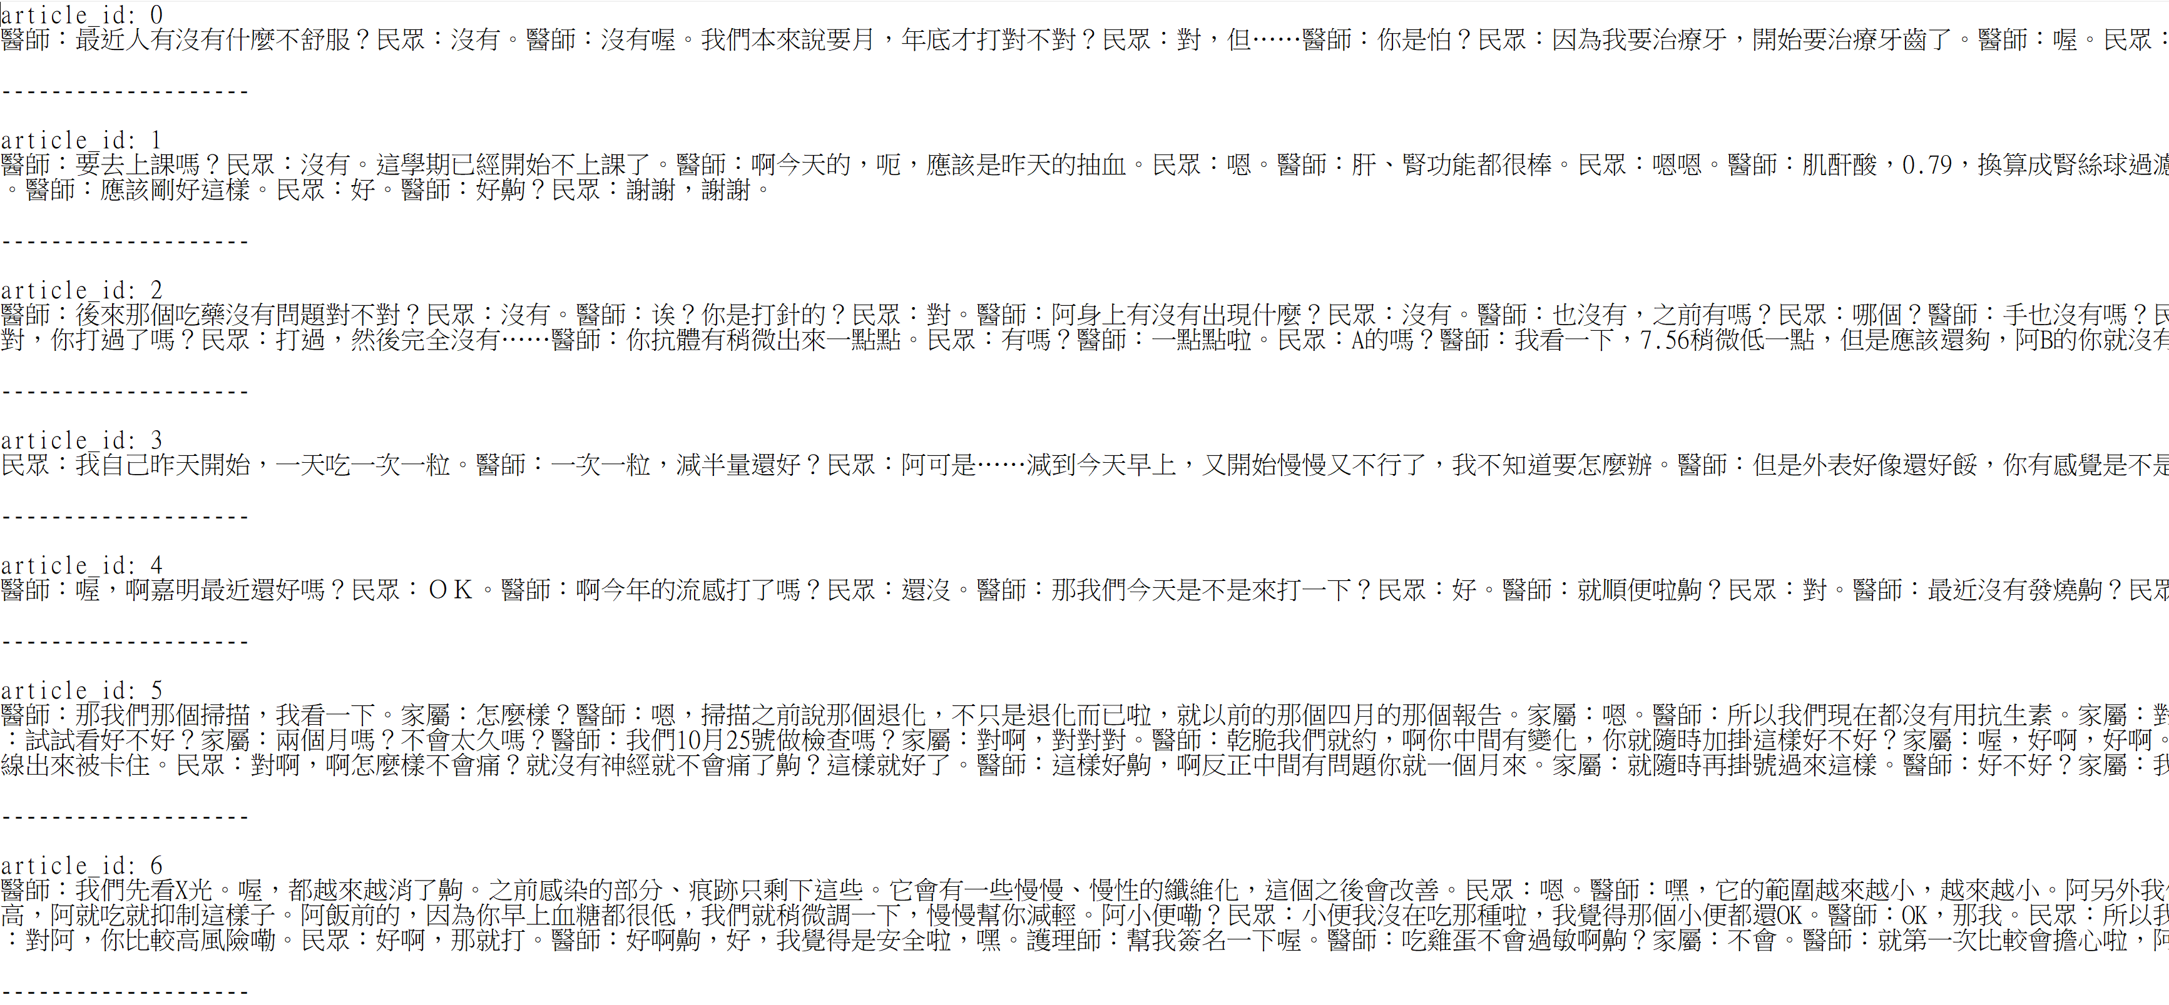
Input Data

Slide 23
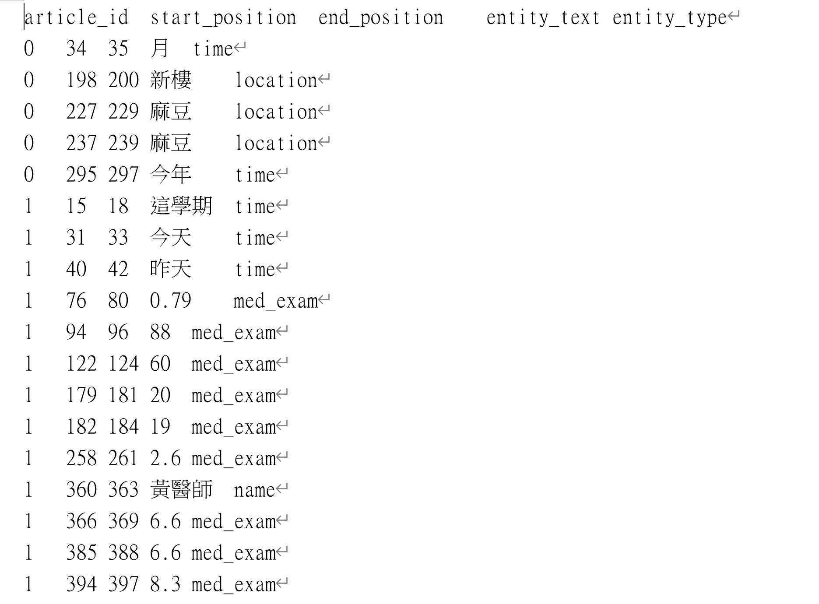
Output Format

Slide 24
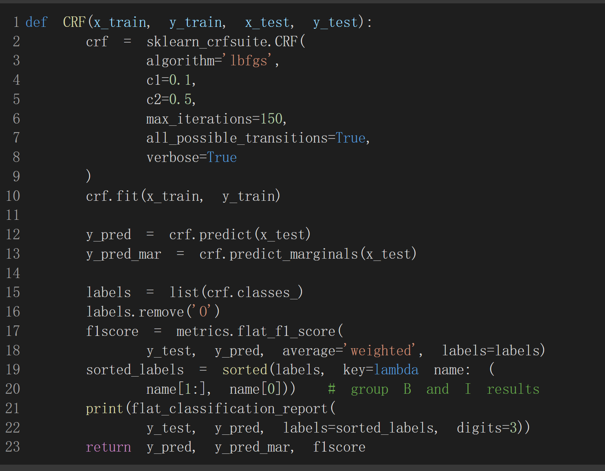
CRF

Slide 25
CRF Performance
Local F1 score: 0.61
Leader Board F1 score: 0.49

Slide 26
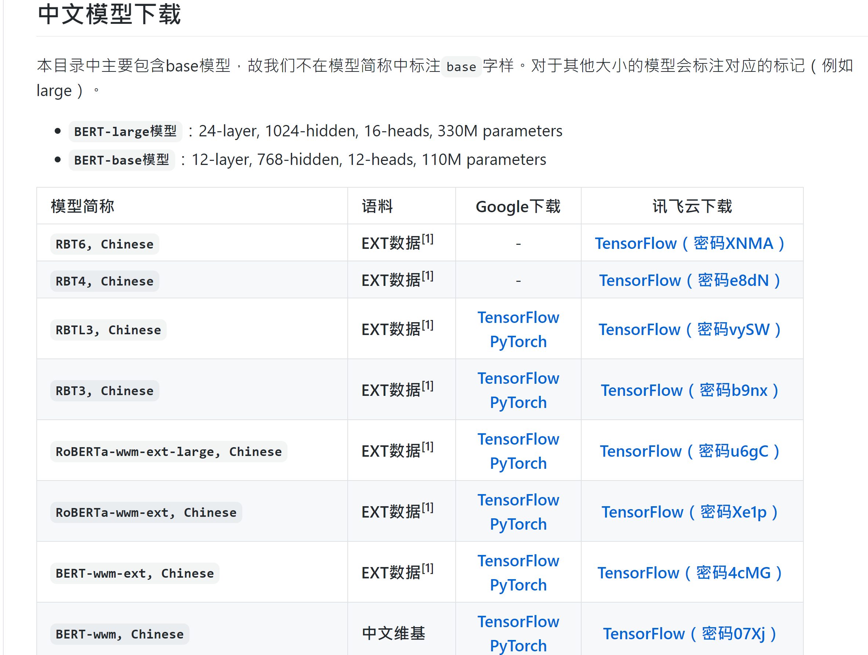
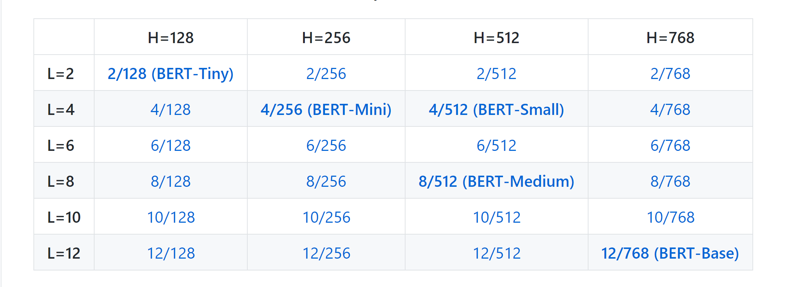
Pre-trained BERT

Slide 27
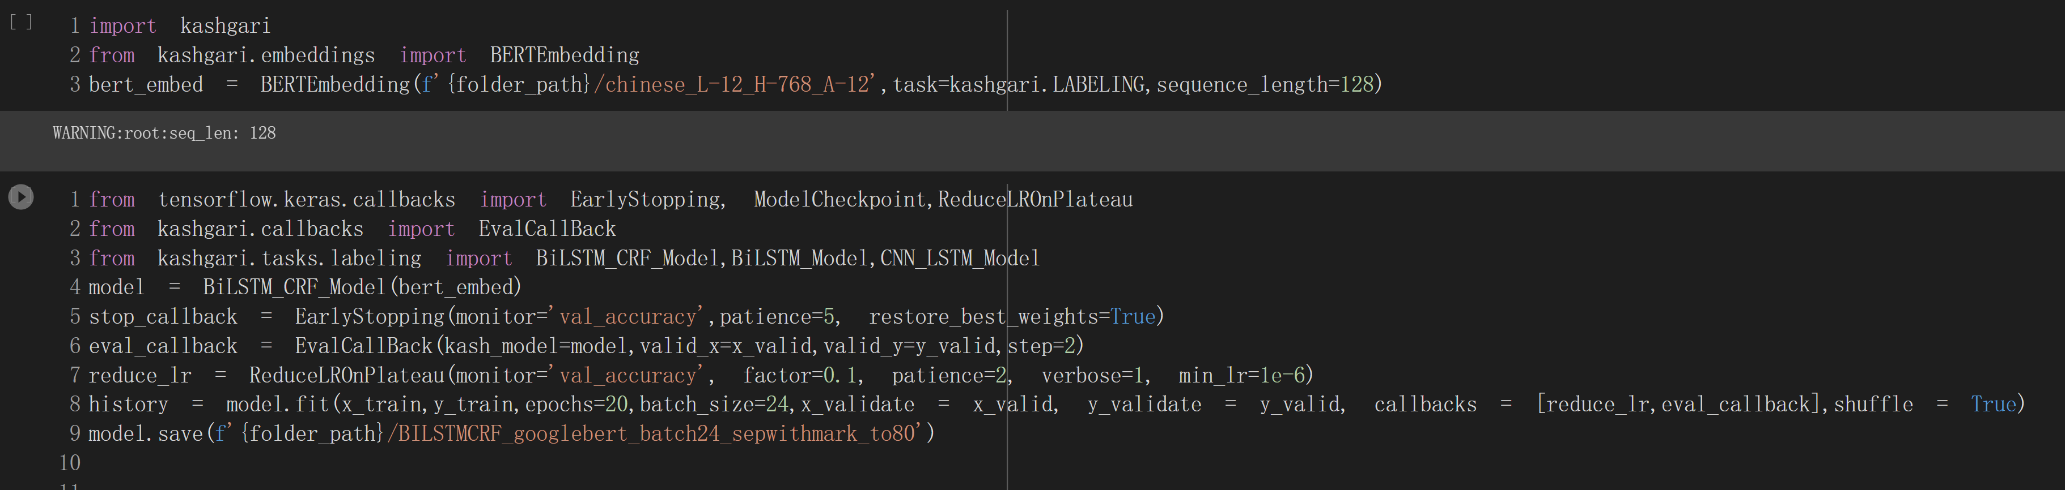
BERT + BILSTM-CRF
BERT Transfer Learning API: Kashgari

Slide 28
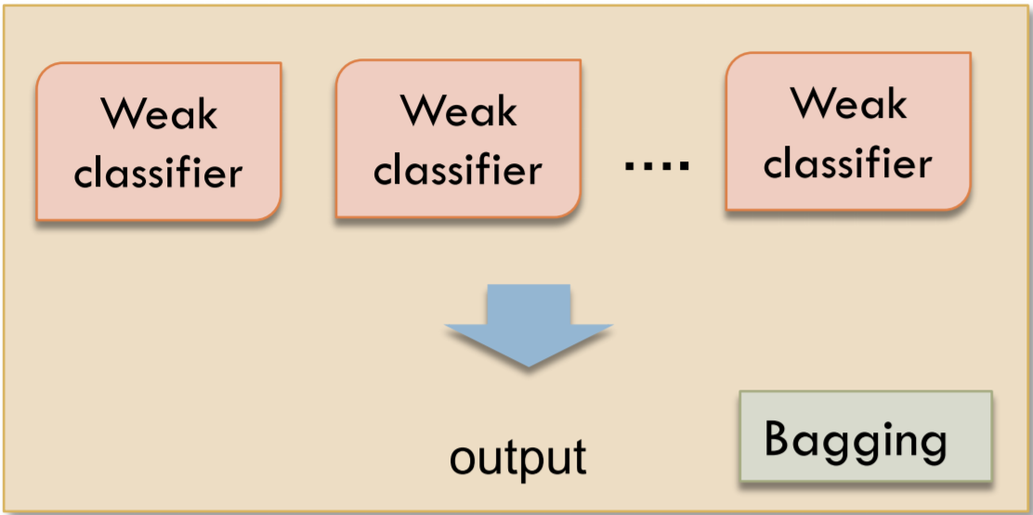
Bagging Method

Slide 29
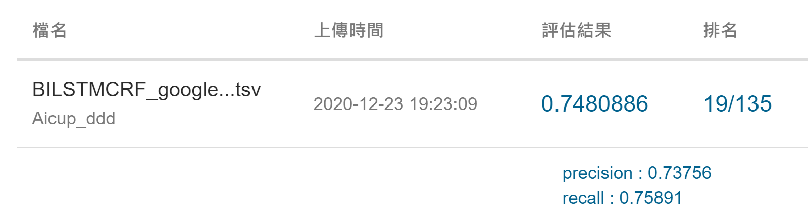
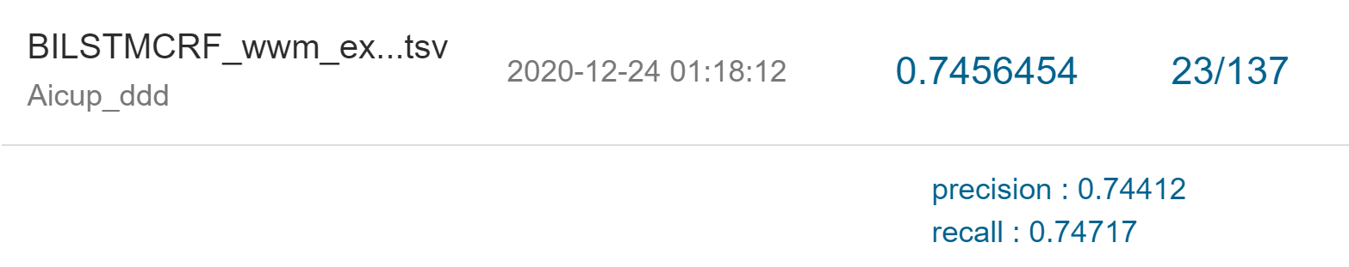
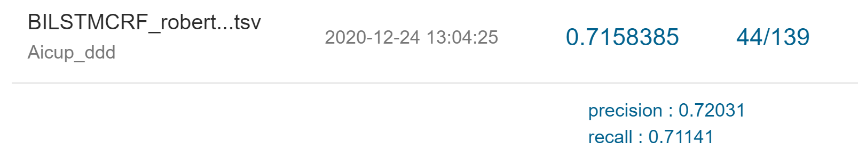
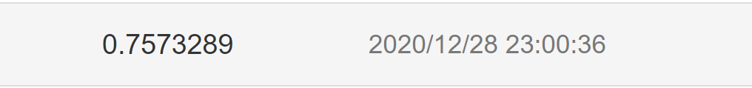
BERT + BILSTM-CRF Performace
Google - BERT
WWM-EXT-BERT
Roberta – WWM-Large-EXT
Bagging BERT

Slide 30
Conclusion
Try Pre-trained BERT model as baseline model when doing NER tasks
Model structure and data preprocessing are way more important than tuning parameters of model
Try Semi- supervised Learning when training data is limited

Slide 31
Reference
https://medium.com/%E6%88%91%E5%B0%B1%E5%95%8F%E4%B8%80%E5%8F%A5-%E6%80%8E%E9%BA%BC%E5%AF%AB/named-entity-recognition-%E5%91%BD%E5%90%8D%E5%AF%A6%E9%AB%94%E8%AD%98%E5%88%A5-309e97823a43
https://codingnote.cc/zh-tw/p/237383/
https://www.youtube.com/watch?v=UYPa347-DdE&list=TLPQMjcwMTIwMjGdRXQD14q8EQ&index=2
https://github.com/ymcui/Chinese-BERT-wwm
https://github.com/google-research/bert

