Slide 1
DBSCAN

Slide 2
Outline
DBSCAN
DBSCAN Implementation
K-means v.s. DBSCAN
DBSCAN Parameter Selection
Reference

Slide 3

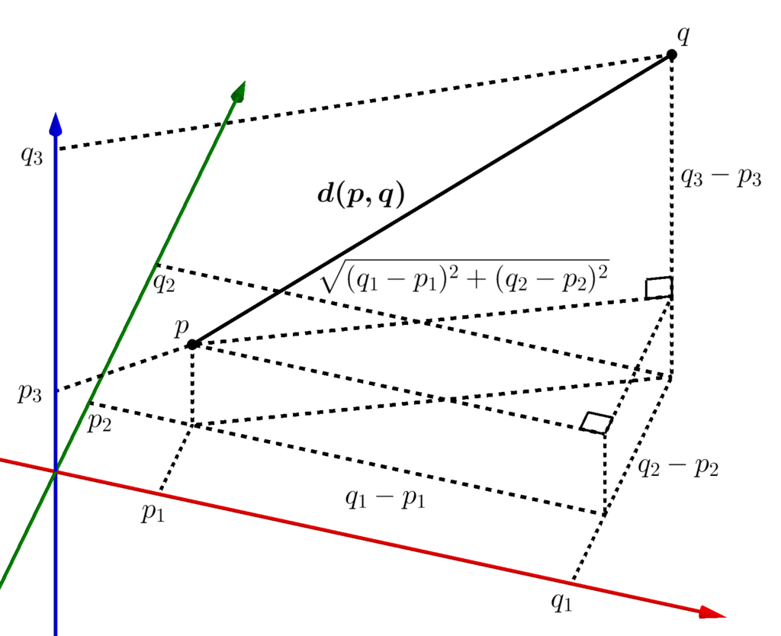
Euclidean Distance

Slide 4
DBSCAN
Minpts: 6
Epsilon
Clusters when a couple data satisfy the two parameters

Slide 5
DBSCAN
Border Point
Core Point
Noise
Epsilon = 1
Minpts = 4

Slide 6
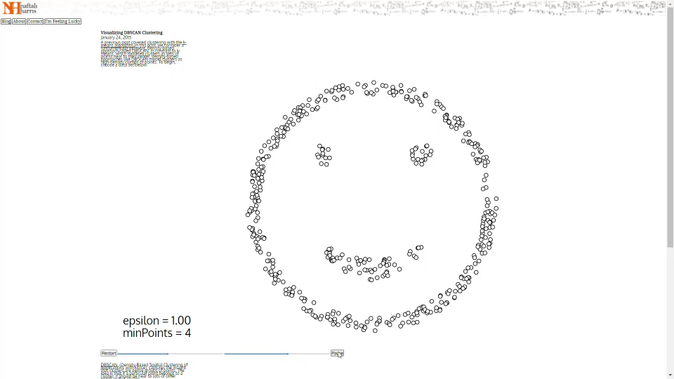

Slide 7
DBSCAN Flow Chart
03
Label the point as noise
Find its neighbor points with epsilon
< Minpts
01
Start from an unvisited point
02
03
Pass all neighbor points to Expand Cluster
>= Minpts
All pts Visited
else (cluster+1)
04
Finish Clustering

Slide 8
Expand Cluster Flow Chart
03
Border Point
Label the point
Find its neighbor points with epsilon
< Minpts
01
Start from an unvisited neighbor point
02
03
1.Join its neighbor points to all the neighbor points
2. Label the point
>= Minpts
All pts Visited
else
04
Back to DBSCAN step 3

Slide 9
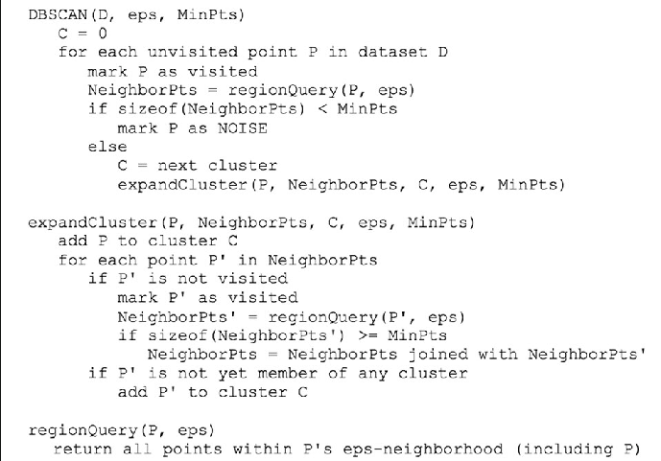
DBSCAN Pseudo Code

Slide 10
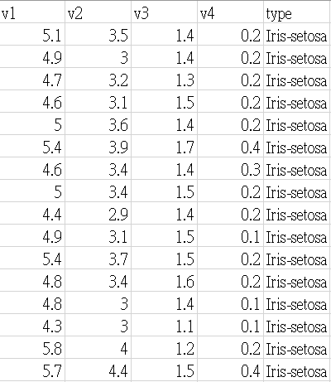
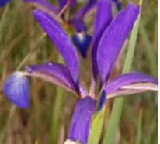
Dataset - Iris
Three kinds of label:
Iris-setosa
Iris-versicolor
Iris-virginica

Slide 11
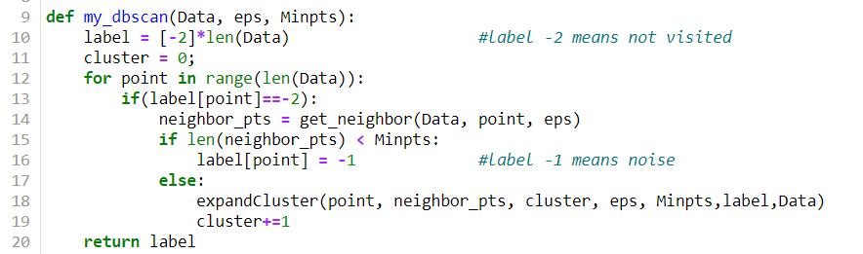
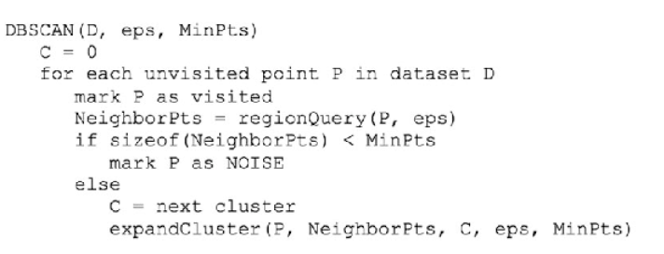
DBSCAN Code

Slide 12
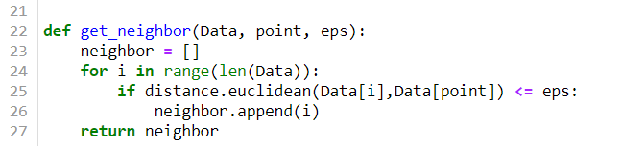

Get neighbor points Code

Slide 13
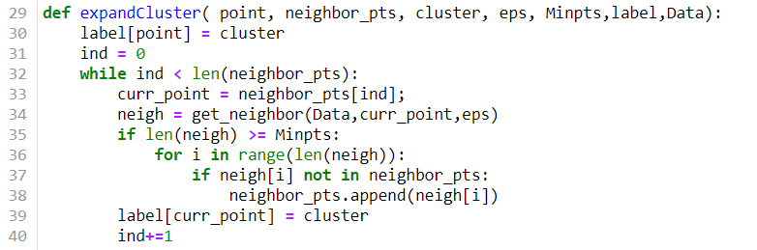
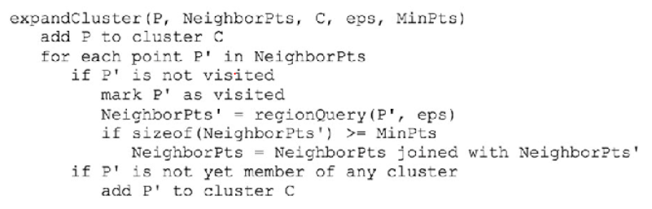
Expand Cluster Code

Slide 14
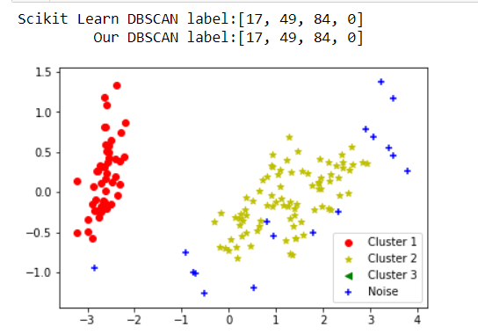
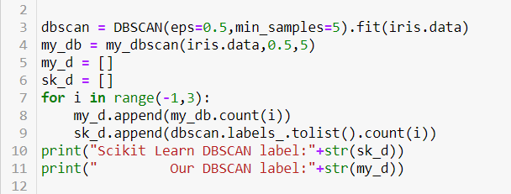
Result

Slide 15
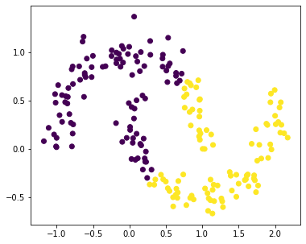
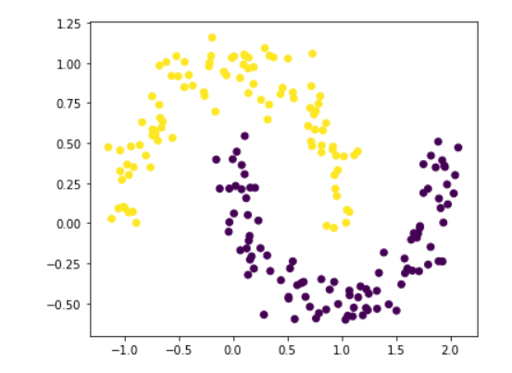
Kmeans VS DBSCAN
K-Means
DBSCAN

Slide 16
DBSCAN Pros and Cons
Pros
Clusters can be any shape
Detect noise
Does not required a predefined number of clusters
Cons
Does not work well in dataset with differing density
Does not work well in high dimension dataset

Slide 17
Differing density dataset

Slide 18
Epsilon too small

Slide 19
Epsilon bigger

Slide 20
Epsilon too big

Slide 21
DBSCAN Parameter Selection
Silhouette Method
Parameter selection algorithm of DBSCAN based on K-means two classification algorithm – 2019.12
Choosing DBSCAN Parameters Automatically using Differential Evolution - 2014.04
KNN-DBSCAN: Using k-nearest neighbor information for parameter-free density based clustering -2017.07

Slide 22



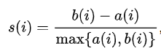

Silhouette Method
a(i) = Average distance inside cluster
b(i) = Average distance to nearest cluster
Ideally, a(i) = 0, b(i) = infinity
s(i) = 1

Slide 23
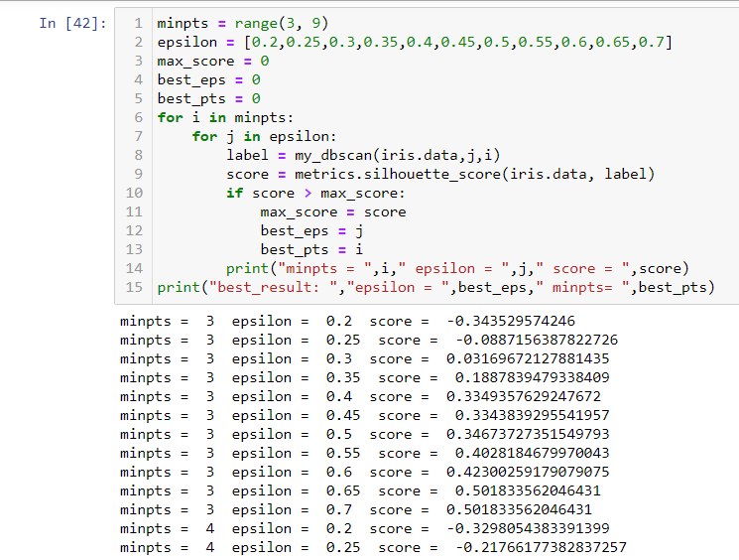
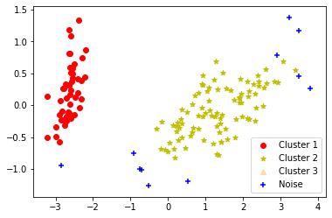

Silhouette Result

Slide 24
Reference
https://www.researchgate.net/figure/Pseudocode-of-the-DBSCAN-algorithm_fig2_325059373
https://en.wikipedia.org/wiki/DBSCAN
https://www.naftaliharris.com/blog/visualizing-dbscan-clustering/
https://medium.com/@mohantysandip/a-step-by-step-approach-to-solve-dbscan-algorithms-by-tuning-its-hyper-parameters-93e693a91289
https://arxiv.org/pdf/1810.13105.pdf
https://archive.ics.uci.edu/ml/datasets/Iris
https://en.wikipedia.org/wiki/Euclidean_distance
https://docs.scipy.org/doc/scipy-0.14.0/reference/generated/scipy.spatial.distance.euclidean.html
https://www.tutorialspoint.com/python/
https://en.wikipedia.org/wiki/Silhouette_(clustering)
https://ieeexplore.ieee.org/document/8957785/figures#figures
https://pdfs.semanticscholar.org/458e/376ae6ef6f0ac0290330f8e535bd7cda1d99.pdf

