Slide 1
K-means Clustering

Slide 2
Outline
Clustering Algorithms
K-means
K-means Implementation
K-means++
The Chosen of K
Reference

Slide 3
Clustering Algorithms
Centroid-based Clustering
Density-based Clustering

Slide 4
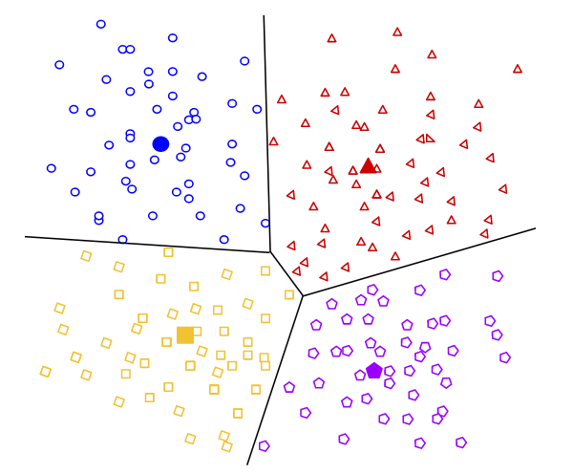
Centroid-based Clustering
Notes:
定義分類的群數

Slide 5
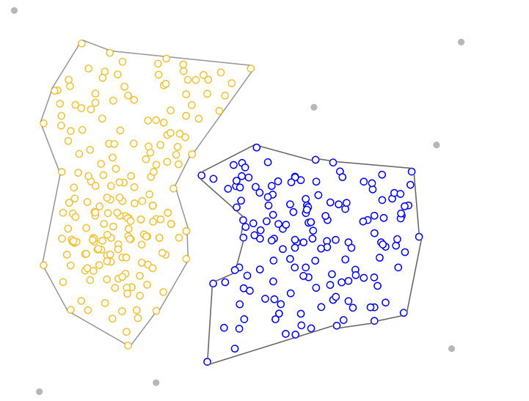
Density-based Clustering
Notes:
不需定義分類的群數

Slide 6

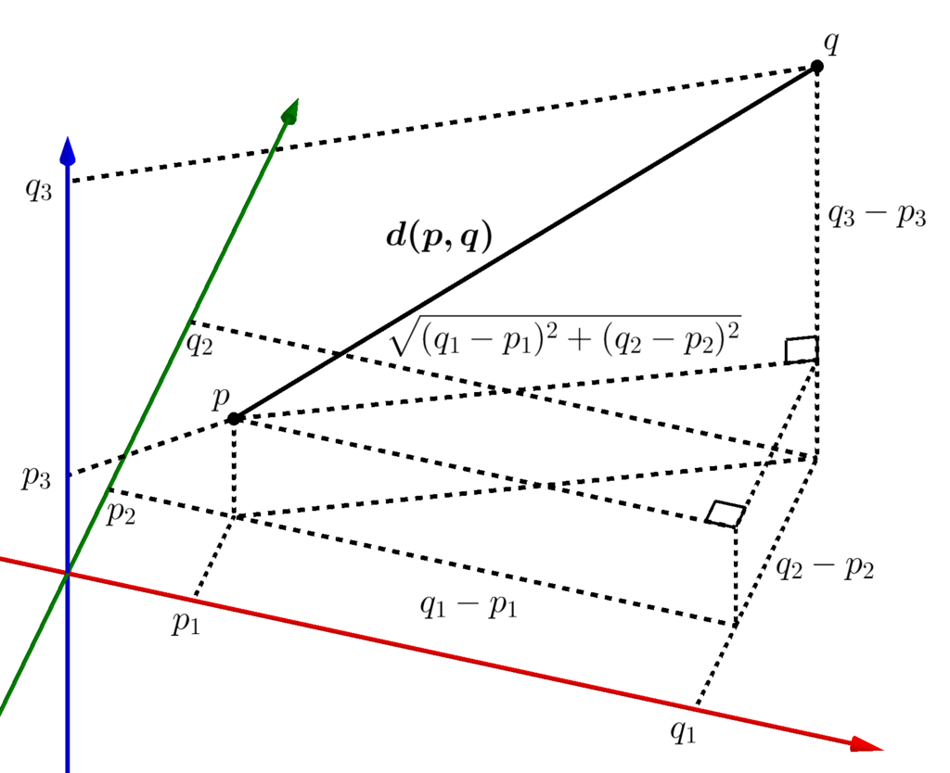
Euclidean Distance

Slide 7
K-means Flow Chart
02
Match all points to the nearest centroids
03
Update new centroids of each group
01
Randomly choose K centroids
Unconverge
05
04
Calculate objective function
Finish Clustering
Converge

Slide 15
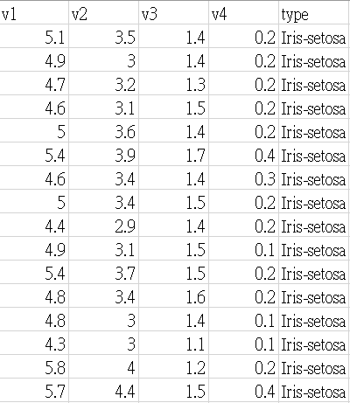
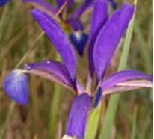
Dataset - Iris
Three kinds of label:
Iris-setosa
Iris-versicolor
Iris-virginica
Notes:
V1:花萼長度
V2:花萼寬度
V3:花瓣長度
V4:花瓣寬度

Slide 16
K-means Pseudo Code
Function Kmeans( )
Initialize k centroids
While all centroids not converge
Update_cluster()
Update_centroids()
Function Update_centroid( )
For all cluster
average all points in that cluster
Function Update_cluster( )
For all data in dataset
find the nearest centroid and assign it to that cluster

Slide 17
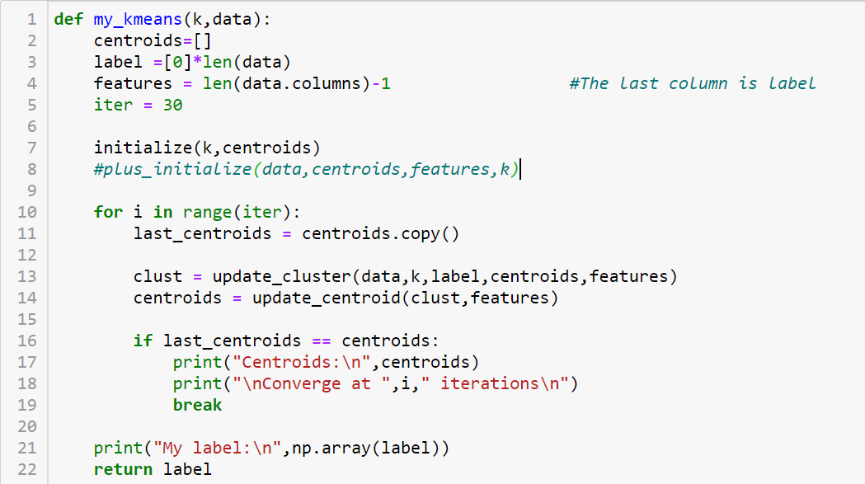
K-means Main Function
Initialize
Update cluster
Update centroid
Check convergence

Slide 18
Initialize
“Randomly “choose K points as centroids

Slide 19
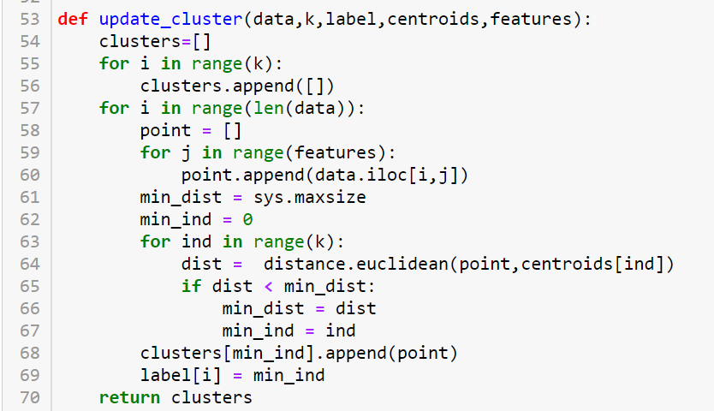
Update Cluster
Find the nearest centroid

Slide 20
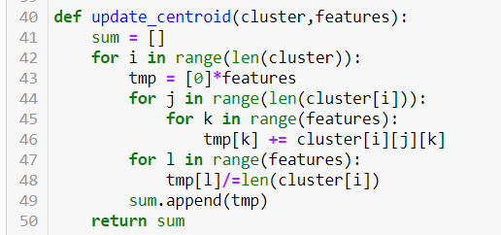
Update Centroids
Average data of each clusters

Slide 21
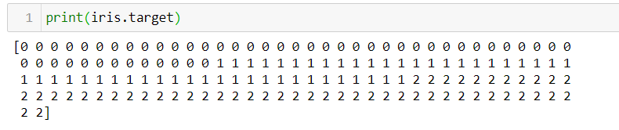
Actual Label of Iris

Slide 22
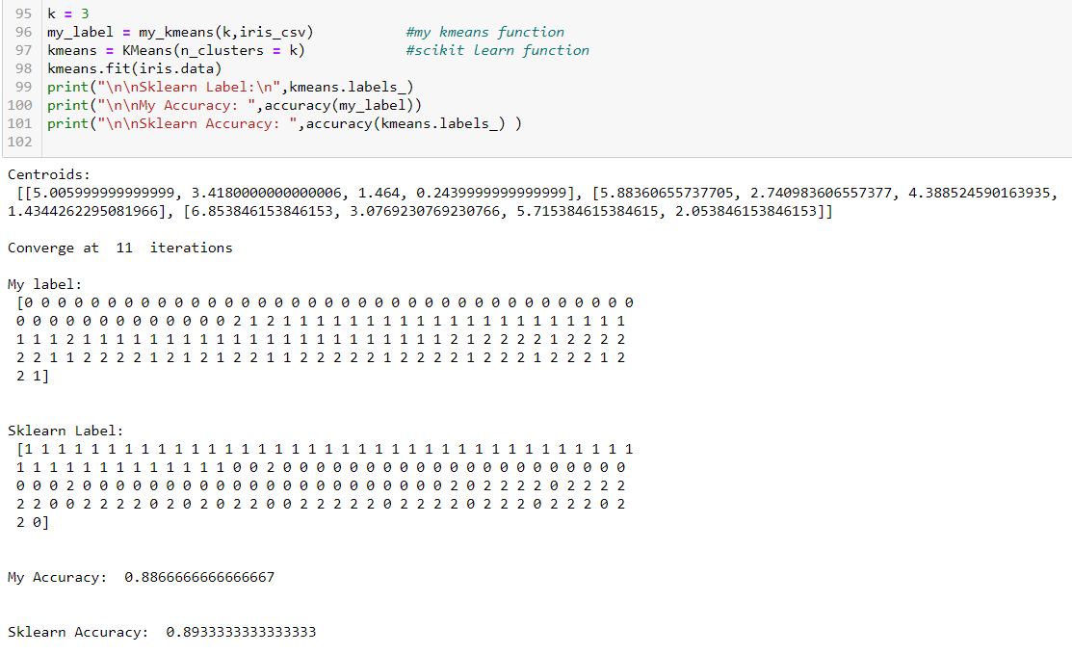
Result
Sometimes the data are only divided into two clusters

Slide 23
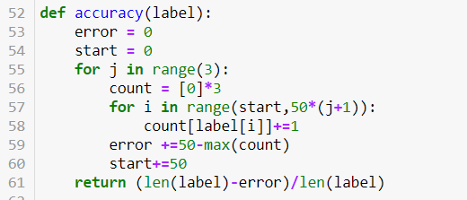
Calculate Accuracy
Find which label dominates in index:
0~49
50~99
100~149
The three labels must be different

Slide 24
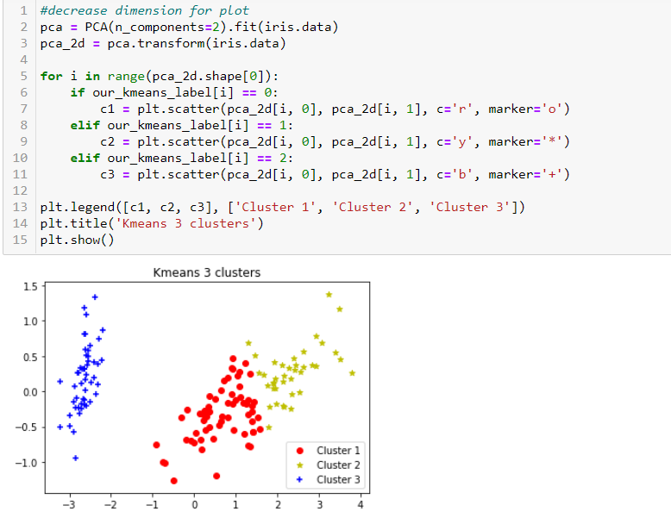
Plot

Slide 25
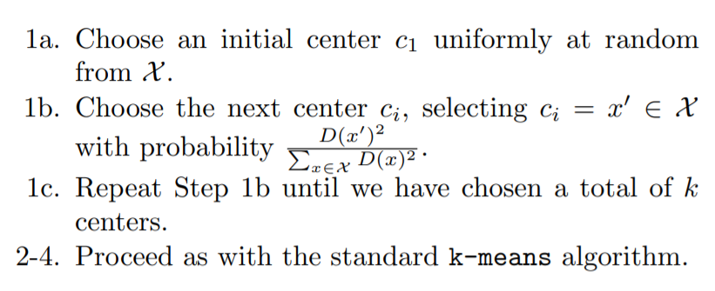
Kmeans++ 2007 by David Arthur and Sergei Vassilvitskii
D(x) : shortest distance from a data point x to the closest center we have already chosen
Find Max D(X) as next centroid

Slide 30


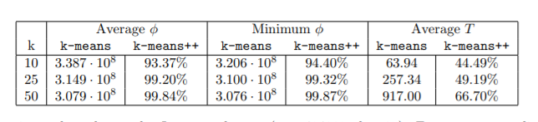
Kmeans++
Percentage of Improvement:
the Intrusion dataset (n = 494019, d = 35) - KDD Cup 1999 dataset.

Slide 31
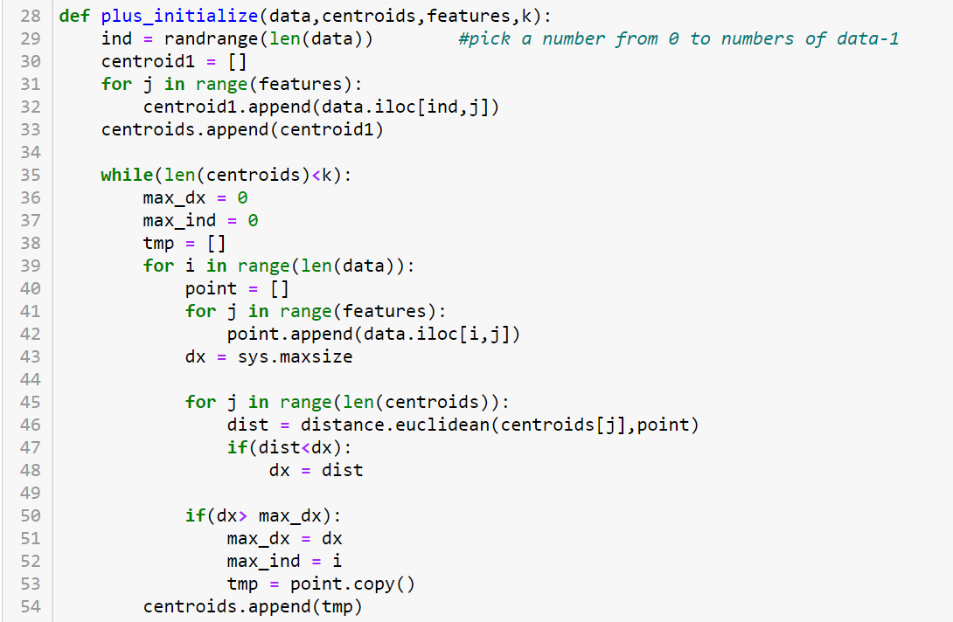
Kmeans++ Implementation
Randomly choose first centroid from data
Calculate D(X)
Find max D(X) in an iteration
Assign the data as centroid

Slide 32
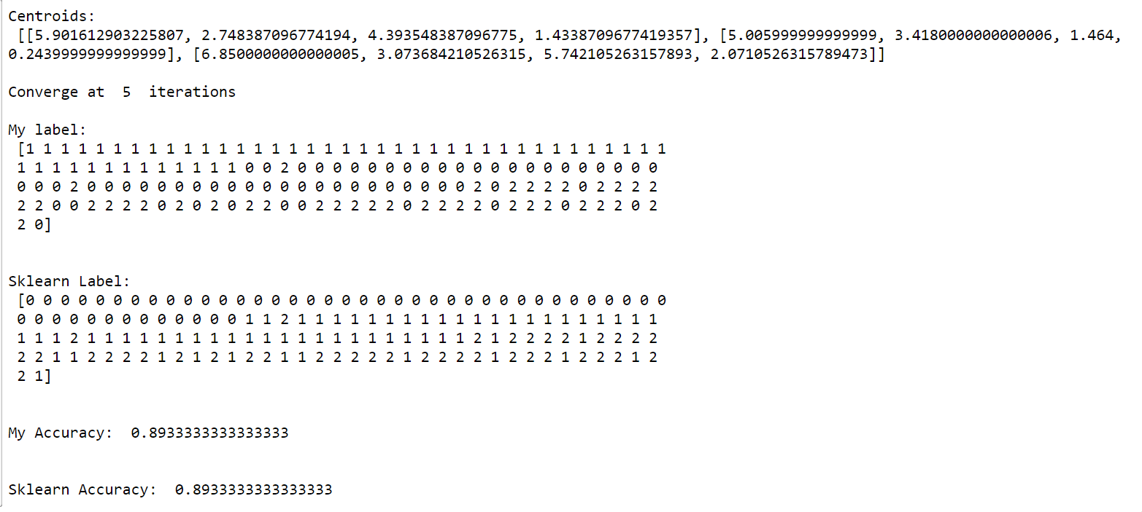
K-means++ Result
The data are always divided into three clusters
Faster

Slide 33
The Chosen of K
Elbow Method
Silhouette Method

Slide 34
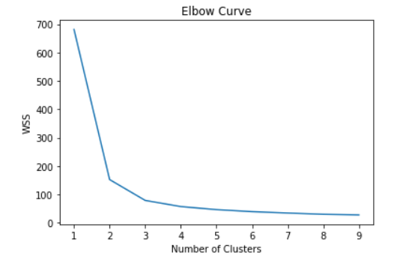
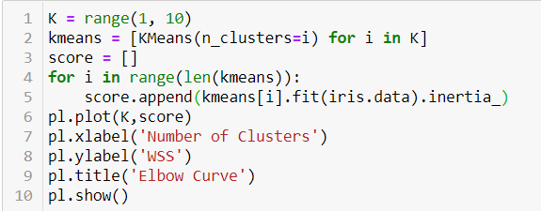
Elbow Method
WSS(Within-Cluster-Sum of Squared )
Sum of the square of the distance for all points from its predicted cluster center.
Any Distance metric can be used. E.g.Euclidean Distance, Manhattan Distance

Slide 35



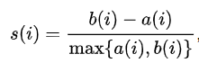

Silhouette Method
a(i) = Average distance inside cluster
b(i) = Average distance to nearest cluster
Ideally, a(i) = 0, b(i) = infinity
s(i) = 1

Slide 36
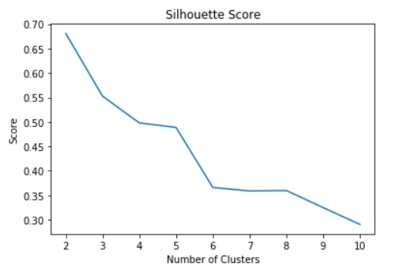
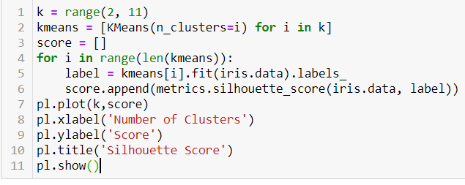
Silhouette Method

Slide 37
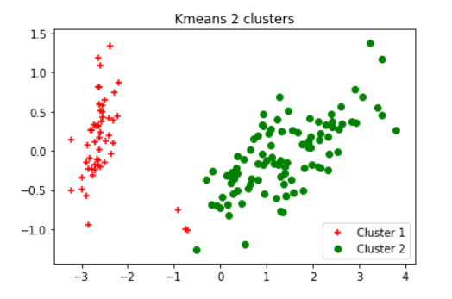
Iris Dataset Conclusion
Silhouette score (K-means) told us that it’s better to have two clusters in Iris Dataset

Slide 38
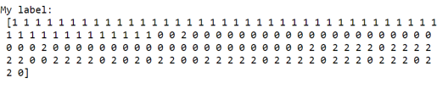
Iris Dataset Conclusion
While there actually exist three kinds of flower….
Iris-versicolor and Iris-virginica are hard to precisely classified by kmeans clustering

Slide 39
Reference
https://developers.google.com/machine-learning/clustering/clustering-algorithms
https://towardsdatascience.com/the-5-clustering-algorithms-data-scientists-need-to-know-a36d136ef68
https://archive.ics.uci.edu/ml/datasets/Iris
https://en.wikipedia.org/wiki/Euclidean_distance
https://www.techbeamers.com/python-generate-random-numbers-list/
https://docs.scipy.org/doc/scipy-0.14.0/reference/generated/scipy.spatial.distance.euclidean.html
https://scikit-learn.org/stable/auto_examples/cluster/plot_kmeans_digits.html
https://scikit-learn.org/stable/modules/generated/sklearn.cluster.KMeans.html
https://stanford.edu/~cpiech/cs221/handouts/kmeans.html

Slide 40
Reference
https://theory.stanford.edu/~sergei/papers/kMeansPP-soda.pdf
https://www.tutorialspoint.com/python/
https://scikit-learn.org/stable/modules/clustering.html
https://medium.com/analytics-vidhya/how-to-determine-the-optimal-k-for-k-means-708505d204eb
https://en.wikipedia.org/wiki/Silhouette_(clustering)

