Slide 1


Pizza Delivered Quickly
Pizza Factory Locator Subsystem
By: Jason Charles, Ron Néo Alexis, Sekaji Maynard
Lecturer: Thomas 许粲昊
Date: 8th December 2020

Slide 2
Management
The initial phase of the project, this is the series of process with the intention of keep the project on track with the shareholders expectations and different goals and plans.
Kickoff Meeting
Stakeholder management
Project Charter
Project Scope
Project Management Plan
Business Case
Staffing Management Plan

Slide 3
Planning
This is a sub heading of the Management section of the project. This is where the initial thoughts, assumptions and first decisions are made that would affect the outcome of the project

Slide 4
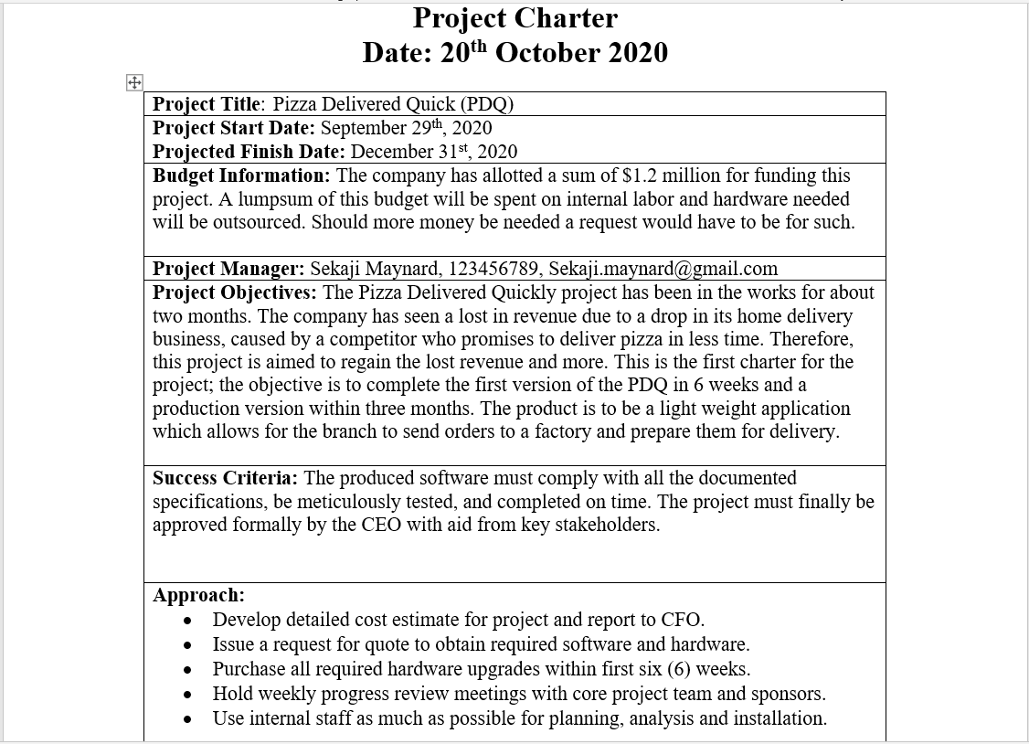
Project Charter
Notes:
The project charter is the initial document that specifies the definition of the project, objectives, and signatures of key stakeholder in a project.

Slide 5
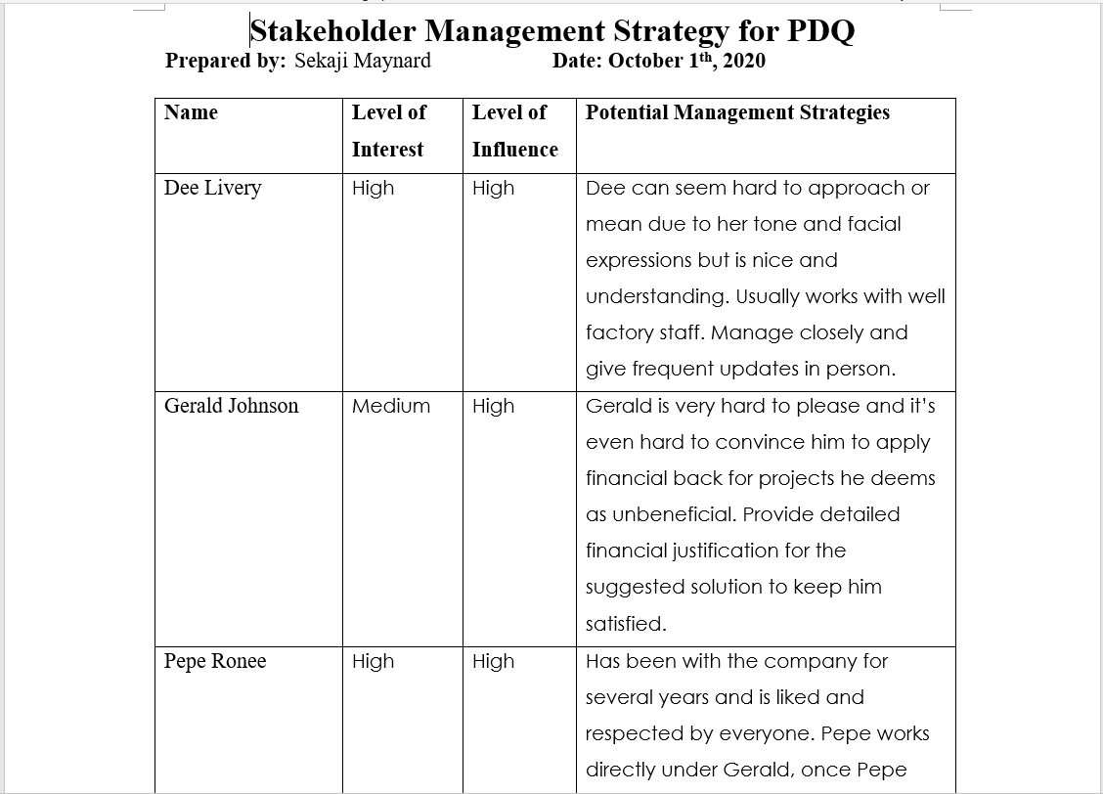
Stakeholder Management
Notes:
This document is meant to gauge the influence and investment of each stakeholder that is a part of the project and by which degree do you need to keep them informed of the project and how to address their concerns.

Slide 6
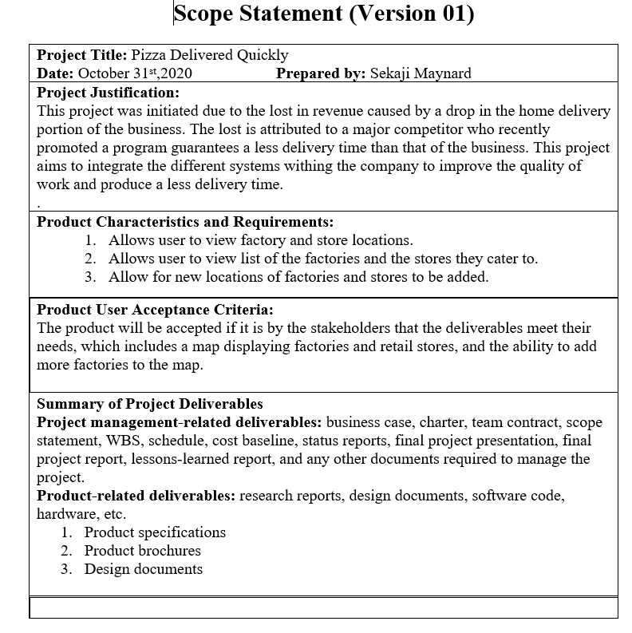
Scope Statement
Notes:
This document is used as reference to state what the project will include and focus on and what the team is meant to accomplish for the project to be considered complete

Slide 7
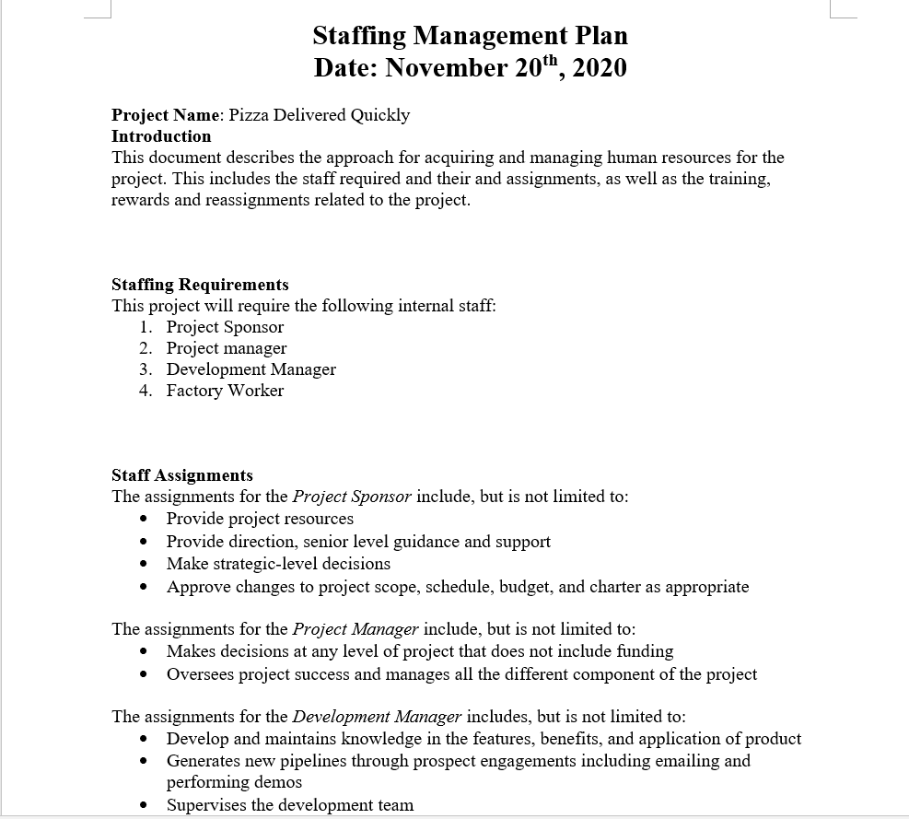
Staffing Management Plan
Notes:
This document is meant for the project heads to use to identify who would be the best fit for developing the application, as well as to when they should acquire these individuals and where they would be best utilized

Slide 8
Meeting
This is a sub heading of the Management section of the project. This is where specified meetings take place planned meetings that have a

Slide 9
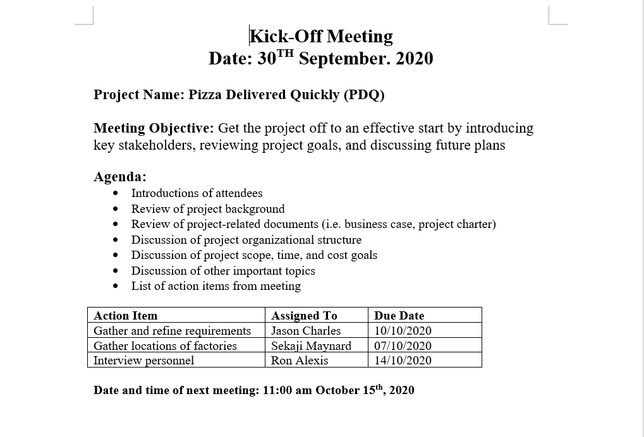
Kickoff Meeting
Notes:
This is the first meeting after the inception of the project and where it is discussed what will be included in the project with the project team and client

Slide 10
Administration
This is a sub heading of the Management section of the project. This is the managerial task that are not included in meeting and planning

Slide 11
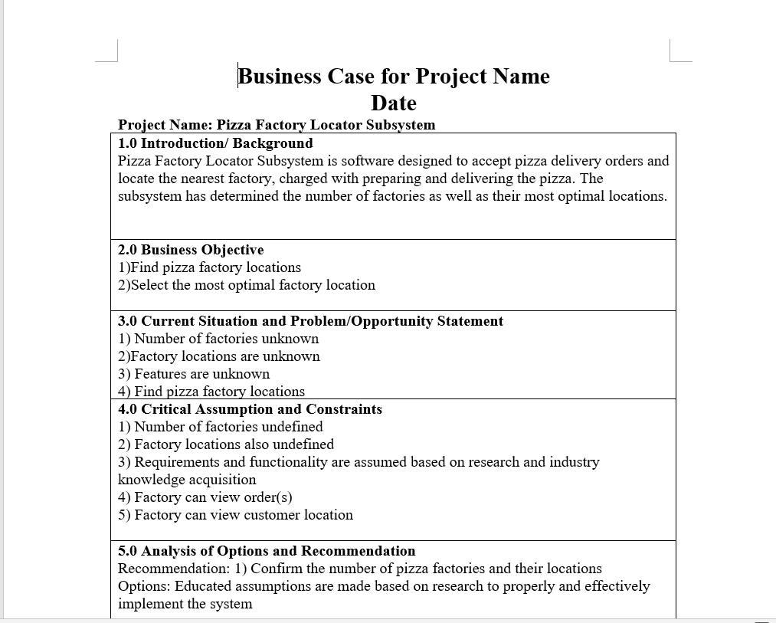
Business Case
Notes:
This documents displays the initial reason behind the inception of the project.

Slide 12
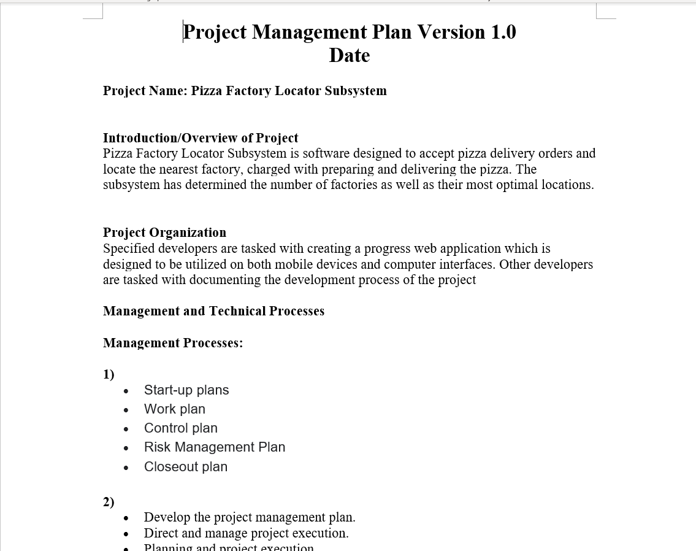
Project Management Plan
Notes:
The document outlines the process by how the team will organize the different events and structure of the project

Slide 13
Requirement
This is the requirements and what needs to be done for the project to be completed
Assumption log
Requirements traceability matrix
Project scope Statement
Contract

Slide 14
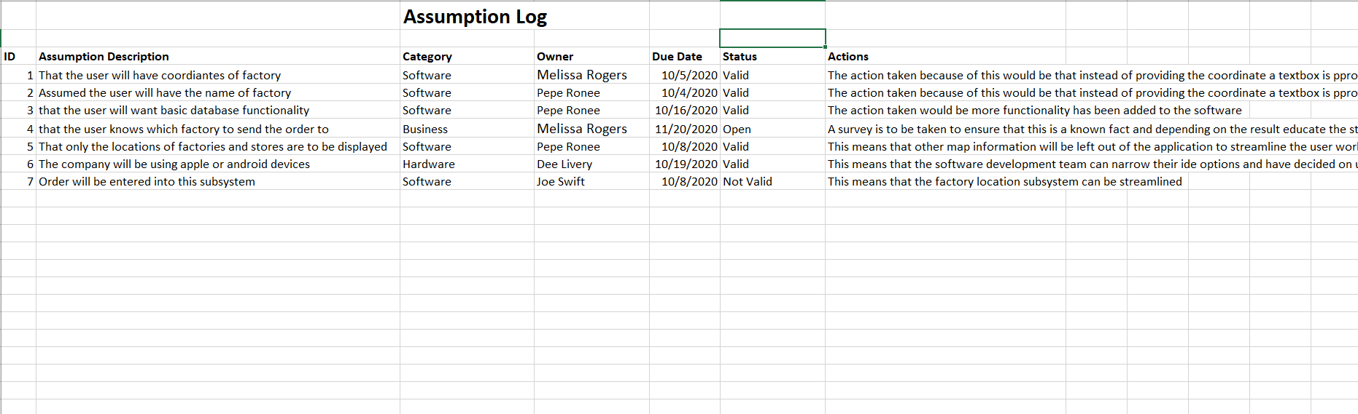
Assumption Log
This is a document where the project managers state the assumptions and preconformed or to be confirmed hypothesis that affect the final product and the build process.

Slide 15
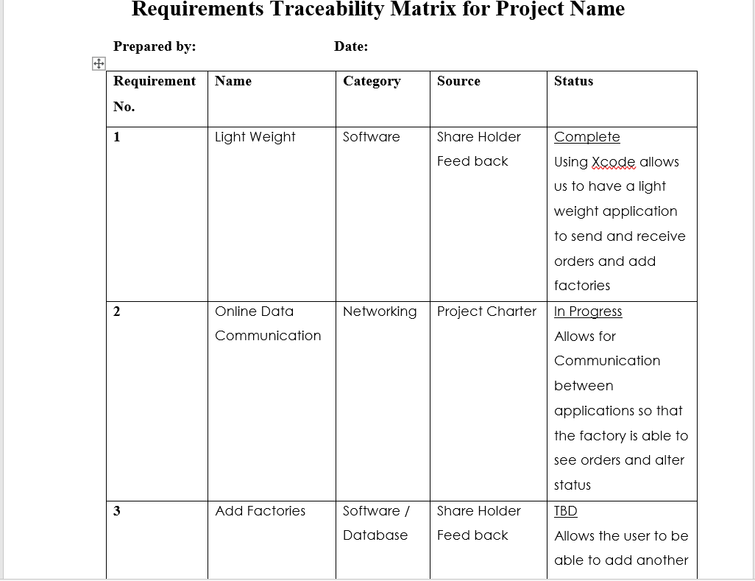
Requirements Traceability Matrix
Notes:
This document is a tabular form which shows the user in brief information what level of importance does a requirement have as well as a short description.

Slide 16
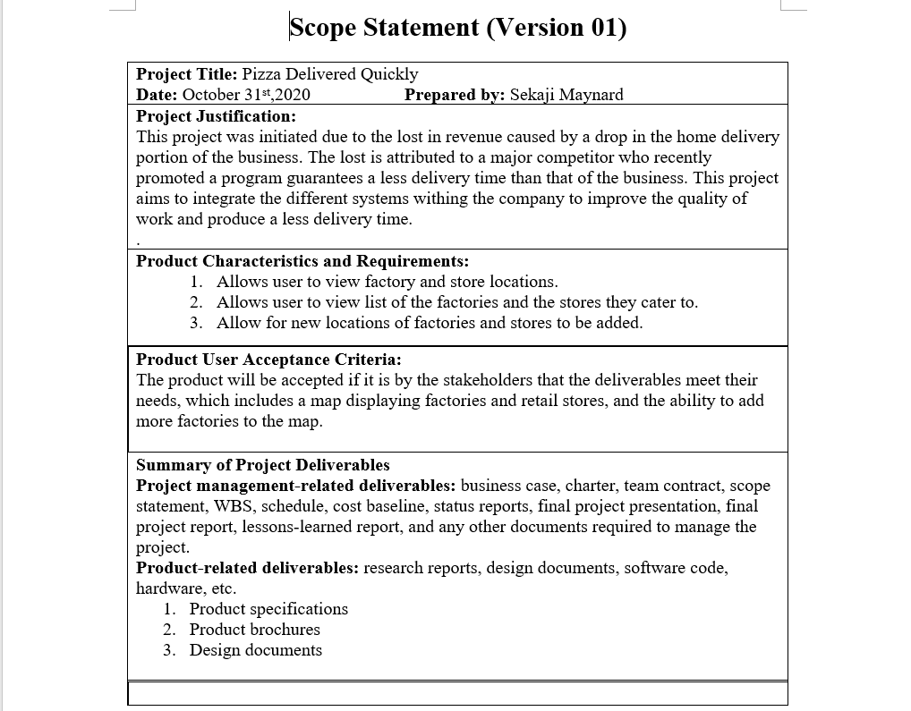
Project Scope Statement
Notes:
This document defines how to manage the project managers define boundaries of a project and how to control them as well as stop scope creep which can endanger a project.

Slide 17
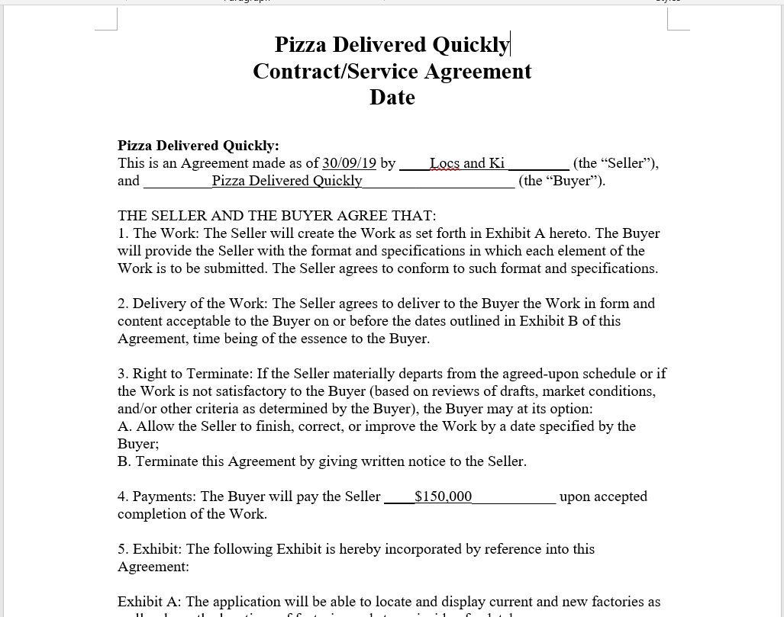
Contract
Notes:
The contract is the document that stipulates the agreed upon actions of each group, from what work will be provided to how much the other party will be compensated for their work.

Slide 18
Construct
This is the process by which the team creates the projects
Milestone List
Milestone Report

Slide 19
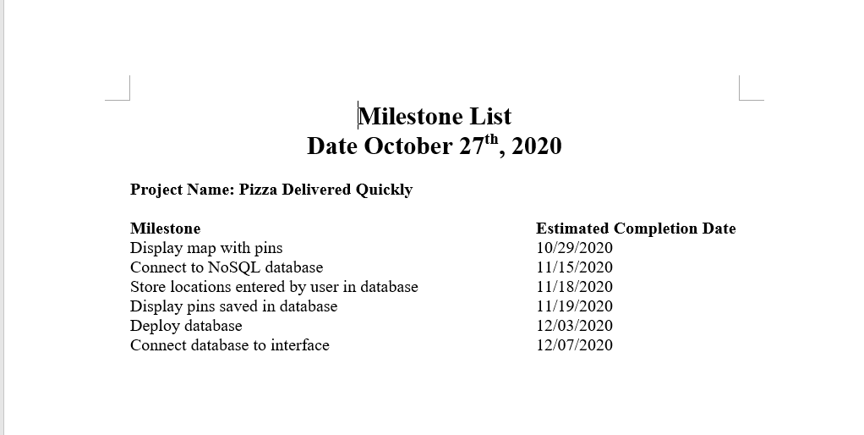
Milestone List
Notes:
This is the list of milestones and major headings in a project

Slide 20
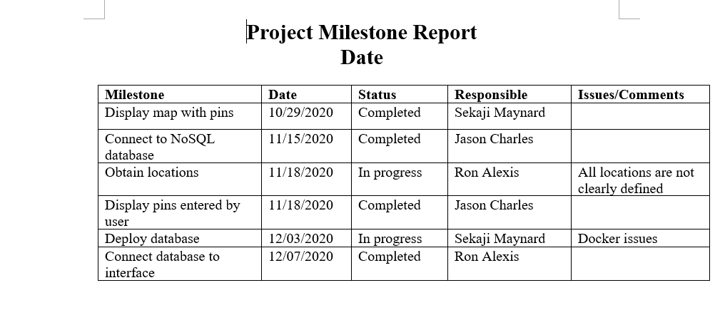
Milestone Report
Notes:
The milestone report is the format for the different entries of the mile stone list

Slide 21
Integration and Testing
This is the process
Quality metrics
Risk Register

Slide 22
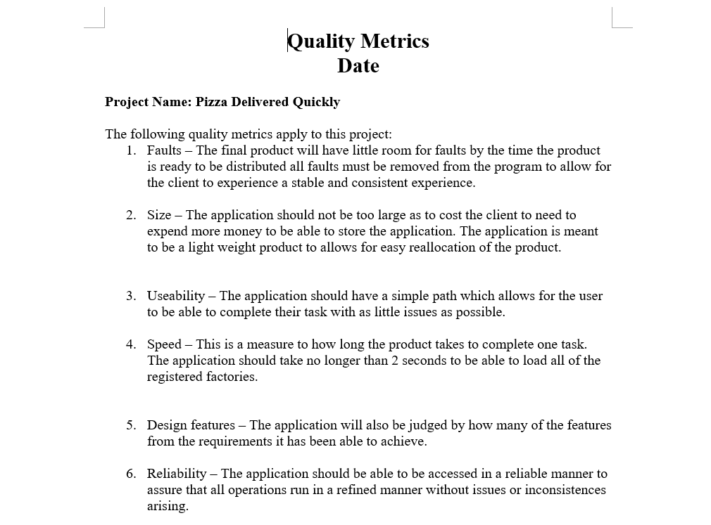
Quality Metrics
Notes:
This document holds the different standards and metrics that the project will use to judge the projects quality

Slide 23
Closing
This is the process by which the team and stakeholders initiate the final procedures to declare the project completed
Contract closure notice
Deliverable Acceptance form

Slide 24
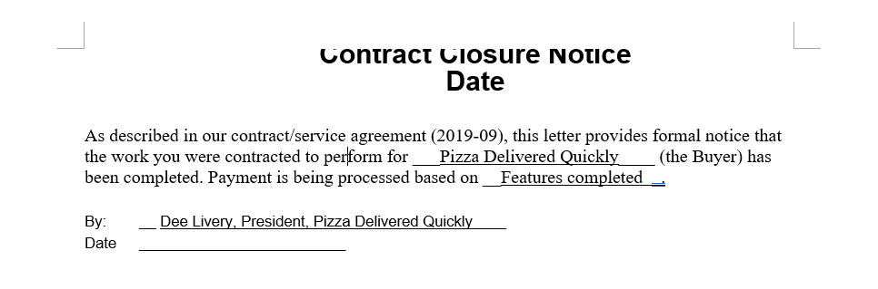
Contract Closure Notice
This document shows the different agreements and statements that are to be upheld as the project is completed

Slide 25
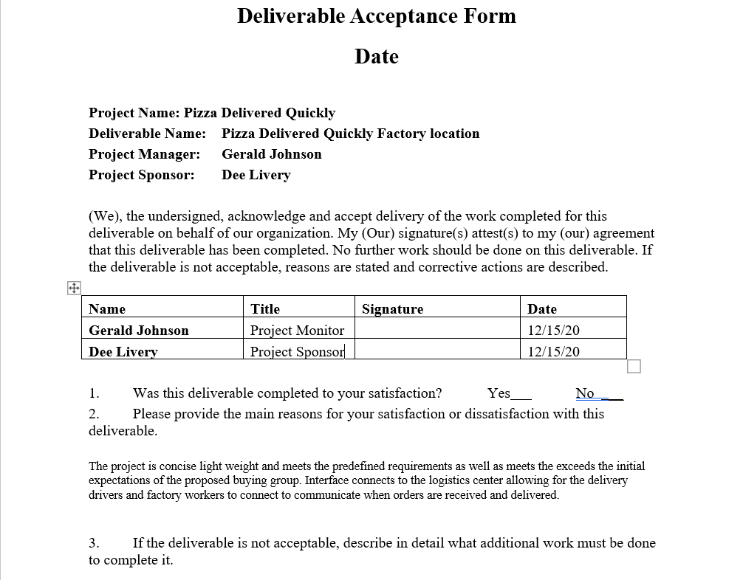
Deliverable Acceptance Form
Notes:
This form is used to show that each party has accepted what the has been proposed as the final deliverables of the project

