Slide 1
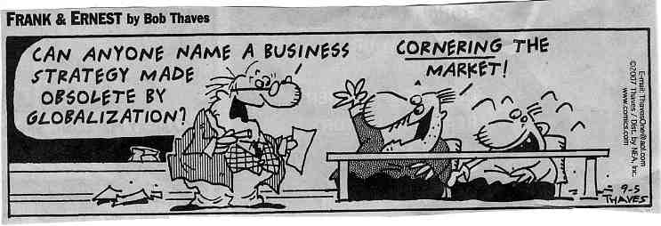
Competitive Strategy

Slide 2
Competitive Strategy
A competitive strategy consists of moves to
  Attract customers
  Withstand competitive pressures
  Strengthen an organization’s market position
The objective of a competitive strategy is to generate a competitive advantage, increase the loyalty of customers and beat competitors
A competitive strategy is narrower in scope than a business strategy
Five competitive strategies are
  Overall low-cost leadership strategy
  Best cost provider strategy
  Broad differentiation strategy
  Focused low-cost strategy
  Focused differentiation strategy

Slide 3
Overall Low-Cost Leadership Strategy
Strive to be the overall low-cost provider in an industry
How to achieve overall low-cost leadership
  Scrutinize each cost activity
  Manage each cost lower year after year
  Reengineer cost activities to reduce overall costs
  Cut some cost activities out of the value chain
Competitive strengths of a overall low-cost strategy
  Organization in a better position to compete offensively on price
  Organization is better able to negotiate with large customers
  Organization is able to use price as a defense against substitutes
  Low cost is a significant barrier to entry
  Organization is more insulated from the power of suppliers

Slide 4
When Does an Overall Low-Cost Strategy Work the Best
When price competition is a dominant competitive force
The product is a “commodity”
There are few ways to differentiate the product
Most customers have similar needs/requirements
Customers incur low switching costs changing sellers
Customers are large and have significant bargaining power

Slide 5
When Doesn’t a Overall Low-Cost Strategy Work
When technological breakthroughs open cost reductions for competitors, negating a low-cost provider’s efficiency advantage
Competitors find it relatively easy and inexpensive to imitate the leader’s low cost methods
Low-cost leader focuses so much on cost reduction that the organization fails to respond to
  Changes in customer requirements for quality and service
  New product developments
  Reduced customer sensitivity to price

Slide 6
Broad Differentiation Strategies
Striving to build customer loyalty by differentiating an organization’s products from competitors’ products
Keys to success include
  Finding ways to differentiate to create value for customers that are not easily copied
  Not spending more to differentiate than the price premium that can be charged
A successful differential strategy allows an organization to
  Set a premium price
  Increase unit sales
  Build brand loyalty

Slide 7
Broad Differentiation Strategies
Where to look for differentiation opportunities
  Supply chain
  Research and development
  Production activities
  Marketing, sales and service activities
Strengths of a Differentiation Strategy
  Customers develop loyalty to the brand
  Brand loyalty acts as an entry barrier
  Organization is better able to fend off threats of substitute products because of brand loyalty
  Reduces bargaining power of large customers since other brands are less attractive
  Seller may be in a better position to resist efforts of suppliers to raise prices

Slide 8
Pitfalls of a Broad Differentiation Strategy
Trying to differentiate on an unimportant product feature that doesn’t result in providing more value to the customer
Over differentiating the product such that the product features exceed the customers’ needs
Charging a price premium that buyers perceive as too high
Ignoring need to signal value
Not identifying what customers consider valuable

Slide 9
Best-Cost Provider Strategy
Striving to give customers more value for the money by combining an emphasis on low cost with an emphasis on upscale differentiation
  Combines low-cost and differentiation
The objective is to create superior value by meeting or beating customer expectation on product attributes and beating their price expectations
Keys to success
  Match close competitors on key product attributes and beat them on cost
  Expertise at incorporating upscale product attributes at a lower cost than competitors
  Contain costs by providing customers a better product

Slide 10
Advantages of Best-Cost Provider Strategy
Competitive advantage comes from matching close competitors on key product attributes and beating them on price
Most successful best-cost providers have skills to simultaneously manage costs down and product quality up
Best-cost provider can often beat an overall low-cost strategy and a broad differentiation strategy where
  Customer diversity makes product differentiation the norm
  Many customers are price and value sensitive

Slide 11
Focus Strategies
Focus strategy based on low-cost
  Concentrate on a narrow customer segment beating the competition on lower cost
Focus strategy based on differentiation
  Offering niche customers a product customized to their needs
Overall objective of both focus strategies is to do a better job of serving a niche target market than competitors
Keys to success
  Choose a niche were customers have a distinctive preference, unique needs or special requirements
  Develop a unique ability to serve the needs of a niche target market

Slide 12
What Makes a Niche Attractive?
Large enough to be profitable
Good growth potential
Not critical to the success of major competitors
Organization has the resources to effectively serve the niche
Organization can defend itself against challengers through a superior ability to serve the niche
No competitors are focusing on the niche

Slide 13
Strengths and Risks of Focus Strategies
Strengths
  Competitors don’t have the motivation to meet specialized needs of the niche
  Organization’s competitive advantage could be seen as a barrier to entry
  Organization’s competitive advantage provides an obstacle for substitutes
  Organization’s ability to meet the needs of customers in the niche can reduce the bargaining power of large niche buyers
Risks
  Broad differentiated competitors may find effective ways to enter the niche
  Niche customers’ preferences may move toward the product attributes desired by a larger market segment
  Profitability may be limited if too many competitors enter the niche

