Slide 1

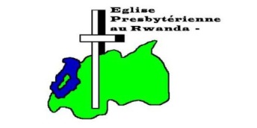
REPUBLIC OF RWANDA MINISTRY OF EDUCATION ECOLE SECONDAIRE TECHNIQUE GISENYI(ESTG)
Topic: ONLINE PATIENT APPOINTMENT SYSTEM Case Study: Clinique Medicale De l’arche

Slide 2
CONTENT
Problems statement
General objectives
Specific objectives
Technique used for collecting information
Description of current system
Description of new system
Tools used in application
System organisation
Conclusion and recommendation

Slide 3
PROBLEMS STATEMENTS
Clinique Medicale de l’arche receives various types of patients, and these patients must be accommodated with a medical care and hospitality. Along with the process, there are activities which present some imperfections; those are:
Lack of data:is loss of data you can losing your data that is stored to the paper or documentation ,the paper can burned
Save time:this software could saving time for travelling to the clinic .

Slide 4
GENERAL OBJECTIVES
The aim of our work is to develop Online patient appointment System which will help Clinique medicale de l’arche to get appointment services online from patient.

Slide 5
SPECIFIC OBJECTIVES
The specific objectives of the new system are:
To develop a web-based application.
To increase the performance and time saving.
To provide efficient and reliable services related to the Online patient appointment system.
To get an easy access on data at time.
Security of data(save in database).

Slide 6
TECHNIQUE USED FOR COLLECTING INFORMATION
DOCUMANTATION
This technique is also necessary for getting information and help the researcher also to increase his/her knowledge so that he can easily solve the problem practically, it permits the researcher to consult books, other previous researchers , class notes, and internet to find different definition of words and codes for solving it .
Here we have read many class notes; consult different books from the school even outside the school so that we can easily solve the problem said in the previous lines

Slide 7
OBSERVATION
Observation is a process or method occurs when you want to see really how things are, for what we saw different things the one which is important is machines used to make their project. In this methodology you go to the place where you want to get or gather their information and observe everything that is taking place without doing anything is called non participative while when you are looking and doing anything is called participative.

Slide 8
INTERVIEW
An interview is a conversation between two people (the interviewer and the interviewee) where questions are asked by the interviewer to obtain information from the interviewee. This is the necessary technique for collecting information gathering before implementing software, and it requires interviewee to have enough knowledge about the questions asked by interviewer so that he/she has all information about what she/he wants to know.
At the beginning of this project we asked the leader of Clinique medical de l’ arche about how they give the appointment to the patient, the system they use to communicate with them, and how they manage information that they receive from them because they use telephone mobile as communicating with patients.

Slide 9
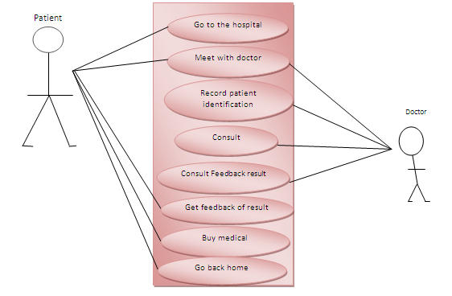
DESCRIPTION OF CURRENT SYSTEM

Slide 10
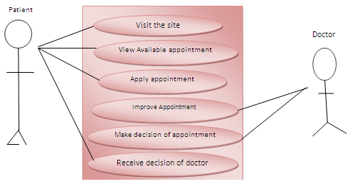
DESCRIPTION OF NEW SYSTEM

Slide 11
TOOLS USED IN APPLICATION
PHP :is scripting languages used to develop dynamic web sites
CSS: is used for giving style of web pages
HTML :is language used for designing web pages
EDIT PLUS: is editor used to write codes of web pages
MYSQL : i s stored in database objects called tables
BROWSER: is that accesses and displays pages and files on the web
Xampp : is a free and open source cross –plat form web server solution stack package, consisting mainly of the Apache HTTP Server, MYSQL database, and interpreters for scripts written in the PHP and Perl programming languages.

Slide 12
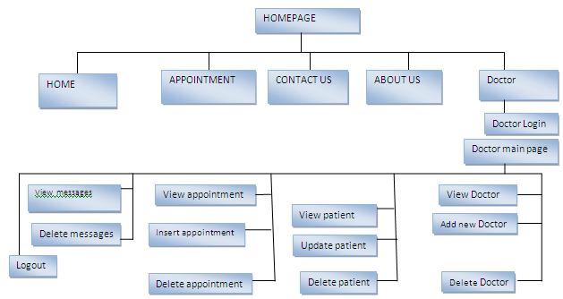
ORGANISATION OF SYSTEM

Slide 13
CONCLUSION
Online Patient Appointment System is a means through which Clinique Medicale de l’arche aims to improve its ICT Support process and by extension quality of services rendered to its patients as well as staff.
Our broad objectives have been well achieved through the development the Online patient appointment System even if there were some constraints to get useful information from Clinique medicale de l’arche Staff. As we started our research project we detailed the problems of the existing manual systems and suggested solution to those problems. The proposed solution included:
All information to be stored in a database;
All information to be easily received in a timely manner;
The patient appointment, fast and well done

Slide 14
RECOMMENDATION
.To Clinique medicale de l’ arche
To implement this system because they have some problems related to time, services delivery, minimize queuing areas and/or hire developers or programmers to develop the applications which will respond to their questions, whereas the cost should serve positively for organization’s prosperity.
Clinique medicale de l’ arche must encourage and support this system port development in order to fulfil their requirements.
wealso recommend ICT Department, to put emphasis on this, and emerge to further testing of Online Patient Appointment System. In the case the use of sample dataas actual patients, doctors and clinic staff members can be used as result of acceptance test of this system.
To ESTG:
To put emphasis on programming and to encourage all students of Computer Science to do IT Project as their Final Research Projects.
TO THE FUTURE ENHANCEMENT
We encourage other researchers and programmers to add new features on this application like Pharmacy management, Laboratory management, accounting management, c.
et

Slide 15
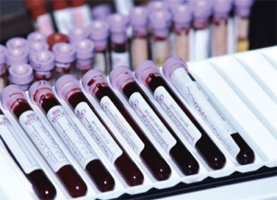
THANK YOU !!!!!!!

