Slide 1
MoveInSync
FDE Case Study
Why Do Employees Rate This App the Way They Do?
And What Should Product & Engineering Fix First?
Google Play · com.moveinsync.ets · 10,144 Reviews · 2018-09-12 → 2026-10-09
Prepared: October 2026

Slide 2
Employee Commute Journey & Business Context
MoveInSync is India's leading employee transportation management platform.
🏠 Book Trip
🔔 Confirmation
📍 Track
🚗 Pickup
🏢 Arrive
Employee books cab via app
Selects pickup, destination, time
App confirms booking
Driver assigned, ETA shown
Live GPS tracking
Push notifications on arrival
Driver arrives at location
Employee check-in
Trip completed
Rating & feedback
Key stakeholders: Employees (end users) · Operations team · Transport vendors · HR/IT admins · MoveInSync platform
The app handles: self-booking, vehicle assignment, routing, pickup tracking, safety checks, and issue escalation.

Slide 3
Data Sources, Collection & Methodology
📦 Source: Google Play Store (com.moveinsync.ets)
⚠️ Limitations:
🛠 Method: google-play-scraper (Python), paginated
• Only publicly visible reviews
📅 Collection date: 2026-10-10
• Rolling window — not full history
🔢 Reviews collected: 10,144
• Total Play Store count may be higher
📆 Date range: 2018-09-12 → 2026-10-09
• Classification is keyword-based
🌏 Language: English | Country: India
• No access to internal telemetry
🔄 Sort orders: NEWEST + MOST_RELEVANT (deduplicated)
• Android only (iOS separate)

Slide 4
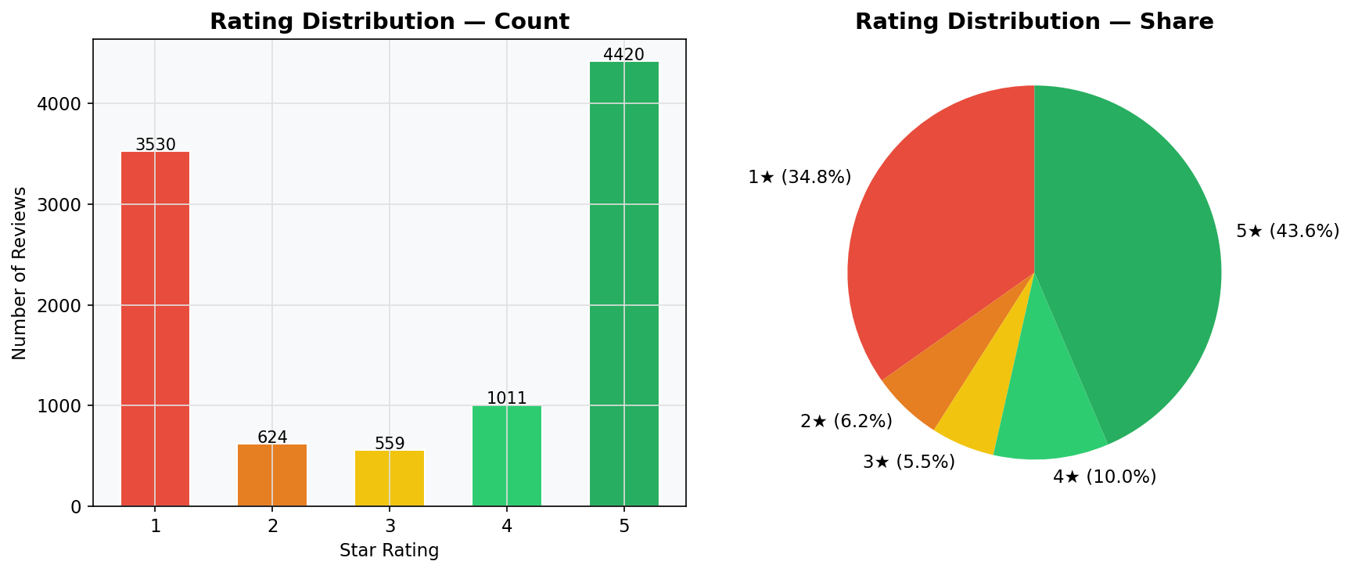
Rating Distribution & Review Trends
3.21
41.0%
10,144
Mean Rating
1★+2★ Share
Reviews Analyzed

Slide 5
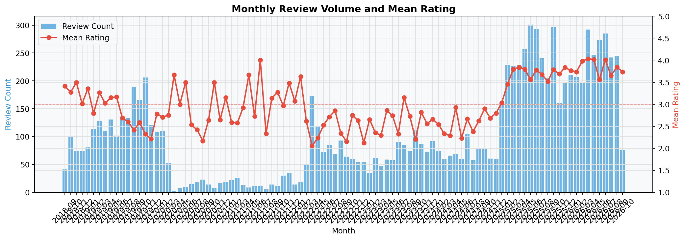
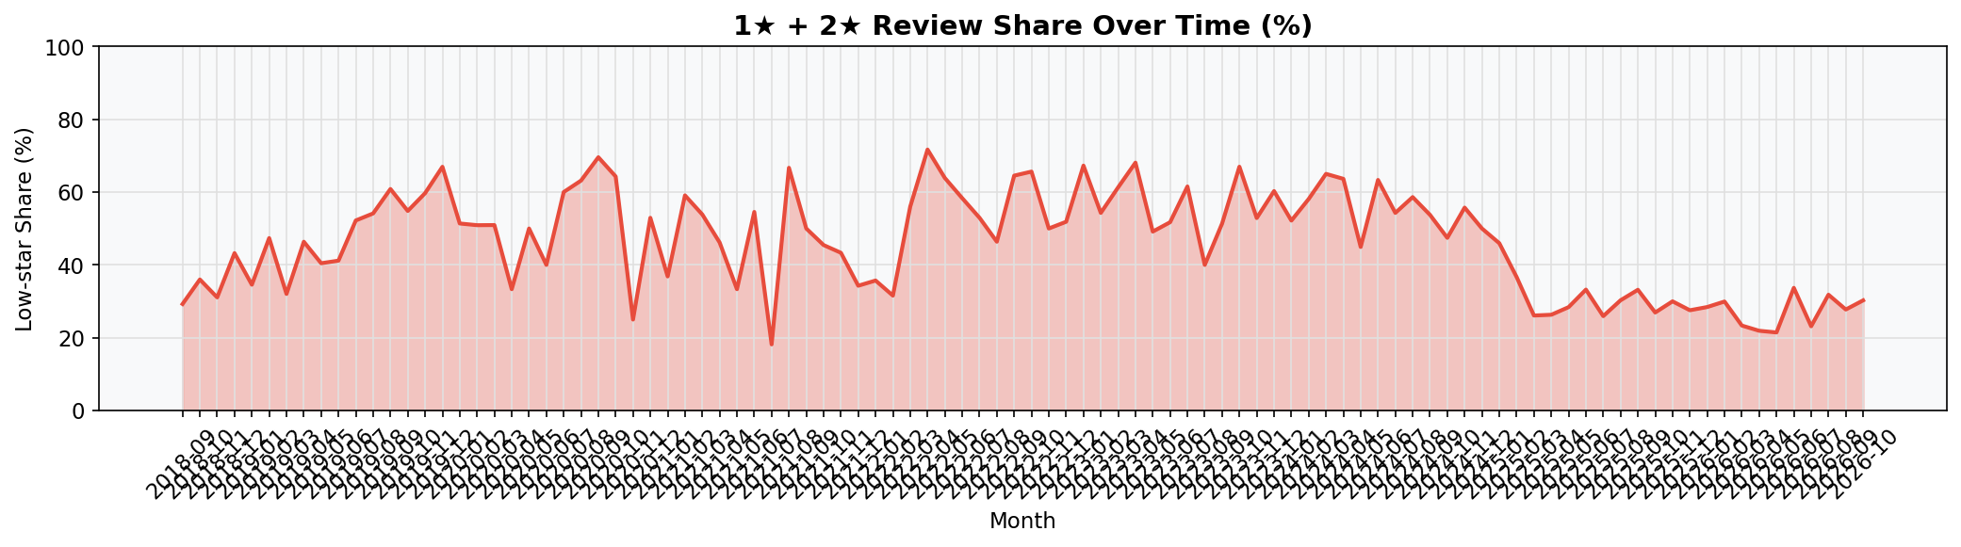
Monthly Volume & Rating Trends
Review volume and mean rating over time. Low-star share is consistently elevated.

Slide 6
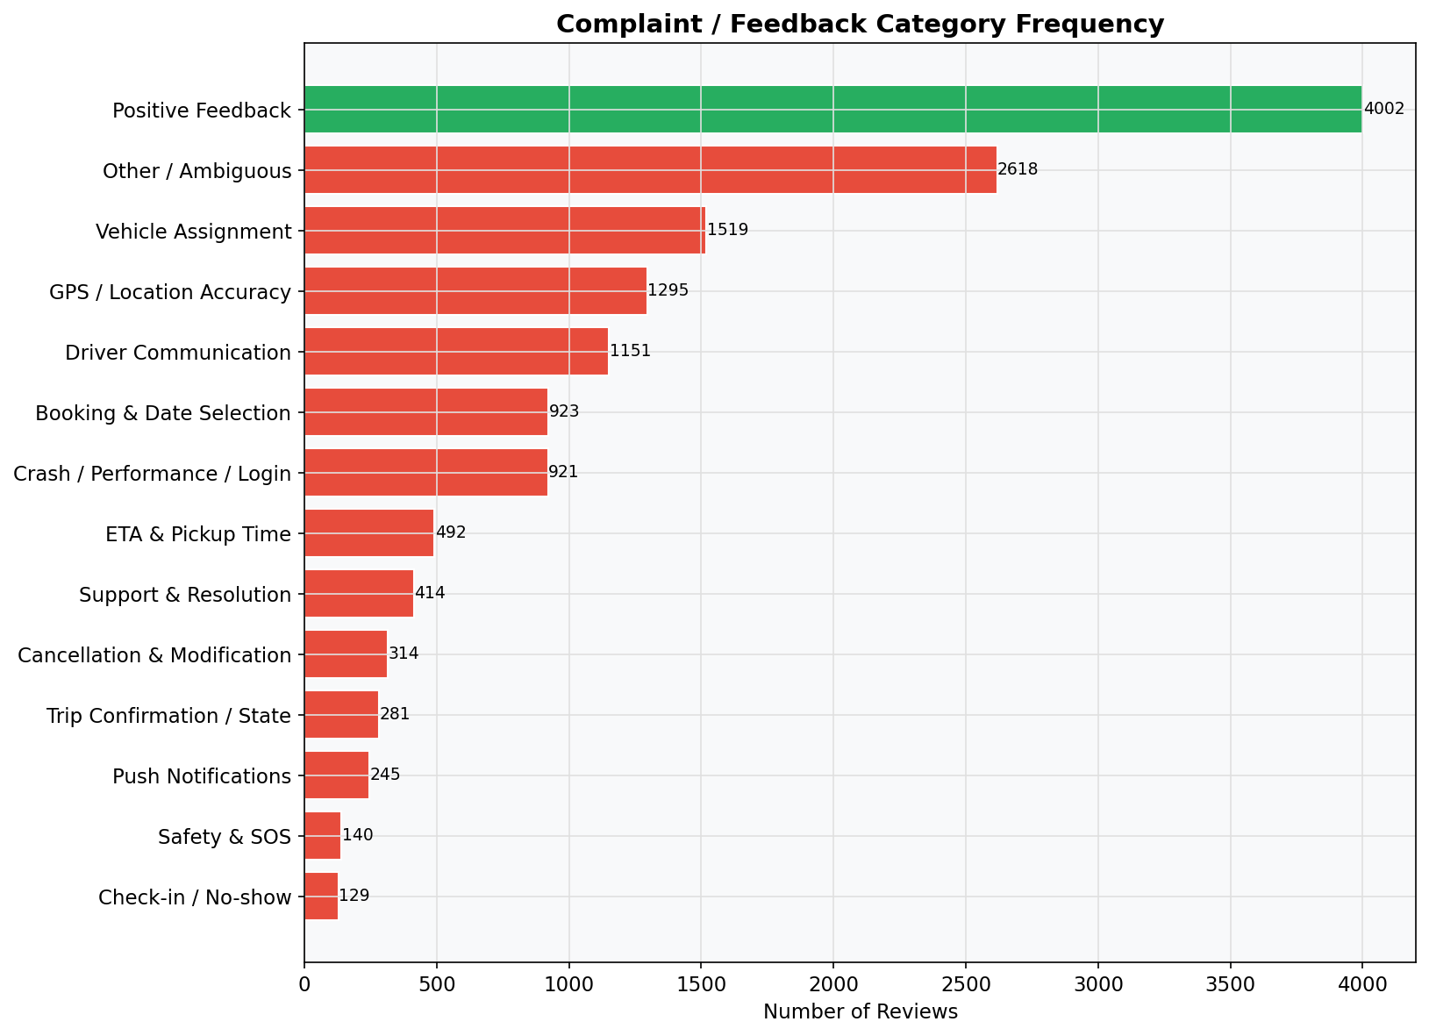
Most Common Complaint Categories
Multi-label keyword classification across 14 categories. One review can match multiple categories.

Slide 7
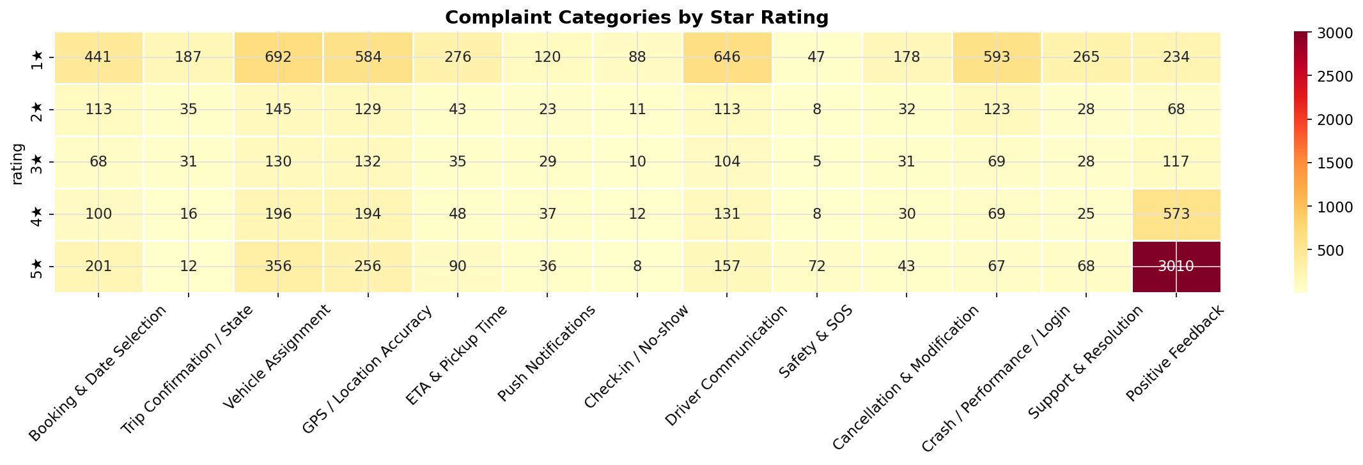
🔴 Issue #1: GPS / Live Location Inaccuracy
Evidence (from 1,295 reviews):
"the update is worse. it wont let you track the location of the van under an hour"
"cab's location is not appropriate"
"map gets stuck, which can cause delays"
Root-cause hypotheses:
• GPS ping interval too infrequent on driver device
• Location events delayed in backend pipeline
• UI renders cached position, not latest event
Validation required: GPS event latency logs, ETA vs actual arrival comparison

Slide 8
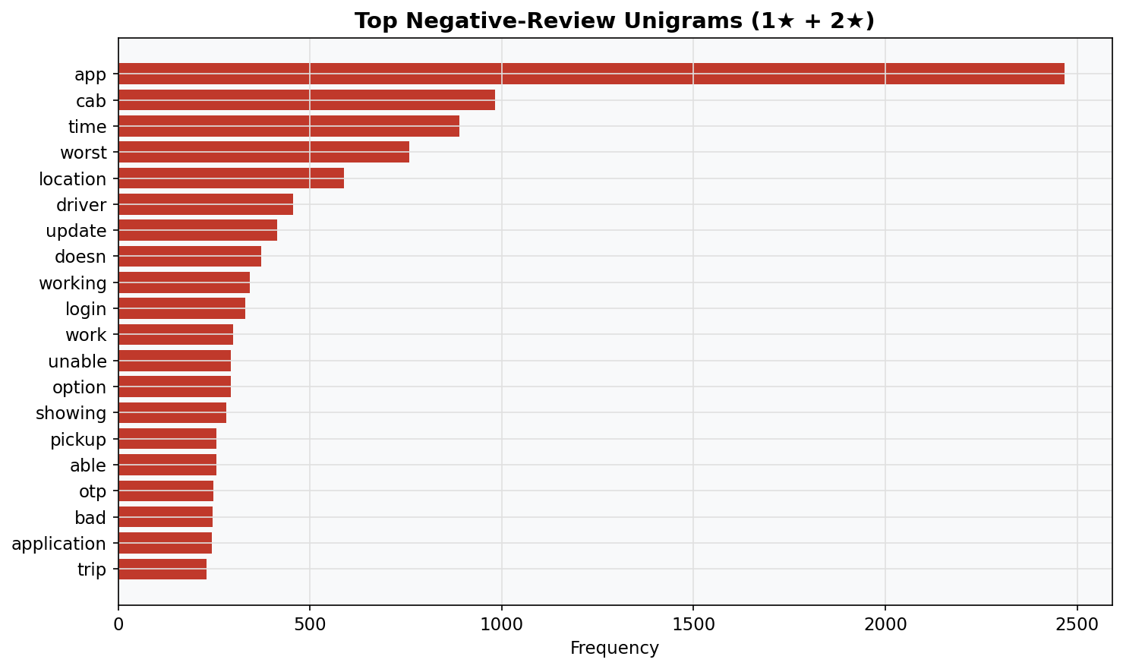
🔴 Issue #2: Crashes, Freezes & Login Failures
Evidence (from 921 reviews):
"app crashing every time I open it"
"OTP not received, cannot login"
"app freezes mid-trip, had to restart"
Root-cause hypotheses:
• Memory leak or ANR on main thread
• OTP SMS delivery failure (single provider)
• Unhandled exception on network timeout
Fix: Crashlytics instrumentation; ANR fix; OTP fallback

Slide 9
Root-Cause Hypotheses & Validation Framework
Issue
Evidence
Hypothesis
Validation Required
GPS Inaccuracy
1,295 reviews
Stale cache, slow pings
Location event latency logs
Crash/Freeze
921 reviews
ANR, memory leak
Crashlytics stack traces
No Notifications
245 reviews
Doze mode, no fallback
FCM delivery rate
No Driver Assigned
1,519 reviews
Silent pool exhaustion
Assignment success rate
No-show Dispute
129 reviews
Tight geofence
Geofence radius vs disputes

Slide 10
Prioritization Matrix
Scoring: Severity × Frequency × Confidence ÷ Implementation Effort
Priority
Issue
Reviews
Severity
Effort
Score
P1 🔴
GPS / Live Location Stale
1,295 (12.8%)
Critical
Med
96
P2 🔴
App Crash / Freeze / Login
921 (9.1%)
Critical
High
90
P3 🟠
Push Notification Failures
245 (2.4%)
High
Med
72
P4 🟠
Driver Not Assigned (Silent)
1,519 (15.0%)
High
Med
70
P5 🟡
No-show Disputes
129 (1.3%)
Medium
Med
54
P6 🟢
Support Unresponsive
414 (4.1%)
Medium
Low
48

Slide 11
Proposed Fixes & Success Metrics
[GPS]
Reduce ping interval; staleness indicator; alert if >60s stale
95% locations fresh <30s; ETA error <3 min
[Crashes]
Crashlytics; fix top ANR paths; add OTP fallback SMS
Crash-free sessions >99.5%
[Notifications]
SMS fallback; Doze-mode testing; monitor FCM delivery rate
Delivery rate >99% within 60s
[Assignment]
Show 'no driver' state; early re-dispatch or alternate option
Driver assigned <5 min for 95% bookings
[No-show]
Expand geofence; grace window; in-app dispute button
Disputed no-shows <1% of trips
[Support]
In-app ticket tracking; SLA visible to employee
CSAT >80%; first response <2h

Slide 12
30-Day Implementation Roadmap
Week 1
Deploy Crashlytics · Fix top 3 ANR paths · Add OTP SMS fallback
Week 1–2
Reduce GPS ping interval · Add location staleness indicator in UI
Week 2
SMS push fallback · Doze-mode testing · FCM delivery monitoring
Week 3
Show 'No driver available' state · Add re-dispatch timer
Week 3–4
Expand geofence · Grace window · In-app dispute flow
Week 4
In-app helpdesk integration · Ticket status visible · SLA alerts
Monitoring: Re-run collection pipeline weekly · Track category trend · Dashboard refresh monthly

