Slide 1
Extracting Deterministic Finite-State Automaton from Recurrent Neural Networks
Zhang Huangzhao
Yuan Pei College
zhang_hz@pku.edu.cn

Slide 2
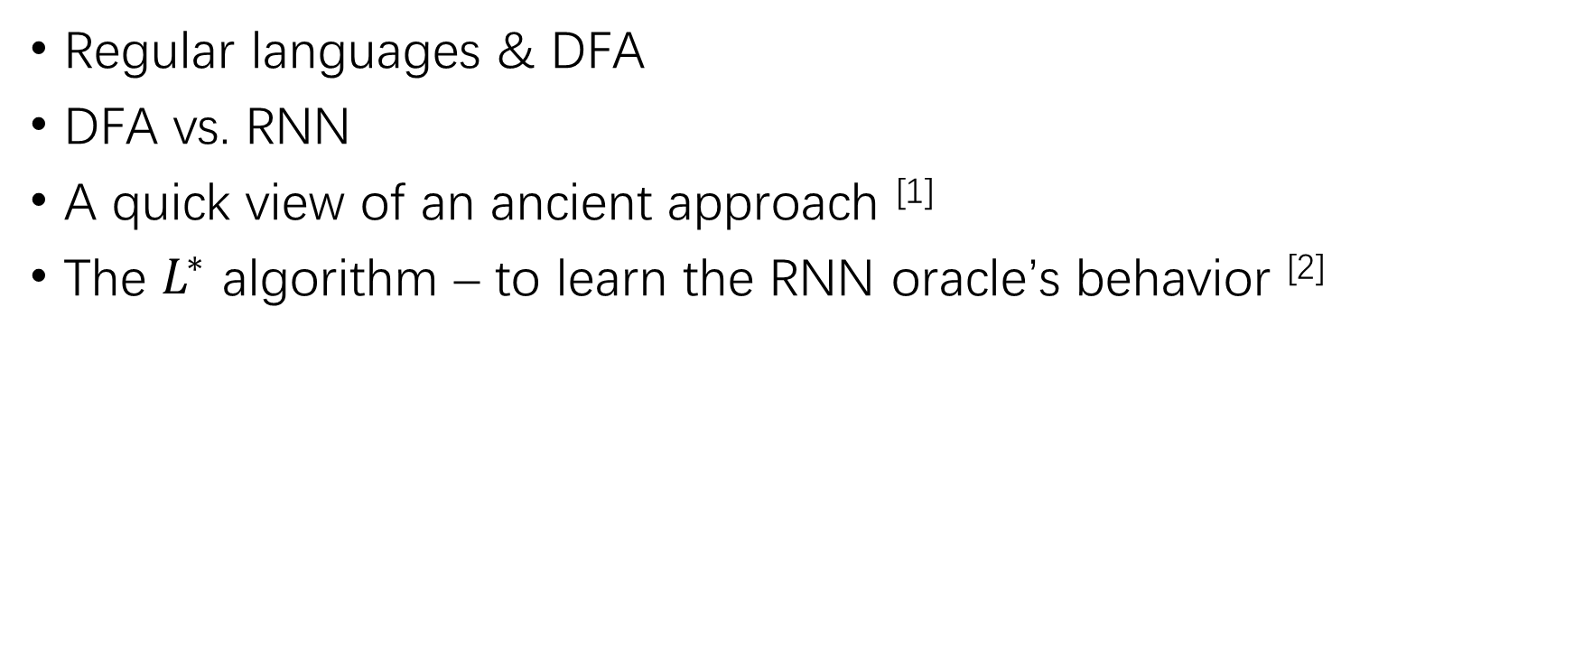
Overview
[1] Christian W. Omlin, C.Lee Giles. Extraction of rules from discrete-time recurrent neural networks[J]. Neural Networks, 1996, 9(1):41-52.
[2] Weiss G, Goldberg Y, Yahav E. Extracting Automata from Recurrent Neural Networks Using Queries and Counterexamples. In Proceedings of the 35th International Conference on Machine Learning.

Slide 3
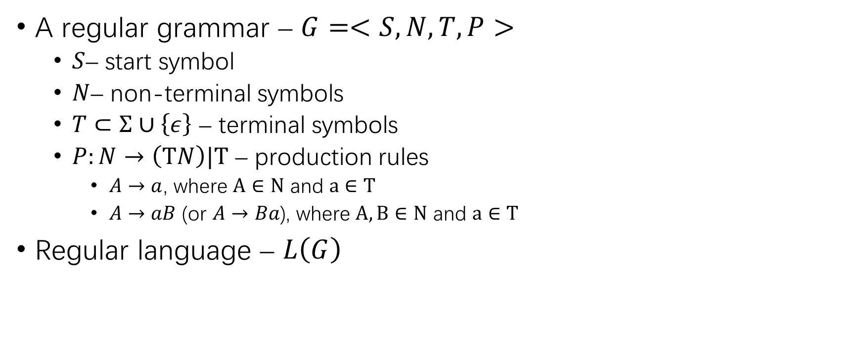
Regular Language
Notes:
Regular languages is the smallest class of formal languages in Chomsky hierarchy. 乔姆斯基
A -> aB, A -> a 右线性
A -> Ba, A -> a 左线性
3型文法，正则文法，DFA
2型文法，上下文无关文法，下推自动机
1型文法，上下文有关文法，线性有界自动机
0型文法，无限制文法，图灵机

Slide 4
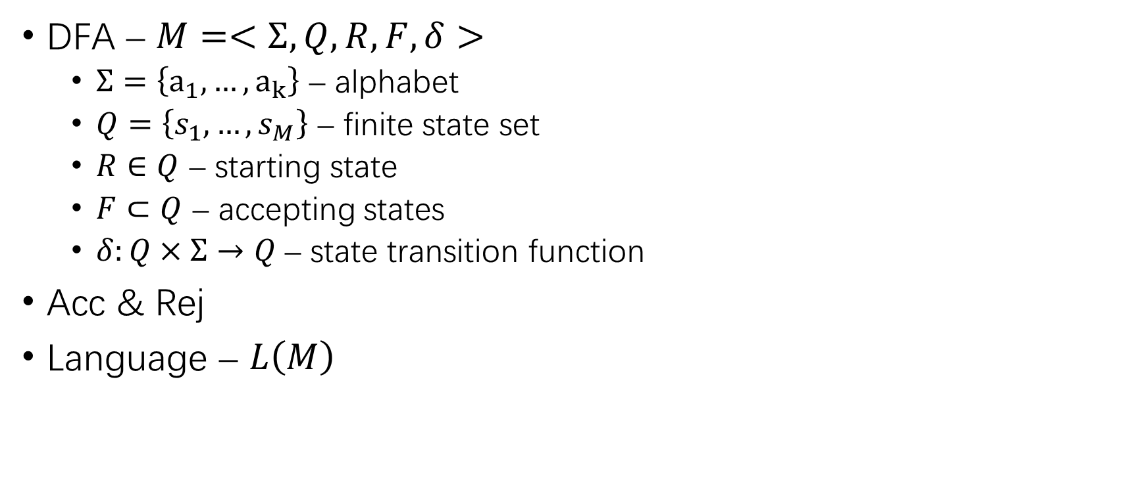
Deterministic Finite-State Automaton

Slide 5
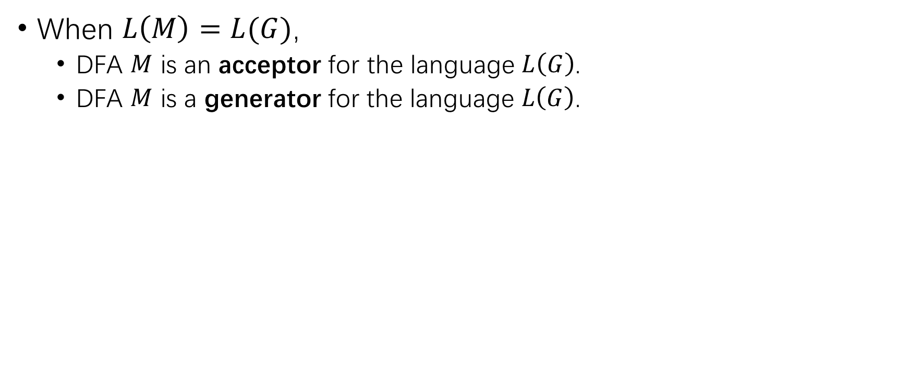
Regular Languages & DFA

Slide 6
Grammatical inference problem
Grammatical inference problem – NP-complete
Infer grammars from samples of strings of an unknown regular language.
Notes:
Grammatical inference problem: inferring grammars from samples of strings of an unknown regular language.

Slide 7
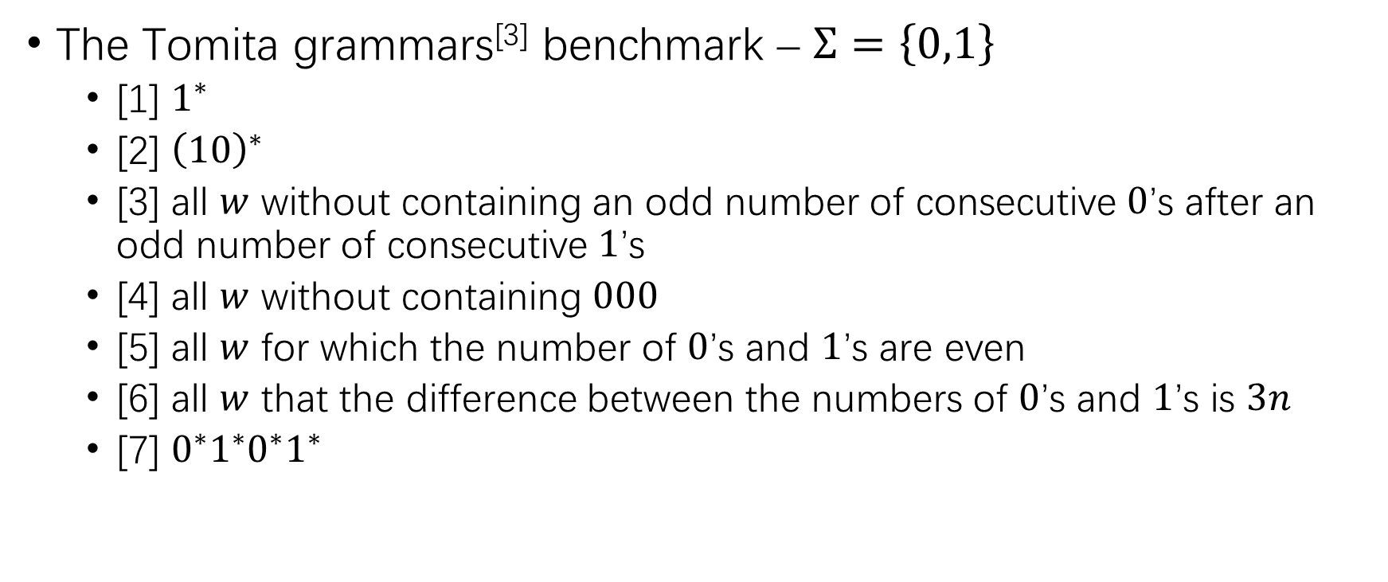
Grammatical inference problem (2)
[3] Tomita M. Dynamic construction of finite automata from examples using hill-climbing[J]. Proc.ann.conf.cogn.sci.soc, 1982.

Slide 8
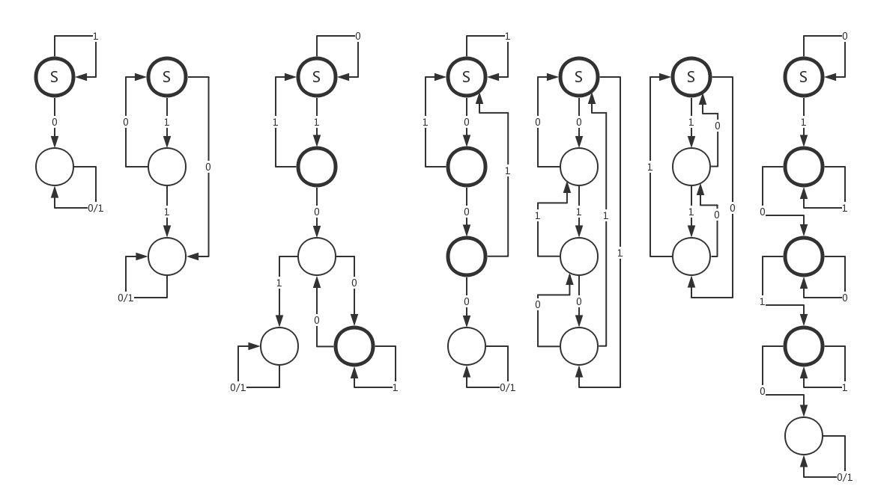
Tomita Grammars
Notes:
[1] 1^∗
[2] (10)^∗
[3] all �� without containing an odd number of consecutive 0’s after an odd number of consecutive 1’s
[4] all �� without containing 000
[5] all �� for which the number of 0’s and 1’s are even
[6] all �� that the difference between the numbers of 0’s and 1’s is 3��
[7] 0^∗ 1^∗ 0^∗ 1^∗

Slide 9
RNN vs. DFA
RNN
More capable
… …
DFA
Robust
Explainable
… …

Slide 10
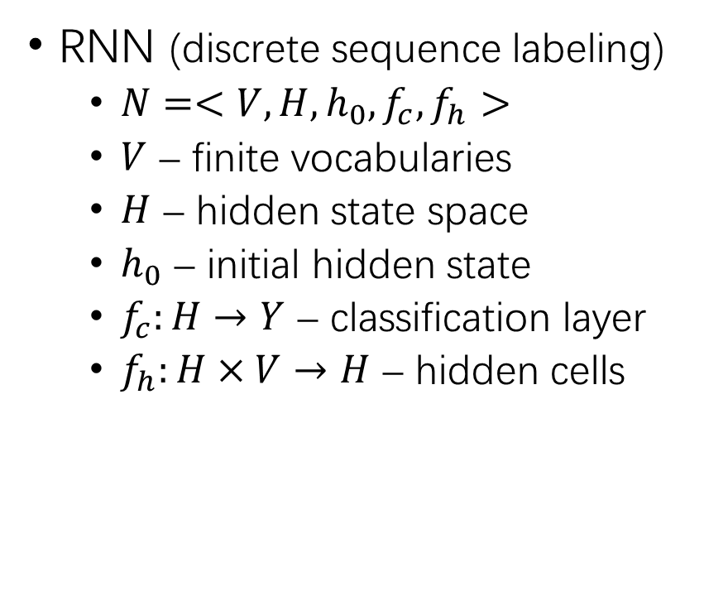
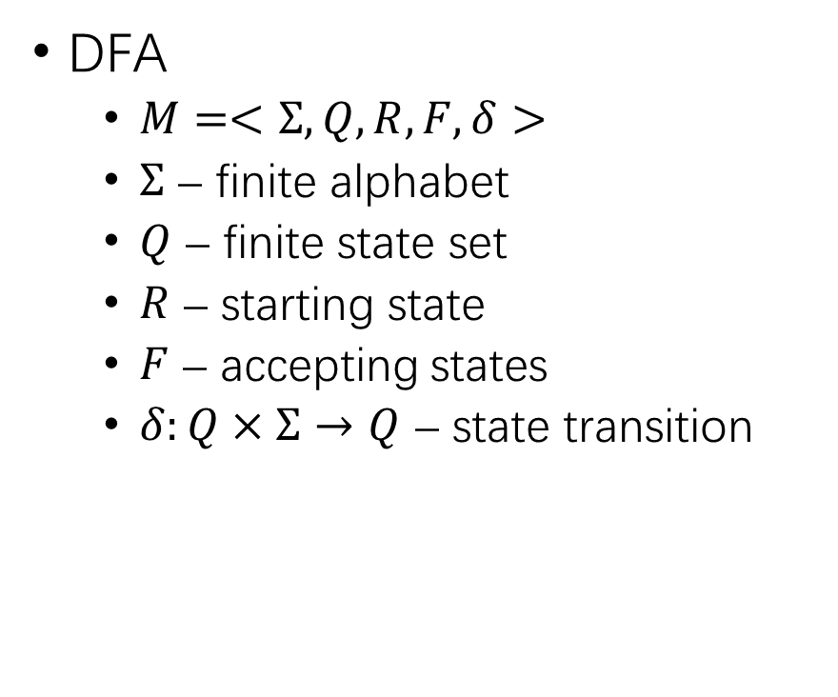
RNN vs. DFA (2)
Notes:
An RNN can be regarded as a deterministic infinite-state automaton.

Slide 11
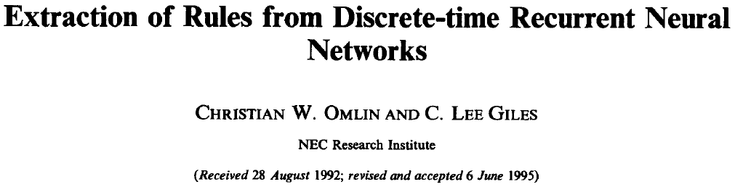

Slide 12
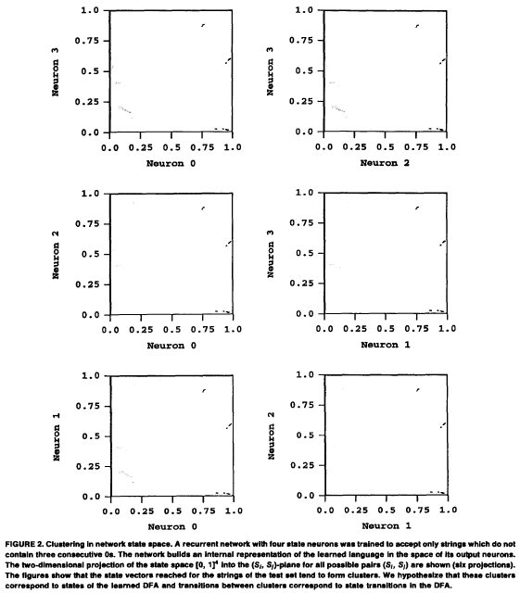
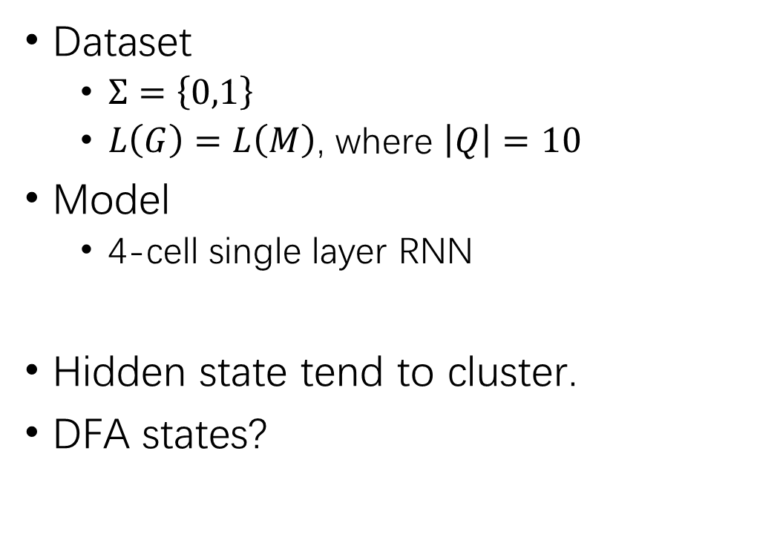
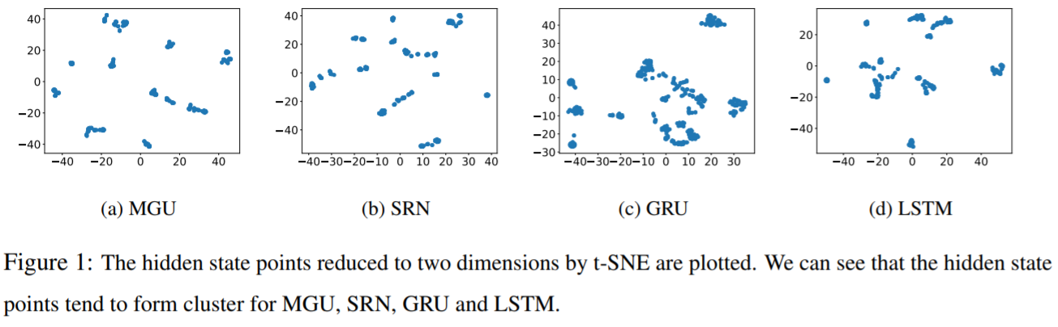
Observation & Hypothesis
[4] Bo-Jian Hou, Zhi-Hua Zhou. Learning with Interpretable Structure from RNN. arXiv:1810.10708
Notes:
The hidden states tend to cluster.
The hypothesis is that the collections of the clusters correspond to the states of the DFA the network has learned.

Slide 13
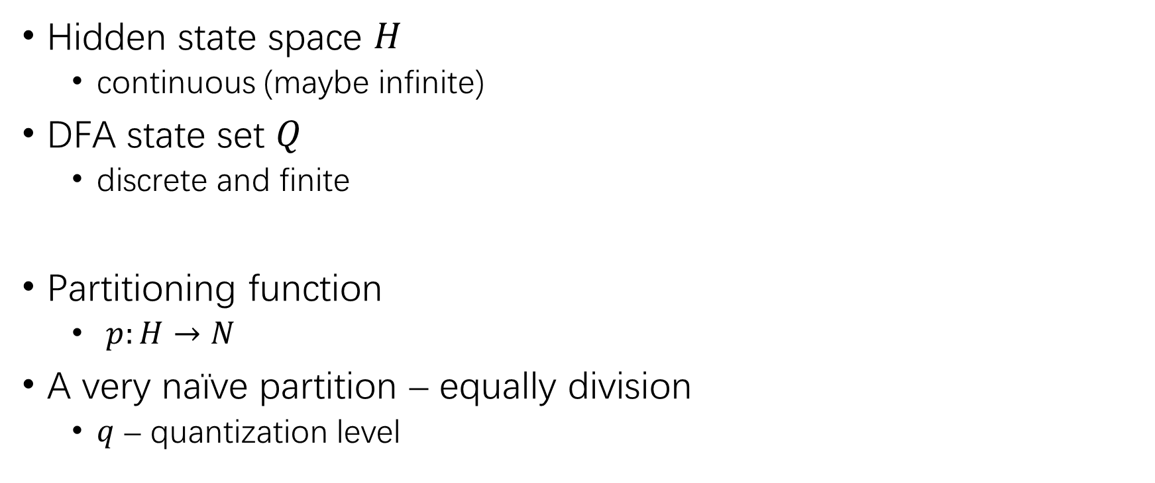
Hidden State Space to Discrete states?
0
1
2
3
4
5
6
7
8
9
10
11
12
13
14
15
Notes:
A simple solution, where correctness is not guaranteed.
Divide the output of each cell (�� in total) into �� intervals of equal size.
Yield ��^�� partitions in the hidden state space.
�� – quantization level

Slide 14

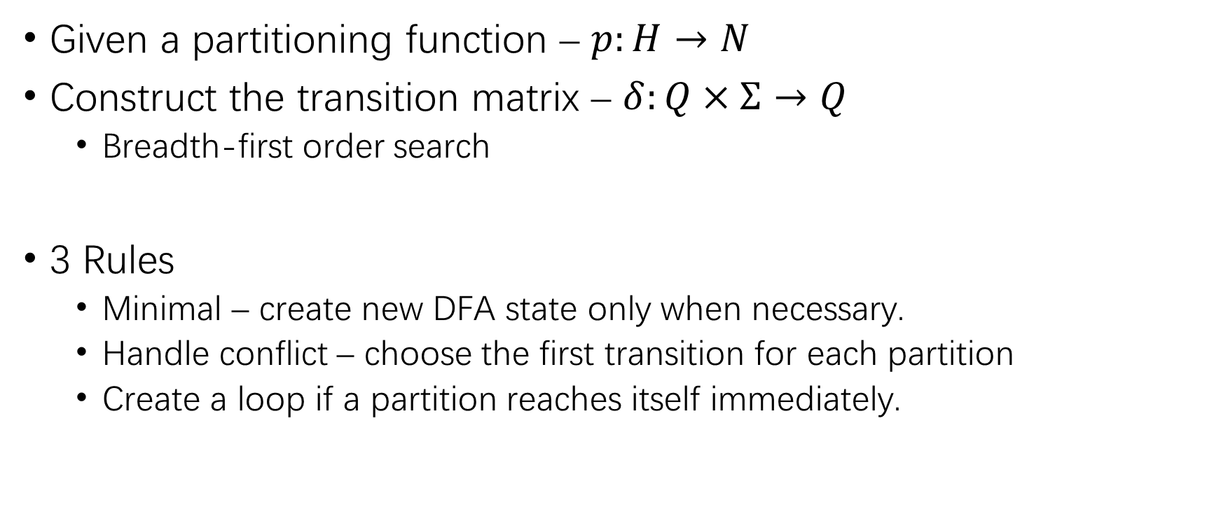
Notes:
1. When a previously visited partition is reached, then only the new transition is defined between the previous and the current partition. Under such circumstances, no new DFA state is created.
2. Choose the transition which first reached a partition, if there are many different possible transitions.
3. Create a loop from a partition immediately to the same partition.

Slide 15
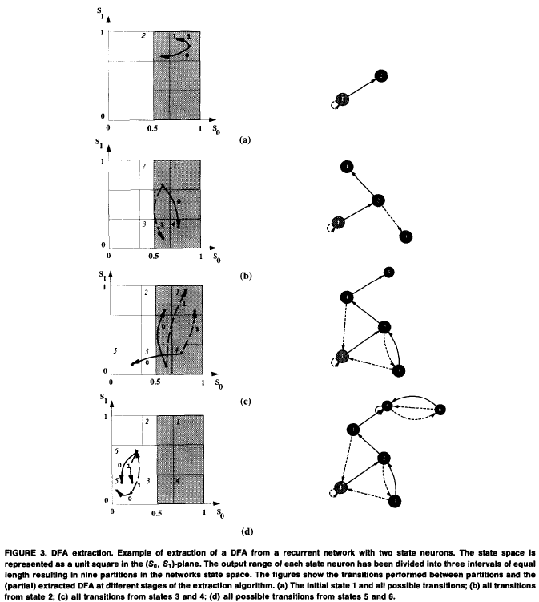

An example

Slide 16
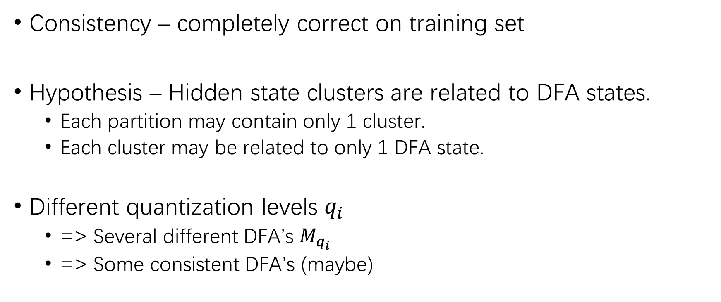
DFA Selection
Notes:
A DFA �� is consistent if it correctly classifies all strings of the training set
If several DFAs are extracted with different quantization levels ��_��, then one or more of the extracted DFA ��_(��_�� ) may be consistent with the training set.

Slide 17
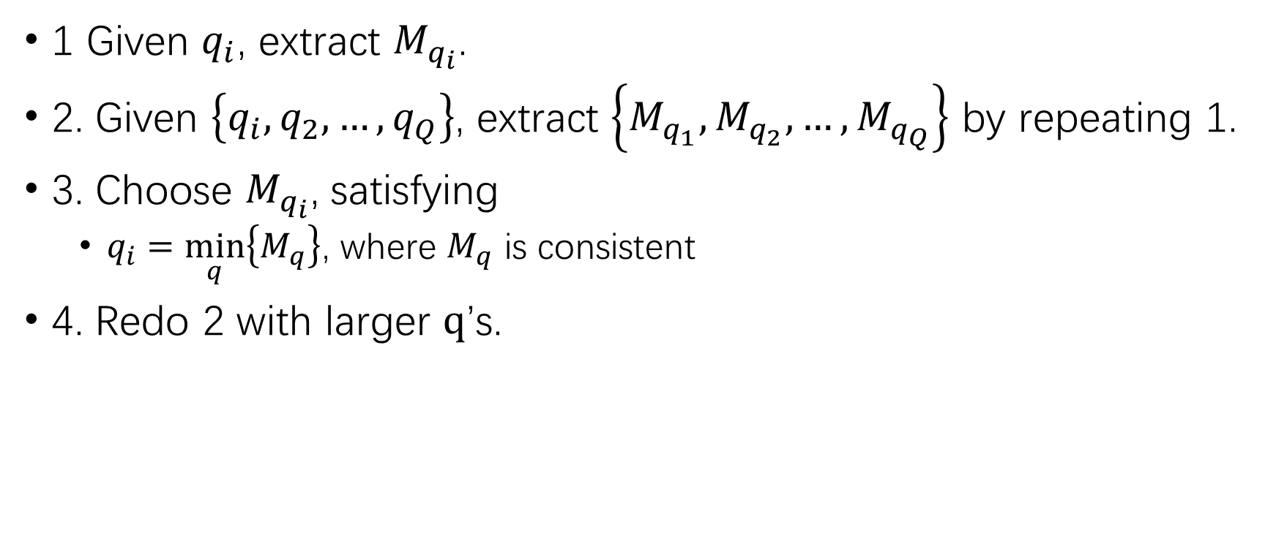
DFA Selection (2)
Notes:
Notice, the task in this paper is too easy, leading to many consistent hypotheses. Under other complicated circumstances, there would be fewer or none consistent hypotheses.

Slide 18
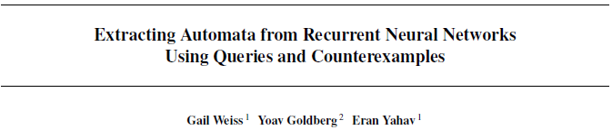

Slide 19
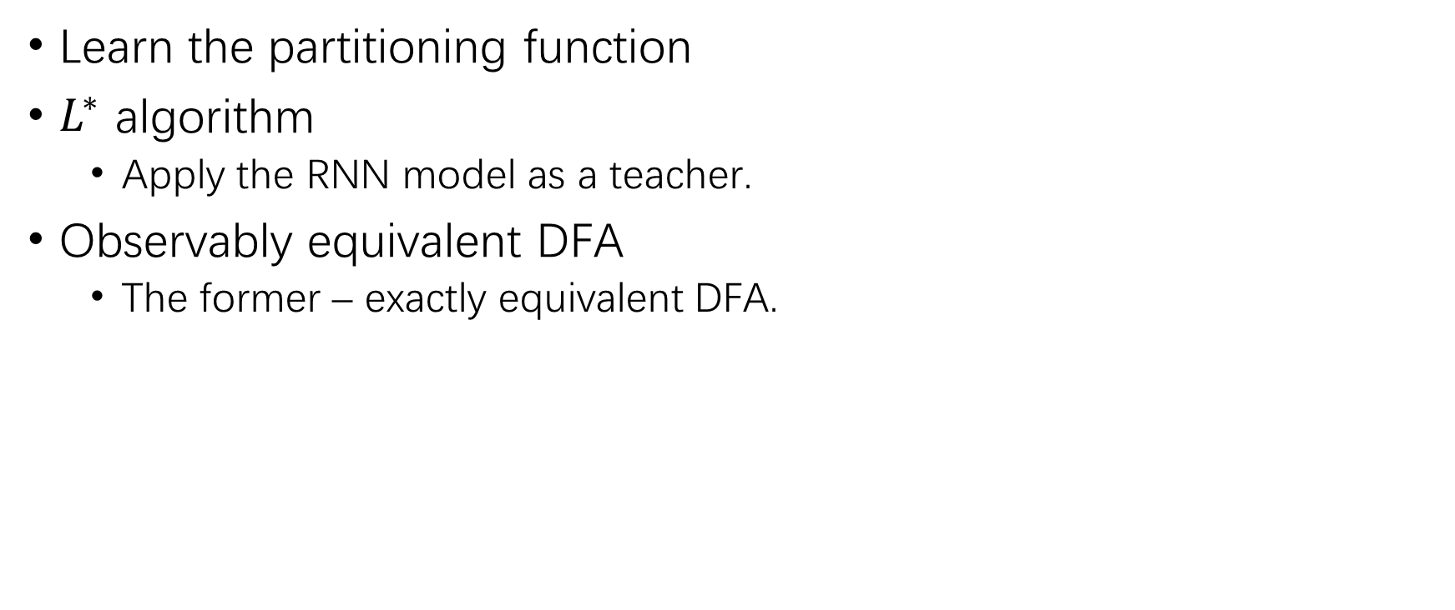
Brief Idea
Notes:
Apply the ��^∗ algorithm as a learner and the RNN as an oracle.
Exactly equivalent DFA => observably equivalent DFA

Slide 20

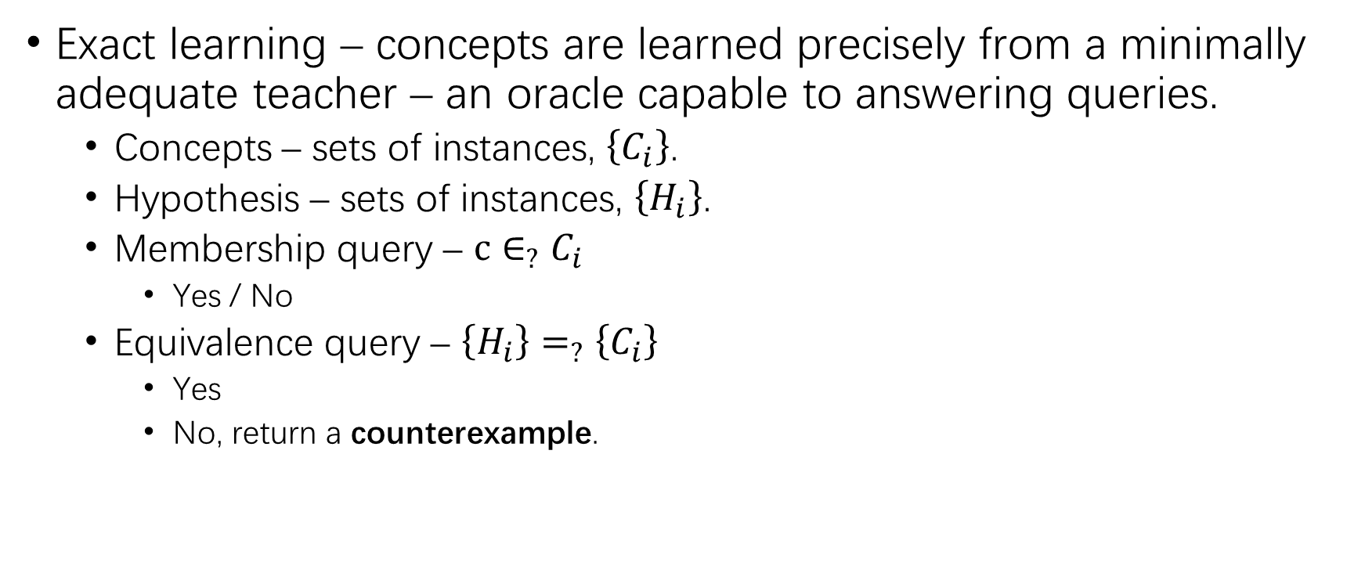
Notes:
Exact learning: concepts (set of instances) are learned precisely from a minimally adequate teacher – an oracle capable to answering queries.
Membership query – to label a given instance.
Equivalence query – to state whether a given hypothesis (set of instances) is equal to the concept held by the teacher. If not, return a counterexample.

Slide 21

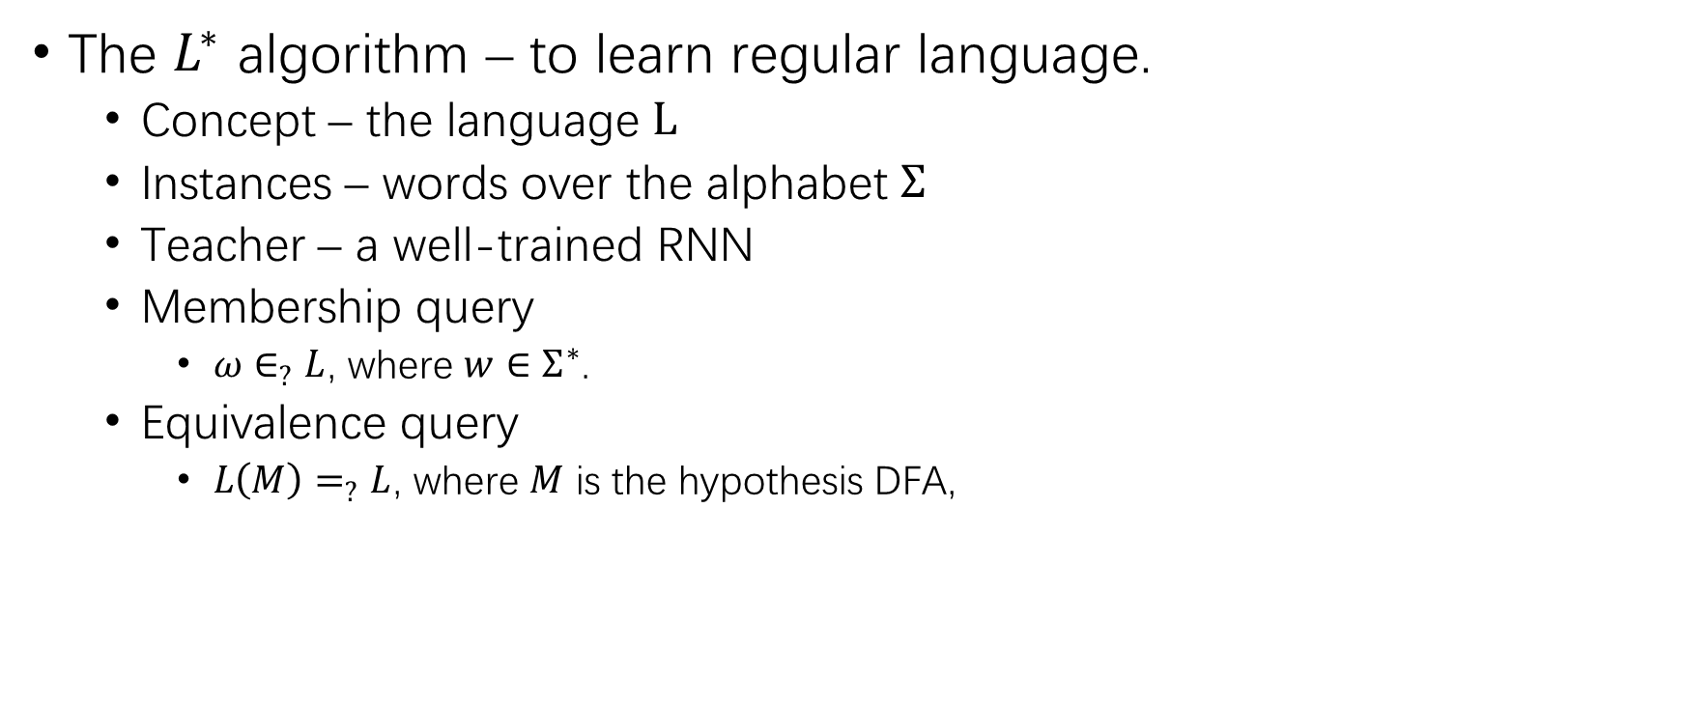

Slide 22
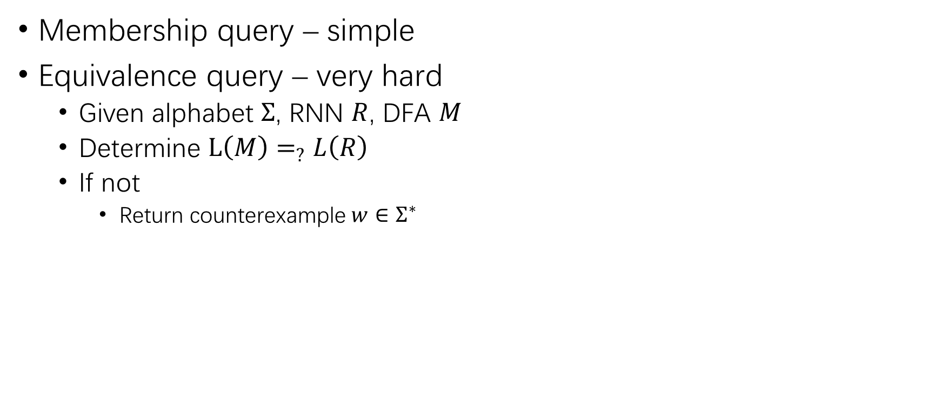
Equivalence Query
Notes:
Given an RNN acceptor �� trained over a finite alphabet Σ, and a DFA �� over Σ, determine whether �� and �� are equivalent, and return a counterexample ��∈Σ^∗ is not.

Slide 23
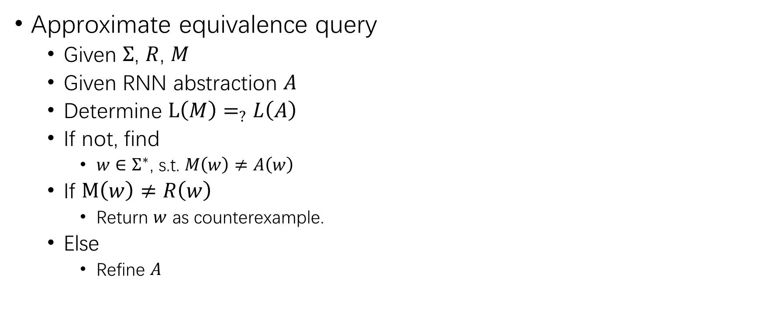
Equivalence Query (2)
Notes:
Approximate equivalence query – A finite abstraction (retrieved through random sampling) of the RNN �� is applied to answer equivalence queries. The finite abstraction and �� must at least be equivalent to each other. If the two disagree on some sample, find its true classification in ��, and determine whether it’s a counterexample, or to perform a refinement to the abstraction.

Slide 24
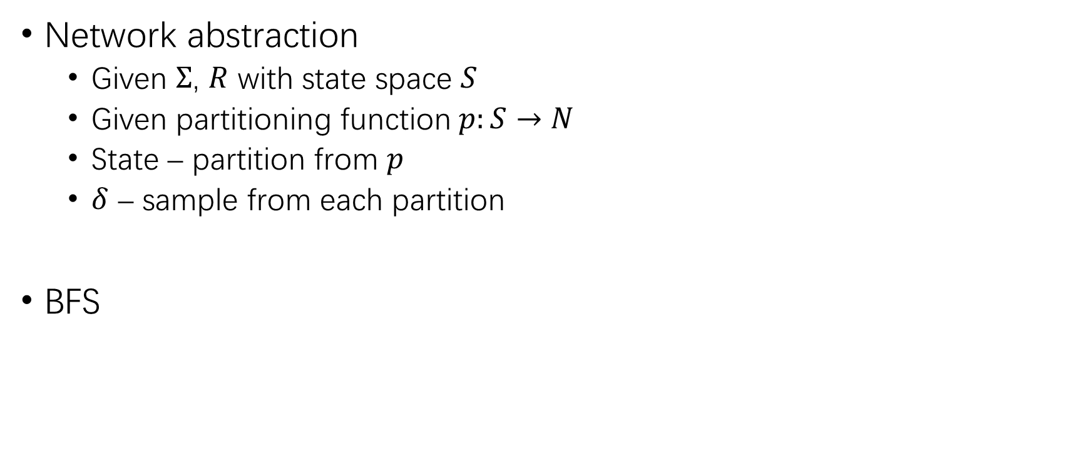
Equivalence Query (3)
Notes:
Network abstraction – Given a NN �� with state space �� and alphabet Σ, and a partitioning function ��:��→��, a DFA can be extracted by regarding every state is a partition from ��, and the state transitions and classifications are defined by a single sample from each partition.

Slide 25
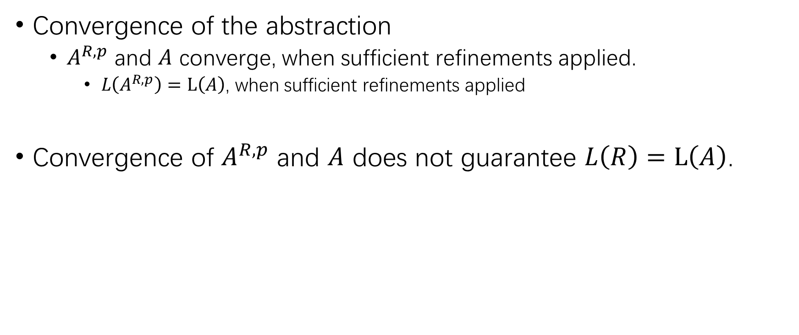
Equivalence Query (4)
Notes:
The proposed DFA �� and the abstraction ��^(��,��) will converge, which means �� and ��^(��,��) are equivalent, (which does not guarantee that �� and �� are equivalent,) after sufficient refinements.

Slide 26
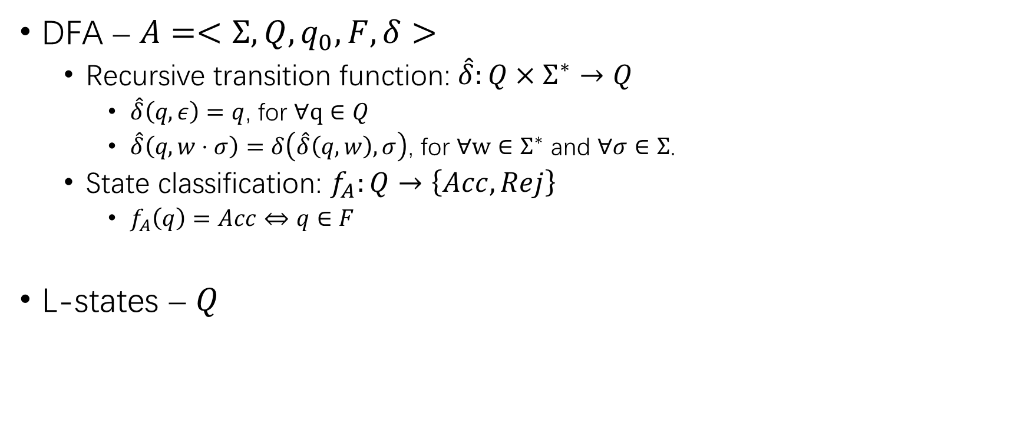
Notations

Slide 27
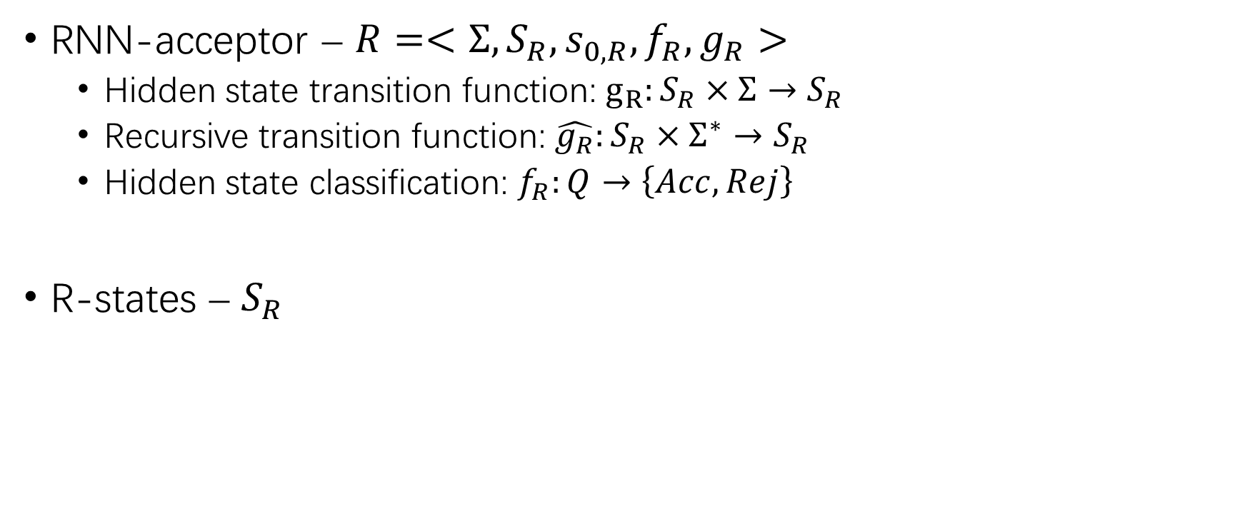
Notations (2)

Slide 28
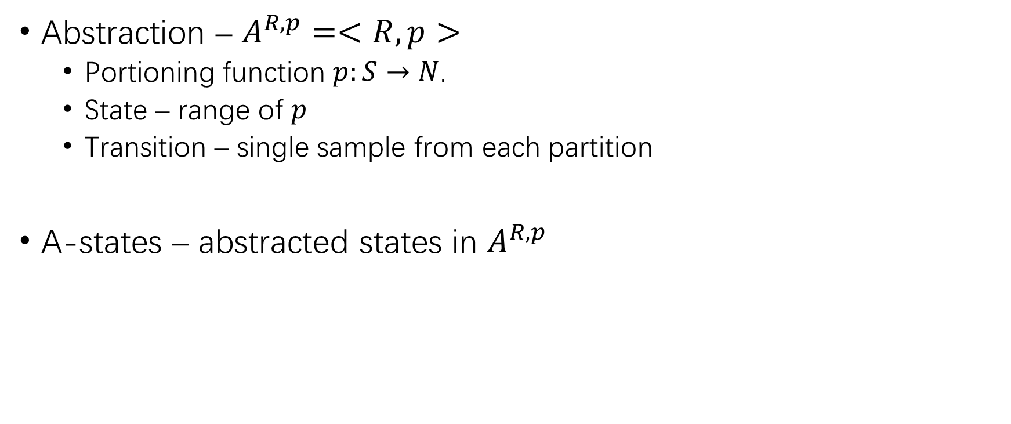
Notations (3)

Slide 29
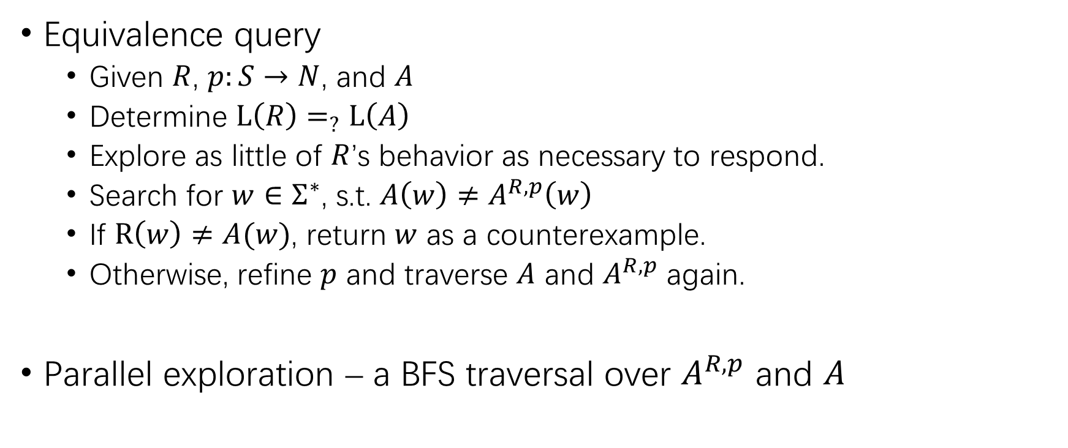
Answering Equivalence Queries
Notes:
Every counterexample �� is inherently true (��_�� (��)≠��_�� (��)).
Property 1. Every separate state in the final extracted DFA �� is justified by concrete input to the RNN ��.
Property 2. Every refinement to the partitioning function �� is justified by concrete input to the RNN ��.

Slide 30
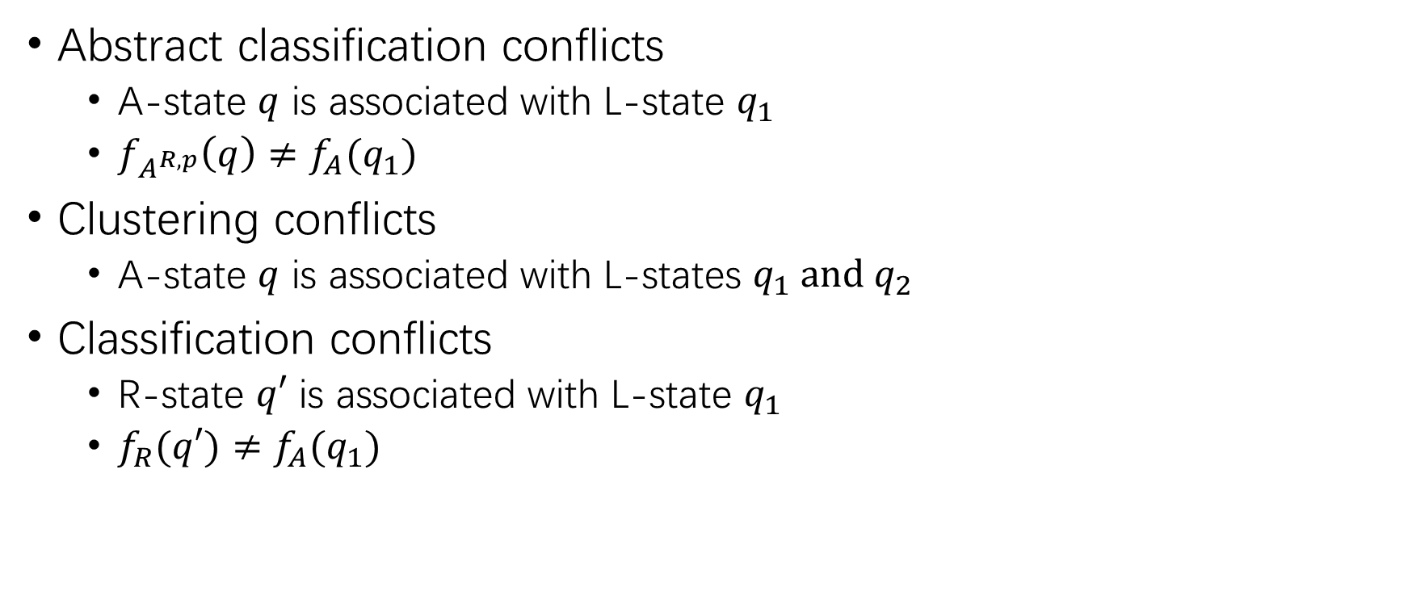
Answering Equivalence Queries (2)
Sample
Refine
Counter-example
Notes:
Abstract classification conflicts – A(n) Acc/Rej A-state is associated with a(n) Rej/Acc L-state.
The classification of an A-state is determined by the R-state when it was first reached. It covers all abstract classification conflicts.
Clustering conflicts – An A-state is associated with 2 different L-states.
Classification conflicts – Classification of each R-state is not identical to that of the L-state, during parallel traversal.

Slide 31
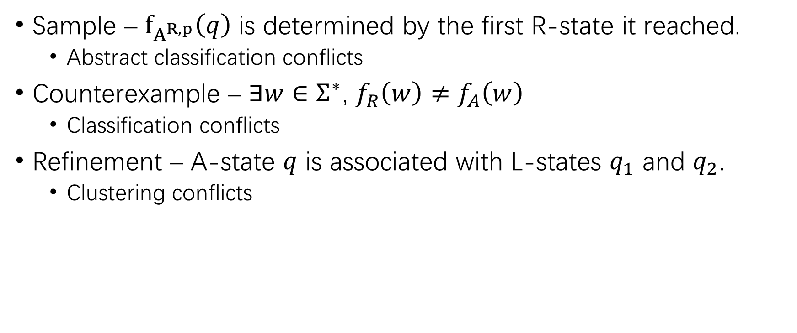
Answering Equivalence Queries (3)
Notes:
The classification of an A-state is determined by the R-state when it was first reached. It covers all abstract classification conflicts.
Refinement – The parallel exploration associates an A-state ��∈��_(��,��) with an L-state ��_2, after �� has already been associated with an L-state ��_1≠��_2.

Slide 32
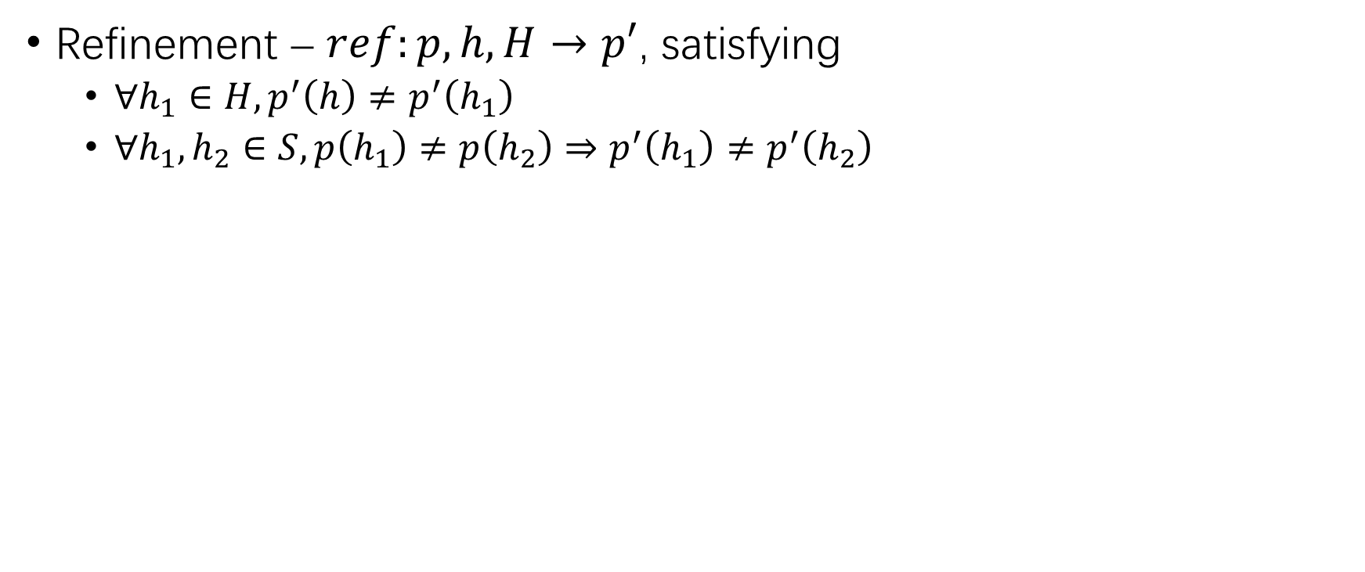
Answering Equivalence Queries (4)
Notes:
Refinement – ������:��,ℎ,��→��′, where ��:��→�� is a partitioning on the R-state space, ℎ is an RNN-state, and ��⊂��/{ℎ} is a set of R-states, and ��′ satisfies
∀ℎ_1∈��, ��^′ (ℎ)≠��^′ (ℎ_1 )
∀ℎ_1,ℎ_2∈��, ��(ℎ_1 )≠��(ℎ_2 )⇒��^′ (ℎ_1 )≠��^′ (ℎ_2 )

Slide 33
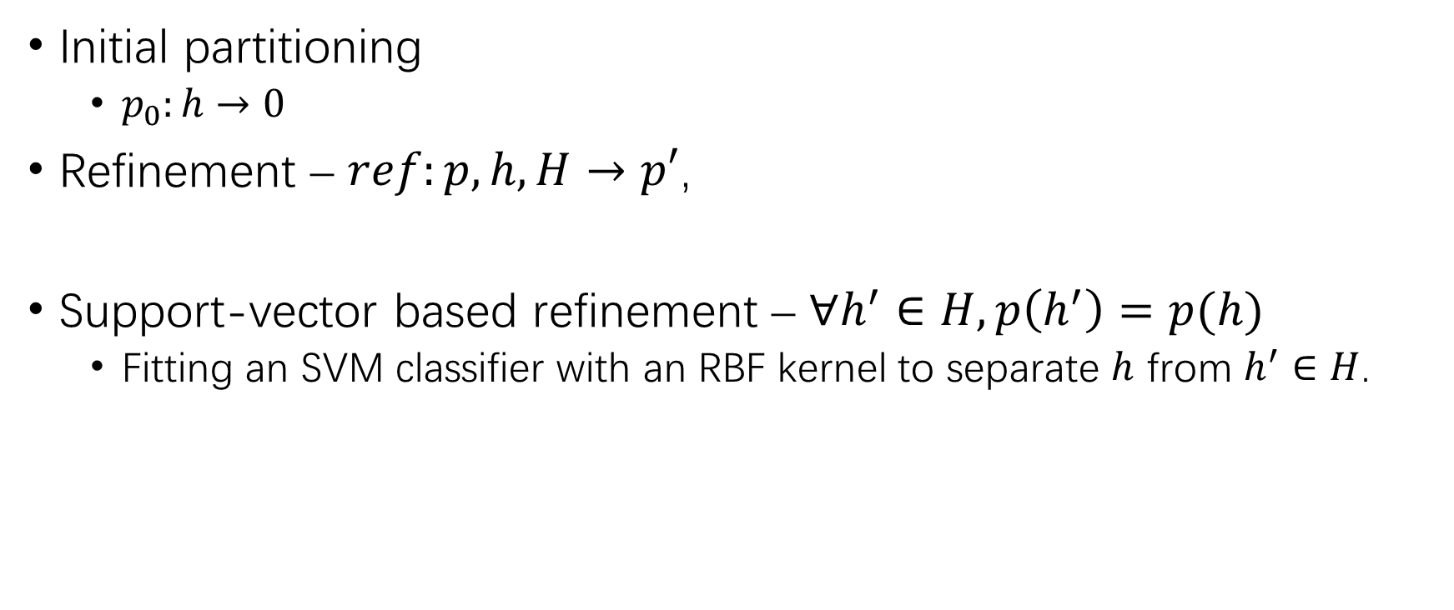
Abstraction Refinement
Notes:
Initial partitioning – Do no separation at all to keep the abstraction as small as possible.
Support-vector based refinement – ∀ℎ^′∈��, ��(ℎ^′ )=��(ℎ). The target is to allocate a region around ℎ that is large enough to contain other similar R-states, but separate from R-states such as ℎ′.

Slide 34
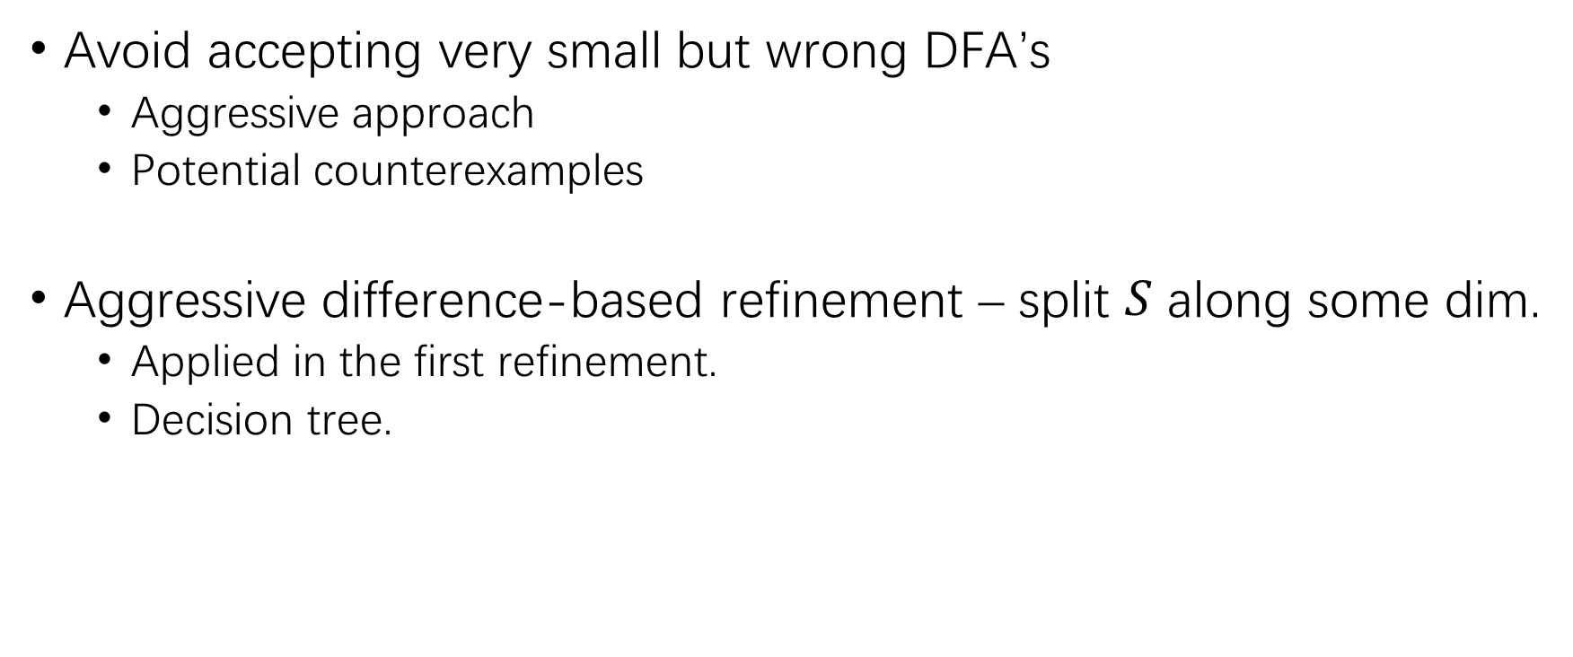
Abstraction Refinement (2)
Notes:
Avoid accepting very small but wrong DFA’s
Use an aggressive approach to generate a large number of A-states in the first refinement.
A pair of Acc/Rej sequences are provided to the teacher as potential counterexamples to be considered at every equivalence query.

Slide 35
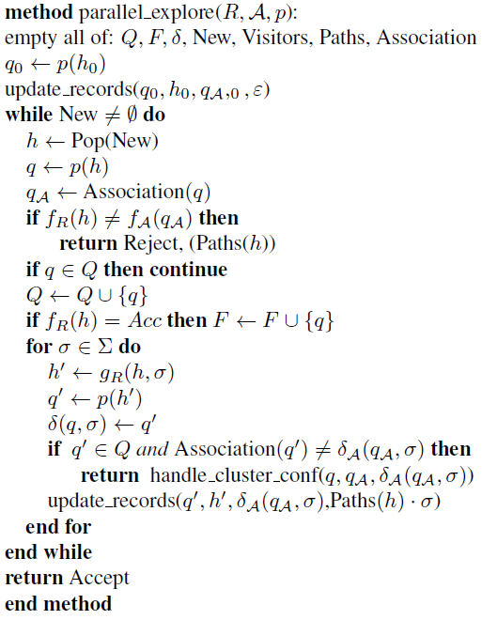
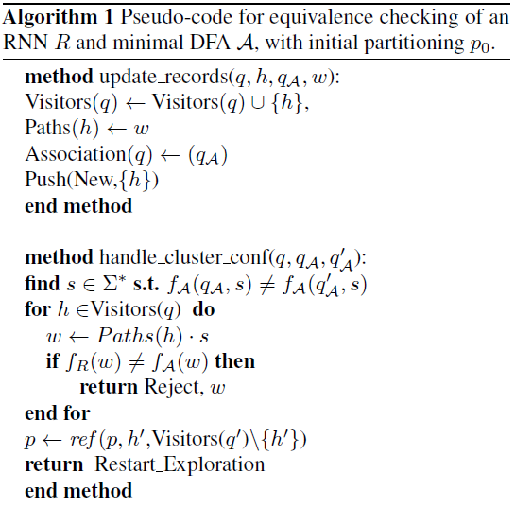
The Algorithm

Slide 36
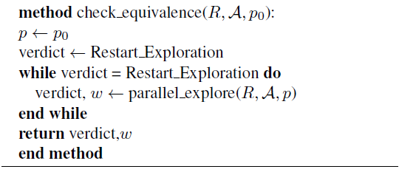
The Algorithm (2)

Slide 37
Experimental Results
Dataset
Tomita grammars benchmark.
Initial aggressive refinement depth
10
RNN-acceptor
100% accuracy on the training set
99.9+% accuracy on the validation set
Notes:
7 RNNs for 7 grammars in Tomita grammars.

Slide 38
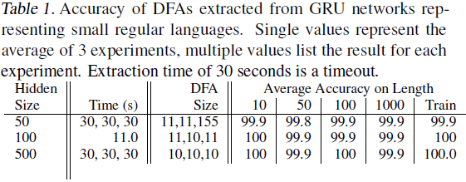
Experimental Results (2)
Effectiveness on Random Regular Languages
The largest Tomita grammar is equivalent to a 5-state DFA.

Slide 39
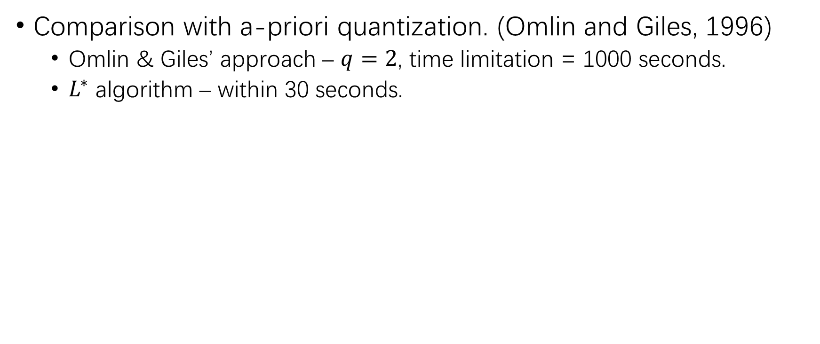
Experimental Results (3)
Notes:
The ��^∗ algorithm is able to find small and accurate DFA’s representing a given RNN, when such DFA’s are really available.

Slide 40
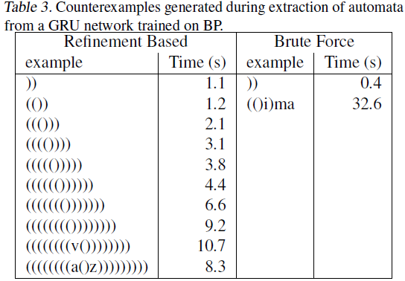
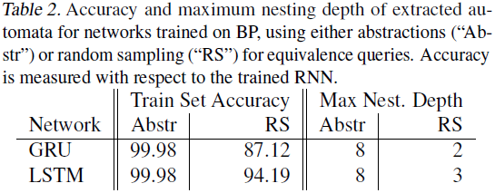
Experimental Results (4)
Abstraction vs. random sampling during equivalence queries.

Slide 41

Polynomial complexity
Intolerance to noise
Notes:
Extraction on complicated networks is extremely slow.
The number of states of DFA’s extracted from complicated RNN is large.

Slide 42

Polynomial complexity & intolerance to noise
Find many simple misclassified examples.
Email addr – [a-z][a-z0-9]*@[a-z0-9]+.(com|net|co.[a-z][a-z0-9]*)$
100% accuracy – easy
Extract a DFA – hard
RNN’s learn far more complicated languages than the regular language.

Slide 43

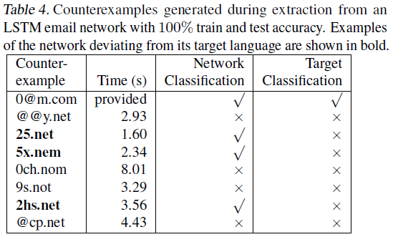

Slide 44
References
[1] Christian W. Omlin, C.Lee Giles. Extraction of rules from discrete-time recurrent neural networks[J]. Neural Networks, 1996, 9(1):41-52.
[2] Weiss G, Goldberg Y, Yahav E. Extracting Automata from Recurrent Neural Networks Using Queries and Counterexamples. In Proceedings of the 35th International Conference on Machine Learning.
[3] Tomita M. Dynamic construction of finite automata from examples using hill-climbing[J]. Proc.ann.conf.cogn.sci.soc, 1982.
[4] Bo-Jian Hou, Zhi-Hua Zhou. Learning with Interpretable Structure from RNN. arXiv:1810.10708

Slide 45
Questions?

Slide 46
THANK YOU!

