Slide 1
Sampling from Sequence Space
Zhang Huangzhao
Yuan Pei College
zhang_hz@pku.edu.cn

Slide 2
Overview
About sampling
Why sample from sequence space?
Markov chain Monte Carlo simulation
Metropolis-Hastings sampling
CGMH sampling
Gibbs sampling

Slide 3
Overview
About sampling
Why sample from sequence space?
Markov chain Monte Carlo simulation
Metropolis-Hastings sampling
CGMH sampling
Gibbs sampling

Slide 4
Sampling
Sampling is the selection of a subset (a statistical sample) of individuals from within a statistical population to estimate characteristics of the whole population.

Slide 5

Sampling from uniform distribution
Linear congruential generator (LCG)
Given modulus ($m>0$), multiplier ($a∈\left(0,m\right)$), increment ($c∈\left[0,m\right)$) and seed ($X_{0}∈\left[0,m\right)$ ), generate pseudo-random integer from $U\left(0,m\right)$.
$$X_{n+1}=\left(aX_{n}+c\right) mod m$$

Slide 6
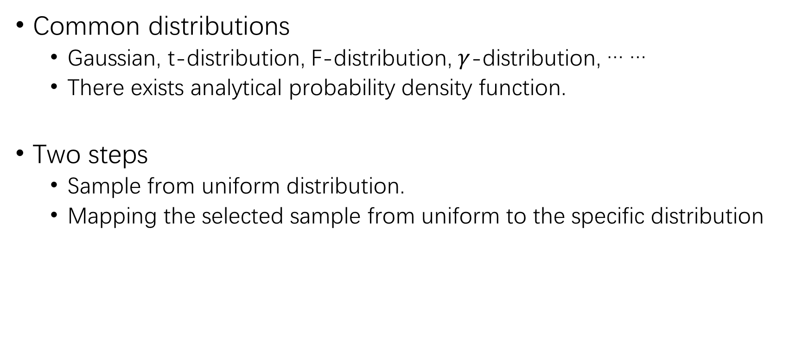
Sampling from common distributions
Common distributions
Gaussian, t-distribution, F-distribution, $γ$-distribution, … …
There exists analytical probability density function.
Two steps
Sample from uniform distribution.
Mapping the selected sample from uniform to the specific distribution

Slide 7
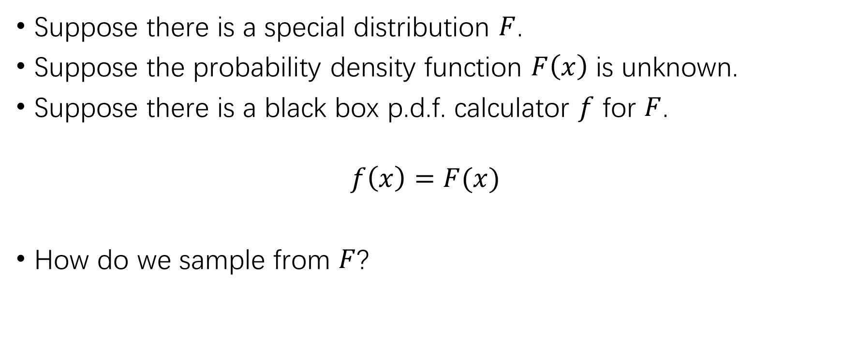
Sampling from other distributions?
Suppose there is a special distribution $F$.
Suppose the probability density function $F\left(x\right)$ is unknown.
Suppose there is a black box p.d.f. calculator $f$ for $F$.
$$f\left(x\right)=F(x)$$
How do we sample from $F$?

Slide 8
Sampling from other distributions (2)
Commonly applied approaches
Monte Carlo simulation
Markov chain simulation
Markov chain Monte Carlo simulation
Metropolis-Hastings sampling
Gibbs sampling

Slide 9
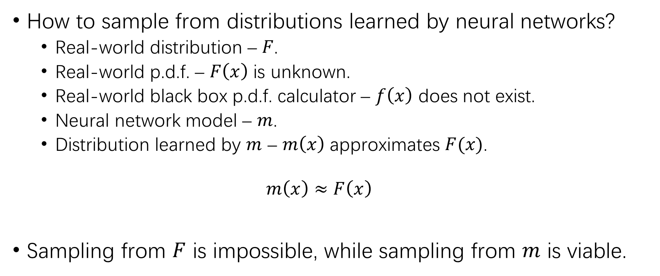
Sampling from other distributions (3)
How to sample from distributions learned by neural networks?
Real-world distribution – $F$.
Real-world p.d.f. – $F\left(x\right)$ is unknown.
Real-world black box p.d.f. calculator – $f\left(x\right)$ does not exist.
Neural network model – $m$.
Distribution learned by $m$ – $m\left(x\right)$ approximates $F(x)$.
$$m\left(x\right)≈F\left(x\right)$$
Sampling from $F$ is impossible, while sampling from $m$ is viable.

Slide 10
Overview
About sampling
Why sample from sequence space?
Markov chain Monte Carlo simulation
Metropolis-Hastings sampling
CGMH sampling
Gibbs sampling

Slide 11
Possible utilizations
Data augmentation
NMT on minority languages
Sequence generation
Adversary
Adversarial attack
Adversarial training
… …

Slide 12
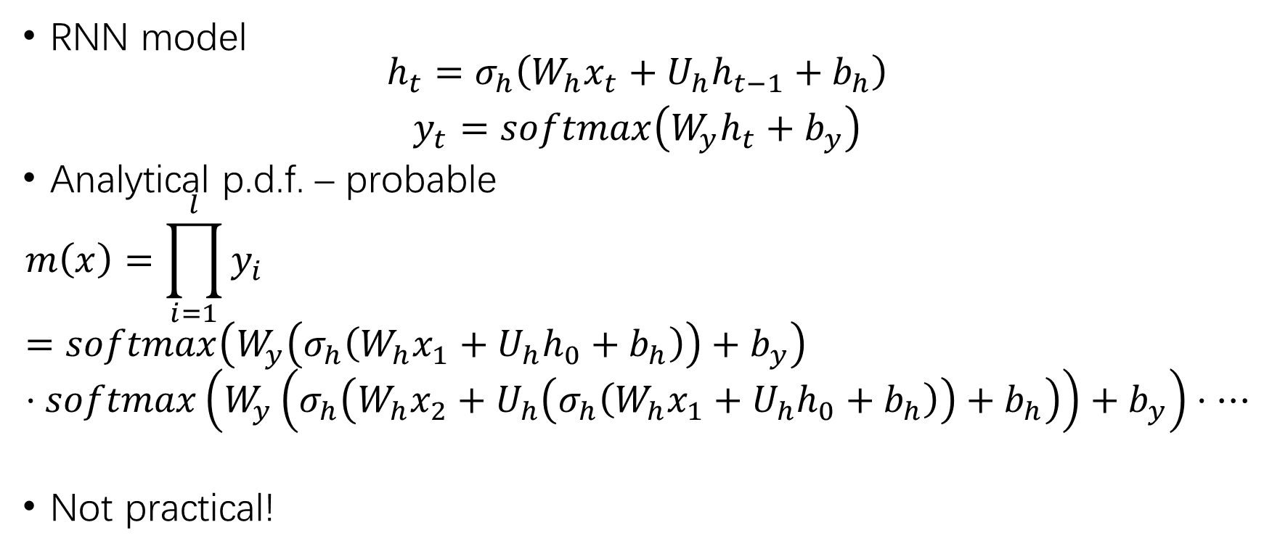
Are NNs black box p.d.f. calculators?
RNN model
$$\begin{matrix}h_{t}=σ_{h}\left(W_{h}x_{t}+U_{h}h_{t−1}+b_{h}\right) \\ y_{t}=softmax\left(W_{y}h_{t}+b_{y}\right)\end{matrix}$$
Analytical p.d.f. – probable
$$m\left(x\right)=\prod_{i=1}^{l}{y_{i}}=softmax\left(W_{y}\left(σ_{h}\left(W_{h}x_{1}+U_{h}h_{0}+b_{h}\right)\right)+b_{y}\right)⋅softmax\left(W_{y}\left(σ_{h}\left(W_{h}x_{2}+U_{h}\left(σ_{h}\left(W_{h}x_{1}+U_{h}h_{0}+b_{h}\right)\right)+b_{h}\right)\right)+b_{y}\right)⋅⋯$$
Not practical!

Slide 13
Overview
About sampling
Why sample from sequence space?
Markov chain Monte Carlo simulation
Metropolis-Hastings sampling
CGMH sampling
Gibbs sampling

Slide 14
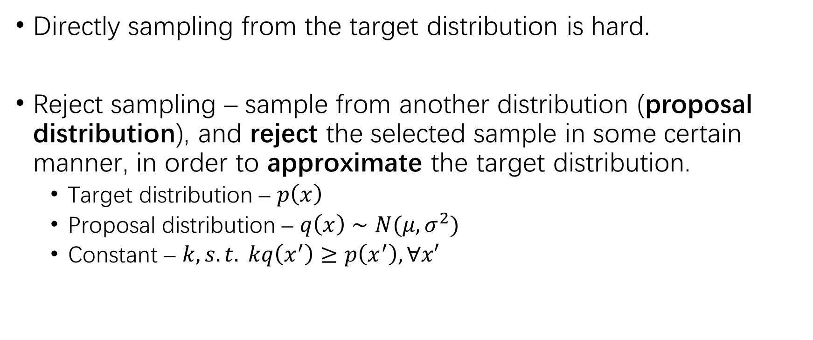
Monte Carlo simulation
Directly sampling from the target distribution is hard.
Reject sampling – sample from another distribution (proposal distribution), and reject the selected sample in some certain manner, in order to approximate the target distribution.
Target distribution – $p\left(x\right)$
Proposal distribution – $q\left(x\right)∼N(μ,σ^{2})$
Constant – $k, s.t. kq\left(x^{′}\right)≥p\left(x^{′}\right), ∀x′$

Slide 15

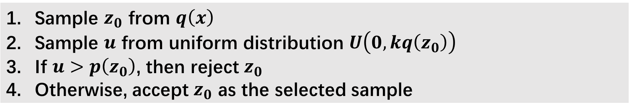

Monte Carlo simulation (2)
$prob\left(z_{0};q\right)=q\left(z_{0}\right)$
$prob\left(ACC | z_{0}\right)=\frac{p\left(z_{0}\right)}{k⋅q\left(z_{0}\right)}$
$prob\left(z_{0}|p\right)=p\left(z_{0}\right)=k⋅prob\left(z_{0}|q\right)⋅prob\left(ACC|z_{0}\right)$
Sample $z_{0}$ from $q\left(x\right)$ Sample $u$ from uniform distribution $U\left(0,kq\left(z_{0}\right)\right)$ If $u>p\left(z_{0}\right)$, then reject $z_{0}$ Otherwise, accept $z_{0}$ as the selected sample

Slide 16
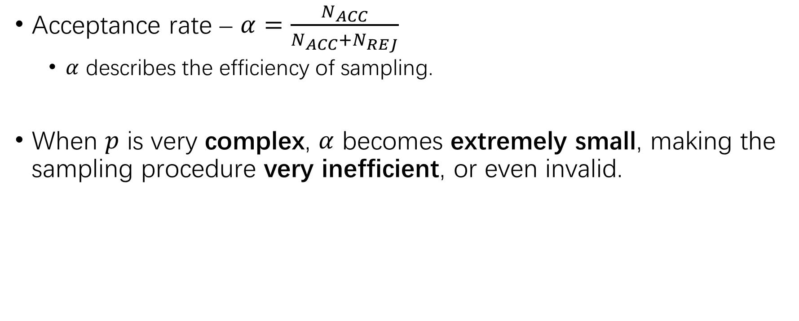
Monte Carlo simulation (3)
Acceptance rate – $α=\frac{N_{ACC}}{N_{ACC}+N_{REJ}}$
$α$ describes the efficiency of sampling.
When $p$ is very complex, $α$ becomes extremely small, making the sampling procedure very inefficient, or even invalid.

Slide 17
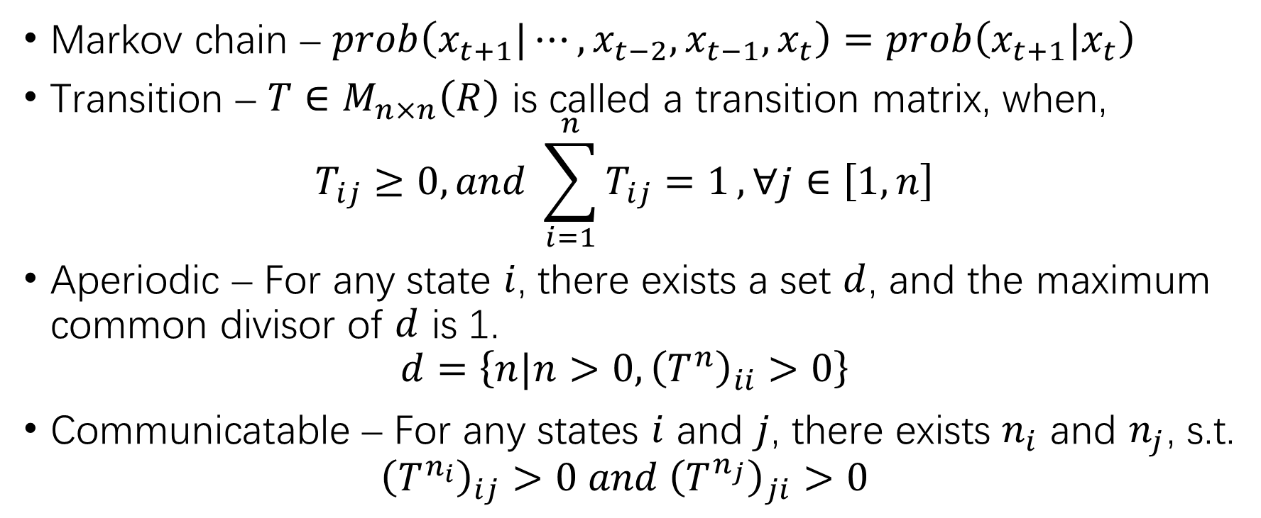
Markov chain simulation
Markov chain – $prob\left(x_{t+1}|⋯,x_{t−2},x_{t−1},x_{t}\right)=prob\left(x_{t+1}|x_{t}\right)$
Transition – $T∈M_{n×n}\left(R\right)$ is called a transition matrix, when,
$$T_{ij}≥0, and \sum_{i=1}^{n}{T_{ij}=1}, ∀j∈\left[1,n\right]$$
Aperiodic – For any state $i$, there exists a set $d$, and the maximum common divisor of $d$ is 1.
$$d=\left\{n|n>0,{\left(T^{n}\right)}_{ii}>0\right\}$$
Communicatable – For any states $i$ and $j$, there exists $n_{i}$ and $n_{j}$, s.t.
$${\left(T^{n_{i}}\right)}_{ij}>0 and {\left(T^{n_{j}}\right)}_{ji}>0$$

Slide 18

Markov chain simulation (2)
Convergence – If $T$ is aperiodic and communicatable, then,
$$\lim_{n→∞}{T^{n}=\left[\begin{matrix}π\left(1\right) & ⋯ & π\left(n\right) \\ ⋯ & ⋯ & ⋯ \\ π\left(1\right) & ⋯ & π\left(n\right)\end{matrix}\right]}$$
$$∃n_{0}, s.t. π_{n}\left(x\right)=π_{n+1}\left(x\right)=⋯=π\left(x\right),where$$
$$π_{i}\left(x\right)=π_{0}\left(x\right)T^{i}$$
$$\sum_{i=1}^{∞}{π\left(i\right)}=1$$

Slide 19
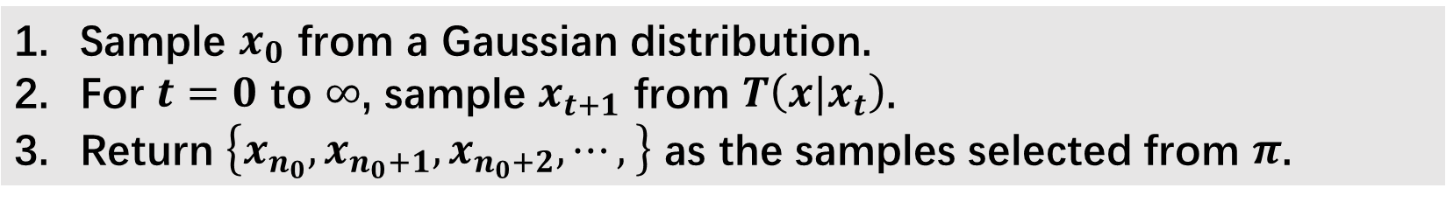

Markov chain simulation (3)
Suppose we have access to transition function $T$ and convergence iteration $n_{0}$ corresponding to any given stationary distribution $π$.
How to find $T$, given the stationary distribution $π$?
Not practical…
Sample $x_{0}$ from a Gaussian distribution. For $t=0$ to $∞$, sample $x_{t+1}$ from $T\left(x|x_{t}\right)$. Return $\left\{x_{n_{0}},x_{n_{0}+1},x_{n_{0}+2},⋯, \right\}$ as the samples selected from $π$.

Slide 20
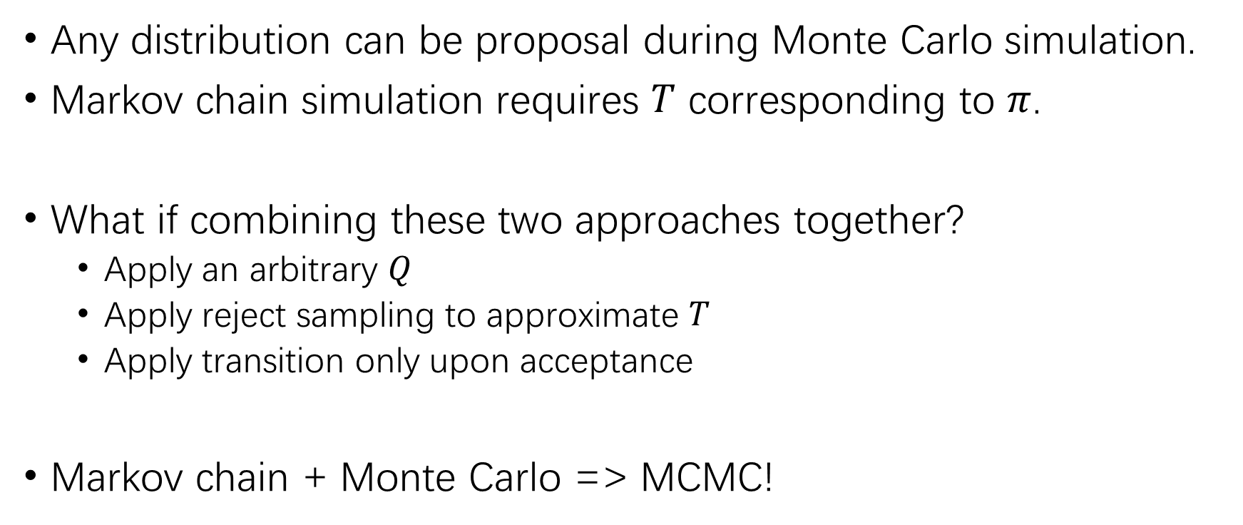
Markov chain Monte Carlo simulation
Any distribution can be proposal during Monte Carlo simulation.
Markov chain simulation requires $T$ corresponding to $π$.
What if combining these two approaches together?
Apply an arbitrary $Q$
Apply reject sampling to approximate $T$
Apply transition only upon acceptance
Markov chain + Monte Carlo => MCMC!

Slide 21
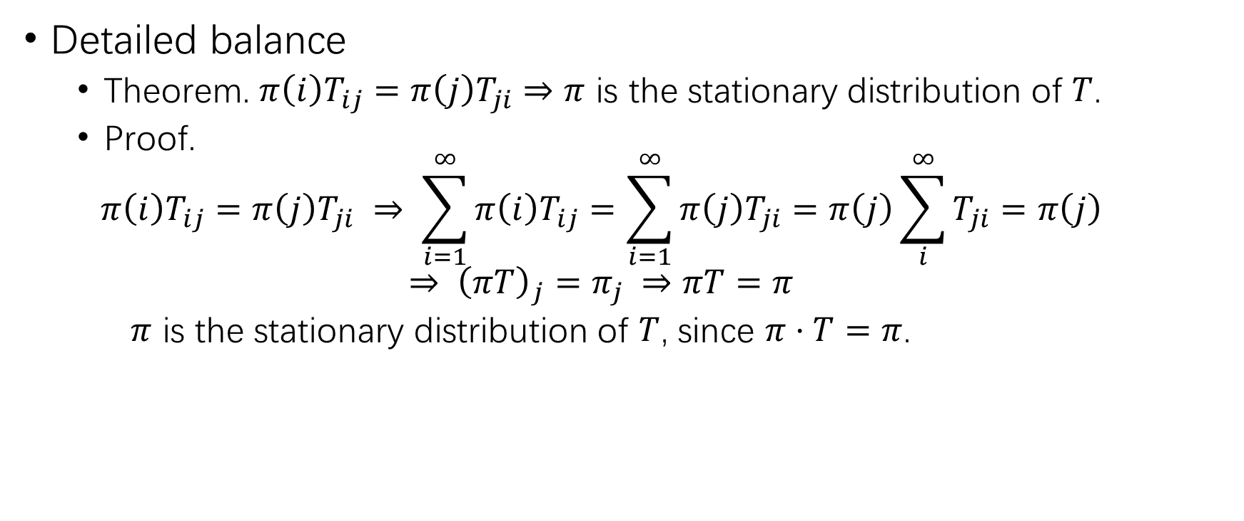
Markov chain Monte Carlo simulation (2)
Detailed balance
Theorem. $π\left(i\right)T_{ij}=π\left(j\right)T_{ji}⇒π$ is the stationary distribution of $T$.
Proof.
$$π\left(i\right)T_{ij}=π\left(j\right)T_{ji} ⇒ \sum_{i=1}^{∞}{π\left(i\right)T_{ij}=\sum_{i=1}^{∞}{π\left(j\right)T_{ji}}}=π\left(j\right)\sum_{i}^{∞}{T_{ji}}=π\left(j\right)$$
$$⇒ {\left(πT\right)}_{j}=π_{j} ⇒πT=π$$
$π$ is the stationary distribution of $T$, since $π⋅T=π$.

Slide 22
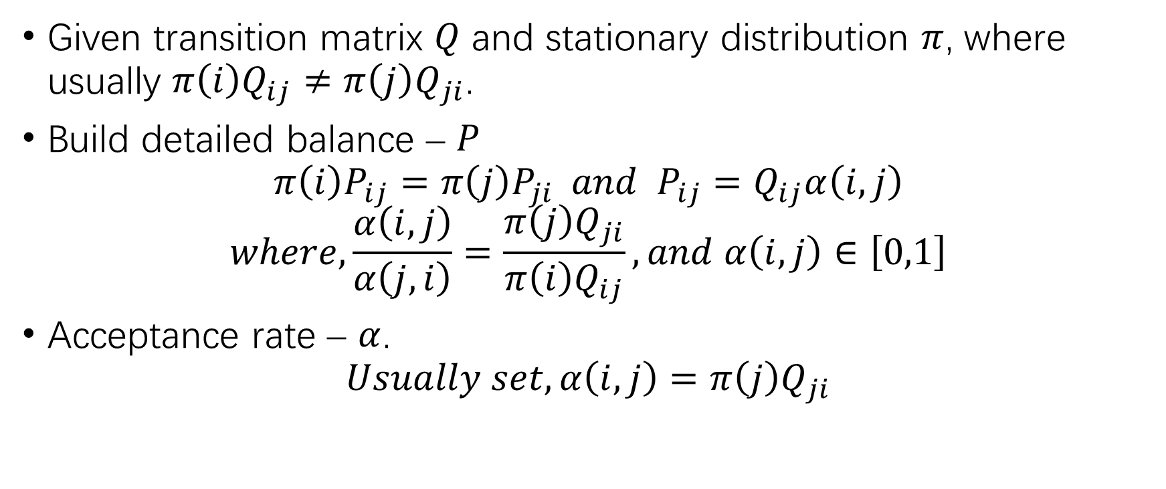
Markov chain Monte Carlo simulation (3)
Given transition matrix $Q$ and stationary distribution $π$, where usually $π\left(i\right)Q_{ij}≠π\left(j\right)Q_{ji}$.
Build detailed balance – $P$
$$π\left(i\right)P_{ij}=π\left(j\right)P_{ji} and P_{ij}=Q_{ij}α\left(i,j\right)$$
$$where,\frac{α\left(i,j\right)}{α\left(j,i\right)}=\frac{π\left(j\right)Q_{ji}}{π\left(i\right)Q_{ij}}, and α\left(i,j\right)∈\left[0,1\right]$$
Acceptance rate – $α$.
$$Usually set, α\left(i,j\right)=π\left(j\right)Q_{ji}$$

Slide 23
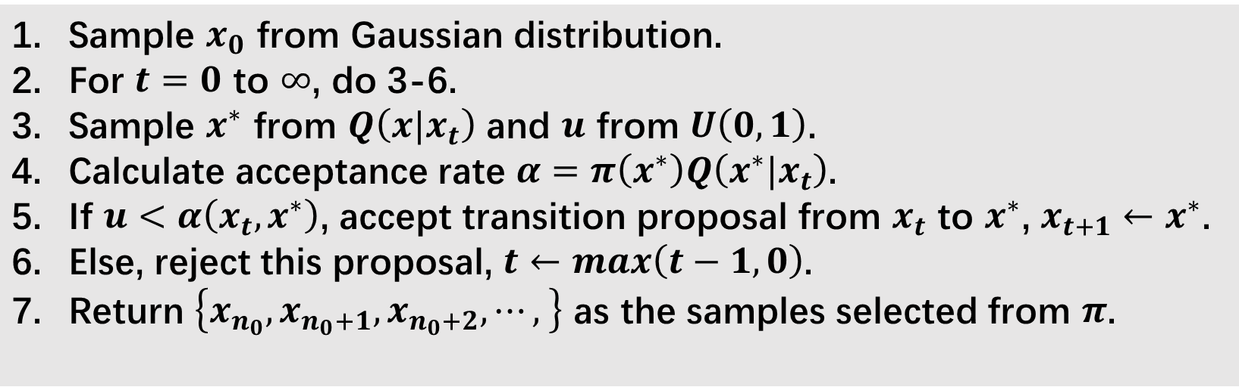

Markov chain Monte Carlo simulation (4)
Transition matrix – $Q$
Target/stationary distribution – $π$
Convergence iteration – $n_{0}$
Sample $x_{0}$ from Gaussian distribution. For $t=0$ to $∞$, do 3-6. Sample $x^{∗}$ from $Q\left(x|x_{t}\right)$ and $u$ from $U\left(0,1\right)$. Calculate acceptance rate $α=π\left(x^{∗}\right)Q\left(x^{∗}|x_{t}\right)$. If $u<α\left(x_{t},x^{∗}\right)$, accept transition proposal from $x_{t}$ to $x^{∗}$, $x_{t+1}←x^{∗}$. Else, reject this proposal, $t←max\left(t−1,0\right)$. Return $\left\{x_{n_{0}},x_{n_{0}+1},x_{n_{0}+2},⋯, \right\}$ as the samples selected from $π$.

Slide 24
Overview
About sampling
Why sample from sequence space?
Markov chain Monte Carlo simulation
Metropolis-Hastings sampling
CGMH sampling
Gibbs sampling

Slide 25
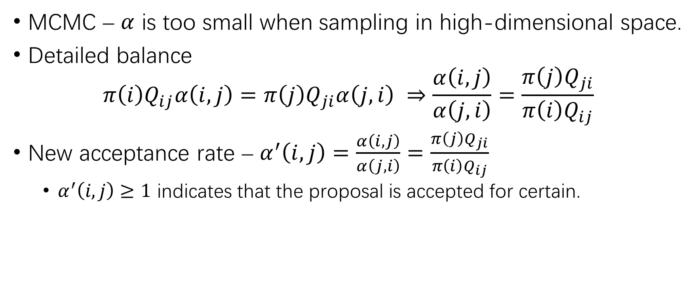
Metropolis-Hastings sampling
MCMC – $α$ is too small when sampling in high-dimensional space.
Detailed balance
$$π\left(i\right)Q_{ij}α\left(i,j\right)=π\left(j\right)Q_{ji}α\left(j,i\right) ⇒\frac{α\left(i,j\right)}{α\left(j,i\right)}=\frac{π\left(j\right)Q_{ji}}{π\left(i\right)Q_{ij}}$$
New acceptance rate – $α^{′}\left(i,j\right)=\frac{α\left(i,j\right)}{α\left(j,i\right)}=\frac{π\left(j\right)Q_{ji}}{π\left(i\right)Q_{ij}}$
$α^{′}\left(i,j\right)≥1$ indicates that the proposal is accepted for certain.

Slide 26
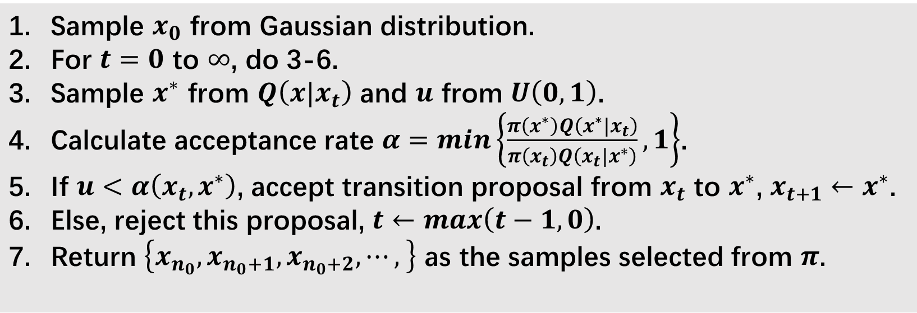
Metropolis-Hastings sampling (2)
Transition matrix – $Q$
Target/stationary distribution – $π$
Convergence iteration – $n_{0}$
Sample $x_{0}$ from Gaussian distribution. For $t=0$ to $∞$, do 3-6. Sample $x^{∗}$ from $Q\left(x|x_{t}\right)$ and $u$ from $U\left(0,1\right)$. Calculate acceptance rate $α=min\left\{\frac{π\left(x^{∗}\right)Q\left(x^{∗}|x_{t}\right)}{π\left(x_{t}\right)Q\left(x_{t}|x^{∗}\right)},1\right\}$. If $u<α\left(x_{t},x^{∗}\right)$, accept transition proposal from $x_{t}$ to $x^{∗}$, $x_{t+1}←x^{∗}$. Else, reject this proposal, $t←max\left(t−1,0\right)$. Return $\left\{x_{n_{0}},x_{n_{0}+1},x_{n_{0}+2},⋯, \right\}$ as the samples selected from $π$.

Slide 27
Overview
About sampling
Why sample from sequence space?
Markov chain Monte Carlo simulation
Metropolis-Hastings sampling
CGMH sampling
Gibbs sampling

Slide 28
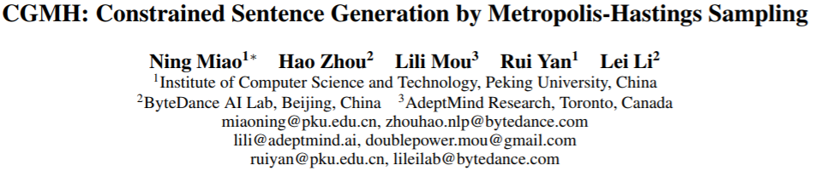

Slide 29
What does CGMH do?
Sample sentences from sentence distribution
Sentence – 𝑥=(𝑤_1,𝑤_2,⋯,𝑤_𝑛)
Sentence distribution – 𝜋
Language model
Proposals – word-level replacement, insertion and deletion
M-H sampling with some additional constraints.
Key words, semantic similarity, sentimental similarity, … …

Slide 30
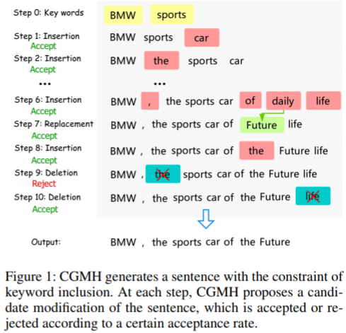

Slide 31
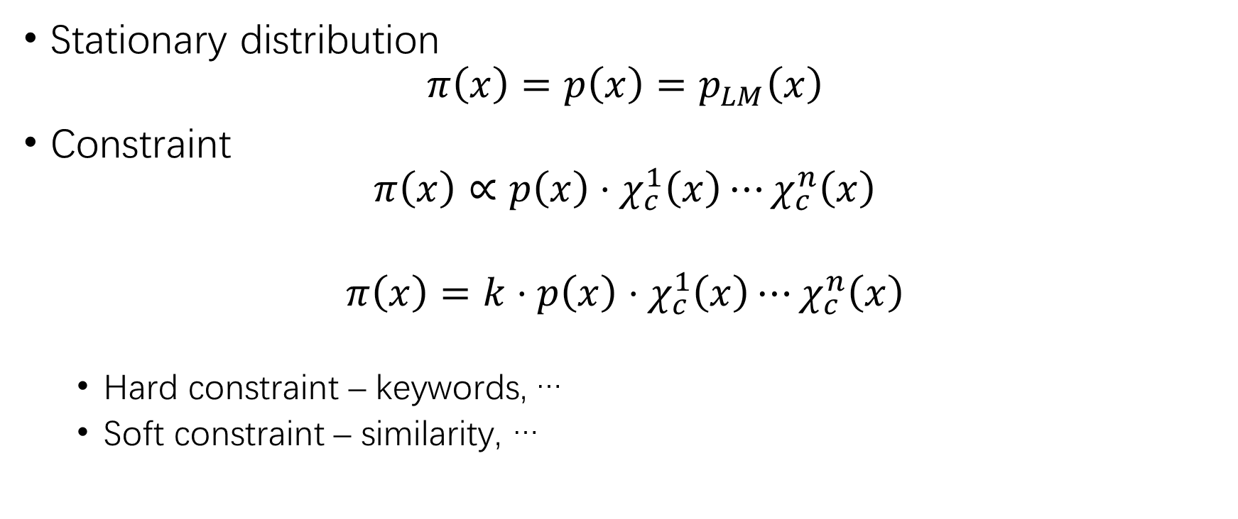
Stationary distribution
Stationary distribution
$$π\left(x\right)=p\left(x\right)=p_{LM}\left(x\right)$$
Constraint
$$π\left(x\right)∝p\left(x\right)⋅χ_{c}^{1}\left(x\right)⋯χ_{c}^{n}\left(x\right)$$
$$π\left(x\right)=k⋅p\left(x\right)⋅χ_{c}^{1}\left(x\right)⋯χ_{c}^{n}\left(x\right)$$
Hard constraint – keywords, …
Soft constraint – similarity, …

Slide 32
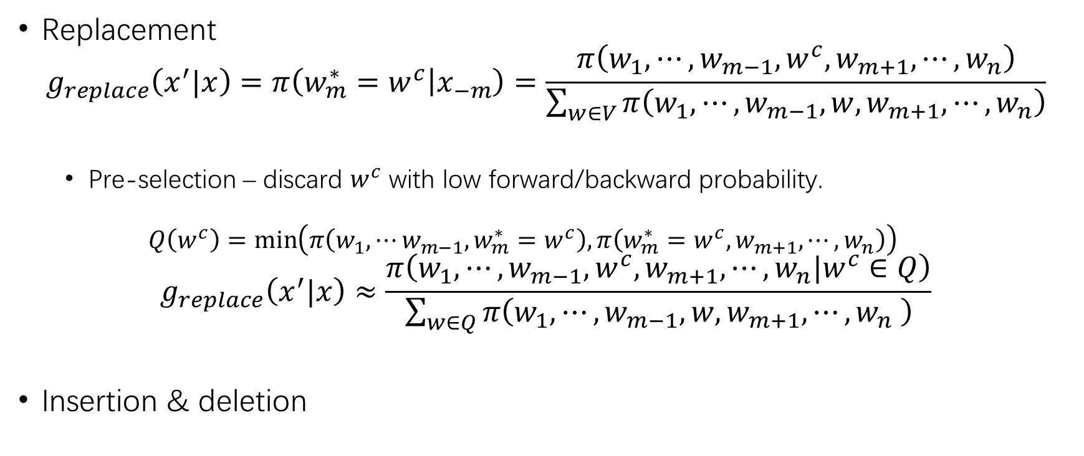
Proposals
Replacement
$$g_{replace}\left(x^{′}|x\right)=π\left(w_{m}^{∗}=w^{c} | x_{−m}\right)=\frac{π\left(w_{1},⋯,w_{m−1},w^{c},w_{m+1},⋯,w_{n}\right)}{\sum_{w∈V}{π\left(w_{1},⋯,w_{m−1},w,w_{m+1},⋯,w_{n}\right)}}$$
Pre-selection – discard $w^{c}$ with low forward/backward probability.
$$Q\left(w^{c}\right)=\min\left(π\left(w_{1},⋯w_{m−1},w_{m}^{∗}=w^{c}\right),π\left(w_{m}^{∗}=w^{c},w_{m+1},⋯,w_{n}\right)\right)$$
$$g_{replace}\left(x^{′}|x\right)≈\frac{π\left(w_{1},⋯,w_{m−1},w^{c},w_{m+1},⋯,w_{n}|w^{c}∈Q\right)}{\sum_{w∈Q}{π\left(w_{1},⋯,w_{m−1},w,w_{m+1},⋯,w_{n} \right)}}$$
Insertion & deletion

Slide 33
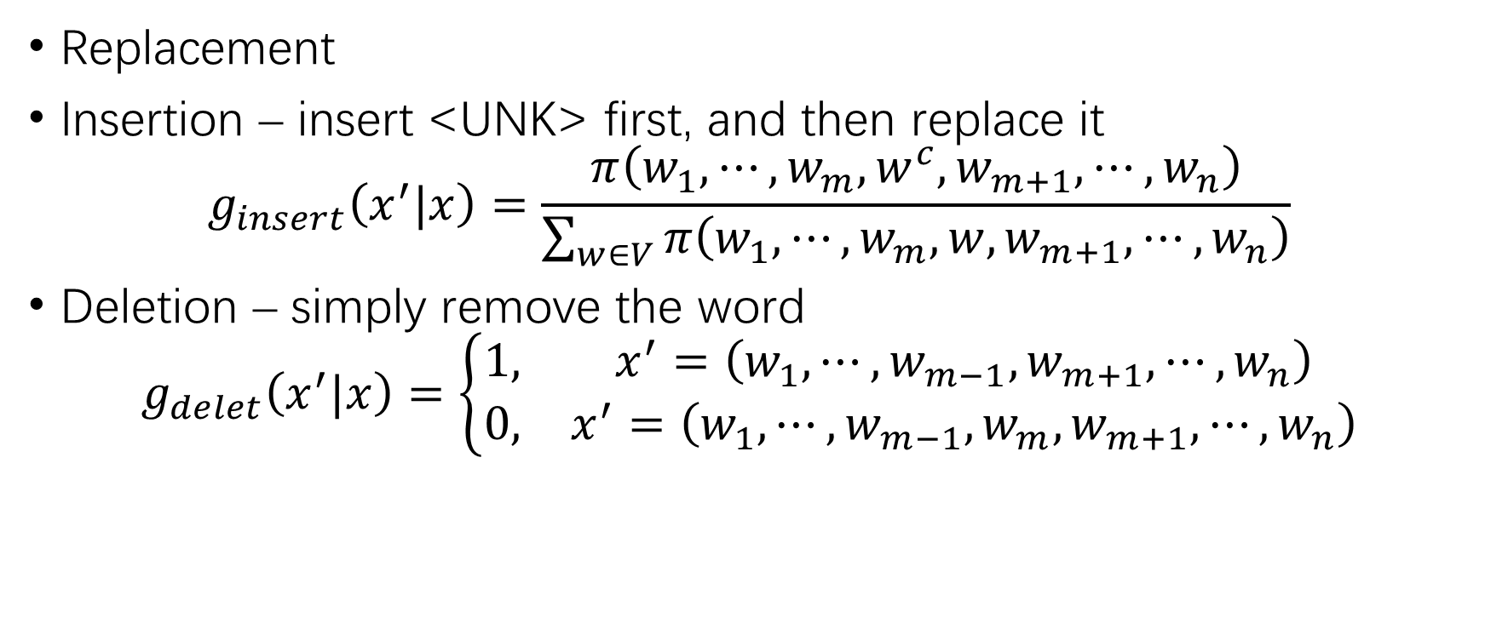
Proposals (2)
Replacement
Insertion – insert <UNK> first, and then replace it
$$g_{insert}\left(x^{′}|x\right)=\frac{π\left(w_{1},⋯,w_{m},w^{c},w_{m+1},⋯,w_{n}\right)}{\sum_{w∈V}{π\left(w_{1},⋯,w_{m},w,w_{m+1},⋯,w_{n}\right)}}$$
Deletion – simply remove the word
$$g_{delet}\left(x^{′}|x\right)=\left\{\begin{matrix}1, & x^{′}=\left(w_{1},⋯,w_{m−1},w_{m+1},⋯,w_{n}\right) \\ 0, & x^{′}=\left(w_{1},⋯,w_{m−1},w_{m},w_{m+1},⋯,w_{n}\right)\end{matrix}\right.$$

Slide 34
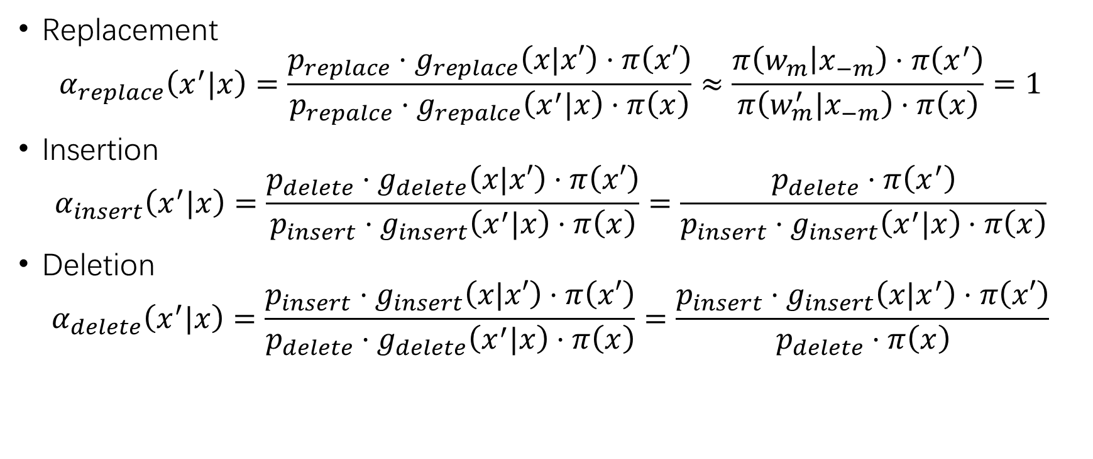
Acceptance rate
Replacement
$$α_{replace}\left(x^{′}|x\right)=\frac{p_{replace}⋅g_{replace}\left(x|x′\right)⋅π\left(x′\right)}{p_{repalce}⋅g_{repalce}\left(x^{′}|x\right)⋅π\left(x\right)}≈\frac{π\left(w_{m} | x_{−m}\right)⋅π\left(x^{′}\right)}{π\left(w_{m}^{′}|x_{−m}\right)⋅π\left(x\right)}=1$$
Insertion
$$α_{insert}\left(x^{′}|x\right)=\frac{p_{delete}⋅g_{delete}\left(x|x′\right)⋅π\left(x′\right)}{p_{insert}⋅g_{insert}\left(x^{′}|x\right)⋅π\left(x\right)}=\frac{p_{delete}⋅π\left(x^{′}\right)}{p_{insert}⋅g_{insert}\left(x^{′}|x\right)⋅π\left(x\right)}$$
Deletion
$$α_{delete}\left(x^{′}|x\right)=\frac{p_{insert}⋅g_{insert}\left(x|x′\right)⋅π\left(x′\right)}{p_{delete}⋅g_{delete}\left(x^{′}|x\right)⋅π\left(x\right)}=\frac{p_{insert}⋅g_{insert}\left(x|x^{′}\right)⋅π\left(x′\right)}{p_{delete}⋅π\left(x\right)}$$

Slide 35
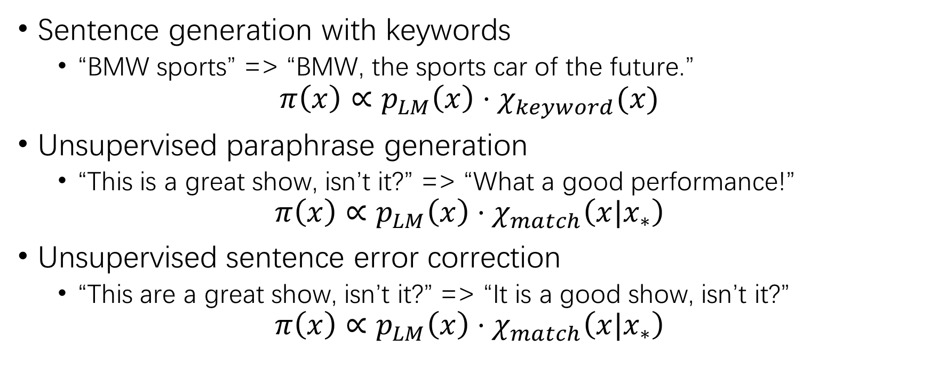
Experiment setting
Sentence generation with keywords
“BMW sports” => “BMW, the sports car of the future.”
$$π\left(x\right)∝p_{LM}\left(x\right)⋅χ_{keyword}(x)$$
Unsupervised paraphrase generation
“This is a great show, isn’t it?” => “What a good performance!”
$$π\left(x\right)∝p_{LM}\left(x\right)⋅χ_{match}\left(x|x_{∗}\right)$$
Unsupervised sentence error correction
“This are a great show, isn’t it?” => “It is a good show, isn’t it?”
$$π\left(x\right)∝p_{LM}\left(x\right)⋅χ_{match}\left(x|x_{∗}\right)$$

Slide 36
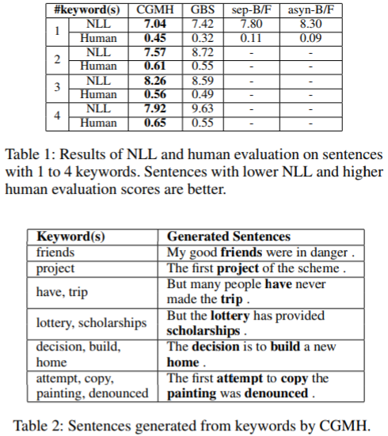
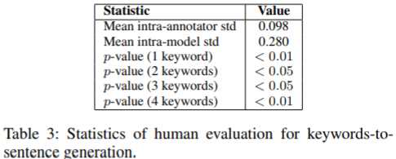
Experimental result
Sentence generation with keywords

Slide 37
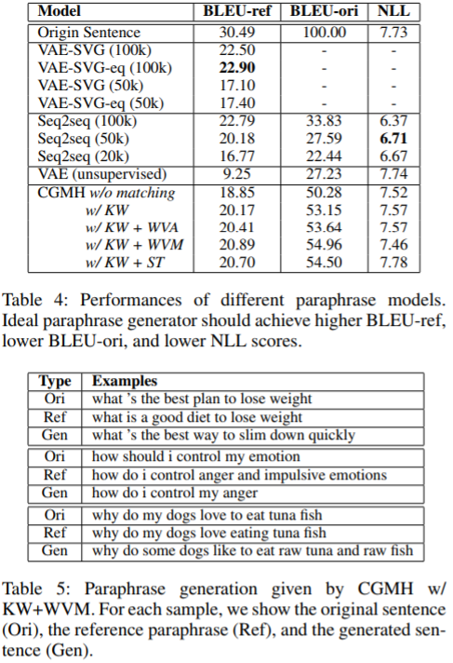
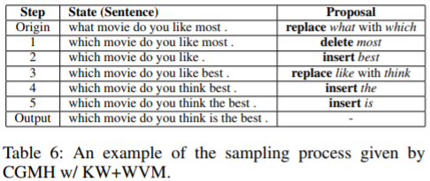
Experimental result (2)
Unsupervised paraphrase generation

Slide 38
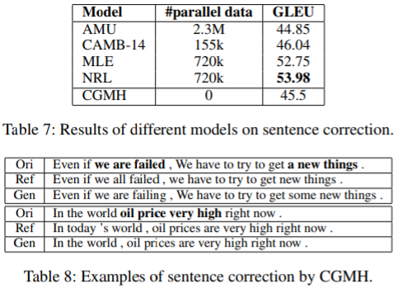
Experimental result (3)
Unsupervised sentence error correction

Slide 39
Overview
About sampling
Why sample from sequence space?
Markov chain Monte Carlo simulation
Metropolis-Hastings sampling
CGMH sampling
Gibbs sampling

Slide 40
Gibbs sampling
To be continued…

Slide 41
THANK YOU!

