Slide 1
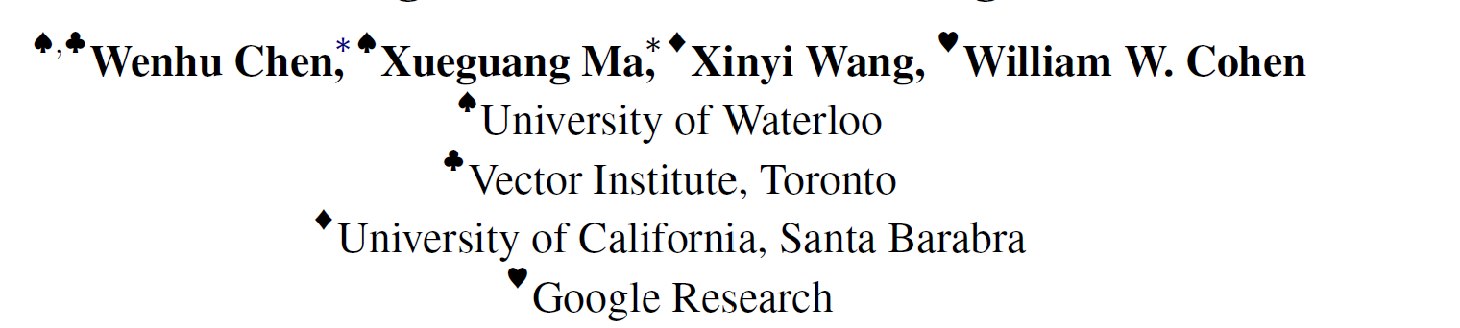
Program of Thoughts Prompting: Disentangling Computation from Reasoning for Numerical Reasoning Tasks

Slide 2
Motivation
CoT is the state-of-art method for many of numerical reasoning tasks
CoT uses LLMs for both reasoning and computation
LLMs cannot solve complex mathematical expressions like polynomial equations or even differential equations
LLMs are highly inefficient at expressing iteration
LLMs are very prone to arithmetic calculation errors

Slide 3
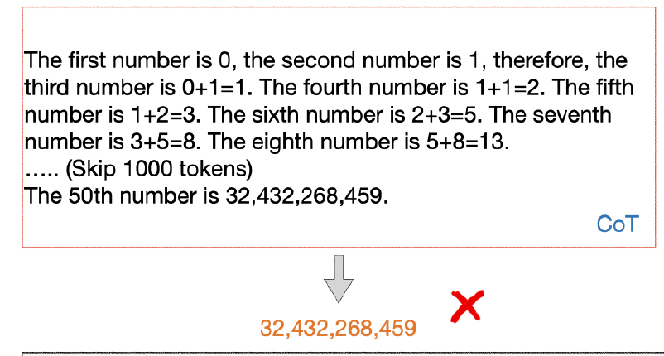
Motivation
The iteration runs for 50 times, which leads to extremely low accuracy

Slide 4
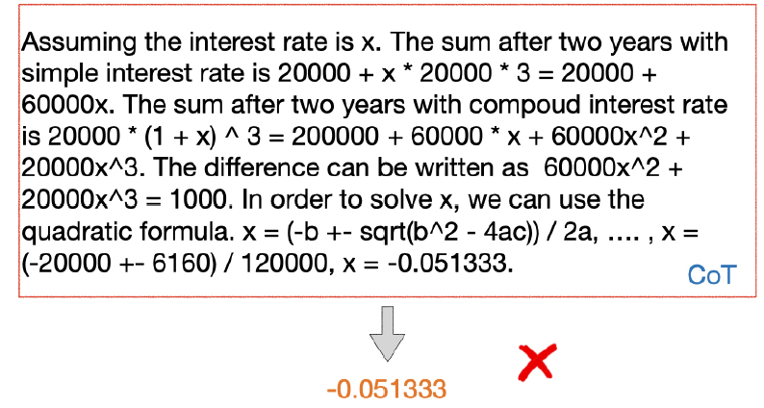
Motivation
CoT cannot solve the cubic equation with language models and outputs a wrong answer

Slide 5
Method
program-of-thoughts (PoT) prompting
LMs can express reasoning steps as Python programs, and the computation can be accomplished by a Python interpreter.

Slide 6
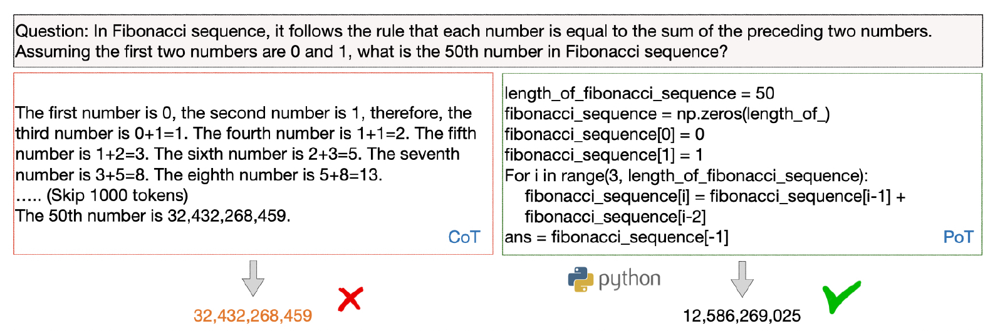
Method

Slide 7
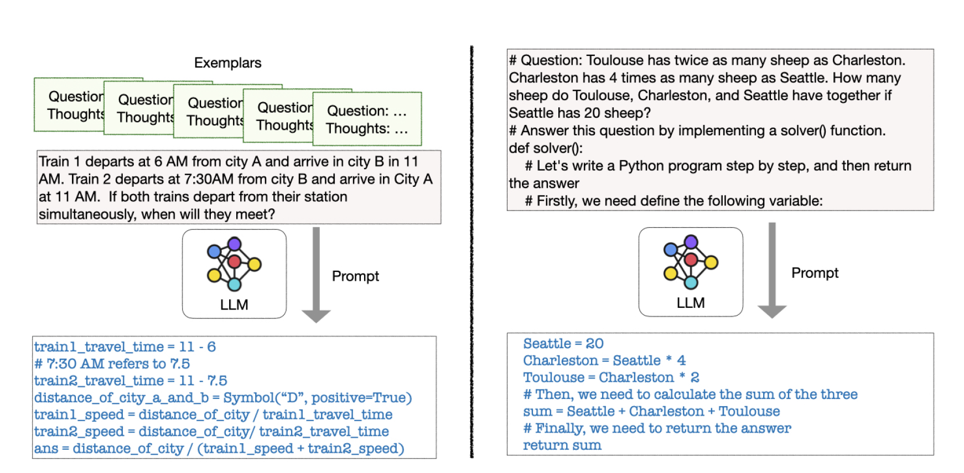
Method
Few-Shot
Zero-Shot

Slide 8
DataSet
Five math word problems datasets
GSM8K
AQuA
SVAMP
TabMWP
MultiArith
Three financial datasets
FinQA
ConvFinQA
TATQA

Slide 9
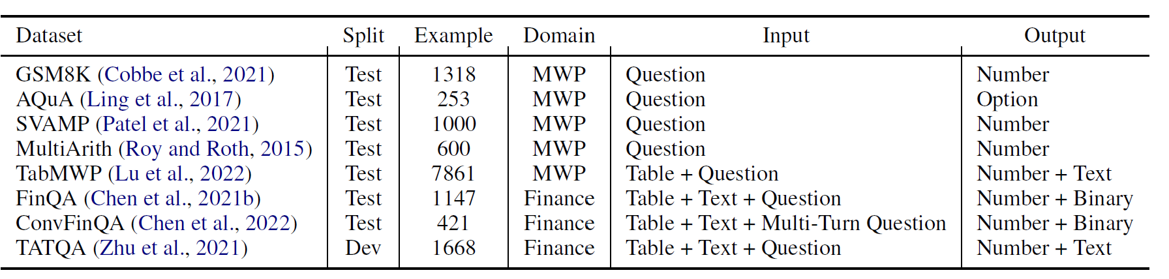
DataSet

Slide 10
Experiments
Linearize a table into a text string
The columns of the table are separated by ‘|’ and the rows are separated by ‘\n’
If a table cell is empty, it is filled by ’-’
Separate tables and text with ‘\n’
Separate conversation turns by ‘\n’
The prompt is constructed by the concatenation of task instruction, text, linearized table/all the dialog history, and question.

Slide 11
Experiments
Model
Codex (code-davinci-002)
GPT-3
Few shot:
1. Use 4-8 shots for all the datasets, based on their difficulty.
2. Generally write prompts for 10-20 examples, and then tune the exemplar selection on a small validation set to choose the best 4-8 shots for the full set evaluation

Slide 12
Experiments
Zero shot:
1. Use the text “Let’s write a Python program step by step" as prompt.
2. Suppress the ‘#’ token logits by -2.
(LLM can fall back to generating a reasoning chain in comments rather than in program.)

Slide 13
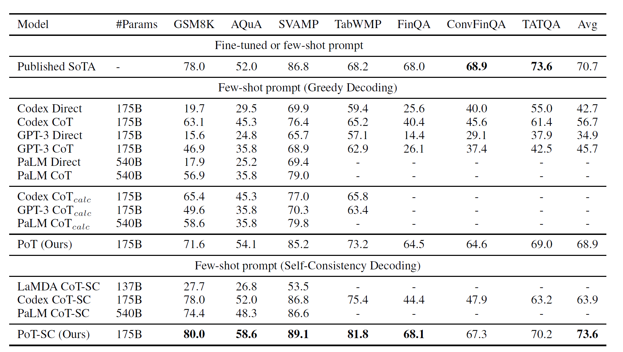
Results
Few Shot

Slide 14
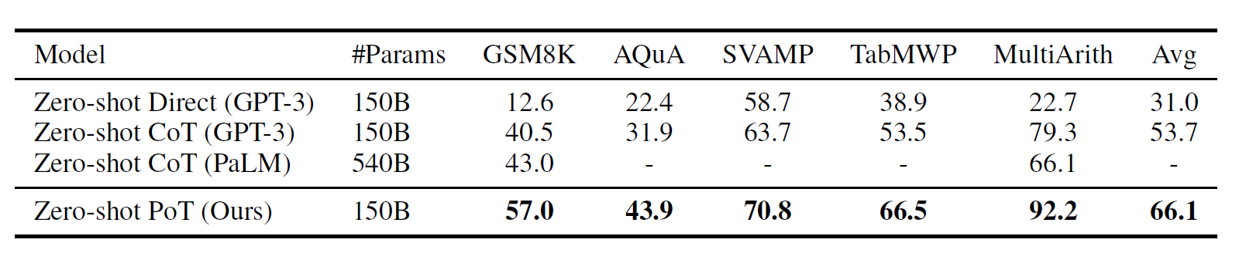
Results
Zero Shot

Slide 15
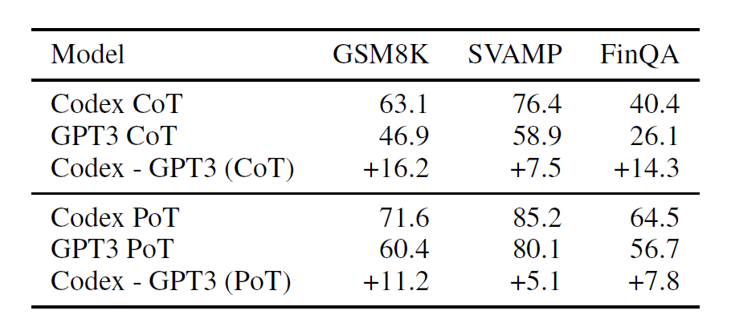
Ablation Studies
Backend GPT-3 vs. Codex

Slide 16
Ablation Studies
Sensitivity to Exemplars
20 total exemplars
For k-shot learning, randomly sample k = (2, 4, 6, 8) out of the 20 exemplars three times as v1, v2, and v3

Slide 17
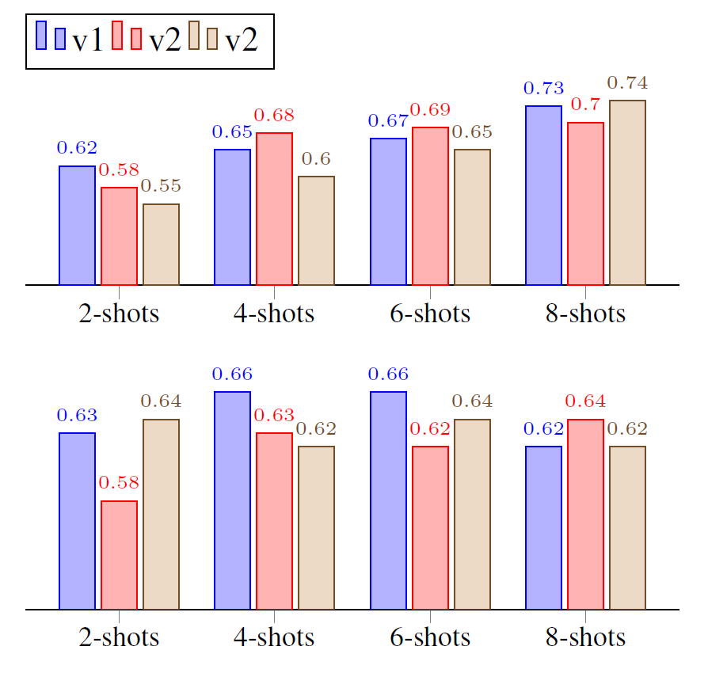
Ablation Studies
Sensitivity to Exemplars
GSM8K
FinQA

Slide 18
Ablation Studies
Semantic Binding and Multi-Step Reasoning
1.multiple steps: breaking down the thought
process into the step-by-step program
2.semantic binding: associating semantic meaning to the variable names

Slide 19
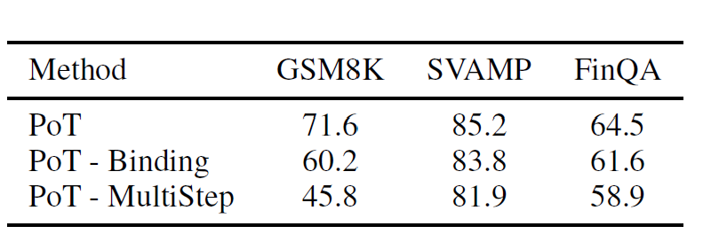
Ablation Studies
Semantic Binding and Multi-Step Reasoning
Binding:Simply use a; b; c as the variable names
MultiStep:Directly predict the final mathematical equation to compute the results

Slide 20
Ablation Studies
Which kinds of problems CoT and PoT differ most in performance

Slide 21
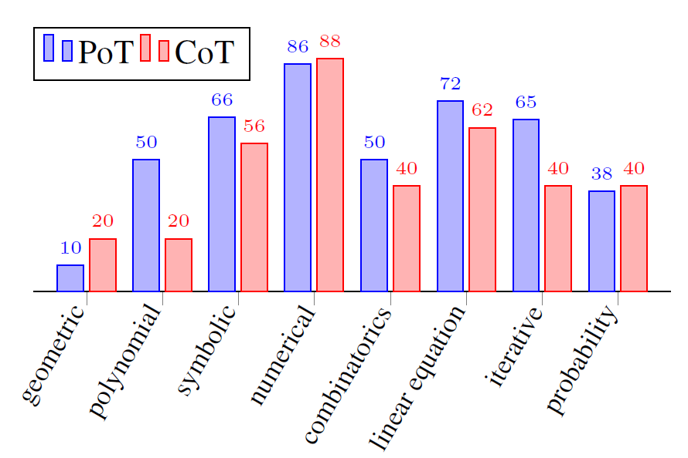
Ablation Studies
AQUA dataset
linear/polynomial equation
iterative
symbolic
combinatorics

Slide 22
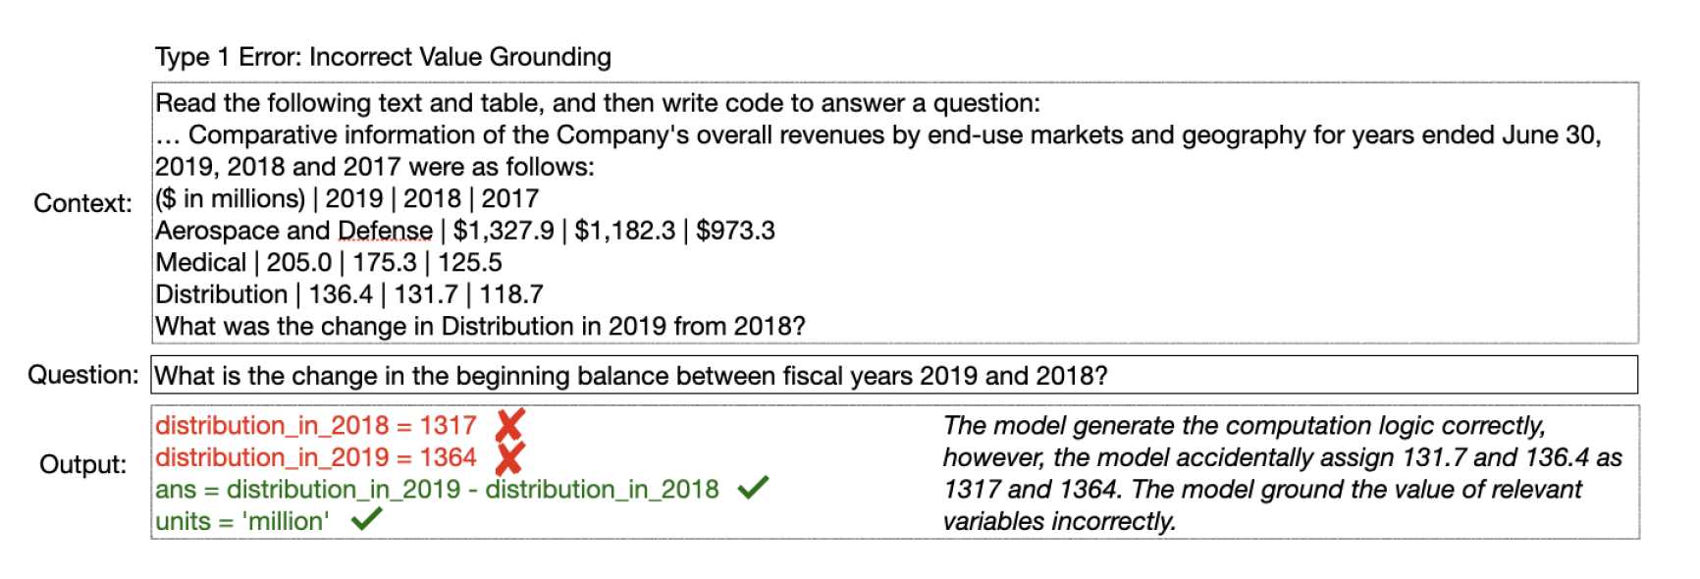
Error Analysis
value grounding error：the model fails to assign correct values to the variables relevant to the question.

Slide 23
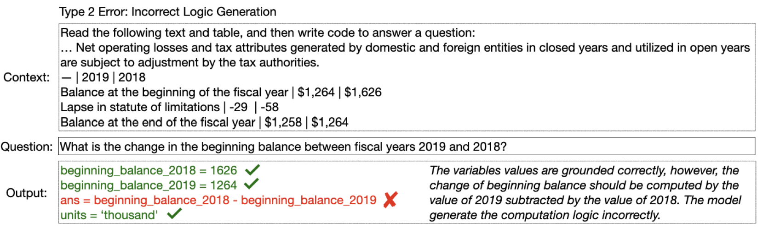
Error Analysis
2. model fails to generate the correct computation process

Slide 24
Error Analysis
TAT-QA dataset
198 errors
47 % value grounding error
33% logic errors
15% both
5% correct
The majority of the errors are value grounding errors

Slide 25
Conclusion
We investigate how to disentangle computation from reasoning in solving numerical problems
This approach is able to boost the state-of-the-art performance on several math datasets significantly

Slide 26
Thanks!

Slide 27
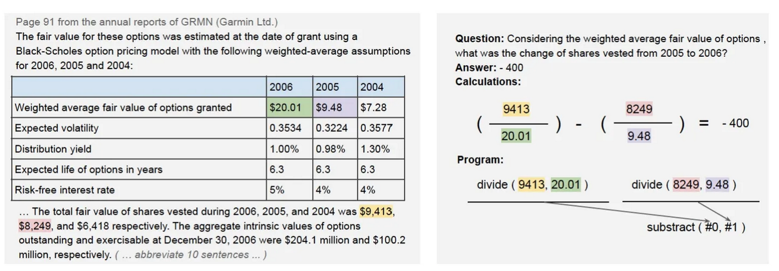
FinQA

