Slide 1
Adversary in Graph Neural Network
Zhang Huangzhao, zhang_hz@pku.edu.cn

Slide 2
Overview
Adversarial vulnerabilities of GNN
Difficulties in GNN adversarial learning
Preliminaries of GNN and its adversary
DefNet – Adversarial defense framework
Experiments

Slide 3
Adversarial Vulnerabilities
Graph domains – Social networks, protein-protein interaction networks, and information networks, et al.
Perturbations – Edge (adding/dropping) and node (feature perturbation).
Outcomes – Wrong classification, or erroneous representation, etc.

Slide 4
Adversarial Vulnerabilities (2)
A simple example…
If GNNs are adversarially vulnerable, why not employ adversarial learning to make it adversarially robust?

Slide 5
Difficulties
Vulnerability of the aggregation layer
Attack can be conducted without touching of the target node.
The aggregation layer computes node representations based on the context (neighbor nodes and connecting edges).
Vulnerability of the perceptron layer
Discrete space
Node feature matrix (sometimes)
Adjacent matrix

Slide 6
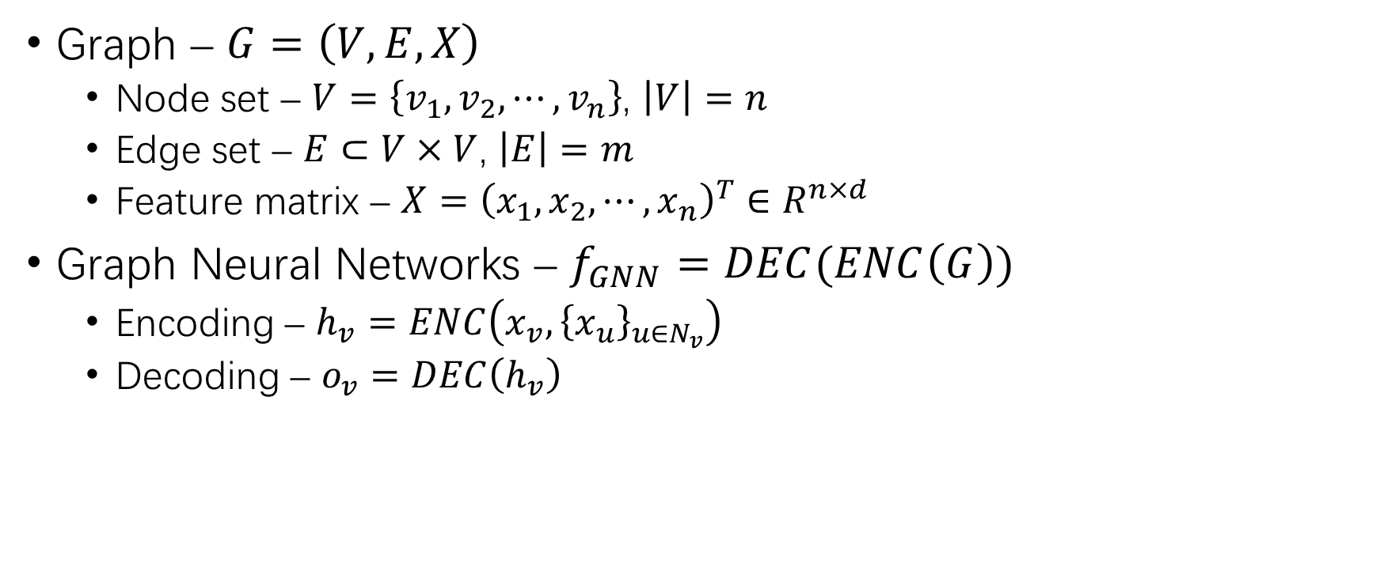
Preliminaries
Graph – $G=\left(V,E,X\right)$
Node set – $V=\left\{v_{1},v_{2},⋯,v_{n}\right\}$, $\left|V\right|=n$
Edge set – $E⊂V×V$, $\left|E\right|=m$
Feature matrix – $X={\left(x_{1},x_{2},⋯,x_{n}\right)}^{T}∈R^{n×d}$
Graph Neural Networks – $f_{GNN}=DEC(ENC\left(G\right))$
Encoding – $h_{v}=ENC\left(x_{v},{\left\{x_{u}\right\}}_{u∈N_{v}}\right)$
Decoding – $o_{v}=DEC\left(h_{v}\right)$

Slide 7
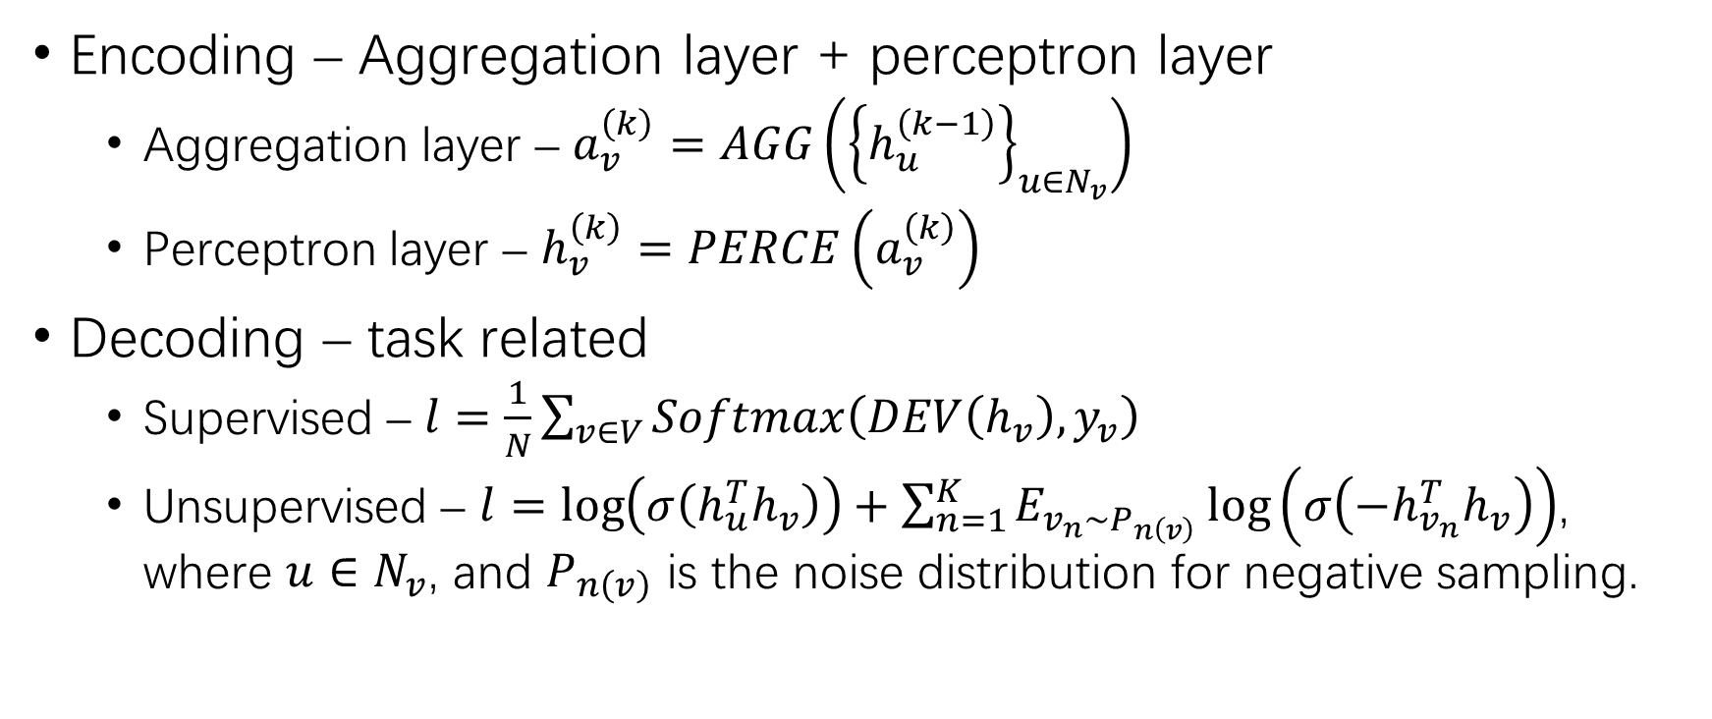
Preliminaries (2)
Encoding – Aggregation layer + perceptron layer
Aggregation layer – $a_{v}^{\left(k\right)}=AGG\left({\left\{h_{u}^{\left(k−1\right)}\right\}}_{u∈N_{v}}\right)$
Perceptron layer – $h_{v}^{\left(k\right)}=PERCE\left(a_{v}^{\left(k\right)}\right)$
Decoding – task related
Supervised – $l=\frac{1}{N}\sum_{v∈V}{Softmax\left(DEV\left(h_{v}\right),y_{v}\right)}$
Unsupervised – $l=\log\left(σ\left(h_{u}^{T}h_{v}\right)\right)+\sum_{n=1}^{K}{E_{v_{n}∼P_{n\left(v\right)}}\log\left(σ\left(−h_{v_{n}}^{T}h_{v}\right)\right)}$, where $u∈N_{v}$, and $P_{n\left(v\right)}$ is the noise distribution for negative sampling.

Slide 8
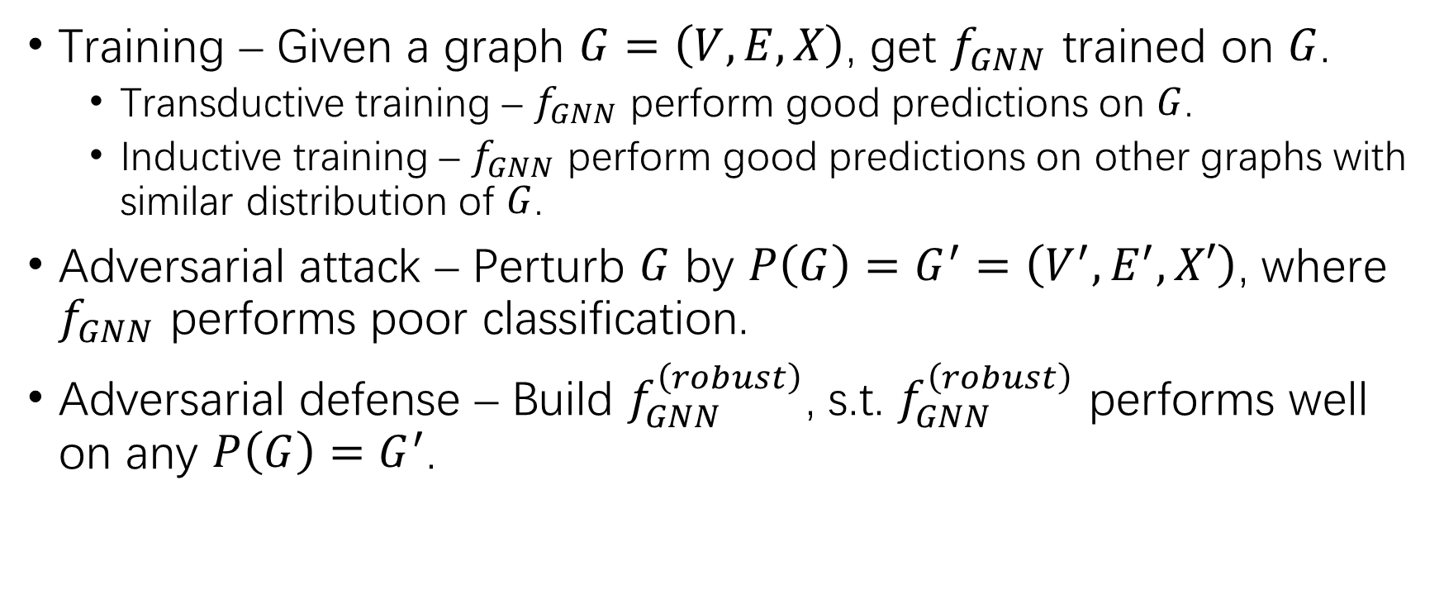
Preliminaries (3)
Training – Given a graph $G=\left(V,E,X\right)$, get $f_{GNN}$ trained on $G$.
Transductive training – $f_{GNN}$ perform good predictions on $G$.
Inductive training – $f_{GNN}$ perform good predictions on other graphs with similar distribution of $G$.
Adversarial attack – Perturb $G$ by $P\left(G\right)=G^{′}=\left(V^{′},E^{′},X′\right)$, where $f_{GNN}$ performs poor classification.
Adversarial defense – Build $f_{GNN}^{\left(robust\right)}$, s.t. $f_{GNN}^{\left(robust\right)}$ performs well on any $P\left(G\right)=G^{′}$.

Slide 9
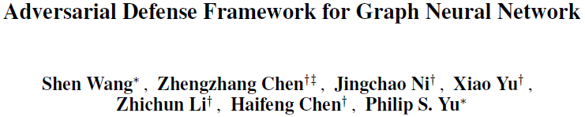

Slide 10
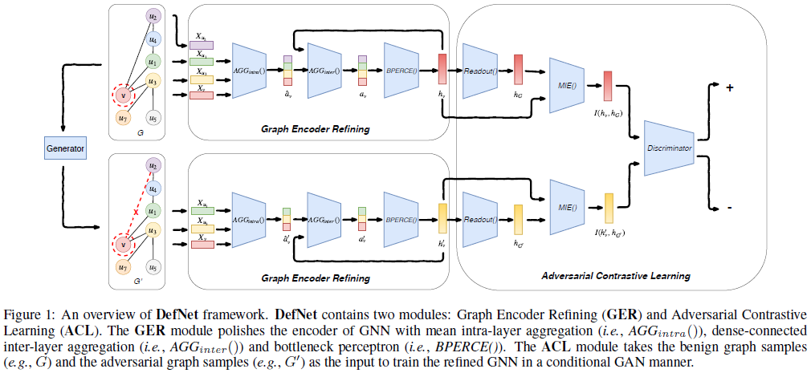
DefNet
Graph Encoder Refining – Examine the vulnerabilities in every layers of a GNN encoder.
Adversarial Contrastive Learning – Train the GNN to be more distinguishable between real benign samples and adversarial samples. (CGAN)

Slide 11
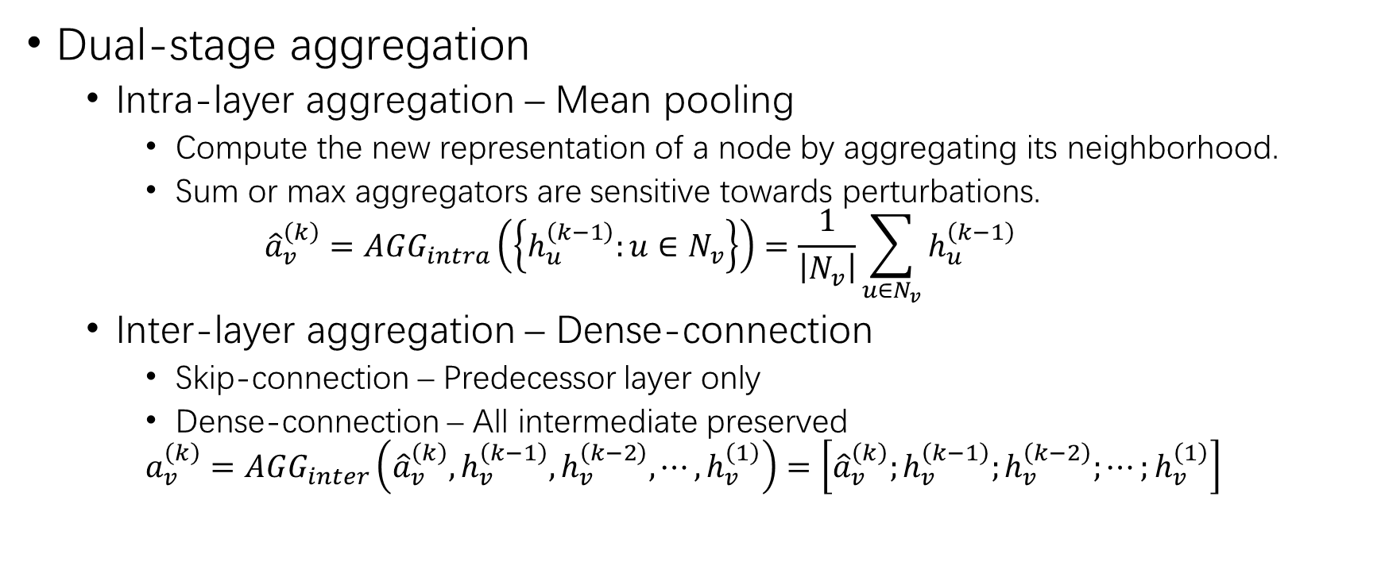
Graph Encoder Refining
Dual-stage aggregation
Intra-layer aggregation – Mean pooling
Compute the new representation of a node by aggregating its neighborhood.
Sum or max aggregators are sensitive towards perturbations.
$${\hat{a}}_{v}^{\left(k\right)}=AGG_{intra}\left(\left\{h_{u}^{\left(k−1\right)}:u∈N_{v}\right\}\right)=\frac{1}{\left|N_{v}\right|}\sum_{u∈N_{v}}{h_{u}^{\left(k−1\right)}}$$
Inter-layer aggregation – Dense-connection
Skip-connection – Predecessor layer only
Dense-connection – All intermediate preserved
$$a_{v}^{\left(k\right)}=AGG_{inter}\left({\hat{a}}_{v}^{\left(k\right)},h_{v}^{\left(k−1\right)},h_{v}^{\left(k−2\right)},⋯,h_{v}^{\left(1\right)}\right)=\left[{\hat{a}}_{v}^{\left(k\right)};h_{v}^{\left(k−1\right)};h_{v}^{\left(k−2\right)};⋯;h_{v}^{\left(1\right)}\right]$$

Slide 12
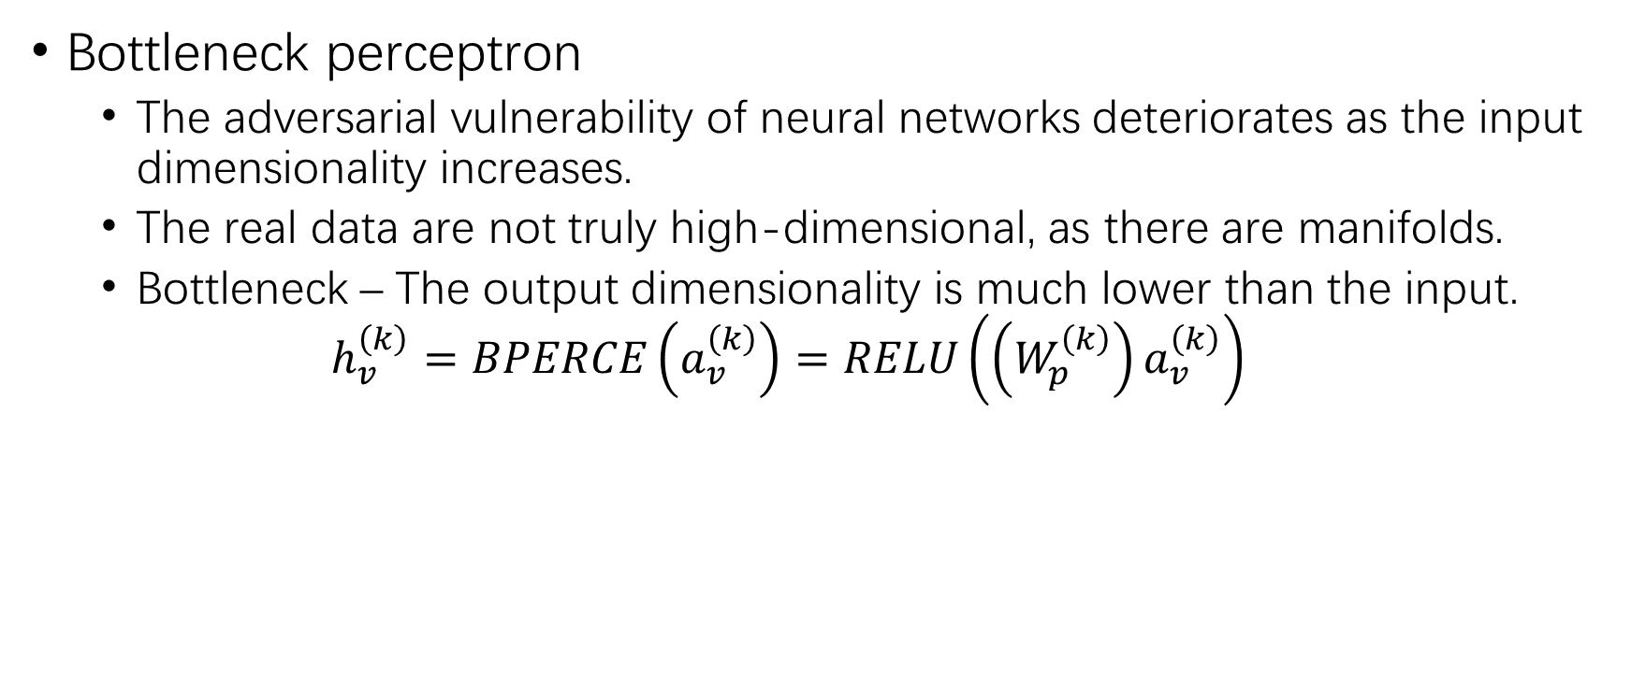
Graph Encoder Refining (2)
Bottleneck perceptron
The adversarial vulnerability of neural networks deteriorates as the input dimensionality increases.
The real data are not truly high-dimensional, as there are manifolds.
Bottleneck – The output dimensionality is much lower than the input.
$$h_{v}^{\left(k\right)}=BPERCE\left(a_{v}^{\left(k\right)}\right)=RELU\left(\left(W_{p}^{\left(k\right)}\right)a_{v}^{\left(k\right)}\right)$$

Slide 13
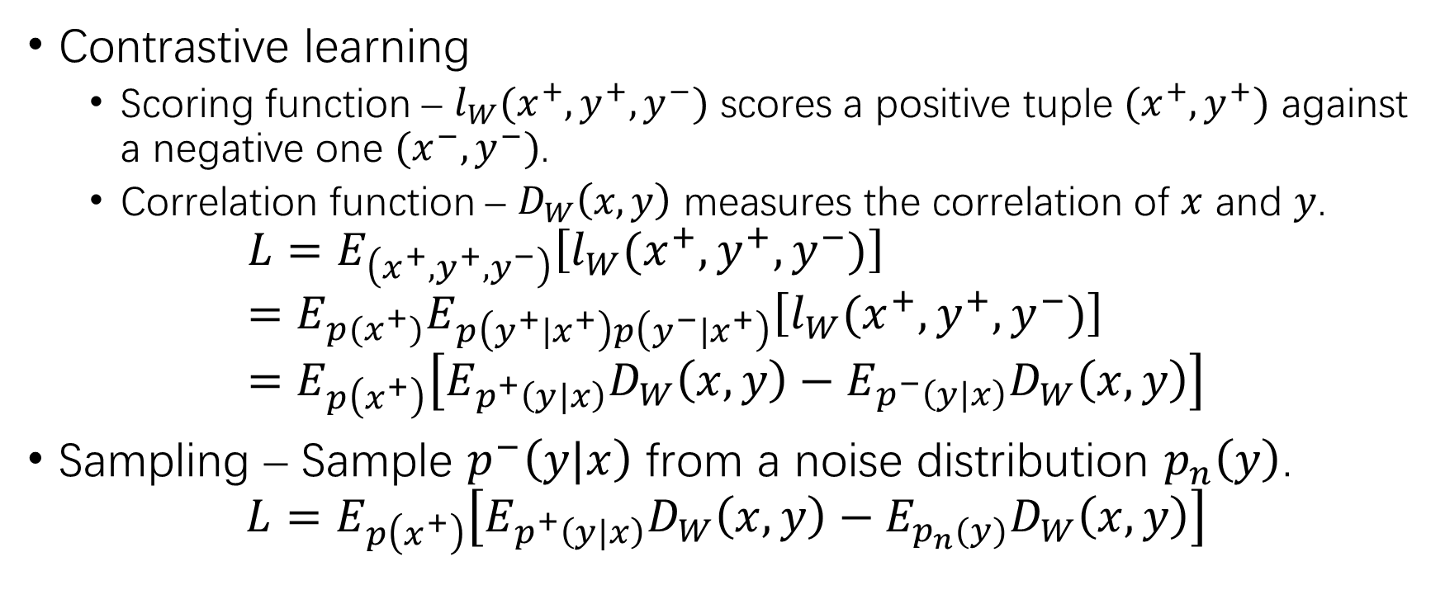
Adversarial Contrastive Learning
Contrastive learning
Scoring function – $l_{W}(x^{+},y^{+},y^{−})$ scores a positive tuple $(x^{+},y^{+})$ against a negative one $(x^{−},y^{−})$.
Correlation function – $D_{W}\left(x,y\right)$ measures the correlation of $x$ and $y$.
$$L=E_{\left(x^{+},y^{+},y^{−}\right)}\left[l_{W}(x^{+},y^{+},y^{−})\right]=E_{p(x^{+})}E_{p\left(y^{+}|x^{+}\right)p\left(y^{−}|x^{+}\right)}\left[l_{W}(x^{+},y^{+},y^{−})\right]=E_{p\left(x^{+}\right)}\left[E_{p^{+}\left(y|x\right)}D_{W}\left(x,y\right)−E_{p^{−}\left(y|x\right)}D_{W}\left(x,y\right)\right]$$
Sampling – Sample $p^{−}\left(y|x\right)$ from a noise distribution $p_{n}\left(y\right)$.
$$L=E_{p\left(x^{+}\right)}\left[E_{p^{+}\left(y|x\right)}D_{W}\left(x,y\right)−E_{p_{n}(y)}D_{W}\left(x,y\right)\right]$$

Slide 14
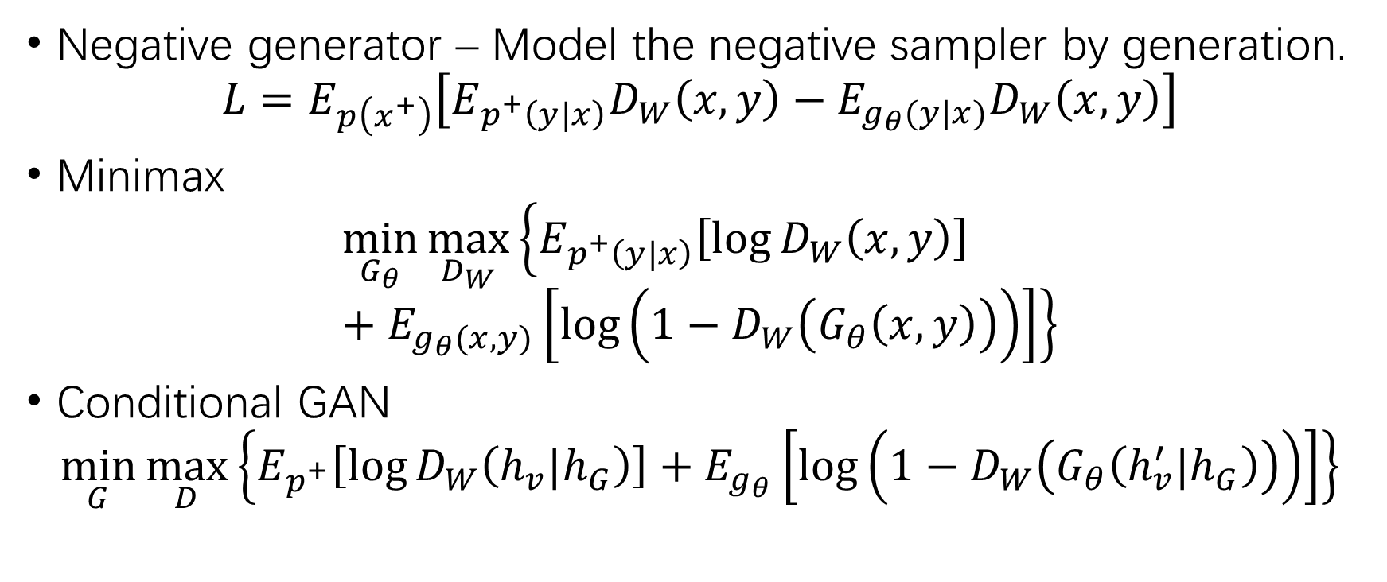
Adversarial Contrastive Learning (2)
Negative generator – Model the negative sampler by generation.
$$L=E_{p\left(x^{+}\right)}\left[E_{p^{+}\left(y|x\right)}D_{W}\left(x,y\right)−E_{g_{θ}(y|x)}D_{W}\left(x,y\right)\right]$$
Minimax
$$\min_{G_{θ}}{\max_{D_{W}}\left\{E_{p^{+}\left(y|x\right)}\left[\log{D_{W}\left(x,y\right)}\right]+E_{g_{θ}(x,y)}\left[\log\left(1−D_{W}\left(G_{θ}\left(x,y\right)\right)\right)\right]\right\}}$$
Conditional GAN
$$\min_{G}{\max_{D}\left\{E_{p^{+}}\left[\log{D_{W}\left(h_{v}|h_{G}\right)}\right]+E_{g_{θ}}\left[\log\left(1−D_{W}\left(G_{θ}\left(h_{v}^{′}|h_{G}\right)\right)\right)\right]\right\}}$$

Slide 15
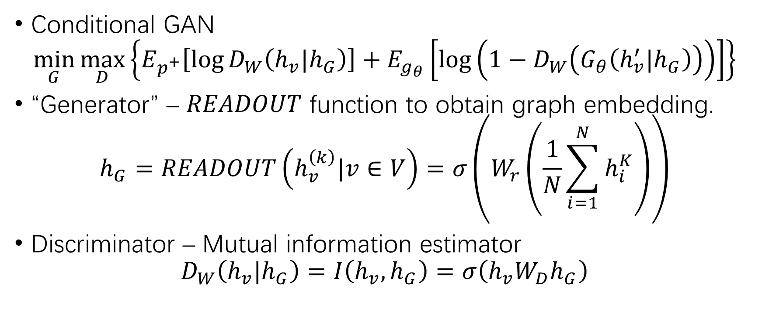
Adversarial Contrastive Learning (3)
Conditional GAN
$$\min_{G}{\max_{D}\left\{E_{p^{+}}\left[\log{D_{W}\left(h_{v}|h_{G}\right)}\right]+E_{g_{θ}}\left[\log\left(1−D_{W}\left(G_{θ}\left(h_{v}^{′}|h_{G}\right)\right)\right)\right]\right\}}$$
“Generator” – $READOUT$ function to obtain graph embedding.
$$h_{G}=READOUT\left(h_{v}^{\left(k\right)}|v∈V\right)=σ\left(W_{r}\left(\frac{1}{N}\sum_{i=1}^{N}{h_{i}^{K}}\right)\right)$$
Discriminator – Mutual information estimator
$$D_{W}\left(h_{v}|h_{G}\right)=I\left(h_{v},h_{G}\right)=σ\left(h_{v}W_{D}h_{G}\right)$$

Slide 16
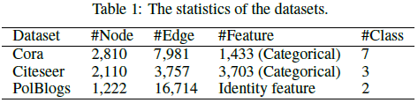
Experiments
Datasets
Attackers – Random, FGSM and NETTACK
Models – GCN and GraphSAGE

Slide 17
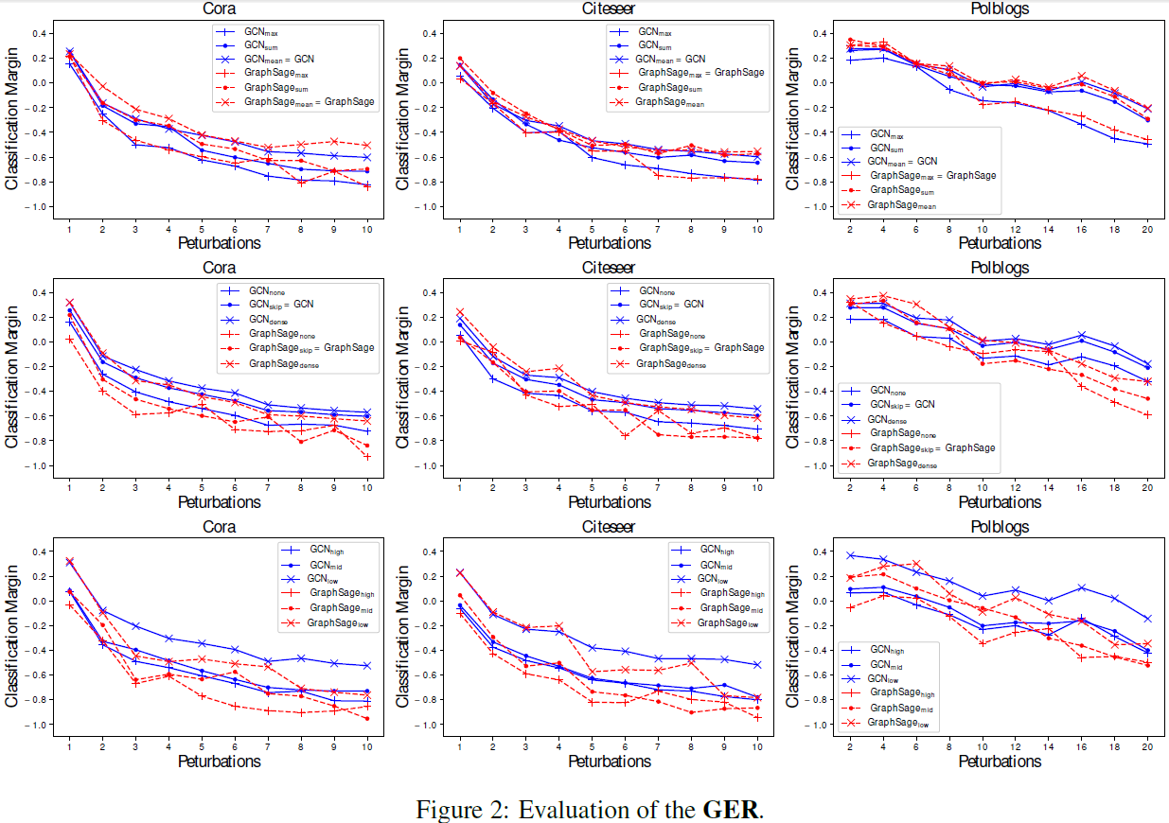
Experiments (2)
GER evaluation – 3 layer GCN & GraphSAGE. NETTACK attack.
The mean intra-aggregator outperforms the sum and max ones.
The dense interaggregator outperforms the case without the inter-aggregator and the skip inter-aggregator.
The lower dimension of the perceptron layer beats both the high and medium ones.

Slide 18
Experiments (3)
GER evaluation

Slide 19
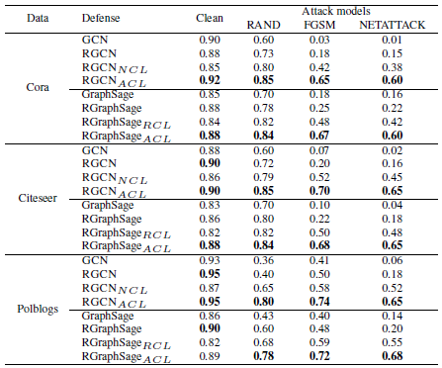
Experiments (4)
ACL evaluation

Slide 20
THANK YOU!

