Slide 1
Benchmark for Automated Proof Generation
Huangzhao Zhang
zhang_hz@pku.edu.cn

Slide 2
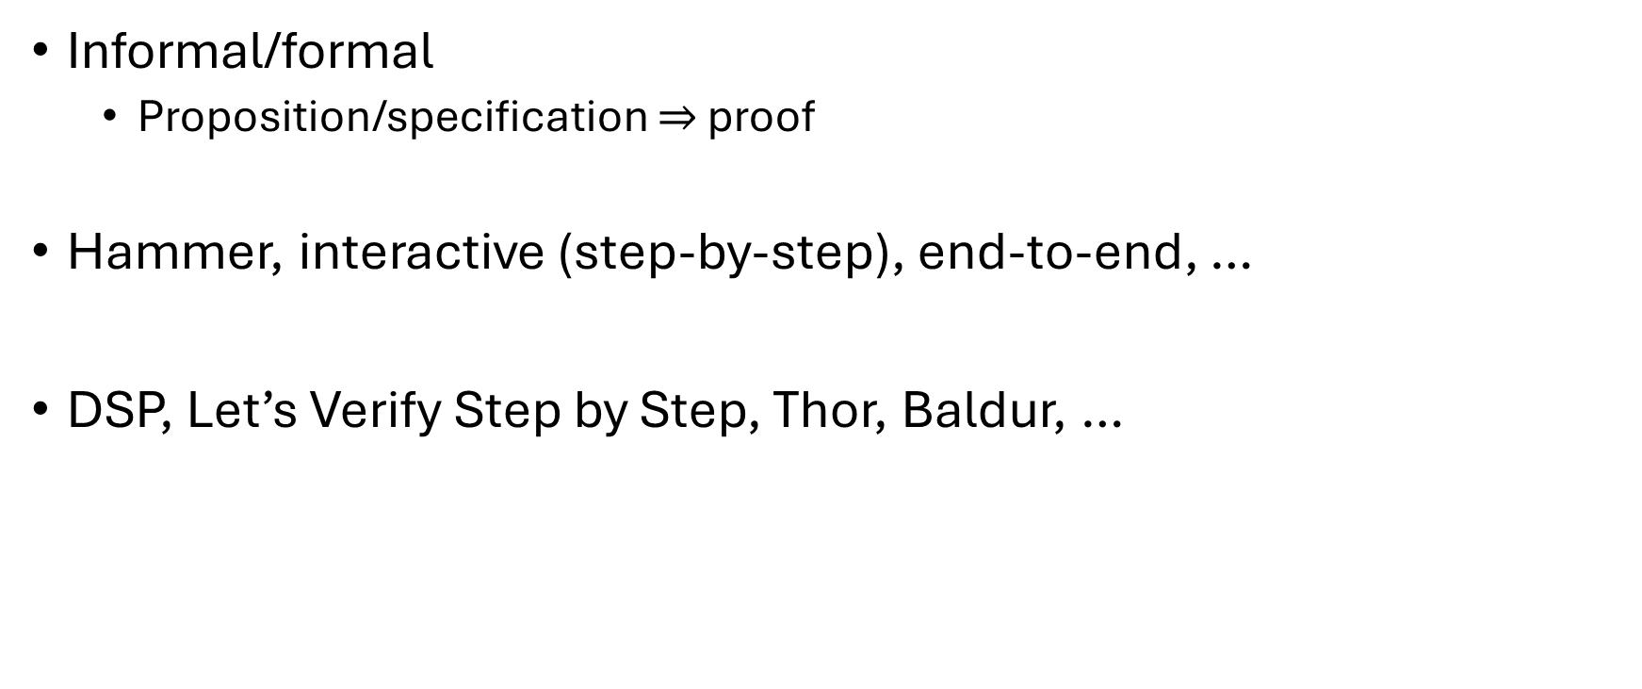
Automated Proof
Informal/formal
Proposition/specification $⇒$ proof
Hammer, interactive (step-by-step), end-to-end, …
DSP, Let’s Verify Step by Step, Thor, Baldur, …

Slide 3
Benchmark
Mathematical/general problem
PISA (AITP’2021)
MiniF2F (ICLR’22)
ProofNet (arXiv’23)
LeanDojo (NeurIPS’23)
Software verification
Clover (arXiv’2023)
Selene (arXiv’2024)

Slide 4
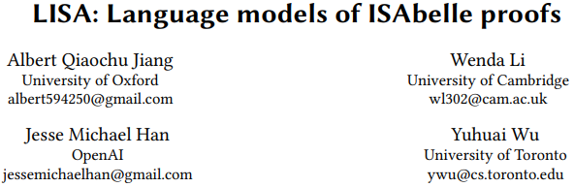

Slide 5
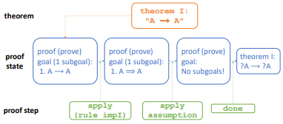
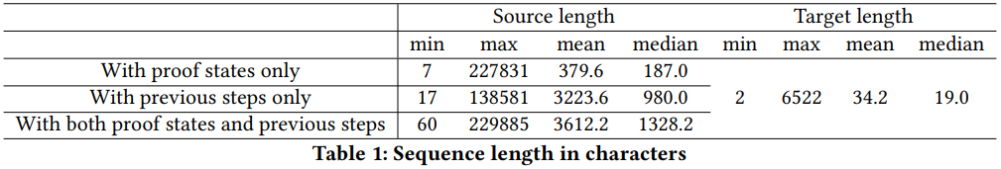
PISA
Proof-step dataset
Source
Isabelle standard library
Archive of Formal Proofs
Statistics
183K theorems, 2.16M input-proof state pairs
Train : valid : test – 95% : 1% : 4%

Slide 6
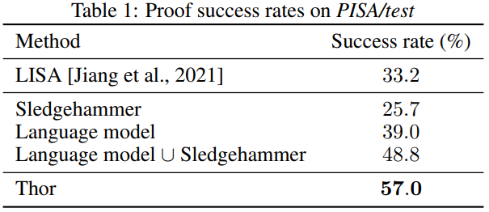
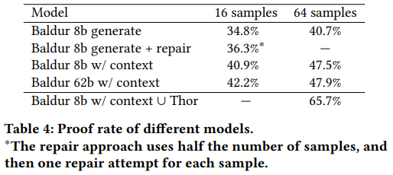
PISA (2)
Thor
Baldur

Slide 7
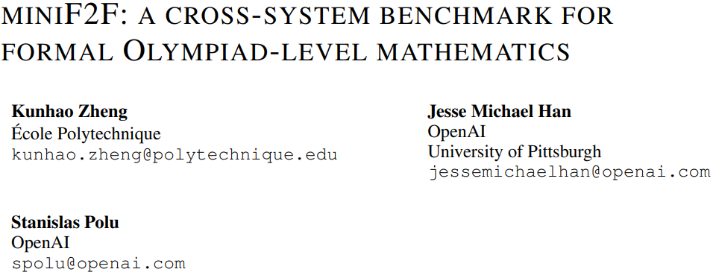

Slide 8
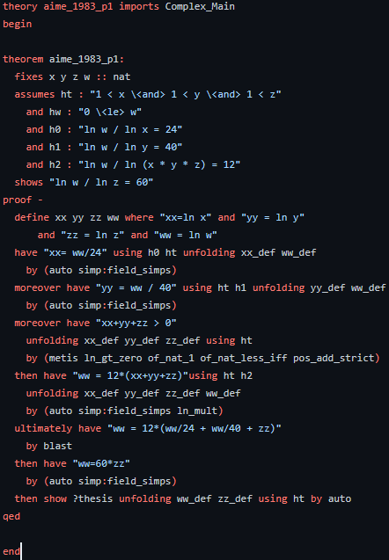
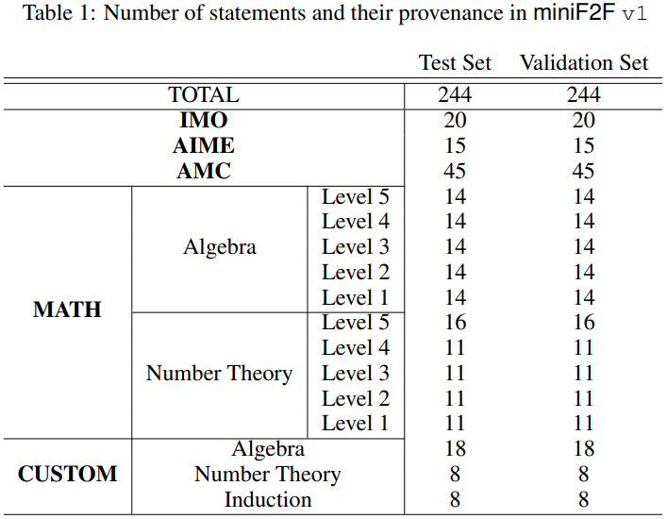
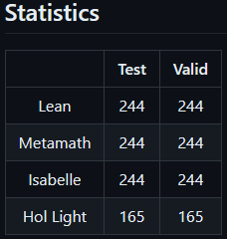
MiniF2F
AIME-1983-p1 (in Isabelle)
Proposition
Proof

Slide 9
MiniF2F (2)
Mathematical problem (informal)
Algebra, number theory, inequality, etc.
High school and undergraduate level exercise to Olympiad problems
Manual formalization
Cross-platform evaluation
Aligned in Lean, Metamath, Isabelle, and HOL-Light

Slide 10
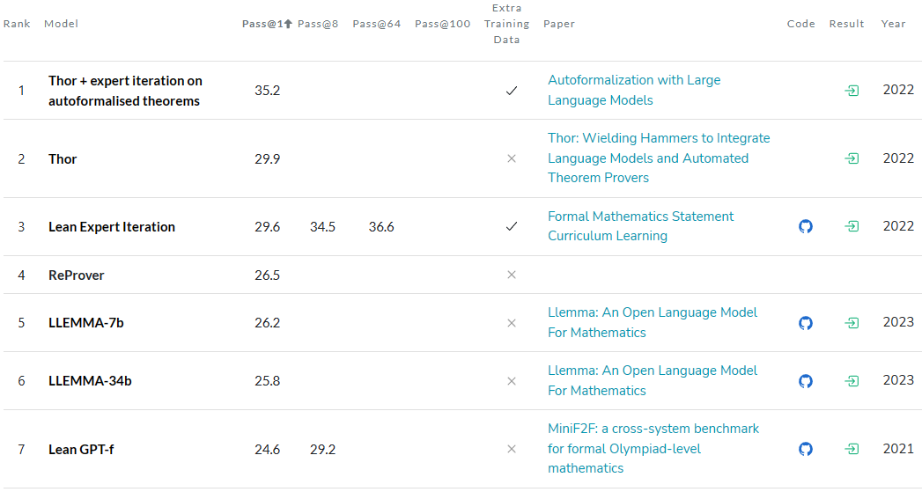
MiniF2F (3)

Slide 11
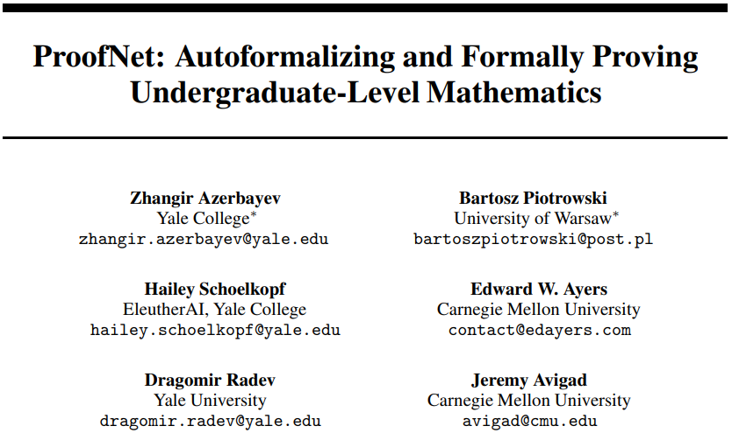

Slide 12
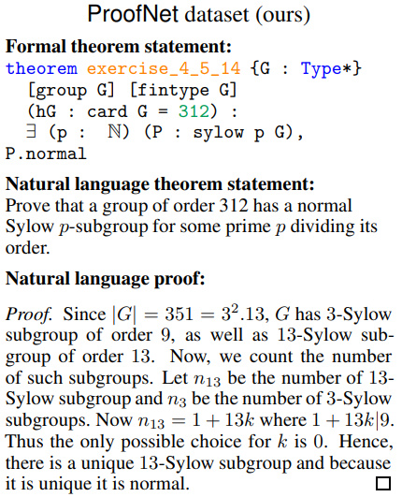
ProofNet
Source – Exercises in undergraduate textbooks
Mathematical analysis, linear algebra, topology, etc.
Statistics – 371 problems
Lean statement + NL statement + NL proof
Formal theorem proving
Informal theorem proving
Auto(in)formalization of statements
Autoformalization of proofs

Slide 13
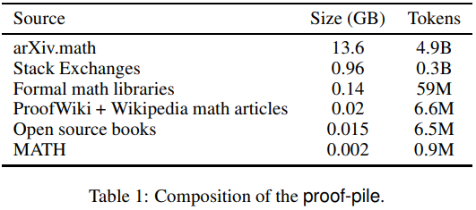
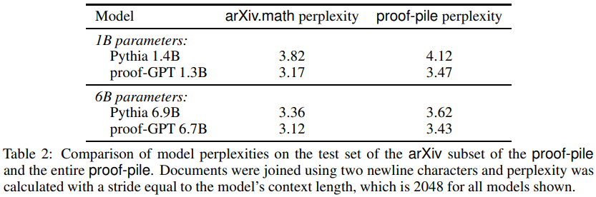
ProofGPT

Slide 14
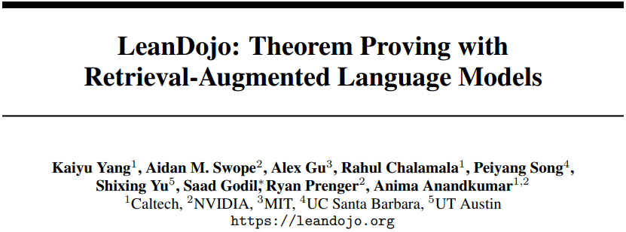

Slide 15
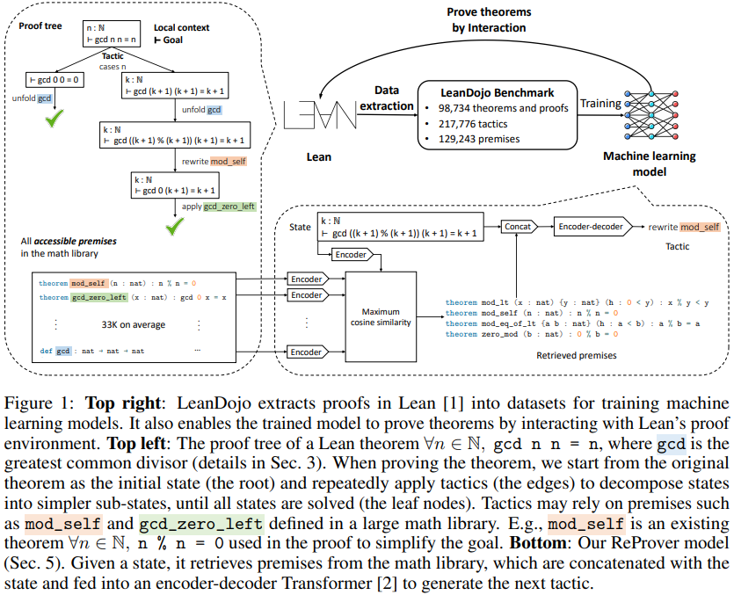
LeanDojo
Source – MathLib
Analysis, algebra, geometry, etc.
Largest math dataset
98,734 theorems from 3,384 files
130,262 premises (e.g., definition)
217,776 tactics
Train/valid/test – 94,734/2,000/2,000
Interactive environment with Lean

Slide 16
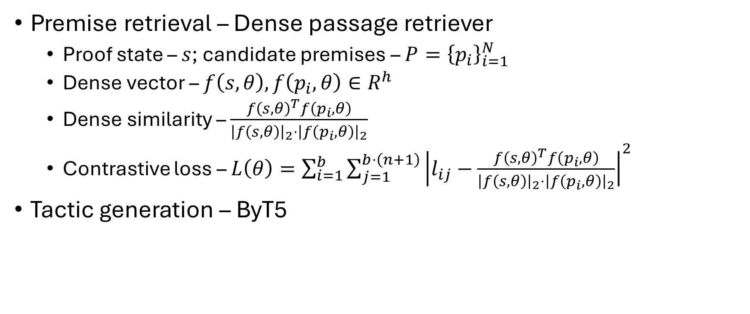
ReProver
Premise retrieval – Dense passage retriever
Proof state – $s$; candidate premises – $P={\left\{p_{i}\right\}}_{i=1}^{N}$
Dense vector – $f\left(s,θ\right),f\left(p_{i},θ\right)∈R^{h}$
Dense similarity – $\frac{{f\left(s,θ\right)}^{T}f\left(p_{i},θ\right)}{{\left|f\left(s,θ\right)\right|}_{2}⋅{\left|f\left(p_{i},θ\right)\right|}_{2}}$
Contrastive loss – $L\left(θ\right)=\sum_{i=1}^{b}{\sum_{j=1}^{b⋅\left(n+1\right)}{{\left|l_{ij}−\frac{{f\left(s,θ\right)}^{T}f\left(p_{i},θ\right)}{{\left|f\left(s,θ\right)\right|}_{2}⋅{\left|f\left(p_{i},θ\right)\right|}_{2}}\right|}^{2}}}$
Tactic generation – ByT5

Slide 17
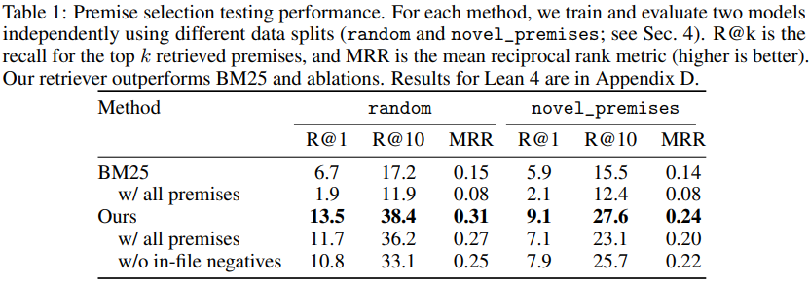
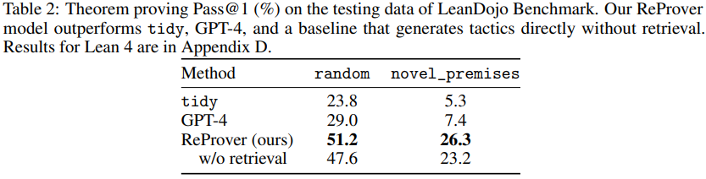
ReProver (2)

Slide 18
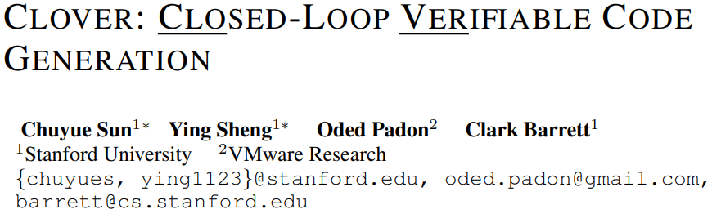

Slide 19
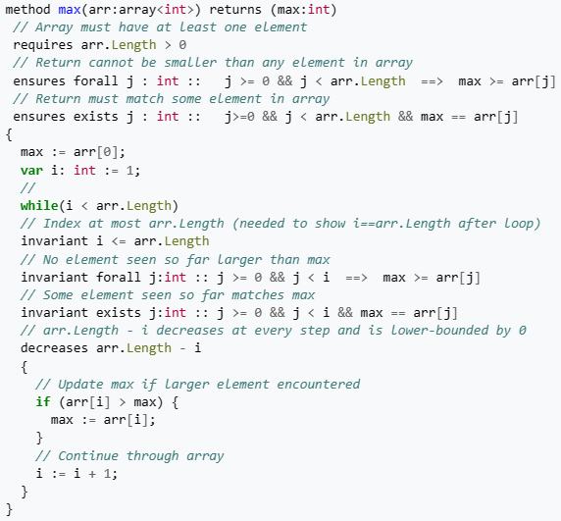
Dafny – Verification-aware PL
Verification-aware PL – Verification along with code development
Formal specification – Pre/post-conditions, loop invariants, etc.
Proof – SMT solver
PL – Compile to other PLs, such as C#, Java, etc.

Slide 20
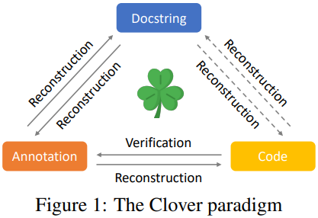
Clover
Code-annotation consistency
Annotation-docstring consistency
Code-docstring consistency
Equivalence checking for code
Equivalence check for docstrings
Equivalence check for annotations

Slide 21
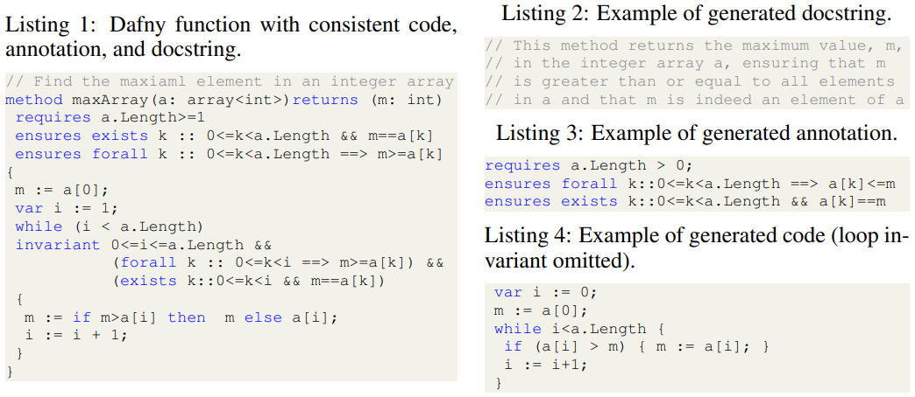
CloverBench
Hand-crafted dataset
60 small hand-written programs, which might be found in textbooks
5 test cases for each example

Slide 22
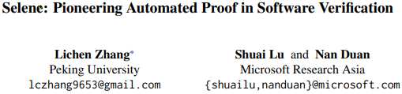

Slide 23
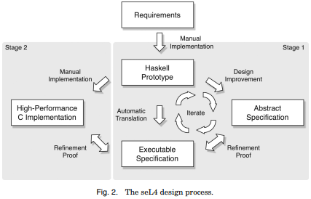
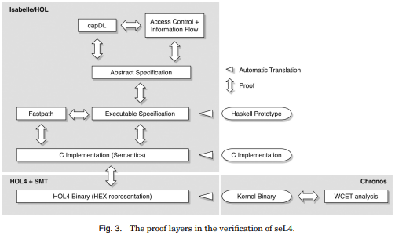
SeL4

Slide 24
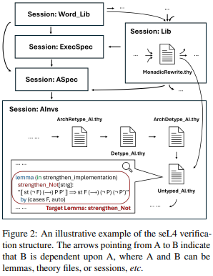
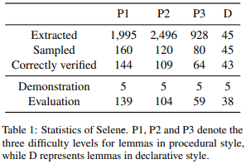
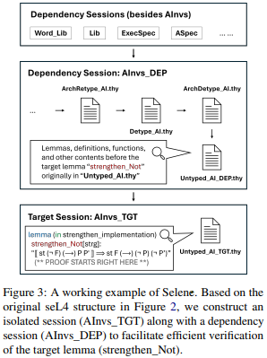
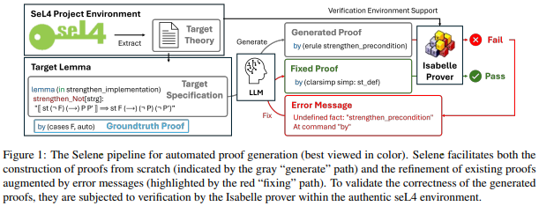
Selene

Slide 25
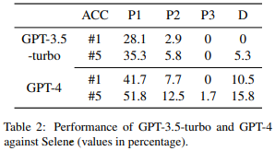
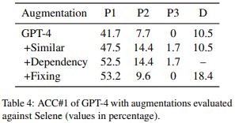
Selene (2)

Slide 26
THANK YOU

