Slide 1

Model-Level Dual Learning

Slide 2
Outline
Introduction
The Framework
Symmetric Model-Level Dual Learning
Asymmetric Model-Level Dual Learning
Application
Neural Machine Translation
Sentiment Analysis
Results
Combination with Dual Inference

Slide 3
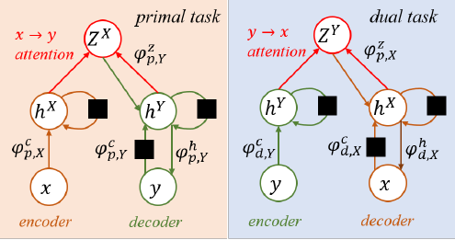





Introduction
Many tasks are of structural duality/symmetry not only in data level, but also in model level
Neural machine translation: a source-language sentence $x∈𝒳$ to a target-language sentence $y∈𝒴$

Slide 4

Introduction
The encoder of the primal task and the decoder of the dual task are highly correlated
Forcing $φ_{p,X}^{c}=φ_{d,X}^{c}$ and $φ_{p,Y}^{c}=φ_{d,Y}^{c}$

Slide 5
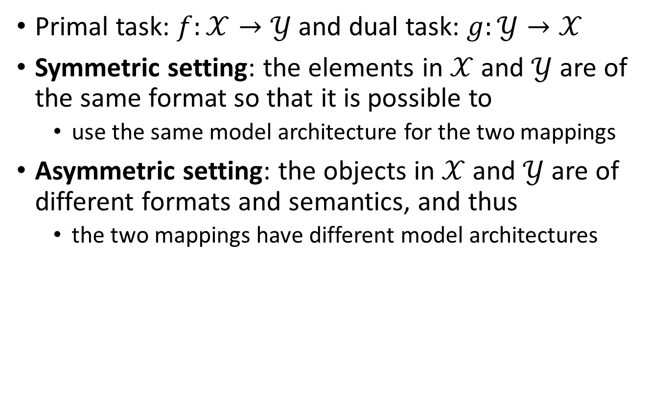
The Framework
Primal task: $f:𝒳→𝒴$ and dual task: $g:𝒴→𝒳$
Symmetric setting: the elements in $𝒳$ and $𝒴$ are of the same format so that it is possible to
use the same model architecture for the two mappings
Asymmetric setting: the objects in $𝒳$ and $𝒴$ are of different formats and semantics, and thus
the two mappings have different model architectures

Slide 6
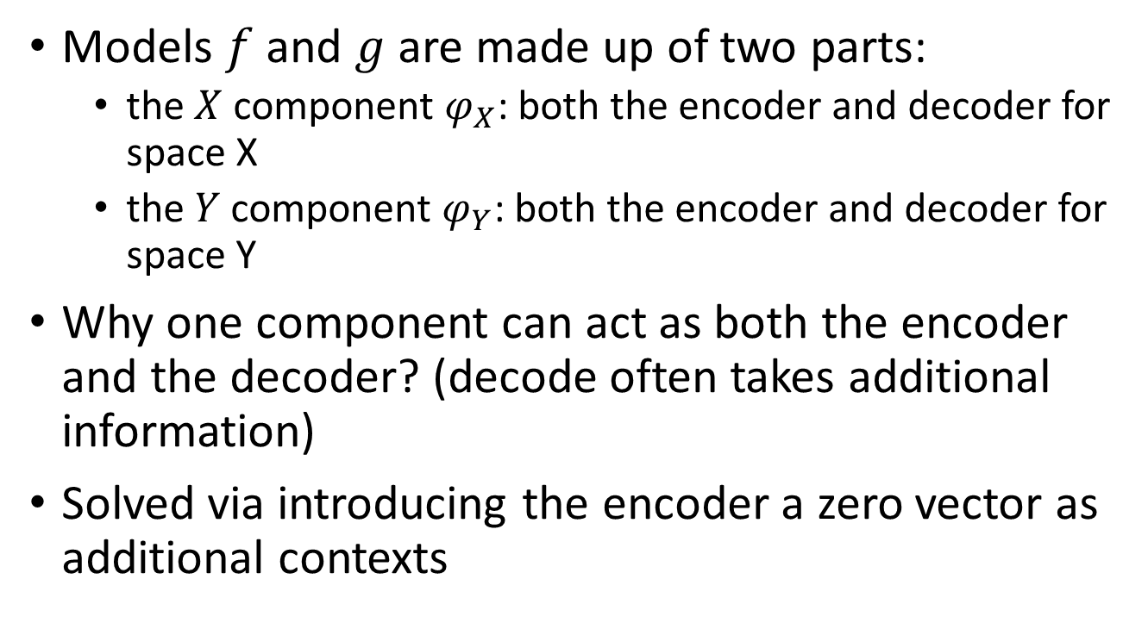
Symmetric Model-Level Dual Learning
Models $f$ and $g$ are made up of two parts:
the $X$ component $φ_{X}$: both the encoder and decoder for space X
the $Y$ component $φ_{Y}$: both the encoder and decoder for space Y
Why one component can act as both the encoder and the decoder? (decode often takes additional information)
Solved via introducing the encoder a zero vector as additional contexts

Slide 7
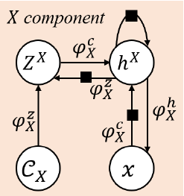
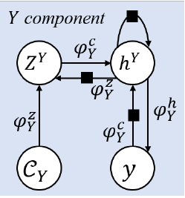



Symmetric Model-Level Dual Learning
$φ_{X}^{c}$, used to combine $x$ and $Z^{X}$
$φ_{X}^{z}$, used to combine $h^{X}$and $C_{X}$
$φ_{X}^{z}$, used to map $h^{X}$to $x$

Slide 8

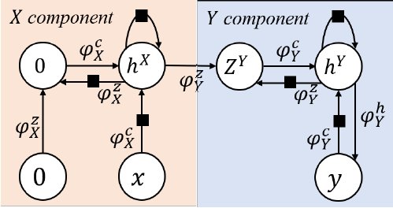






Symmetric Model-Level Dual Learning
Model for primal task
Encoder
Decoder

Slide 9
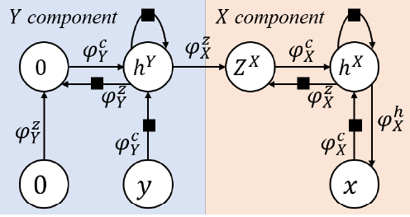

Symmetric Model-Level Dual Learning
Model for dual task
$$C_{X}=h^{Y}$$

Slide 10
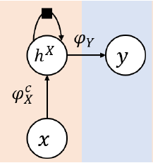
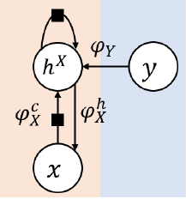








Asymmetric Model-Level Dual Learning
Example: sentiment analysis
primal model $f$
dual model $g$

Slide 11
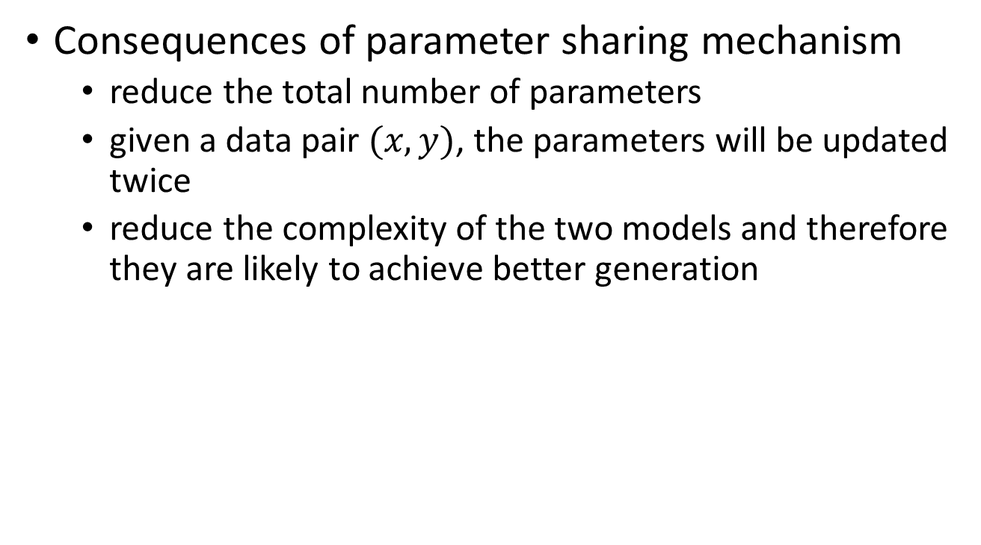
Discussions
Consequences of parameter sharing mechanism
reduce the total number of parameters
given a data pair $(x, y)$, the parameters will be updated twice
reduce the complexity of the two models and therefore they are likely to achieve better generation

Slide 12
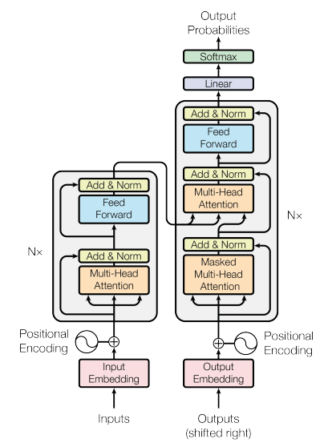
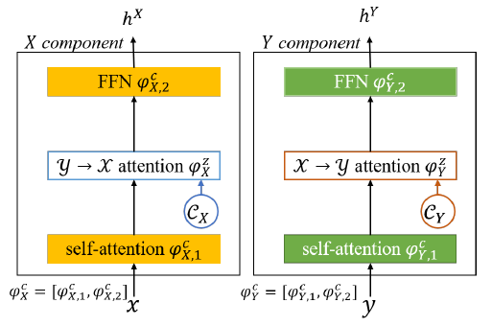
Application to Neural Machine Translation
NMT fits into the symmetric setting
Basic model: Transformer

Slide 13








Application to Neural Machine Translation
Primal task: $f:𝒳→𝒴$

Slide 14
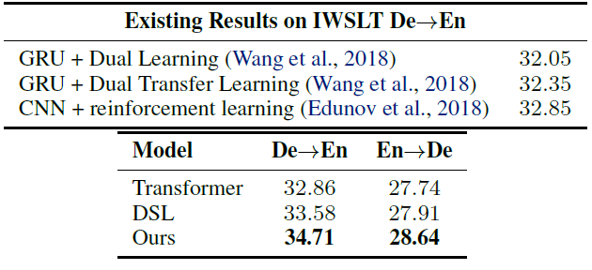
Application to Neural Machine Translation
Results
BLEU scores on IWSTL14 De↔En

Slide 15
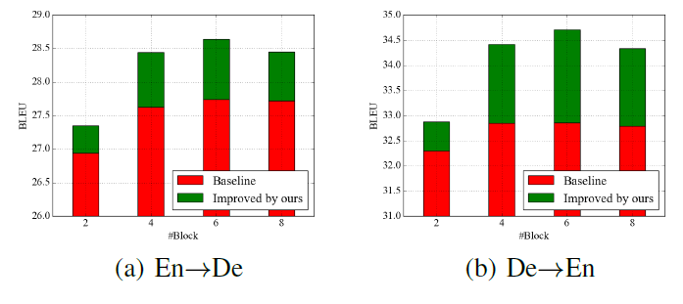
Application to Neural Machine Translation
works with respect to different model complexities
BLEUs w.r.t different number of blocks

Slide 16
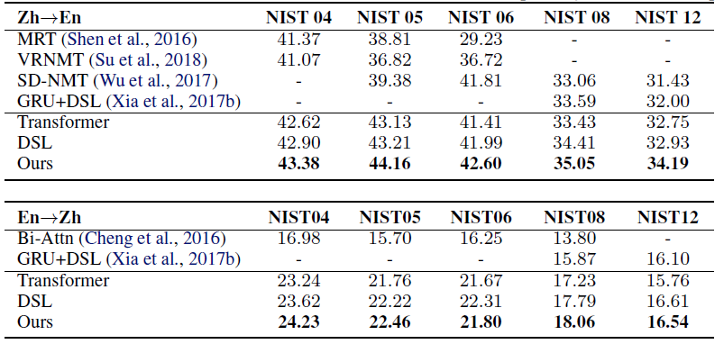
Application to Neural Machine Translation
Results
Translation results of Zh ↔ En (trained on LDC dataset)

Slide 17
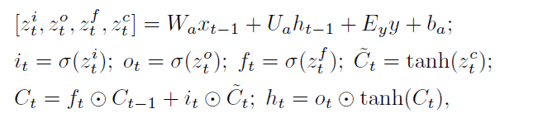

Application to Sentiment Analysis
X is the space of natural sentences, and Y is the space of sentiment labels
Basic building block: LSTM

Slide 18
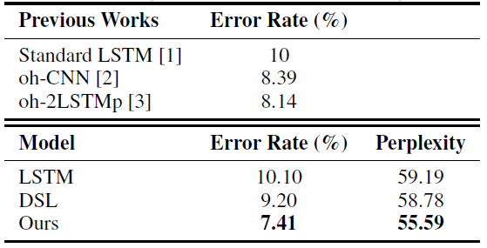
Application to Sentiment Analysis
Results
Results of sentiment analysis on IMDB dataset

Slide 19
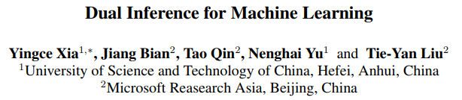
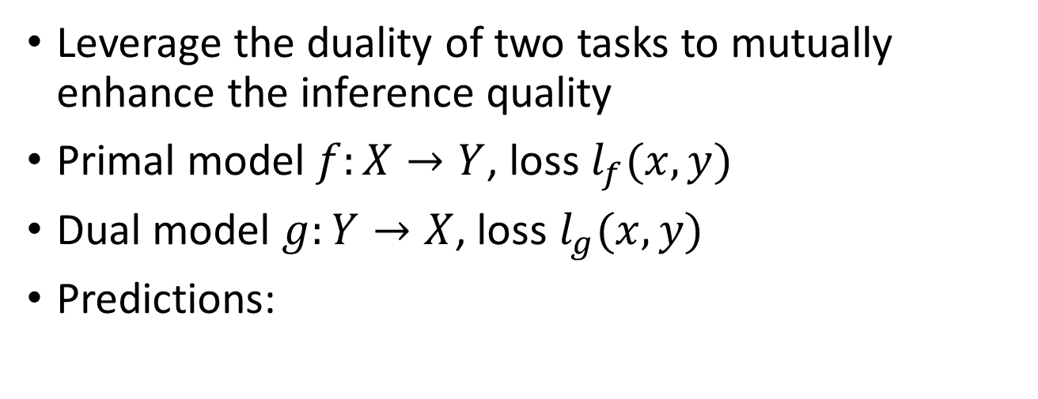
Combination with Dual Inference
Leverage the duality of two tasks to mutually enhance the inference quality
Primal model $f:X→Y$, loss $l_{f}(x,y)$
Dual model $g:Y→X$, loss $l_{g}(x,y)$
Predictions:

Slide 20
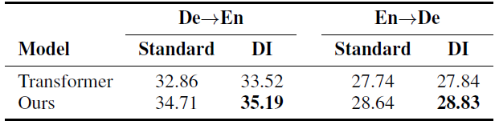
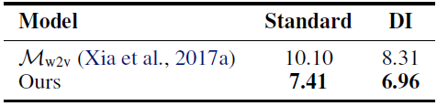
Combination with Dual Inference
Results
Dual inference results on IWSLT De-En
Error rates on IMDB classification w/o dual inference

Slide 21


Discussion
Combine model-level dual learning with data-level dual learning
Model-level dual learning and copy mechanism
$$y$$

Slide 22

Discussion
Primal task
Dual task

