Slide 1
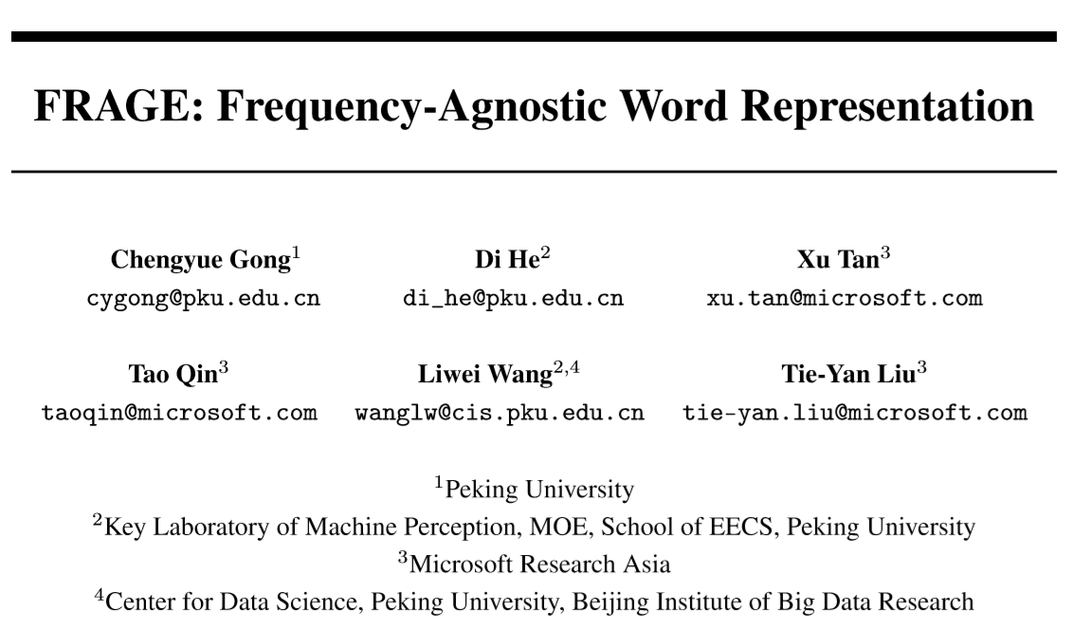
Reporter: Li Qingtao

Slide 2
Outline
Problem in word embedding
Empirical study
Method: adversarial training
Experiments

Slide 3
Outline
Problem in word embedding
Empirical study
Method: adversarial training
Experiments

Slide 4
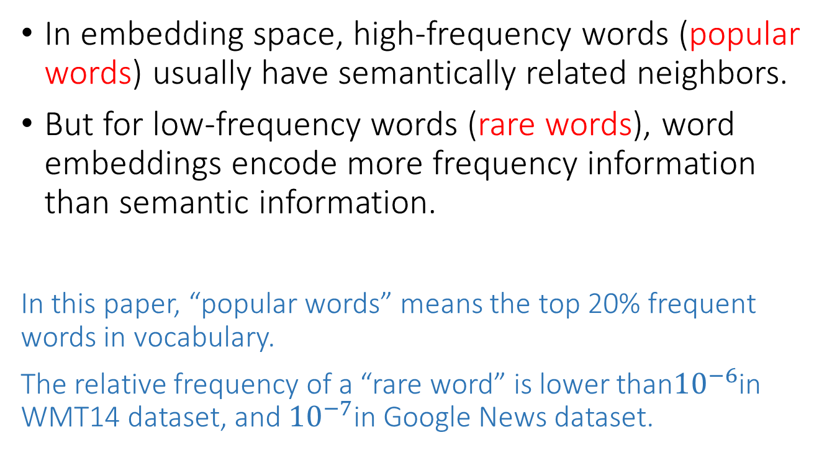
Problem in word embedding
In embedding space, high-frequency words (popular words) usually have semantically related neighbors.
But for low-frequency words (rare words), word embeddings encode more frequency information than semantic information.
In this paper, “popular words” means the top 20% frequent words in vocabulary.
The relative frequency of a “rare word” is lower than${10}^{−6}$in WMT14 dataset, and ${10}^{−7}$in Google News dataset.

Slide 5
Outline
Problem in word embedding
Empirical study
Method: adversarial training
Experiments

Slide 6
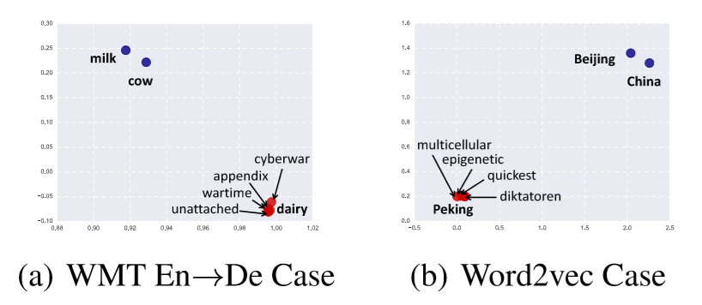
Empirical study
Notes:
Reduce dimensions by SVD

Slide 7
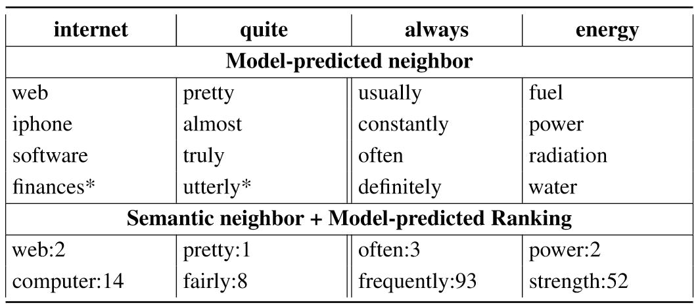
Empirical study

Slide 8
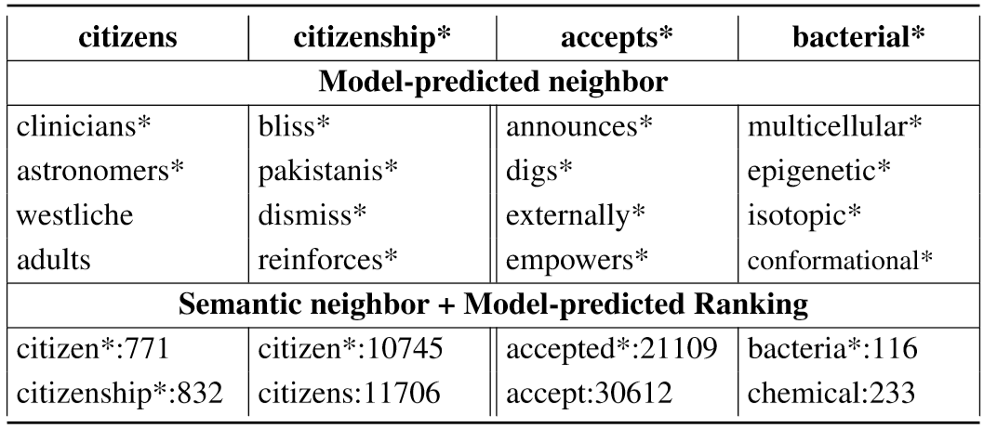
Empirical study

Slide 9
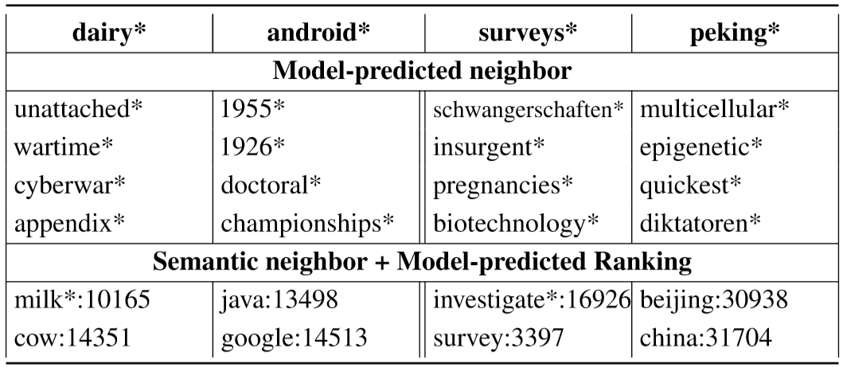
Empirical study

Slide 10
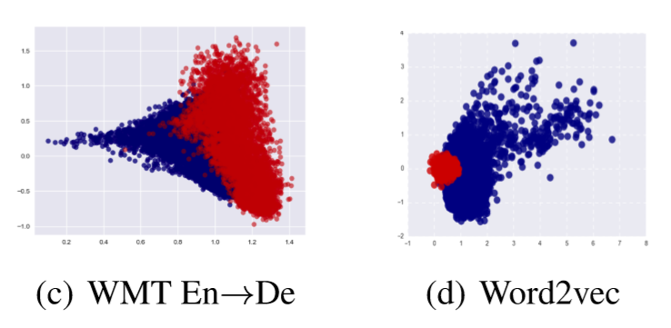
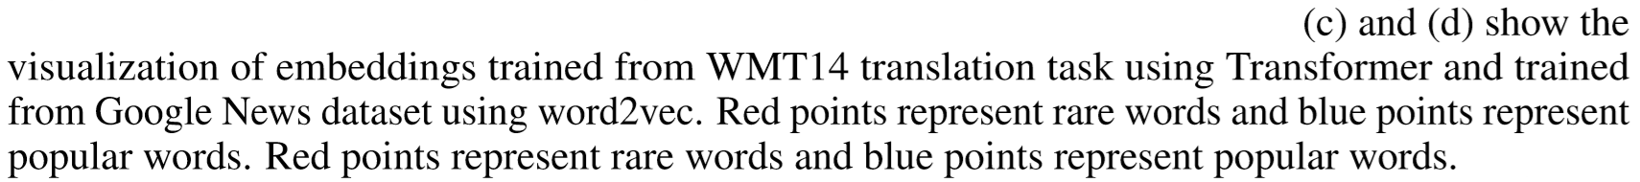
Empirical study
Notes:
more than 50% rare words are nouns, e.g., company names, city names
around 10% percent of rare words include a hyphen (which is usually used to join popular words)
over 30% rare words are different PoSs of popular words

Slide 11
A possible explanation
During traning, the embedding of a popular word updates more frequently.
According to our study, on average, the moving distance of the embedding for a popular word is twice longer than that of a rare word during training.

Slide 12
Outline
Problem in word embedding
Empirical study
Method: adversarial training
Experiments

Slide 13
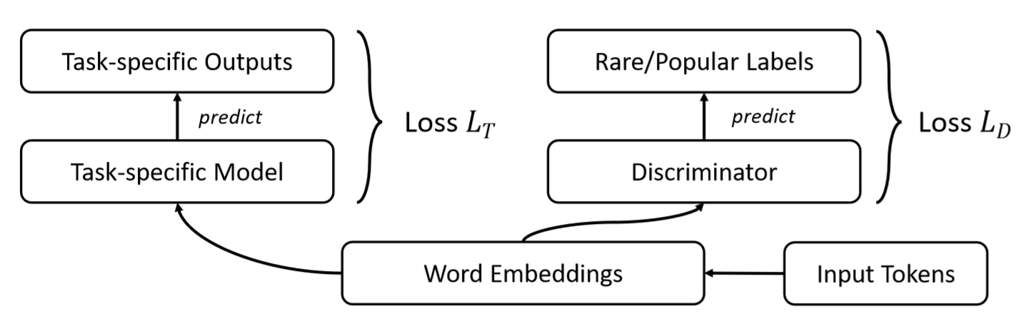
Method

Slide 14
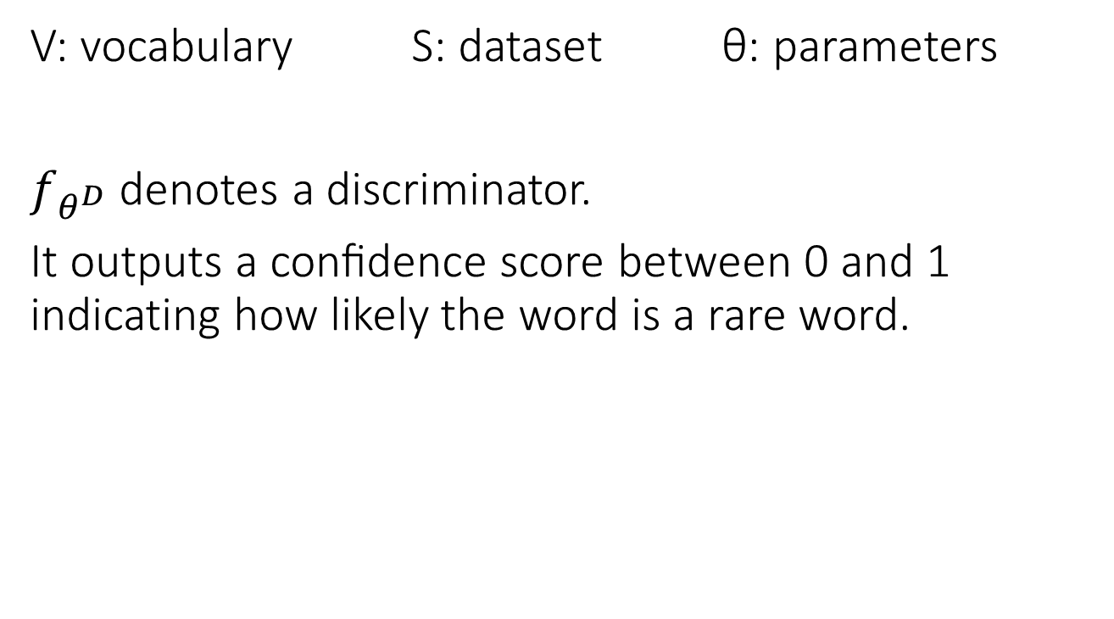
Method
V: vocabulary S: dataset θ: parameters
$f_{θ^{D}}$ denotes a discriminator.
It outputs a conﬁdence score between 0 and 1 indicating how likely the word is a rare word.
In this paper, they use logistic regression or a one-layer NN as the discriminator.

Slide 15
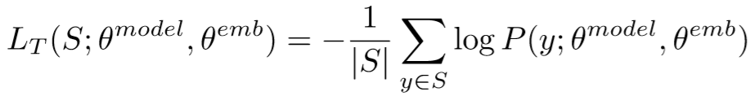
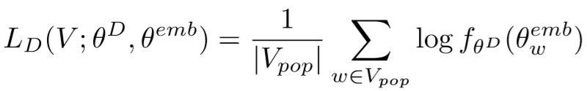
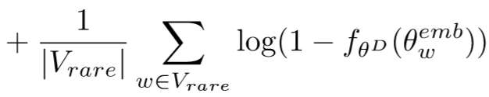
Method
Notes:
λ set to 0.1 in this paper

Slide 16
Outline
Problem in word embedding
Empirical study
Method: adversarial training
Experiments

Slide 17
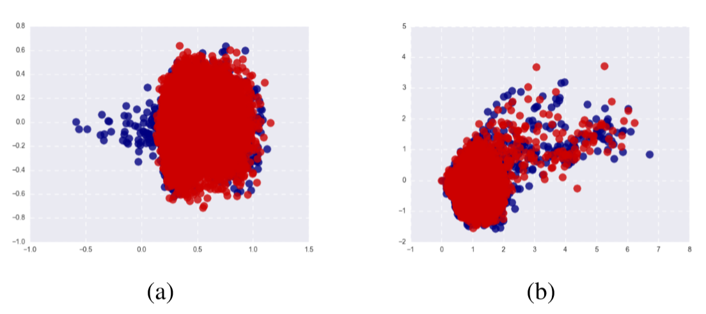
Case Study

Slide 18
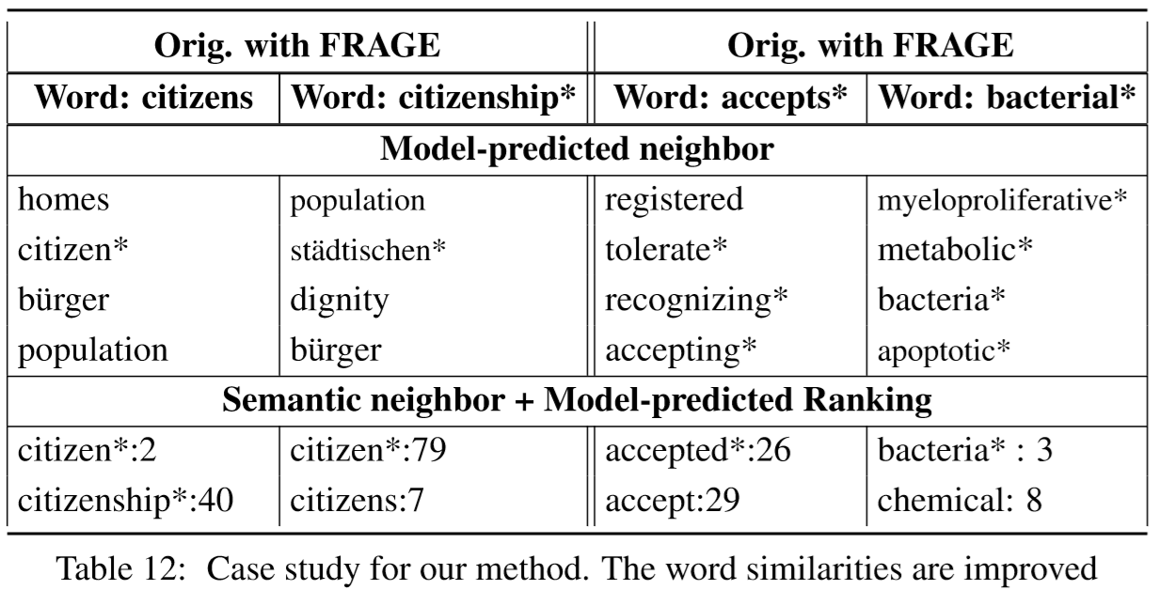
Case Study

Slide 19
Tasks
Word Similarity: RG65, WS and RW
Language Modeling: Penn Treebank (PTB) and WikiText-2 (WT2)
Machine Translation: WMT14 English-German and IWSLT14 German-English
Text Classiﬁcation: AG’s news corpus (AGs), IMDB movie review dataset (IMDB) and 20 Newsgroups (20NG)
For each task, they choose the state-of-the-art architecture together with the state-of-the-art training method as our baseline.

Slide 20
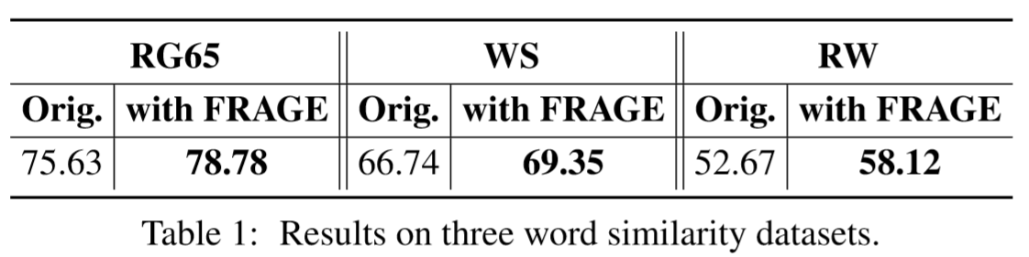
Results
Word Similarity
Skip-gram model, spearman rank correlation
Notes:
用cosine distance得到相关次序，而后计算Spearman秩相关系数。

Slide 21
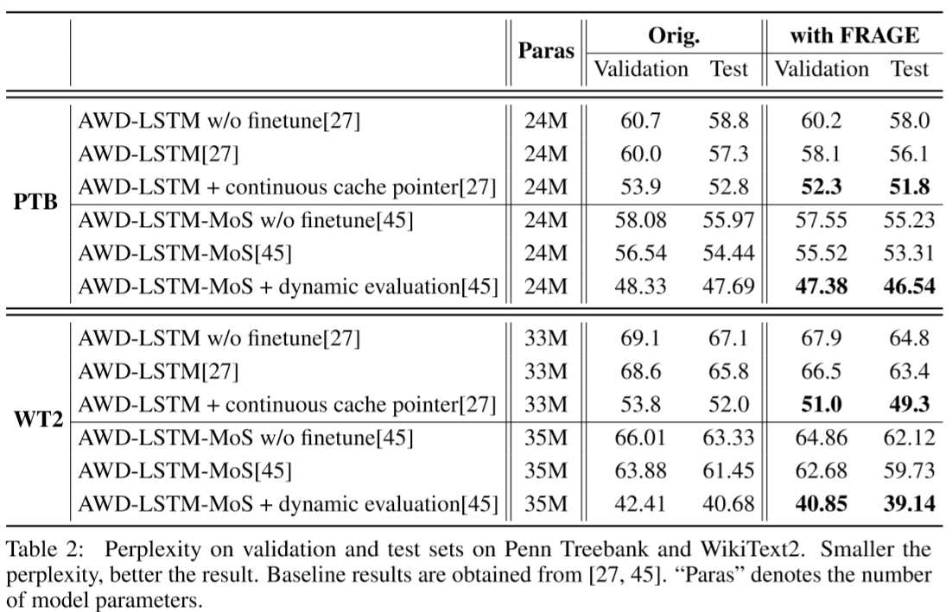
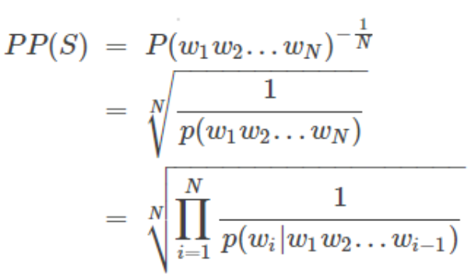
Results
Language Model
the AWD-LSTM model and AWD-LSTM-MoS model, perplexity

Slide 22
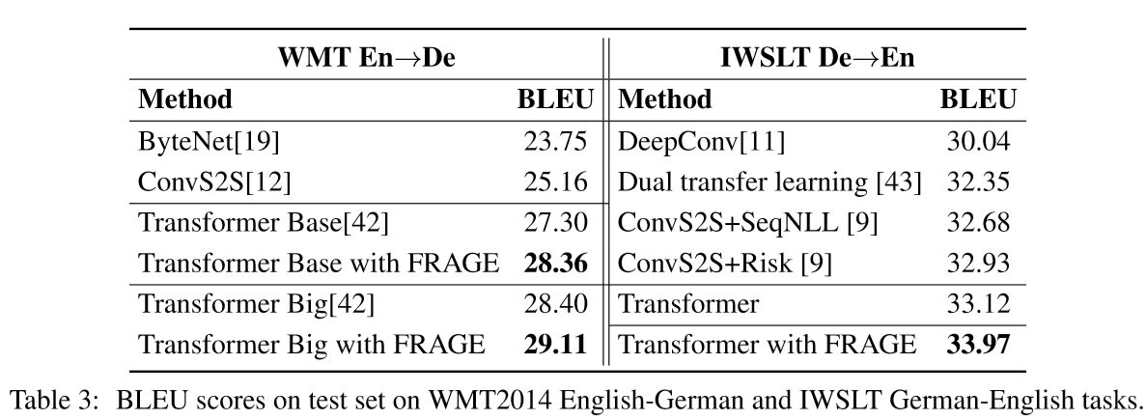
Results
Machine Translation
Transformer model, BLEU score
<Attention is all you need>
Notes:
用cosine distance得到相关次序，而后计算Spearman秩相关系数。

Slide 23
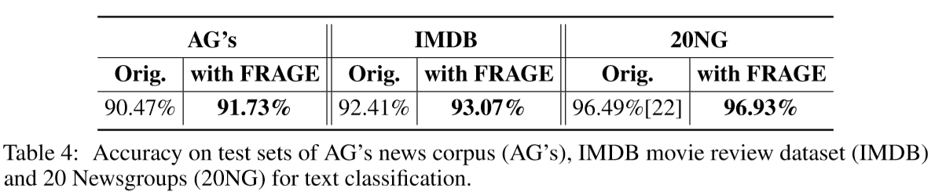
Results
Text classification
Recurrent CNN-based model, accuracy
Notes:
用cosine distance得到相关次序，而后计算Spearman秩相关系数。

Slide 24
Thanks for Listening!
Any Questions?

