Slide 1
Adaptive Performance Anomaly Detection for Online Service Systems via Pattern Sketching
Reported by: Yang Zhen
Contact: zhyang8-c@my.cityu.edu.hk

Slide 2

ICSE22

Slide 3
Introduction

Slide 4
Background
The performance of online service systems (e.g., apis of codex) is an important quality attribute. As online services need to serve millions of customers worldwide, a short period of performance degradation could lead to economic loss and user dissatisfaction. Therefore, proactive and even adaptive system troubleshooting has become the core competence of online service providers, such component is called Automated Anomaly Detection System(AADS). Besides, their performances are monitored by various metrics (e.g., the CPU usage of an application, service response delay), which are normally exploited by AADS for analysis.

Slide 5
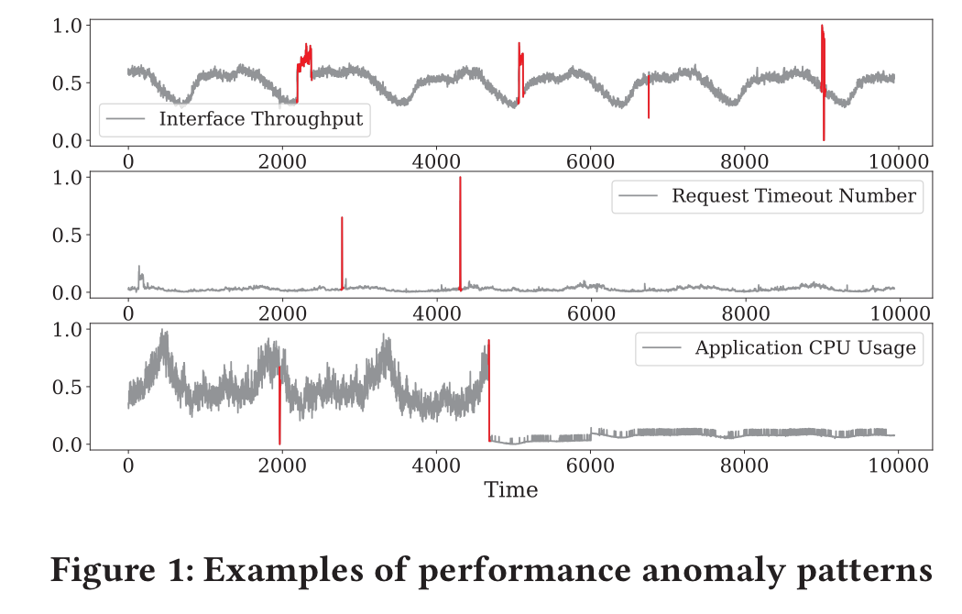

Slide 6
Motivation
most of the existing AADS does not possess the merit of interpretability. Specifically, at each timestamp, they calculate a probability indicating the likelihood of performance anomalies. A threshold is then chosen to convert the probability into a binary label – normal vs. anomaly.
many state-of-the-art methods train models with historical metric data in an offline setting. As online services continuously undergo feature upgrades and system renewal, the patterns of metrics may evolve accordingly, i.e., concept drift.

Slide 7
Solution & Experimental Results
In this paper, we propose ADSketch, a performance anomaly detection approach for online service systems based on pattern sketching, which is interpretable and adaptive. The main idea is to identify discriminative subsequences from metric time series that can represent classes of service performance issues.
Experimental results demonstrate the superiority of our design over the existing state-of-the-art time series anomaly detectors on both public and industrial data. In particular, we have achieved an average F1 score of over 0.8 in production systems.

Slide 8
Methodology

Slide 9
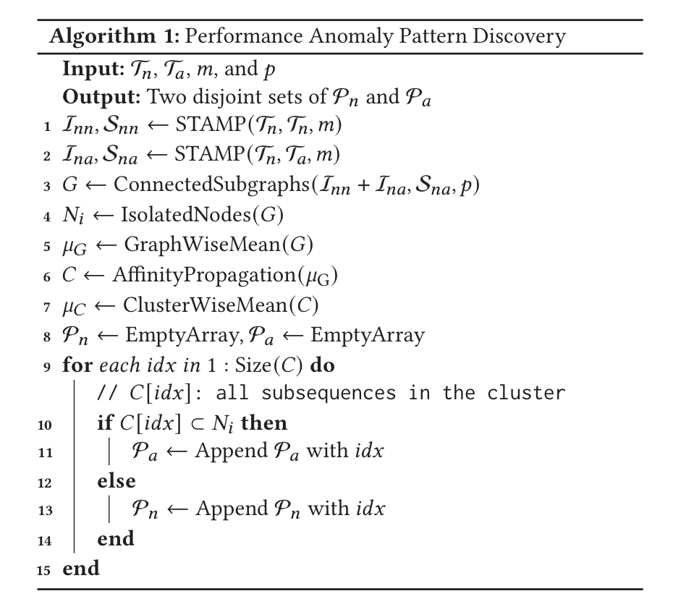


Offline Anomaly Detection
calculating the smallest pair-wise distance, line 1,2
Connect nodes (subseqs) to construct graphs, line 3
introduce a percentile threshold (i.e., 𝑝 ) on cut edges. Subgraphs with single nodes are anomaly candidates. Line 4
Merge similar subgraphs to form clusters via Affinity propagation algorithm(operated on mean vector), line 5,6
Check whether the cluster contain only anomaly candidates, if so, anomaly, otherwise, normal. Line 7-15.
for each metric pattern (cluster), domain engineers will label the type of performance issue that triggers it. For interpretation.

Slide 10
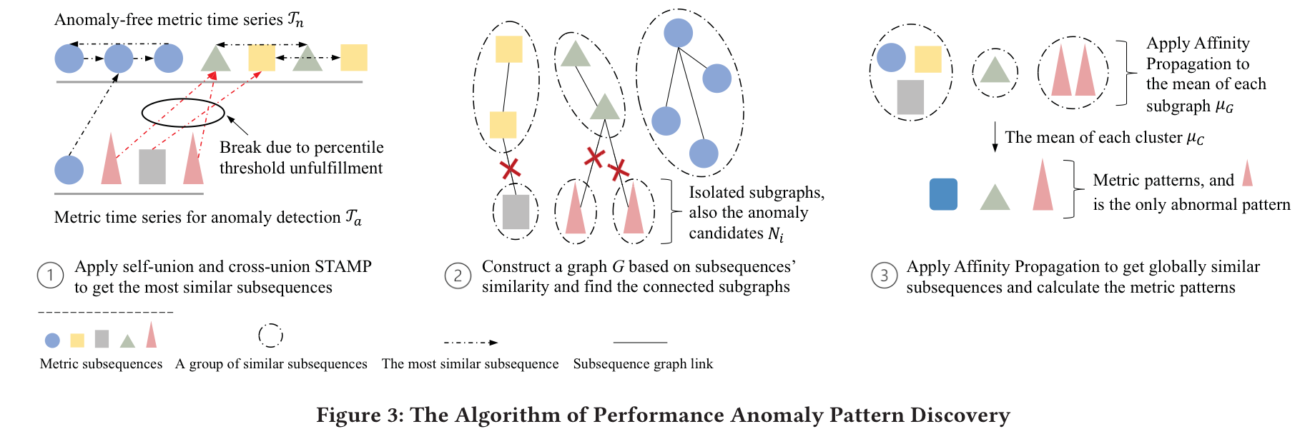

Slide 11
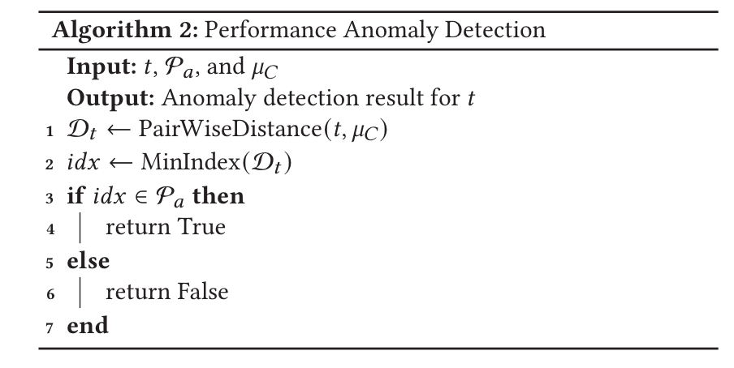
Online Anomaly Detection
given a new metric subsequence 𝑡 with length 𝑚, we search for its most similar metric pattern (line 1-2) and check which pattern pool it comes from. If 𝑡 is more similar to an abnormal pattern, it will be predicted as anomalous; otherwise, normal (line 3-7). According to the metric pattern, corresponding interpretation can be given.

Slide 12
Adaptive Pattern Learning
The main idea is that given a new subsequence 𝑡, we determine whether it possesses a known metric pattern carried by an existing cluster. If yes, the cluster will absorb 𝑡 as a new member and update its properties; otherwise, a brand-new anomalous cluster with only 𝑡 itself will be created, representing an unseen metric pattern.

Slide 13
Specifically, we first search for the closest pattern of 𝑡. Then, we determine whether 𝑡 should become a new member to the corresponding cluster by checking if the distance D_𝑡 [𝑖𝑑𝑥] is smaller than the largest radius recorded in all clusters, i.e., D_𝑡 [𝑖𝑑𝑥] ≤ Max(R_𝐶 ). If it is the case, 𝑡 should be considered as an old pattern; otherwise, it should be expressing a new pattern. Afterward, update the size, radius, and mean vector of the cluster.
An issue with this strategy is that false positives will accumulate as the unseen patterns can also be normal.

Slide 14
We alleviate it by setting a threshold to the size of the newly-formed anomalous clusters. The role of the cluster will be switched from abnormal to normal if its size exceeds the threshold.
The rationale is that performance anomalies are generally rare events. A large anomalous cluster would mean the particular type of issue it represents occurs too often. However, a pattern with a large frequency tends to be the metric’s normal behavior.

Slide 15
EXPERIMENTS

Slide 16
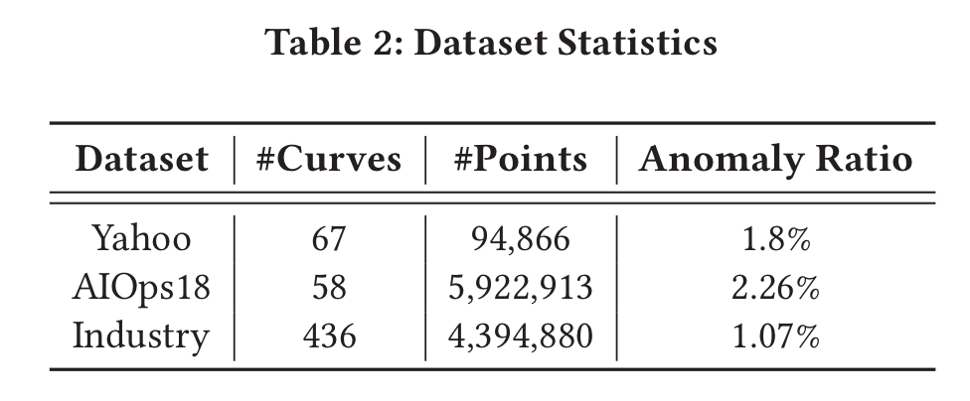
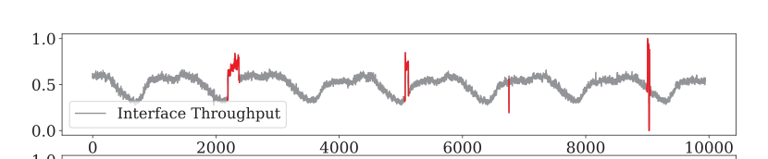


Experiment Setting
Public dataset:
Yahoo
AIOps18
Industry dataset:
Huawei Cloud

Slide 17
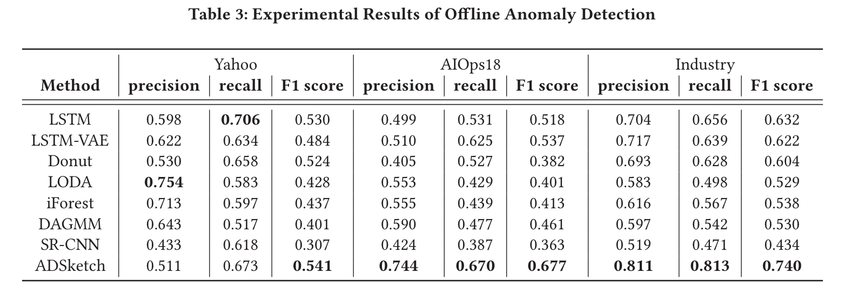
Experimental Results

Slide 18
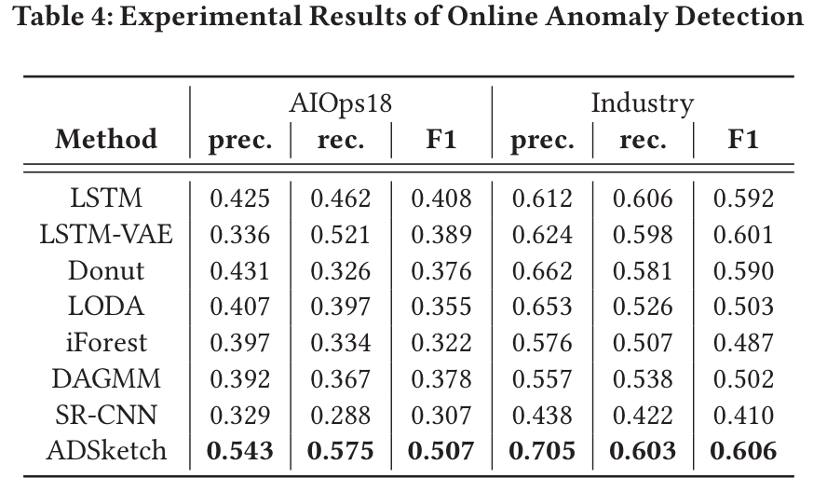
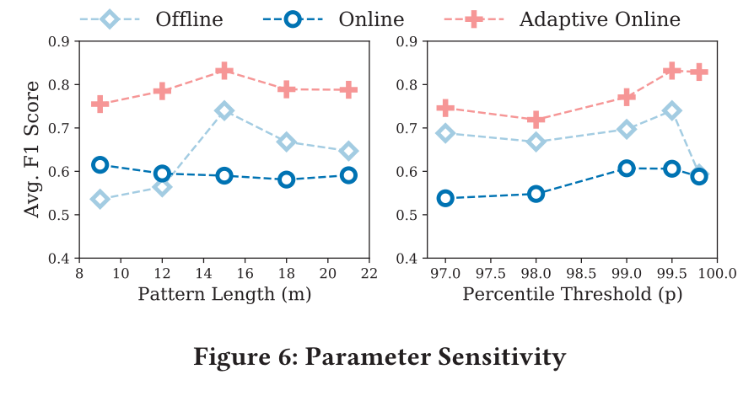
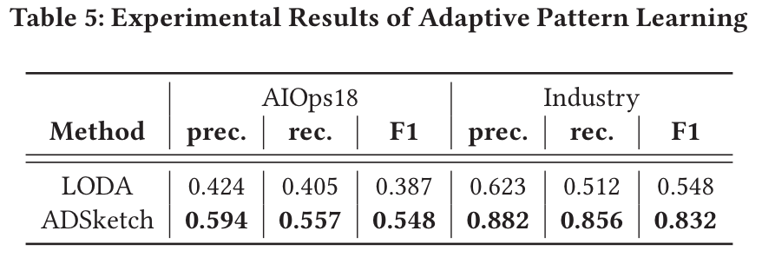

Slide 19
THANKS

