Slide 1
Bert vs. Bert
Huangzhao Zhang, zhang_hz@pku.edu.cn

Slide 2
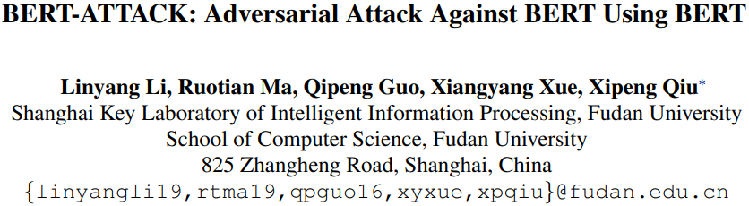

Slide 3
Motivation
Adversary in NLP
Discrete sentence space
Imperceptible to human beings
Misleading to NN models
Fluent in grammar
Semantically consistent with the original
White-box adversary
HotFlip
Black-box adversary
Rule-based replacement
Fluency or correctness checking

Slide 4
Motivation (2)
Adversary in NLP
Discrete sentence space
Imperceptible to human beings
Misleading to NN models
Fluent in grammar
Semantically consistent with the original
BERT
A fine-tuned BERT is hard to be attacked
BERT is able to produce more fluent and semantic-consistent examples
Turn BERT against its fine-tuned models

Slide 5
Masked LM
Original
[CLS]
my
dog
is
cute
[SEP]
he
likes
play
#ing
[SEP]
[CLS]
my
dog
is
[M]
[SEP]
he
likes
play
#ing
[SEP]
80%
Masked
(15%)
[CLS]
my
dog
is
cat
[SEP]
he
likes
play
#ing
[SEP]
10%
[CLS]
my
dog
is
cute
[SEP]
he
likes
play
#ing
[SEP]
10%
BERT
C
T₁
T₂
T₃
T₄
T_{[SEP]}
T₁’
T₂’
T₃’
T₄’
T_{[SEP]}
cute
Classification
big
huge
…

Slide 6
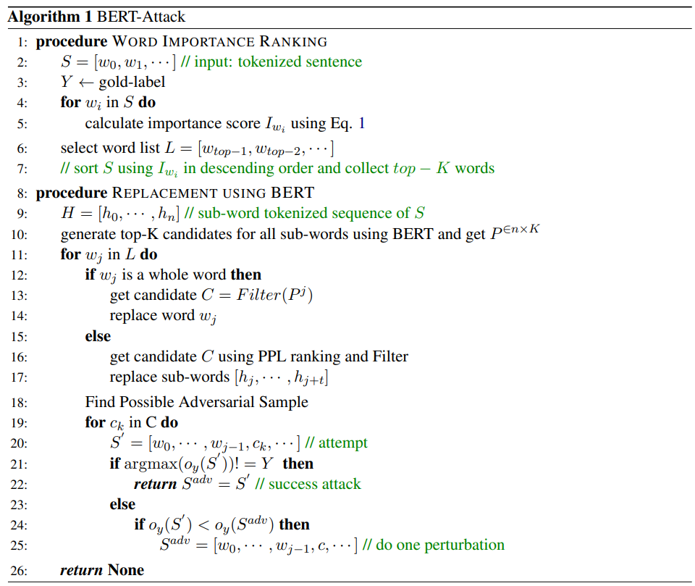
BERT-Attack
Finding vulnerable words
Target fine-tuned BERT (or other black-box model)
Importance score via masked classification
Word replacement with BERT
Another pre-trained BERT
Candidate substitution generation

Slide 7
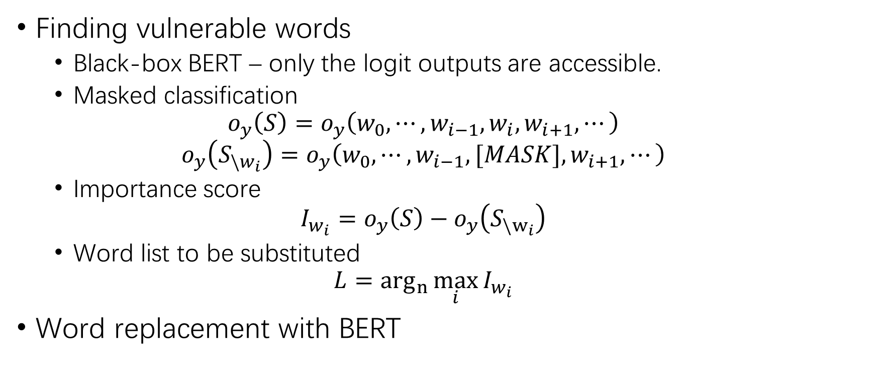
BERT-Attack (2)
Finding vulnerable words
Black-box BERT – only the logit outputs are accessible.
Masked classification
$$o_{y}\left(S\right)=o_{y}\left(w_{0},⋯,w_{i−1},w_{i},w_{i+1},⋯\right)$$
$$o_{y}\left(S_{\backslash w_{i}}\right)=o_{y}\left(w_{0},⋯,w_{i−1},[MASK],w_{i+1},⋯\right)$$
Importance score
$$I_{w_{i}}=o_{y}\left(S\right)−o_{y}\left(S_{\backslash w_{i}}\right)$$
Word list to be substituted
$$L=\arg_{n}{\max_{i}{I_{w_{i}}}}$$
Word replacement with BERT

Slide 8
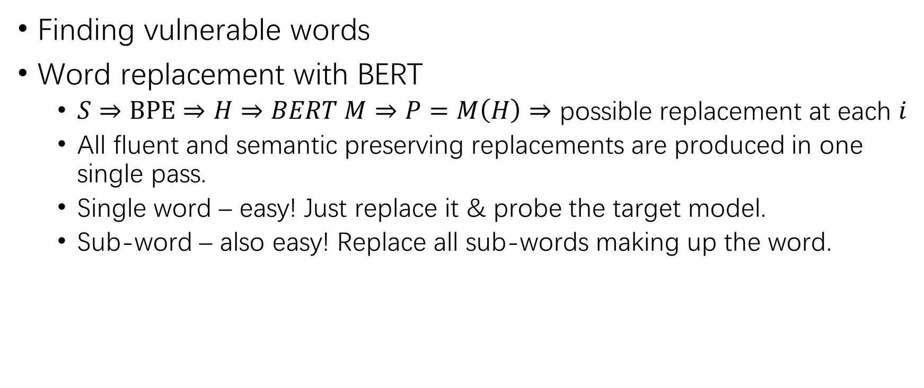
BERT-Attack (3)
Finding vulnerable words
Word replacement with BERT
$S⇒BPE⇒H⇒BERT M⇒P=M\left(H\right)⇒$ possible replacement at each $i$
All fluent and semantic preserving replacements are produced in one single pass.
Single word – easy! Just replace it & probe the target model.
Sub-word – also easy! Replace all sub-words making up the word.

Slide 9
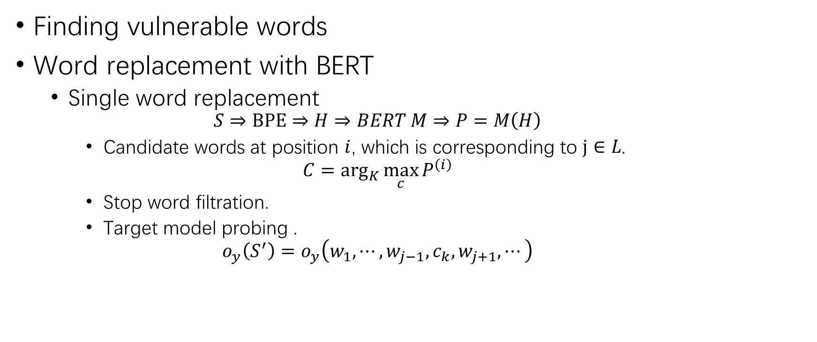
BERT-Attack (4)
Finding vulnerable words
Word replacement with BERT
Single word replacement
$$S⇒BPE⇒H⇒BERT M⇒P=M\left(H\right)$$
Candidate words at position $i$, which is corresponding to $j∈L$.
$$C=\arg_{K}{\max_{c}{P^{\left(i\right)}}}$$
Stop word filtration.
Target model probing .
$$o_{y}\left(S^{′}\right)=o_{y}\left(w_{1},⋯,w_{j−1},c_{k},w_{j+1},⋯\right)$$

Slide 10
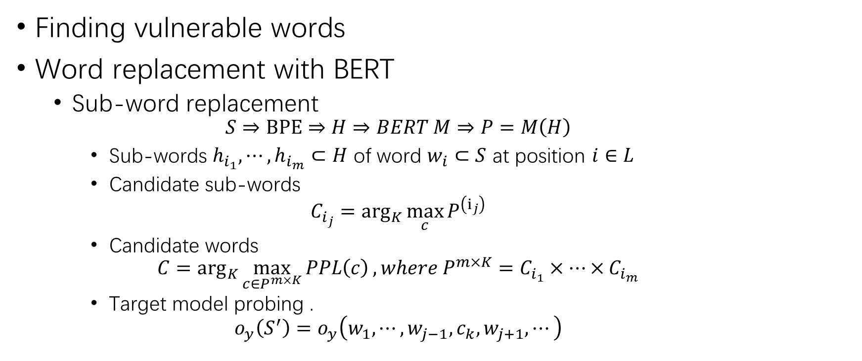
BERT-Attack (5)
Finding vulnerable words
Word replacement with BERT
Sub-word replacement
$$S⇒BPE⇒H⇒BERT M⇒P=M\left(H\right)$$
Sub-words $h_{i_{1}},⋯,h_{i_{m}}⊂H$ of word $w_{i}⊂S$ at position $i∈L$
Candidate sub-words
$$C_{i_{j}}=\arg_{K}{\max_{c}{P^{\left(i_{j}\right)}}}$$
Candidate words
$$C=\arg_{K}{\max_{c∈P^{m×K}}{PPL\left(c\right)}}, where P^{m×K}=C_{i_{1}}×⋯×C_{i_{m}}$$
Target model probing .
$$o_{y}\left(S^{′}\right)=o_{y}\left(w_{1},⋯,w_{j−1},c_{k},w_{j+1},⋯\right)$$

Slide 11
BERT-Attack (6)
Masked classification
Finding vulnerable words
One pass generation with BERT
Word replacement with BERT
Single word replacement
Sub-word replacement
Probing the target model

Slide 12
Experimental Setups
Datasets
Text classification – Yelp, IMDB, AG’s News, FAKE
Natural language inference – SNLI, MNLI
Metrics
Success rate
Perturbed percentage
Query number of the target black-box model
Semantic consistency – Universal Sentence Encoder

Slide 13
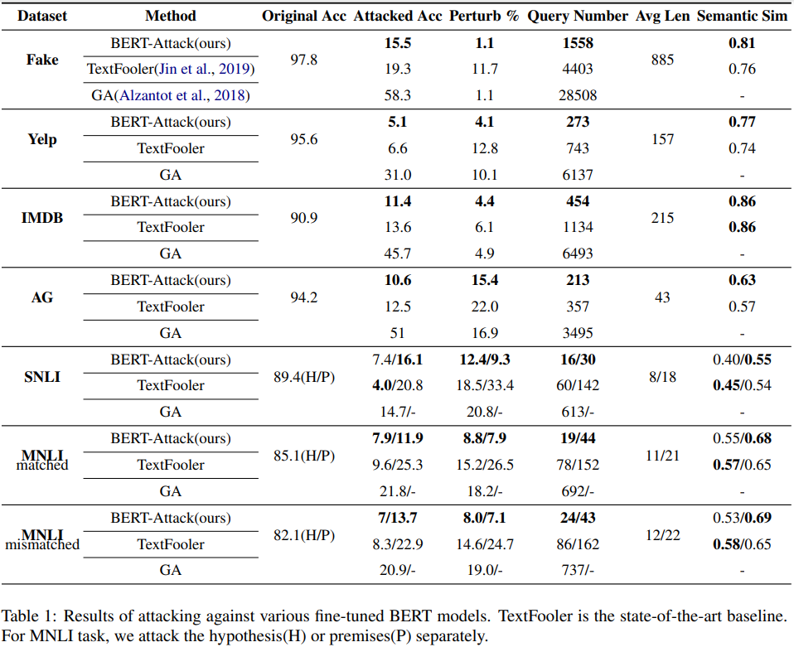
Experimental Results
Attack
High success rate
Low perturbed percentage
Low query number
Good semantic similarity

Slide 14
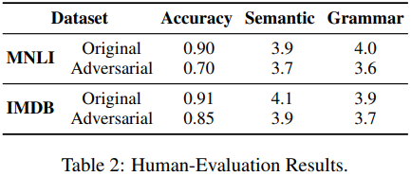
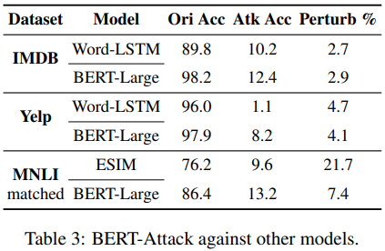
Experimental Results (2)
Human evaluation
Score – 1-5
100 samples
3 human annotators
Attack against other models
BERT-Attack is capable to attack LSTM-based models.

Slide 15
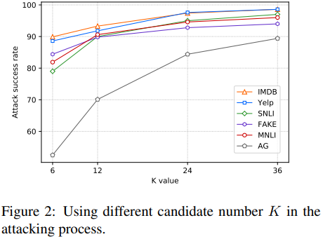
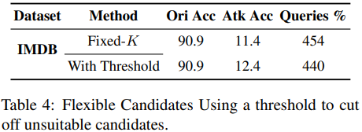

Ablations
Candidate number $K$
Static $K$
Flexible $K$
Applying threshold to cut off unsuitable candidates.
Lower query number.

Slide 16
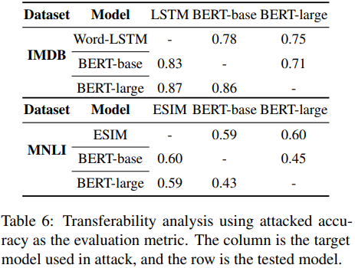
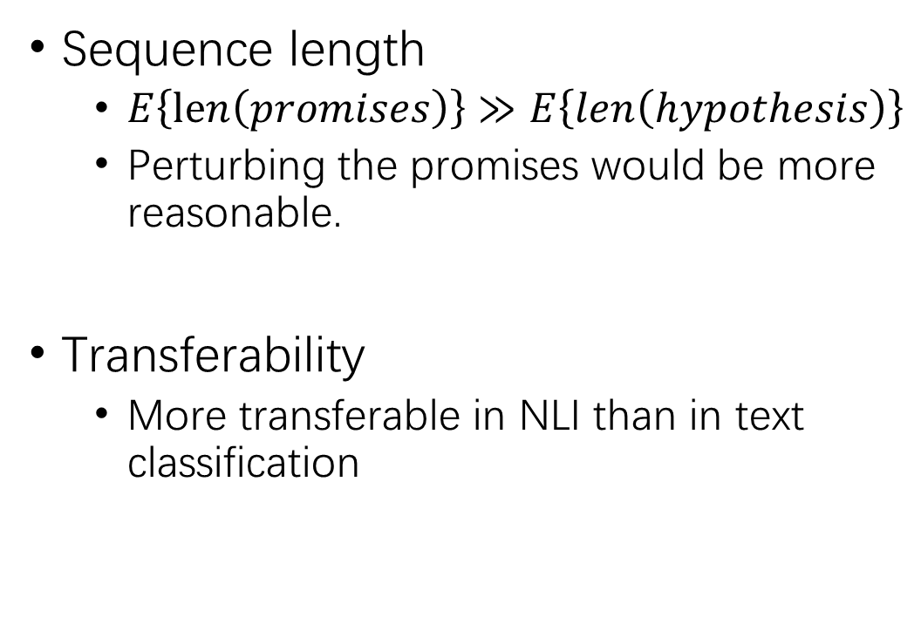
Ablations (2)
Sequence length
$E\left\{len\left(promises\right)\right\}≫E\left\{len\left(hypothesis\right)\right\}$
Perturbing the promises would be more reasonable.
Transferability
More transferable in NLI than in text classification

Slide 17
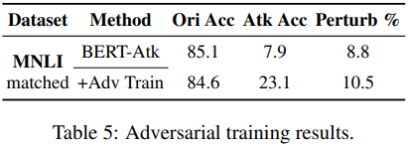
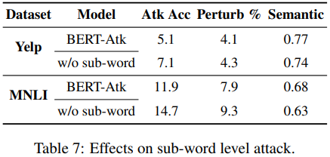
Ablations (3)
Adversarial training
Sub-word replacement

Slide 18
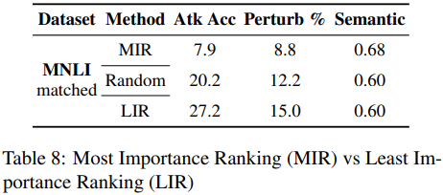
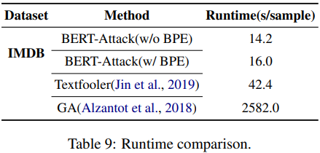
Ablations (4)
Word importance ranking
Most importance ranking
Random
Least importance ranking
Time cost

Slide 19
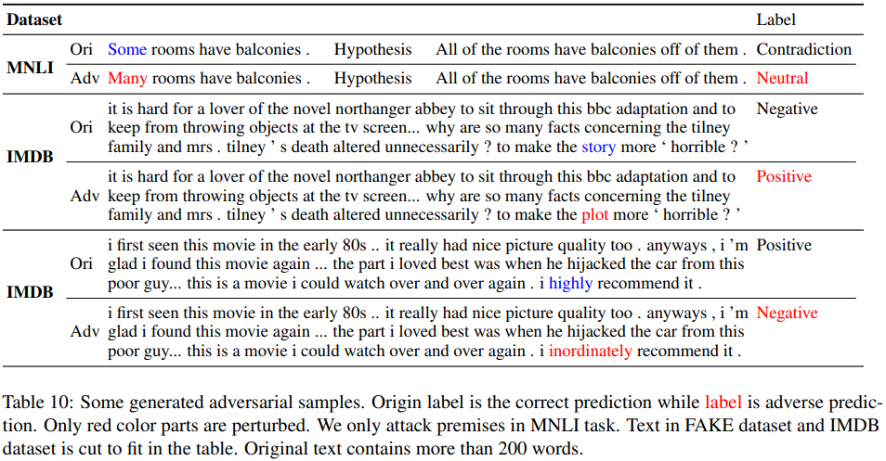
Ablations (5)

Slide 20
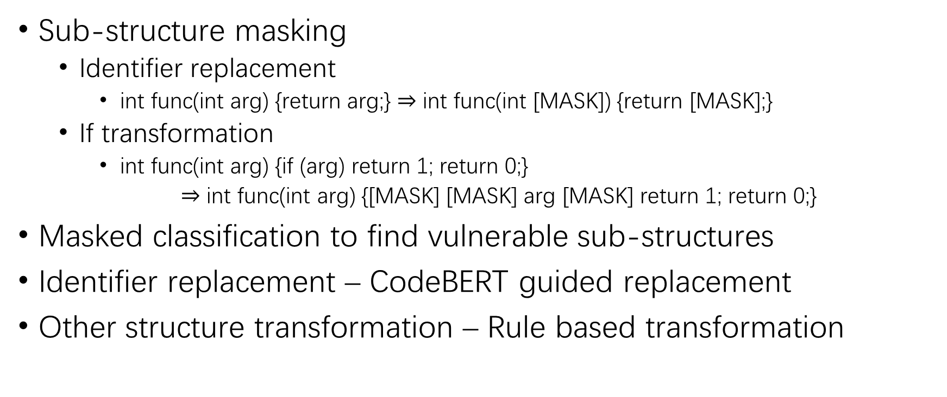
CodeBERT-Attack?
Sub-structure masking
Identifier replacement
int func(int arg) {return arg;} $⇒$ int func(int [MASK]) {return [MASK];}
If transformation
int func(int arg) {if (arg) return 1; return 0;}
$⇒$ int func(int arg) {[MASK] [MASK] arg [MASK] return 1; return 0;}
Masked classification to find vulnerable sub-structures
Identifier replacement – CodeBERT guided replacement
Other structure transformation – Rule based transformation

Slide 21
THANK YOU!

