Slide 1
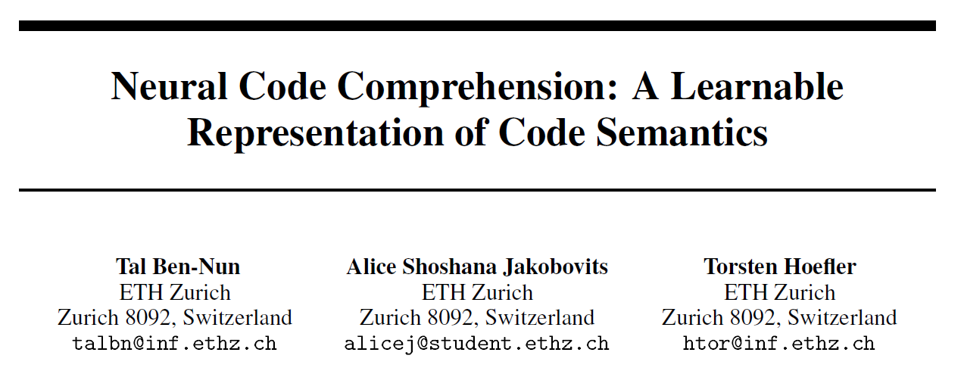
Reporter: Li Qingtao

Slide 2
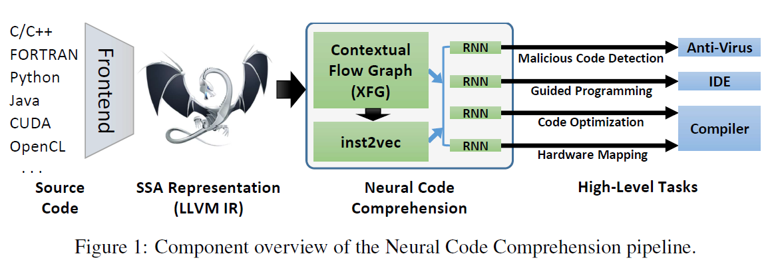

Slide 3
Outline
Starting Point:
Distributional Hypothesis of Code
Program Representation:
from LLVM IR to ConteXtual Flow Graph
New Program Embedding:
inst2vec
Evaluation & Experiments

Slide 4
Outline
Starting Point:
Distributional Hypothesis of Code
Program Representation:
from LLVM IR to ConteXtual Flow Graph
New Program Embedding:
inst2vec
Evaluation & Experiments

Slide 5
Distributional Hypothesis of Code
The linguistic Distributional Hypothesis:
Words that occur in the same contexts tend to
have similar meanings.
Distributional Hypothesis of Code:
Statements that occur in the same contexts tend to have similar semantics.

Slide 6
Distributional Hypothesis of Code
Statements:
Wish to be independent of the source language, as well as the hardware architecture. ==> LLVM IR
Context:
Statements whose execution directly depends on each other (including data and execution dependence).
Similarity:
Two statements consuming the same resources or
modifying the system state in a similar way.
Notes:
高级语言的一个statement可能是一个简单的算术，一系列操作，或者是一个对象的定义；
硬件语言过于底层，难以体现代码语义。同一个statement可能在多处被用于不同的目的。
Resources包括存储单元等。Modify system state例如将两个数相加。

Slide 7
Outline
Starting Point:
Distributional Hypothesis of Code
Program Representation:
from LLVM IR to ConteXtual Flow Graph
New Program Embedding:
inst2vec
Evaluation & Experiments

Slide 8
LLVM IR
LLVM
LLVM是构架编译器(compiler)的框架系统，以C++编写而成，用于优化以任意程序语言编写的程序的编译时间(compile-time)、链接时间(link-time)、运行时间(run-time)以及空闲时间(idle-time)，对开发者保持开放，并兼容已有脚本。
LLVM计划启动于2000年，最初由美国UIUC大学的Chris Lattner博士主持开展。2006年Chris Lattner加盟Apple Inc.并致力于LLVM在Apple开发体系中的应用。Apple也是LLVM计划的主要资助者。
From https://baike.baidu.com/item/LLVM

Slide 9
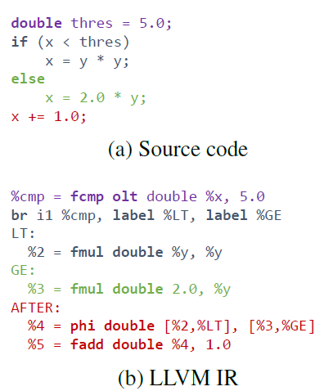
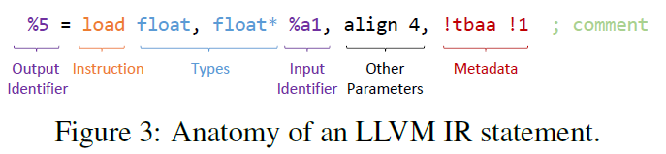
LLVM IR
LLVM
Intermediate
Representation

Slide 10
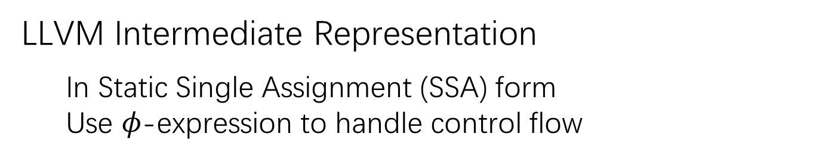
LLVM IR
LLVM Intermediate Representation
In Static Single Assignment (SSA) form
Use $φ\text{−}\text{expression}$ to handle control flow
Notes:
SSA:一个变量仅被赋值一次

Slide 11
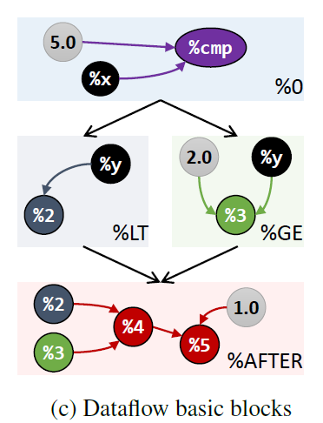
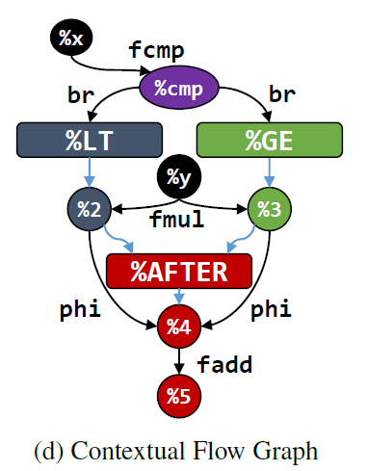
XFG: conteXtual Flow Graphs
Notes:
左图是LLVM的解析结果，每个basic block内部不包含控制流。
左图不足以提供statement的上下文，例如在控制流附近。（？）

Slide 12
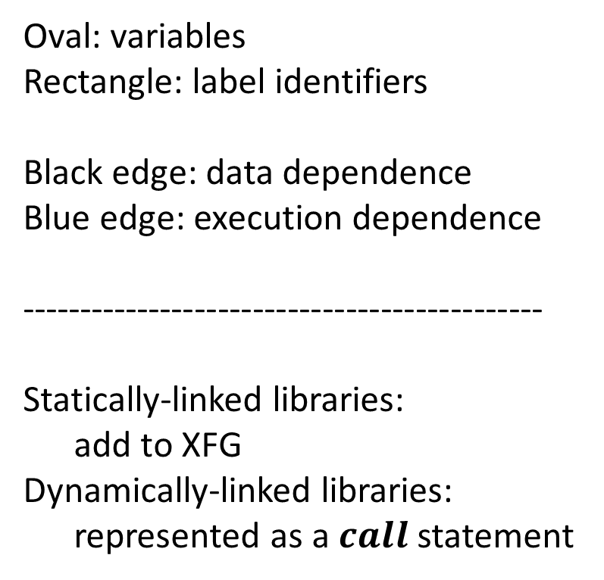
XFG: conteXtual Flow Graphs
Oval: variables
Rectangle: label identifiers
Black edge: data dependence
Blue edge: execution dependence
---------------------------------------------
Statically-linked libraries:
add to XFG
Dynamically-linked libraries:
represented as a $call$ statement
Notes:
作者表示，他们是第一个提出 a hybrid of control and data flow for the training of embeddings

Slide 13
Outline
Starting Point:
Distributional Hypothesis of Code
Program Representation:
from LLVM IR to ConteXtual Flow Graph
New Program Embedding:
inst2vec
Evaluation & Experiments

Slide 14


inst2vec
Pre-processing:
delete comments & metadata
identifier ➔ %ID
immediate values ➔ <INT/FLOAT/STRING>
data structures ➔ encoded within statement

Slide 15
inst2vec
Generating neighbor statement pairs:
up to a certain context size N
discard statements that occur less than 300 times in pairs
perform subsampling of frequent pairs
Inst2vec model:
use skip-gram model
embedDim=200
train for 5 epochs

Slide 16
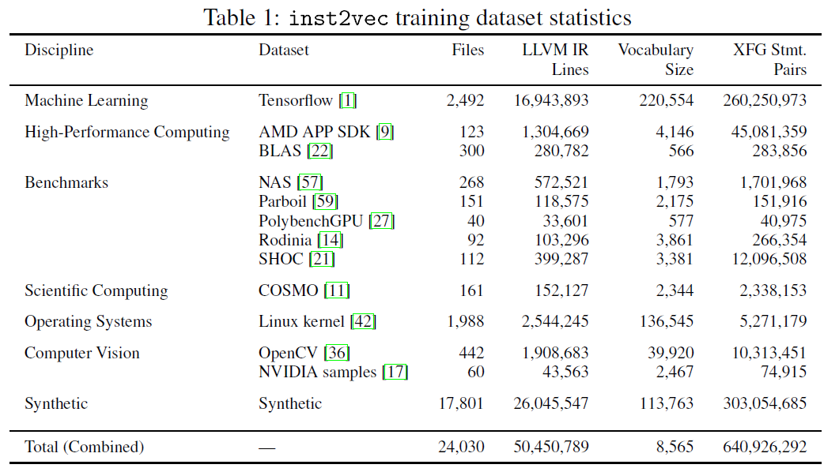
inst2vec

Slide 17
Outline
Starting Point:
Distributional Hypothesis of Code
Program Representation:
from LLVM IR to ConteXtual Flow Graph
New Program Embedding:
inst2vec
Evaluation & Experiments

Slide 18
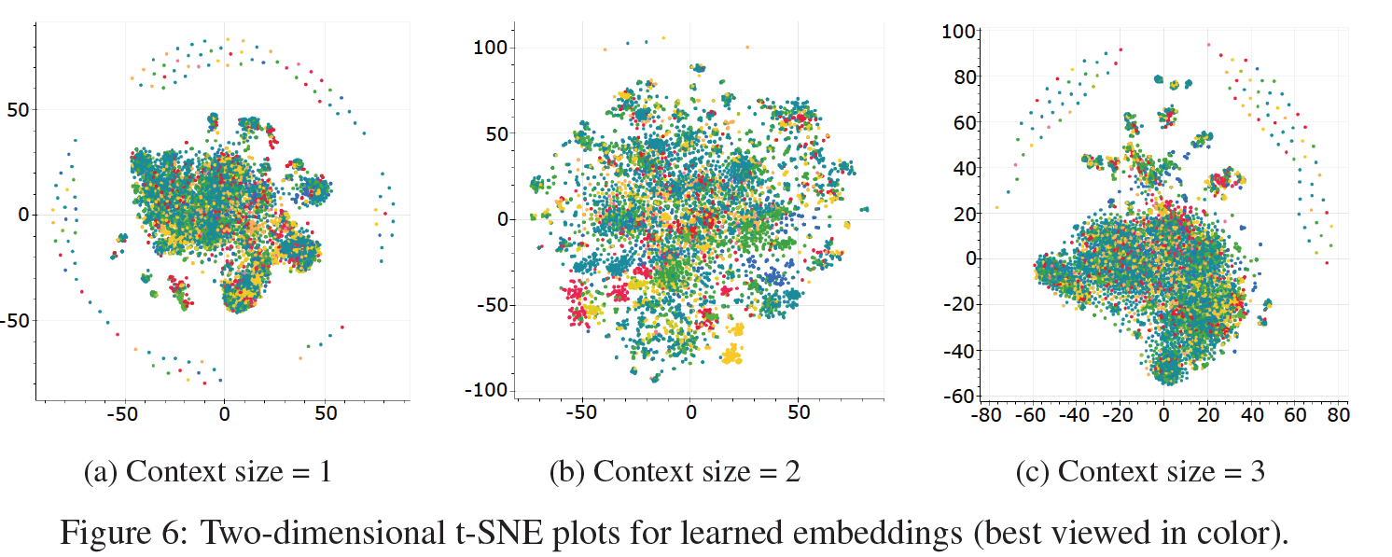
Clustering

Slide 19
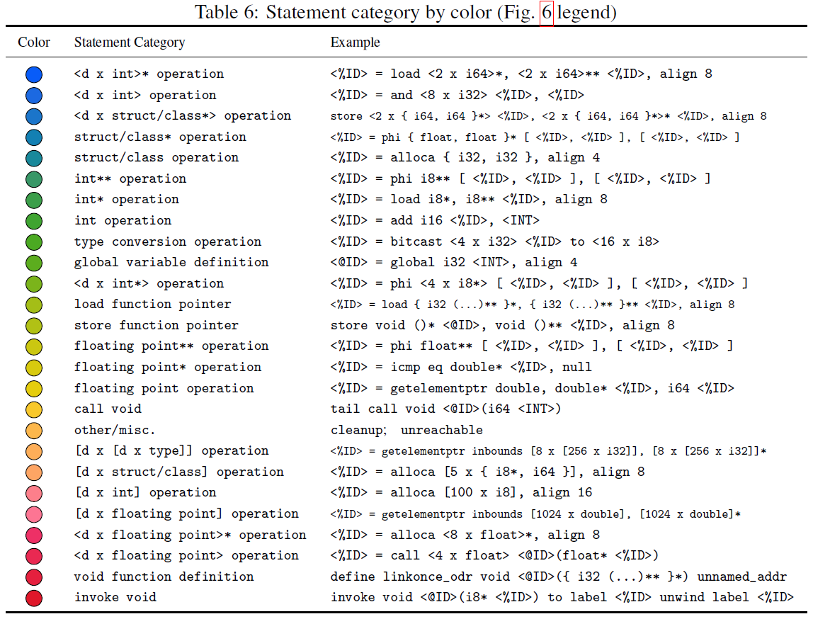

Slide 20

Analogies
Examples:
Task:
Computing a-b+c and asking whether the result is in the top-5 neighbors (cosine distance)

Slide 21
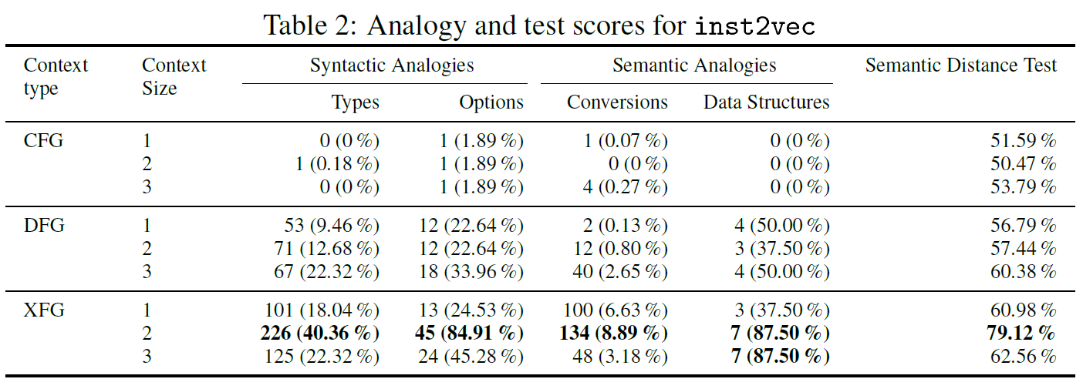
Analogies
Notes:
different categories： data types (i.e., transitions between types), options (e.g., fast math), conversions (e.g., bit casting, extension, truncation), and data structures (e.g., vector-type equivalents of structures)

Slide 22
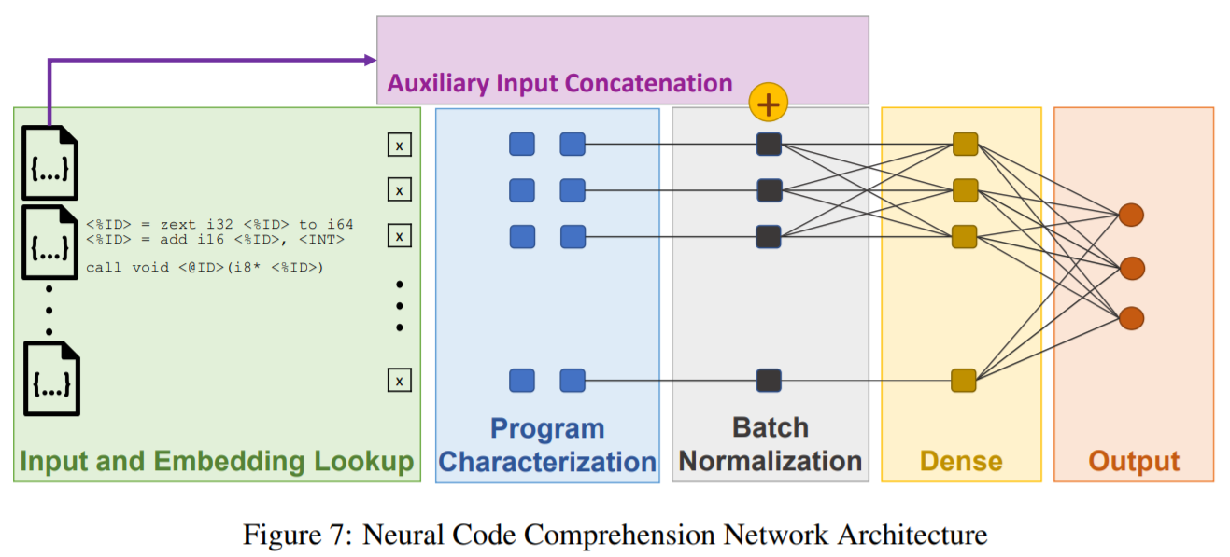
Code comprehension
Pre-trained inst2vec + model below:
(Needed in some tasks)
LSTM, 200
32
Notes:
附录里还做了把immediate value拼到embedding上的实验，在异构设备任务上提高了~4%准确率。

Slide 23
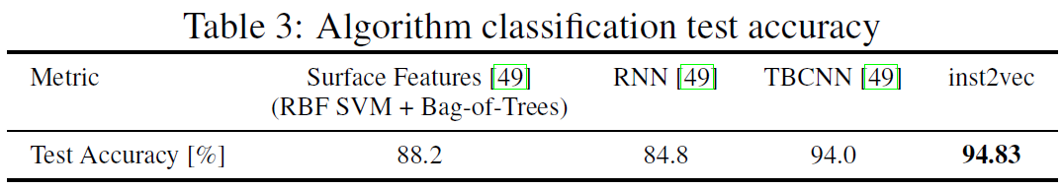
Algorithm classification
Dataset: POJ-104
Data augmented by compile 8 times with different flags.

Slide 24
Heterogeneous Compute Device Mapping
Task:
predict whether a given OpenCL program will run faster on a CPU or a GPU given its code, input data size, and work-group size.
Dataset:
OpenCL code dataset, Cummins et al.
Two sets of experiments:
Intel i7-3820 vs AMD Tahiti
Intel i7-3820 vs NVIDIA GTX
Notes:
Train 10 times and report the best result.
680

Slide 25
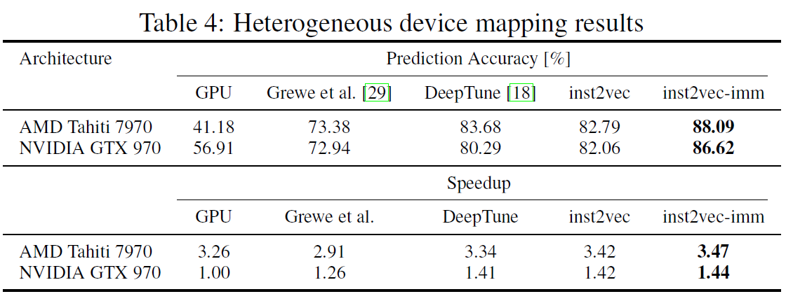
Heterogeneous Compute Device Mapping

Slide 26
Optimal Thread Coarsening Factor Prediction
Task:
predicts the best-performing thread coarsening factor, a measure of the amount of work done per GPU thread (1,2,4,8,16,32)
Dataset:
17 OpenCL programs
Two sets of experiments:
Intel i7-3820 vs AMD Tahiti
Intel i7-3820 vs NVIDIA GTX

Slide 27
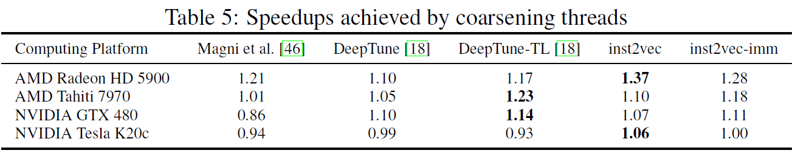
Optimal Thread Coarsening Factor Prediction
Notes:
作者：数据集小不是我们的锅

Slide 28
Outline
Starting Point:
Distributional Hypothesis of Code
Program Representation:
from LLVM IR to ConteXtual Flow Graph
New Program Embedding:
inst2vec
Evaluation & Experiments

Slide 29
Thanks for Listening!
Any Questions?

