Slide 1
Large Language Models with Multi-Token Prediction
Reporter: Jia Li♂
2024.5.14

Slide 2
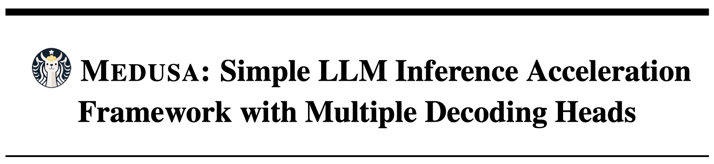
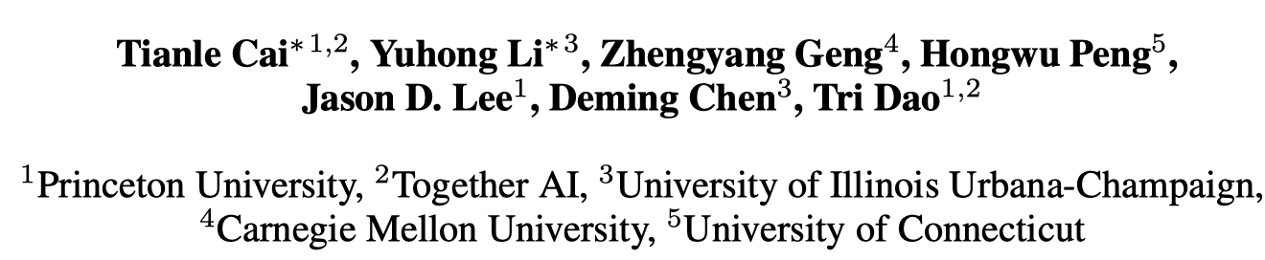
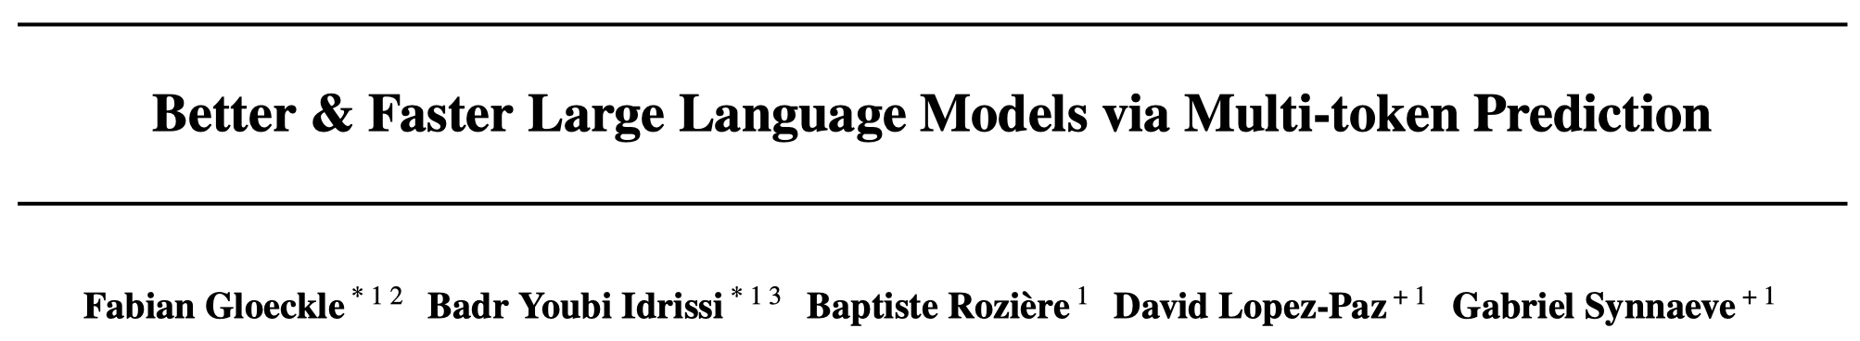
Abstract
During the training and inference stage, large language models only generate a token every decoding step.
What about generating multiple tokens (current token and future tokens) ?
Inference with Multi-Token Prediction
Pre-training with Multi-Token Prediction

Slide 3
arXiv 2024.1.19

Slide 5
Introduction
How to accelerate the inference of LLMs?
Speculative decoding - reducing the number of decoding steps
A draft model and a reference model
Challenging to select a suitable draft model
Additional memory overhead

Slide 6
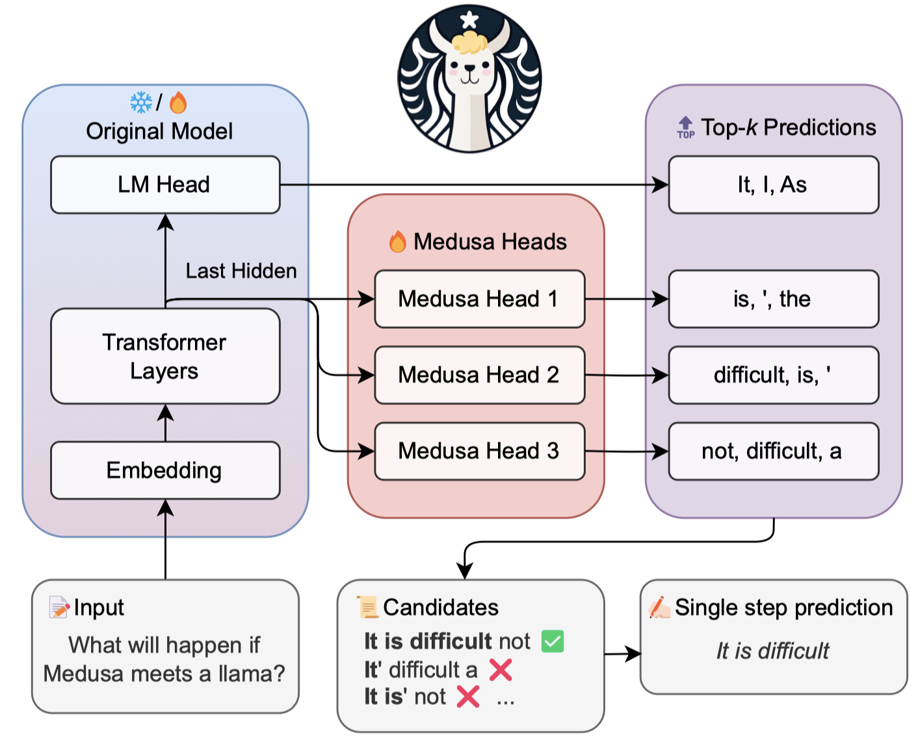
Medusa
Medusa（美杜莎）
Consider a LLM itself as the draft model
Integrate additional decoding heads capable of concurrently predicting multiple tokens
Generate multiple candidates
Accept candidates

Slide 7
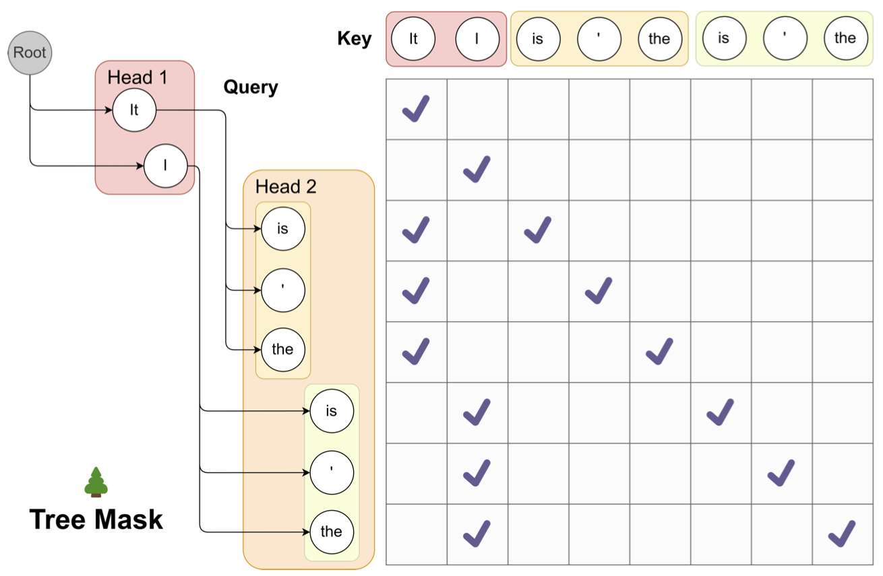
Medusa
Tree Attention
Accelerate the process of accepting candidates

Slide 8
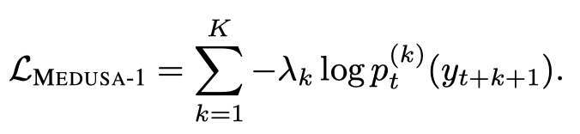


Training Strategy
Medusa-1: Frozen Backbone
Computed by the $k$-th head at $t$-th decoding step
Medusa-2: Joint Training
Differential learning rates, Heads warmup

Slide 9
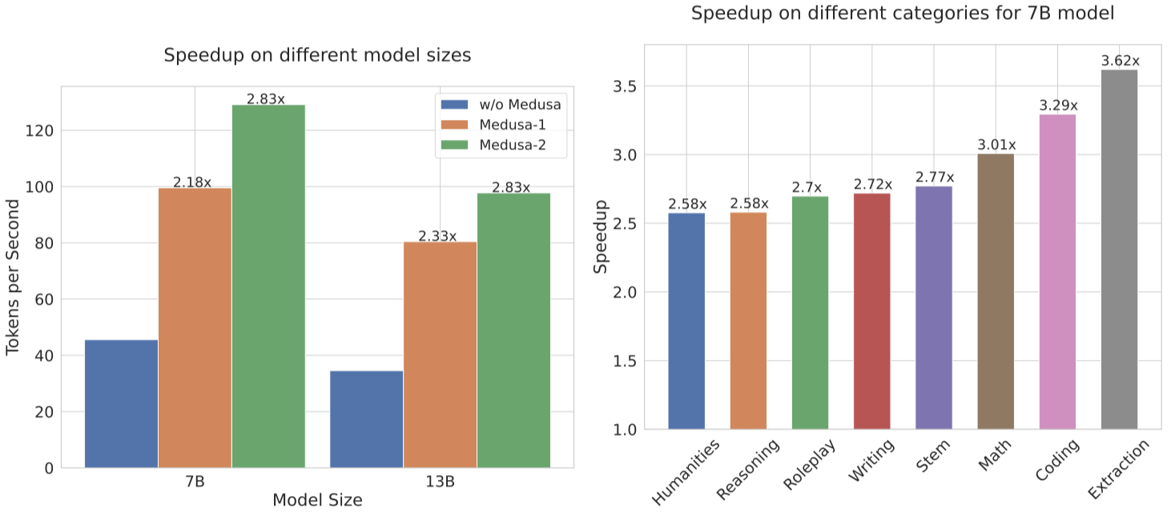
Experiments
Medusa-1 vs. Meduse-2
Base LLMs: Vicuna-7B, 13B
Benchmark: MT-Bench
Notes:
具体在用的时候，模型的输入包括…生成对应的补丁…然后使用Test cases去评估生成的补丁…

Slide 10
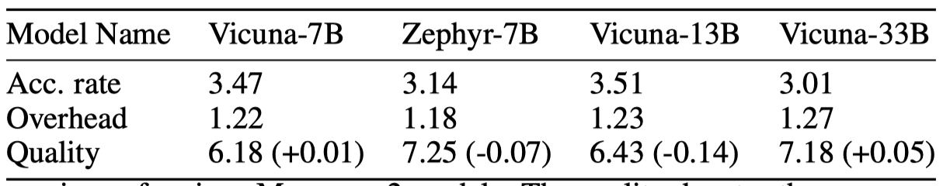
Experiments
Meduse-2
Training Data: ShareGPT, UltraChat

Slide 11
arXiv 2024.4.30

Slide 12
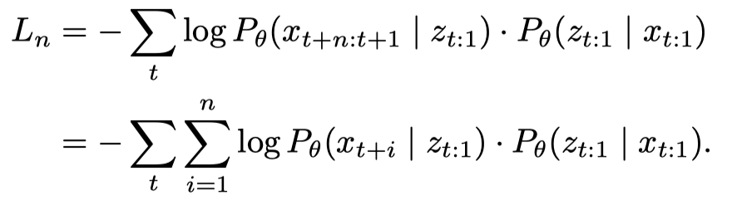
Introduction
Integrate multi-token prediction into pre-training

Slide 13
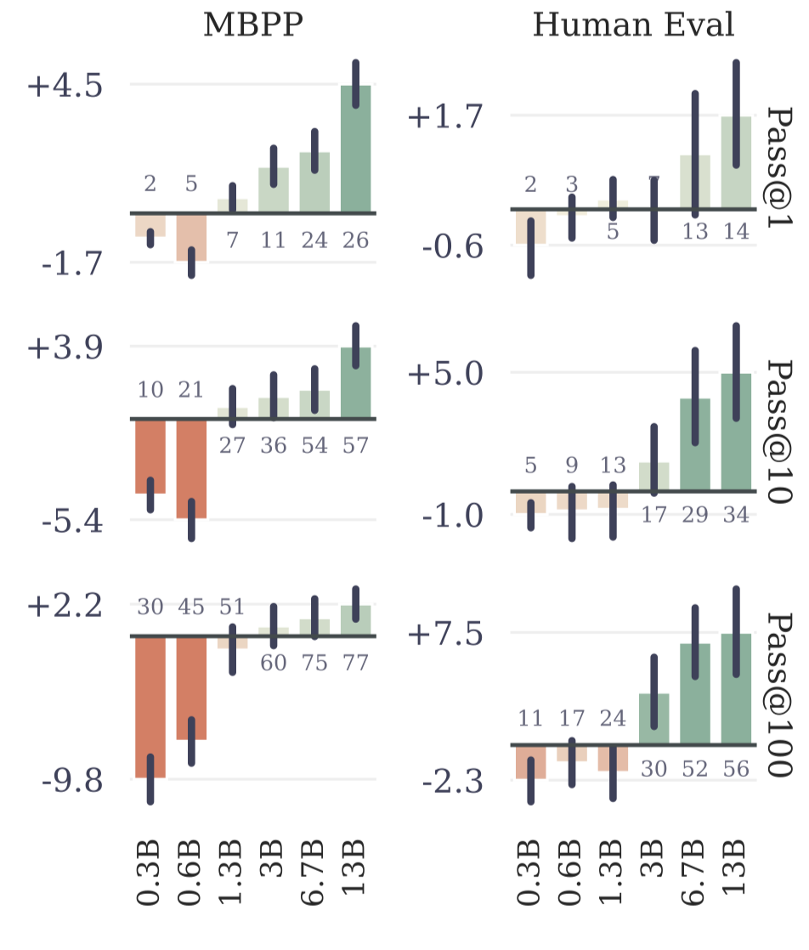
Experiments
Only use the next-token head
Multi-token prediction works at a large scale

Slide 14
Experiments
Use multiple heads + Speculative decoding
3.0x speed up on code
2.7x speed up on text

Slide 15
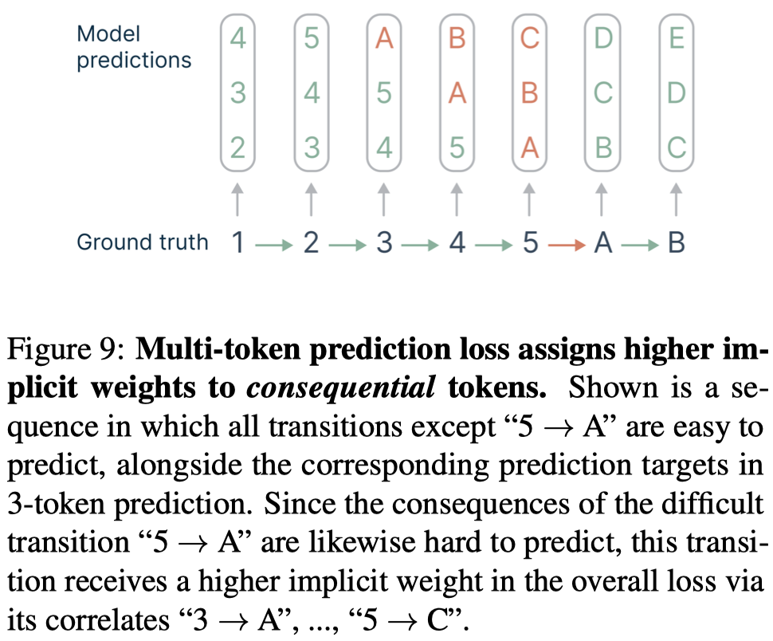
Why It Works?
Notes:
为什么仅用the next-token head的时候也有效。
之前next-token prediction的学习效率低，可能使模型仅关注部分特征。Multi-token prediction可以迫使模型去预测更远的位置，捕捉到长距离依赖，提升学习效率。

