Slide 1
Relational Recurrent Neural Networks
Adam Santoro, Ryan Faulkner, David Raposo, Jack Rae, Mike Chrzanowski, Theophane Weber, Daan Wierstra, Oriol Vinyals, Razvan Pascanu, Timothy Lillicrap
NeruIPS 2018
Reporter: Lu Shuai
Notes:
DeepMind

Slide 2
Outline
Relational reasoning
Model
Experiments

Slide 3
Outline
Relational reasoning
Model
Experiments

Slide 4
Relational reasoning
We take relational reasoning to be the process of understanding the ways in which entities are connected and using this understanding to accomplish some higher order goal.
Since we can often quite fluidly define what constitutes an “entity” or a “relation”, one can imagine a spectrum of neural network inductive biases that can be cast in the language of relational reasoning.
Memory
Attention
We begin by demonstrating that current models do indeed struggle in this domain by developing a toy task to stress relational reasoning of sequential information.
Notes:
CNN对相邻的像素， RNN在时域上归纳关系

Slide 5
Outline
Relational reasoning
Model
Experiments

Slide 6
Model
We assemble building blocks from LSTMs, memory-augmented neural networks, and non-local networks (in particular, the Transformer seq2seq model).
We allow for interactions between memory slots using an attention mechanism.
In contrast to previous work we apply attention between memories at a single time step, and not across all previous representations computed from all previous observations.

Slide 7
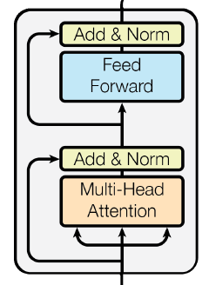
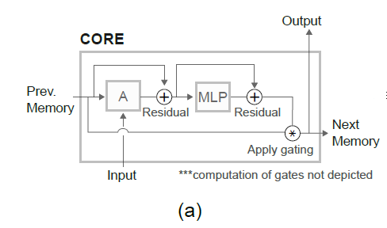
Model
Relational Memory Core
Notes:
A multi-head att

Slide 8
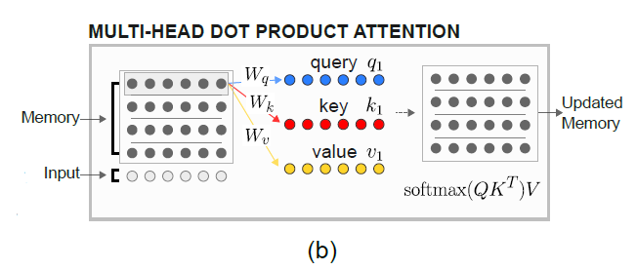

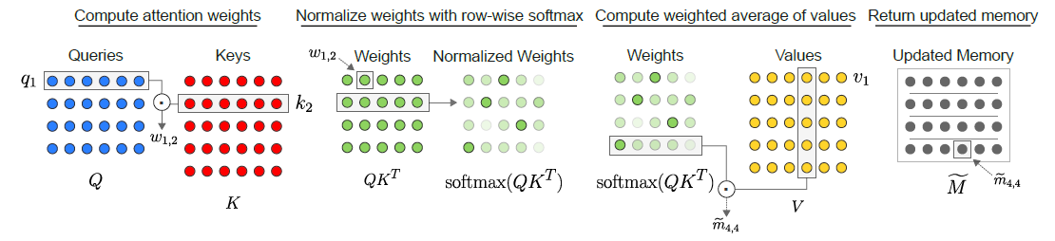
Model
we use [M; x] when computing the keys and values, and only M when computing the queries.

Slide 9
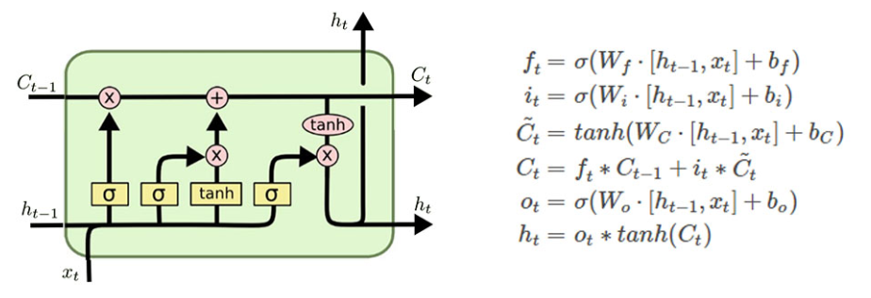
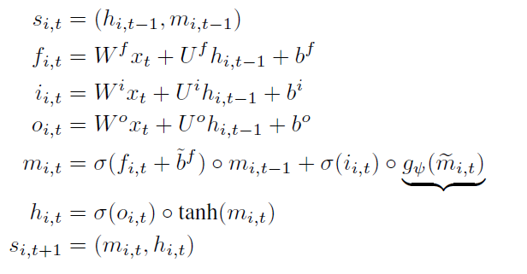
Model
Introducing recurrence and embedding into an LSTM

Slide 10
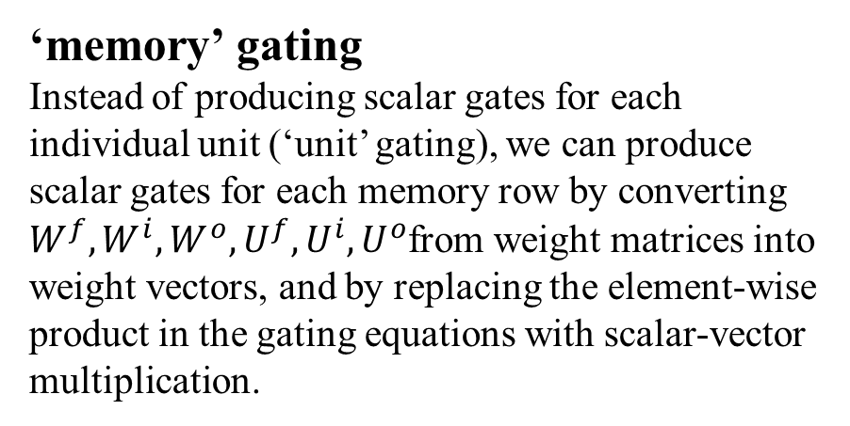
Model
Introducing recurrence and embedding into an LSTM
‘memory’ gating
Instead of producing scalar gates for each individual unit (‘unit’ gating), we can produce scalar gates for each memory row by converting $W^{f},W^{i},W^{o},U^{f},U^{i},U^{o}$from weight matrices into weight vectors, and by replacing the element-wise product in the gating equations with scalar-vector multiplication.

Slide 11
Outline
Relational reasoning
Model
Experiments

Slide 12
Experiments
“total units”: The total number of elements in the memory matrix M. Equivalent to the size of each memory multiplied by the number of memories.
“num heads”: The number of attention heads; i.e., the number of unique sets of queries, keys, and values produced for the memories.
“memory slots” or “number of memories”: Equivalent to the number of rows in matrix M.
“num blocks”: The number of iterations of attention performed at each time-step.
“gate style”: Gating per unit or per memory slot.

Slide 13
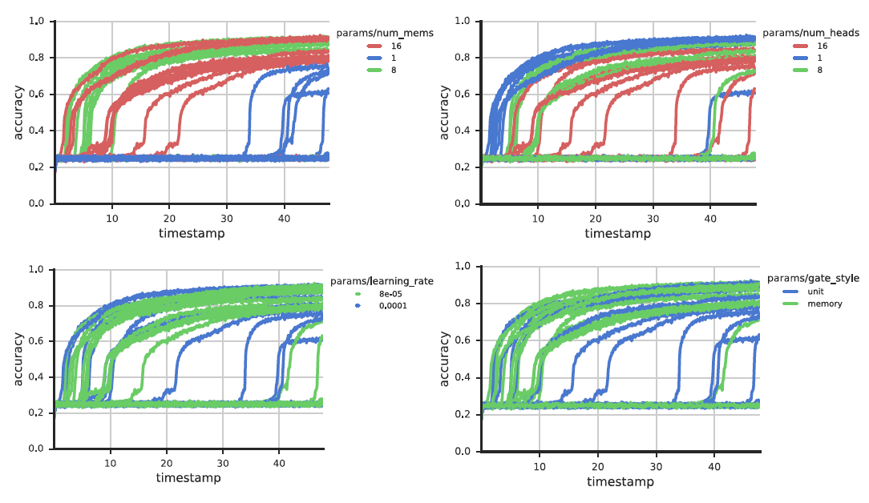
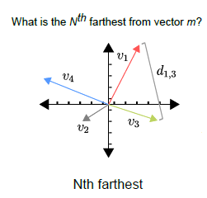
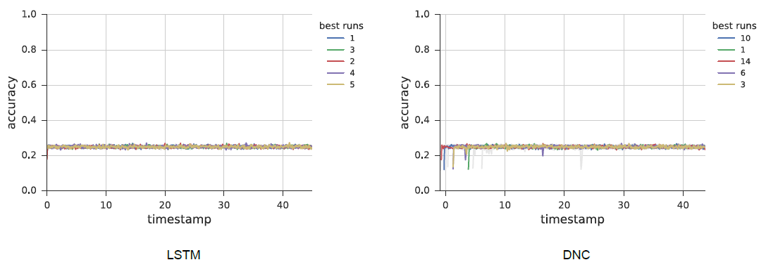

Experiments
$N^{th}$ Fartheset
*Hybrid computing using a neural network with dynamic external memory. Nature 2016

Slide 14
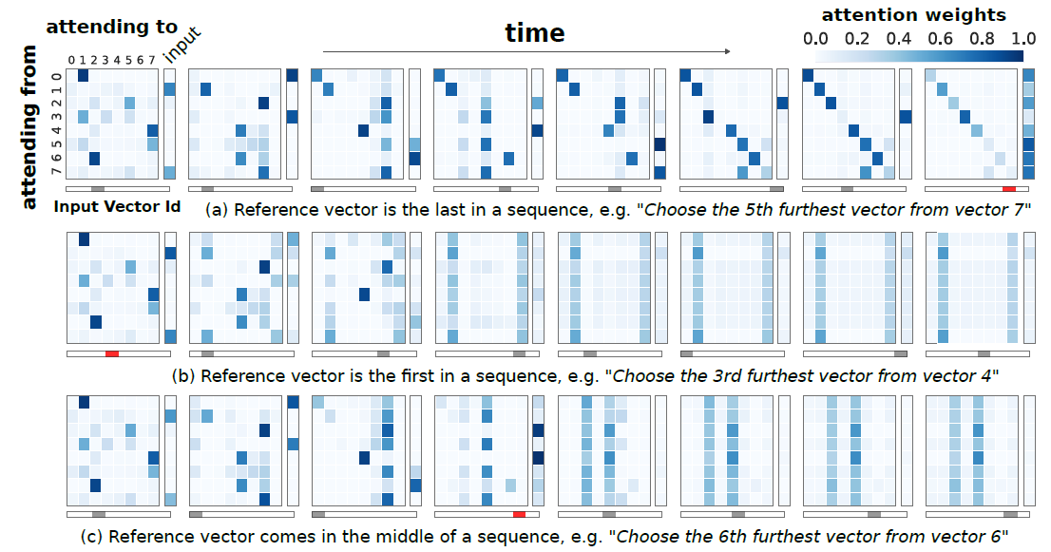
Experiments
$N^{th}$ Fartheset
Each row depicts the attention matrix at each timestep of a particular sequence. The text beneath spells out the particular task for the sequence, which was encoded and provided to the model as an input. We mark in red the vector that is referenced in the task.

Slide 15
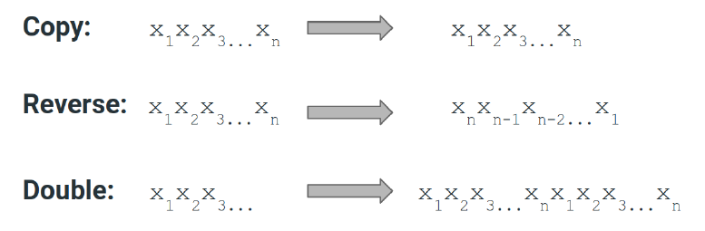
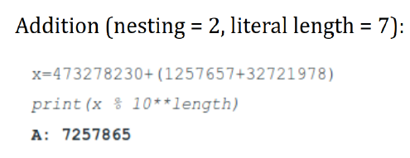
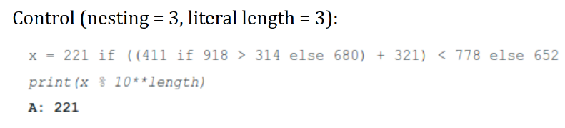
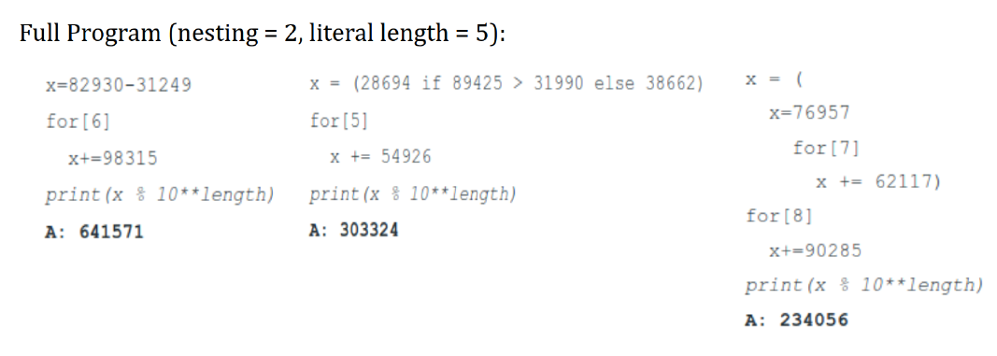
Experiments
Program Evaluation

Slide 16
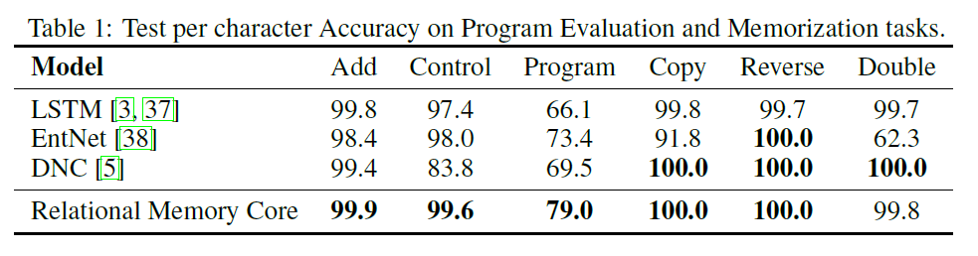
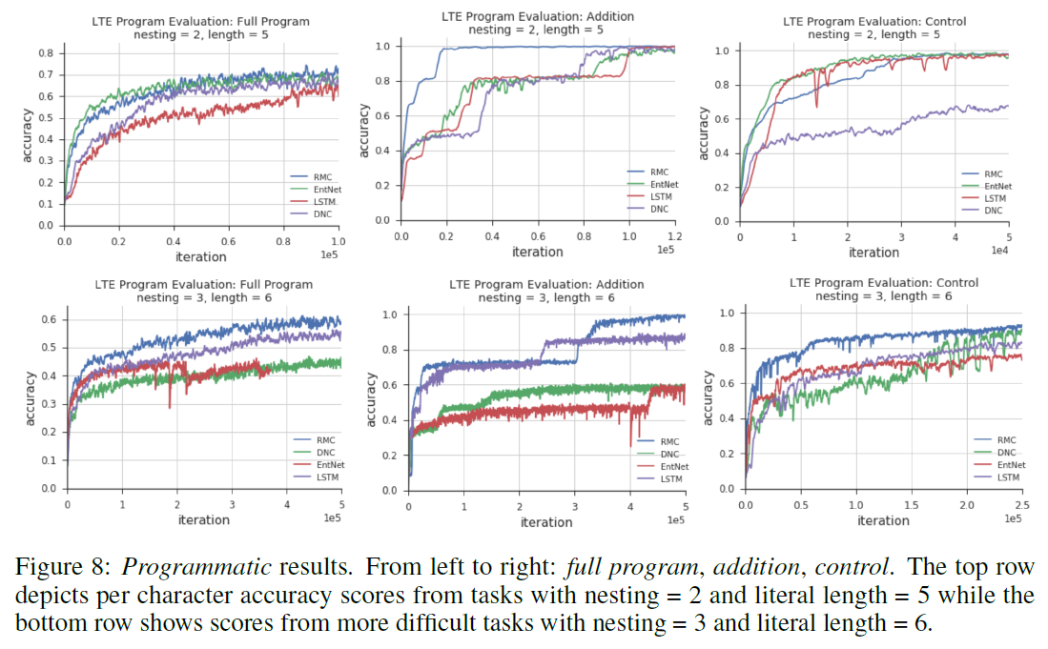
Experiments
Program Evaluation

Slide 17
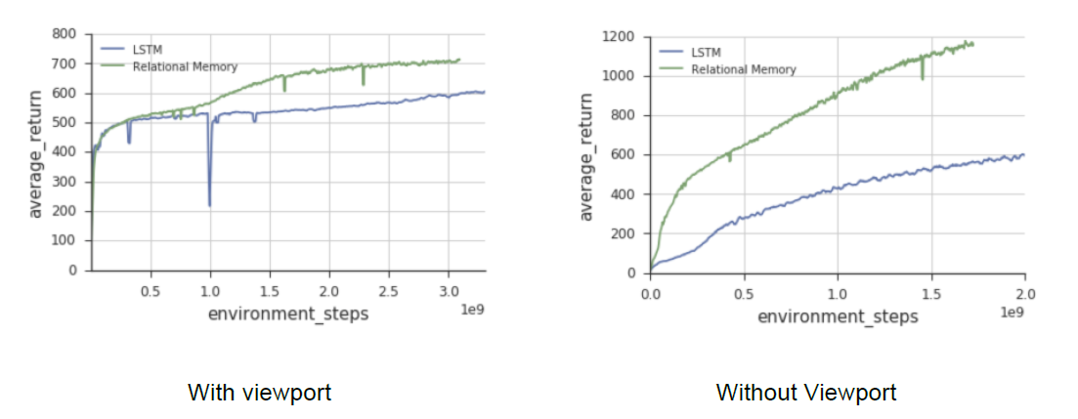
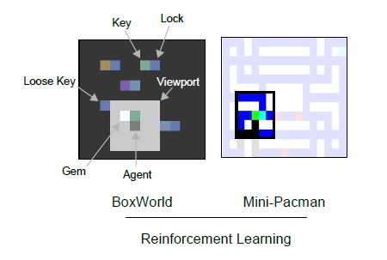
Experiments
Mini Pacman with viewport
Why viewport?
The task is therefore partially observable, since the agent must navigate the space and take in information through this viewport. Thus, the agent must predict the dynamics of the ghosts in memory, and plan its navigation accordingly, also based on remembered information about which food has already been picked up.

Slide 18
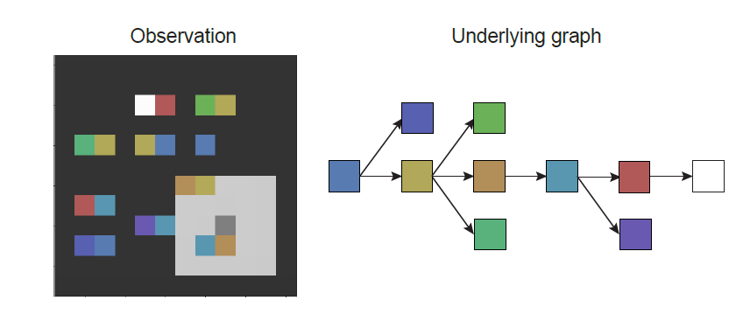
Experiments
Viewport BoxWorld
This agent achieved high performance in the task, correctly solving 98% of the levels after 1e9 steps. The same agent augmented instead with a ConvLSTM performed significantly worse, reaching only 73%.

Slide 19
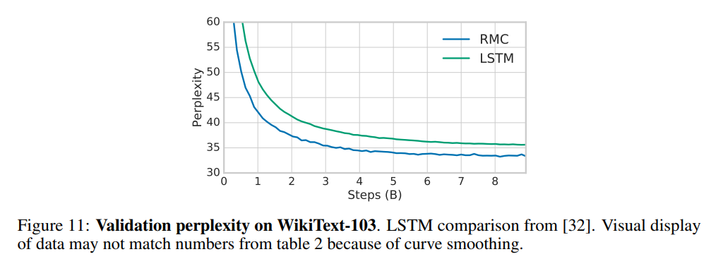
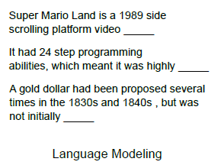
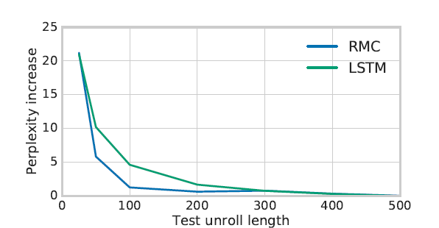
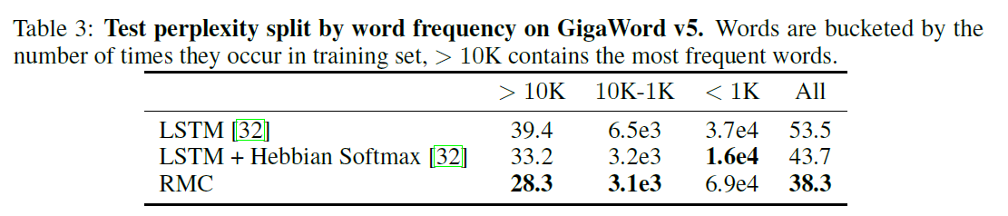
Experiments
Language Modeling

Slide 20
Thank You!

