Slide 1
To Learn the Embedding Dynamically?
Zhang Huangzhao 张煌昭
Yuan Pei College 元培学院
Zhang_hz@pku.edu.cn

Slide 2
Outline
What I did & what I’m doing
A maybe feasible method to embed UID’s
<Learning to Learn Programs from Examples: Going Beyond Program Structure> by Kevin Ellis, MIT & Sumit Gulwani, Microsoft, in IJCAI-2017

Slide 3
Current Situation & Goal
To embed the key words (eg. for, if, etc.) and frequently-used functions (eg. printf, scanf, etc.) is easy.
To embed the UID’s (eg. variables, user-defined functions, etc.) and the constants (eg. constant integers, strings, etc.) is very hard.
The goal is –
To separate program (eg. the key words, etc.) and data (eg. UID’s, constants, etc.);
To perform different kinds of embedding on each kind inputs;
To embed UID’s dynamically;
To embed constants.
？
✔
？

Slide 4
Current Situation & Goal
Separate data from program
-- Use an extra “memory”, MAYBE.
Perform different kinds of embeddings
-- Use flag vector to tag the type of each input vector.
Embed UID dynamically
-- Use static features (type + index, maybe) and current RNN hidden cell states.
Embed constants
-- No idea ☹. Maybe put them in the “memory”?

Slide 5
Data + Program
Byte code sequence
.o file -- .Data section, .Text section … …
Why not use byte code, or assembly code? What if we build a model to “run” a program?
UID’s in source code
Key words
UID -- type + index
Constant -- “CONST”

Slide 6
A Solution to UID, Maybe
The model learns the embeddings of the UID’s all by itself.
The embeddings of the UID’s are dynamic, instead of static.
Input
Output
Embedding for UID
Embedding for UID
Gate Signal
raw_rnn???
while loop???
…

Slide 7
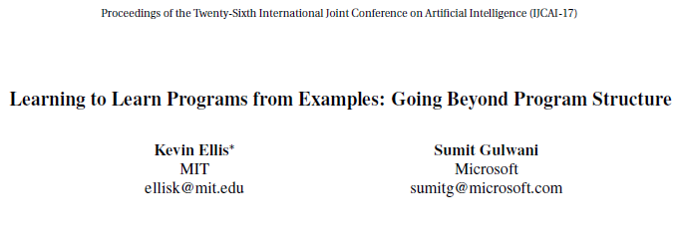

Slide 8
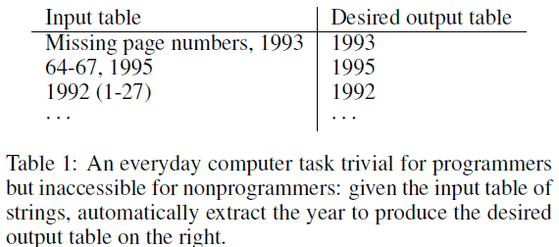
Programming by Examples (PBE)
Input examples of intended behavior
Respond by inducing and running a program
Eg. Flash Fill
Baseline: PROSE software library in Microsoft Excel

Slide 9





Notation
Program to be learned --
Domain Specific Language --
Labeled input/output instances --
Number of the labeled instances --
Unlabeled input/output instances --
Total number of the instances --

Slide 10
Notation
Manually crafted scoring function on specific DSL
Frontier, the top K programs under the scoring function --
Size of the frontier --
Inputs -- Labeled outputs –
PROSE approach --
Some specific feature extractor --
Weights placed on the features --

Slide 11
The Flow of Idea
To improve the current methods
-- Features of program structure
To improve the current methodology
-- Features of program trace
To generate a new method(methodology)
-- Features of program outputs

Slide 12

Extracting Predictive Features
Features of Program Structure
Intuition – Prefer short, simple rather than long, complicated programs.
Feature extractor for programs --
The program predicted by the learner --
Examples of the feature extractor
Probabilistic grammar -- counts the grammar productions used, and are log production probabilities.

Slide 13
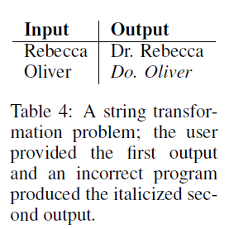
Extracting Predictive Features
Features of Program Structure
used by the authors -- Count the occurrences of different program primitives.
Detect the presence of domain-specific code templates.
Eg. Count the number of times that an input is parsed as a date.
Structure features are static. The authors go beyond it by introducing features of program behaviors.

Slide 14
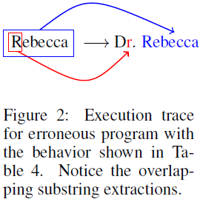
Extracting Predictive Features
Features of Program Trace
PROSE is tuned to prefer programs that extract prefixes (due to its preference on shorter programs).
PROSE’s inductive bias is written by hand rather than being learned from data.
-- “… Simply introducing an inductive bias against accessing overlapping regions of the input is enough to disprefer the erroneous program …”

Slide 15
Extracting Predictive Features
Features of Program Trace
A special case for substring extractor --Trace feature extractor
Feature 1 -- Does substring extractions overlap?
Correct programs usually pull out the intended data only once.
Feature 2 -- Are substring extractions repeated?
Feature 3 -- Are substring extractions adjacent?
Intended programs often split adjacent inputs.
Feature 1 strongly predicted program incorrectness; Feature 2 and feature 3 are a weaker signals.

Slide 16
Extracting Predictive Features
Features of Program Outputs
To find “well-typed” programs is important.
Descriptor -- a description (good or bad) of the outputs.
Smoothness -- a score of programs’ outputs.
Preference for “smooth programs” is like regularization
To formalize the preference, a regularization-like penalty on programs whose outputs are too dissimilar is performed.

Slide 17
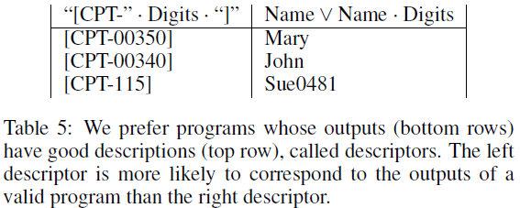
Program Descriptor & Smooth Programs

Slide 18
Program Descriptor & Smooth Programs
Assume that the descriptor is a probabilistic generative model over strings
Assume that we can model prior probabilities of descriptor for correct / incorrect programs’ outputs

Slide 19
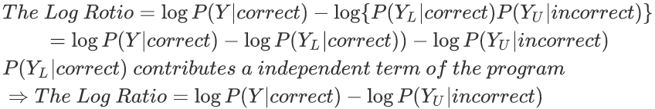
Program Descriptor & Smooth Programs
2 hypotheses
The candidate program is correct → Y are the result of the intended program
The candidate program is incorrect → Y_{L} are the result of a correct program and Y_{U} are the result of an unintended program
The log odds ratio of the 2 hypotheses

Slide 20
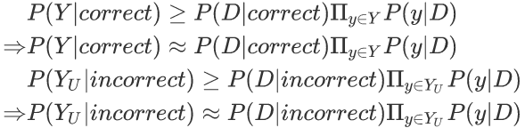
Program Descriptor & Smooth Programs
Approximations
Assume a log linear prior over D

Slide 21
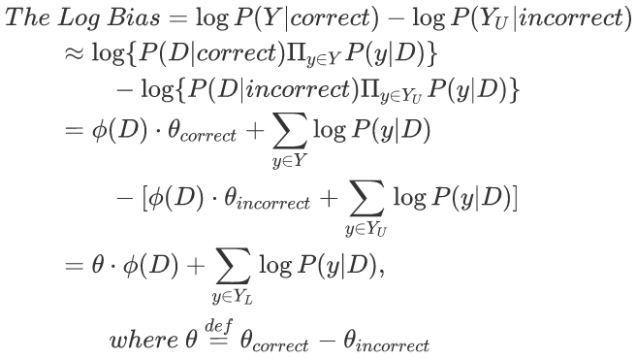
Program Descriptor & Smooth Programs
Final expression for the inductive bias over program outputs

Slide 22

Program Descriptor & Smooth Programs
Prefer outputs whose D has certain features.
eg. not containing empty strings, or containing common sense categories.
Prefer outputs whose D puts high probability mass on the outputs the user actually provided.

Slide 23
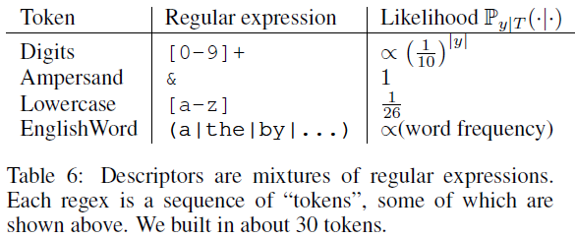
Program Descriptor & Smooth Programs
Representing descriptors
Mixtures / Disjunctions of regular expressions, eg. “Name V Name · Digits”
The regular expressions are sequences of tokens (30 predefined tokens).
Equip each token T with a likelihood model P_{y|T} over string y.

Slide 24
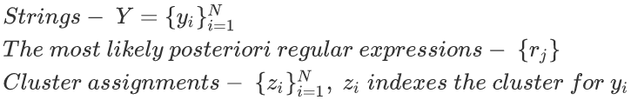

Program Descriptor & Smooth Programs
Inferring descriptors
What is the most likely descriptor? -- Unsupervised clustering
Don’t know the number of mixture components – Chinese Restaurant Process (CRP, Bayesiana nonparametrics), using DP / greedy

Slide 25
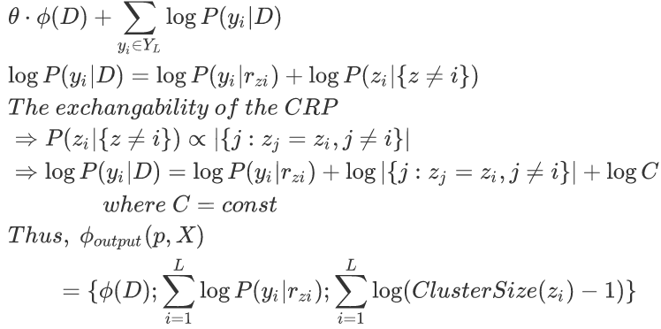
Program Descriptor & Smooth Programs
The probability of a user-labeled output given its RegEx in D
Extracting features from a descriptor
Log of size of the cluster containing the user labeled outputs

Slide 26
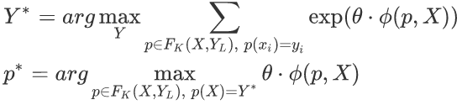

Learning to Pick a Program
Probabilistic Model
Inferring the Model Parameters -- RMSProp

Slide 27
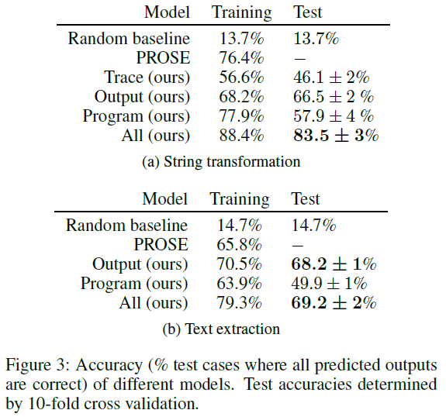
Results

Slide 28
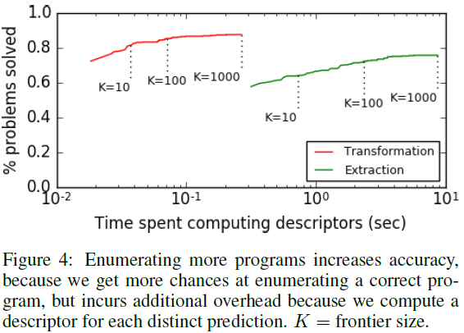
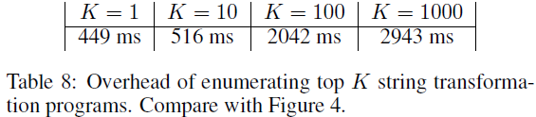
Results

Slide 29
THANK YOU! ☺

