Slide 1
CAPSULES
Zhang Huangzhao, Yuan Pei College
zhang_hz@pku.edu.cn

Slide 2
To-do List
Recent work
Transforming Auto-encoders
Dynamic Routing Between Capsules

Slide 3
About Code Embedding
Key words & commonly-used functions – ‘Fixed’
Variables – Type + index
Constants – Can do nothing about them …
Key Words
Float’s
Int’s
… …
Constants

Slide 4
About Code Embedding
Key Words
Float’s
Int’s
… …
Constants
“Dynamic” section

Slide 5
About Code Embedding
Output(t)
State(t)
Basic
LSTM
Cell
“Memory”
Real Input(t)
Input(t)
State(t-1)
Real Input(t)
Input(t)
Dynamic
Section
New LSTM Cell

Slide 6
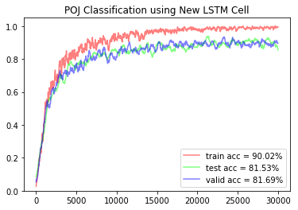
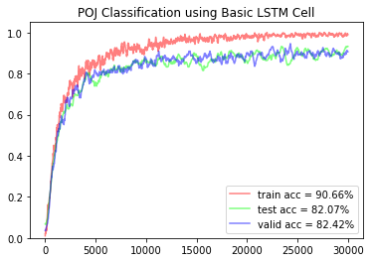
About Code Embedding
POJ classification
Almost the same …

Slide 7
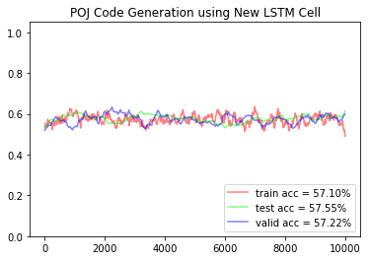
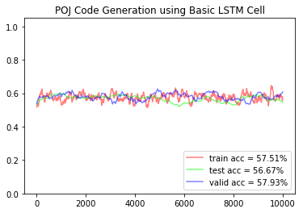
About Code Embedding
POJ code generation
Still almost the same …

Slide 8
To-do Work
Test on other datasets
Examine the “memory” and the dynamic section

Slide 9
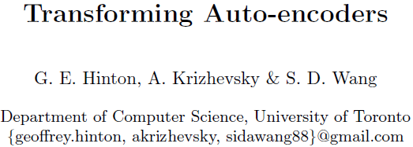
The story begins …

Slide 10
What’s wrong with CNN?
CNNs now aim for viewpoint invariance.
Reduce the number of free parameters, by using hand-coded weight-sharing schemes.
Subsampling the activities of local pools of translated replicas of the same kernel.
Neurons use a single scalar output to summarize the activities of a local pool of replicated feature detectors.
Single scalar output is insufficient.

Slide 11
What are ‘capsules’?
Inputs -> capsule -> some complicated internal computations -> encapsulate the results -> outputs the vector.
Each capsule only recognizes one limited domain of view points / deformations of a visual entity (implicitly defined).
Capsule outputs the probability that the entity is present within the domain, and a set of instantiation parameters that describes the deformation relative to an canonical version of the entity (implicitly defined).

Slide 12
What are ‘capsules’?
The probability is locally invariant. The instantiation parameters are equivariant.
The probability – the entity presents or not
The instantiation parameters – the pose, lighting, transformation…
Activation – If capsules have the right spatial relationship, the entity exists, the instantiation parameters agree to each other, these capsules can activate a certain higher level capsule.
Part-whole relationship -- hierarchical

Slide 13



Capsule C – Face (higher-level capsule)
Capsule A – Eyes
Capsule B – Mouths
Capsule A
Capsule B
Capsule C
✖
✖
✔

Slide 14
Difficulty
Existence + pose -> existence + pose (higher-level)
Easy
Pixel intensities -> existence + pose
Hard?
The question addressed by this paper

Slide 15
Problem
A simple 2-D image shift problem
Pose – position, (x, y)
Input – an image and desired shift, (Δx, Δy) as input.
Output – the shifted image.
Model – Transforming Auto-encoders

Slide 16
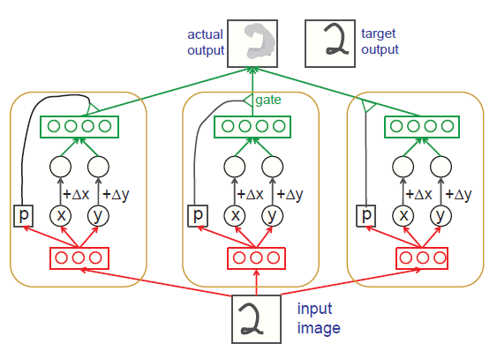
Transforming Auto-encoders
The network composes a number of separate capsules.
‘Generation units’ compute the capsule’s contribution to the transformed image.
Logistic ‘recognition units’ compute x, y and p.
Capsules cooperate to produce the shifted image.

Slide 17
Demonstration
MNIST images shifted randomly by -2 ~ +2 pixels in x and y directions.
Input – MNIST digit image, Δx and Δy.
Target output – shifted MNIST digit image.
30 capsules
Each has 10 recognition units
Each has 20 generation units.
Each capsule sees the whole of an MNIST digit image.

Slide 18
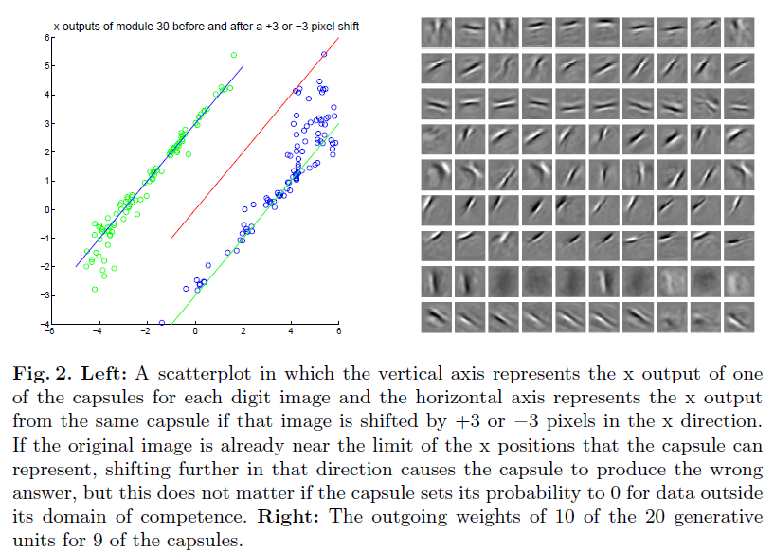

Slide 19
Affine transformation
2-D affine transformation – apply a transformation matrix T to the output.
3-D affine transformation – the same.
Cap
A
3 x 3
Matrix
A
Matrix
TA
Gen
Unit
9 real-valued outputs
real-valued inputs
Transfor
-mation
Matrix
T

Slide 20
Complex 3D Affine Transformation
Dataset – computer graphics generated stereo images of various types of car from many different viewpoints.
900 capsules, each with two layers, first 32 then 64 as recognition units.
11 x 11 pixel receptive fields; 30 x 30 grid over 96 x 96 image; stride between neighborhoods = 3 pixels.
… …

Slide 21
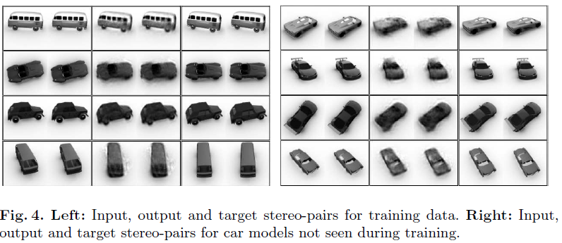

Slide 22
Brief Sum-up
Existence + instantiation parameters
Advantages (maybe)
Capsules in one local would discover overlapping.
Disadvantages (maybe)
One entity for one capsule only
Naïve, immature

Slide 23
Converting digital to capsule vector is possible.
But the transforming auto-encoder is just a toy.

Slide 24
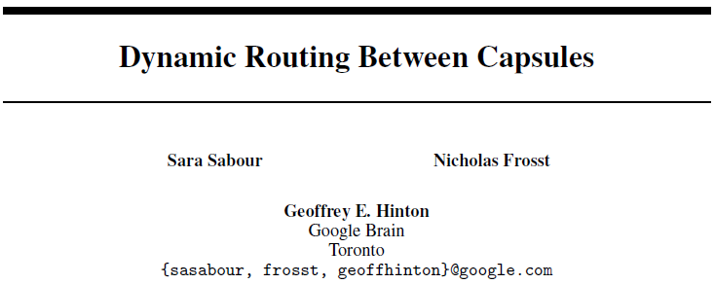
The story goes on …

Slide 25
Stick with Capsules
CNN is misguided.
Capsule – each recognizes a certain entity, and outputs a scalar as the probability and a vector as the instantiation parameters.
Hierarchy & convolution
Main ideas of the paper
Vector output (vs. scalar output in CNN)
Routing-by-agreement (vs. pooling in CNN)

Slide 26
… …
Route to the next layer
As a gate
scalar + vector
C¹₁
C¹₂
C¹₃
C¹_{n}
P
Instantiation Parameters
Capsule Hierarchy
… …
scalar + vector
Image
Some
Capsule
C⁰₁
C⁰₂
C⁰₃
C⁰_{n}
… …
Pixel
Input

Slide 27
How to compute the vectors?

Slide 28


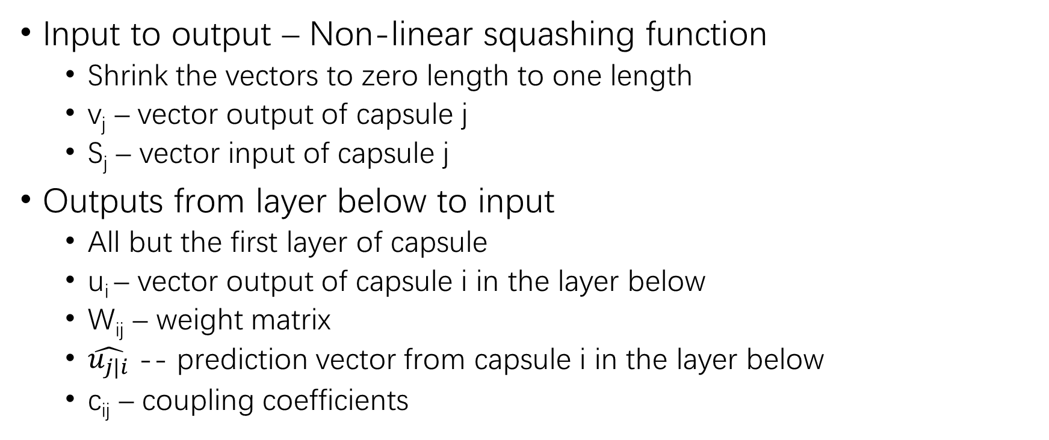
How to compute the vectors?
Input to output – Non-linear squashing function
Shrink the vectors to zero length to one length
v_{j} – vector output of capsule j
S_{j} – vector input of capsule j
Outputs from layer below to input
All but the first layer of capsule
u_{i} – vector output of capsule i in the layer below
W_{ij} – weight matrix
$\hat{u_{j|i}}$ -- prediction vector from capsule i in the layer below
c_{ij} – coupling coefficients

Slide 29

How to compute the vectors?
Coupling coefficients – c between capsule i and all capsule in the layer above sum to 1.
Routing softmax
b_{ij} – the log prior probabilities that capsule i should be coupled to capsule j
Refine b_{ij} – using agreement
b_{ij} depend on the location and type but not the current image.
b_{ij} is iteratively refined by measuring the agreement a_{ij}.
Agreement is treated as if it is a log likelihood

Slide 30
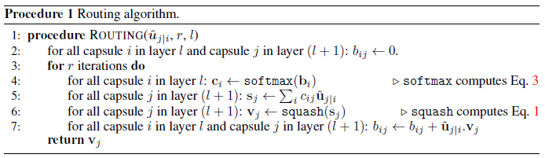
Routing-by-Agreement Algorithm

Slide 31
Layer below
Curr layer
(not the first)
Routing
Softmax
b_{ij}
c_{i}
Caps i
u_{i}
u_{j|i}
s_{j}
Caps j
v_{j}
Squashing
Function
W_{ij}

Slide 32
Margin Loss
Separate margin loss – L_{k} for each digit capsule k (capsule in the top level)
T_{k} = 1 ↔ a digit class k is present & m⁺=0.9 & m⁻=0.1
Total loss – the sum of the losses of all digit capsules.

Slide 33
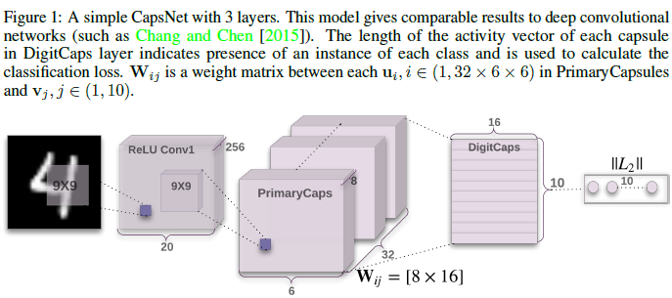
CapsNet Architecture

Slide 34
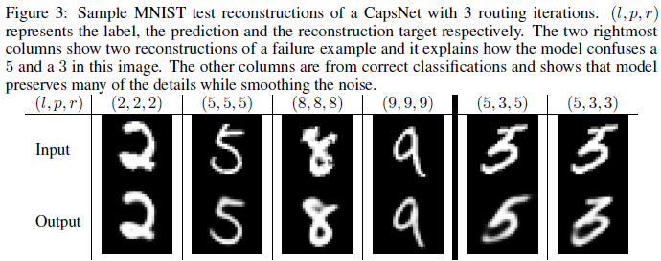
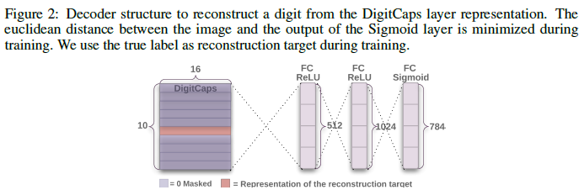
CapsNet Architecture

Slide 35
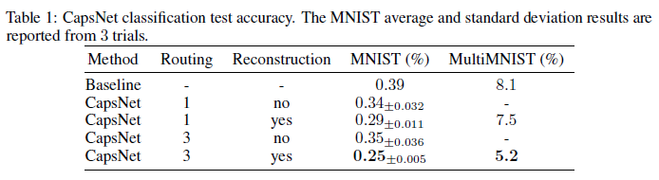
Capsules on MNIST
Baseline – conv -> conv -> conv -> fc -> fc -> softmax
35.4M parameters
CapsNet – conv -> caps -> fc -> fc -> softmax
8.2M parameters with reconstruction subnetwork
6.8M parameters without reconstruction subnetwork

Slide 36
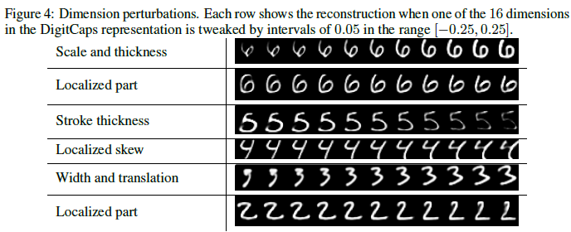
Capsules on MNIST
What the individual dimensions of a capsule represent

Slide 37
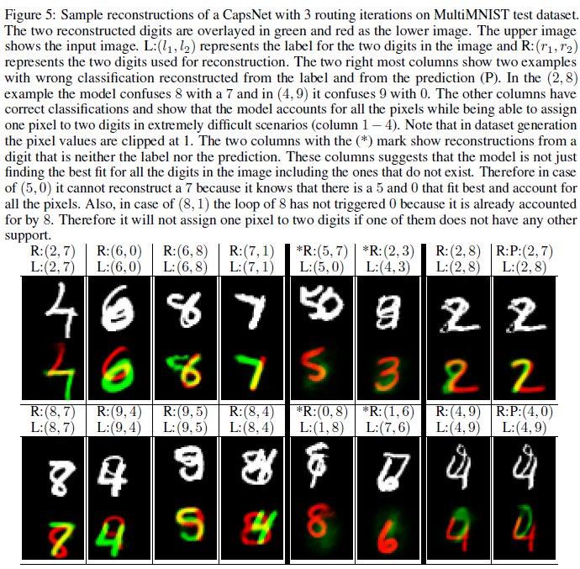
Capsules on MNIST
MultiMNIST segmenting
Parallel attention

Slide 38
Capsules on Other Datasets
CIFAR-10 – 10.6% error
Introduce ‘none-of-the-above’ category for the routing softmaxes.
≈ standard CNN applied to CIFAR-10 (Zeiler and Fergus [2013])
smallNORB – 2.7% error
On-par with the state-of-the-art
SVHN – 4.3% error
Structure is still important!

Slide 39
Summary
Substitution of BP? – Not exactly
Routing-by-agreement + BP
What’s good about Capsules?
Vector outputs
Parallel attention
Easy to explain
Spatial information preserved
What’s not so good about Capsules?
One entity per capsule only
… …

