Slide 1
Dynamic Embedding with Context Information
Zhang Huangzhao 张煌昭
Yuan Pei College 元培学院
Zhang_hz@pku.edu.cn

Slide 2
To-do List
Motivation
The Model to Achieve Context Embedding
Experiment on Artificial Dataset
Experiment on NLP Task
Experiment on Source Code Task

Slide 3
Motivation
UID’s in source code
‘int tmp’ in different programs have different meanings.
‘int a’ and ‘int b’ may be the same thing in different programs.
Word tokens in NL
“Like” in “I like you” and “I am like you” means differently.
“against” in “I am against you” and “disagree” in “I disagree with you” may have the same meaning.
etc.

Slide 4
Motivation
Polysemy
The same token has different meaning when in different environment (context).
Eg. “like” – I like you. v.s. I am like you.
Synonym
Different tokens have the same meaning when in some specific environment (context).
Eg. “like” – I am like you. v.s. “similar” – I am similar to you.
Current Embedding Method
One fixed embedding per token, not considering the context information.

Slide 5
Motivation
A maybe better way is to use context information to generate embeddings dynamically.
Simple Implementation
Concatenate the original embedding and context information.
Token Embedding Domain
Context Information Domain
New Dynamic Embedding with Context Information

Slide 6
The Model
Where is the context information?
In LSTM, they are stored in the “cell”
How can we use the information?
Use a slot memory, each slot represents a piece of “meta-information”. Select slots based on the cell, or hidden state of the current time-step.
Implementation?
For each time-step, generate a “selection vector” to select memory slots, add the slots linearly to get the context vector, and finally concatenate the context vector with the input vector.

Slide 7
The Model
Output Layer
Slot 0
Slot Memory
Slot 1
Slot 2
Softmax
… … … …
Hidden Layer (Cells)
Selection Vector
Input Layer
Slot (m-1)
Input Vector
Context Vector

Slide 8
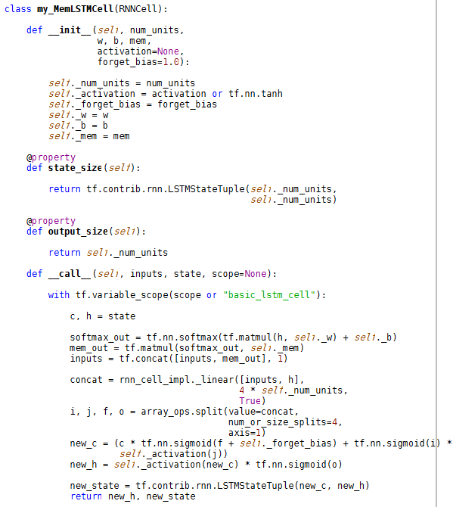
The Model

Slide 9
Experiment on Artificial Dataset
Simple GE/LT Dataset
Task – Input a string which consists of two integer numbers, decide if the first number is larger than or equal to the second number.
Input: a string contains only 0-9 and blank (11 in total). The number pairs are generated randomly, and the string has a fixed length (blank padding).
Output: if the first number in the string is larger than or equal to the second number, output “GE” (for greater/equal); otherwise, output “LT” (for less than)
eg. (“11111 11111 ”, “GE”) (“11223 34455 ”, “LT”)

Slide 10
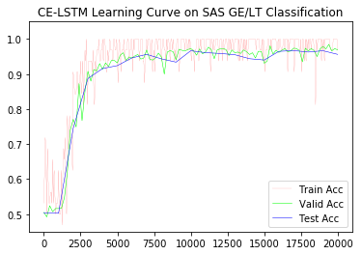
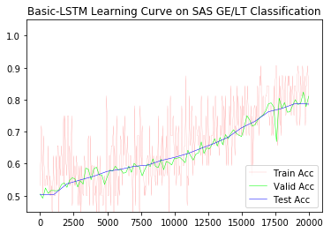
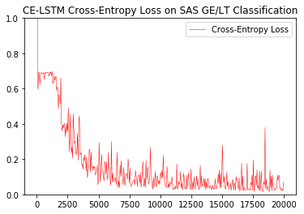
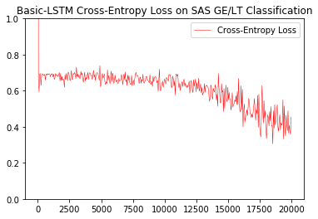
Experiment on Artificial Dataset
CE-LSTM – Context Embedding LSTM
CE-LSTM with proper slot memory hyper parameter performs better than Basic-LSTM, when other architectures are all the same, on this artificial sequence classification dataset.

Slide 11
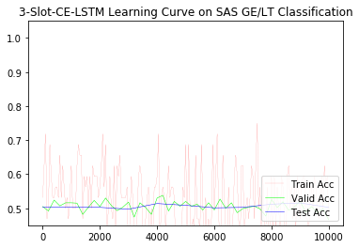
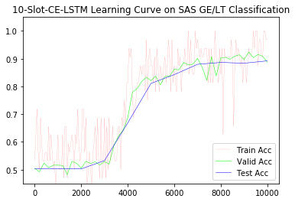
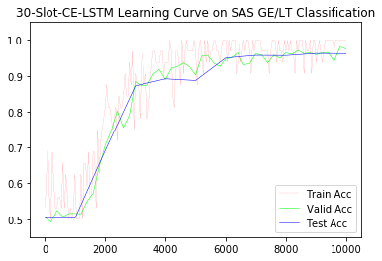
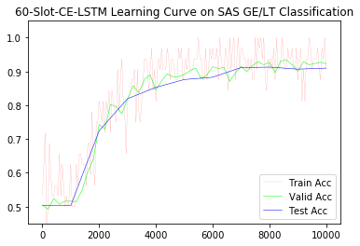
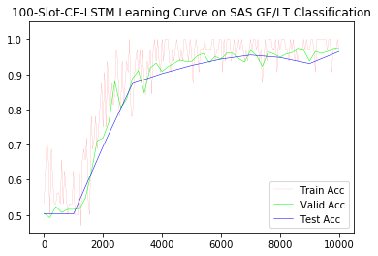
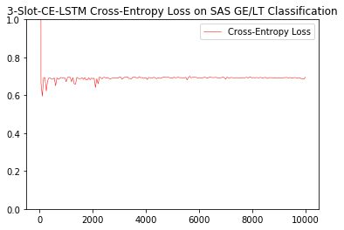
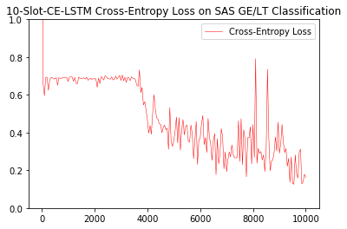
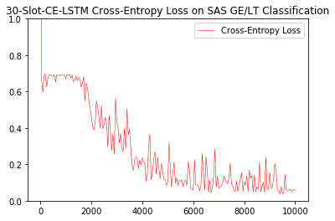
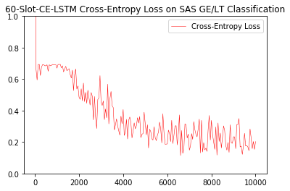
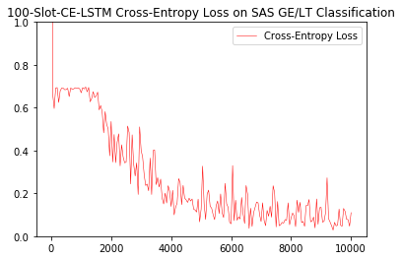
Experiment on Artificial Dataset
Slot Number
Too small – degenerate into Basic-LSTM, or even worse.
Too large – waste of memory, and waste of CPU time.
Rule-of-thumbs on GE/LT dataset – same order of magnitude with vocabulary size

Slide 12
Experiment on Artificial Dataset
Is the context vector really about context?
Get each context vector for each time-step in each sequence.
Obviously, the input of the last time-step is partial of the context of the input of the current time-step. Call the input vector and the context vector a “close context pair”.
Get every close context pair. Do a 2d-PCA on the memory slot, and perform the same transformation on the context vectors in the close context pairs.
Plot the transformed context vectors.
What’s context in this task? – Are the previous tokens digits or blanks?

Slide 13
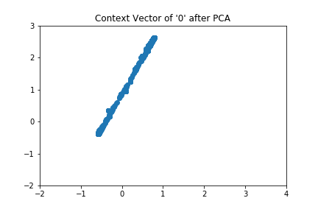
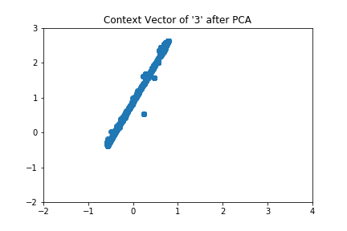
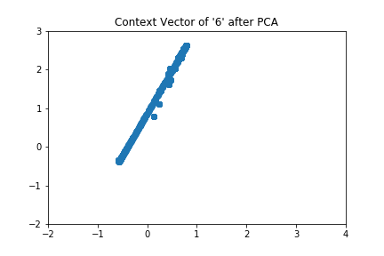
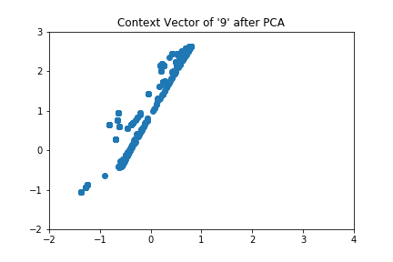
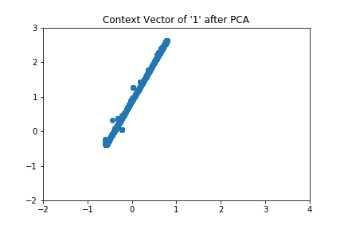
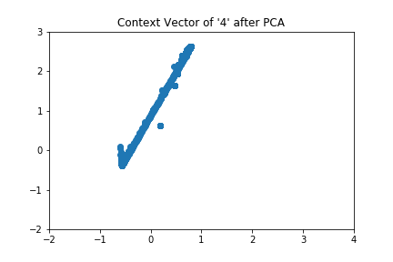
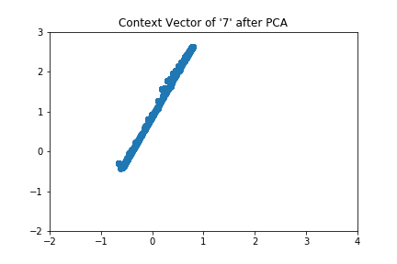

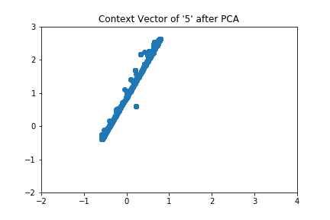
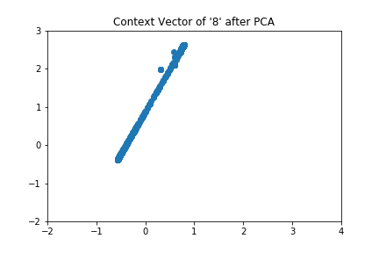
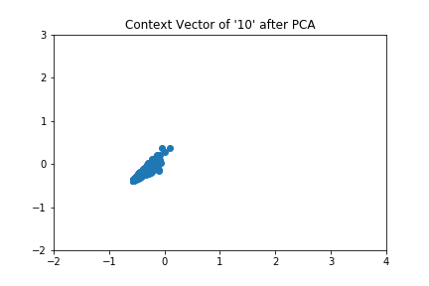
Experiment on Artificial Dataset
Digits
Blank

Slide 14
Experiment on Artificial Dataset
What are the memory slots?
Get the input of the last time-step and the selection vector of the current time-step, called a “close selection pair”.
Perform frequent pattern mining. Mine for frequent selection pattern of each type of input under different min-support.
Label those frequent slots on the transformed slot map.

Slide 15
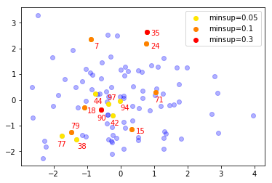


Experiment on Artificial Dataset
Min-Support = 0.05
Min-Support = 0.1
Maybe, each slot represents a piece of “meta-context information”.

Slide 16
Experiment on Artificial Dataset
Proper slot memory hyper parameters makes CE-LSTM convergent much more quickly than Basic-LSMT on GE/LT task.
Polysemy and synonym phenomena arise in the context vectors, which meets expectation.
Each memory slot may contains a “meta-context information”. The model select different slot based on the state, and generate the context vector.
Rule-of-thumb: slot number has the same order of magnitude with vocabulary size; slot width (dimension of context vector) number has the same order of magnitude with input vector width.

Slide 17
Experiment on NLP Task
Text Topic Classification
AG’s News
Dbpedia
Yahoo! Answers
Amazon Review Full/Polarity
Sogou News
Yelp Review Full/Polarity
All available at: https://drive.google.com/drive/folders/0Bz8a_Dbh9Qhbfll6bVpmNUtUcFdjYmF2SEpmZUZUcVNiMUw1TWN6RDV3a0JHT3kxLVhVR2M

Slide 18
Experiment on NLP Task
Yahoo! Answers Dataset
1,400,000 pieces of train data
60,000 pieces of test data
Each piece of data contains: a question title, a question description in detail (optional), an answer (selected from many answers), a topic label.
Topic labels are integers from 1 to 10. The dataset is already balanced.
Question Topic Classification Task
Concatenate the question title and question description as the whole question. Use the original label as the question label.

Slide 19
Experiment on NLP Task
Select questions: sequence length <= 100
Train-set: 1,296,335 questions
Test-set: 55133 questions
Vocabulary size: ~340,000
Available at: https://github.com/LC-John/Yahoo-Answers-Topic-Classification-Dataset

Slide 20
Experiment on NLP Task & Source Code Task
NLP
Still running … 10 epochs per day …
Source Code
… … … …

Slide 21
The END. Thank you!

