Slide 1
Persistent Memory
Zhang Huangzhao, Yuan Pei College
zhang_hz@pku.edu.cn

Slide 2
Outline
DTR module
Dynamic Token Representation
DTR with assistant network
TB-CapsNet & Tree2Tree?
PRNN
PRNN: Recurrent Neural Network with Persistent Memory

Slide 3

Dynamic Token Representation
x – token vector (original token representation)
v – context vector
Ws, bs – weights
M – morpheme slot memory
x* -- dynamic token representation

Slide 4
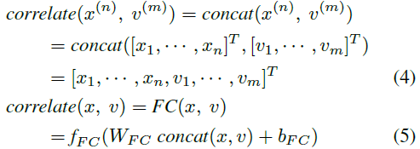
Dynamic Token Representation
Correlate function
Currently, use concatenate function.
A well-designed function may perform better.

Slide 5
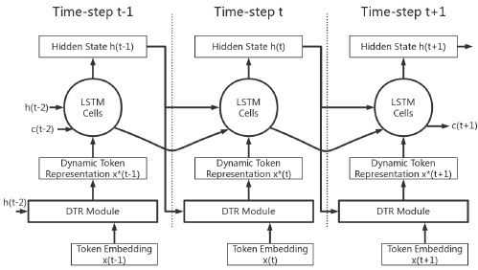
DTR-LSTM

Slide 6
DTR with Assistant Network
Problems of current DTR module.
Hard to understand the morpheme slot memory for human beings.
Hard to learn synonymous tokens.
… …

Slide 7
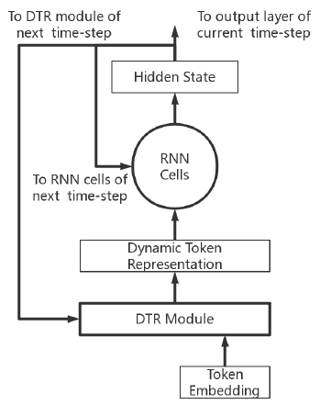
DTR with Assistant Network
Assistant Network
Try to restore the token vector from dynamic representation.
Help to understand the slots in the morpheme slot memory.
Help to distinct synonymous tokens.
Assistant Network
s
Restored Token

Slide 8
DTR with Assistant Network
Loss
L_{o} = original main network loss
L_{a} = Loss (restored tokens, token vectors)
L = α L_{o} + (1-α) L_{a}

Slide 9
DTR with Assistant Network
Implementation
RNN cell with unusual return values
RNN cell with 3 return values
A pair of RNN cells sharing the same weights
slot select
new state
slot select
hidden state
new state
slot select
hidden state
new state
RNN Cell
RNN Cell
RNN Cell
RNN Cell
x[t]
state
x[t]
state
x[t]
state
x[t]
state

Slide 10
TB-CapsNet?
How to extract features without (max-)pooling?
Parent-child(s) convolutional capsule?
Is the assistant network necessary?
… … … …

Slide 11
Tree2Tree?
TBCNN – “Encoding”
Deconvolution decoding?
Image style transfer?

Slide 12

PRNN

Slide 13
Overview
RNN is inadequate when processing sequences with multiple patterns.
Introduce a external persistent memory to store principle patterns.
Update states according to the similarities between encoded inputs and memory slots.
Global patterns (dataset level) !

Slide 14
Previous memory approach
External memory for each sequence.
Memory alters during sequence processing, and extracts patterns of this very sequence.
Addressing methods – location based addressing, context based addressing.
Update methods – explicitly reading / writing operation.

Slide 15

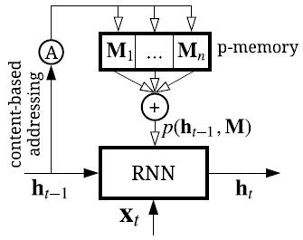
Persistent Memory
M – external persistent memory to memorize the principal patterns.
m x n – slot number = n, slot width = m.
p(·) – memory accessing via content-based addressing.
g(·) – remains the same, indicating the RNN cell need not change its structure.

Slide 16




Memory Accessing
si – similarity between h(t-1) and each slot.
Mahalanobis distance, cosine similarity.
wi – combination weight.
p(·) – memory accessing.
No update during sequence processing!
Update by BP algorithm during training procedure.

Slide 17
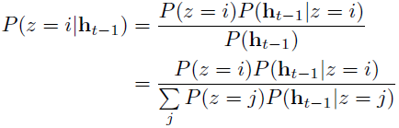

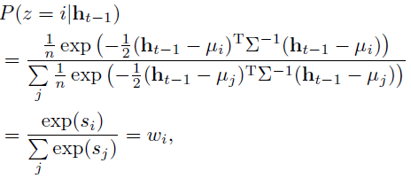
Mixture Model Perspective
All hidden states are partitioned into n clusters.
Assume h(t-1) are Gaussian variables.
Uniformly distributed prior. P(z=i)=1/n.
The process of accessing p-memory is indeed soft clustering. h(t-1) is assigned to the corresponding center.
Mahalanobis distance
Combination weight

Slide 18
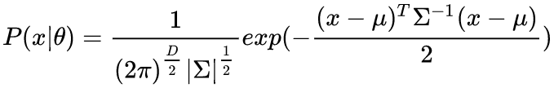

Mixture Model & EM algorithm
Gaussian model – MLE, etc.
Gaussian mixture model – EM iterative
Hidden variables
EM algorithm.
E-step: Expectation. E(γ_{jk}|X,θ), for all j=1,2,…,N
M-step: Maximization. Maximize and update all parameters.

Slide 19
Mixture Model Perspective
Variant of the EM algorithm.
E-step – assigns wi to each cluster via memory addressing.
M-step – optimizes the parameters in each memory slot based on wi.

Slide 20
Experiments
Time series prediction
Power Consumption (PC)
Sales Forecast (SF)
Language modeling
Penn Treebank (PTB)
20-Newsgroup (20NG)
Word-level prediction
LSTM baseline vs. P-LSTM

Slide 21

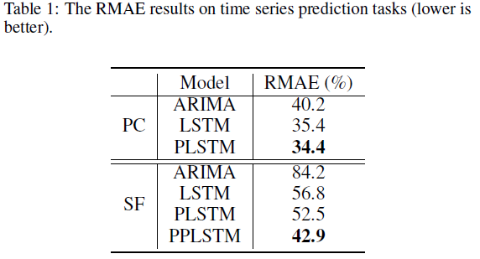
Time Series Prediction
RMAE – Relative Mean Absolute Error.
ARIMA – a classical model.
PPLSTM – PLSTM with prior knowledge.

Slide 22
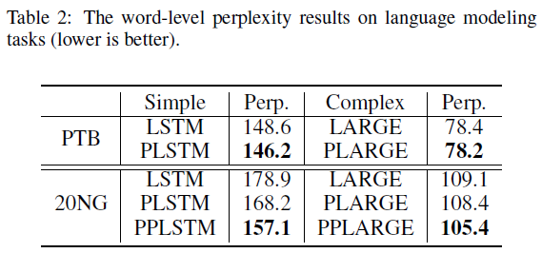
Language Modeling
Perplexity – determine whether the language model is good.
Simple – simple setting. (slimmer embedding, hidden layer, …)
Complex – complex setting. (larger embedding, hidden layer, …)

Slide 23
Summary
Persistent memory to store principle patterns. – GOOD!
Mixture model perspective. – very ELEGANT!
Experiments. – NAH…

