Slide 1
Generating SQL from NL & Pointer Networks
Zhang Huangzhao, Yuan Pei College

Slide 2
Contents
What is SQL?
Why generating SQL?
SEQ2SQL (the paper)
Augmented Pointer Networks
Model: Aggregation operation + SELECT column + WHERE clause
WikiSQL
Evaluation & Result
Pointer Networks (the paper)
SEQ2SEQ to attention to Ptr-Nets
Datasets

Slide 3
What is SQL?
Problem-oriented programming language.
Specific for relational database queries.
Database table
Typical query: SELECT xxx FROM xxx WHERE <some conditions>
Table Name = Employee
ID | Name | Salary | Manager | …
xxx | xxx | xxx | xxx | …

Slide 4
Why Generating SQL?
Most queries in a problem-oriented language is much easier to understand.
Even more strict structure than other PL’s, such as C/C++.
Usually very short.
Each token in a SQL query is strongly relevant to the NL description.

Slide 5
Difficulties?
Sequence model may not be a good choice for such PL’s with very strict structure.
Nested SQL?
Verbose NL description?

Slide 6
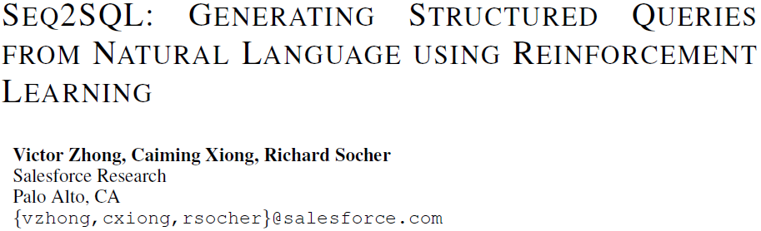
SEQ2SQL
Execution accuracy: 35.9% -> 59.4%
Logical form accuracy: 23.4% -> 48.3%

Slide 7
SEQ2SQL
Relational database is powerful. But accessing the database is very hard to master.
Simple SQL queries are much often used than those complex, nested queries.
Seq2SQL: use RL training.
WikiSQL: a dataset released by the authors.

Slide 8
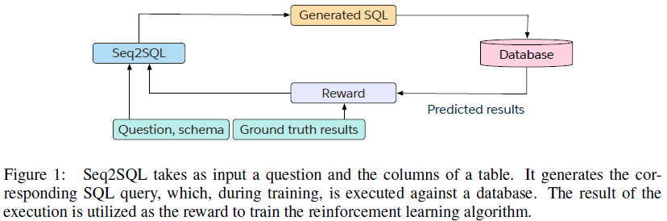
Model

Slide 9
Model
Augmented Pointer Network
Generates the SQL query tokens by selecting from the input sequence.
Input sequence = question + column names + limited SQL vocabularies.
SEQ2SQL
Aggregation classifier + SELECT column pointer + WHERE clause pointer decoder.
Aggregation operation: Attention.
SELECT column: A matching problem based on the table columns and the question -> pointer network.
WHERE column: There are maybe more than one WHERE clauses -> augmented pointer network & RL.

Slide 10
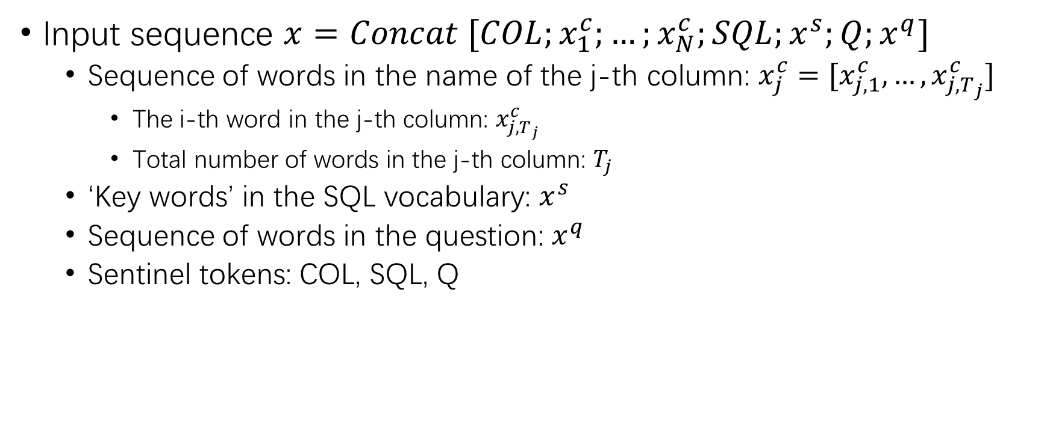
Augmented Pointer Network
Input sequence $x=Concat [COL;x_{1}^{c};…;x_{N}^{c};SQL;x^{s};Q;x^{q}]$
Sequence of words in the name of the j-th column: $x_{j}^{c}=[x_{j,1}^{c},…,x_{j,T_{j}}^{c}]$
The i-th word in the j-th column: $x_{j,T_{j}}^{c}$
Total number of words in the j-th column: $T_{j}$
‘Key words’ in the SQL vocabulary: $x^{s}$
Sequence of words in the question: $x^{q}$
Sentinel tokens: COL, SQL, Q

Slide 11
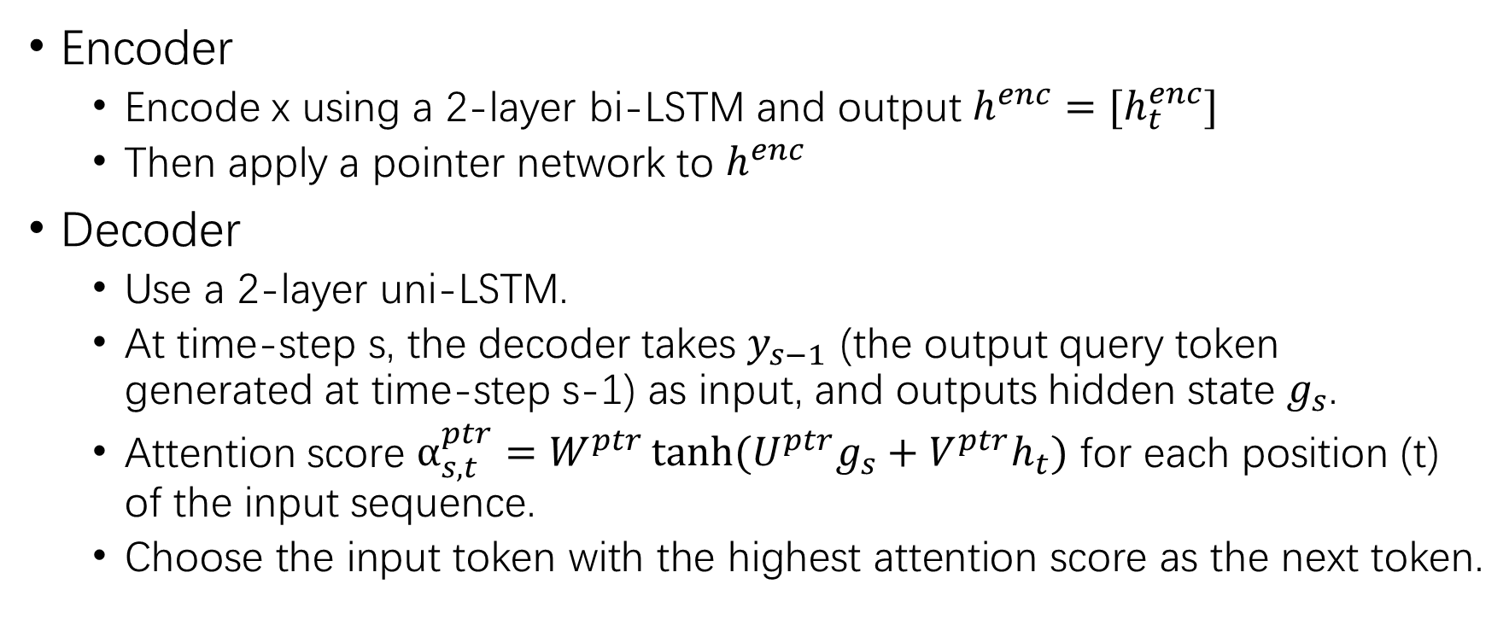
Augmented Pointer Network
Encoder
Encode x using a 2-layer bi-LSTM and output $h^{enc}=[h_{t}^{enc}]$
Then apply a pointer network to $h^{enc}$
Decoder
Use a 2-layer uni-LSTM.
At time-step s, the decoder takes $y_{s−1}$ (the output query token generated at time-step s-1) as input, and outputs hidden state $g_{s}$.
Attention score $α_{s,t}^{ptr}=W^{ptr}\tanh{(U^{ptr}g_{s}+V^{ptr}h_{t})}$ for each position (t) of the input sequence.
Choose the input token with the highest attention score as the next token.

Slide 12
Interrupt!
Breakpoint at SEQ2SQL
Let’s have a look at Ptr-Nets first.

Slide 13
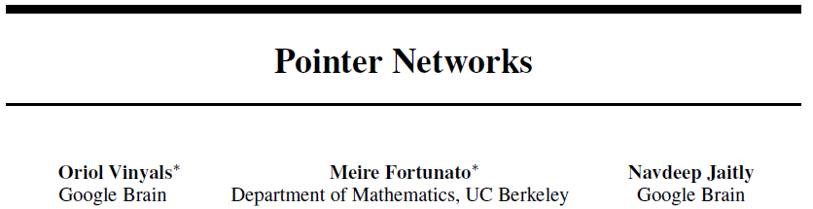
Pointer Networks

Slide 14
Why Ptr-Net?
The size of the output dictionary is not fixed!
In many scenarios, the answer is already within the question. (The output dictionary size is dependent on the input sequence length.)
The sequence length of the question is variable.
When facing long sequences, blending the hidden units as a context vector may not be a good idea.
… …

Slide 15
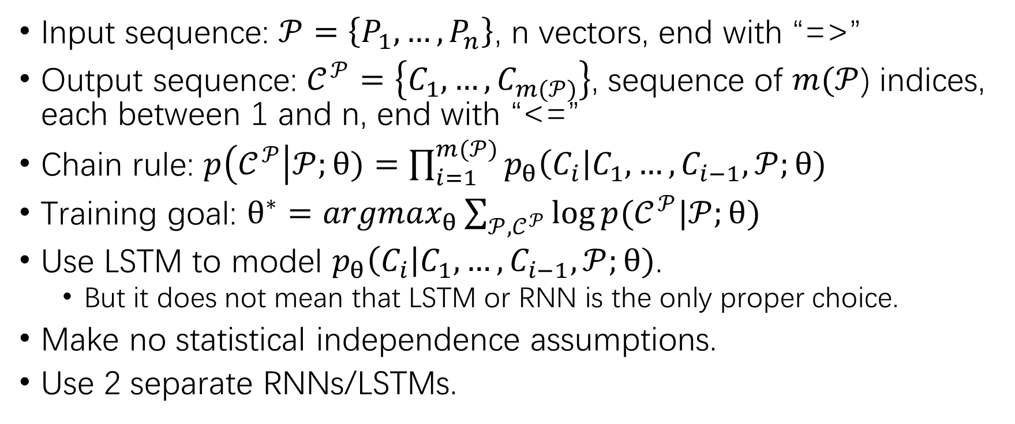
Sequence-to-Sequence Model
Input sequence: $𝒫=\left\{P_{1},…,P_{n}\right\}$, n vectors, end with “=>”
Output sequence: $𝒞^{𝒫}=\left\{C_{1},…,C_{m(𝒫)}\right\}$, sequence of $m(𝒫$) indices, each between 1 and n, end with “<=”
Chain rule: $p\left(𝒞^{𝒫}\right|𝒫;θ)=\prod_{i=1}^{m(𝒫)}{p_{θ}\left(C_{i}\right|C_{1},…,C_{i−1},𝒫;θ)}$
Training goal: $θ^{∗}={argmax}_{θ}\sum_{𝒫,𝒞^{𝒫}}{\log{p(𝒞^{𝒫}|𝒫;θ)}}$
Use LSTM to model $p_{θ}\left(C_{i}\right|C_{1},…,C_{i−1},𝒫;θ)$.
But it does not mean that LSTM or RNN is the only proper choice.
Make no statistical independence assumptions.
Use 2 separate RNNs/LSTMs.

Slide 16
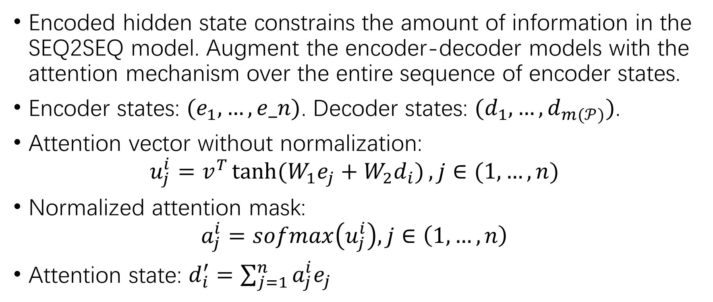
Attention
Encoded hidden state constrains the amount of information in the SEQ2SEQ model. Augment the encoder-decoder models with the attention mechanism over the entire sequence of encoder states.
Encoder states: $(e_{1},…,e_n)$. Decoder states: $(d_{1},…,d_{m(𝒫)})$.
Attention vector without normalization:
$$u_{j}^{i}=v^{T}\tanh{(W_{1}e_{j}+W_{2}d_{i})}, j∈(1,…,n)$$
Normalized attention mask:
$$a_{j}^{i}=sofmax\left(u_{j}^{i}\right), j∈\left(1,…,n\right)$$
Attention state: $d_{i}^{′}=\sum_{j=1}^{n}{a_{j}^{i}e_{j}}$

Slide 17
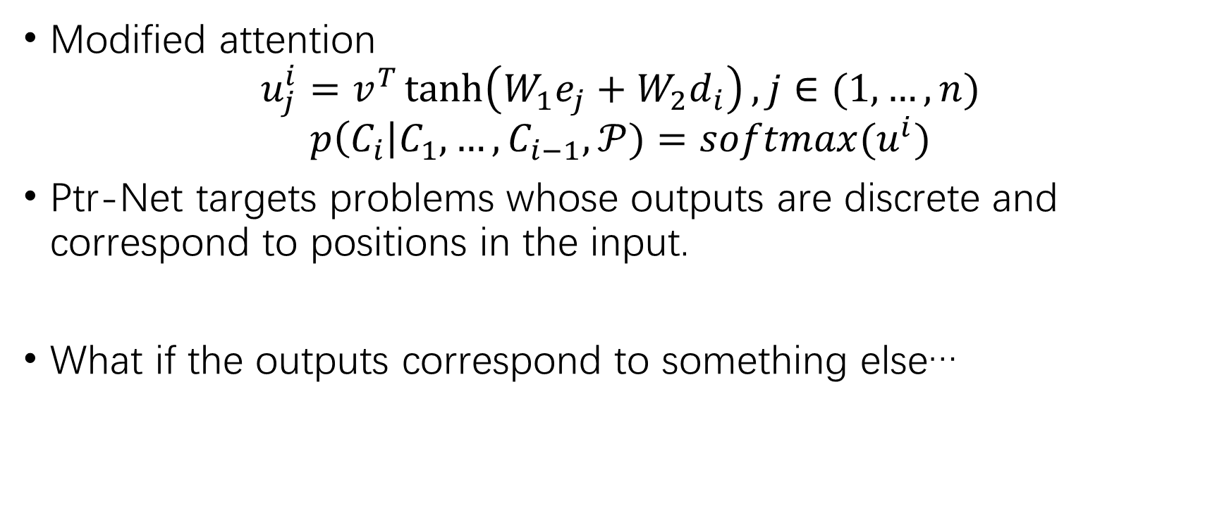
Ptr-Net Model
Modified attention
$$u_{j}^{i}=v^{T}\tanh\left(W_{1}e_{j}+W_{2}d_{i}\right), j∈(1,…,n)$$
$$p\left(C_{i}\right|C_{1},…,C_{i−1},𝒫)=softmax(u^{i})$$
Ptr-Net targets problems whose outputs are discrete and correspond to positions in the input.
What if the outputs correspond to something else…

Slide 18
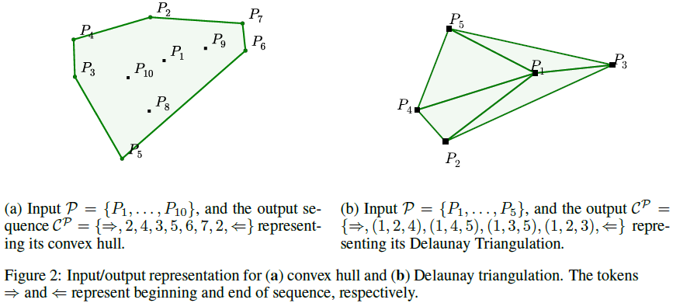
Datasets
Convex Hull – find the convex hull of a finite number of points.
Delaunay Triangulation – find all triangles which don’t contain any other points, given a finite number of points.
Travelling Salesman Problem (TSP)

Slide 19
Interruption!
Back to SEQ2SQL

Slide 20
SEQ2SQL
A typical SQL query:
SELECT COUNT FROM xxx WHERE xxx AND xxx AND …
Aggregation operation
SELECT column
WHERE clause

Slide 21


Aggregation Operation
Scalar attention score: , for t-th token in the input sequence.
Normalized score:
Input representation:
Scores over aggregation and no-aggregation operations:
Generate probabilities:

Slide 22

SELECT Column
Table columns + question
Encoding of each column name:
Representation for the question: , same architecture with untied weights.
Score for each column j:
Generate probabilities:

Slide 23

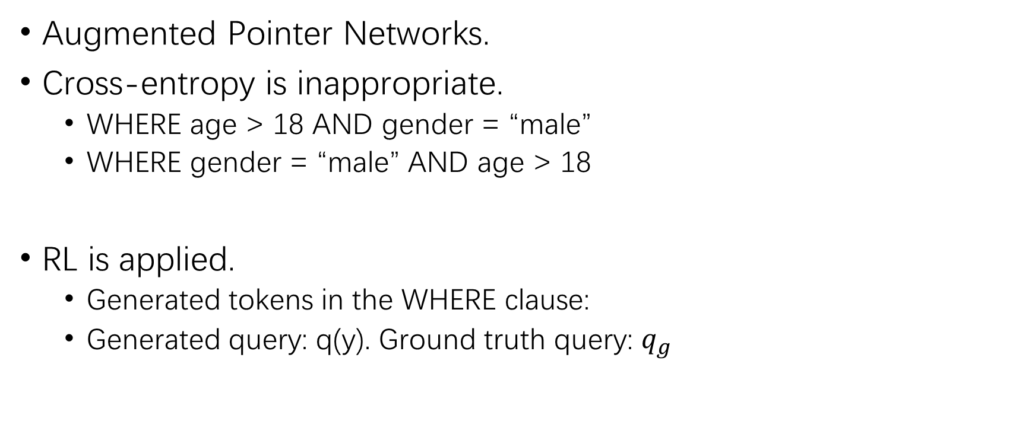
WHERE Clause
Augmented Pointer Networks.
Cross-entropy is inappropriate.
WHERE age > 18 AND gender = “male”
WHERE gender = “male” AND age > 18
RL is applied.
Generated tokens in the WHERE clause:
Generated query: q(y). Ground truth query: $q_{g}$

Slide 24

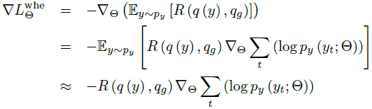
WHERE Clause
Negative expected reward loss:
Policy gradient:
Mixed objective function:

Slide 25
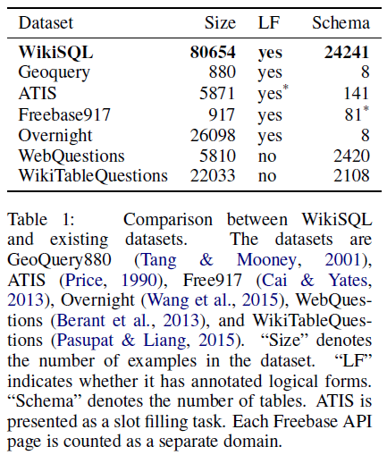
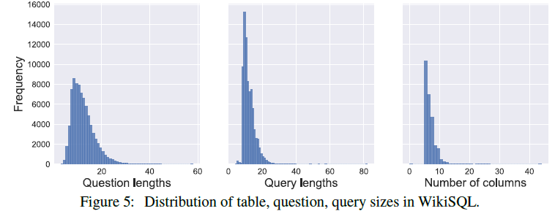
Dataset – WikiSQL
WikiSQL – A collection of questions, corresponding SQL queries and SQL tables.

Slide 26
Evaluation
Execution accuracy:
Logical form accuracy:
Because acc_{lf} penalizes correct queries different from the ground truth, it is used only to evaluate the model, instead of training.

Slide 27
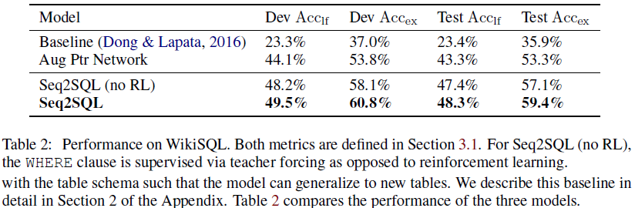
Result

Slide 28
Thank You!

