Slide 1
“PHPs” for Neural Programming
Zhang Huangzhao, Yuan Pei College

Slide 2
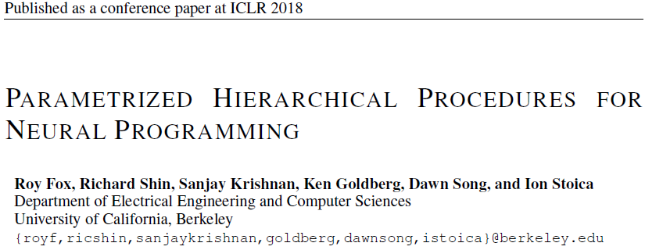

Slide 3
Outline
Task
Neural programming
Background
Imitation learning (IL)
Expectation-Maximization (EM) & Expectation-Gradient (EG)
Problem statement
IL deterministic dynamic system model for computation
PHPs
Hierarchical Procedures (HPs)
Parametrized Hierarchical Procedures (PHPs)

Slide 4
Outline
Training algorithm
EG method
Training two-or-multi-level PHPs
Experiments
NanoCraft
Long-Hand Addition
Discussion

Slide 5
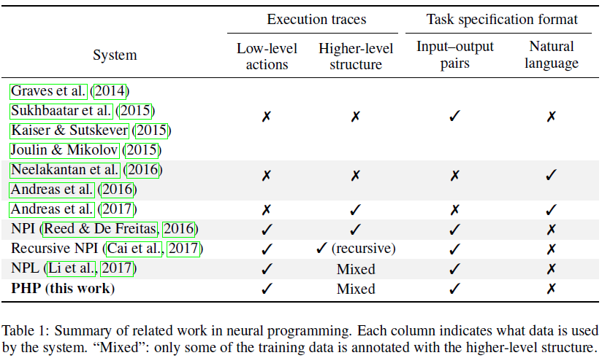
Task
Neural programming
Use input-output pair examples to specify the task.
Use execution traces to specify the necessary steps to solve the given problem (optional).

Slide 6
Background – IL
Imitation Learning
An agent learns to behave in its environment using supervisor demonstrations of the intended behavior. (To imitate the supervisor)
Challenges in algorithmic domains
‘All-or-None’ accuracy criteria – The constraint of output correctness is very hard. Even a minor error is intolerable.
Data structures – Algorithms often use specific data structures, which requires the agent policy to have a particular structure.
Unobservable environment – The program input and the data structures can be only scanned using limited reading apparatus (such as R/W heads in a Turing Machine).

Slide 7
Background – EM
Expectation-Maximization algorithm
Applied when there exists unobservable hidden variables in the model.
E-step – Calculate the expectation of the hidden variables, with the latest version of parameters.
M-step – Perform MLE on the model parameters using the expectation retrieved from E-step.
Iteratively repeat E-step and M-step, until convergent.
Infeasible for neural networks
Maximization on the neural networks in the M-step is almost impossible.

Slide 8
Background – EG
A compromise when maximization is unfeasible.
Apply gradient ascent instead.
Expectation-Gradient algorithm
E-step – Calculate the expectation of the hidden variables, with the latest parameters. (Same as E-step in EM.)
G-step – Update the parameters in the model by gradient ascent.
Iteratively repeat E-step and G-step, until convergent.

Slide 9
Problem Statement – IL Model
All computer algorithms are virtually computation.
Computation can be modeled as a deterministic dynamic system.
IL model
Agent – computer
Environment – program input and its data structure

Slide 10
Problem Statement – IL Model
Environment
State space –
Observation space –
Action space –
State-dependent observation –
State transition –
Initial state (program input) –

Slide 11
Problem Statement – IL Model
Agent
Maintaining memory – , store the past observation.
Stochastic policy – . Parameter –
Probability of updating the memory –
Policy rolling-out – stochastic process

Slide 12

Problem Statement – IL Model
Imitation Learning (Behavior Cloning)
The supervisor rolls out its policy to generate a batch of demonstrations.
The agent’s policy is trained using the generated demonstrations.
Strong supervision – observation + action + memory state
The agent can directly imitate the behavior of the supervisor.
Weak supervision – observation + action
The memory state of the supervisor is hidden variable. Apply EG algorithm.

Slide 13
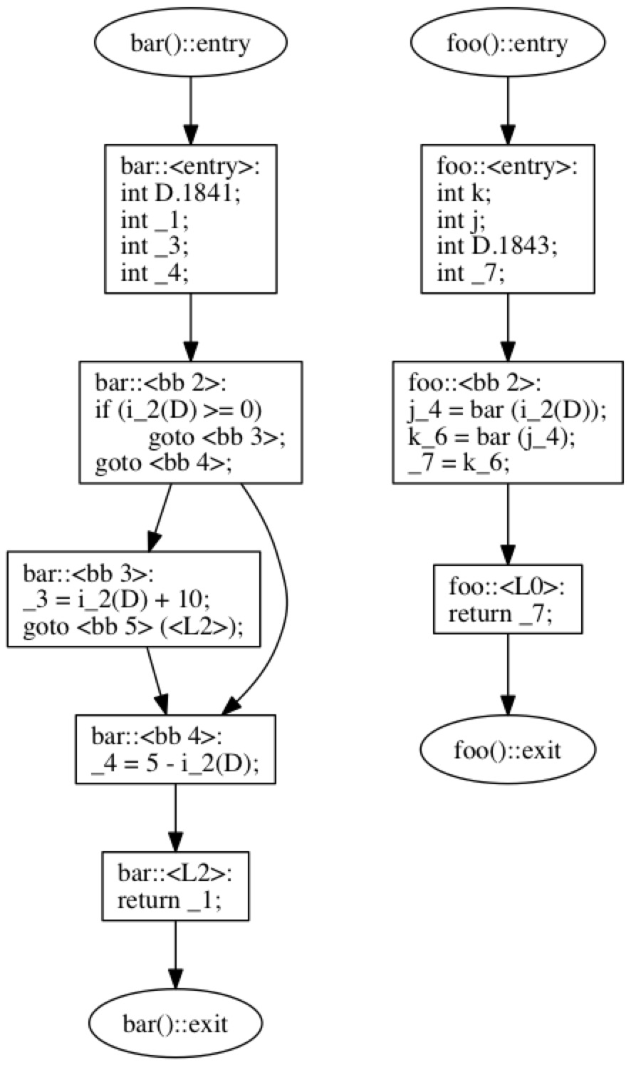
PHPs
Basic unit – procedure
Each procedure has several statements.
One procedure may invoke another, and leads to a call stack.
The procedure terminates itself when finished.
Timestep in PHPs
Timestep is corresponding to observation and action.
In one timestep, there may be many procedures invoked / terminated.

Slide 14
PHPs – HPs
Hierarchical procedure –
Statement sequence –
Statement –
Operation statement –
Termination statement –
The operation statement is a conditional branching block, based on the observation. The operation is either taking an action or invoke another procedure.
The termination statement is a conditional termination indicator. Once it indicates 1, the procedure would be self-terminated.

Slide 15
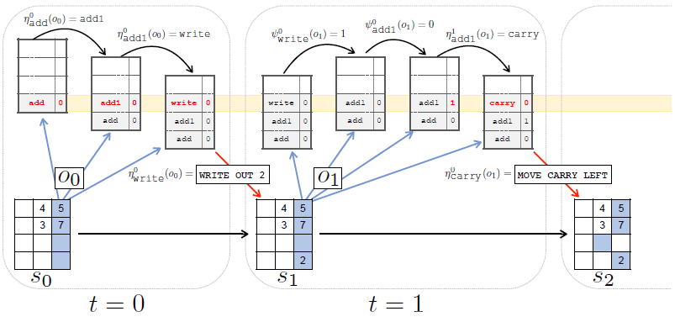
PHPs – HPs
Agent memory
Procedure call stack – (active procedures)
Program counter – a pointer which points at the top active procedure.
Initialization – Only the root procedure is in the stack, and the PC is 0.

Slide 16
PHPs – HPs
Limitations of HPs
Recursive procedures are not supported. (Loops / cycles in the invocation graph)
The procedure is allowed to invoke another procedure or execute an action, but not both.
Practical solution
Layering the procedures in levels.
Lowest-level procedures can execute action.
The higher-level procedure can invoke procedures in the level directly below it.

Slide 17
PHPs – PHPs
Parametrized Hierarchical Procedures (PHPs)
Representation of HPs by differentiable parametrization.
Two MLPs with ReLU activations for operation statement and termination statement.
Input – concatenation of the observation and the program counter (real number form).
Training – Apply softmax to obtain stochastic statements.
Testing – Apply argmax to obtain deterministic statements.

Slide 18
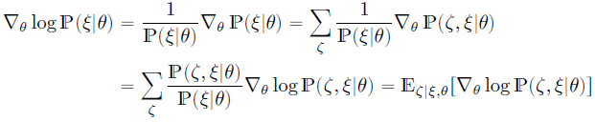
Training algorithm – EG
Strong supervision – directly applying MLE is feasible.
Weak supervision
Only observation sequence and action sequence are available.
The memory state sequence is latent.
Computation of the log-likelihood gradient is impossible.
EG trick

Slide 19
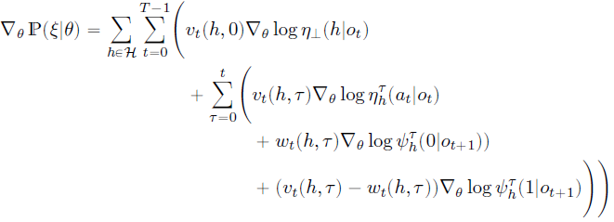
Training algorithm – Two-level PHPs
High level PHPs – invoke low-level PHPs
Low level PHPs – execute actions
The full likelihood is a product of the terms that generate the demonstration.
The full likelihood gradient decomposes into a sum of policy-gradient terms.

Slide 20
Training algorithm – Multi-level PHPs
Same technique would cause exponential blow-up.
Train each level separately.
Level indexing – from highest to lowers; 0 for root PHP, and d-1 for the lowest level of PHPs.
Separate the lower levels – When training level-(i+1), regard level-(i) and any other lower level PHPs as one PHP, which is the new lowest level.
Strong supervision – Truncate the stack.
Weak supervision – An algorithm is needed, which decodes the observation and action sequence, and replacing the elementary actions with higher-level operations.
Separate the higher levels – Approximate separation from higher levels which have not been trained yet, by augmenting the root PHP used for training with an LSTM.

Slide 21
Experiments – NanoCraft
NanoCraft – Build a rectangular building of a certain height and width, at a certain location, in a 2D grid world.
PHPs and actions
Top-level PHPs – {moves_r, moves_d, …, return}
Lowest-level PHPs – {move_r, mode_d, …, return}
Actions – {MOVE_RIGHT, MODE_DOWN, …}
Setup
Demonstrations – 16, 32, 64
Mixed – strong and weak supervisions are mixed.

Slide 22
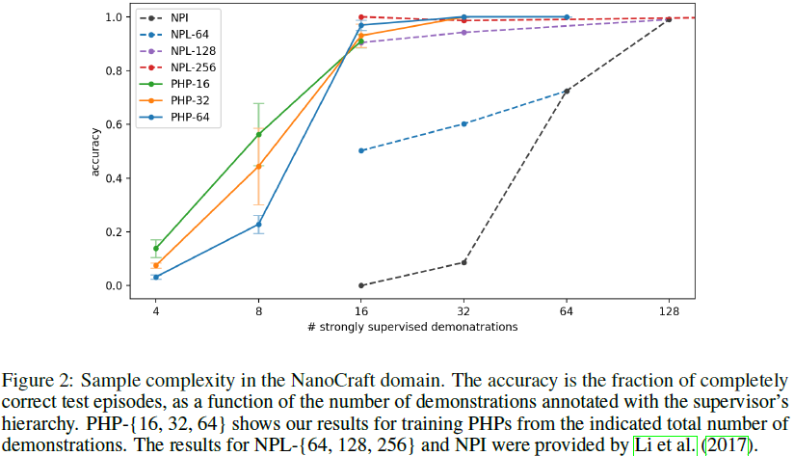
Experiments – NanoCraft

Slide 23
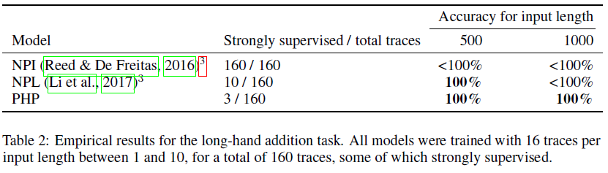
Experiments – Long-Hand Addition
Long-Hand Addition – add two numbers represented in decimal, by starting at LSD.
PHPs and actions
Top-level PHP – ‘add’ repeatedly calls ‘add1’.
‘add1’ calls ‘write’, ‘carry’, and ‘lshift’.
Actions – MOVE CARRY LEFT WRITE

Slide 24
THE END
THANK YOU!

