Slide 1
Natural Language Querying against Relational Database
Zhang Huangzhao, Yuan Pei College

Slide 2
Overview
Two major approaches
Generate the result directly & Generate SQL queries
The paper
An Encoder-Decoder Framework Translating Natural Language to Database Queries
Additional symbol labels generated by CRF
Output masking by BNF grammar
My idea
Atomic relational algebra operations
Generate operation sequences hierarchically

Slide 3
Approaches
Generate processing result directly
Get rid of grammar restraint
Linear computational complexity to the cardinality of the target data
Not reusable when data tuples are updated
Translate NL queries to SQL queries
Seq2seq
Reusable when the data tuples are updated
“More scalable and extensible”

Slide 4
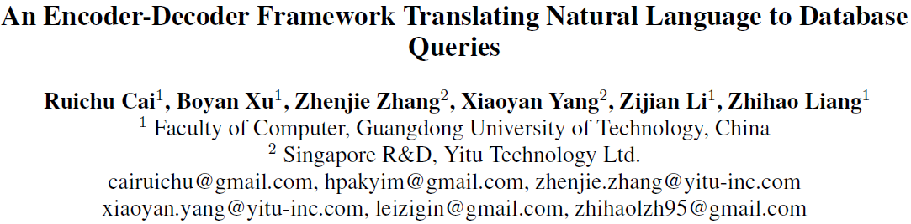

Slide 5
Overview of the paper
In-general model
SQL BNF grammar
The encoder processes the input sequences with labels.
The decoder outputs sequences with masking.
Experiments & results

Slide 6
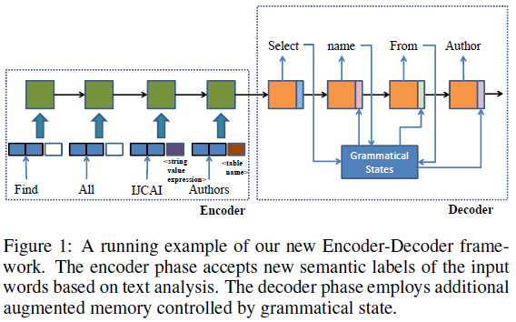
In-general model
Task: NL query -> SQL query
Seq2seq framework
Label the input tokens, e.g. column name, table name, constant value, etc.
Combine NNs with traditional grammar masking.

Slide 7
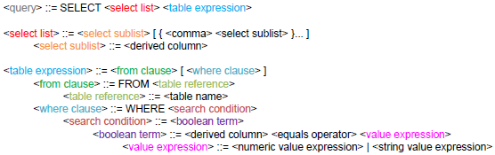
SQL BNF
Root: <query>
Non-terminal: colored. E.g. <select list>.
Terminal: black. E.g. SELECT, <table name>.
<xxx> – symbol.
[xxx] – optional, “+”.
{xxx} – multiple, “*”.

Slide 8

Label
Label the input sequence $N∈ℕ$ with SQL BNF non-terminals.
<derived column>
<table name>
<value expression>
<string expression>
Find | all | IJCAI | authors | .
None | None | <string expression> | <table name> | None

Slide 9
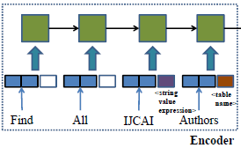
Label - 2
The labels are generated by a CRF model.
The CRF model is trained with a small group of manually labeled samples.
(Datasets such as ATIS may help with the CRF training …)
The vectorized token representations have several additional bits for their labels.
During the encoding phase, the encoder only considers the NL query sequence, regardless of the schema.

Slide 10
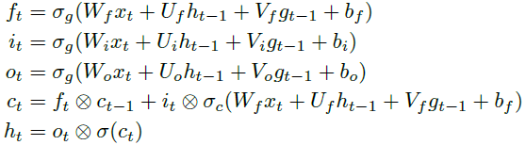

Decoder
LSTM + parser
The LSTM generates candidates for the parser.
The parser selects the output symbol, and updates its grammar vector and grammar status ($g_{t}$) following BNF.

Slide 11
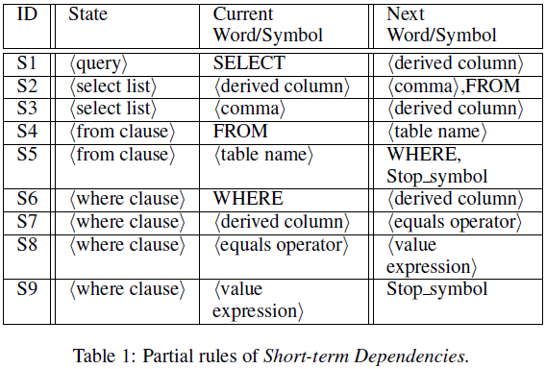
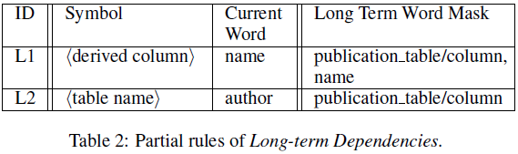
Mask
Short-term dependencies & Long term dependencies
Short-term dependencies ensure that the generated SQL query can be compiled.
Generated from the BNF
Long-term dependencies ensure that the generated SQL query is executable.
Generated from the BNF and the schema of the DB

Slide 12
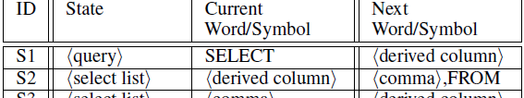
Mask - 2
At each timestep, the decoder chooses one rule from candidate short-term dependencies, and multiple rules from candidate long-term dependencies.
Short-term
State & Current Word/Symbol columns are used for rule matching.
Next Word/Symbol column indicates the valid output of the next timestep.
Once there is a matching rule, the decoder generates a masking over the vocabulary dictionary.

Slide 13
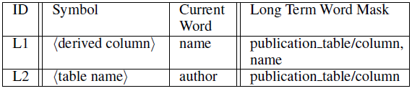
Mask - 3
Long-term
Updated based on the active symbols chosen by the SQL parser, which is maintained in the grammar state vector.
When deactivated, the corresponding rule is removed.

Slide 14
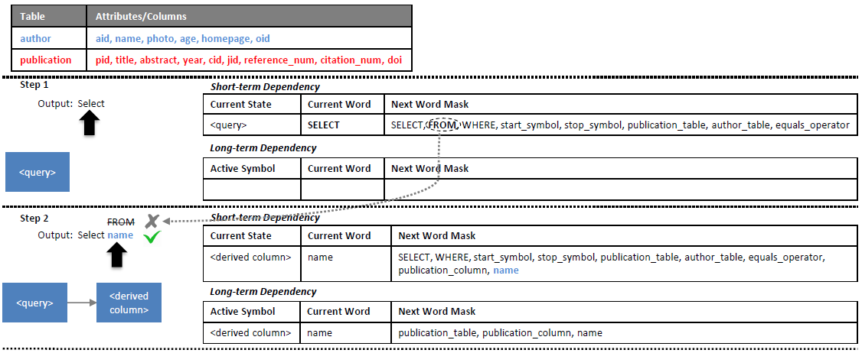
Decoder - 2

Slide 15
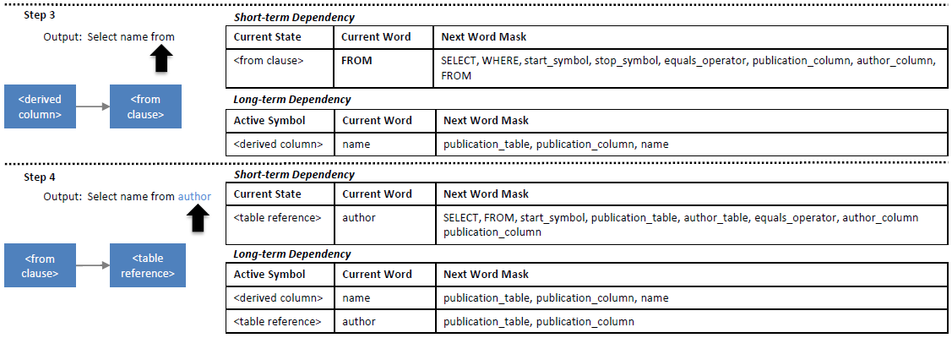
Decoder - 3

Slide 16
Experiments
SELECT queries
SELECT <column array> FROM <table>
WHERE <column> =/> <value>
JOIN queries
SELECT AGG(<table1 column array>) FROM <table1>
INNER JOIN <table2> ON <table1.key> = <table2.key>
WHERE <table2.column> =/> <value>

Slide 17
Experiments - 2
Datasets
Geo880
Academic
IMDB
The SQL queries are manually labeled by volunteers.
Metrics
BLEU
Tuple accuracy
Tuple recall & tuple precision

Slide 18
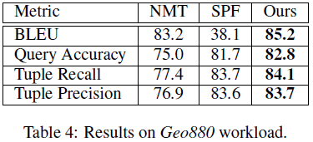
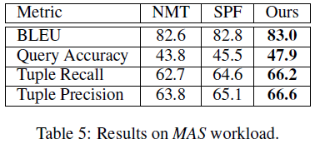
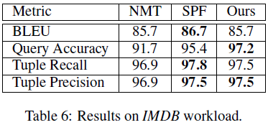
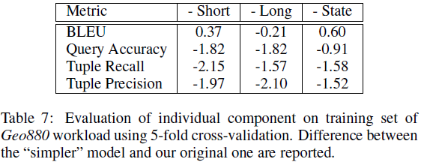
Results

Slide 19
Reflection
Pro
NN + BNF grammar
Con
Rely on long-term dependency to ensure schema consistency

Slide 20
ABOUT MY IDEA…

Slide 21
THANK YOU!

