Slide 1
Verifiable Robustness of Deep Learning Models
Zhang Huangzhao
zhang_hz@pku.edu.cn

Slide 2
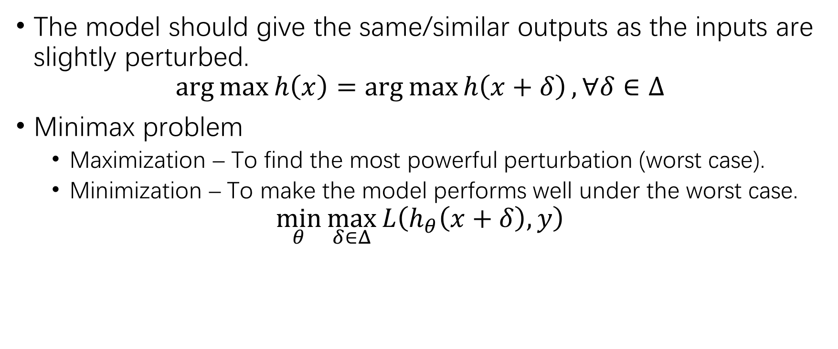
Robustness
The model should give the same/similar outputs as the inputs are slightly perturbed.
$$\arg{\max{h\left(x\right)}}=\arg{\max{h\left(x+δ\right)}}, ∀δ∈Δ$$
Minimax problem
Maximization – To find the most powerful perturbation (worst case).
Minimization – To make the model performs well under the worst case.
$$\min_{θ}{\max_{δ∈Δ}{L\left(h_{θ}\left(x+δ\right),y\right)}}$$

Slide 3
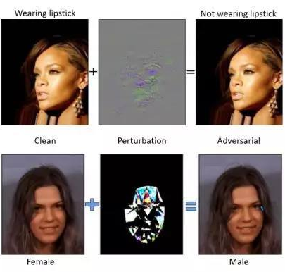
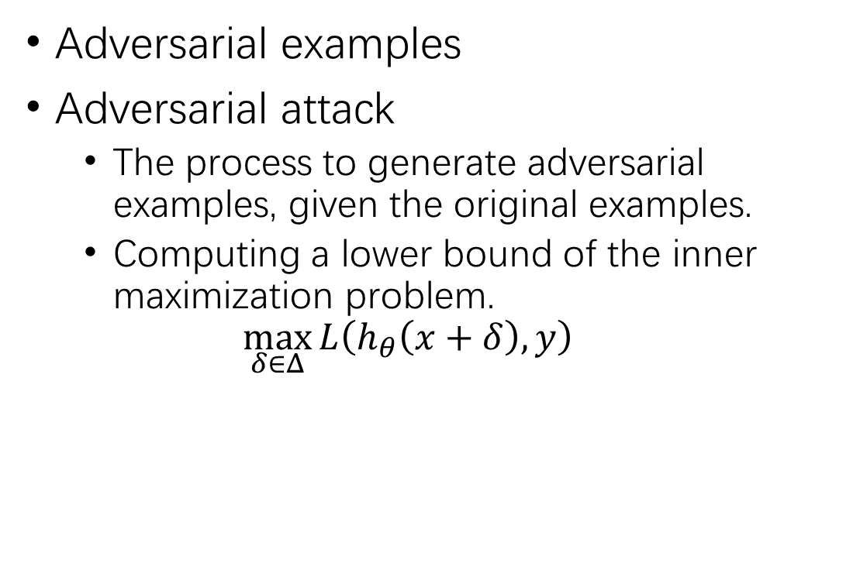
Adversarial Attack & Adversarial Examples
Adversarial examples
Adversarial attack
The process to generate adversarial examples, given the original examples.
Computing a lower bound of the inner maximization problem.
$$\max_{δ∈Δ}{L\left(h_{θ}\left(x+δ\right),y\right)}$$

Slide 4
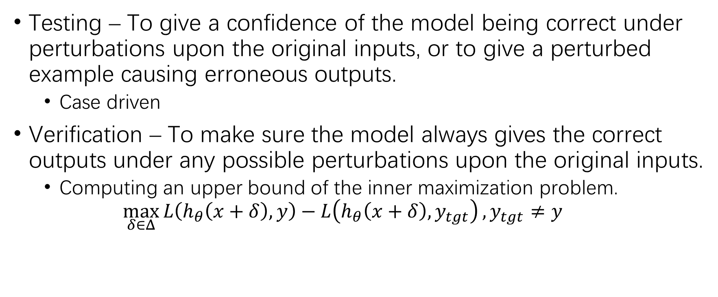
Robustness Verification
Testing – To give a confidence of the model being correct under perturbations upon the original inputs, or to give a perturbed example causing erroneous outputs.
Case driven
Verification – To make sure the model always gives the correct outputs under any possible perturbations upon the original inputs.
Computing an upper bound of the inner maximization problem.
$$\max_{δ∈Δ}{L\left(h_{θ}\left(x+δ\right),y\right)−L\left(h_{θ}\left(x+δ\right),y_{tgt}\right)}, y_{tgt}≠y$$

Slide 5
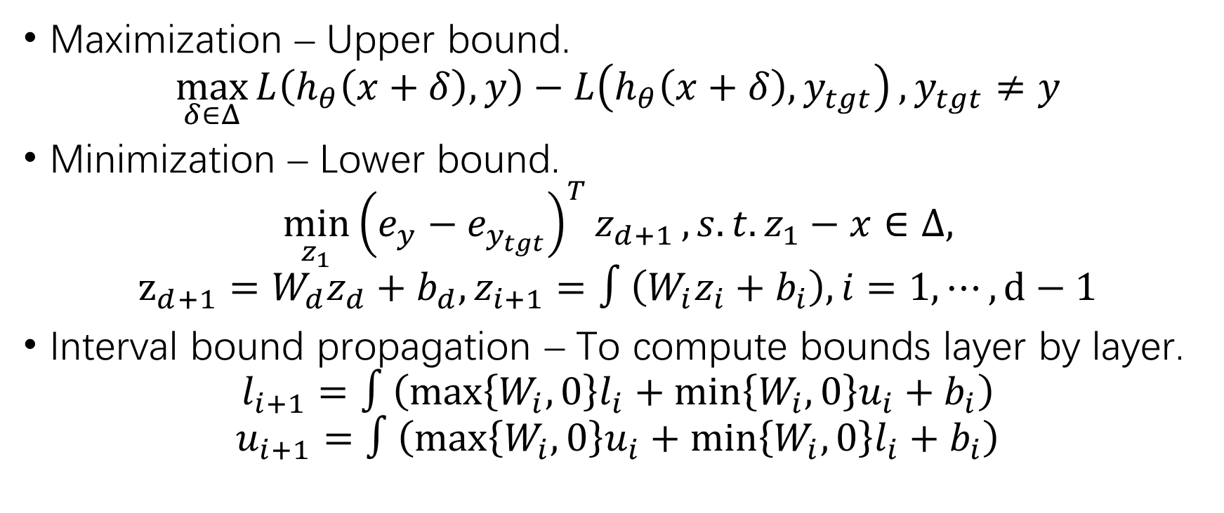
Robustness Verification (2)
Maximization – Upper bound.
$$\max_{δ∈Δ}{L\left(h_{θ}\left(x+δ\right),y\right)−L\left(h_{θ}\left(x+δ\right),y_{tgt}\right)}, y_{tgt}≠y$$
Minimization – Lower bound.
$$\min_{z_{1}}{{\left(e_{y}−e_{y_{tgt}}\right)}^{T}z_{d+1}}, s.t. z_{1}−x∈Δ,$$
$$z_{d+1}=W_{d}z_{d}+b_{d}, z_{i+1}=∫\left(W_{i}z_{i}+b_{i}\right), i=1,⋯,d−1$$
Interval bound propagation – To compute bounds layer by layer.
$$l_{i+1}=∫\left(\max\left\{W_{i},0\right\}l_{i}+\min\left\{W_{i},0\right\}u_{i}+b_{i}\right)$$
$$u_{i+1}=∫\left(\max\left\{W_{i},0\right\}u_{i}+\min\left\{W_{i},0\right\}l_{i}+b_{i}\right)$$

Slide 6

Adversarial Training
Adversarial training
$$\min_{θ}\left(L\left(h_{θ}\left(x\right),y\right)+λ⋅\max_{δ∈Δ}{L\left(h_{θ}\left(x+δ\right),y\right)}\right)$$
Lower bound based – Adversarial examples
Upper bound based – Interval bound propagation

Slide 7
Possible Research Directions
Adversarial attack algorithms towards NLP.
Robustness verification on NLP.
Adversarial attack algorithms towards GNN.
Robustness verification on GNN.

Slide 8
1. Adversarial Attack in NLP
HotFlip – FGSM + Discretization
[1] Ebrahimi J, Rao A, Lowd D, et al. HotFlip: White-Box Adversarial Examples for Text Classification[C]. ACL 2018.
GA – Genetic algorithm
[2] Alzantot M, Sharma Y, Elgohary A, et al. Generating Natural Language Adversarial Examples[C]. EMNLP 2018.
MHA – M-H sampling
[3] Zhang H, Zhou H, Miao N, et al. Generating fluent adversarial examples for natural languages[C]. ACL 2019.
MHM – M-H sampling
[4] Zhang H, Li Z, Li G, et al. Generating adversarial examples for holding robustness of source code processing. AAAI 2020.
Simulated annealing + HotFlip = ?

Slide 9
2. Robustness Verification in NLP
Interval bound propagation – Directly apply IBP.
[5] Huang P S, Stanforth R, Welbl J, et al. Achieving Verified Robustness to Symbol Substitutions via Interval Bound Propagation[C]. EMNLP 2019.
POPQORN – Nonlinear relaxation + IBP on RNNs
[6] Ko C Y, Lyu Z, Weng L, et al. POPQORN: Quantifying Robustness of Recurrent Neural Networks[C]. ICML 2019.

Slide 10
3. Adversarial Attack on GNN
NETTACK – Edge adding/dropping + feature perturbation
[7] Zügner D, Akbarnejad A, Günnemann S. Adversarial attacks on neural networks for graph data[C]. SIGKDD 2018.
DefNet – CGAN + model refining
[8] Wang X, Liu X, Hsieh C J. GraphDefense: Towards Robust Graph Convolutional Networks[J]. arXiv 2019.
HotFlip on GNN?

Slide 11
4. Robustness Verification on GNN
Apply IBP directly on GNN?

