Slide 1
Robust Node Classification on Citation Networks
Shen Sijie, sjshen@pku.edu.cn
Zhang Huangzhao, zhang_hz@pku.edu.cn

Slide 2
Node Classification
The task is to determine the labels of the nodes by looking at the features of themselves and their neighbors (or the whole graph).
B
D
0,0,0,0,1,…0,0,0,0
0,1,0,0,0,…0,1,0,0
A
1,1,0,0,0,…0,0,0,1
C
0,0,1,0,1,…0,0,0,0
B
0,0,0,0,0,…1,0,0,0

Slide 3

Robust Node Classification
The model should give the same/similar outputs as the inputs (nodes, features or edges, etc.) are slightly perturbed.
$$\arg{\max{h\left(x\right)}}=\arg{\max{h\left(x+δ\right)}}, ∀δ∈Δ$$
B
D
0,0,0,0,1,…0,0,0,0
0,1,0,0,0,…0,1,0,0
A
1,1,0,0,0,…0,0,0,1
C
0,0,1,0,1,…0,0,0,0
B
0,0,0,0,0,…1,0,0,0

Slide 4

Robust Node Classification
The model should give the same/similar outputs as the inputs (nodes, features or edges, etc.) are slightly perturbed.
$$\arg{\max{h\left(x\right)}}=\arg{\max{h\left(x+δ\right)}}, ∀δ∈Δ$$
B
D
0,0,0,0,1,…0,0,0,0
0,1,0,0,0,…0,1,0,1
D
1,1,0,0,0,…0,0,0,1
B
0,0,1,0,1,…0,0,0,0
B
0,0,0,0,0,…1,0,0,0

Slide 5
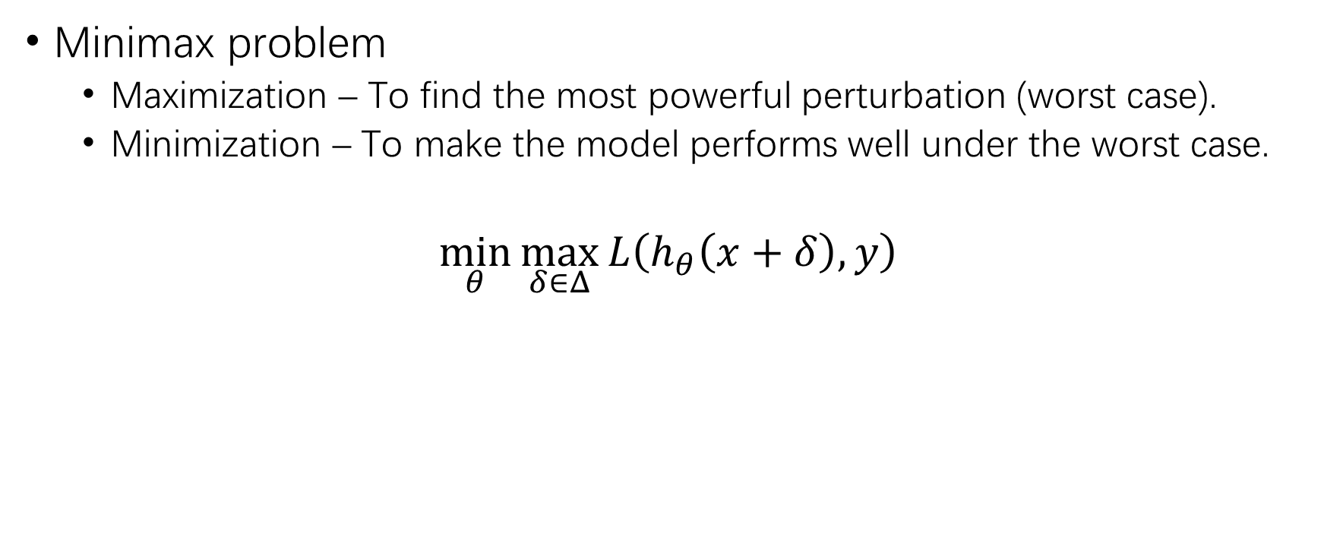
Robust Node Classification (2)
Minimax problem
Maximization – To find the most powerful perturbation (worst case).
Minimization – To make the model performs well under the worst case.
$$\min_{θ}{\max_{δ∈Δ}{L\left(h_{θ}\left(x+δ\right),y\right)}}$$

Slide 6
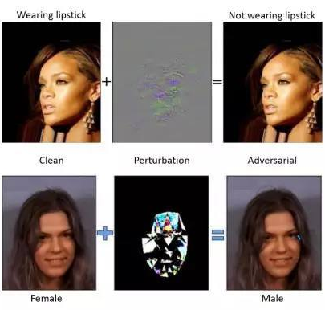
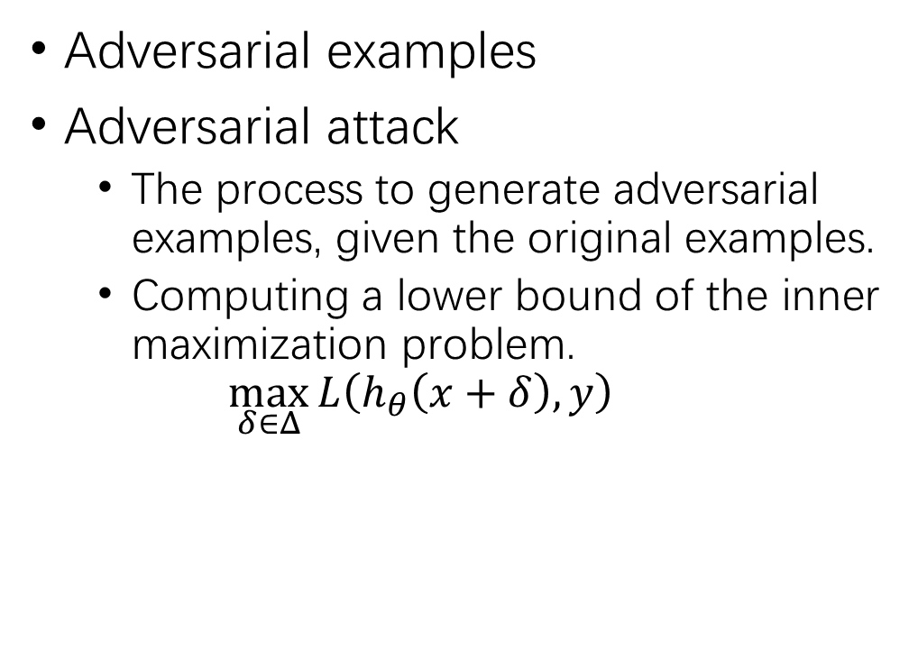
Adversarial Attack
Adversarial examples
Adversarial attack
The process to generate adversarial examples, given the original examples.
Computing a lower bound of the inner maximization problem.
$$\max_{δ∈Δ}{L\left(h_{θ}\left(x+δ\right),y\right)}$$
B
D
0,0,0,0,1,…0,0,0,0
0,1,0,0,0,…0,1,0,1
D
1,1,0,0,0,…0,0,0,1
B
B
0,0,1,0,1,…0,0,0,0
0,0,0,0,0,…1,0,0,0

Slide 7
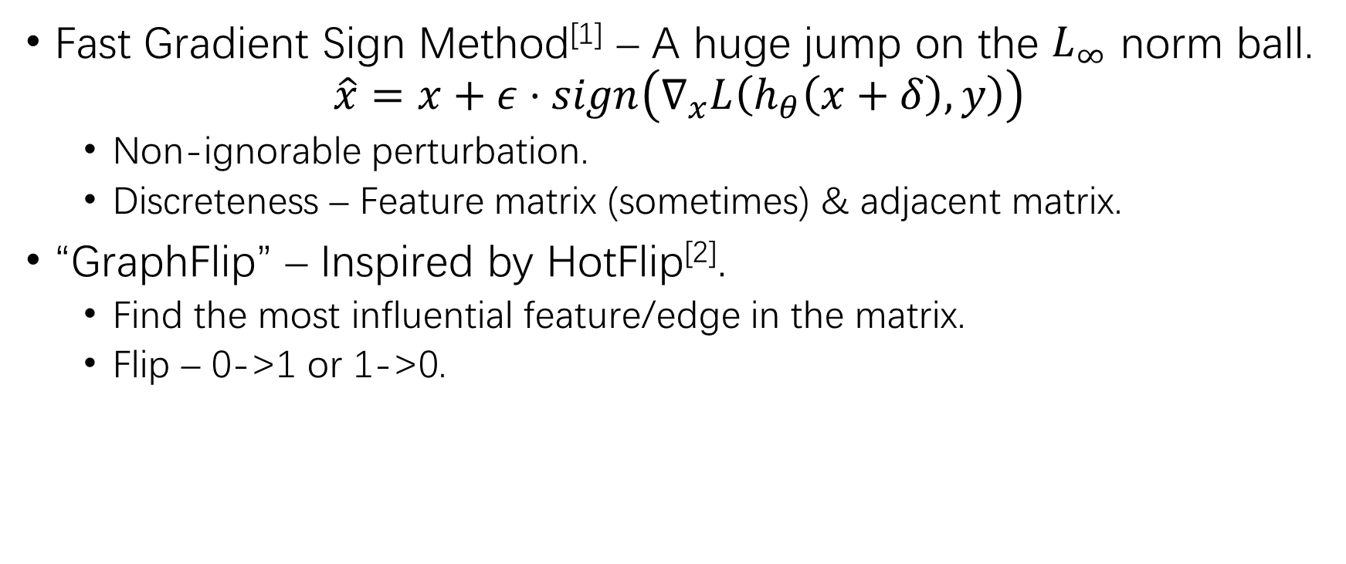
Adversarial Attack (2)
Fast Gradient Sign Method^{[1]} – A huge jump on the $L_{∞}$ norm ball.
$$\hat{x}=x+ε⋅sign\left(∇_{x}L\left(h_{θ}\left(x+δ\right),y\right)\right)$$
Non-ignorable perturbation.
Discreteness – Feature matrix (sometimes) & adjacent matrix.
“GraphFlip” – Inspired by HotFlip^{[2]}.
Find the most influential feature/edge in the matrix.
Flip – 0->1 or 1->0.
[1] Ian J. Goodfellow, Jonathon Shlens, Christian Szegedy. Explaining and Harnessing Adversarial Examples. arXiv:1412.6572.
[2] Javid Ebrahimi, Anyi Rao, Daniel Lowd, Dejing Dou. HotFlip: White-Box Adversarial Examples for Text Classification. arXiv:1712.06751.

Slide 8
Adversarial Attack (3)
GraphFlip
FGSM

Slide 9
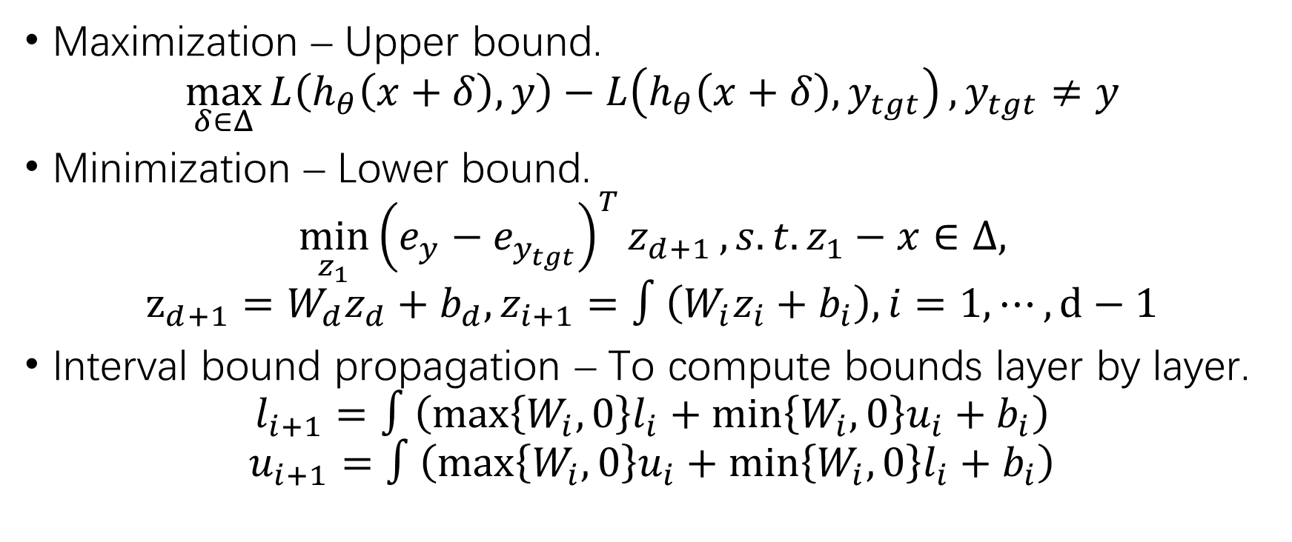
Robustness Verification (2)
Maximization – Upper bound.
$$\max_{δ∈Δ}{L\left(h_{θ}\left(x+δ\right),y\right)−L\left(h_{θ}\left(x+δ\right),y_{tgt}\right)}, y_{tgt}≠y$$
Minimization – Lower bound.
$$\min_{z_{1}}{{\left(e_{y}−e_{y_{tgt}}\right)}^{T}z_{d+1}}, s.t. z_{1}−x∈Δ,$$
$$z_{d+1}=W_{d}z_{d}+b_{d}, z_{i+1}=∫\left(W_{i}z_{i}+b_{i}\right), i=1,⋯,d−1$$
Interval bound propagation – To compute bounds layer by layer.
$$l_{i+1}=∫\left(\max\left\{W_{i},0\right\}l_{i}+\min\left\{W_{i},0\right\}u_{i}+b_{i}\right)$$
$$u_{i+1}=∫\left(\max\left\{W_{i},0\right\}u_{i}+\min\left\{W_{i},0\right\}l_{i}+b_{i}\right)$$

Slide 10

Adversarial Training
Adversarial training
$$\min_{θ}\left(L\left(h_{θ}\left(x\right),y\right)+λ⋅\max_{δ∈Δ}{L\left(h_{θ}\left(x+δ\right),y\right)}\right)$$
Lower bound based – Adversarial examples
Upper bound based – Interval bound propagation

Slide 11
Possible Research Directions
Adversarial attack algorithms towards NLP.
Robustness verification on NLP.
Adversarial attack algorithms towards GNN.
Robustness verification on GNN.

Slide 12
1. Adversarial Attack in NLP
HotFlip – FGSM + Discretization
[1] Ebrahimi J, Rao A, Lowd D, et al. HotFlip: White-Box Adversarial Examples for Text Classification[C]. ACL 2018.
GA – Genetic algorithm
[2] Alzantot M, Sharma Y, Elgohary A, et al. Generating Natural Language Adversarial Examples[C]. EMNLP 2018.
MHA – M-H sampling
[3] Zhang H, Zhou H, Miao N, et al. Generating fluent adversarial examples for natural languages[C]. ACL 2019.
MHM – M-H sampling
[4] Zhang H, Li Z, Li G, et al. Generating adversarial examples for holding robustness of source code processing. AAAI 2020.
Simulated annealing + HotFlip = ?

Slide 13
2. Robustness Verification in NLP
Interval bound propagation – Directly apply IBP.
[5] Huang P S, Stanforth R, Welbl J, et al. Achieving Verified Robustness to Symbol Substitutions via Interval Bound Propagation[C]. EMNLP 2019.
POPQORN – Nonlinear relaxation + IBP on RNNs
[6] Ko C Y, Lyu Z, Weng L, et al. POPQORN: Quantifying Robustness of Recurrent Neural Networks[C]. ICML 2019.

Slide 14
3. Adversarial Attack on GNN
NETTACK – Edge adding/dropping + feature perturbation
[7] Zügner D, Akbarnejad A, Günnemann S. Adversarial attacks on neural networks for graph data[C]. SIGKDD 2018.
DefNet – CGAN + model refining
[8] Wang X, Liu X, Hsieh C J. GraphDefense: Towards Robust Graph Convolutional Networks[J]. arXiv 2019.
HotFlip on GNN?

Slide 15
4. Robustness Verification on GNN
Apply IBP directly on GNN?

