Slide 1
Sequence Adversarial Example Generation
张煌昭 1901111303 zhang_hz@pku.edu.cn

Slide 2
Overview
Sequence adversary
Metropolis-Hastings sampling
M-H based natural language adversarial example generation
Zhang H, Zhou H, Miao N, et al. Generating fluent adversarial examples for natural languages[C]//Proceedings of the 57th Annual Meeting of the Association for Computational Linguistics. 2019: 5564-5569.
M-H based source code adversarial example generation
Zhang H, Li Z, Li, G, et al. Generating adversarial examples for holding robustness of source code processing[C] //To appear in Proceedings of the AAAI Conference on Artificial Intelligence. 2020.
Future works

Slide 3
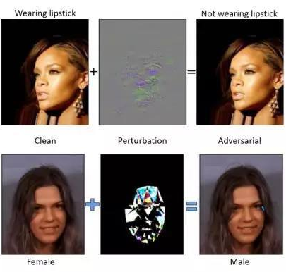
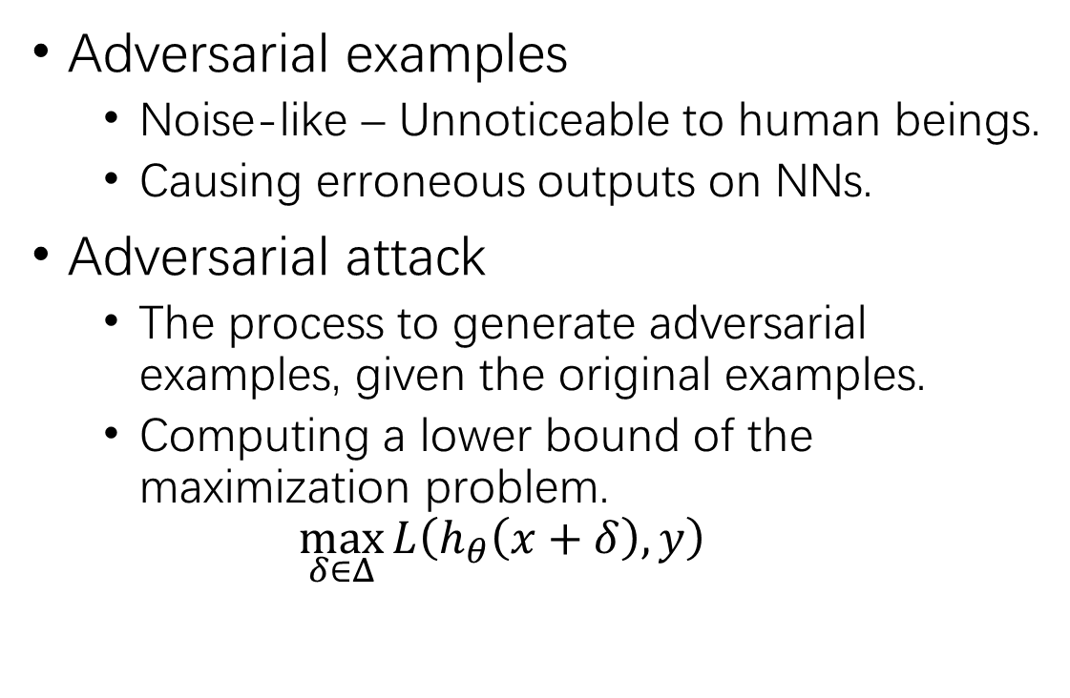
Adversarial Examples & Adversarial Attack
Adversarial examples
Noise-like – Unnoticeable to human beings.
Causing erroneous outputs on NNs.
Adversarial attack
The process to generate adversarial examples, given the original examples.
Computing a lower bound of the maximization problem.
$$\max_{δ∈Δ}{L\left(h_{θ}\left(x+δ\right),y\right)}$$

Slide 4
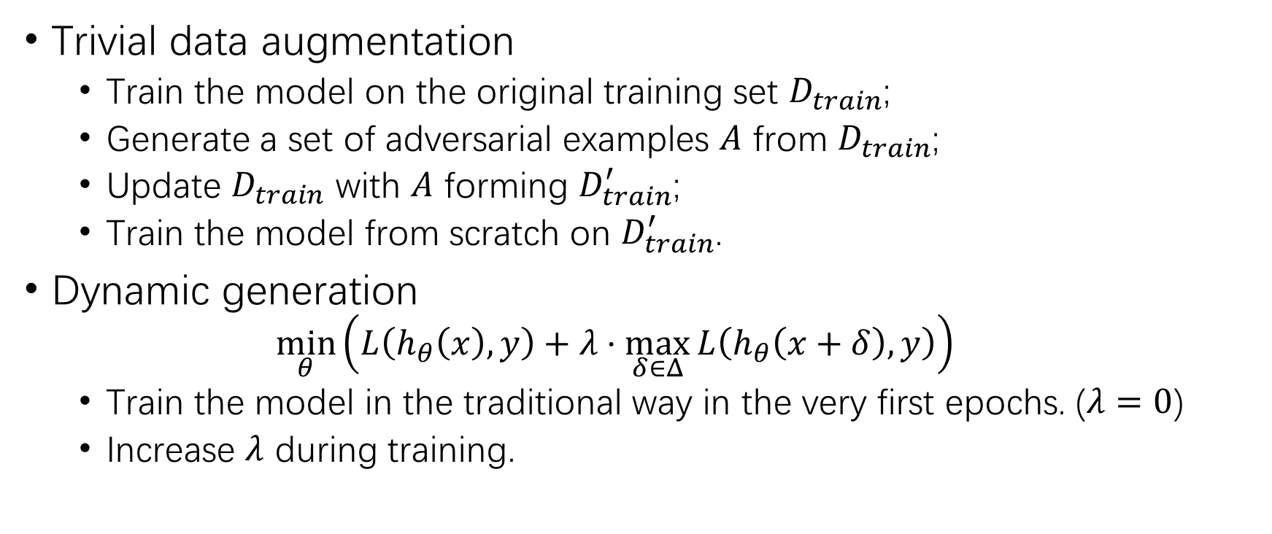
Adversarial Training
Trivial data augmentation
Train the model on the original training set $D_{train}$;
Generate a set of adversarial examples $A$ from $D_{train}$;
Update $D_{train}$ with $A$ forming $D_{train}^{′}$;
Train the model from scratch on $D_{train}^{′}$.
Dynamic generation
$$\min_{θ}\left(L\left(h_{θ}\left(x\right),y\right)+λ⋅\max_{δ∈Δ}{L\left(h_{θ}\left(x+δ\right),y\right)}\right)$$
Train the model in the traditional way in the very first epochs. ($λ=0$)
Increase $λ$ during training.

Slide 5
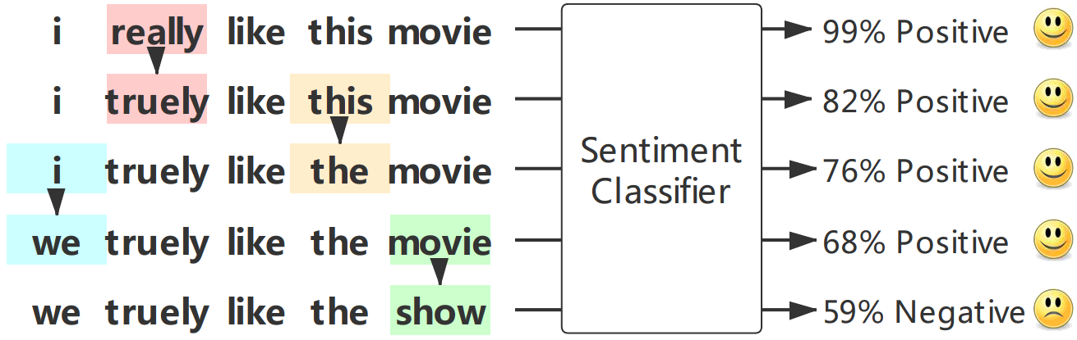
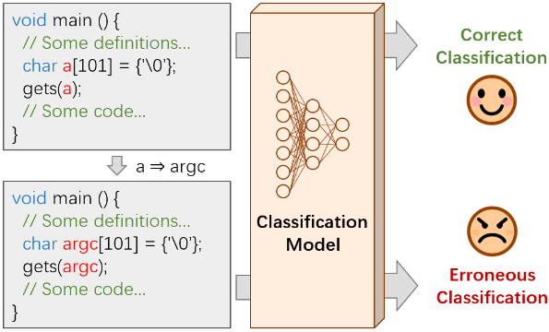
Sequence Adversarial Examples

Slide 6
Sequence Adversarial Examples (2)
Challenges
Discreteness of sequence space – Replacement, insertion, deletion.
Correctness – Word/char-level operation should be error-free.
Noticeability – Word/char-level operation should be unnoticeable.
Previous works
HotFlip – Character flipping.
Ebrahimi J, Rao A, Lowd D, et al. HotFlip: White-Box Adversarial Examples for Text Classification[C]//Proceedings of the 56th Annual Meeting of the Association for Computational Linguistics (Volume 2: Short Papers). 2018: 31-36.
GeneticAttack – Genetic algorithm.
Alzantot M, Sharma Y, Elgohary A, et al. Generating Natural Language Adversarial Examples[C]//Proceedings of the 2018 Conference on Empirical Methods in Natural Language Processing. 2018: 2890-2896.

Slide 7
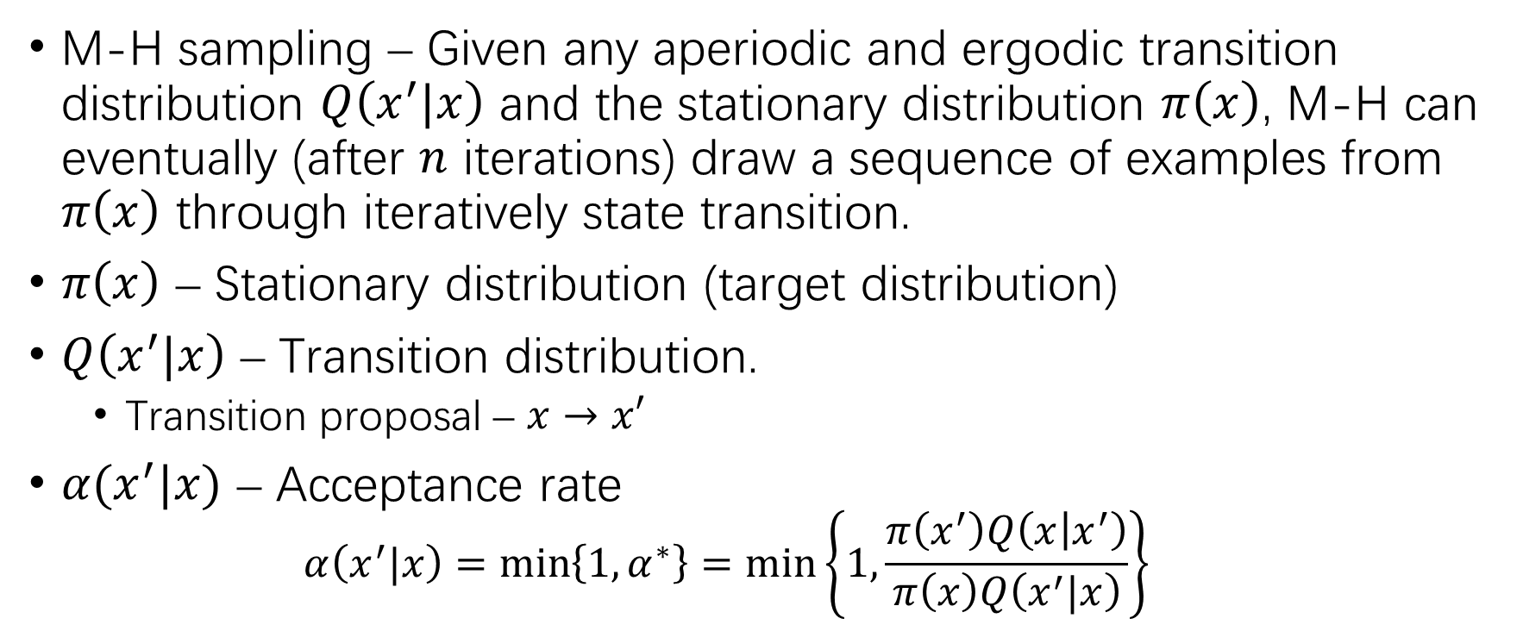
Metropolis-Hastings Sampling
M-H sampling – Given any aperiodic and ergodic transition distribution $Q\left(x^{′}|x\right)$ and the stationary distribution $π\left(x\right)$, M-H can eventually (after $n$ iterations) draw a sequence of examples from $π\left(x\right)$ through iteratively state transition.
$π\left(x\right)$ – Stationary distribution (target distribution)
$Q\left(x^{′}|x\right)$ – Transition distribution.
Transition proposal – $x→x′$
$α(x^{′}|x)$ – Acceptance rate
$$α\left(x^{′}|x\right)=\min\left\{1,α^{∗}\right\}=\min\left\{1,\frac{π\left(x^{′}\right)Q\left(x | x^{′}\right)}{π\left(x\right)Q\left(x^{′}|x\right)}\right\}$$

Slide 8
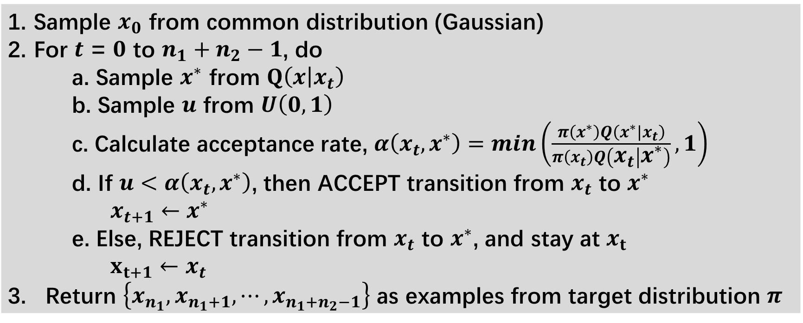
Metropolis-Hastings Sampling (2)
Sample $x_{0}$ from common distribution (Gaussian) For $t$ = $0$ to $n_{1}+n_{2}−1$, do a. Sample $x^{∗}$ from $Q\left(x | x_{t}\right)$ b. Sample $u$ from $U\left(0,1\right)$ c. Calculate acceptance rate, $α\left(x_{t},x^{∗}\right)=min\left(\frac{π\left(x^{∗}\right)Q\left(x^{∗}|x_{t}\right)}{π\left(x_{t}\right)Q\left(x_{t} | x^{∗}\right)},1\right)$ d. If $u<α\left(x_{t},x^{∗}\right)$, then ACCEPT transition from $x_{t}$ to $x^{∗}$ $x_{t+1}←x^{∗}$ e. Else, REJECT transition from $x_{t}$ to $x^{∗}$, and stay at $x_{t}$ $x_{t+1}←x_{t}$ 3. Return $\left\{x_{n_{1}},x_{n_{1}+1},⋯,x_{n_{1}+n_{2}−1}\right\}$ as examples from target distribution $π$

Slide 9
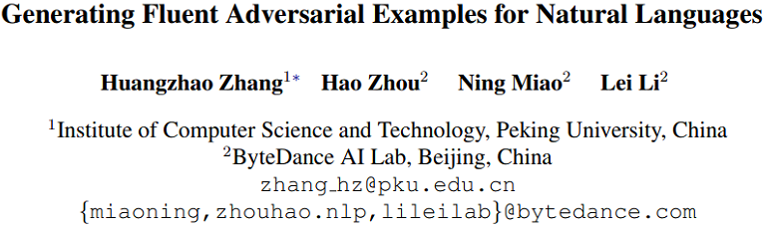
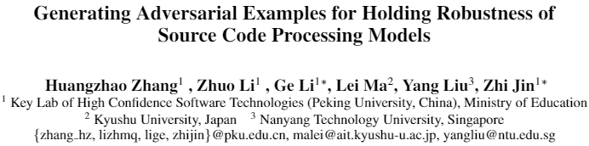
Natural Language Adversary
Zhang H, Zhou H, Miao N, et al. Generating fluent adversarial examples for natural languages[C]//Proceedings of the 57th Annual Meeting of the Association for Computational Linguistics. 2019: 5564-5569.

Slide 10
Natural Language Adversary (2)
Motivations
How to make use of gradient information to perturb in the discrete sentence space is a hard problem.
The generated adversarial examples are sometimes not fluent, which can be filtered out by syntax/semantic checking.
Proposed method – Metropolis-Hastings Attacker (MHA)
White-box availability – Guide transition proposal with gradients.
Fluency – Incorporate language model into stationary distribution.

Slide 11
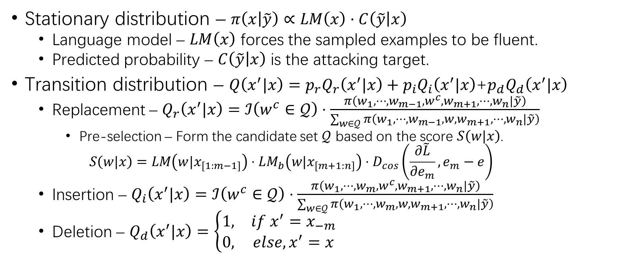
MHA
Stationary distribution – $π\left(x | \tilde{y}\right)∝LM\left(x\right)·C\left(\tilde{y} | x\right)$
Language model – $LM\left(x\right)$ forces the sampled examples to be fluent.
Predicted probability – $C\left(\tilde{y} | x\right)$ is the attacking target.
Transition distribution – $Q\left(x^{′}|x\right)=p_{r}Q_{r}\left(x^{′}|x\right)+p_{i}Q_{i}\left(x^{′}|x\right)$+$p_{d}Q_{d}\left(x^{′}|x\right)$
Replacement – $Q_{r}\left(x^{′}|x\right)=ℐ\left(w^{c}∈𝒬\right)⋅\frac{π\left(w_{1},⋯,w_{m−1},w^{c},w_{m+1},⋯,w_{n}|\tilde{y}\right)}{\sum_{w∈𝒬}{π\left(w_{1},⋯,w_{m−1},w,w_{m+1},⋯,w_{n}|\tilde{y}\right)}}$
Pre-selection – Form the candidate set $𝒬$ based on the score $S\left(w|x\right)$.
$$S\left(w|x\right)=LM\left(w|x_{\left[1:m−1\right]}\right)⋅LM_{b}\left(w|x_{\left[m+1:n\right]}\right)⋅D_{cos}\left(\frac{∂\tilde{L}}{∂e_{m}},e_{m}−e\right)$$
Insertion – $Q_{i}\left(x^{′}|x\right)=ℐ\left(w^{c}∈𝒬\right)⋅\frac{π\left(w_{1},⋯,w_{m},w^{c},w_{m+1},⋯,w_{n}|\tilde{y}\right)}{\sum_{w∈𝒬}{π\left(w_{1},⋯,w_{m},w,w_{m+1},⋯,w_{n}|\tilde{y}\right)}}$
Deletion – $Q_{d}\left(x^{′}|x\right)=\left\{\begin{matrix}1, & if x^{′}=x_{−m} \\ 0, & else, x^{′}=x\end{matrix}\right.$

Slide 12
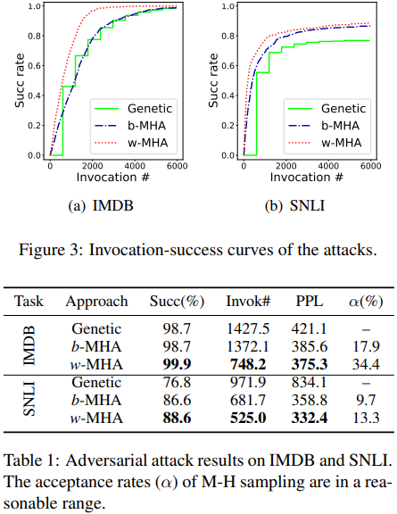
MHA Adversarial Attack
MHA is more efficient.
MHA generates more fluent examples.

Slide 13
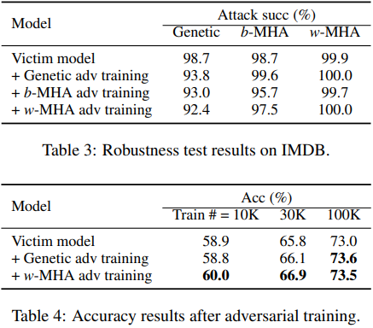
MHA Adversarial Training
MHA adversarial training can improve robustness against GeneticAttack.
MHA adversarial training may improve performance of the model.

Slide 14
Source Code Adversary
Zhang H, Li Z, Li, G, et al. Generating adversarial examples for holding robustness of source code processing[C] //To appear in Proceedings of the AAAI Conference on Artificial Intelligence. 2020.

Slide 15
Source Code Adversary (2)
Motivations
How to perturb in the discrete source space is a hard problem.
The generated adversarial examples must be compilable.
The execution results of the generated adversarial code must be correct.
Proposed method – Metropolis-Hastings Modifier (MHM)
Compilability & executability – Synonymous modification upon the original source code snippet.

Slide 16
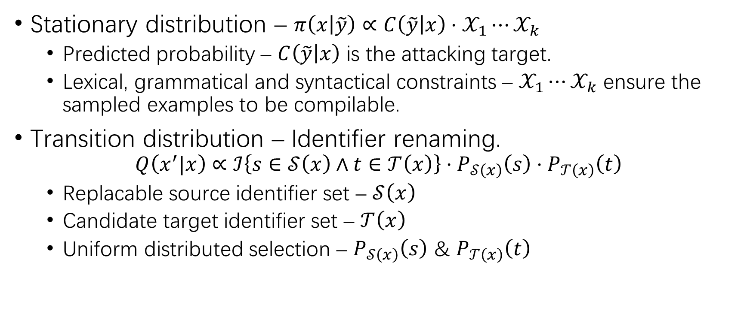
MHM
Stationary distribution – $π\left(x | \tilde{y}\right)∝C\left(\tilde{y} | x\right)⋅𝒳_{1}⋯𝒳_{k}$
Predicted probability – $C\left(\tilde{y} | x\right)$ is the attacking target.
Lexical, grammatical and syntactical constraints – $𝒳_{1}⋯𝒳_{k}$ ensure the sampled examples to be compilable.
Transition distribution – Identifier renaming.
$$Q\left(x^{′}|x\right)∝ℐ\left\{s∈𝒮\left(x\right)∧t∈𝒯\left(x\right)\right\}⋅P_{𝒮\left(x\right)}\left(s\right)⋅P_{𝒯\left(x\right)}\left(t\right)$$
Replacable source identifier set – $𝒮\left(x\right)$
Candidate target identifier set – $𝒯\left(x\right)$
Uniform distributed selection – $P_{𝒮\left(x\right)}\left(s\right)$ & $P_{𝒯\left(x\right)}\left(t\right)$

Slide 17
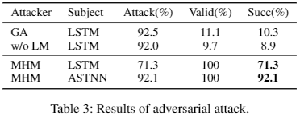
MHM Adversarial Attack
MHM always generates valid adversarial source code examples.
MHM effectively attacks source code classifier.

Slide 18
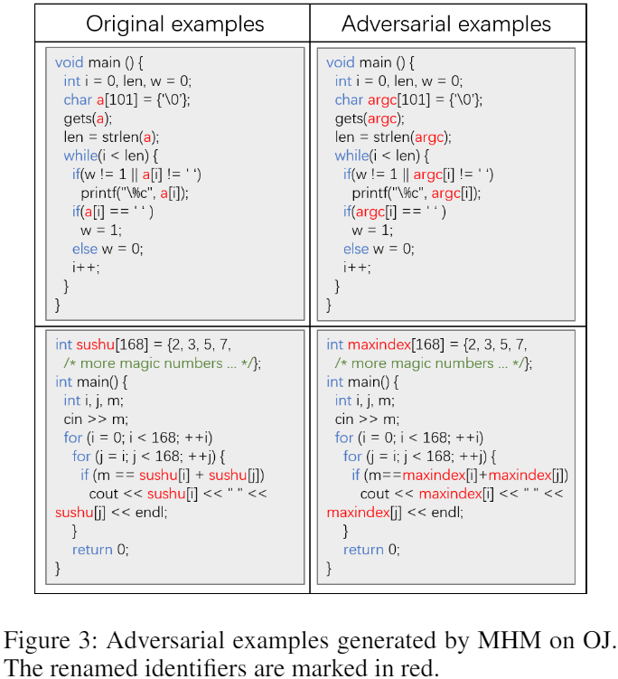
MHM Adversarial Attack (2)

Slide 19
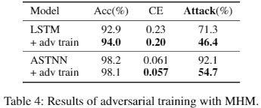
MHM Adversarial Training
MHM adversarial training can improve robustness of source code processing models.
MHM adversarial training may improve performance of the source code processing model.

Slide 20
Future Works
Simulated annealing based HotFlip
HotFlip jumps as far as allowed along the gradient direction.
Hill-climbing is not a appropriate approach for non-convex loss surfaces.
SA encourages jumping to different hill at the first stages.
“Universal” MHM
MHM renames the identifiers to perturb the source code.
Synonymous transformations – “for” => “while”
Graph-structured data
Edge dropping/adding
Feature matrix perturbation

Slide 21
THANK YOU!

