Slide 1
Adversarial examples in Source Code Processing
Huangzhao Zhang (张煌昭), 1901111303
Zhang_hz@pku.edu.cn

Slide 2
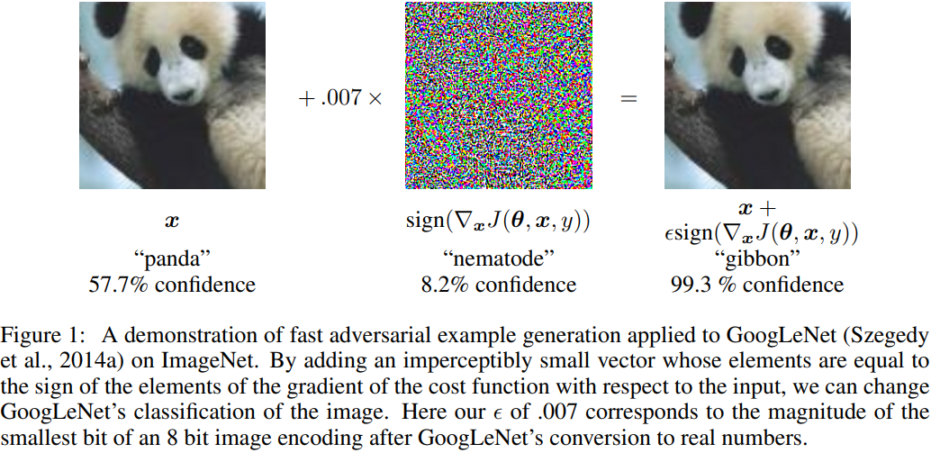
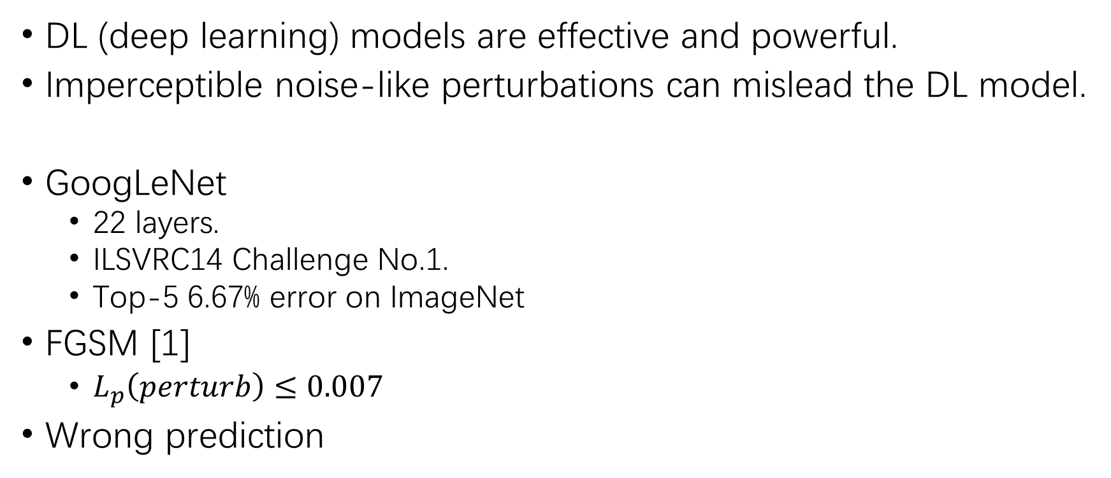
Adversarial Examples – a Teaser
DL (deep learning) models are effective and powerful.
Imperceptible noise-like perturbations can mislead the DL model.
GoogLeNet
22 layers.
ILSVRC14 Challenge No.1.
Top-5 6.67% error on ImageNet
FGSM [1]
$L_{p}\left(perturb\right)≤0.007$
Wrong prediction
[1] Ian J. Goodfellow, Jonathon Shlens, Christian Szegedy. Explaining and Harnessing Adversarial Examples. ICLR (Poster) 2015

Slide 3
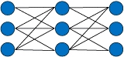


Adversarial Examples – a Teaser (2)
Adversarial examples [2] –
Mislead the target model to produce erroneous outputs.
Imperceptible to human eyes (human beings regard the perturbed and the original examples as the same or a similar pair).
Upper: PANDA
Lower: GIBBON
Original
example
$$√$$
$$×$$
DL model
Perturb
Adversarial
example
All PANDA
Human being
[2] Christian Szegedy, Wojciech Zaremba, Ilya Sutskever, Joan Bruna, Dumitru Erhan, Ian J. Goodfellow, Rob Fergus. Intriguing properties of neural networks. ICLR (Poster) 2014

Slide 4

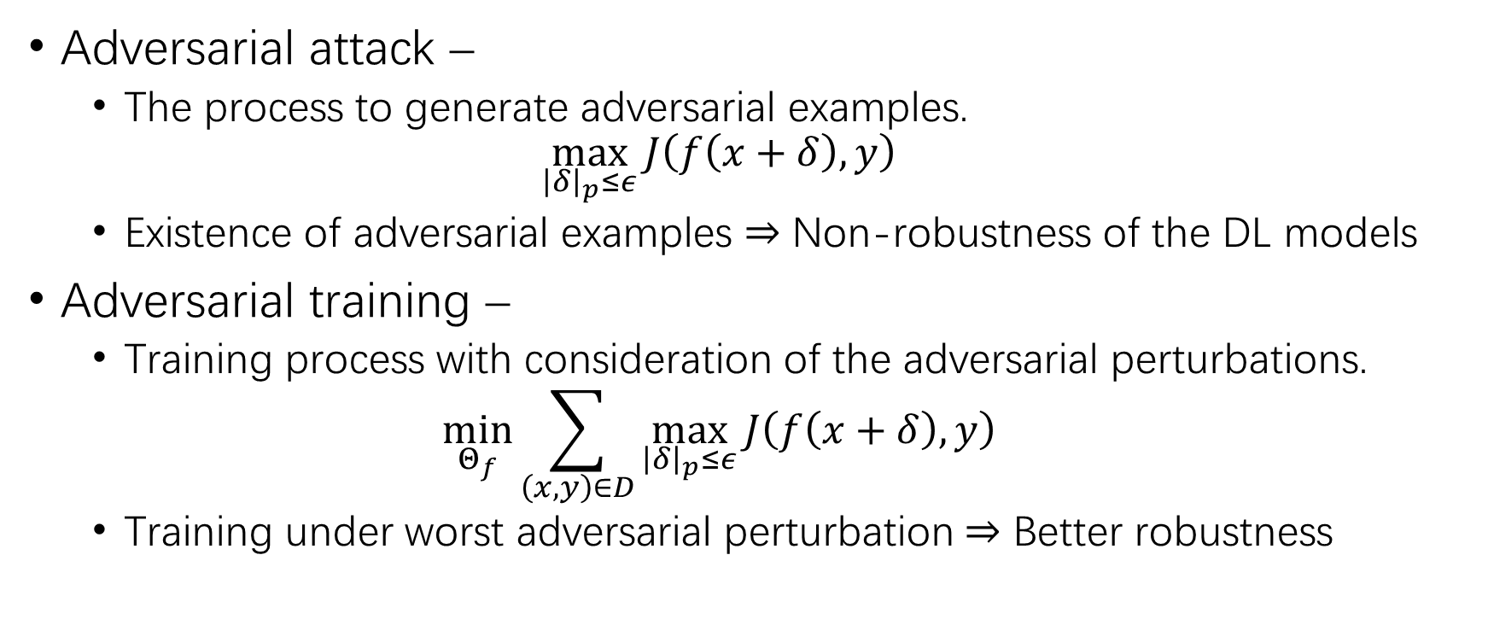
Adversarial Examples – a Teaser (3)
Traditional training –
$$\min_{Θ_{f}}{J\left(f\left(x\right),y\right)}$$
Adversarial attack –
The process to generate adversarial examples.
$$\max_{{\left|δ\right|}_{p}≤ε}{J\left(f\left(x+δ\right),y\right)}$$
Existence of adversarial examples $⇒$ Non-robustness of the DL models
Adversarial training –
Training process with consideration of the adversarial perturbations.
$$\min_{Θ_{f}}{\sum_{\left(x,y\right)∈D}{\max_{{\left|δ\right|}_{p}≤ε}{J\left(f\left(x+δ\right),y\right)}}}$$
Training under worst adversarial perturbation $⇒$ Better robustness
[3] Zico Kolter and Aleksander Madry. Adversarial robustness: Theory and practice. NeurIPS (tutorial) 2018

Slide 5
Overview
Adversarial examples – a teaser
Adversary in source code processing
Metropolis-Hastings modifier
Current work & Future work

Slide 6
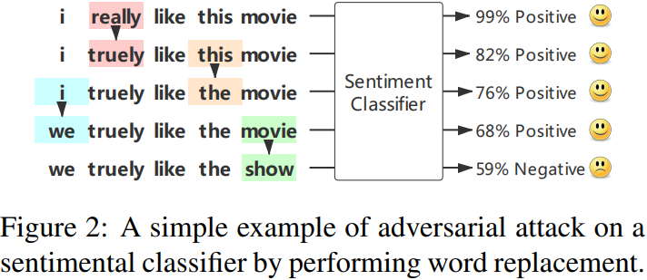
Adversary in Source Code Processing
Sequence processing (discrete) –
Natural language processing (NLP)
Sentimental analysis, language modeling, machine translation, …
Source code processing
Code functionality analysis, code completion, comment generation, …
LSTM binary sentimental classifier
83.1% test accuracy on IMDB.
MHA [4] – Word rep/ins/del
0.1% accuracy under attack
[4] Huangzhao Zhang, Hao Zhou, Ning Miao, Lei Li. Generating Fluent Adversarial Examples for Natural Languages. ACL (short) 2019

Slide 7
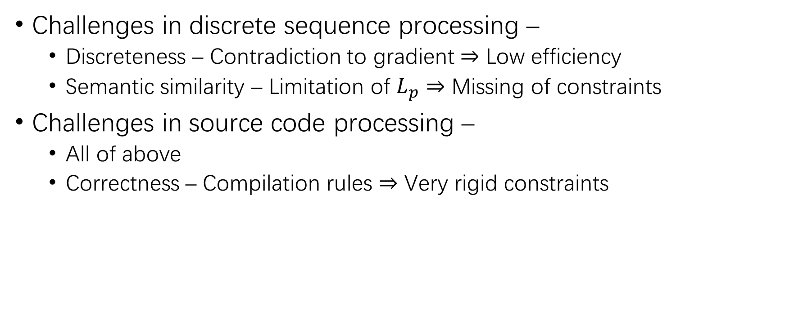
Adversary in Source Code Processing (2)
Challenges in discrete sequence processing –
Discreteness – Contradiction to gradient $⇒$ Low efficiency
Semantic similarity – Limitation of $L_{p}$ $⇒$ Missing of constraints
Challenges in source code processing –
All of above
Correctness – Compilation rules $⇒$ Very rigid constraints

Slide 8
Adversary in Source Code Processing (3)
Adversarial attack approaches in NLP
Genetic attack [5] – Black-box population-based word replacement.
Hotflip [6] – Gradient-based character replacement.
M-H attack [4] – Metropolis-Hastings-based gradient-incorporated word insertion / deletion / replacement.
Correctness still cannot be ensured.
[4] Huangzhao Zhang, Hao Zhou, Ning Miao, Lei Li. Generating Fluent Adversarial Examples for Natural Languages. ACL (short) 2019
[5] Moustafa Alzantot, Yash Sharma, Ahmed Elgohary, Bo-Jhang Ho, Mani B. Srivastava, Kai-Wei Chang. Generating Natural Language Adversarial Examples. EMNLP (short) 2018
[6] Javid Ebrahimi, Anyi Rao, Daniel Lowd, Dejing Dou. HotFlip: White-Box Adversarial Examples for Text Classification. ACL (poster) 2018

Slide 9
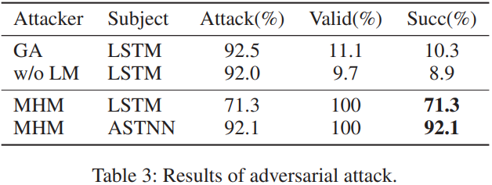
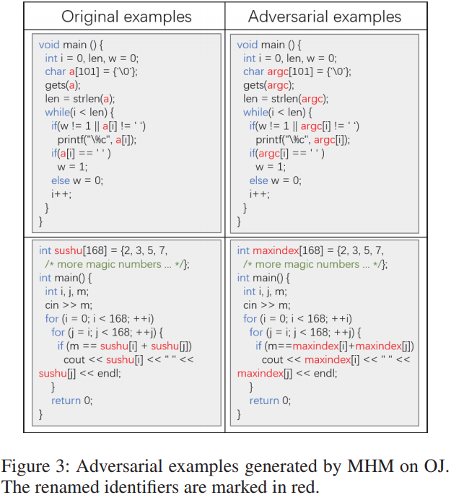
Metropolis-Hastings modifier
Metropolis-Hastings modifier [7] –
Iterative identifier renaming.
Renaming in the manner of M-H.
ASTNN model
98.2% test accuracy on OJ.
MHM
92.1% originally correct examples are erroneously classified on OJ after attack.
[7] Huangzhao Zhang, Zhuo Li, Ge Li, Lei Ma, Yang Liu, Zhi Jin. Generating Adversarial Examples for Holding Robustness of Source Code Processing Models. AAAI (poster) 2020

Slide 10
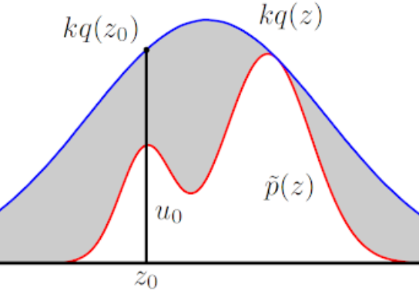
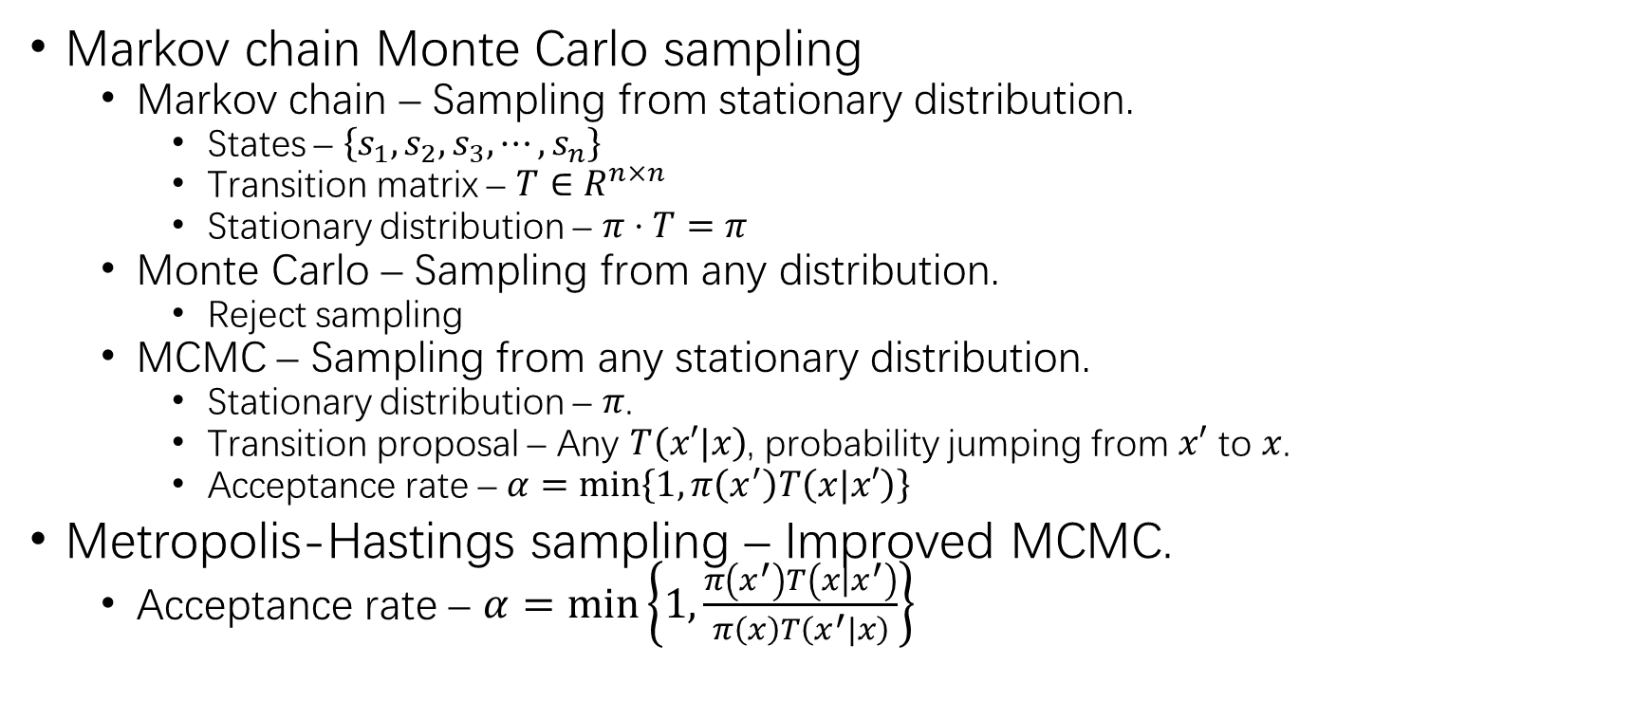
Metropolis-Hastings modifier (2)
Markov chain Monte Carlo sampling
Markov chain – Sampling from stationary distribution.
States – $\left\{s_{1},s_{2},s_{3},⋯,s_{n}\right\}$
Transition matrix – $T∈R^{n×n}$
Stationary distribution – $π⋅T=π$
Monte Carlo – Sampling from any distribution.
Reject sampling
MCMC – Sampling from any stationary distribution.
Stationary distribution – $π$.
Transition proposal – Any $T\left(x′|x\right)$, probability jumping from $x′$ to $x$.
Acceptance rate – $α=\min\left\{1,π\left(x^{′}\right)T\left(x|x′\right)\right\}$
Metropolis-Hastings sampling – Improved MCMC.
Acceptance rate – $α=\min\left\{1,\frac{π\left(x^{′}\right)T\left(x|x^{′}\right)}{π\left(x\right)T\left(x^{′}|x\right)}\right\}$

Slide 11
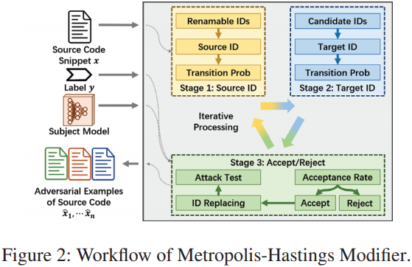
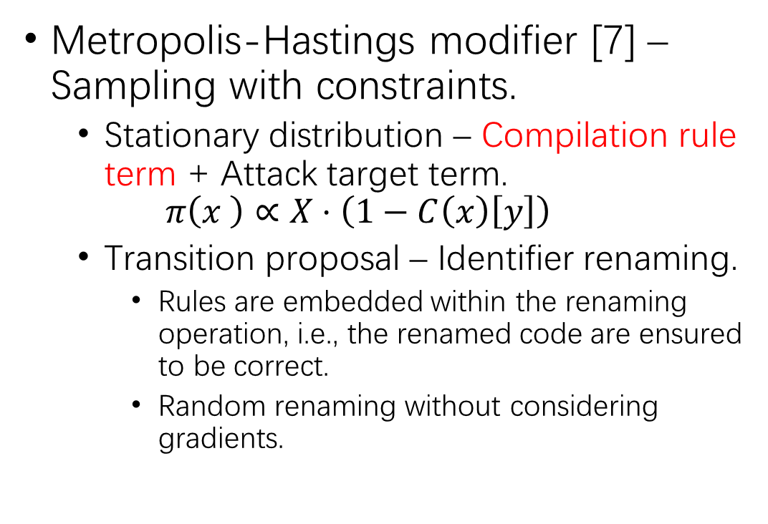
Metropolis-Hastings modifier (3)
Metropolis-Hastings modifier [7] – Sampling with constraints.
Stationary distribution – Compilation rule term + Attack target term.
$$π\left(x \right)∝X⋅\left(1−C\left(x\right)\left[y\right]\right)$$
Transition proposal – Identifier renaming.
Rules are embedded within the renaming operation, i.e., the renamed code are ensured to be correct.
Random renaming without considering gradients.
[7] Huangzhao Zhang, Zhuo Li, Ge Li, Lei Ma, Yang Liu, Zhi Jin. Generating Adversarial Examples for Holding Robustness of Source Code Processing Models. AAAI (poster) 2020

Slide 12
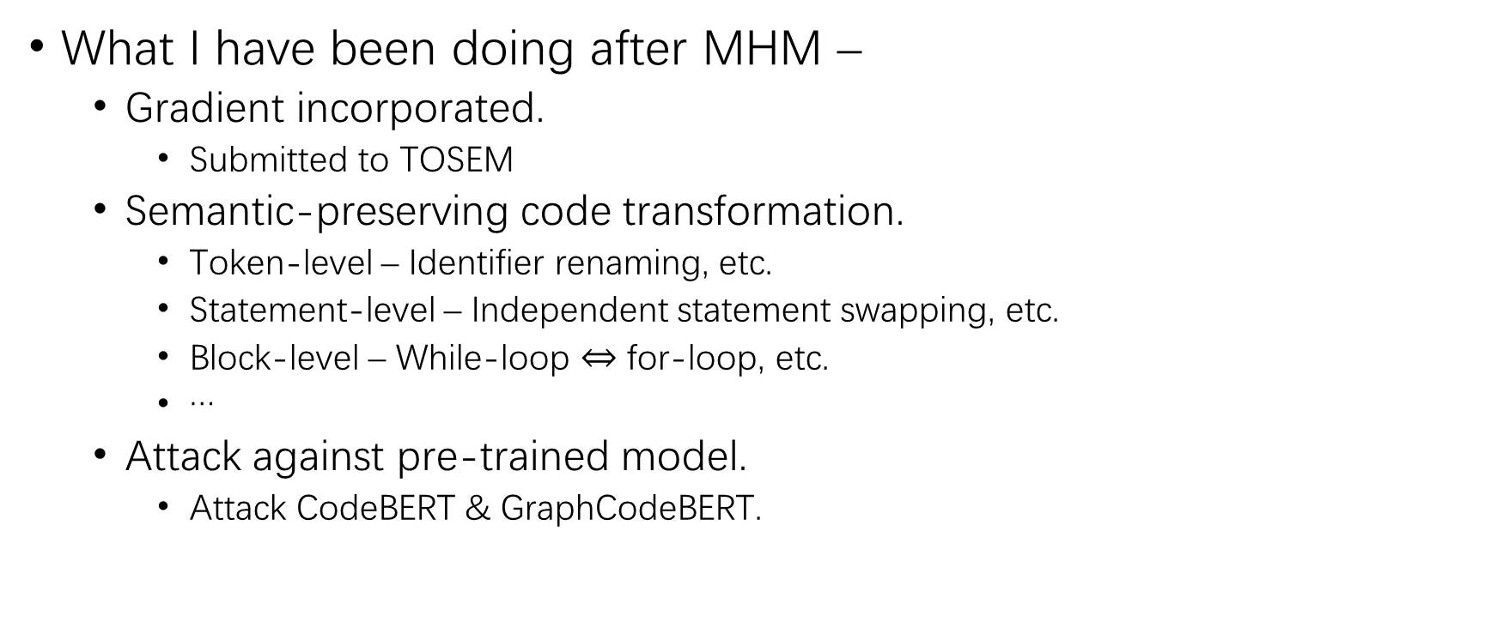
Current Work & Future Work
What I have been doing after MHM –
Gradient incorporated.
Submitted to TOSEM
Semantic-preserving code transformation.
Token-level – Identifier renaming, etc.
Statement-level – Independent statement swapping, etc.
Block-level – While-loop $⇔$ for-loop, etc.
…
Attack against pre-trained model.
Attack CodeBERT & GraphCodeBERT.

Slide 13
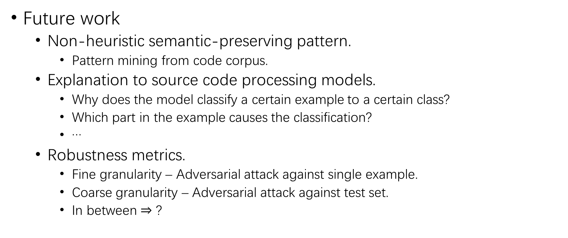
Current Work & Future Work (2)
Future work
Non-heuristic semantic-preserving pattern.
Pattern mining from code corpus.
Explanation to source code processing models.
Why does the model classify a certain example to a certain class?
Which part in the example causes the classification?
…
Robustness metrics.
Fine granularity – Adversarial attack against single example.
Coarse granularity – Adversarial attack against test set.
In between $⇒$ ?

Slide 14
References
[1] Ian J. Goodfellow, Jonathon Shlens, Christian Szegedy. Explaining and Harnessing Adversarial Examples. ICLR (Poster) 2015
[2] Christian Szegedy, Wojciech Zaremba, Ilya Sutskever, Joan Bruna, Dumitru Erhan, Ian J. Goodfellow, Rob Fergus. Intriguing properties of neural networks. ICLR (Poster) 2014
[3] Zico Kolter and Aleksander Madry. Adversarial robustness: Theory and practice. NeurIPS (tutorial) 2018
[4] Huangzhao Zhang, Hao Zhou, Ning Miao, Lei Li. Generating Fluent Adversarial Examples for Natural Languages. ACL (short) 2019
[5] Moustafa Alzantot, Yash Sharma, Ahmed Elgohary, Bo-Jhang Ho, Mani B. Srivastava, Kai-Wei Chang. Generating Natural Language Adversarial Examples. EMNLP (short) 2018
[6] Javid Ebrahimi, Anyi Rao, Daniel Lowd, Dejing Dou. HotFlip: White-Box Adversarial Examples for Text Classification. ACL (poster) 2018
[7] Huangzhao Zhang, Zhuo Li, Ge Li, Lei Ma, Yang Liu, Zhi Jin. Generating Adversarial Examples for Holding Robustness of Source Code Processing Models. AAAI (poster) 2020

Slide 15
Q&A

Slide 16
THANK YOU!

