Slide 1
Combinatorial Adversarial Attack through Particle Swarm Optimization
Huangzhao Zhang, zhang_hz@pku.edu.cn

Slide 2
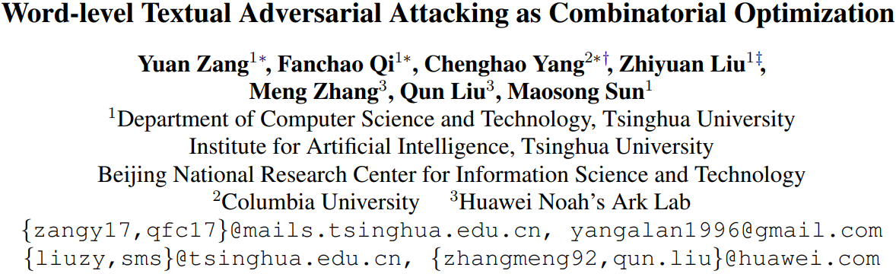

Slide 3
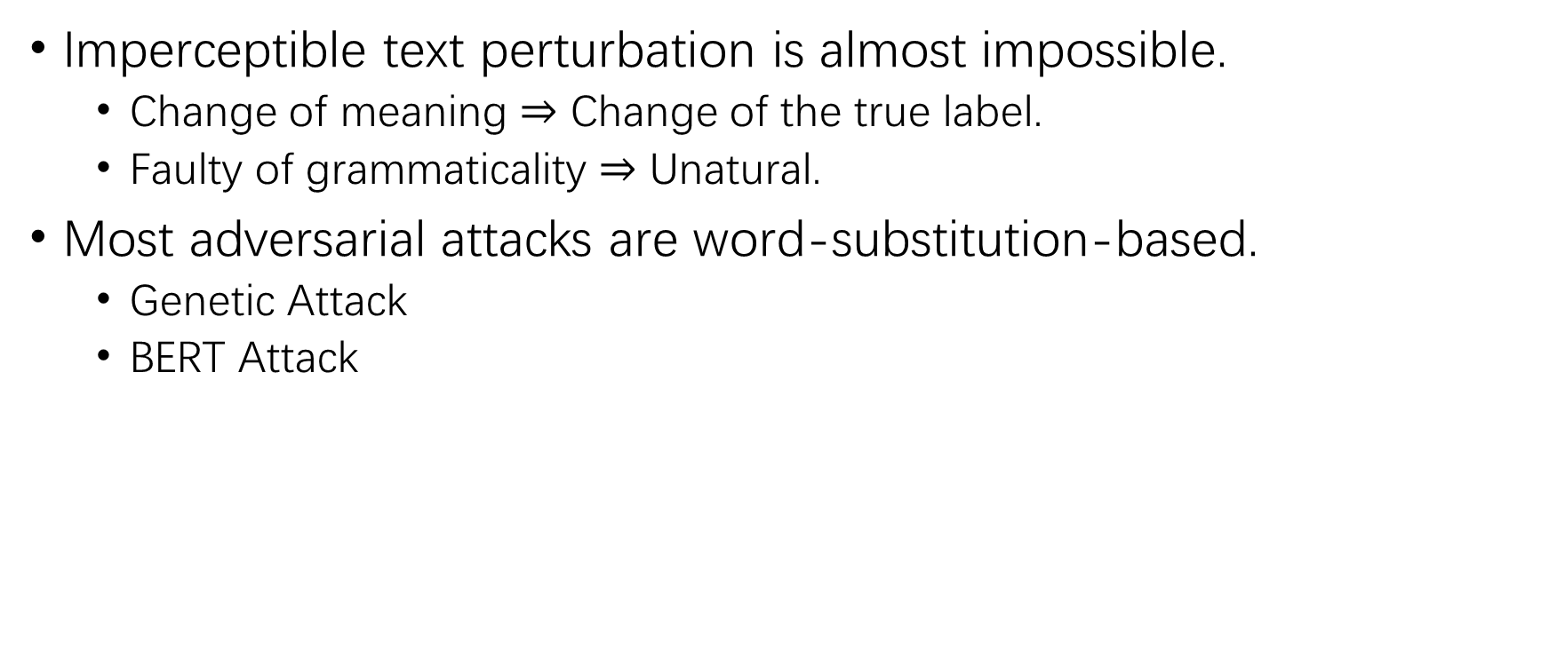
Text Adversarial Attack
Imperceptible text perturbation is almost impossible.
Change of meaning $⇒$ Change of the true label.
Faulty of grammaticality $⇒$ Unatural.
Most adversarial attacks are word-substitution-based.
Genetic Attack
BERT Attack

Slide 4
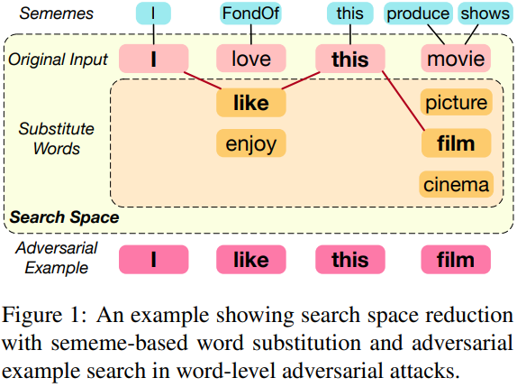
Text Adversarial Attack (2)
Word-substitution-based attack as combinatorial optimization.
Goal – To craft adversarial examples which can successfully fool the victim model using a limited vocabulary.
2-step combinatorial optimization.
Reducing the search space.
Searching for adversarial examples.
Previous studies.
Step 1 – Usually disregarded in previous work.
Step 2 – Searching.
White-box – eg. GD. Impractical.
Black-box – eg. Genetic. Ineffective & inefficient.

Slide 5
Text Adversarial Attack (3)
Sememe PSO Attack
Step 1 – Sememe-based word substitution
Sememe – Semantic labels of words.
HowNet – A sememe knowledge base. 100K words. 2K sense-level sememes.
Step 2 – Particle swarm optimization
PSO – A population-based evolutionary algorithm.

Slide 6
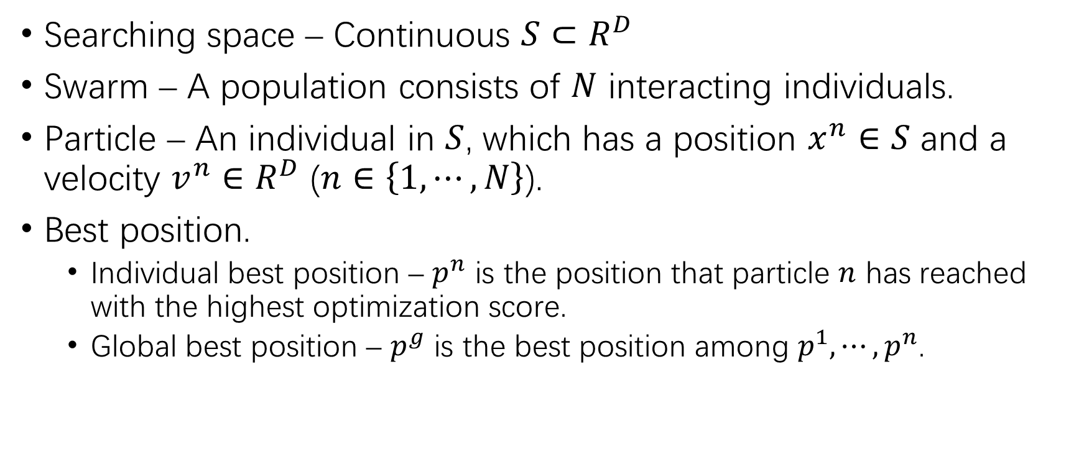
Particle Swarm Optimization
Searching space – Continuous $S⊂R^{D}$
Swarm – A population consists of $N$ interacting individuals.
Particle – An individual in $S$, which has a position $x^{n}∈S$ and a velocity $v^{n}∈R^{D}$ ($n∈\left\{1,⋯,N\right\}$).
Best position.
Individual best position – $p^{n}$ is the position that particle $n$ has reached with the highest optimization score.
Global best position – $p^{g}$ is the best position among $p^{1},⋯,p^{n}$.

Slide 7
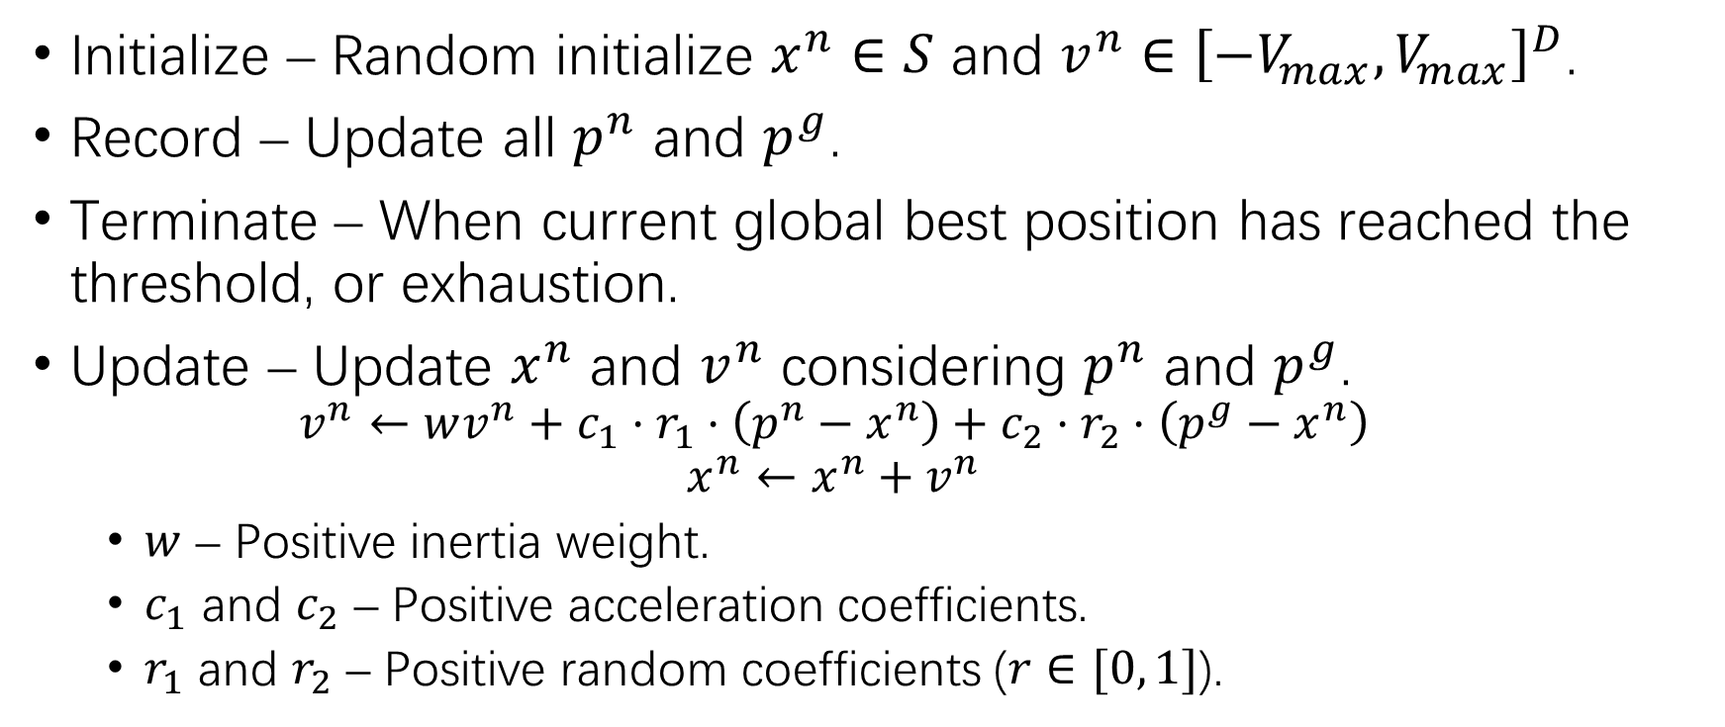
Particle Swarm Optimization (2)
Initialize – Random initialize $x^{n}∈S$ and $v^{n}∈{\left[−V_{max},V_{max}\right]}^{D}$.
Record – Update all $p^{n}$ and $p^{g}$.
Terminate – When current global best position has reached the threshold, or exhaustion.
Update – Update $x^{n}$ and $v^{n}$ considering $p^{n}$ and $p^{g}$.
$$v^{n}←wv^{n}+c_{1}⋅r_{1}⋅\left(p^{n}−x^{n}\right)+c_{2}⋅r_{2}⋅\left(p^{g}−x^{n}\right)$$
$$x^{n}←x^{n}+v^{n}$$
$w$ – Positive inertia weight.
$c_{1}$ and $c_{2}$ – Positive acceleration coefficients.
$r_{1}$ and $r_{2}$ – Positive random coefficients ($r∈[0, 1]$).

Slide 8

Particle Swarm Optimization (3)
$$v^{n}←wv^{n}+c_{1}⋅r_{1}⋅\left(p^{n}−x^{n}\right)+c_{2}⋅r_{2}⋅\left(p^{g}−x^{n}\right)$$
$$x^{n}←x^{n}+v^{n}$$
Terms
Momentum term – $wv^{n}$.
Self experience term – $c_{1}⋅r_{1}⋅\left(p^{n}−x^{n}\right)$.
Population experience term – $c_{2}⋅r_{2}⋅\left(p^{g}−x^{n}\right)$
Bird flocking

Slide 9
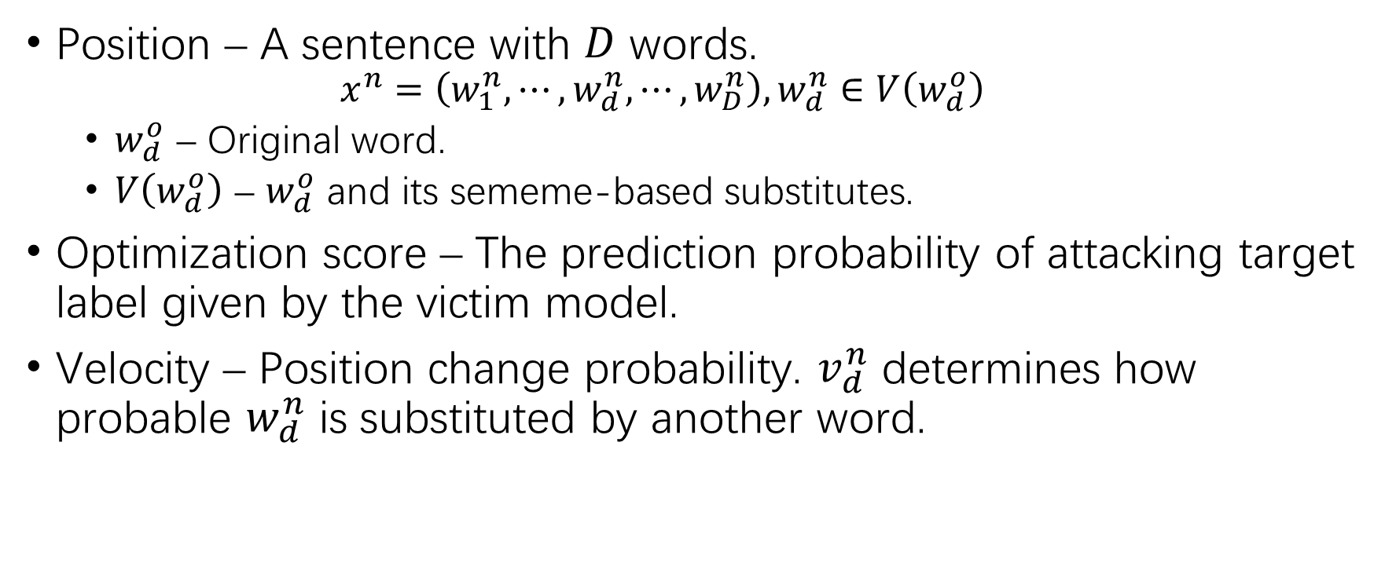
PSO-base Adversarial Attack
Position – A sentence with $D$ words.
$$x^{n}=\left(w_{1}^{n},⋯,w_{d}^{n},⋯,w_{D}^{n}\right), w_{d}^{n}∈V\left(w_{d}^{o}\right)$$
$w_{d}^{o}$ – Original word.
$V\left(w_{d}^{o}\right)$ – $w_{d}^{o}$ and its sememe-based substitutes.
Optimization score – The prediction probability of attacking target label given by the victim model.
Velocity – Position change probability. $v_{d}^{n}$ determines how probable $w_{d}^{n}$ is substituted by another word.

Slide 10
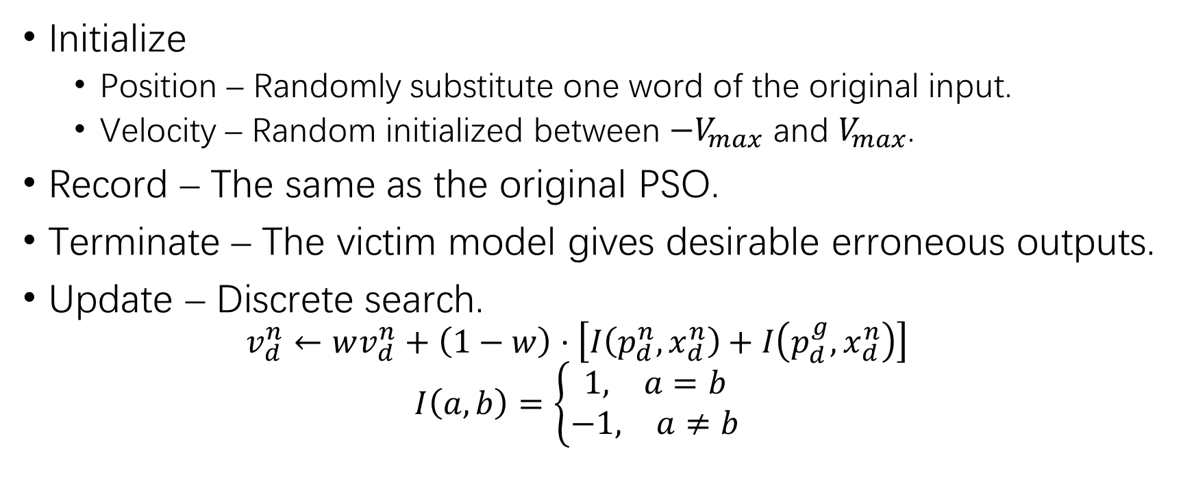
PSO-base Adversarial Attack (2)
Initialize
Position – Randomly substitute one word of the original input.
Velocity – Random initialized between $−V_{max}$ and $V_{max}$.
Record – The same as the original PSO.
Terminate – The victim model gives desirable erroneous outputs.
Update – Discrete search.
$$v_{d}^{n}←wv_{d}^{n}+\left(1−w\right)⋅\left[I\left(p_{d}^{n},x_{d}^{n}\right)+I\left(p_{d}^{g},x_{d}^{n}\right)\right]$$
$$I\left(a,b\right)=\left\{\begin{matrix}\begin{matrix}1, & a=b\end{matrix} \\ \begin{matrix}−1, & a≠b\end{matrix}\end{matrix}\right.$$

Slide 11

PSO-base Adversarial Attack (3)
Update – Discrete search.
Velocity.
$$v_{d}^{n}←wv_{d}^{n}+\left(1−w\right)⋅\left[I\left(p_{d}^{n},x_{d}^{n}\right)+I\left(p_{d}^{g},x_{d}^{n}\right)\right]$$
$$I\left(a,b\right)=\left\{\begin{matrix}\begin{matrix}1, & a=b\end{matrix} \\ \begin{matrix}−1, & a≠b\end{matrix}\end{matrix}\right.$$
Decreasing inertia weight.
$$w=\left(w_{max}−w_{min}\right)⋅\frac{T−t}{T}+w_{min}$$

Slide 12
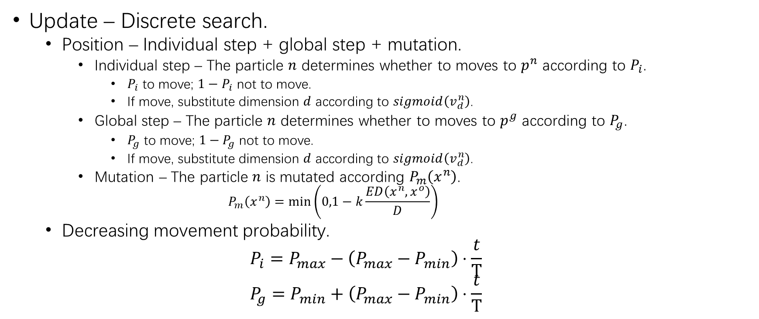
PSO-base Adversarial Attack (4)
Update – Discrete search.
Position – Individual step + global step + mutation.
Individual step – The particle $n$ determines whether to moves to $p^{n}$ according to $P_{i}$.
$P_{i}$ to move; $1−P_{i}$ not to move.
If move, substitute dimension $d$ according to $sigmoid\left(v_{d}^{n}\right)$.
Global step – The particle $n$ determines whether to moves to $p^{g}$ according to $P_{g}$.
$P_{g}$ to move; $1−P_{g}$ not to move.
If move, substitute dimension $d$ according to $sigmoid\left(v_{d}^{n}\right)$.
Mutation – The particle $n$ is mutated according $P_{m}\left(x^{n}\right)$.
$$P_{m}\left(x^{n}\right)=\min\left(0,1−k\frac{ED\left(x^{n},x^{o}\right)}{D}\right)$$
Decreasing movement probability.
$$P_{i}=P_{max}−\left(P_{max}−P_{min}\right)⋅\frac{t}{T}$$
$$P_{g}=P_{min}+\left(P_{max}−P_{min}\right)⋅\frac{t}{T}$$

Slide 13
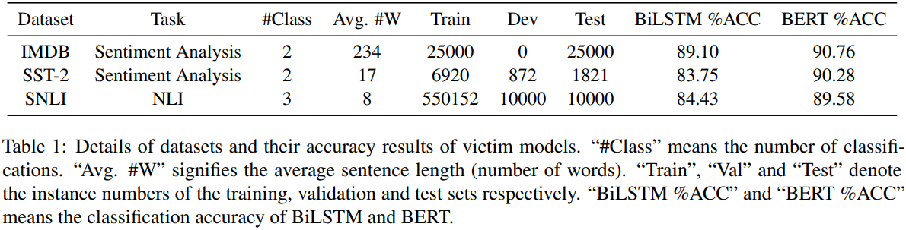
Experimental Settings
Datasets.
Binary sentimental classification – IMDB, SST-2.
Natural language inference – SNLI.
Victim models – BiLSTM and BERT-base.
Baselines.
Genetic Attack – Embedding/LM + Genetic.
PWWS – Synonym + Greedy.

Slide 14
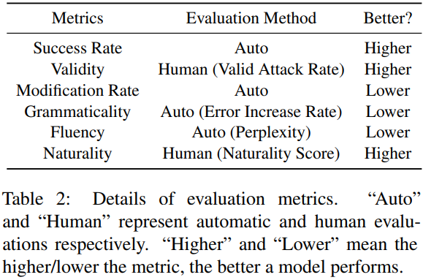
Evaluation Metrics
Success rate
Validity
Quality
Modification – Edit distance.
Grammaticality – LanguageTool
Fluency – GPT-2
Naturality

Slide 15
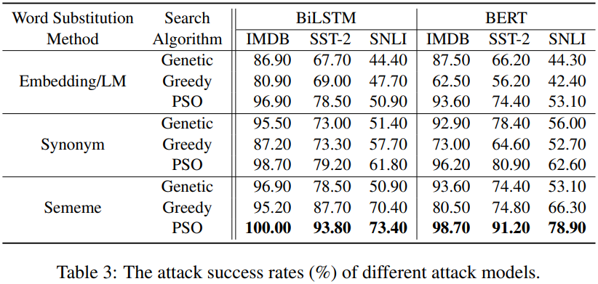
Experimental Results

Slide 16
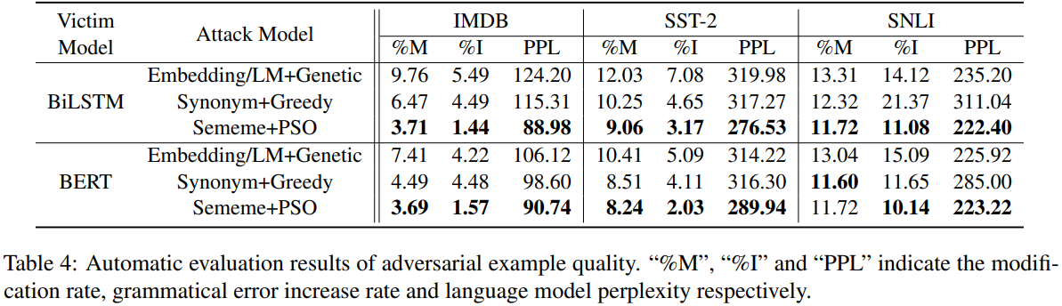
Experimental Results (2)

Slide 17
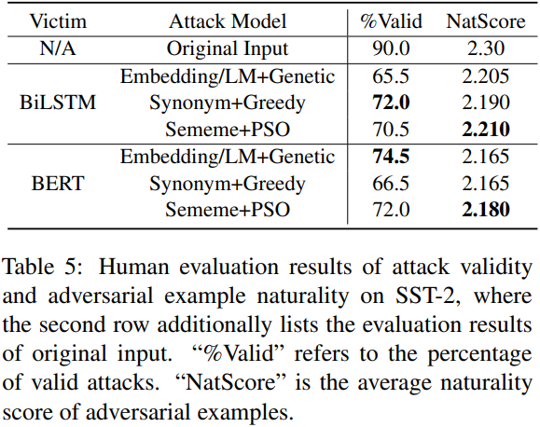
Experimental Results (3)

Slide 18
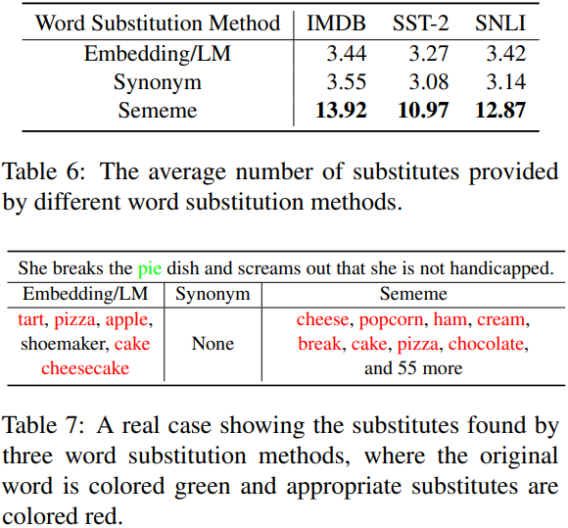
Ablation Analyses

Slide 19
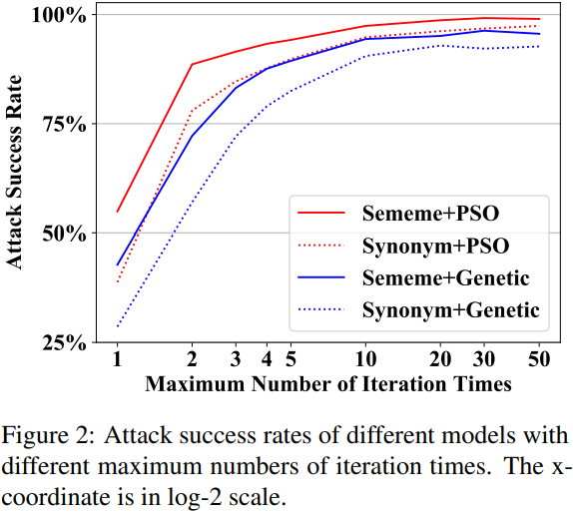
Ablation Analyses (2)

Slide 20
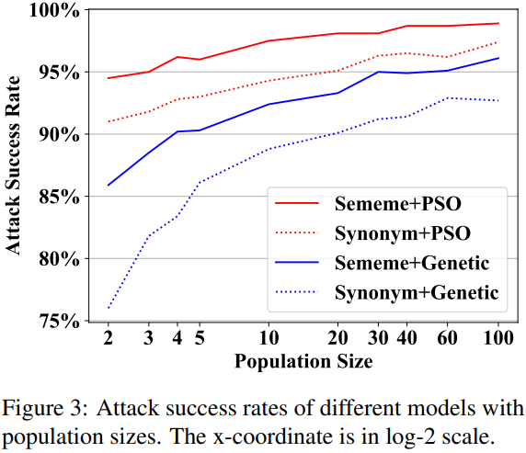
Ablation Analyses (3)

Slide 21
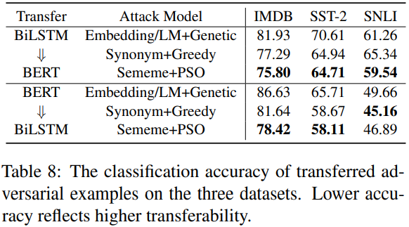
Ablation Analyses (4)

Slide 22
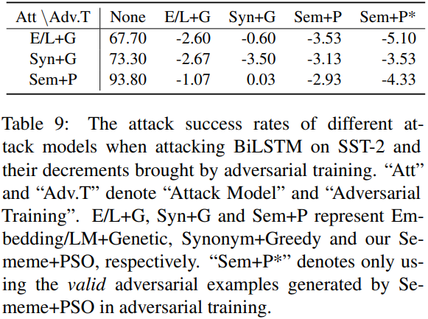
Ablation Analyses (4)

Slide 23
CodeBERT-Attack on OJ
ID substitution against CodeBERT
MHM – 8.04%
CBA – 11.58%
SACBA – 13.48%
ID substitution against LSTM
MHM – 29.58%
CBA – 34.92%
SACBA – 36.20%
ID substitution against CodeBERT (with RTD)
CBA – 35.12%
SACBA – 36.25%
CMP swapping against CodeBERT – About 1%...
WS insertion
CBA – 23.54%
SACBA – 23.87%

Slide 24
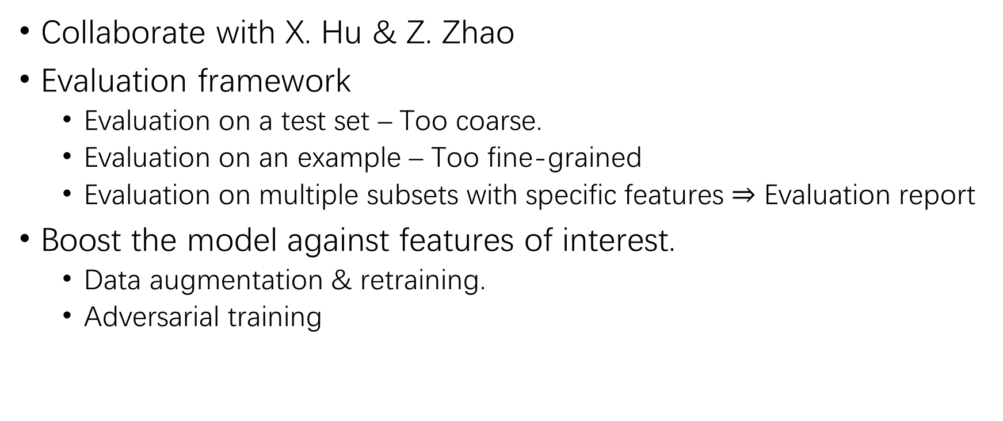
Checklist Evaluation
Collaborate with X. Hu & Z. Zhao
Evaluation framework
Evaluation on a test set – Too coarse.
Evaluation on an example – Too fine-grained
Evaluation on multiple subsets with specific features $⇒$ Evaluation report
Boost the model against features of interest.
Data augmentation & retraining.
Adversarial training

Slide 25
THANK YOU!

