Slide 1
Training Data Privacy Attack in NLP
Huangzhao Zhang, zhang_hz@pku.edu.cn

Slide 2
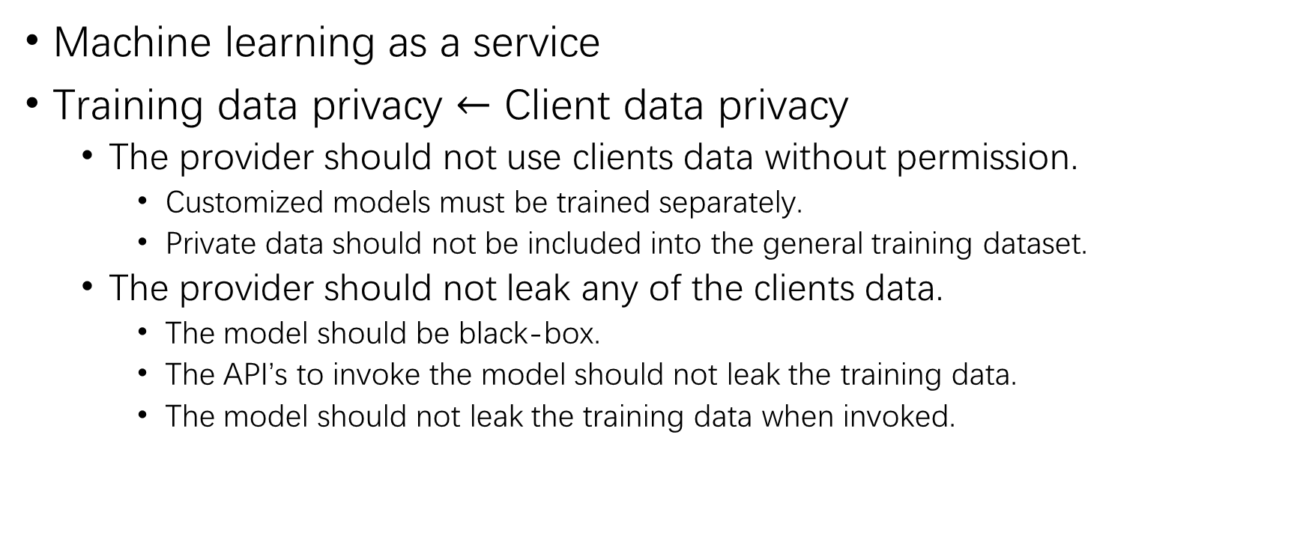
Training Data Privacy
Machine learning as a service
Training data privacy $←$ Client data privacy
The provider should not use clients data without permission.
Customized models must be trained separately.
Private data should not be included into the general training dataset.
The provider should not leak any of the clients data.
The model should be black-box.
The API’s to invoke the model should not leak the training data.
The model should not leak the training data when invoked.

Slide 3
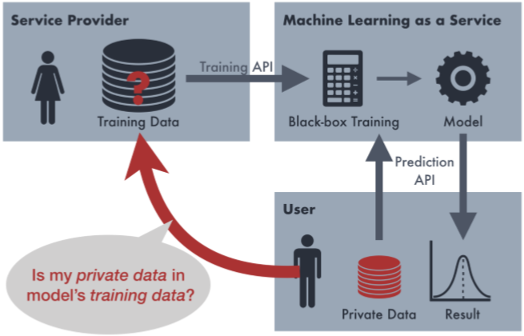
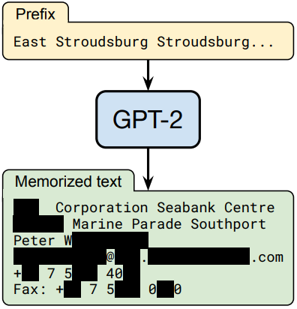
Training Data Privacy Attack
Membership inference attack
Given a data example and black-box access to a model’s API, determine whether a sample exists in the model’s training data.
Training data extracting attack
Given a black-box access to a model’s API, reconstruct verbatim data examples in the training data.

Slide 4
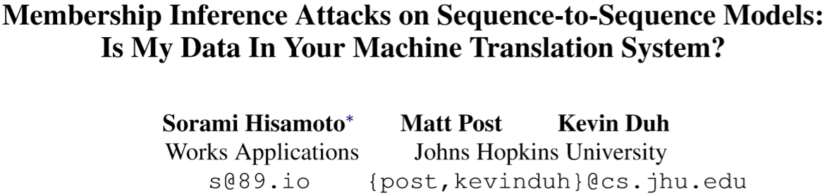

Slide 5
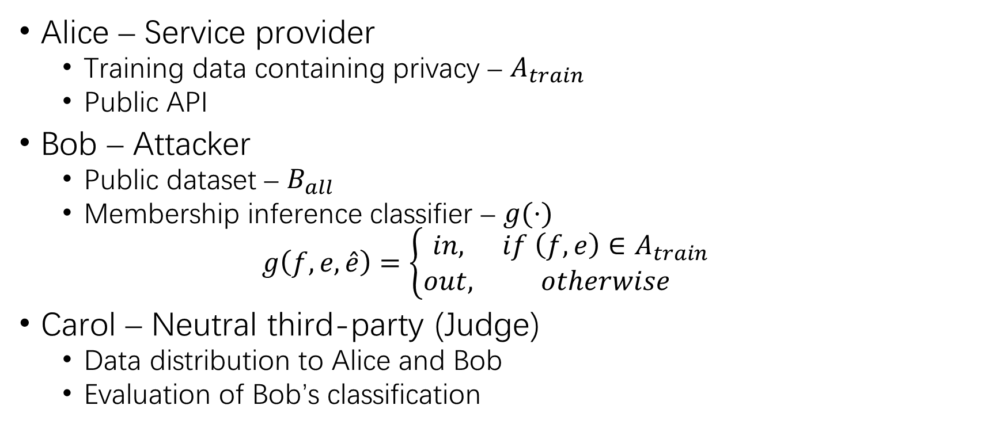
Membership Inference Attack
Alice – Service provider
Training data containing privacy – $A_{train}$
Public API
Bob – Attacker
Public dataset – $B_{all}$
Membership inference classifier – $g(⋅)$
$$g\left(f,e,\hat{e}\right)=\left\{\begin{matrix}in, & if \left(f,e\right)∈A_{train} \\ out, & otherwise\end{matrix}\right.$$
Carol – Neutral third-party (Judge)
Data distribution to Alice and Bob
Evaluation of Bob’s classification

Slide 6
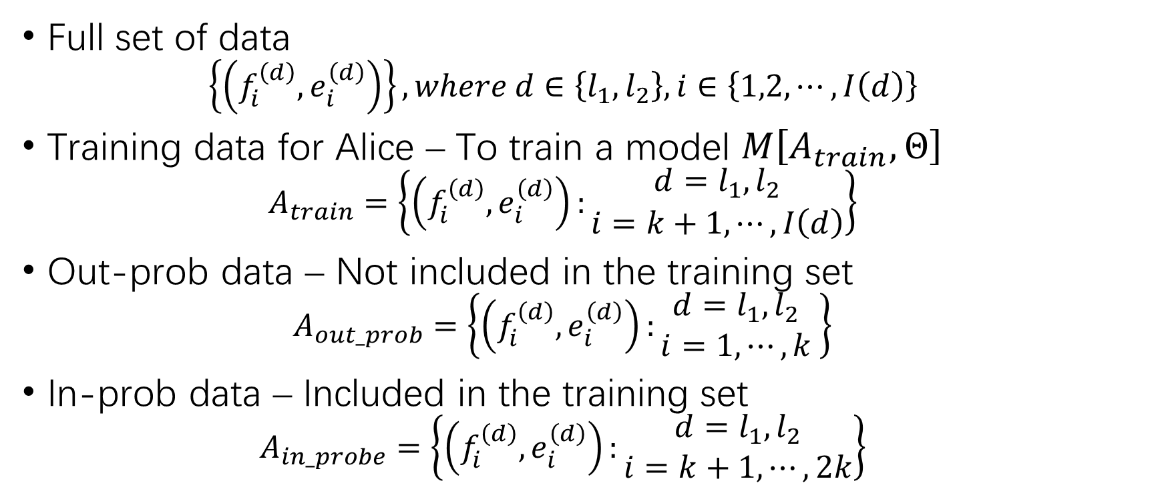
Data Distribution
Full set of data
$$\left\{\left(f_{i}^{\left(d\right)},e_{i}^{\left(d\right)}\right)\right\}, where d∈\left\{l_{1},l_{2}\right\}, i∈\left\{1,2,⋯,I\left(d\right)\right\}$$
Training data for Alice – To train a model $M\left[A_{train},Θ\right]$
$$A_{train}=\left\{\left(f_{i}^{\left(d\right)},e_{i}^{\left(d\right)}\right):\begin{matrix}d=l_{1},l_{2} \\ i=k+1,⋯,I\left(d\right)\end{matrix}\right\}$$
Out-prob data – Not included in the training set
$$A_{out_prob}=\left\{\left(f_{i}^{\left(d\right)},e_{i}^{\left(d\right)}\right):\begin{matrix}d=l_{1},l_{2} \\ i=1,⋯,k\end{matrix} \right\}$$
In-prob data – Included in the training set
$$A_{in_probe}=\left\{\left(f_{i}^{\left(d\right)},e_{i}^{\left(d\right)}\right):\begin{matrix}d=l_{1},l_{2} \\ i=k+1,⋯,2k\end{matrix}\right\}$$

Slide 7
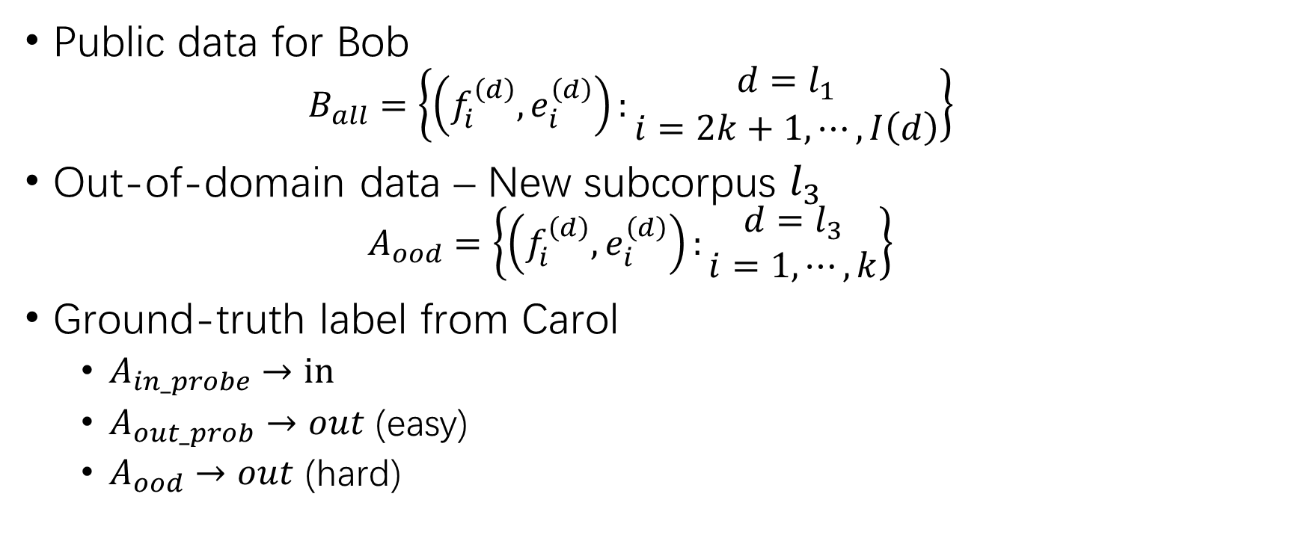
Data Distribution (2)
Public data for Bob
$$B_{all}=\left\{\left(f_{i}^{\left(d\right)},e_{i}^{\left(d\right)}\right):\begin{matrix}d=l_{1} \\ i=2k+1,⋯,I\left(d\right)\end{matrix}\right\}$$
Out-of-domain data – New subcorpus $l_{3}$
$$A_{ood}=\left\{\left(f_{i}^{\left(d\right)},e_{i}^{\left(d\right)}\right):\begin{matrix}d=l_{3} \\ i=1,⋯,k\end{matrix}\right\}$$
Ground-truth label from Carol
$A_{in_probe}→in$
$A_{out_prob}→out$ (easy)
$A_{ood}→out$ (hard)

Slide 8
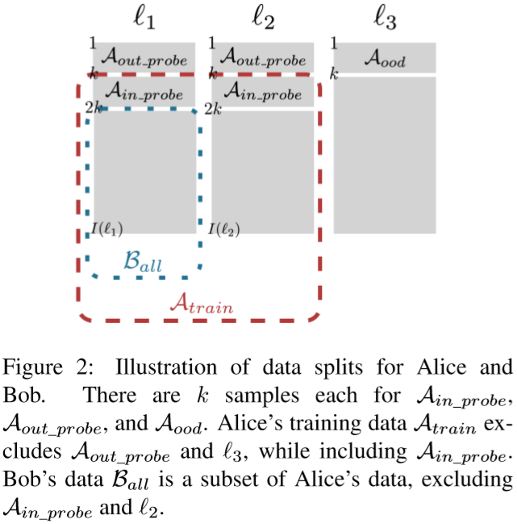
Data Distribution (3)

Slide 9
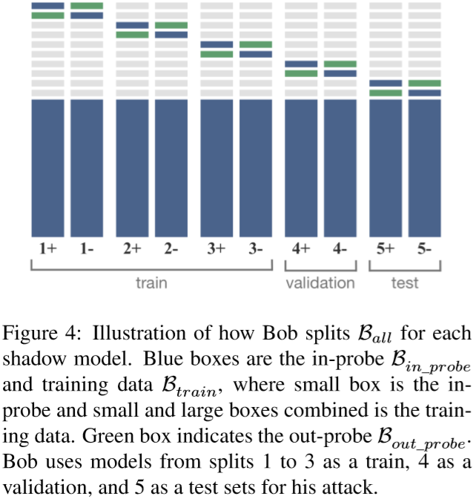
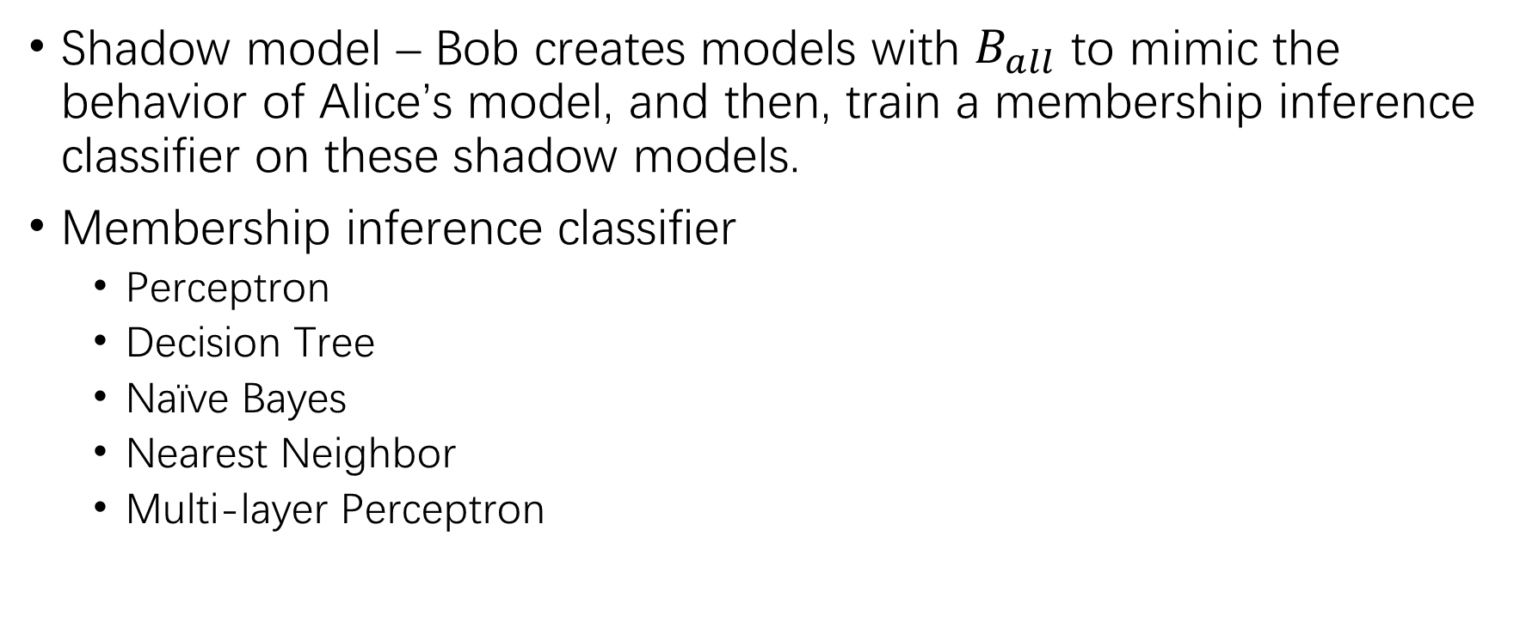
Shadow Model Framework
Shadow model – Bob creates models with $B_{all}$ to mimic the behavior of Alice’s model, and then, train a membership inference classifier on these shadow models.
Membership inference classifier
Perceptron
Decision Tree
Naïve Bayes
Nearest Neighbor
Multi-layer Perceptron

Slide 10
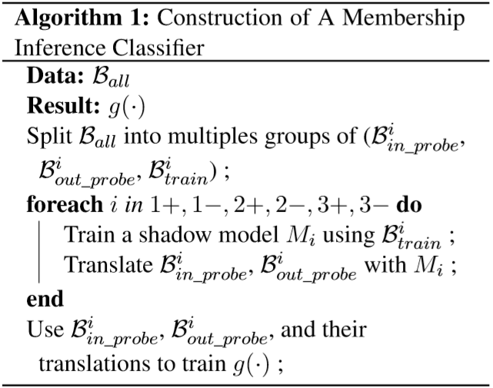
Shadow Model Framework (2)

Slide 11
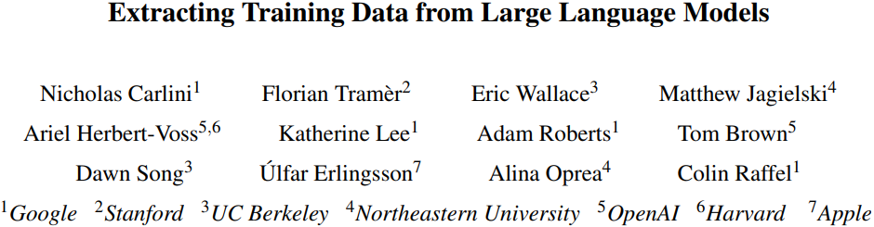

Slide 12
Training Data Extraction
Model inversion attack – To reconstruct representative views of a subset of examples
Training data extraction attack – To reconstruct verbatim training data points.
Overfitting vs. training data extraction

Slide 13
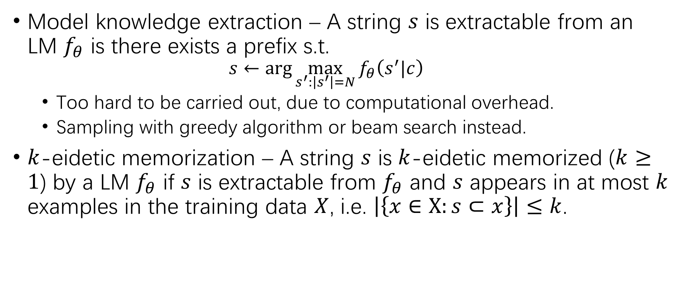
Eidetic Memorization
Model knowledge extraction – A string $s$ is extractable from an LM $f_{θ}$ is there exists a prefix s.t.
$$s←\arg{\max_{s^{′}:\left|s^{′}\right|=N}{f_{θ}\left(s^{′}|c\right)}}$$
Too hard to be carried out, due to computational overhead.
Sampling with greedy algorithm or beam search instead.
$k$-eidetic memorization – A string $s$ is $k$-eidetic memorized ($k≥1$) by a LM $f_{θ}$ if $s$ is extractable from $f_{θ}$ and $s$ appears in at most $k$ examples in the training data $X$, i.e. $\left|\left\{x∈X:s⊂x\right\}\right|≤k$.

Slide 14
Strawman Training Data Extraction
Text generation
Top-n sampling at each step for each trial
Membership inference
Filtering according to PPL

Slide 15
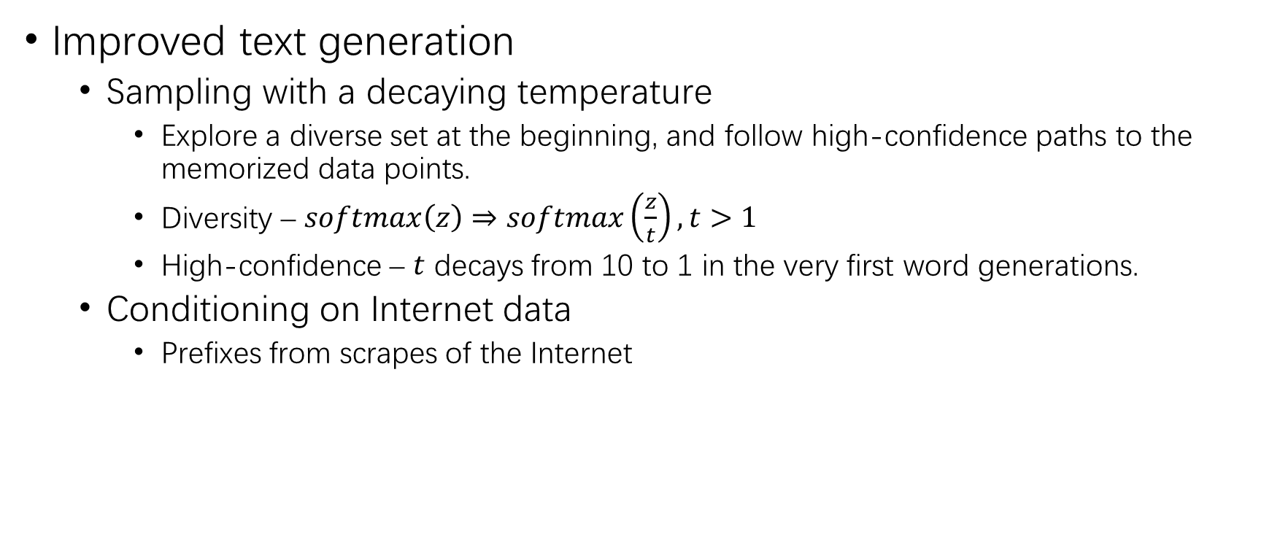
Improved Training Data Extraction
Improved text generation
Sampling with a decaying temperature
Explore a diverse set at the beginning, and follow high-confidence paths to the memorized data points.
Diversity – $softmax\left(z\right)⇒softmax\left(\frac{z}{t}\right),t>1$
High-confidence – $t$ decays from 10 to 1 in the very first word generations.
Conditioning on Internet data
Prefixes from scrapes of the Internet

Slide 16
Improved Training Data Extraction (2)
Issues of the strawman membership inference
Trivial memorizations – Repeating numbers from 1 to 100.
Repeating substring – Eg. “I like this. I like this. I like this.”
Improved membership inference
Comparing to other neural language models – Smaller LM.
Comparing to compression – Zlib entropy of the text.
Comparing to lowercased text – PPL after lowercasing.
PPL on a sliding window – Memorized substrings may be surrounded by non-memorized texts.

Slide 17
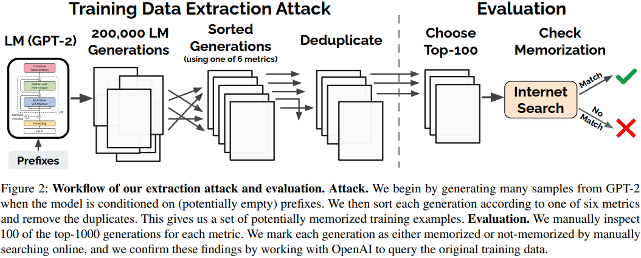
Workflow of Experiments

Slide 18
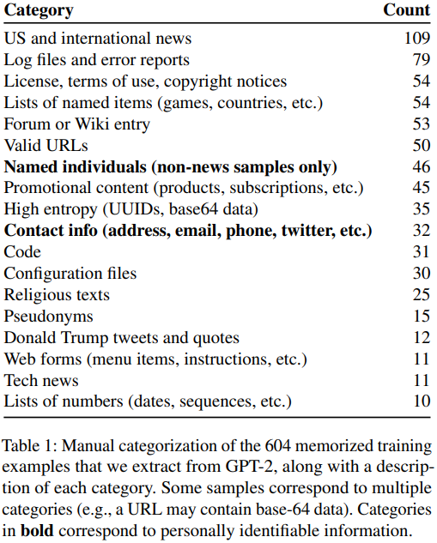
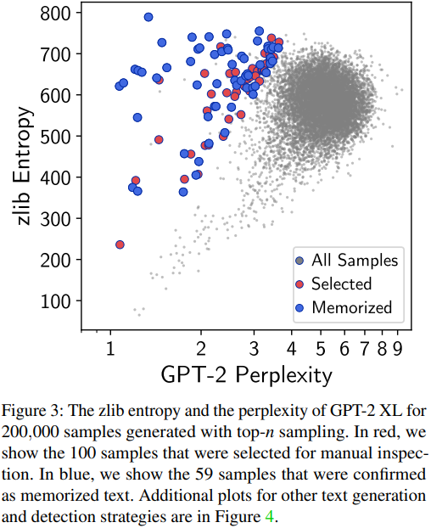
Results

Slide 19
THANK YOU!

