Slide 1
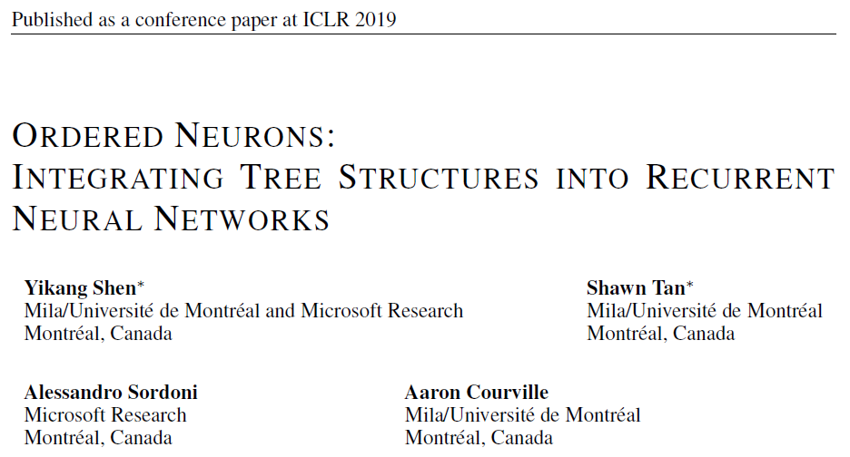
Reporter: Li Qingtao

Slide 2
Outline
Motivation
Ordered Neurons LSTM (ON-LSTM)
Experiments

Slide 3
Motivation
Learning tree structure in an unsupervised manner...
Drawbacks of supervised methods:
few languages have comprehensive annotated data for supervised parser training;
in available language data, syntax rules tend to be broken (e.g. in tweets);
languages change over time with use, so syntax rules may evolve.
通用性、实用性不足

Slide 4
Motivation
and introducing a relatively simple model.
Drawbacks of existing unsupervised methods:
suffer from inducing trivial structure
encounter difficulties in training, caused by RL
relatively complex to implement and train
实现和训练难度较大

Slide 5
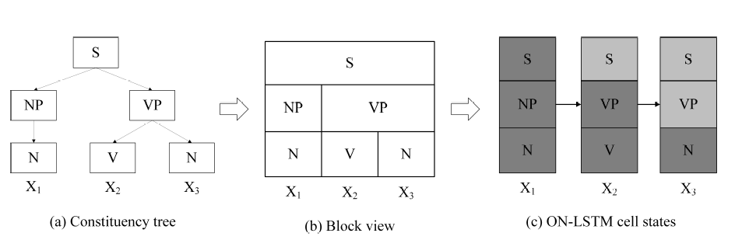
Ordered Neurons
High-ranking neurons will store long-term information.
Low-ranking neurons will store short-term information that can be rapidly forgotten.
Notes:
High-ranking neurons will store long-term information which is kept for a large number of steps,
while low-ranking neurons will store short-term information that can be rapidly forgotten.

Slide 6
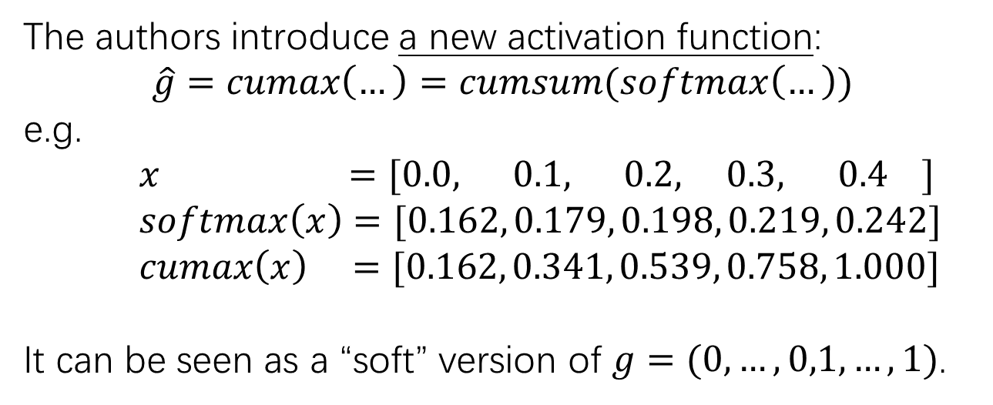
Ordered Neurons
But how to ensure the order of neurons?
The authors introduce a new activation function:
$$\hat{g}=cumax\left(…\right)=cumsum(softmax\left(…\right))$$
e.g.
$x =[0.0, 0.1, 0.2, 0.3, 0.4 ]$
$softmax\left(x\right)=[0.162, 0.179, 0.198, 0.219, 0.242]$
$cumax\left(x\right) =[0.162, 0.341, 0.539, 0.758, 1.000]$
It can be seen as a “soft” version of $g=(0,…,0,1,…,1)$.
第d位

Slide 7
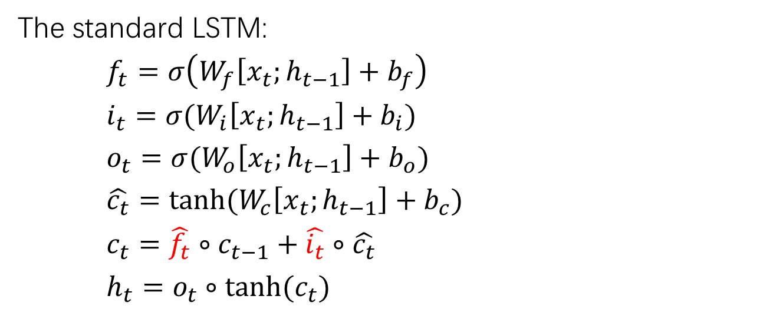
ON-LSTM
The standard LSTM:
$f_{t}=σ\left(W_{f}\left[x_{t};h_{t−1}\right]+b_{f}\right)$
$i_{t}=σ(W_{i}\left[x_{t};h_{t−1}\right]+b_{i})$
$o_{t}=σ(W_{o}\left[x_{t};h_{t−1}\right]+b_{o})$
$\hat{c_{t}}=tanh(W_{c}\left[x_{t};h_{t−1}\right]+b_{c})$
$c_{t}=\hat{f_{t}}∘c_{t−1}+\hat{i_{t}}∘\hat{c_{t}}$
$h_{t}=o_{t}∘tanh(c_{t})$

Slide 8
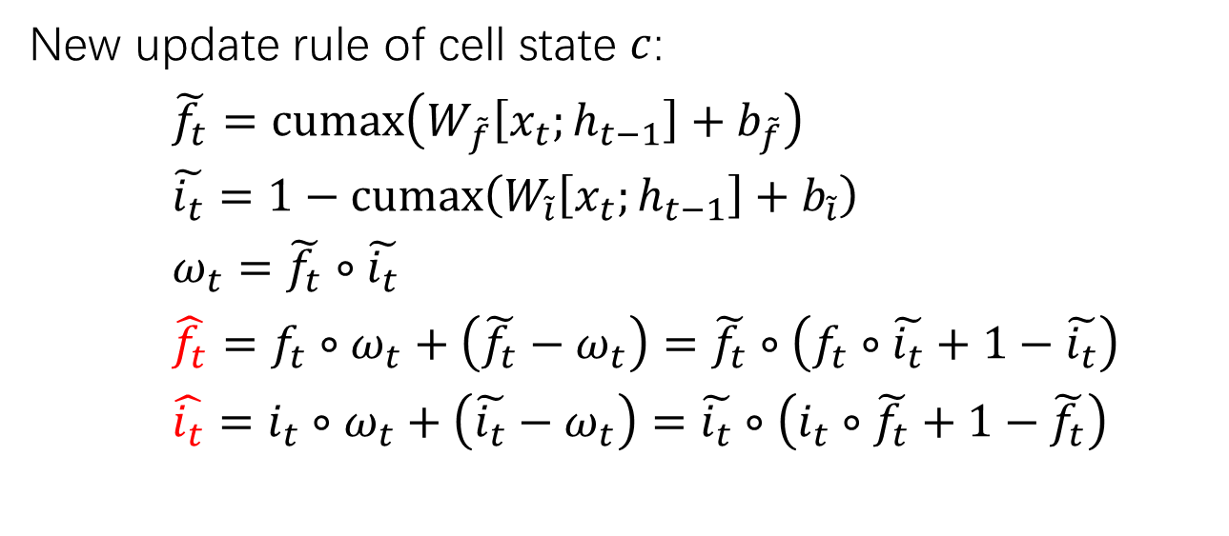
ON-LSTM
Master forget gate
Master input gate
New update rule of cell state $c$:
$\tilde{f_{t}}=cumax\left(W_{\tilde{f}}\left[x_{t};h_{t−1}\right]+b_{\tilde{f}}\right)$
$\tilde{i_{t}}=1−cumax\left(W_{\tilde{i}}\left[x_{t};h_{t−1}\right]+b_{\tilde{i}}\right)$
$ω_{t}=\tilde{f_{t}}∘\tilde{i_{t}}$
$\hat{f_{t}}=f_{t}∘ω_{t}+\left(\tilde{f_{t}}−ω_{t}\right)=\tilde{f_{t}}∘\left(f_{t}∘\tilde{i_{t}}+1−\tilde{i_{t}}\right)$ $\hat{i_{t}}=i_{t}∘ω_{t}+\left(\tilde{i_{t}}−ω_{t}\right)=\tilde{i_{t}}∘\left(i_{t}∘\tilde{f_{t}}+1−\tilde{f_{t}}\right)$
Notes:
Structured gating mechanism

Slide 9
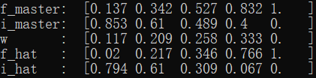
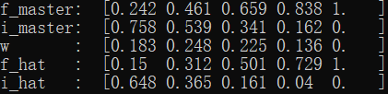
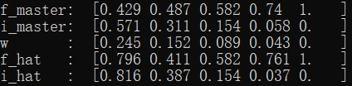
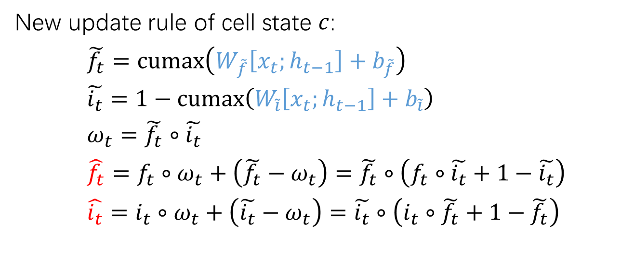
ON-LSTM
Master forget gate
Master input gate
New update rule of cell state $c$:
$\tilde{f_{t}}=cumax\left(W_{\tilde{f}}\left[x_{t};h_{t−1}\right]+b_{\tilde{f}}\right)$
$\tilde{i_{t}}=1−cumax\left(W_{\tilde{i}}\left[x_{t};h_{t−1}\right]+b_{\tilde{i}}\right)$
$ω_{t}=\tilde{f_{t}}∘\tilde{i_{t}}$
$\hat{f_{t}}=f_{t}∘ω_{t}+\left(\tilde{f_{t}}−ω_{t}\right)=\tilde{f_{t}}∘\left(f_{t}∘\tilde{i_{t}}+1−\tilde{i_{t}}\right)$ $\hat{i_{t}}=i_{t}∘ω_{t}+\left(\tilde{i_{t}}−ω_{t}\right)=\tilde{i_{t}}∘\left(i_{t}∘\tilde{f_{t}}+1−\tilde{f_{t}}\right)$
leaf
root
leaf
root
Notes:
Forget gate 还是 remaining gate?

Slide 10
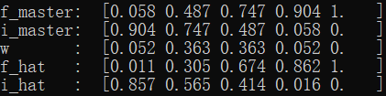
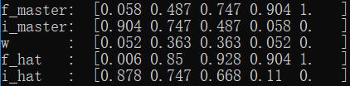
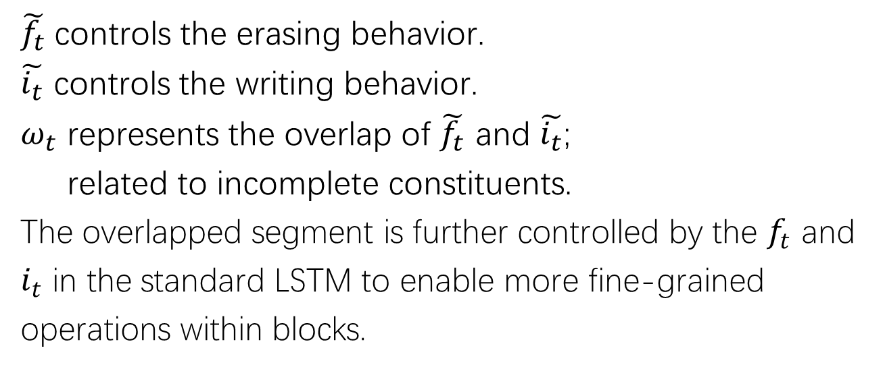
ON-LSTM
$\tilde{f_{t}}$ controls the erasing behavior.
$\tilde{i_{t}}$ controls the writing behavior.
$ω_{t}$ represents the overlap of $\tilde{f_{t}}$ and $\tilde{i_{t}}$;
related to incomplete constituents.
The overlapped segment is further controlled by the $f_{t}$ and $i_{t}$ in the standard LSTM to enable more fine-grained operations within blocks.
Notes:
希望通过原始的 f 和 i 来微调 overlap block 内部的神经元

Slide 11

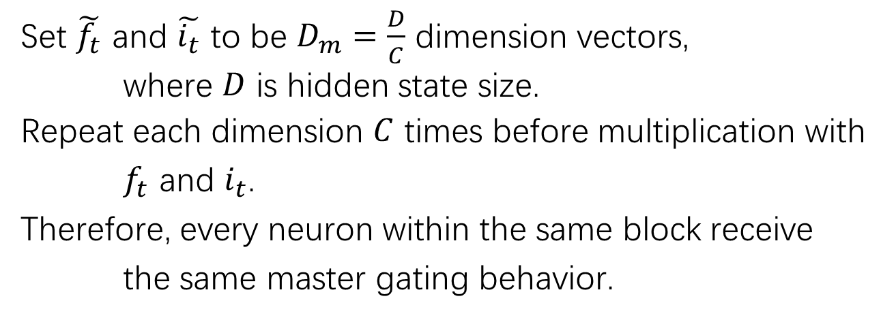




Downsizing
Set $\tilde{f_{t}}$ and $\tilde{i_{t}}$ to be $D_{m}=\frac{D}{C}$ dimension vectors,
where $D$ is hidden state size.
Repeat each dimension $C$ times before multiplication with $f_{t}$ and $i_{t}$.
Therefore, every neuron within the same block receive the same master gating behavior.
$$\tilde{f_{t}}$$
$$upsized$$
$$f_{t}$$
$$∘$$
$$=$$

Slide 12
Experiments

Slide 13
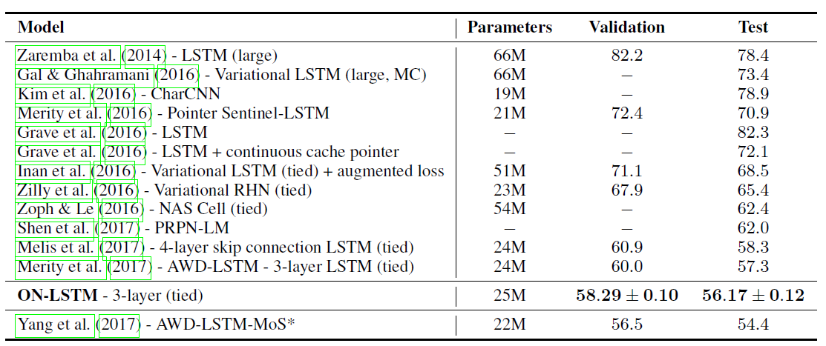

Language Modeling
Dataset and metric: Penn TreeBank; perplexity
$$D=1150, C=10$$
Notes:
AWD-LSTM-MoS 调整了最后一步softmax层的操作，与本文贡献点不同

Slide 14
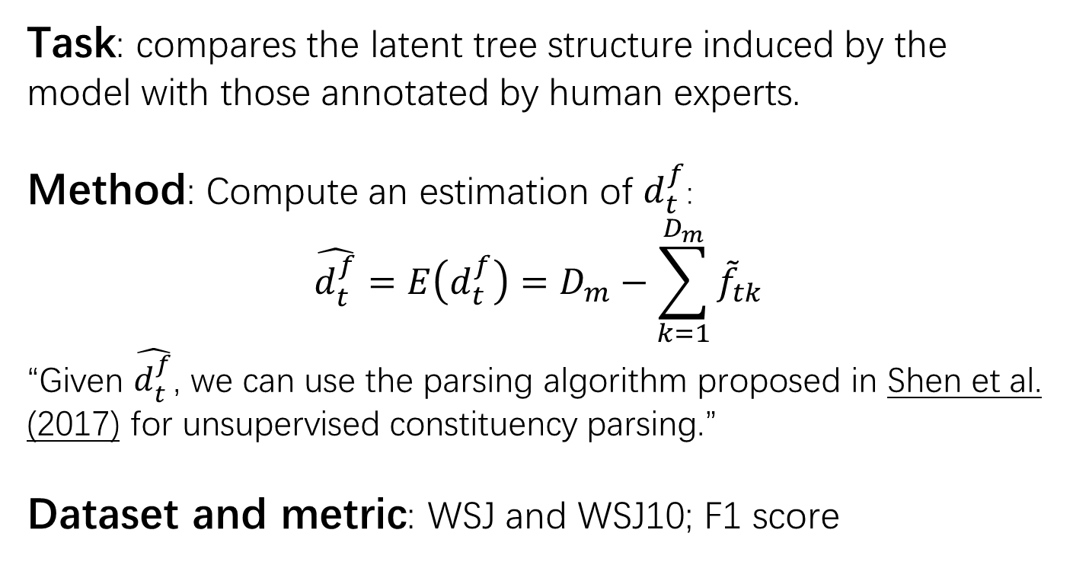
Unsupervised Constituency Parsing
Task: compares the latent tree structure induced by the model with those annotated by human experts.
Method: Compute an estimation of $d_{t}^{f}$:
$$\hat{d_{t}^{f}}=E\left(d_{t}^{f}\right)=D_{m}−\sum_{k=1}^{D_{m}}{{\tilde{f}}_{tk}}$$
“Given $\hat{d_{t}^{f}}$, we can use the parsing algorithm proposed in Shen et al. (2017) for unsupervised constituency parsing.”
Dataset and metric: WSJ and WSJ10; F1 score
本文作者
“PRPN”
Notes:
WSJ10 dataset: filtered from WSJ dataset
WSJ10 test set: from train/val/test set of PTB
WSJ test set: == test set of PTB

Slide 15
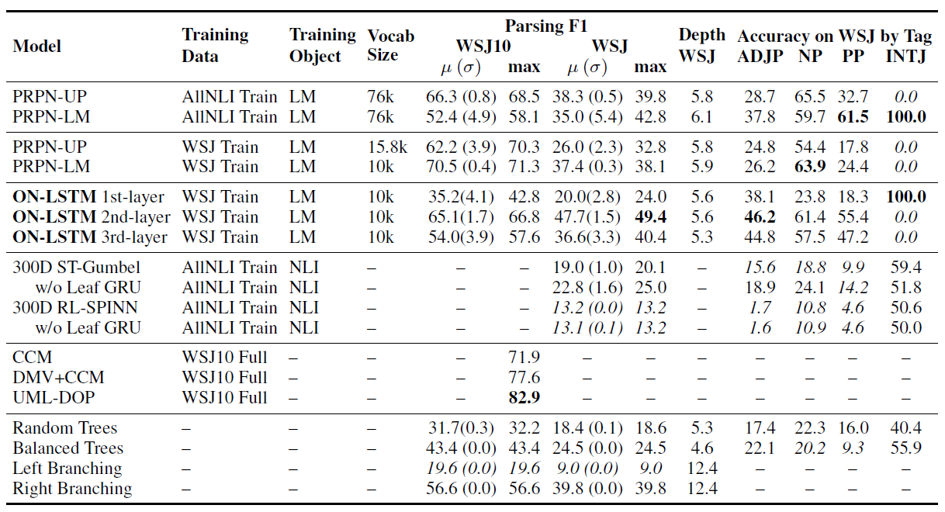
Unsupervised Constituency Parsing
Notes:
WSJ10可能过于简单，WSJ的结果比较重要。结果显示，ON-LSTM对长依赖的处理更好，而对短依赖欠缺；可能是因为hidden state size不足。
作者：只使用一层或两层的结果不佳。
WSJ10 baselines are trained using additional information such as POS tags and dependency parser.

Slide 16
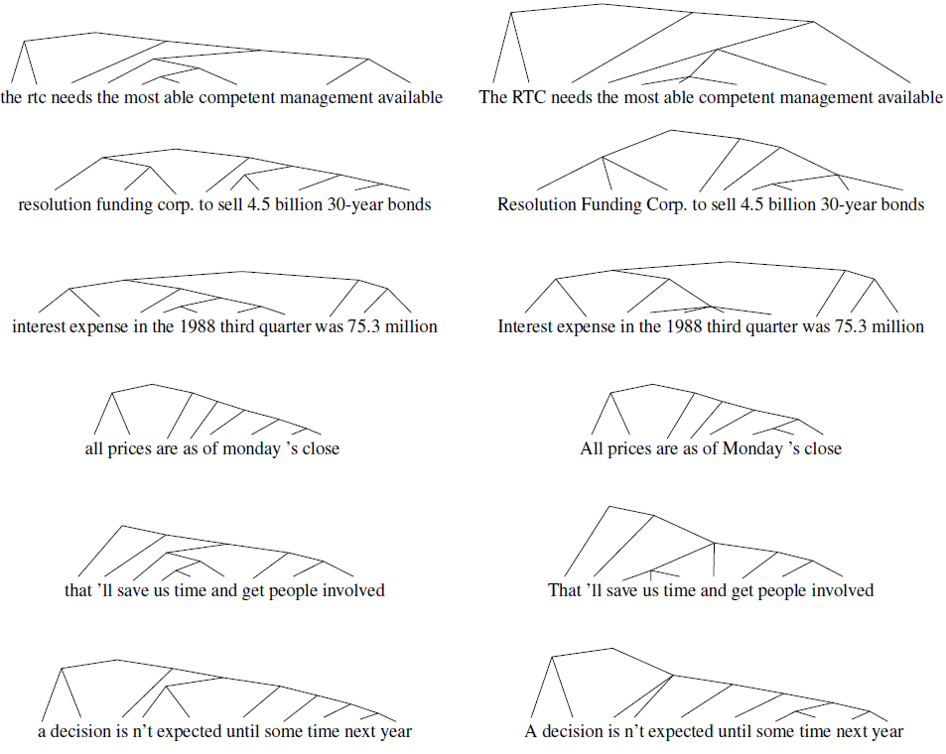
ON-LSTM
Human
Notes:
文中没有交代如何处理不同深度的叶子节点

Slide 17
Targeted Syntactic Evaluation
Marvin & Linzen (2018) 提出的任务，针对三种语言现象主谓一致、反身代词指代、负极性词，构造差异很小的正误语句对，模型需要辨别两个句子的正误。
Notes:
负极性词语(如“任何”、“挂齿”、“吭声”、“示弱”、“好惹”等)是指典型地用于 否定句、条件句、比较句、疑问旬中的词语

Slide 18
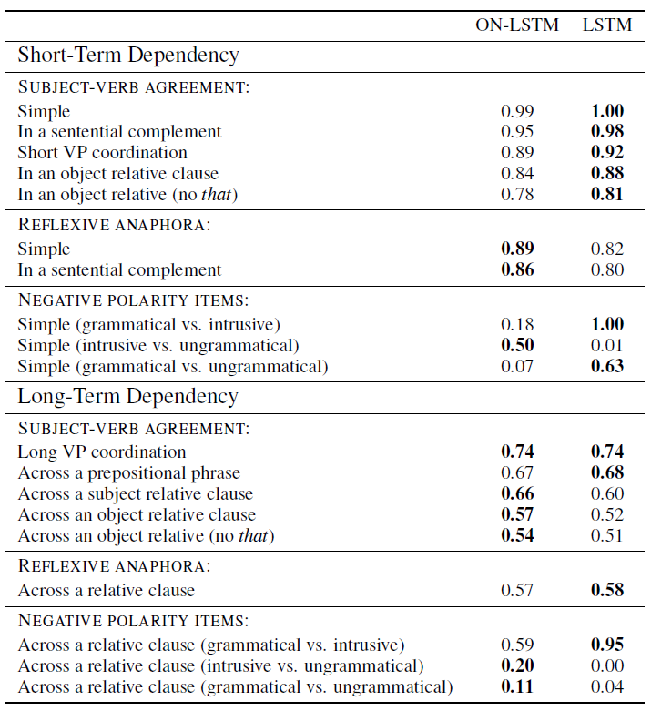

Slide 19
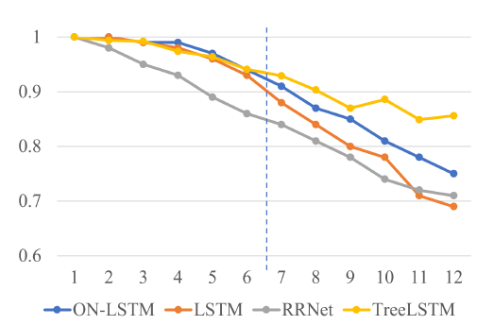
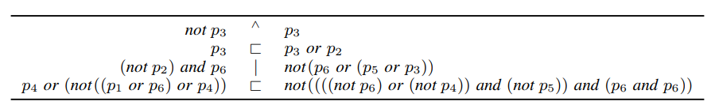
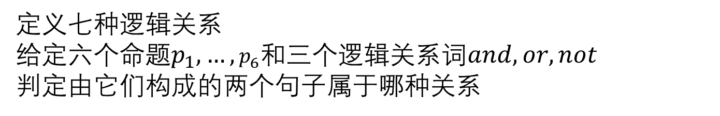
Logical Inference
定义七种逻辑关系
给定六个命题$p_{1},…,p_{6}$和三个逻辑关系词$and, or, not$
判定由它们构成的两个句子属于哪种关系
Notes:
训练集句子<=6，测试集句子<=12

Slide 20
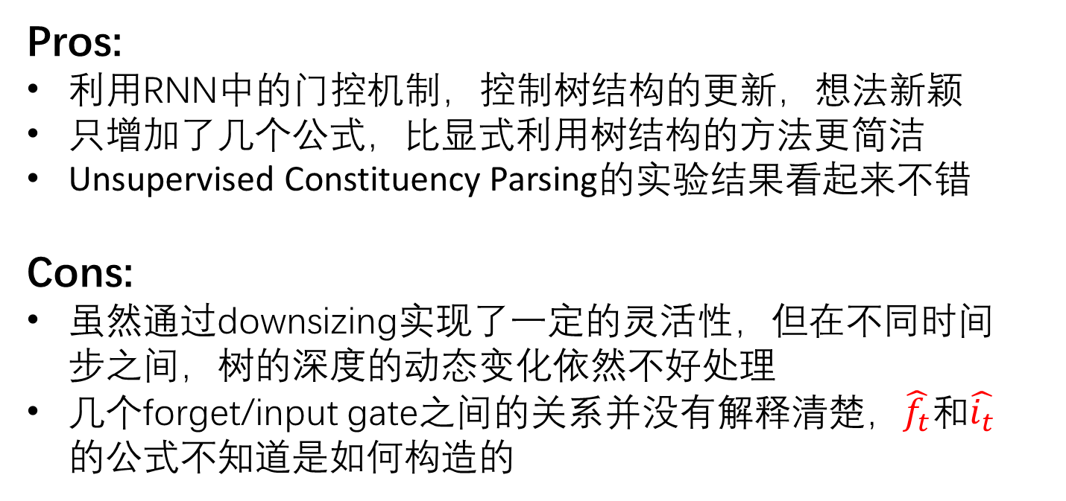
Pros & cons
Pros:
利用RNN中的门控机制，控制树结构的更新，想法新颖
只增加了几个公式，比显式利用树结构的方法更简洁
Unsupervised Constituency Parsing的实验结果看起来不错
Cons:
虽然通过downsizing实现了一定的灵活性，但在不同时间步之间，树的深度的动态变化依然不好处理
几个forget/input gate之间的关系并没有解释清楚，$\hat{f_{t}}$和$\hat{i_{t}}$的公式不知道是如何构造的
Notes:
reviewers也表示，第一和第四个实验的结果并不是非常的好

