Slide 1
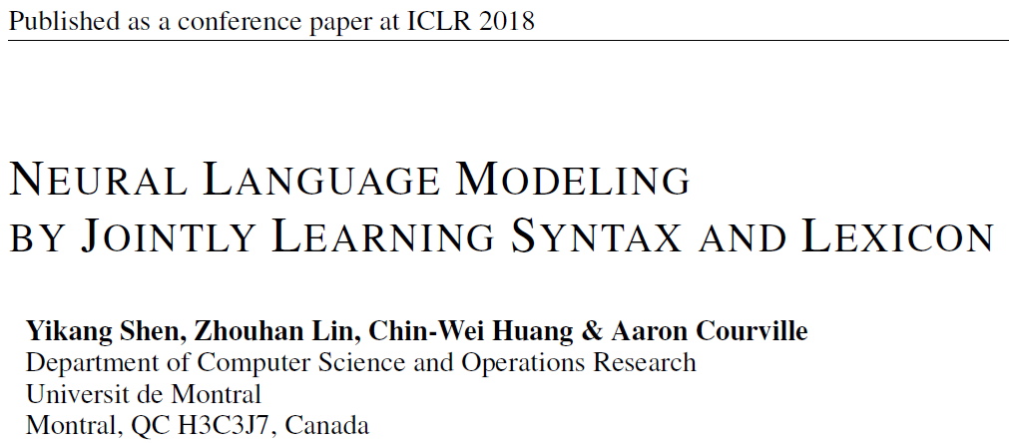
Reporter: Li Qingtao

Slide 2
Outline
Motivation
Parsing-Reading-Predict Networks (PRPN)
Experiments

Slide 3
Motivation
Learning syntactic structure in an unsupervised manner.
Drawbacks of syntactic parsers:
few languages have comprehensive annotated data for supervised parser training;
in available language data, syntax rules tend to be broken (e.g. in tweets);
languages change over time with use, so syntax rules may evolve.

Slide 4
Parsing-Reading-Predict Networks
PRPN can simultaneously:
induce the syntactic structure from unannotated sentences
leverage the inferred structure to form a better language model
PRPN is composed of:
a differentiable neural Parsing Network
a Reading Network
a Predict Network

Slide 5
Parsing-Reading-Predict Networks
PRPN is evaluated on three tasks:
word-level language modeling
character-level language modeling
unsupervised constituency parsing

Slide 6
Parsing-Reading-Predict Networks
Notes:
例子：只需要看树结构

Slide 7

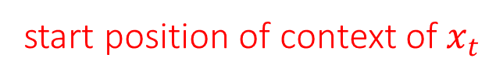
Parsing-Reading-Predict Networks
start position of context of $x_{t}$
Parsing
(Skip-connection gate)
Reading
Predict
Notes:
The underlying assumption is that each node depends only on its parent and its left siblings.

Slide 8
Parsing-Reading-Predict Networks
e.g.
hard line indicate valid connection in Reading Network,
dash line indicate valid connection in Predict Network.

Slide 9


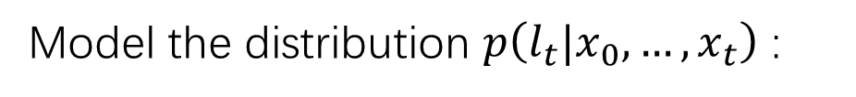
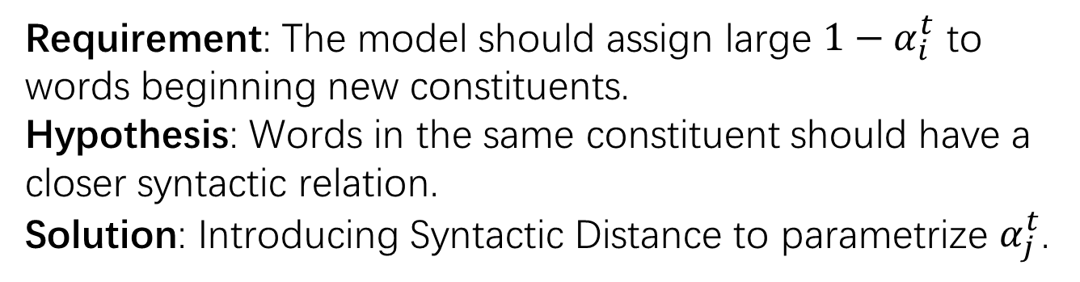
Parsing Network
Model the distribution $p\left(l_{t}|x_{0},…,x_{t}\right)$ :
thus
Requirement: The model should assign large $1−α_{i}^{t}$ to words beginning new constituents.
Hypothesis: Words in the same constituent should have a closer syntactic relation.
Solution: Introducing Syntactic Distance to parametrize $α_{j}^{t}$.
Notes:
Stick-Breaking Process

Slide 10

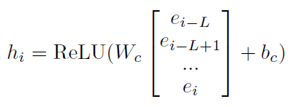

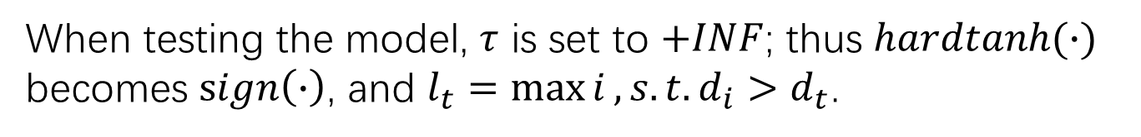
Parsing Network
where $d_{i}$ represents syntactic distance between $\left(x_{i−1},x_{i}\right).$
When testing the model, $τ$ is set to $+INF$; thus $hardtanh(∙)$ becomes $sign\left(∙\right)$, and $l_{t}=\max{i}, s.t. d_{i}>d_{t}$.
Notes:
对[e_i-L]做卷积，对h_i做窗口为1的卷积

Slide 11
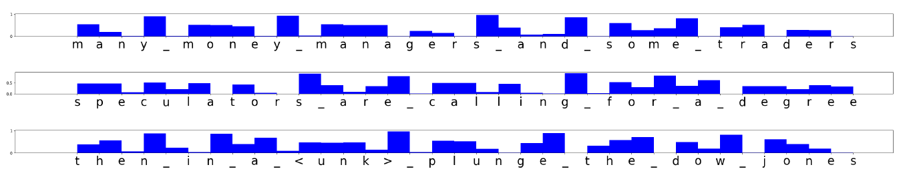
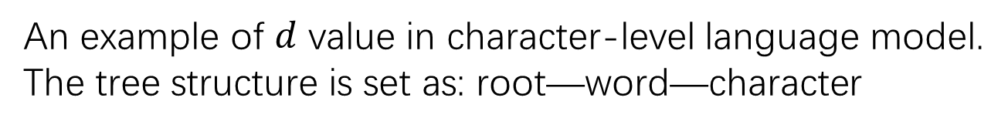
Parsing Network
An example of $d$ value in character-level language model.
The tree structure is set as: root—word—character

Slide 12
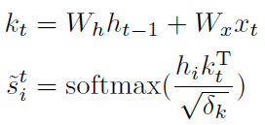

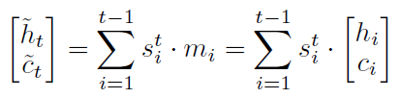
Reading Network
Structured attention :
then compute $(h_{t},c_{t})$ by one LSTM step: $LSTM(x_{t}; {\tilde{h}}_{t},{\tilde{c}}_{t})$

Slide 13

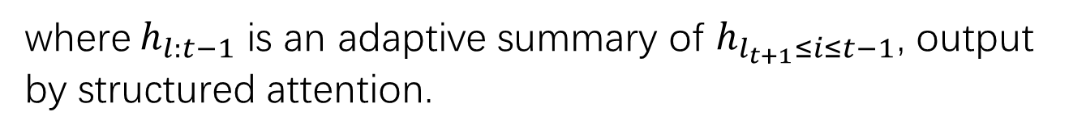
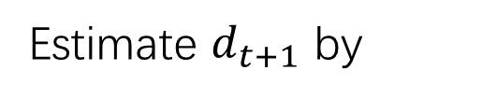
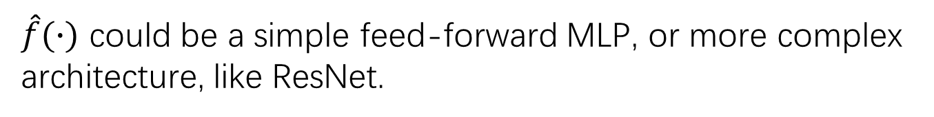
Predict Network
Estimate $d_{t+1}$ by
Run Parsing Network and Reading Network, and predict $x_{t+1}$:
where $h_{l:t−1}$ is an adaptive summary of $h_{l_{t+1}≤i≤t−1}$, output by structured attention.
$\hat{f}(∙)$ could be a simple feed-forward MLP, or more complex architecture, like ResNet.

Slide 14
Experiments

Slide 15
Hyperparameters:
Reading Network has 2 layers
Predict Network has 1 residual block
Hidden state size: 1024
Embedding size: 128 (not shared)
L = 10
Dropout on (input/output embeddings, between
recurrent layers, and on recurrent states) : (0, 0.25, 0.1)
Apply gradient clipping: 1.0

Slide 16
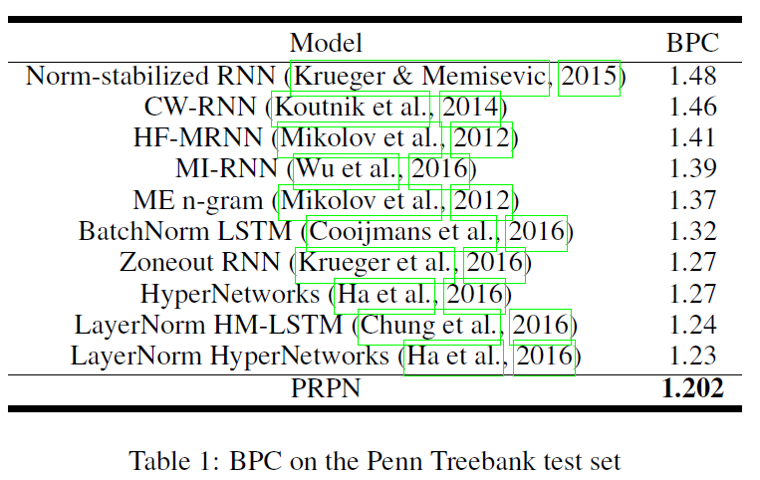
Character-level Language Model
Dataset: Penn TreeBank

Slide 17
Word-level Language Model
Dataset: Penn TreeBank
Hyperparameters:
Predict Network has no residual block
Hidden state size: 1200
Embedding size: 800 (shared)
L = 5
Dropout: (0.7, 0.5, 0.5)

Slide 18
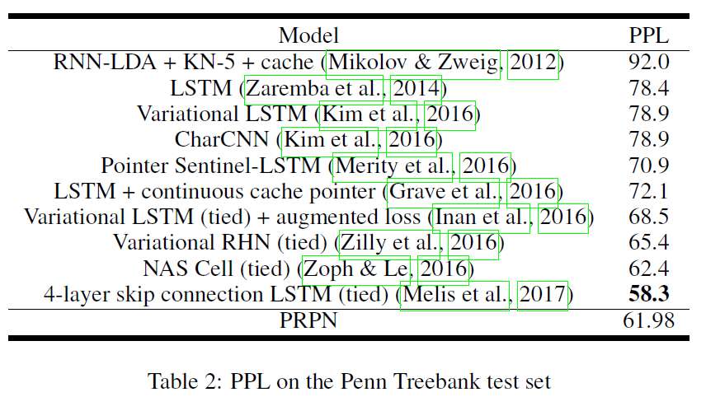
Word-level Language Model

Slide 19
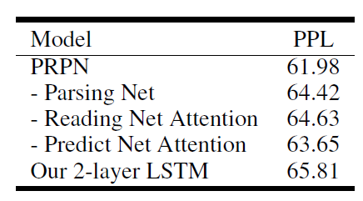
Word-level Language Model

Slide 20
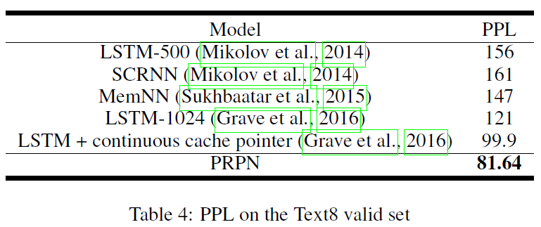
Word-level Language Model
Dataset: Text8
Hyperparameters [3]:
Dropout: (0.4, 0.2, 0.2)
Notes:
(Mikolov 2014) split 99:1 train and valid set

Slide 21
Unsupervised Constituency Parsing
Dataset: WSJ10
Unlabeled F1 score:
“Evaluation was done by seeing whether proposed constituent spans are also in the Treebank parse.”
“Unlabeled” means the labels of constituent trees are not concerned.
Notes:
Constituents which could not be gotten wrong (those of span one and those spanning entire sentences) were discarded.

Slide 22
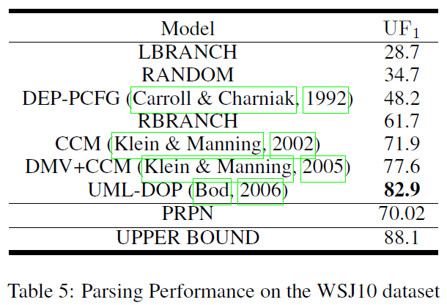
Unsupervised Constituency Parsing
“The DMV+CCM model has extra information from a dependency parser.
The UML-DOP approach captures both contiguous and non-contiguous lexical dependencies.”

Slide 23
Tree structure inferred from the syntactic distances

