Slide 1

from EMNLP 2018
Reporter: Li Qingtao

Slide 2
Introduction
Attention matrix is assumed to have a “soft” token-wise alignment between the source and target sequences.
However, attention mechanism performs worse comparing to conventional alignment models. It captures more information other than alignment. (Ghader and Monz, 2017; Liu et al., 2016)
This paper proposes a method explicitly models the token-wise alignment.

Slide 3
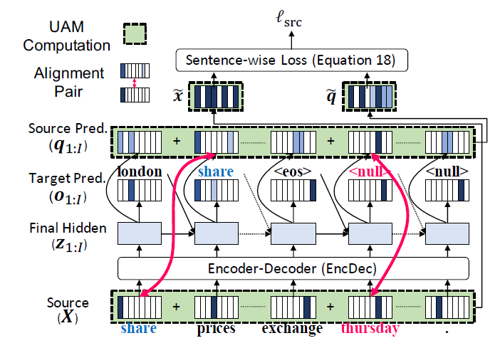
Model Overview

Slide 4
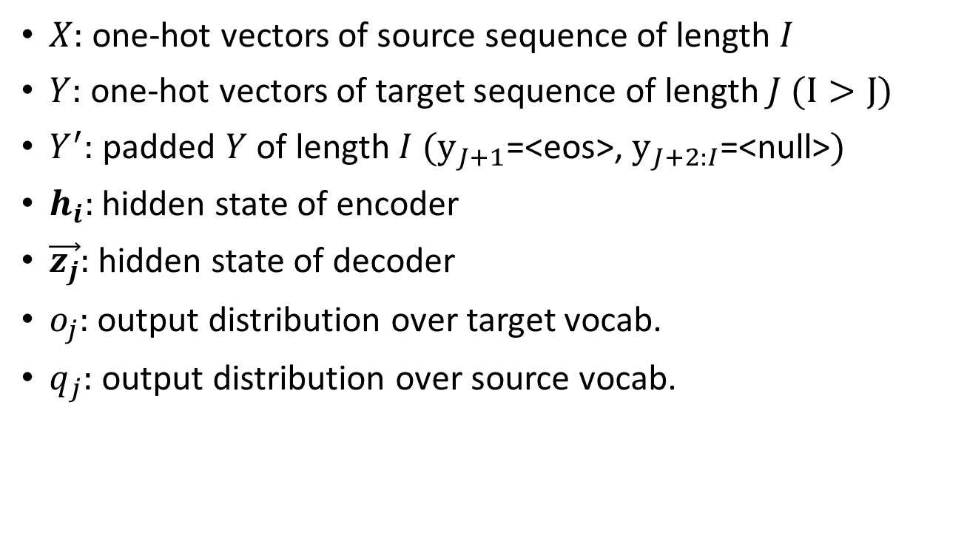
Symbols
$X:$ one-hot vectors of source sequence of length $I$
$Y:$ one-hot vectors of target sequence of length $J (I>J)$
$Y^{′}:$ padded $Y$ of length $I$ $(y_{J+1}$=<eos>, $y_{J+2:I}$=<null>$)$
$h_{i}:$ hidden state of encoder
$\vec{z_{j}}:$ hidden state of decoder
$o_{j}:$ output distribution over target vocab.
$q_{j}:$ output distribution over source vocab.

Slide 5
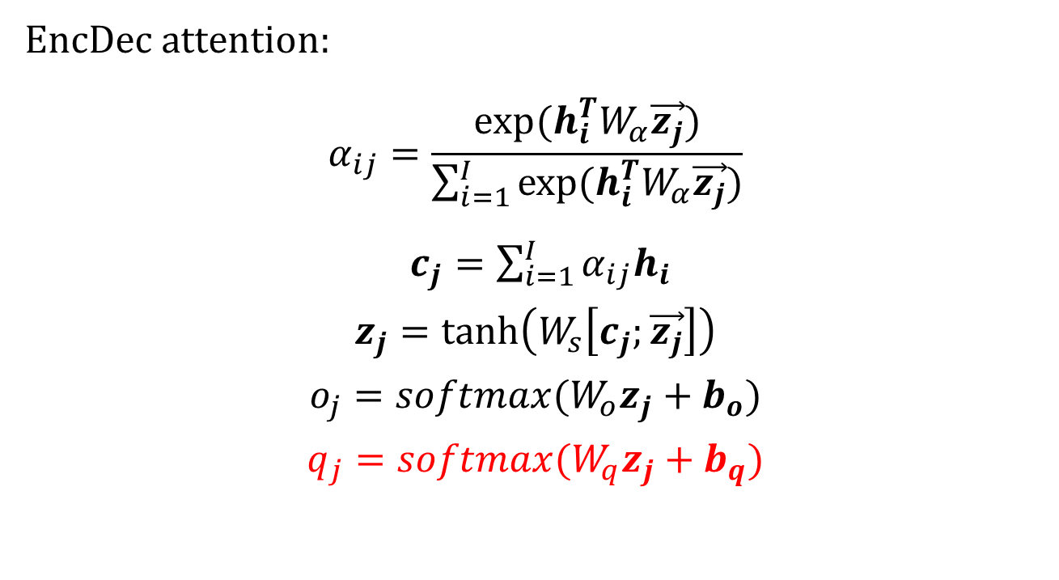
Model
EncDec attention:
$$α_{ij}=\frac{exp⁡(h_{i}^{T}W_{α}\vec{z_{j}})}{\sum_{i=1}^{I}{exp⁡(h_{i}^{T}W_{α}\vec{z_{j}})}}$$
$c_{j}=\sum_{i=1}^{I}{α_{ij}h_{i}}$
$$z_{j}=\tanh\left(W_{s}\left[c_{j};\vec{z_{j}}\right]\right)$$
$$o_{j}=softmax(W_{o}z_{j}+b_{o})$$
$$q_{j}=softmax(W_{q}z_{j}+b_{q})$$

Slide 6
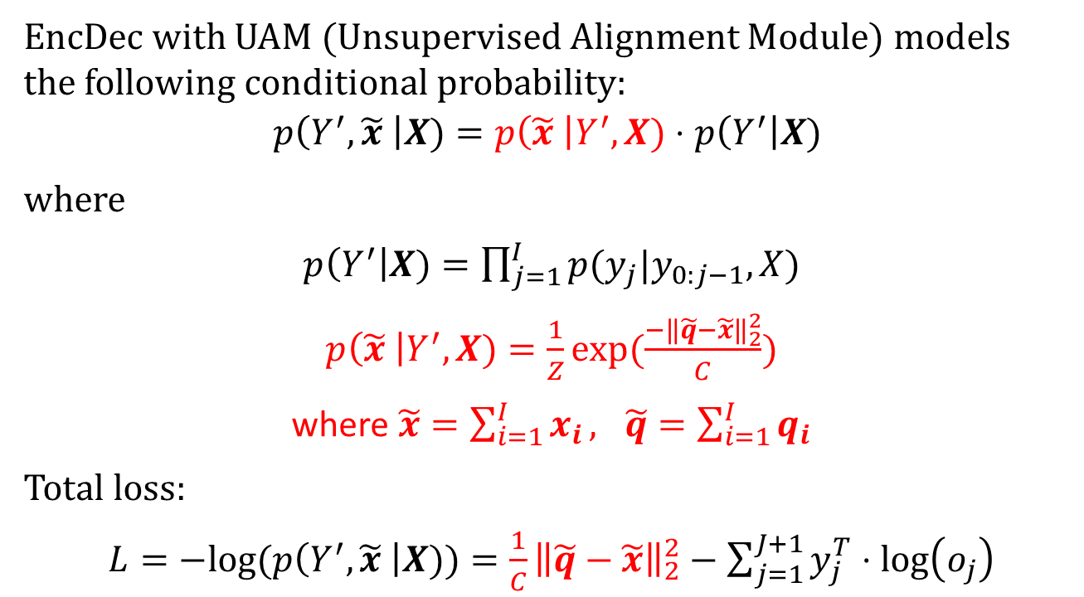
Model
EncDec with UAM (Unsupervised Alignment Module) models the following conditional probability:
$$p\left(Y^{′},\tilde{x} \right|X)=p\left(\tilde{x} \right|Y^{′},X)⋅p\left(Y^{′}\right|X)$$
where
$p\left(Y^{′}\right|X)=\prod_{j=1}^{I}{p(y_{j}|y_{0:j−1},X)}$
$p\left(\tilde{x} \right|Y^{′},X)=\frac{1}{Z}exp⁡(\frac{−{\left\|\tilde{q}−\tilde{x}\right\|}_{2}^{2}}{C})$
where $\tilde{x}=\sum_{i=1}^{I}{x_{i}}, \tilde{q}=\sum_{i=1}^{I}{q_{i}}$
Total loss:
$L=−log(p\left(Y^{′},\tilde{x} \right|X))=\frac{1}{C}{\left\|\tilde{q}−\tilde{x}\right\|}_{2}^{2}−\sum_{j=1}^{J+1}{y_{j}^{T}⋅\log\left(o_{j}\right)}$

Slide 7
Task: Headline Generation
Introduced by (Rush et al., 2015).
Dataset
is from English Gigaword corpus
source is the first sentence of a news article, and target is the article’s headline
has 3.8M, 200K, 400K pairs for training, validation and test
Test set in this paper:
Test(Ours): randomly sampled 10K pairs
Test(Zhou): (Zhou et al., 2017), 2K pairs
MSR-ATC: (Toutanova et al., 2016), ~26K pairs, created manually
Notes:
However, abstractive sentence summarization is different from MT in two ways.
First, there is no explicit alignment relationship between the input sentence and the output summary except for the common words.
Second, summarization task needs to keep the highlights and remove the unnecessary information, while MT needs to keep all information literally.

Slide 8
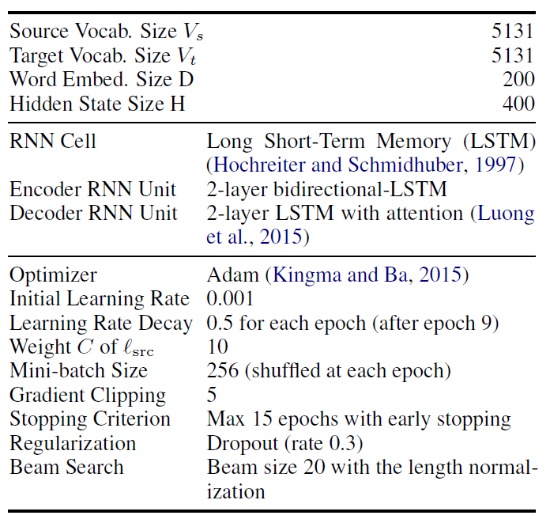
Experiment Details
Notes:
Length normalization: score=logP/lp(Y), lp(Y)=(5+|Y|)^a/(5+1)^a

Slide 9


Experiment Details
Vocabulary:
Constructed using BPE (Byte Pair Encoding, Sennrich et al., 2016), and the number of BPE merge operations is 5000.
Models:
SEASS: (Zhou et al., 2017)
EncDec+sGate: SEASS reimplemented by this paper
EncDec+sGate+UAM: proposed model
Notes:
有一些实现细节不同。如：
SEASS使用concat attention，UAM使用general attention
计算z_j时，SEASS还拼上了w_{t-1}，同时结果向量为两倍宽度
计算softmax时，SEASS使用了maxout layer将宽度变回一倍

Slide 10
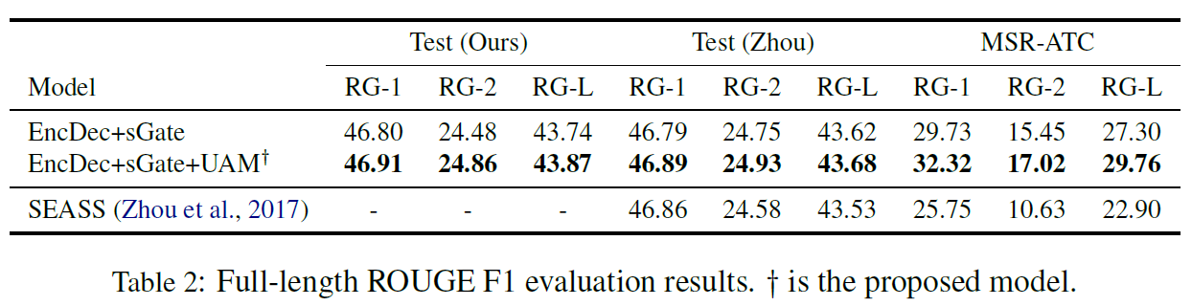
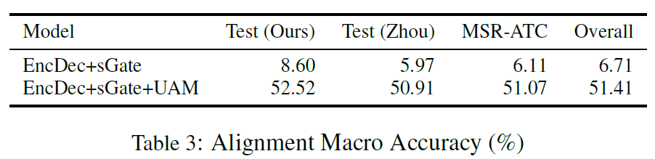
Experiment Results

Slide 11
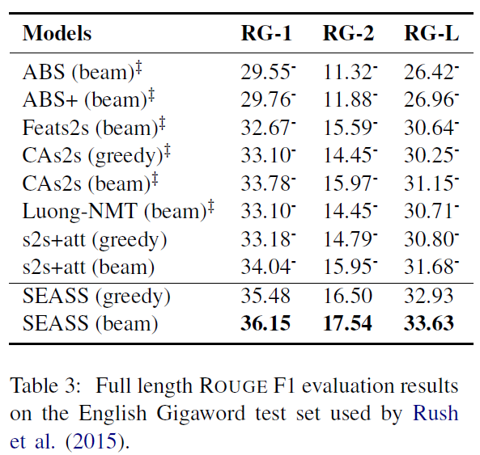
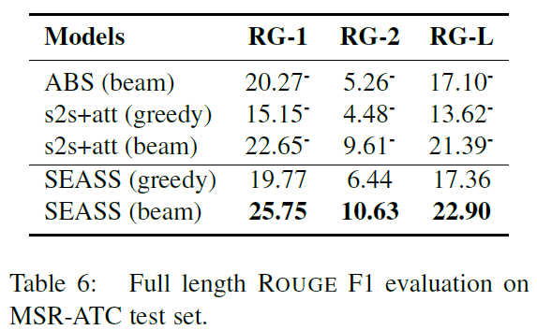
Experiment Results
Tables from (Zhou et al., 2017)

Slide 12
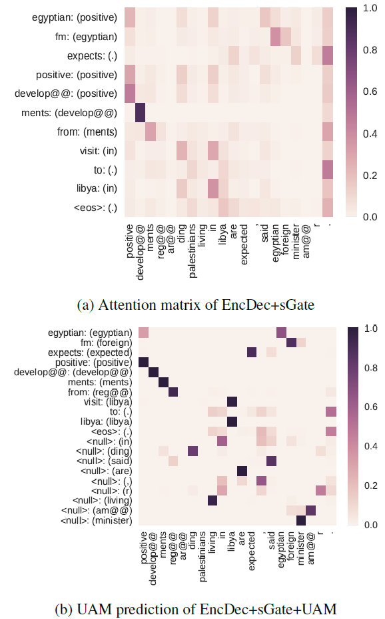
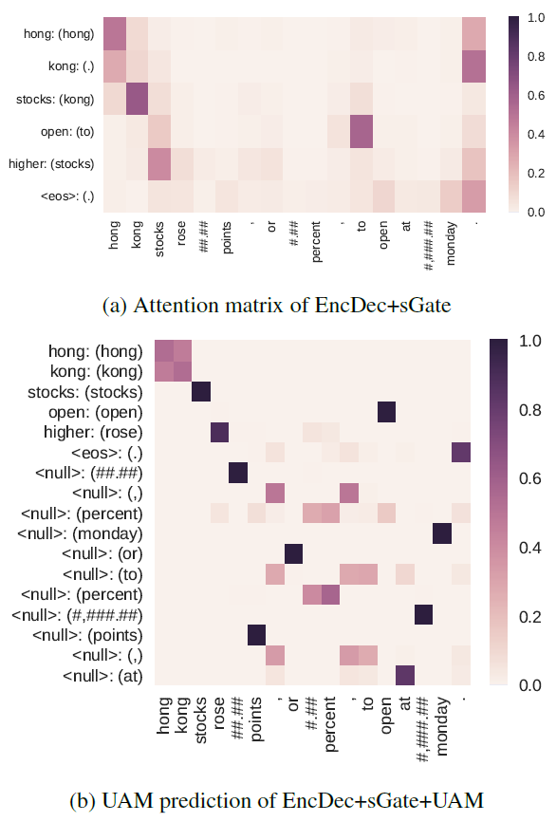
Visualization

Slide 13
Thanks for listening!
Thanks for listening!

