Slide 1
Adversarial Examples for Neural Machine Translation
Zhang Huangzhao, Yuan Pei College, zhang_hz@pku.edu.cn

Slide 2
Overview
Adversarial examples
Adversarial attack & adversarial training
AdvGen algorithm
Attack
Defense
Experimental Results

Slide 3
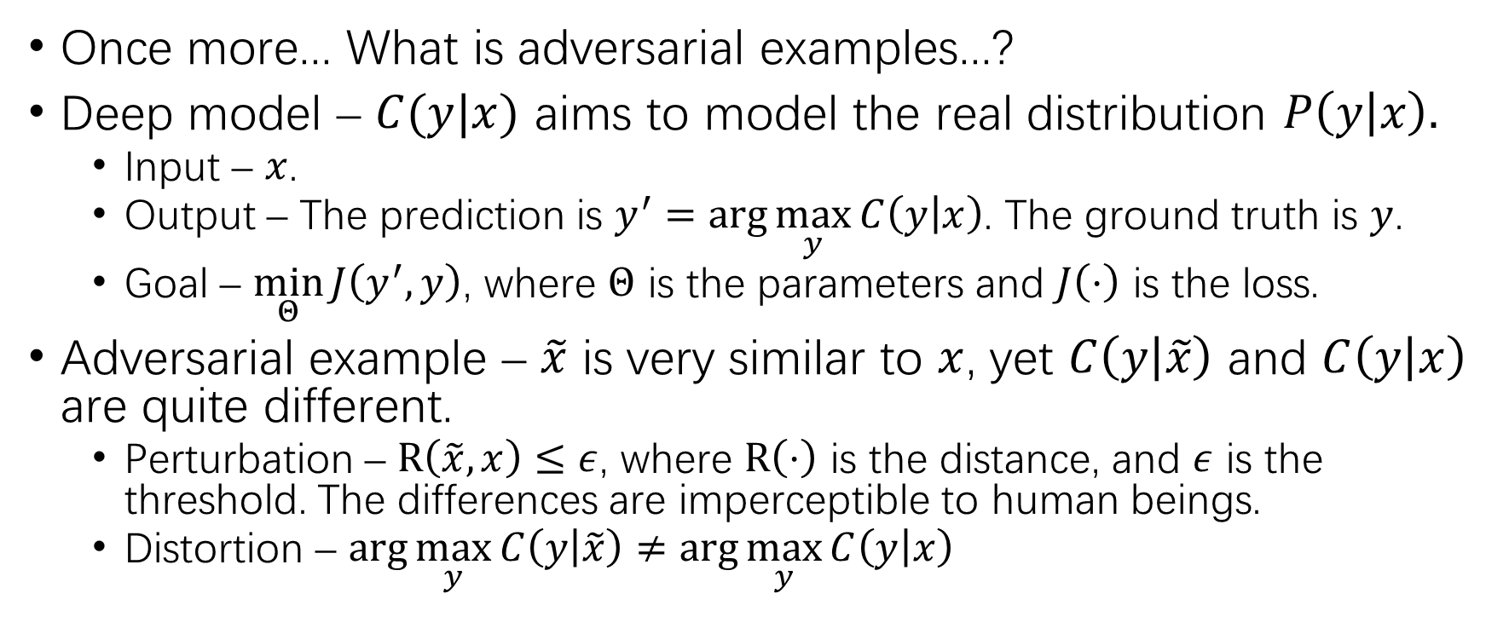
Adversarial Examples
Once more... What is adversarial examples...?
Deep model – $C(y|x)$ aims to model the real distribution $P\left(y | x\right).$
Input – $x$.
Output – The prediction is $y^{′}=\arg{\max_{y}{C\left(y | x\right)}}$. The ground truth is $y$.
Goal – $\min_{Θ}{J\left(y^{′},y\right)}$, where $Θ$ is the parameters and $J\left(⋅\right)$ is the loss.
Adversarial example – $\tilde{x}$ is very similar to $x$, yet $C\left(y | \tilde{x}\right)$ and $C\left(y | x\right)$ are quite different.
Perturbation – $R\left(\tilde{x},x\right)≤ε$, where $R\left(⋅\right)$ is the distance, and $ε$ is the threshold. The differences are imperceptible to human beings.
Distortion – $\arg{\max_{y}{C\left(y | \tilde{x}\right)}≠\arg{\max_{y}{C\left(y | x\right)}}}$

Slide 4
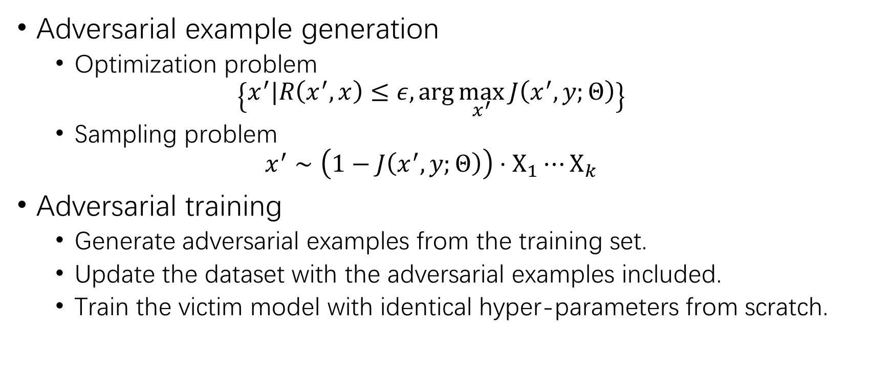
Adversarial Attack & Training
Adversarial example generation
Optimization problem
$$\left\{x^{′}|R\left(x^{′},x\right)≤ε,\arg{\max_{x^{′}}{J\left(x^{′},y;Θ\right)}}\right\}$$
Sampling problem
$$x^{′}∼\left(1−J\left(x^{′},y;Θ\right)\right)⋅Χ_{1}⋯Χ_{k}$$
Adversarial training
Generate adversarial examples from the training set.
Update the dataset with the adversarial examples included.
Train the victim model with identical hyper-parameters from scratch.

Slide 5
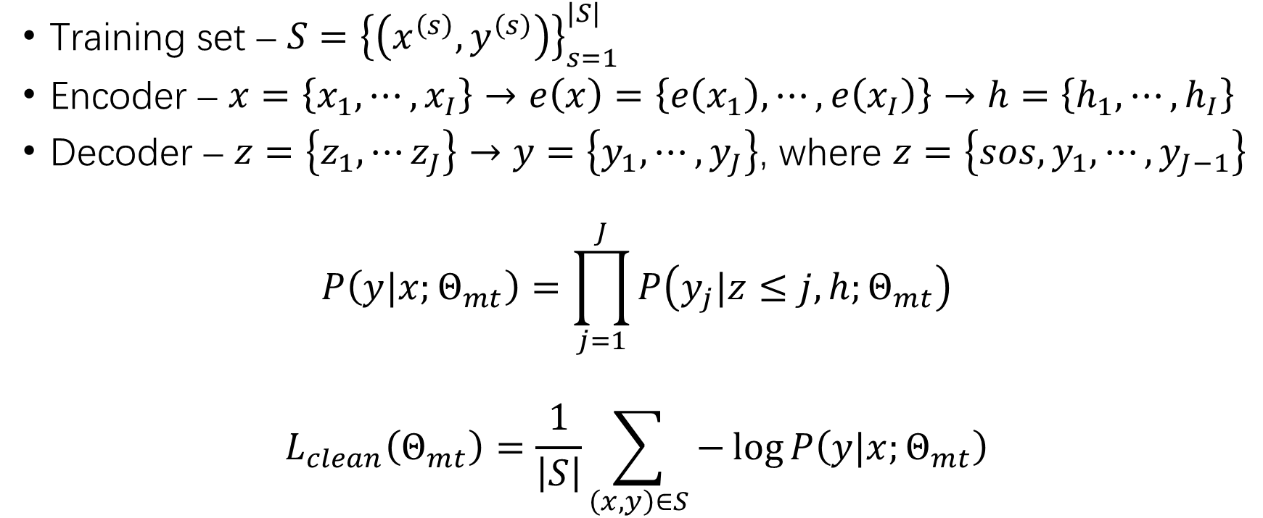
NMT Model
Training set – $S={\left\{\left(x^{\left(s\right)},y^{\left(s\right)}\right)\right\}}_{s=1}^{|S|}$
Encoder – $x=\left\{x_{1},⋯,x_{I}\right\}→e\left(x\right)=\left\{e\left(x_{1}\right),⋯,e\left(x_{I}\right)\right\}→h=\left\{h_{1},⋯,h_{I}\right\}$
Decoder – $z=\left\{z_{1},⋯z_{J}\right\}→y=\left\{y_{1},⋯,y_{J}\right\}$, where $z=\left\{sos, y_{1},⋯,y_{J−1}\right\}$
$$P\left(y|x;Θ_{mt}\right)=\prod_{j=1}^{J}{P\left(y_{j}|z≤j,h;Θ_{mt}\right)}$$
$$L_{clean}\left(Θ_{mt}\right)=\frac{1}{\left|S\right|}\sum_{\left(x,y\right)∈S}{−\log{P\left(y|x;Θ_{mt}\right)}}$$

Slide 6
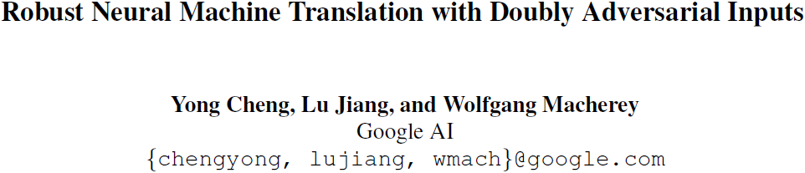
AdvGen

Slide 7
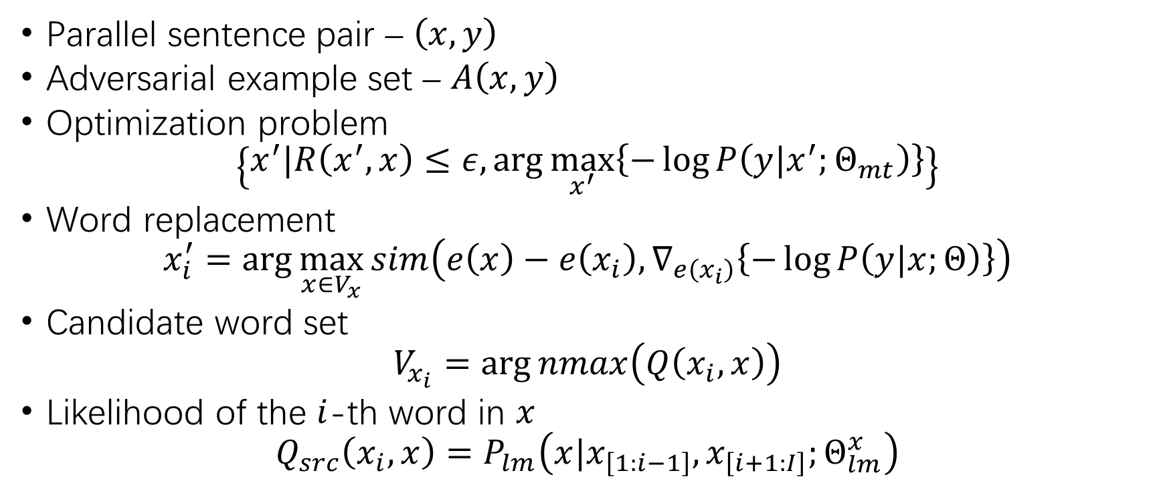
Attack with Adversarial Source Input
Parallel sentence pair – $\left(x,y\right)$
Adversarial example set – $A\left(x,y\right)$
Optimization problem
$$\left\{x^{′}|R\left(x^{′},x\right)≤ε,\arg{\max_{x^{′}}\left\{−\log{P\left(y|x^{′};Θ_{mt}\right)}\right\}}\right\}$$
Word replacement
$$x_{i}^{′}=\arg{\max_{x∈V_{x}}{sim\left(e\left(x\right)−e\left(x_{i}\right),∇_{e\left(x_{i}\right)}\left\{−\log{P\left(y|x;Θ\right)}\right\}\right)}}$$
Candidate word set
$$V_{x_{i}}=\arg{nmax\left(Q\left(x_{i},x\right)\right)}$$
Likelihood of the $i$-th word in $x$
$$Q_{src}\left(x_{i},x\right)=P_{lm}\left(x|x_{\left[1:i−1\right]},x_{\left[i+1:I\right]};Θ_{lm}^{x}\right)$$

Slide 8
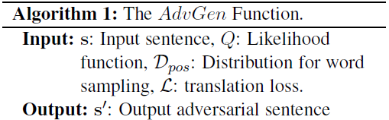
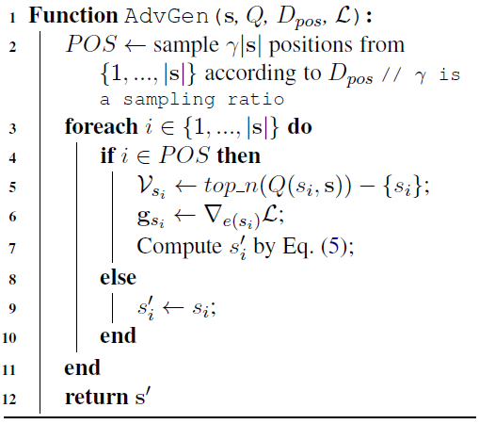
Attack with Adversarial Source Input (2)

Slide 9
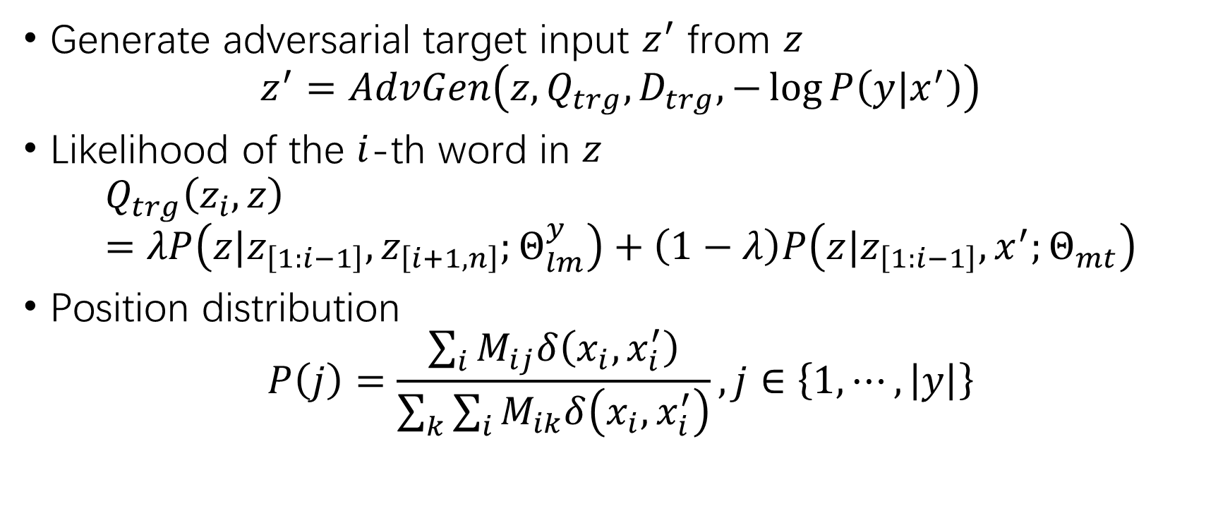
Defense with Adversarial Target Inputs
Generate adversarial target input $z^{′}$ from $z$
$$z^{′}=AdvGen\left(z,Q_{trg},D_{trg},−\log{P\left(y|x^{′}\right)}\right)$$
Likelihood of the $i$-th word in $z$
$$Q_{trg}\left(z_{i},z\right)=λP\left(z|z_{\left[1:i−1\right]},z_{\left[i+1,n\right]};Θ_{lm}^{y}\right)+\left(1−λ\right)P\left(z|z_{\left[1:i−1\right]},x^{′};Θ_{mt}\right)$$
Position distribution
$$P\left(j\right)=\frac{\sum_{i}{M_{ij}δ\left(x_{i},x_{i}^{′}\right)}}{\sum_{k}{\sum_{i}{M_{ik}δ\left(x_{i},x_{i}^{′}\right)}}},j∈\left\{1,⋯,\left|y\right|\right\}$$

Slide 10
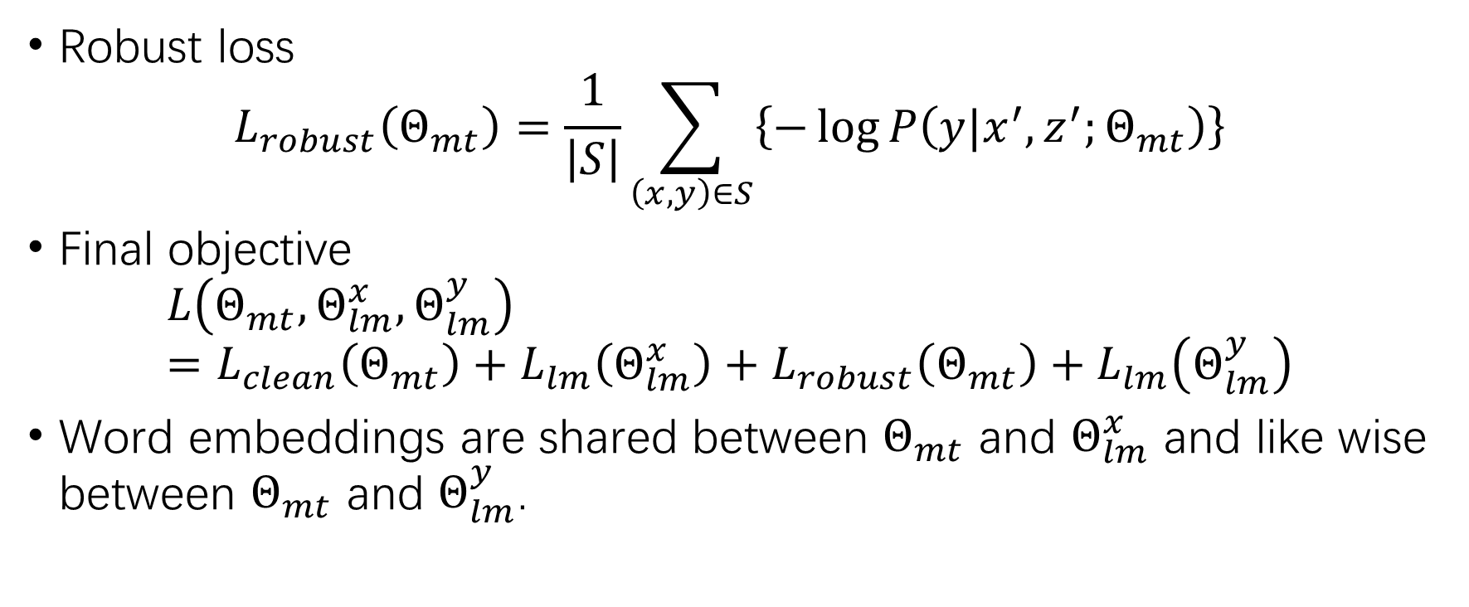
Adversarial Training
Robust loss
$$L_{robust}\left(Θ_{mt}\right)=\frac{1}{\left|S\right|}\sum_{\left(x,y\right)∈S}{\left\{−\log{P\left(y|x^{′},z^{′};Θ_{mt}\right)}\right\}}$$
Final objective
$$L\left(Θ_{mt},Θ_{lm}^{x},Θ_{lm}^{y}\right)=L_{clean}\left(Θ_{mt}\right)+L_{lm}\left(Θ_{lm}^{x}\right)+L_{robust}\left(Θ_{mt}\right)+L_{lm}\left(Θ_{lm}^{y}\right)$$
Word embeddings are shared between $Θ_{mt}$ and $Θ_{lm}^{x}$ and like wise between $Θ_{mt}$ and $Θ_{lm}^{y}$.

Slide 11
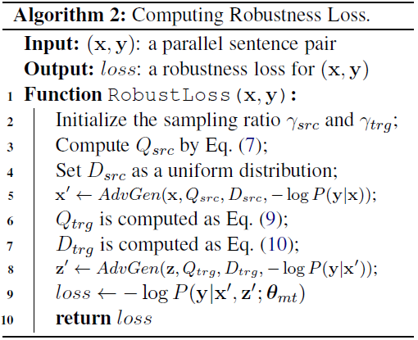
Adversarial Training (2)

Slide 12
Experimental Setups
Chinese-English translation
Training set – LDC corpus (1.2M sentence pairs)
Validation set – NIST 2006
Test set – NIST 2002, 2003, 2004, 2005, 2008
English-German translation
Training set – WMT’14 corpus (4.5M sentence pairs)
Validation set – newstest2013
Validation set – newstest2014
Source and target sentences are BPE tokenized.
Victim model – left2right and right2left transformers

Slide 13
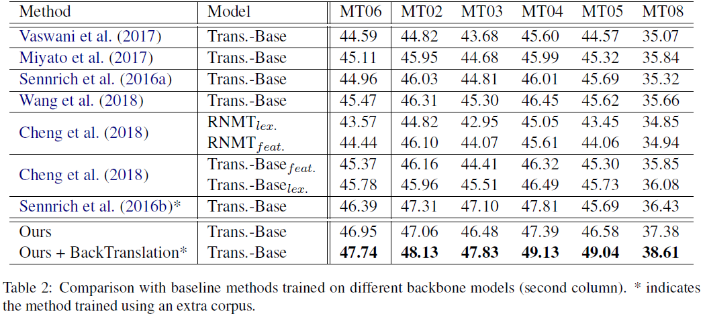
Experimental Results

Slide 14
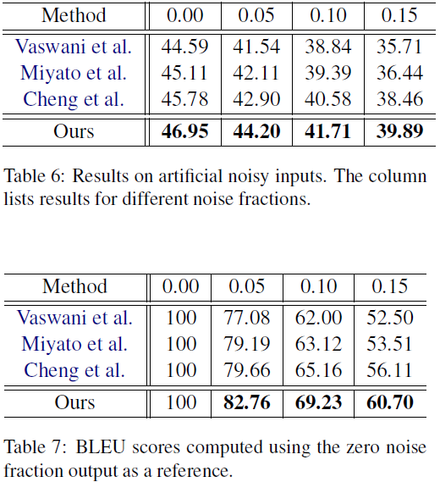
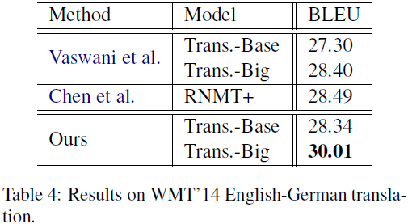
Experimental Results (2)

Slide 15
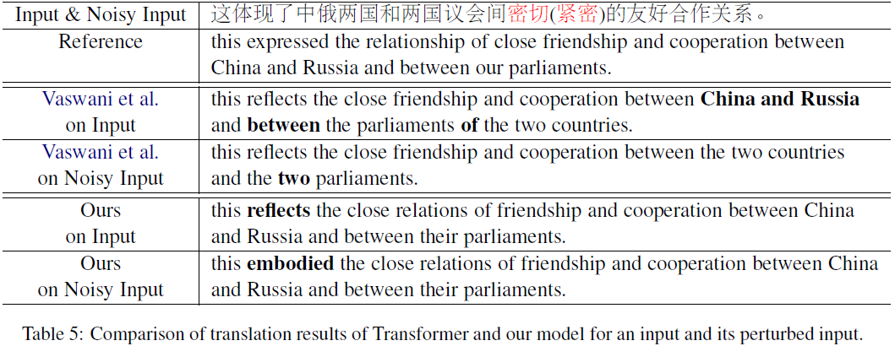
Experimental Results (3)

Slide 16
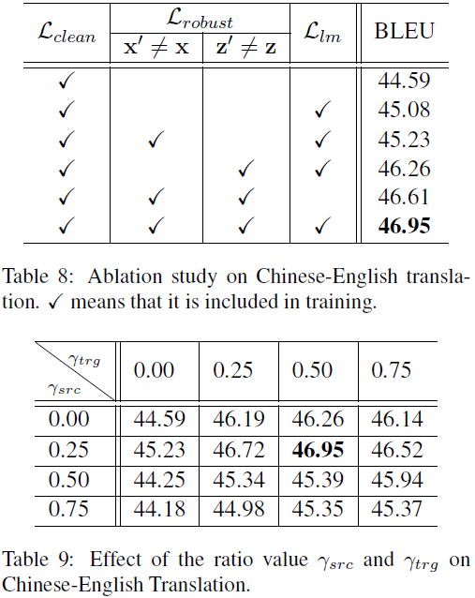
Experimental Results (4)

Slide 17
THANK YOU!

