Slide 1
Verified Robustness of Deep Learning Models
Zhang Huangzhao, 张煌昭
zhang_hz@pku.edu.cn

Slide 2
Overview
Robustness
Adversarial attack & training
Bounding techniques
Verified robustness
Modeling sequence perturbations
Simplex perturbation
Interval bound propagation for symbol substitution
Experiments
Setups
Results
Discussion

Slide 3
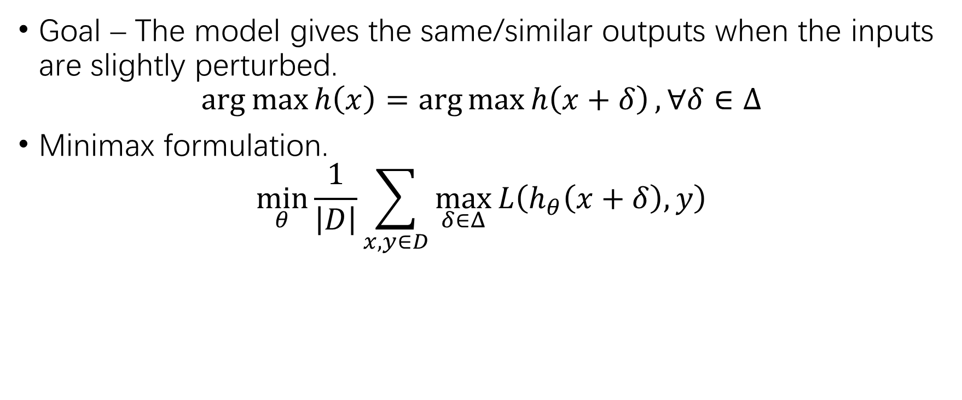
Robustness
Goal – The model gives the same/similar outputs when the inputs are slightly perturbed.
$$\arg{\max{h\left(x\right)}}=\arg{\max{h\left(x+δ\right)}}, ∀δ∈Δ$$
Minimax formulation.
$$\min_{θ}{\frac{1}{\left|D\right|}\sum_{x,y∈D}{\max_{δ∈Δ}{L\left(h_{θ}\left(x+δ\right),y\right)}}}$$

Slide 4
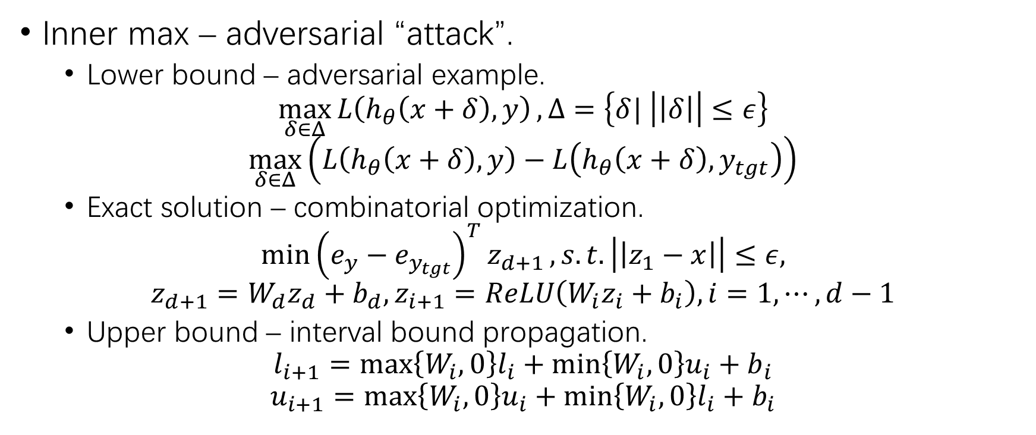
Robustness (2)
Inner max – adversarial “attack”.
Lower bound – adversarial example.
$$\max_{δ∈Δ}{L\left(h_{θ}\left(x+δ\right),y\right)},Δ=\left\{δ| \left|\left|δ\right|\right|≤ε\right\}$$
$$\max_{δ∈Δ}\left(L\left(h_{θ}\left(x+δ\right),y\right)−L\left(h_{θ}\left(x+δ\right),y_{tgt}\right)\right)$$
Exact solution – combinatorial optimization.
$$\min{{\left(e_{y}−e_{y_{tgt}}\right)}^{T}z_{d+1}}, s.t. \left|\left|z_{1}−x\right|\right|≤ε,$$
$$z_{d+1}=W_{d}z_{d}+b_{d}, z_{i+1}=ReLU\left(W_{i}z_{i}+b_{i}\right),i=1,⋯,d−1$$
Upper bound – interval bound propagation.
$$l_{i+1}={\max\left\{W_{i},0\right\}l_{i}+\min\left\{W_{i},0\right\}u_{i}+b}_{i}$$
$$u_{i+1}=\max\left\{W_{i},0\right\}u_{i}+\min\left\{W_{i},0\right\}l_{i}+b_{i}$$

Slide 5
Robustness (3)
Outer min – adversarial “training”.
Adversarial examples.
Exact max solution.
Upper boundary.

Slide 6


Robustness (4)
Exact solution – mixed integer linear programming.
ReLU activation.
Bounds of $z_{i}$ ($\left[l_{i},u_{i}\right]$) is known.
$$\min_{z_{1,⋯,d+1},v_{1,⋯,d−1}}{{\left(e_{y}−e_{y_{tgt}}\right)}^{T}z_{d+1}}$$
$$s.t. z_{i+1}≥W_{i}z_{i}+b_{i},i=1,⋯,d−1$$
$$z_{i+1}≥0,i=1,⋯,d−1$$
$$z_{i+1}≤u_{i}⋅v_{i},i=1,⋯,d−1$$
$$z_{i+1}+\left(1−v_{i}\right)l_{i}≤W_{i}z_{i}+b_{i},i=1,⋯,d−1$$
$$v_{i}∈{\left\{0,1\right\}}^{\left|v_{i}\right|}$$
$$z_{1}≤x+δ$$
$$z_{1}≥x−δ$$
$$z_{d+1}=W_{d}z_{d}+b_{d}$$

Slide 7
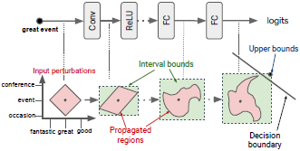
Robustness (5)
Bound propagation.

Slide 8

Robustness (6)
Verification.
Upper bound.
$$\max_{δ∈Δ}{L\left(h_{θ}\left(x+δ\right),y\right)}≤u≤0$$
Linear programming.
$${\left(e_{y_{tgt}}−e_{y}\right)}^{T}z_{K}≤u≤0, ∀y_{tgt}$$

Slide 9
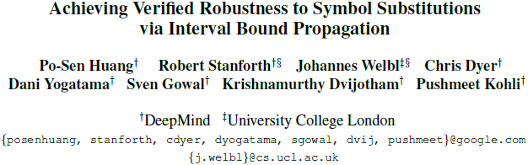

Slide 10
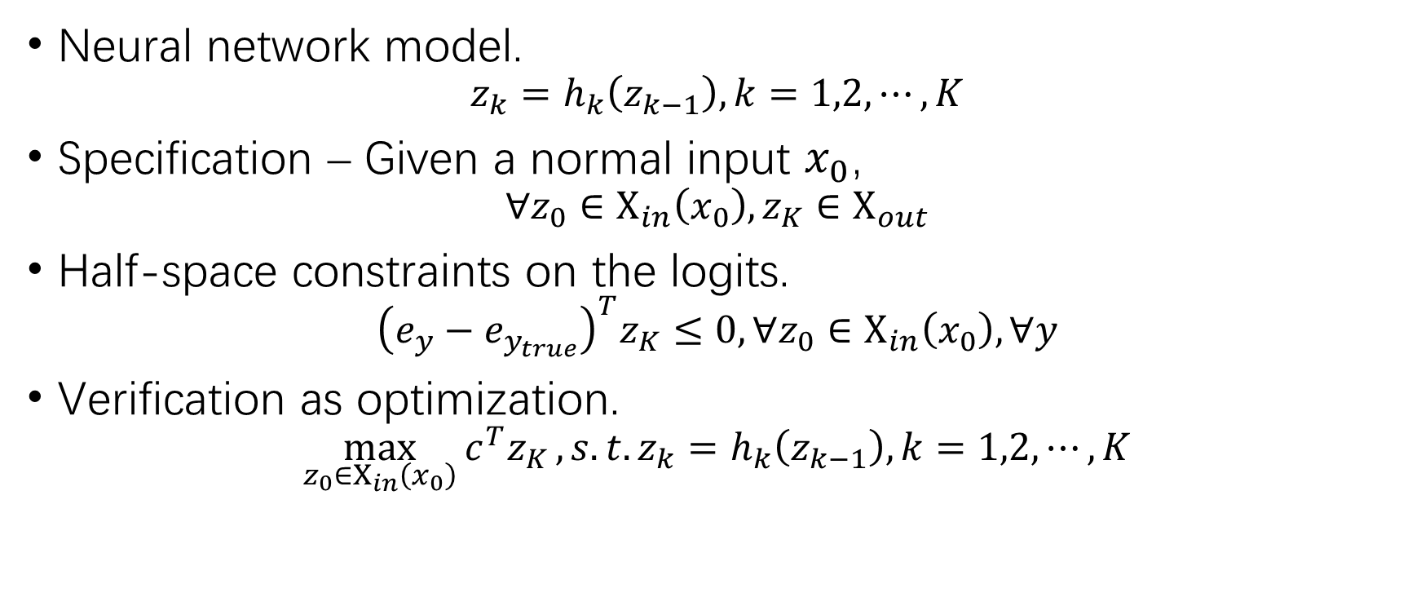
Notations
Neural network model.
$$z_{k}=h_{k}\left(z_{k−1}\right), k=1,2,⋯,K$$
Specification – Given a normal input $x_{0}$,
$$∀z_{0}∈Χ_{in}\left(x_{0}\right), z_{K}∈Χ_{out}$$
Half-space constraints on the logits.
$${\left(e_{y}−e_{y_{true}}\right)}^{T}z_{K}≤0, ∀z_{0}∈Χ_{in}\left(x_{0}\right), ∀y$$
Verification as optimization.
$$\max_{z_{0}∈Χ_{in}\left(x_{0}\right)}{c^{T}z_{K}}, s.t. z_{k}=h_{k}\left(z_{k−1}\right), k=1,2,⋯,K$$

Slide 11
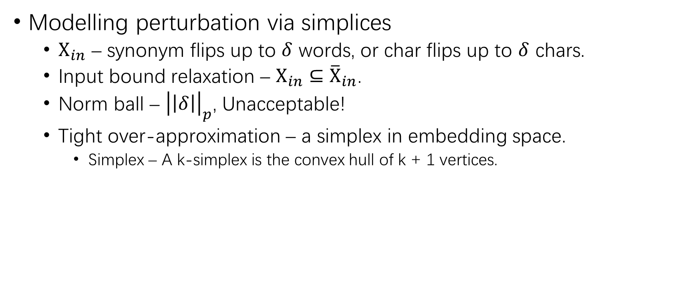
Methodology
Modelling perturbation via simplices
$Χ_{in}$ – synonym flips up to $δ$ words, or char flips up to $δ$ chars.
Input bound relaxation – ${Χ_{in}⊆\overline{Χ}}_{in}$.
Norm ball – ${\left|\left|δ\right|\right|}_{p}$, Unacceptable!
Tight over-approximation – a simplex in embedding space.
Simplex – A k-simplex is the convex hull of k + 1 vertices.

Slide 12
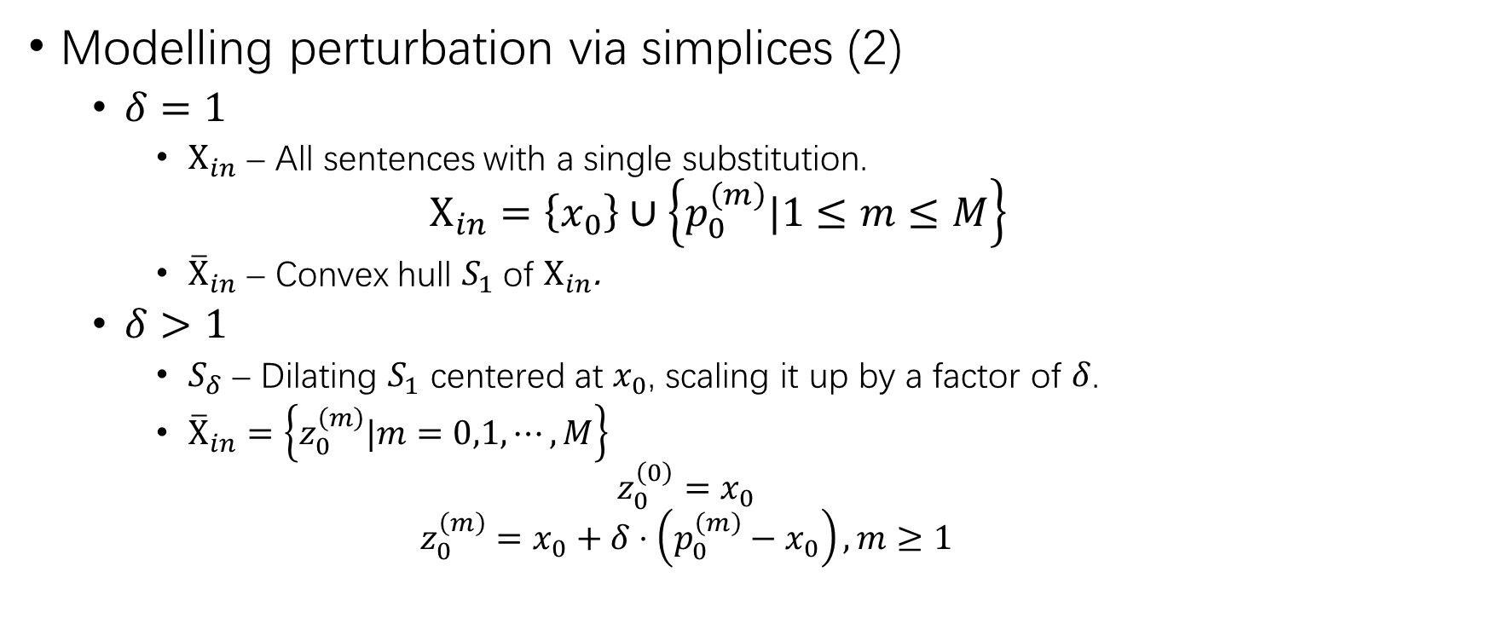
Methodology (2)
Modelling perturbation via simplices (2)
$δ=1$
$Χ_{in}$ – All sentences with a single substitution.
$$Χ_{in}=\left\{x_{0}\right\}∪\left\{p_{0}^{\left(m\right)}|1≤m≤M\right\}$$
${\overline{Χ}}_{in}$ – Convex hull $S_{1}$ of $Χ_{in}$.
$δ>1$
$S_{δ}$ – Dilating $S_{1}$ centered at $x_{0}$, scaling it up by a factor of $δ$.
${\overline{Χ}}_{in}=\left\{z_{0}^{\left(m\right)}|m=0,1,⋯,M\right\}$
$$z_{0}^{\left(0\right)}=x_{0}$$
$$z_{0}^{\left(m\right)}=x_{0}+δ⋅\left(p_{0}^{\left(m\right)}−x_{0}\right), m≥1$$

Slide 13
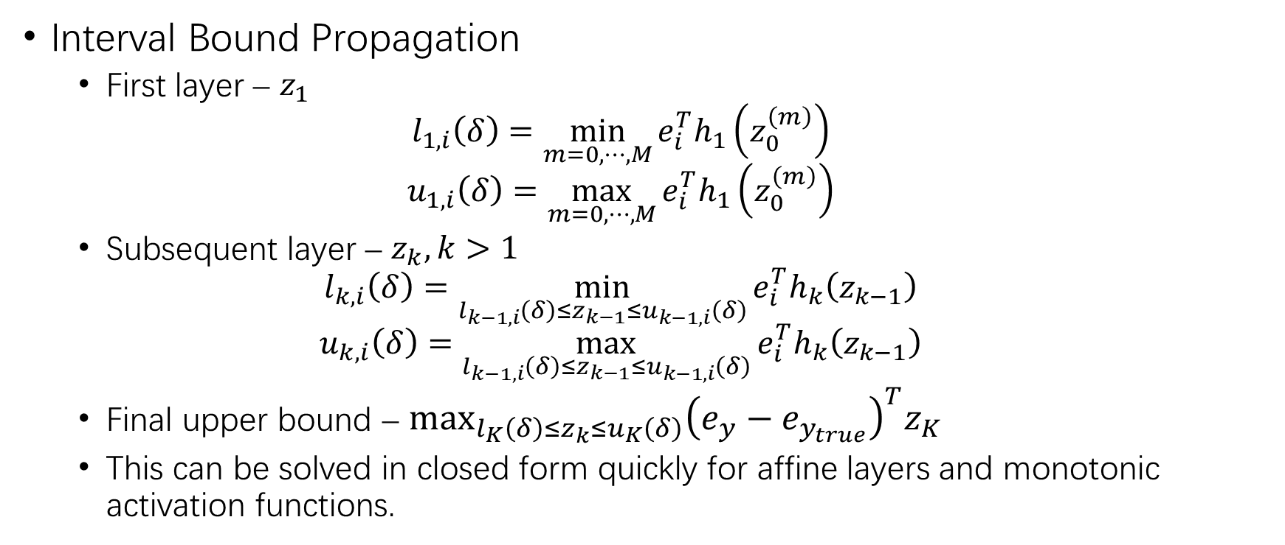
Methodology (3)
Interval Bound Propagation
First layer – $z_{1}$
$$l_{1,i}\left(δ\right)=\min_{m=0,⋯,M}{e_{i}^{T}h_{1}\left(z_{0}^{\left(m\right)}\right)}$$
$$u_{1,i}\left(δ\right)=\max_{m=0,⋯,M}{e_{i}^{T}h_{1}\left(z_{0}^{\left(m\right)}\right)}$$
Subsequent layer – $z_{k}, k>1$
$$l_{k,i}\left(δ\right)=\min_{l_{k−1,i}\left(δ\right)≤z_{k−1}≤u_{k−1,i}\left(δ\right)}{e_{i}^{T}h_{k}\left(z_{k−1}\right)}$$
$$u_{k,i}\left(δ\right)=\max_{l_{k−1,i}\left(δ\right)≤z_{k−1}≤u_{k−1,i}\left(δ\right)}{e_{i}^{T}h_{k}\left(z_{k−1}\right)}$$
Final upper bound – $\max_{l_{K}\left(δ\right)≤z_{k}≤u_{K}\left(δ\right)}{{\left(e_{y}−e_{y_{true}}\right)}^{T}z_{K}}$
This can be solved in closed form quickly for affine layers and monotonic activation functions.

Slide 14
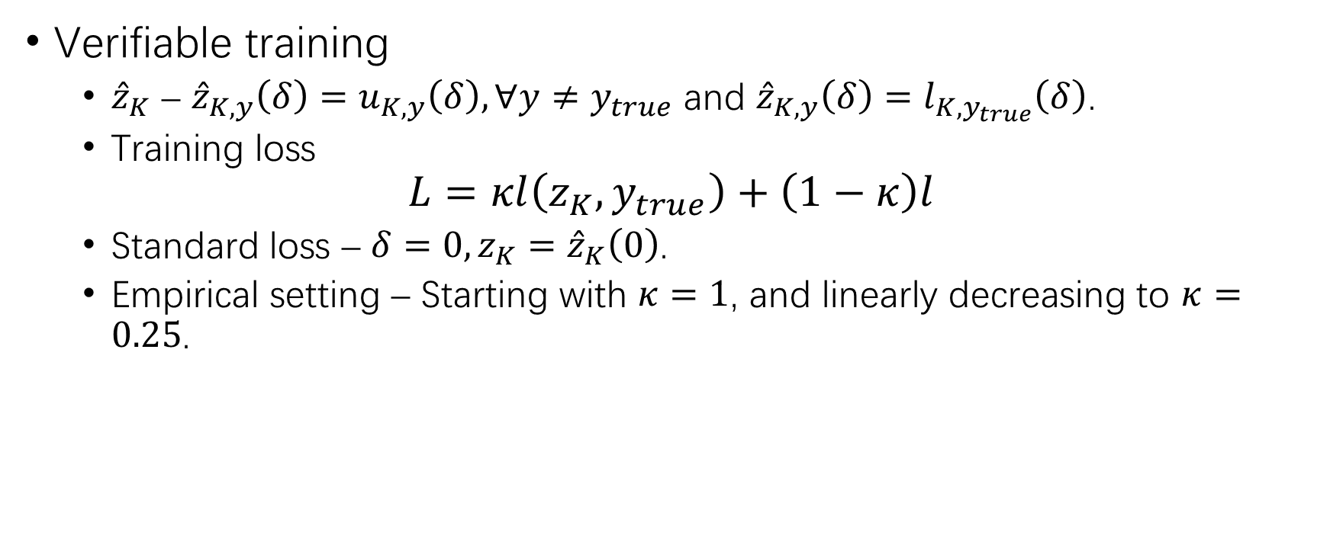
Methodology (4)
Verifiable training
${\hat{z}}_{K}$ – ${\hat{z}}_{K,y}\left(δ\right)=u_{K,y}\left(δ\right), ∀y≠y_{true}$ and ${\hat{z}}_{K,y}\left(δ\right)=l_{K,y_{true}}\left(δ\right)$.
Training loss
$$L=κl\left(z_{K},y_{true}\right)+\left(1−κ\right)l$$
Standard loss – $δ=0, z_{K}={\hat{z}}_{K}\left(0\right)$.
Empirical setting – Starting with $κ=1$, and linearly decreasing to $κ=0.25$.

Slide 15
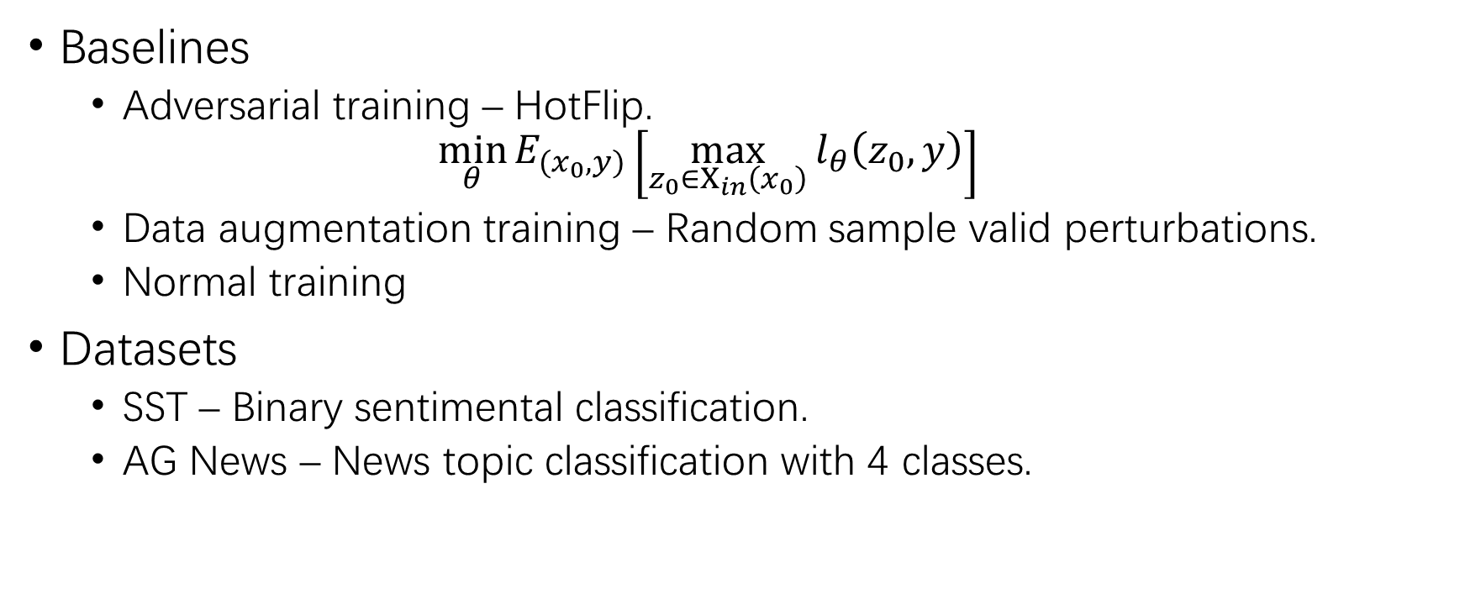
Experiments
Baselines
Adversarial training – HotFlip.
$$\min_{θ}{E_{(x_{0},y)}\left[\max_{z_{0}∈Χ_{in}\left(x_{0}\right)}{l_{θ}\left(z_{0},y\right)}\right]}$$
Data augmentation training – Random sample valid perturbations.
Normal training
Datasets
SST – Binary sentimental classification.
AG News – News topic classification with 4 classes.

Slide 16
Experiments (2)
Classifiers & substitutions
Word-level and char-level CNNs.
Word-level – Constructing synonym pairs on the PPDB database.
Char-level – Applying synthetic keyboard typos.
Evaluation metrics
Acc. – Test set accuracy.
Adv. Acc. – Accuracy against HotFlip adversarial attack.
IBP-verified – The test sample ratio that IBP can verify that the specification is not violated.
Oracle – Exhaustively verified accuracy by testing all possible perturbations.

Slide 17
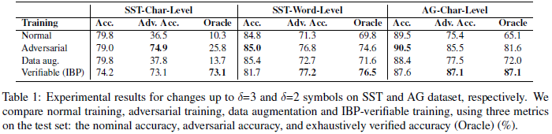
Experiments (3)

Slide 18
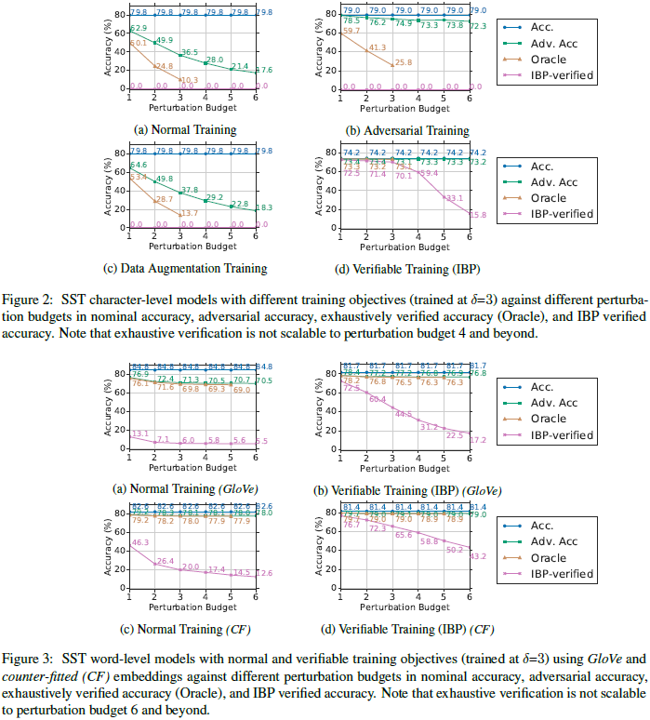
Experiments (4)

Slide 19
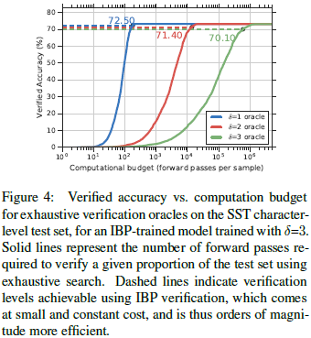
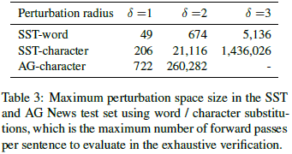
Experiments (5)

Slide 20
THANK YOU

