Slide 1
Supervised Deep Features for Software Functional Clone Detection by Exploiting Lexical and Syntactical Information in Source Code
Hui-Hui Wei and Ming Li
National Key Laboratory for Novel Software Technology, Nanjing University
Collaborative Innovation Center of Novel Software Technology and Industrialization
Nanjing 210023, China
{weihh, lim}@lamda.nju.edu.cn

Slide 2
Background
Software clone means reusing code or implementing a functionality similar to existing one
Software clone may easily lead to:
injection of software defects
infringement of copyright

Slide 3
Software clone detection aims to identify similar code fragments
Categorization
Type-1: identical code fragments in addition to comments and layout
Type-2: identical code fragments except for different identifier names and
literal values
Type-3: syntactically similar code that differ at statement level
Type-4: syntactically dissimilar code that has the same functionality, also called functional clones
e.g. summation implemented with for-loop and recursion

Slide 4
Current Methods
Hand-craft certain similarity between code fragments
With lexical information (Type-1 and Type-2), e.g.
NICAD [Roy and Cordy, 2008]
SourcerCC [Sajnani et al., 2016]
With syntactical information (mainly Type-3), e.g.
Deckard [Jiang et al., 2007]
Unsupervised methods
Applying autoencoder to learn semantical latent features [White et al., 2016]

Slide 5
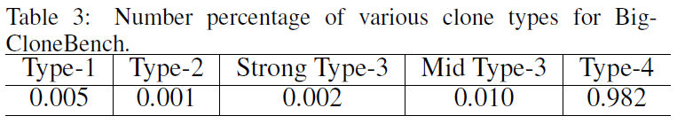
But type-4 clones are much more than other types

Slide 6
Motivation
Software functional clone detection (type-4 clone) by learning supervised deep features
Using both lexical and syntactical aspects of source codes

Slide 7
Contribution
Formulate clone detection as a supervised deep learning problem by introducing pairwise labels.
CDLH, an end-to-end deep feature learning framework, which simultaneously learns
representations of code fragments (by AST-based LSTM)
parameters of hash functions

Slide 8
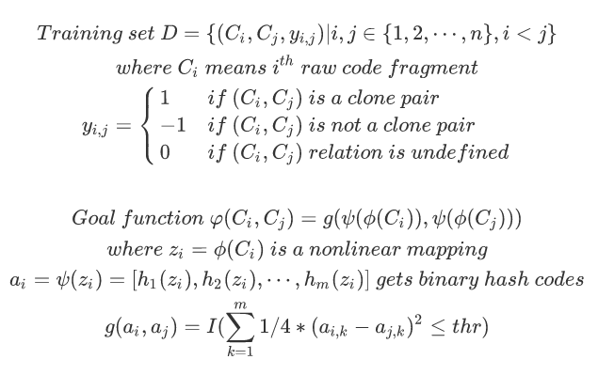

Problem Definition

Slide 9
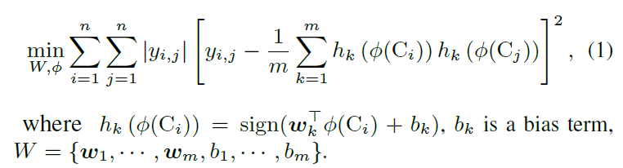
Problem Definition
Use AST-based LSTM to learn representation mapping function Φ
ps: for parameter learning, use AdaDelta [Zeiler, 2012] for optimization

Slide 10
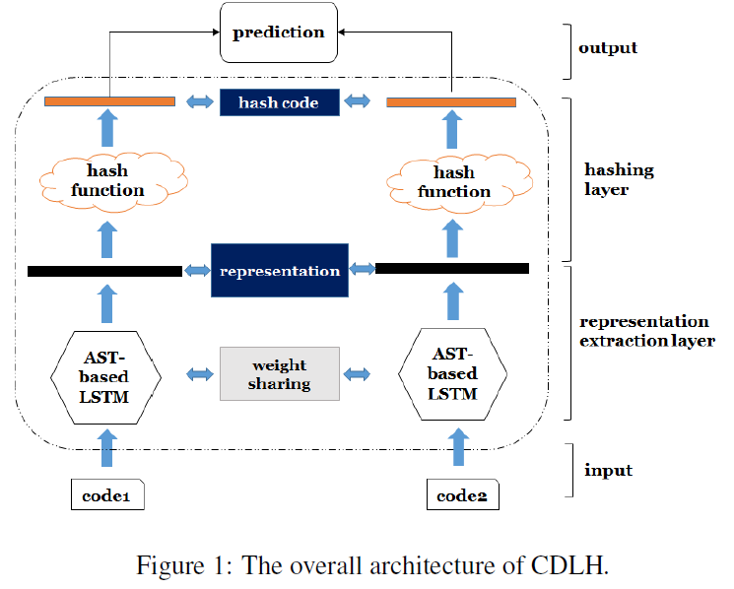



CDLH--Clone Detection with Learning to Hash
Map row code fragments to pairwise labels, use hamming distance to judge clone pair
Hash functions encode those representations into binary hash codes
Transforms code fragments to AST, then uses AST-based LSTM to obtain the real-valued representations

Slide 11
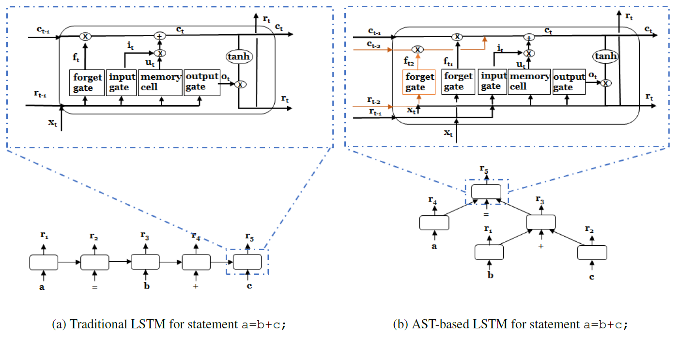
AST-based LSTM
Incorporate the lexical and syntactical information of source codes
AST, structure information of code fragments
LSTM, semantic information carried by lexical tokens of source codes

Slide 12
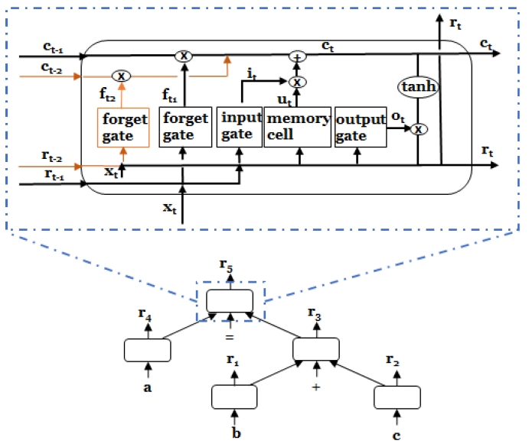
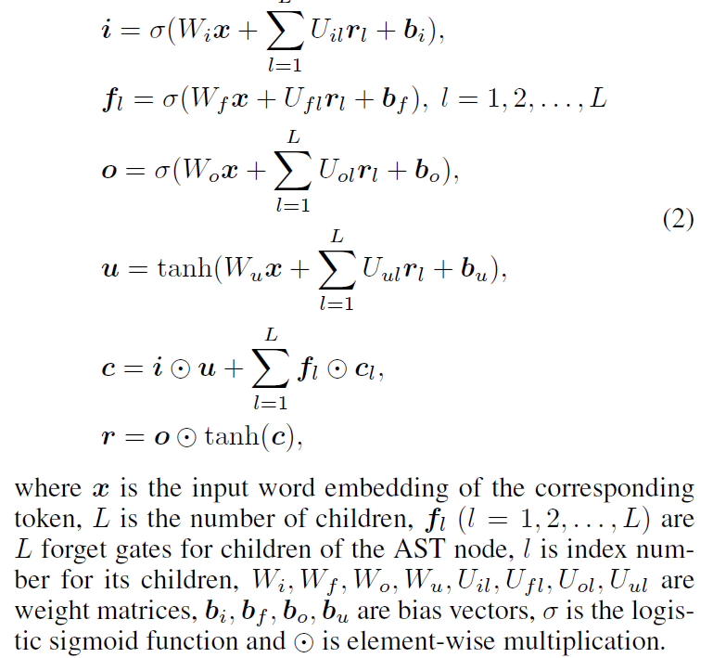
Same part: an input gate, a memory cell and an output gate
Different part: contains multiple forget gates (one per child)
Similar to [Tai et al., 2015], an AST-based LSTM unit is updated as following:

Slide 13
L varies for different nodes of different ASTs, parameter-sharing?
Turn AST to binary tree, whose nodes only contain 2 or 0 children
Compute states and cell states recursively in a bottom-up way
Output form AST root is the complete representation for code fragment

Slide 14
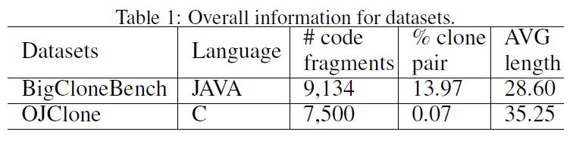
Experiment
Datasets:
BigCloneBench (with JAVA), benchmark dataset for clone detection, clone types are given by domain experts
OJClone (with C), 编程网格, codes solving same programming problem are consider as a type-3 clone pair at least
Assistant tools:
use javalang and pycparser to parse source code
use word2vec to generate word embeddings of length 100

Slide 15
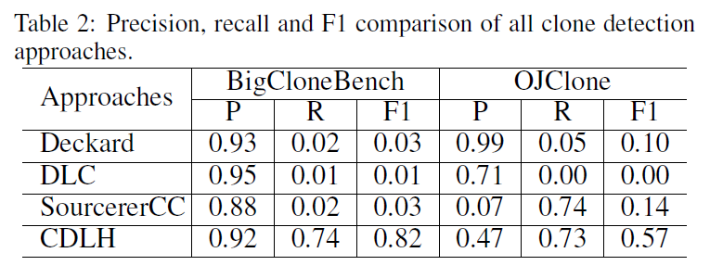
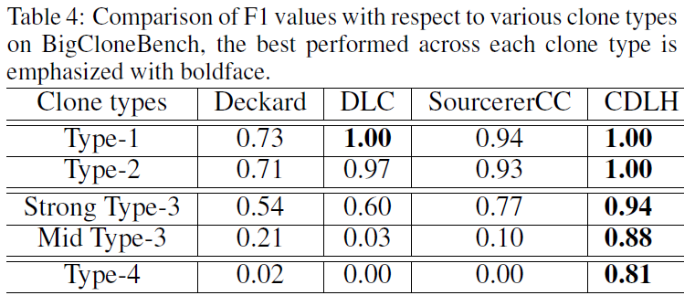
Supervised information is suitable for learning latent feature vectors of code fragments for clone detection tasks, especially for Type-4 clone.
Ps: DLC is approach proposed by [White et al., 2016]
[Svajlenko et al., 2014] divide clone types for BCB into 5 categories, Strong Type-3 with similarity range in [0.7, 1), Mid Type-3 in [0.5, 0.7), and Type-4 in [0.5, 0).

Slide 16
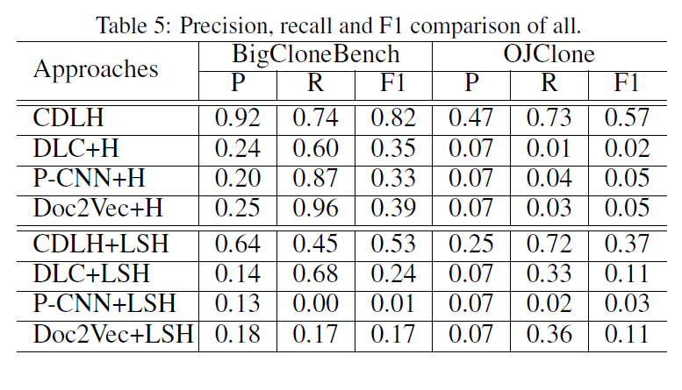
The Effectiveness of Representation Extraction
i.e., the effectiveness of AST-based LSTM
1). fix the hashing layer of CDLH and 2). replace learning to hash with LSH to eliminate effects of learning to hash
Ps: P-CNN is derived from subnetwork of NP-CNN [Huo et al., 2016]
LSH, Locality-sensitive hashing, a unsupervised date-independent hashing

Slide 17
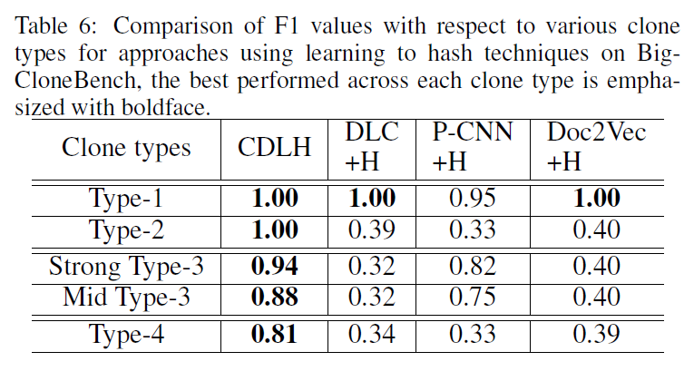
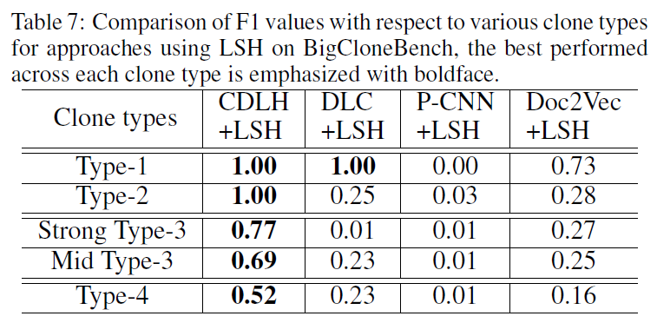

Slide 18
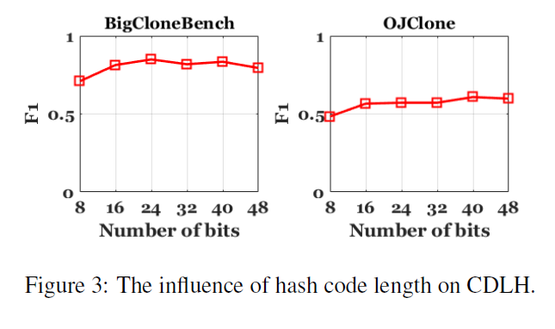
Hyper-Parameter
CDLH is not sensitive to hash code length in range [8, 48]

Slide 19
THANKS!

