Slide 1
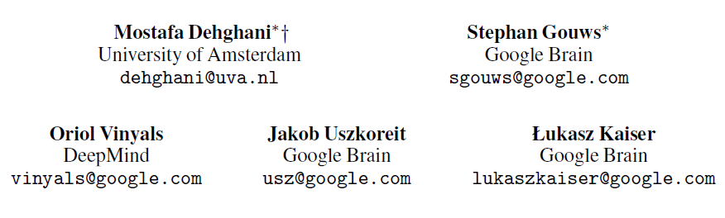
Universal Transformer
2018.11.7
报告人：傅智毅

Slide 2
OUTLINE
Review on the Transformer model
Why to introduce this model？
How does it work？
What performance can it achieve?
Universal Transformer

Slide 3
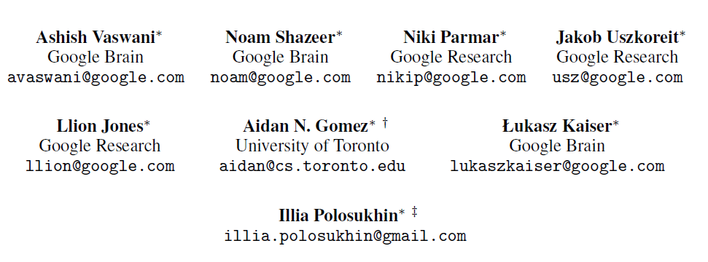
Attention Is All You Need

Slide 4
Why?
Sequential computation nature of RNN: h(t) must rely on h(t-1)
Preclude parallelization
Long time to train a model
Weakly capture long-term dependency

Slide 5
Inspiration: compute all positions in parallel
Some models had tried to reduce sequential computation
The Extended Neural GPU
ByteNet
ConvS2S
All of them use CNN as basic block, computing hidden representations in parallel for all input & output positions
However, long-term dependency still is a problem

Slide 6
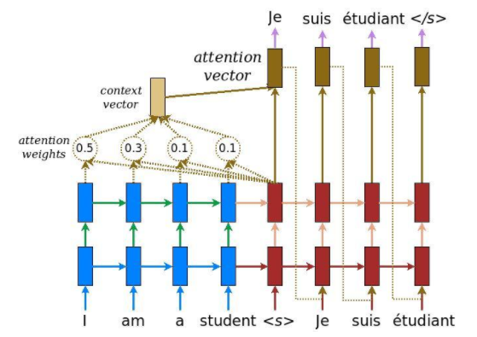
Inspiration: attention & global dependency
Attention Mechanism:
Usually used in encoder-decoder architecture
Could obtain global dependencies between input and output

Slide 7
How?
“I don’t need CNN or RNN anymore!”
Attention Mechanism
Scaled Dot-Product Attention
Multi-head Attention
Self-attention
Position-wise Feed-Forward Networks
Positional Encoding

Slide 8
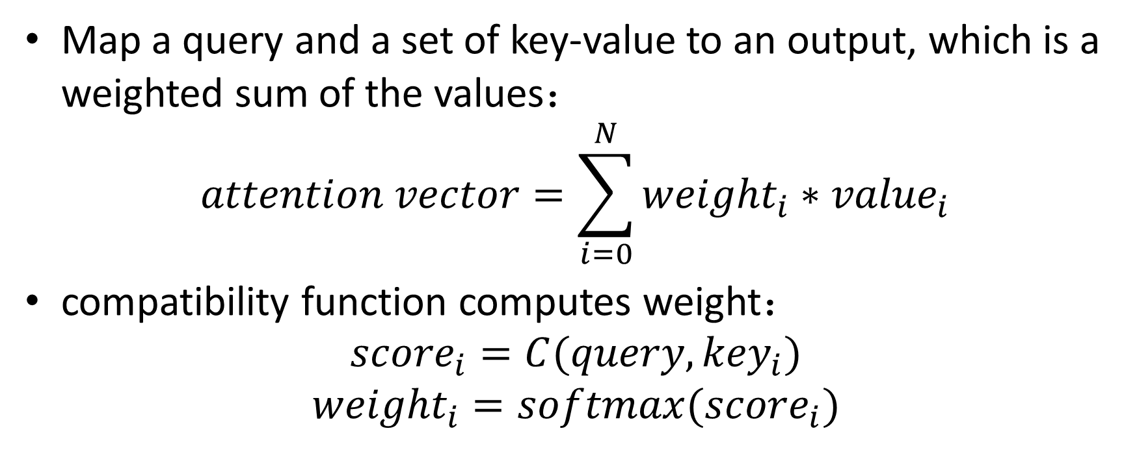
Attention Mechanism
Map a query and a set of key-value to an output, which is a weighted sum of the values：
$$attention vector=\sum_{i=0}^{N}{{weight}_{i}}∗{value}_{i}$$
compatibility function computes weight：
$${score}_{i}=C(query, {key}_{i})$$
$${weight}_{i}=softmax({score}_{i})$$

Slide 9
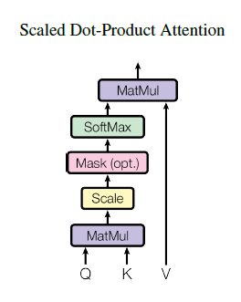

Scaled Dot-Product Attention
Choose dot-product as compatibility function
Fast & Space-Saved
Why scale? Big dimension make this dot-product large in magnitude

Slide 10
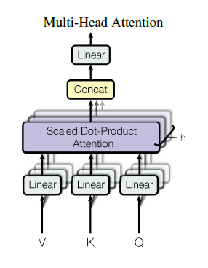


Multi-head Attention
Jointly attend to information from different representation subspaces at different positions
Computation cost compensation:

Slide 11
Self-attention
Query = Key
Each key has been a query
Concern that query of current decoder hidden state can only attend to hidden states leftward

Slide 12
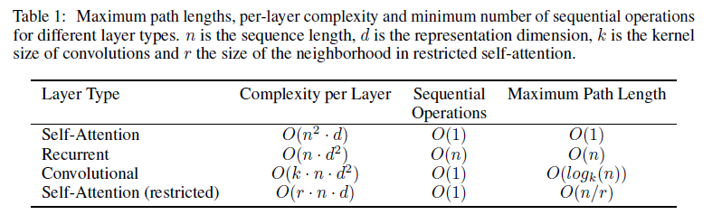
Why Self-attention
Computational complexity
Parallelization
The path length between long range dependencies

Slide 13
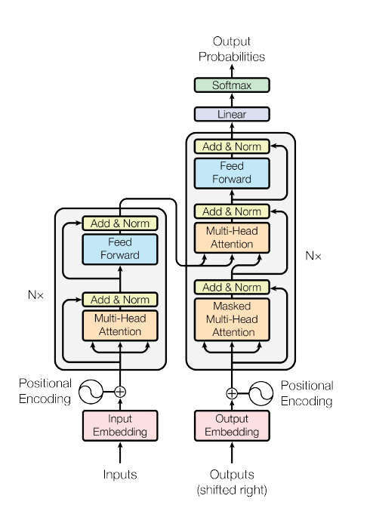
Attentions in the Transformer
Notes:
Embedding layers and the pre-softmax linear transformation

Slide 14

Position-wise Feed-Forward Networks
Position-wise：applied to each position separately and identically
The linear transformations are the same across positions, but different from layer to layer

Slide 15

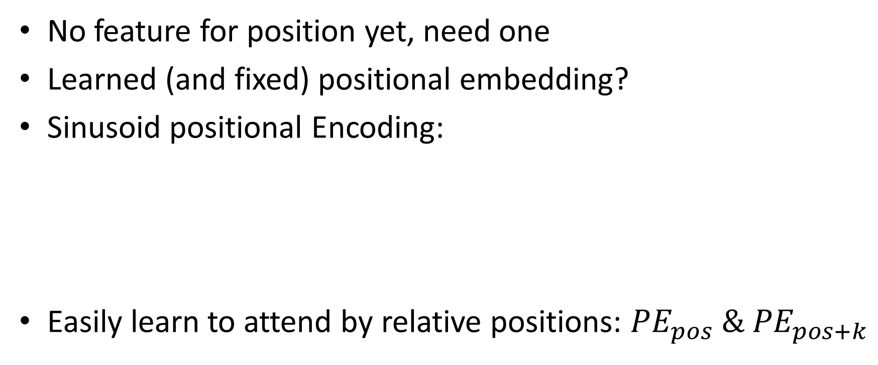
Positional Encoding
No feature for position yet, need one
Learned (and fixed) positional embedding?
Sinusoid positional Encoding:
Easily learn to attend by relative positions: ${PE}_{pos}{ \& PE}_{pos+k}$

Slide 16
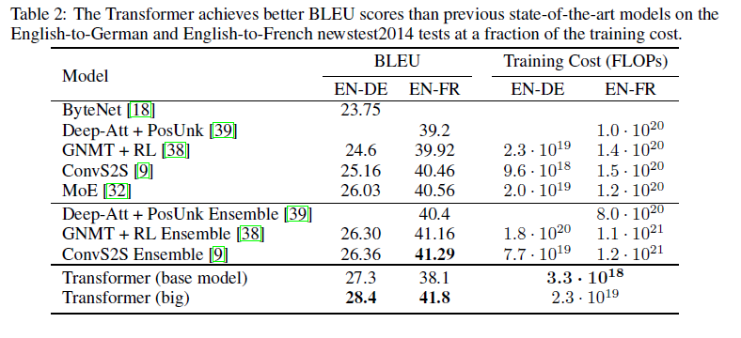
What can the Transformer do?
WMT 2014 English-German: 4.5 million sentence pairs
WMT 2014 English-French: 36 million sentences

Slide 17
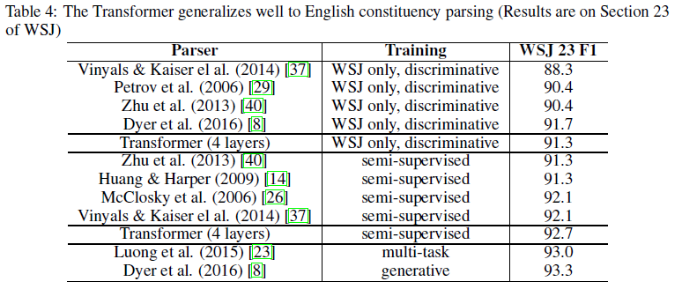
What can the Transformer do?
English Constituency Parsing task
Wall Street Journal (WSJ) portion of the Penn Treebank

Slide 18
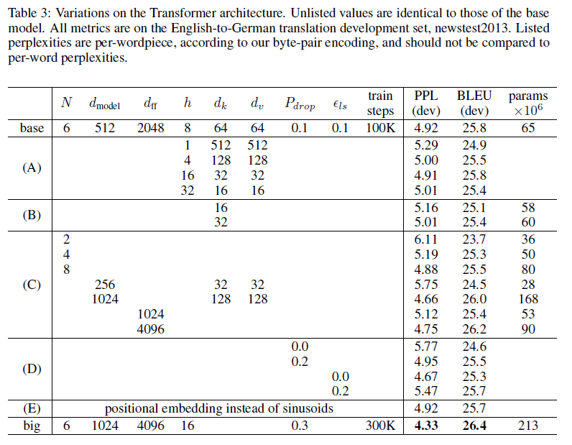
Variants of Transformer

Slide 19
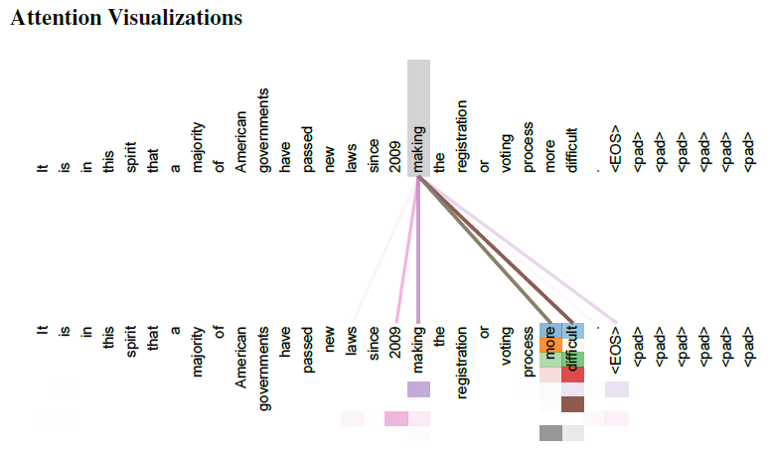
Attention Weight Analysis

Slide 20
Conclusion
What did the transformer achieve?
make parallelization possible
quick to train
could capture long-term/global dependency
self-attention refine structural representations
address the vanishing gradients problem

Slide 21
Universal Transformer

Slide 22
Problems with the Transformer
Fail to generalize in many easy tasks like copying strings
Does not generalize well to input lengths not encountered during training
What’s wrong with it?
the Transformer lose the recurrent inductive bias

Slide 23
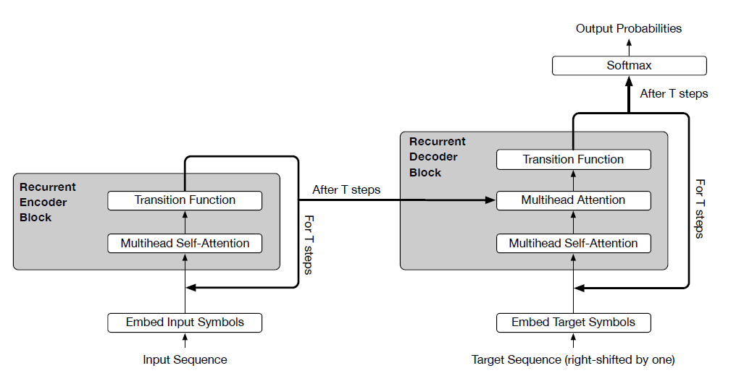
The Universal Transformer

Slide 24
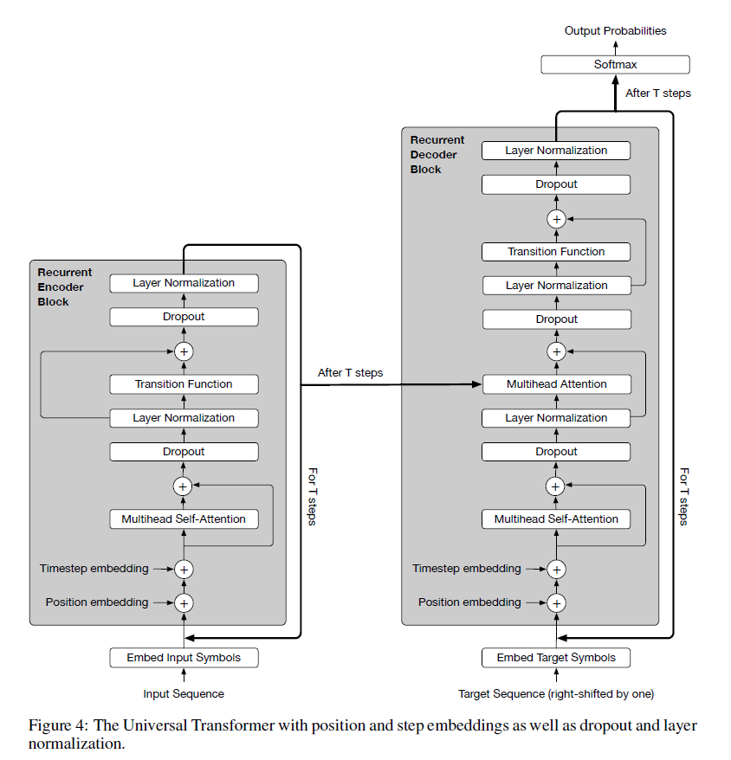
Details

Slide 25
Each Step/Iteration
Self-attention mechanism
Exchange information across all positions
Recurrent transformation
A depth wise separable convolution
Or, a position-wise fully connected layer
a shared transition function, independently at each position

Slide 26
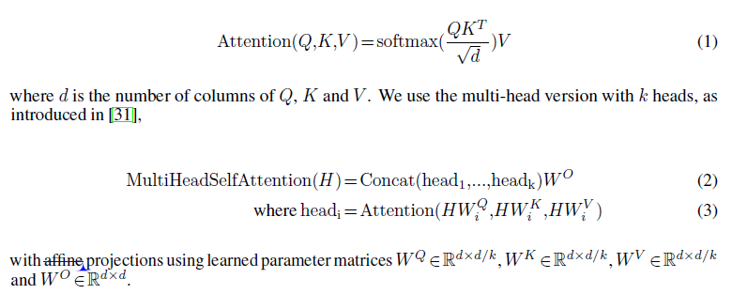
Attention Mechanism

Slide 27
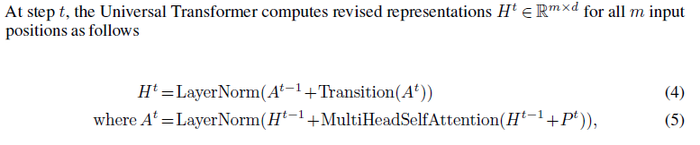

Transition function & coordinate embedding

Slide 28
The Adaptive Universal Transformer
Adaptive Computation Time (ACT) Mechanism
Ponder: go on or halt (for each position)
Once the per symbol recurrent block halts, simply copy to next step

Slide 29
Experiments
bAbI Question-Answering
Subject-Verb Agreement
LAMBADA Language Modeling
Algorithmic Tasks
Learning to Execute (LTE)
Machine Translation

Slide 30
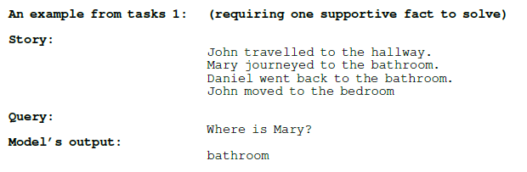
bAbI Question-Answering
bAbI, a Facebook dataset, consist of 20 different tasks
Each task need to answer a question given a story by several English facts/sentences

Slide 31
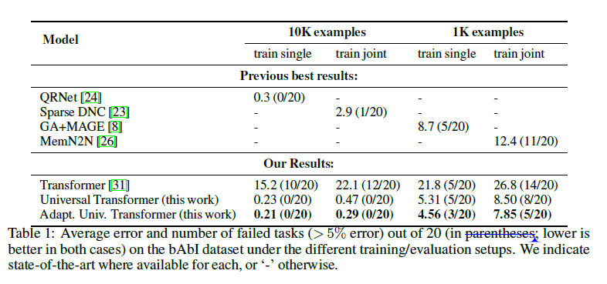
bAbI Question-Answering

Slide 32
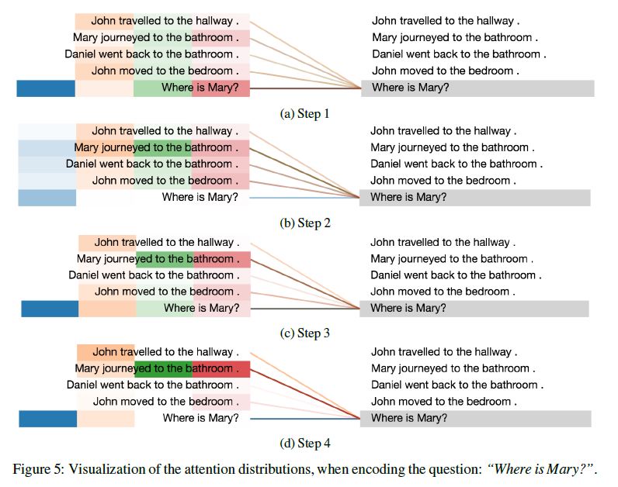
Attention Weight Visualization
Notes:
4 heads in total

Slide 33
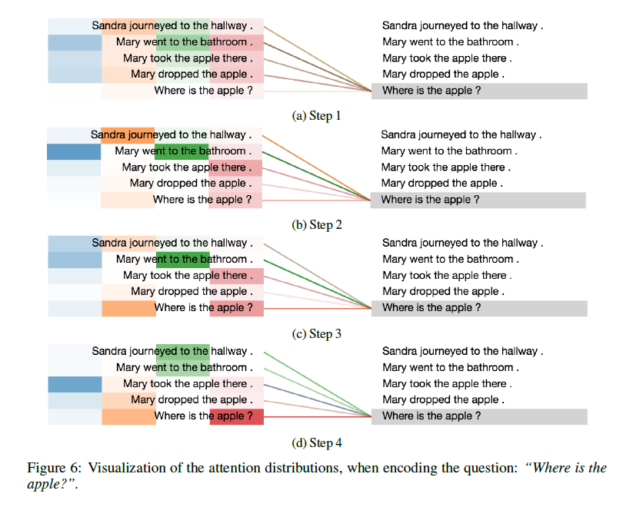
Attention Weight Visualization

Slide 34
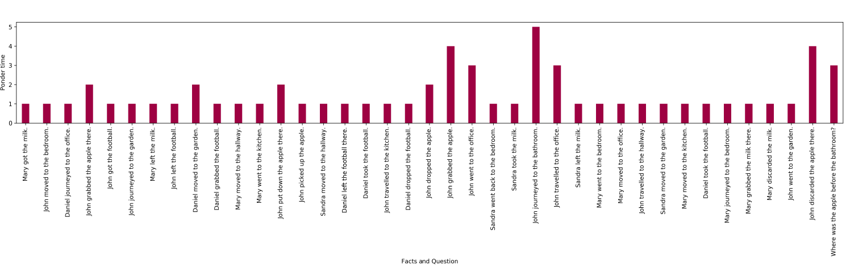
Ponder Times
The more facts required for the task, the bigger average ponder time is, and the sharper ponder time distributes

Slide 35
Subject-Verb Agreement
Given subject and agreement attractors, predict suitable next token, that is the right verb.
Given “The keys to the cabinet”
Predict “are” rather than “is”
Ranking accuracy

Slide 36
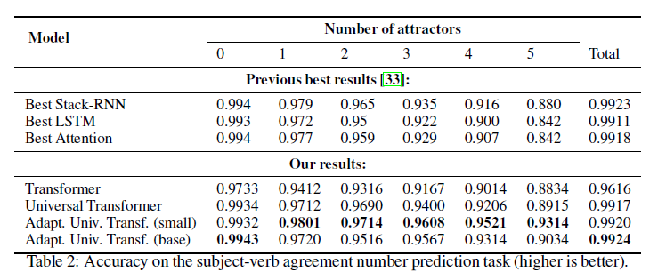
Subject-Verb Agreement

Slide 37
LAMBADA Language Modeling
Predict a missing target word given its sentence and a broader context of 4-5 preceding sentences.
Two settings for this task:
As language modeling: next word
As reading comprehension: use target sentence (minus the last word) as query to select the target word from context sentences

Slide 38
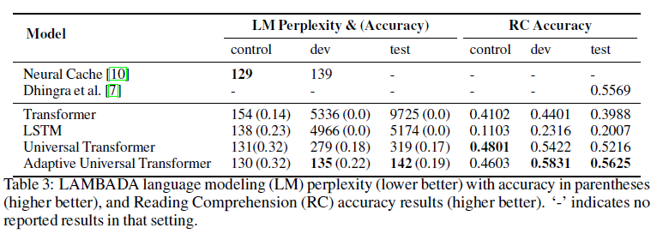
LAMBADA Language Modeling

Slide 39
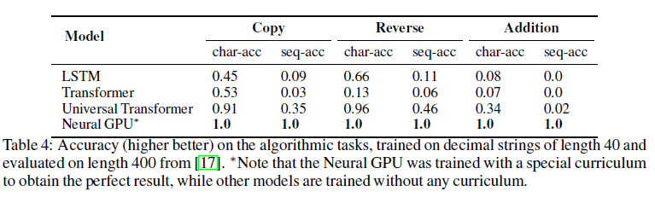
Algorithmic Tasks
Copy, Reverse, Addition
All on strings composed of ‘0’-’9’

Slide 40
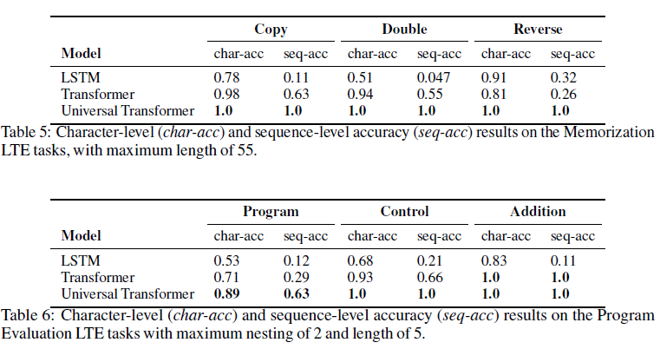
Learning to Execute
Evaluation tasks: program, control, addition
Memorization tasks: copy, double, reverse

Slide 41
The Universal Transformer

Slide 42
Conclusion
Recurrent over “depth”
Not computationally bound by number of symbols, but by number of revisions
Computationally universal
Not just suitable for NMT anymore
Key properties: Weight sharing & Conditional Computation (ACT)

Slide 43
Thanks!

