Slide 1
Learning Long Term Dependencies via Fourier Recurrent Units
Jiong Zhang, Yibo Lin, Zhao Song, Inderjit S. Dhillon
UT-Austin
ICML 2018
报告人：傅智毅
2018.08.01
Notes:
UT-Austin

Slide 2
Outline
Background：gradients vanish and explode, long term dependencies
From SRU to FRU
Experiments
Conclusion

Slide 3
Background
Training DNNs is difficult because of gradients vanishing or exploding in BP, especially in RNNs (Bengio et al.,1994).
Many tasks with long-term dependencies suffer from difficulty of training.

Slide 4
Gradient vanishing problem
Approaches or models proposed to address this issue:
Gate-based: LSTM, GRU
Residual Connection: ResNet(2016) and extensions
SRU: statistical recurrent units (2017)
Other tricks:
subtle initialization
gradient clipping
normalization
spectral regularization
Gradients vanishing is still a problem.
Notes:
上面的所有模型和方法都没有很好地解决梯度消失问题

Slide 5
From SRU to FRU
SRU: Statistical Recurrent Unit
Summarizes hidden states along the temporal dimension, directly obtain the statistical summary of past layers.
FRU: Fourier Recurrent Unit
Summarizes hidden states with Fourier basis functions.
Stabilizes gradients:
residual learning structure
gradient lower and upper bounds independent of temporal dimension
Fewer parameters:
strong expressivity power of sparse Fourier basis
Notes:
所谓的Global surport
之前也有将DNN和傅里叶变换结合的工作，比如激活函数，FCNN（卷积层换成傅里叶变换）——但是都没有很好地解决梯度消失/爆炸问题

Slide 6

Basic RNN

Slide 7
SRU
At each time step SRU memory cells incorporate new information at rate α and old information at rate (1 - α).
Further linearly combine multiple memory cells with different α, SRU gets a multi-scale view of the past.
Shortcoming: expressive power of the basis of exponential functions is mall.
Notes:
Rather than use gated units to decide what should be memorized
但是时间步足够长，还是会发生衰减，忘记之前的信息；反过来说，存在梯度消失的可能性

Slide 8
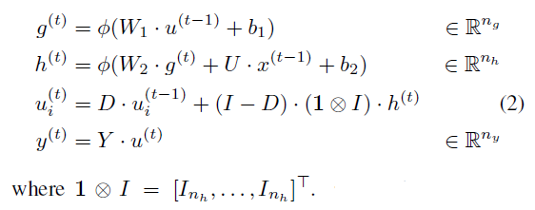


SRU

Slide 9
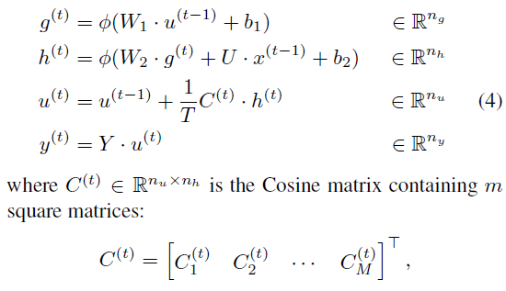

FRU
Notes:
K1=m(j-1)+1, k2=mj, d is dimension for each frequency
m = K/M, K是选择的频率个数

Slide 10
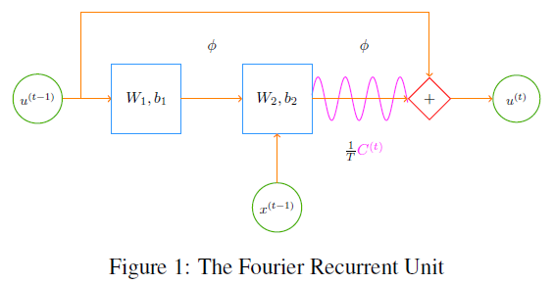


FRU
Information flows from layer (t-1) to layer t along two paths.
FRU directly incorporates the idea of residual learning：
Like a regularization：

Slide 11

Compare SRU with FRU: vanishing gradient?
In the linear setting, SRU (exponential basis) still suffers from vanishing gradient.
But FRU (Fourier basis) doesn’t.
In linear setting, SRU only improves the gradient lower/upper bound of RNN with form (e^aT, b^aT), while FRU bounds the gradient by constant independent of the temporal dimension.
Notes:
表达能力要弱一些

Slide 12
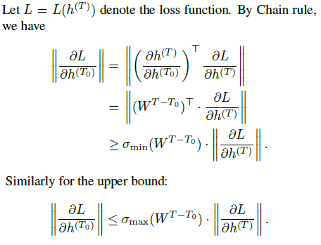
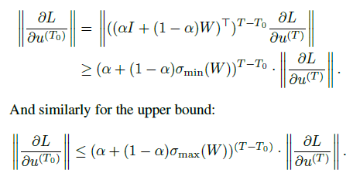

Lower and Upper Bounds

Slide 13
Experiments
Synthetic Datasets
Pixel-MNIST Dataset
Permuted MNIST Dataset
IMDB Dataset
Notes:
理论上FRU做分类或者回归都可以，但是论文里展示的都是分类任务

Slide 14
Synthetic datasets
mix-sin dataset
Construct K components with each component being a combination of D sinusoidal functions.
For each data point, mix the K components with randomly sampled weights.
mix-poly dataset
at each time step t, models are asked to predict the sequence value at time step t+1. 80% for training, 20% for testing.
set sequence length to 176, K to 5, D to 15 for mix-sin and 5/10/15 for mix-poly.
Notes:
模型需要学会这K个函数，以及相应的组合权重

Slide 15
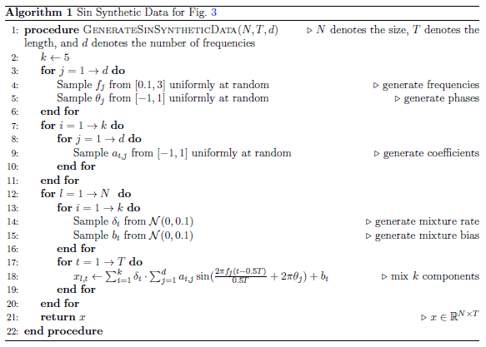
Synthetic Dataset

Slide 16
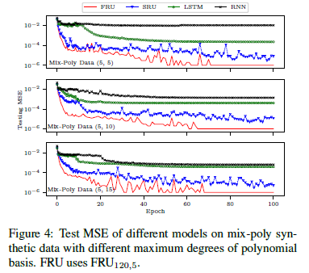
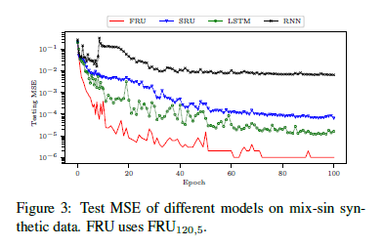
Synthetic Dataset
Notes:
FRU只有使用SRU一半的参数量，更说明express power强

Slide 17
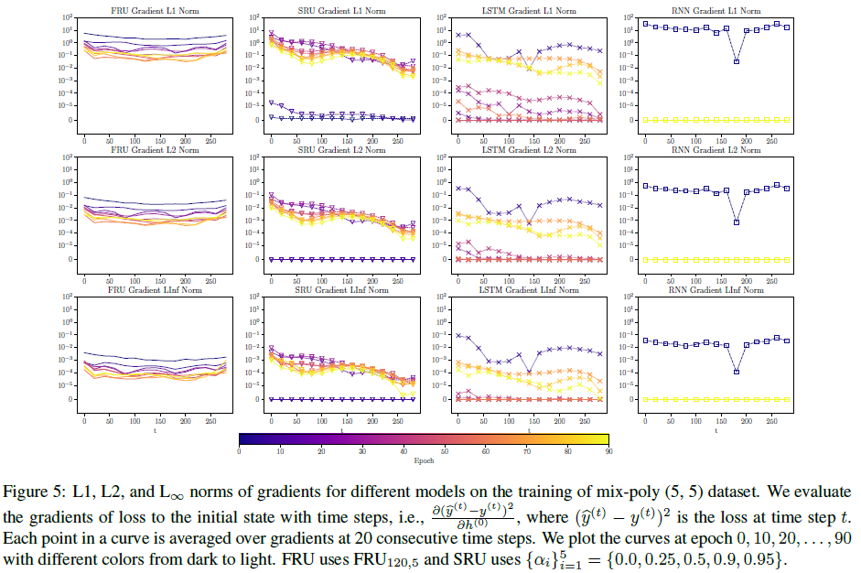
Synthetic Dataset
Notes:
分析不同距离/远近的偏导数，展示梯度稳定性和学习强依赖的能力
FRU逐渐下降；SRU下降很快，指数级别——SRU无长期依赖的学习能力

Slide 18
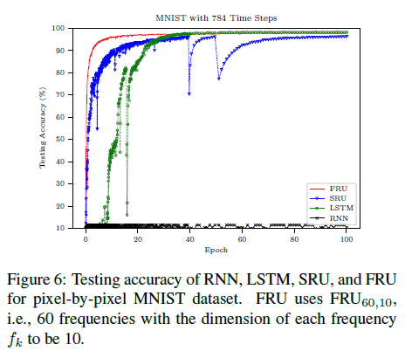
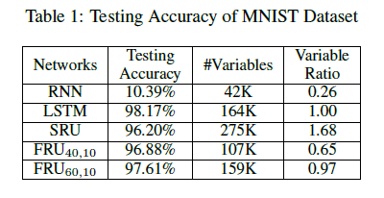
Pixel-MNIST Dataset
Flatten 28*28 sized image to 784 sized sequence
Batch size 256, without dropout
Notes:
不同设置下的FRU（40/60频率）都有着和LSTM相近的准确度，而且收敛更快，更稳定
可训练的参数比例
说明了FRU的强模型表达能力

Slide 19
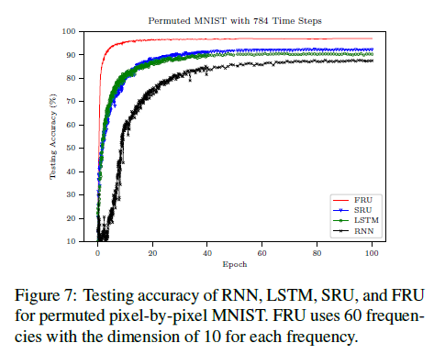
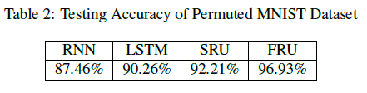
Permuted MNIST Dataset
Random but fixed permutation among its pixels.
It is reported the permutation increases the difficulty of classification(2016)
Notes:
展示了SRU和FRU更强的模型表达能力

Slide 20
IMDB Dataset
IMDB movie review dataset, 25K training and 25K testing
avg-length 284 and max-length 2800, truncate all sequences to length 300.
All models use single layer with 128 units, batch size 32, 0.2 dropout rate.
FRU uses 5 frequencies with dimension 10.
Notes:
其他调优

Slide 21
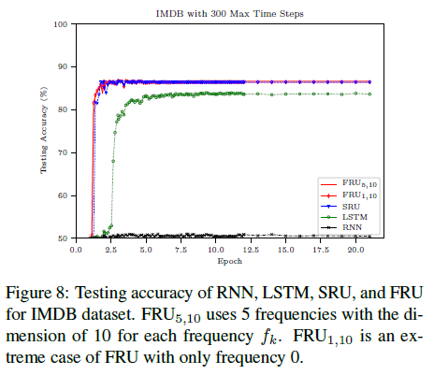
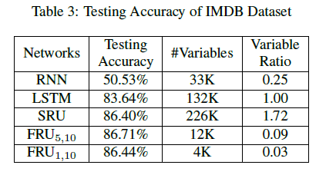
IMDB Dataset
Notes:
FRU achieves the highest acc with 10X fewer variables than LSTM, and 19X fewer variables than SRU, indicating its exceptional expressive power.
特别例子是FRU1,10——frequency 0 基频，reduced to a RNN-like cell

Slide 22
Conclusion
FRU has the structure of residual learning and exploits the expressive power of Fourier basis.
FRU does not suffer from vanishing/exploding gradient in the linear case, and is able to capture long term dependencies.
Could further extend the Fourier idea to MLP/RNN.
Other basis functions? Polynomial basis will behave on similar architectures, e.g. Chebyshev’s polynomial.
Notes:
指数基础的function会面临梯度消失的问题

Slide 23
Thanks

